Slide 1
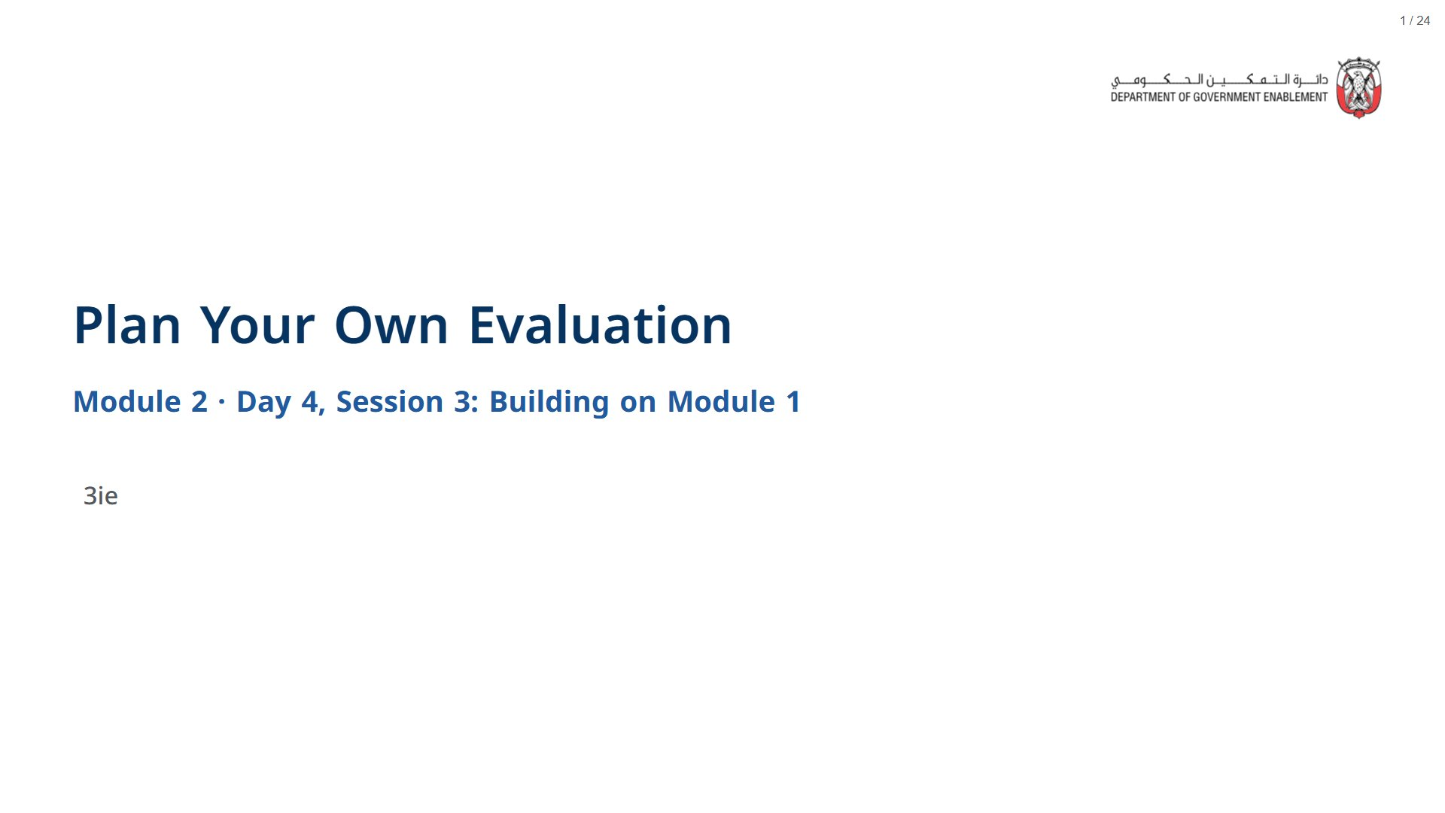

Slide 2

Notes:
About 5 minutes.
span.MJX_Assistive_MathML {
position:absolute!important;
clip: rect(1px, 1px, 1px, 1px);
padding: 1px 0 0 0!important;
border: 0!important;
height: 1px!important;
width: 1px!important;
overflow: hidden!important;
display:block!important;
}

Slide 3
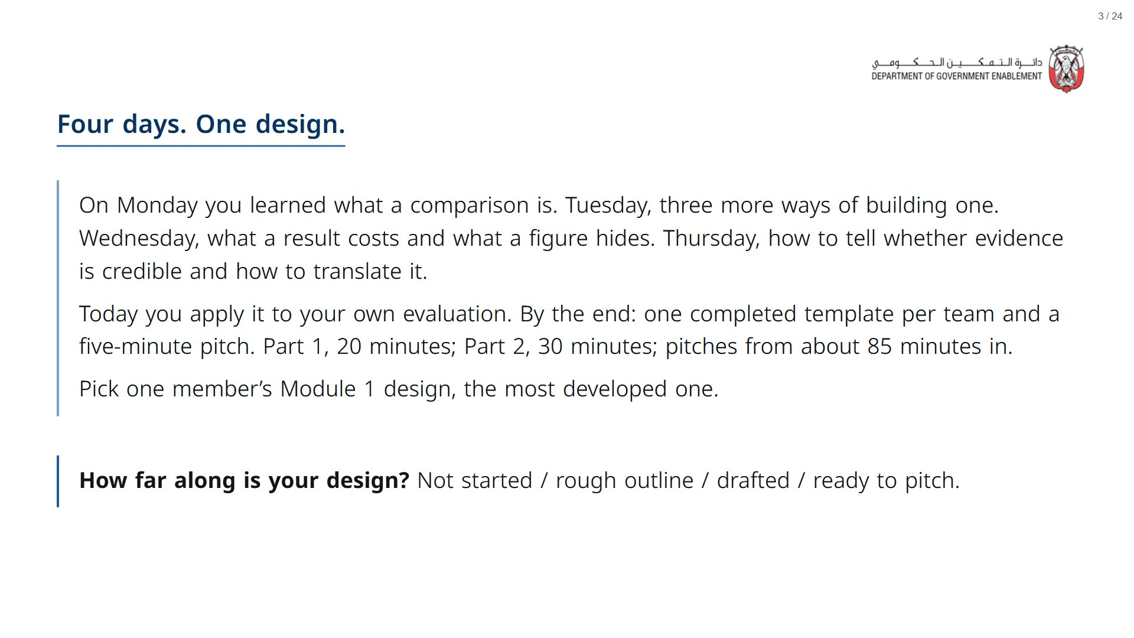
Notes:
Timing for 120 minutes with three teams: opening 5, Part 1 30 (10 of slides, 20 of work), Part 2 45 (10 of slides, 30 of work, 5 of break), pitches 30 (5 of set-up, 3 teams at 8 minutes), close 10. More than three teams: cut each pitch to 3 minutes plus 2 of feedback, or Part 2 to 25 minutes.
span.MJX_Assistive_MathML {
position:absolute!important;
clip: rect(1px, 1px, 1px, 1px);
padding: 1px 0 0 0!important;
border: 0!important;
height: 1px!important;
width: 1px!important;
overflow: hidden!important;
display:block!important;
}

Slide 4

Notes:
About 30 minutes: 10 of slides, then 20 of working time.
span.MJX_Assistive_MathML {
position:absolute!important;
clip: rect(1px, 1px, 1px, 1px);
padding: 1px 0 0 0!important;
border: 0!important;
height: 1px!important;
width: 1px!important;
overflow: hidden!important;
display:block!important;
}

Slide 5
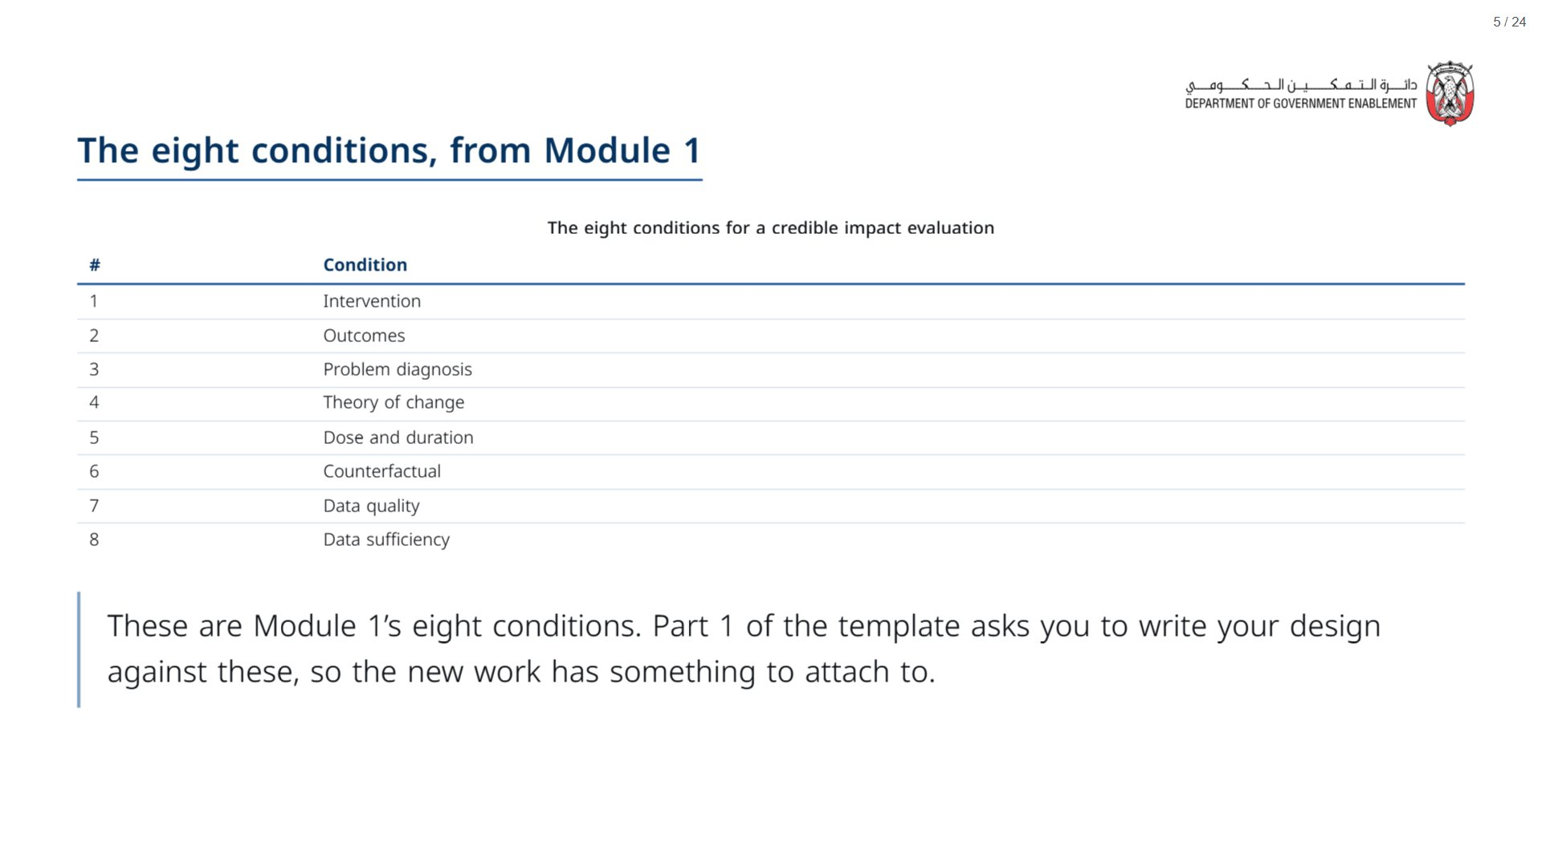

Slide 6
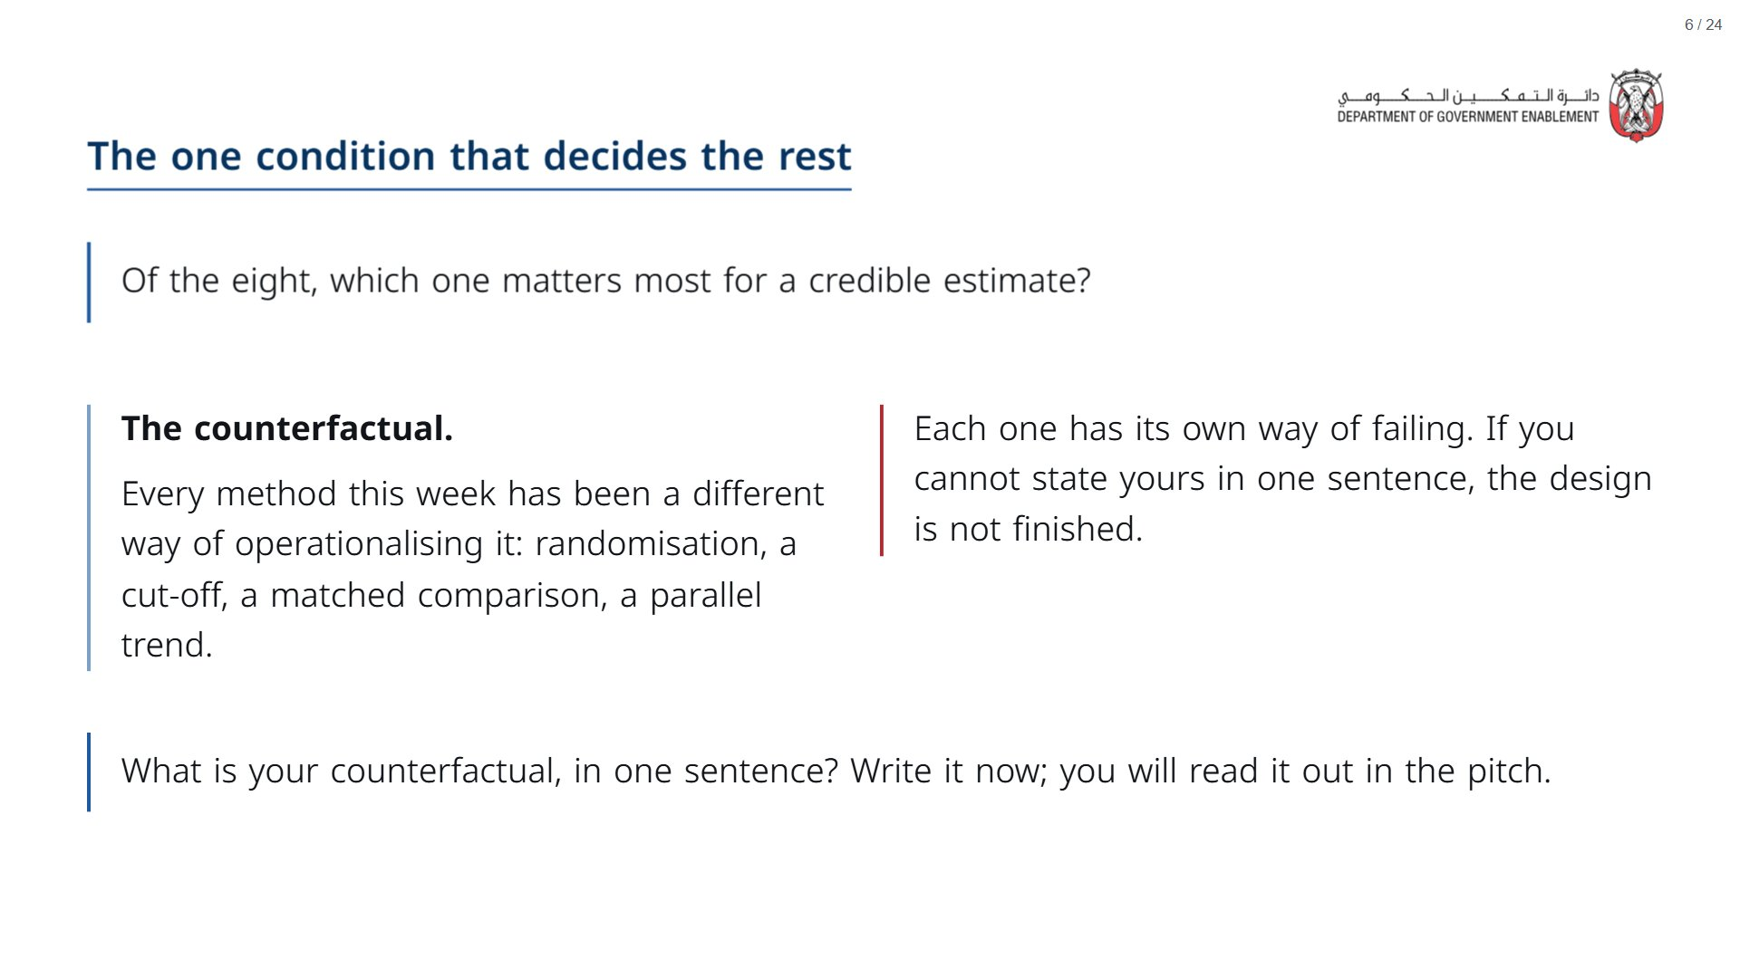

Slide 7
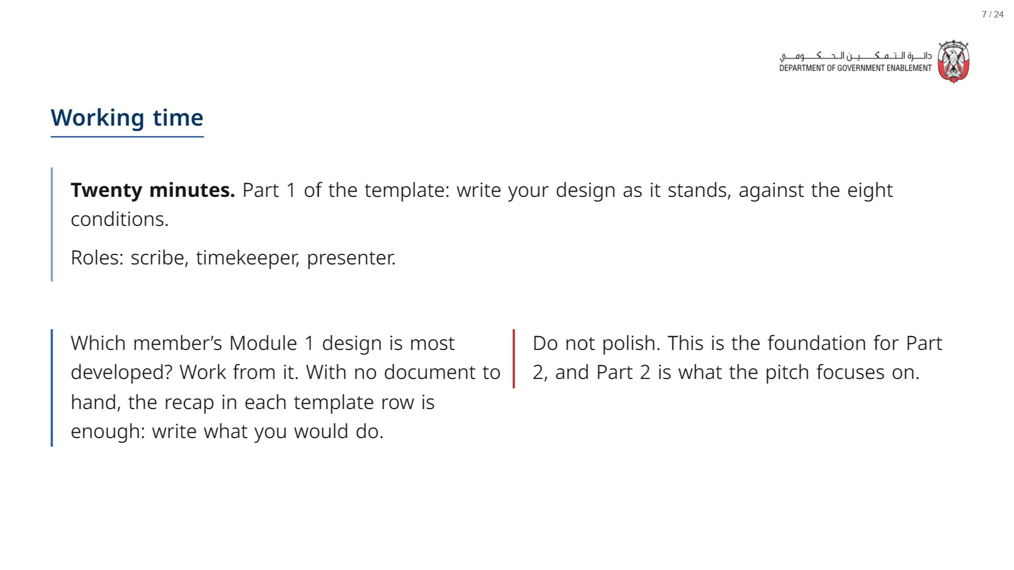
Notes:
Paper (Oct15_session3_materials.docx): Hand out the Evaluation Design Update (pack pages 1 to 3), one per team. Teams start on Part 1 (pack page 1).
span.MJX_Assistive_MathML {
position:absolute!important;
clip: rect(1px, 1px, 1px, 1px);
padding: 1px 0 0 0!important;
border: 0!important;
height: 1px!important;
width: 1px!important;
overflow: hidden!important;
display:block!important;
}

Slide 8

Notes:
About 45 minutes: 10 of slides, 30 of working time, then the 5-minute break.
span.MJX_Assistive_MathML {
position:absolute!important;
clip: rect(1px, 1px, 1px, 1px);
padding: 1px 0 0 0!important;
border: 0!important;
height: 1px!important;
width: 1px!important;
overflow: hidden!important;
display:block!important;
}

Slide 9
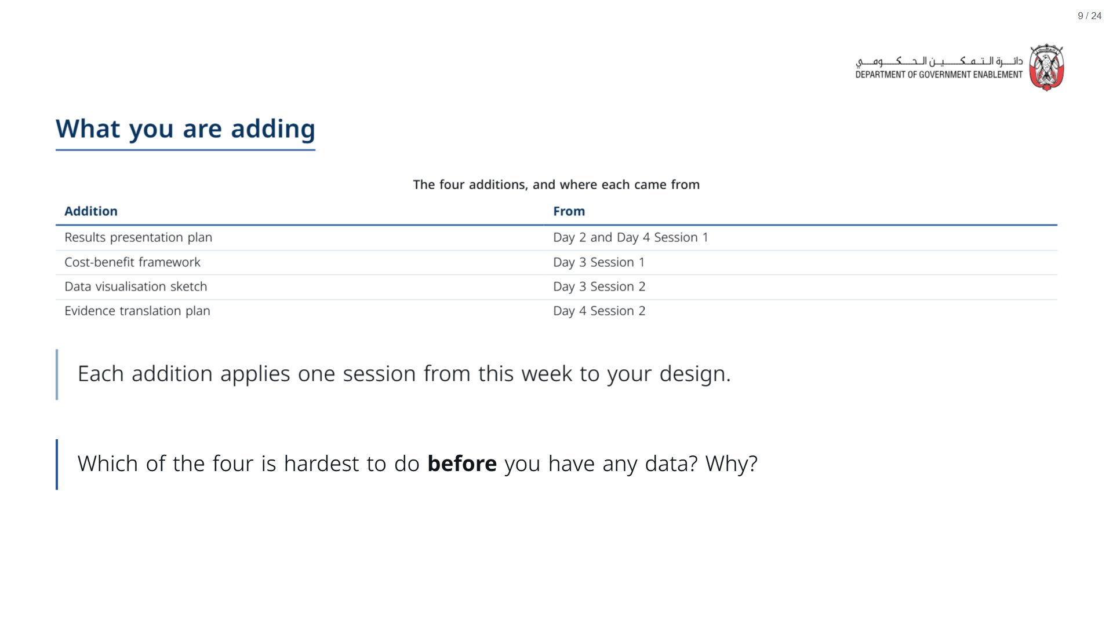

Slide 10
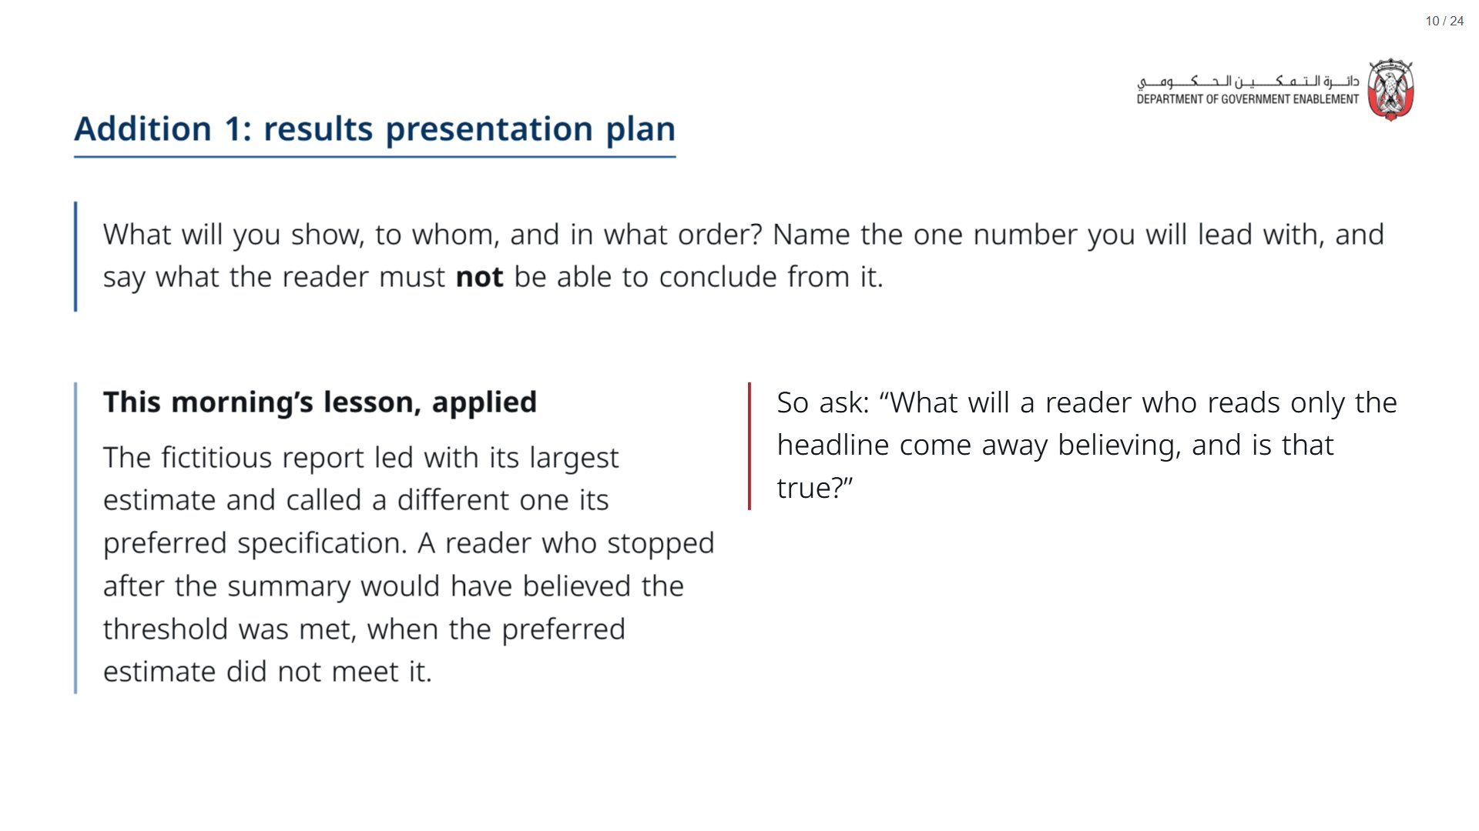

Slide 11
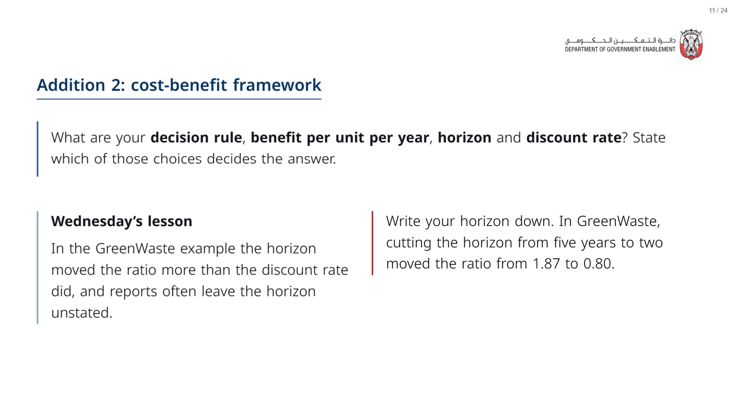

Slide 12
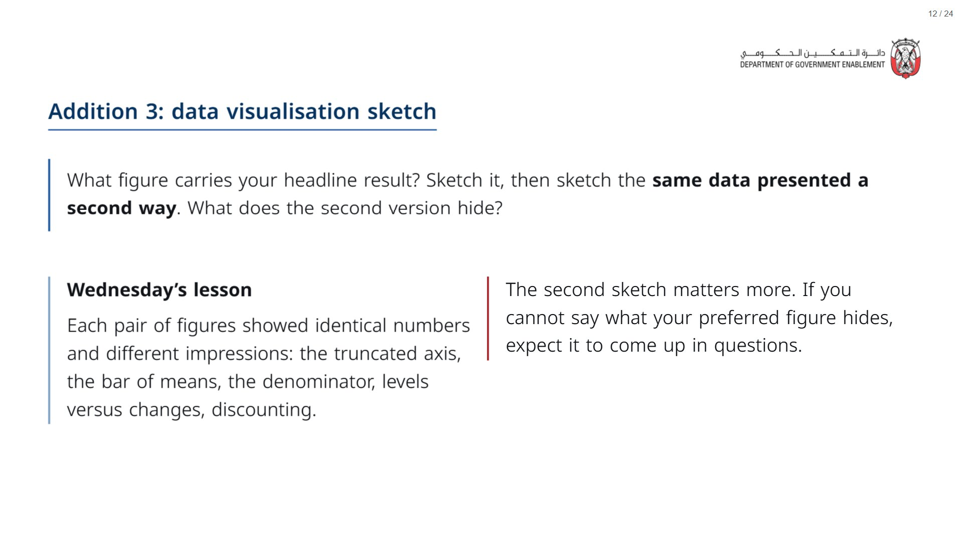

Slide 13
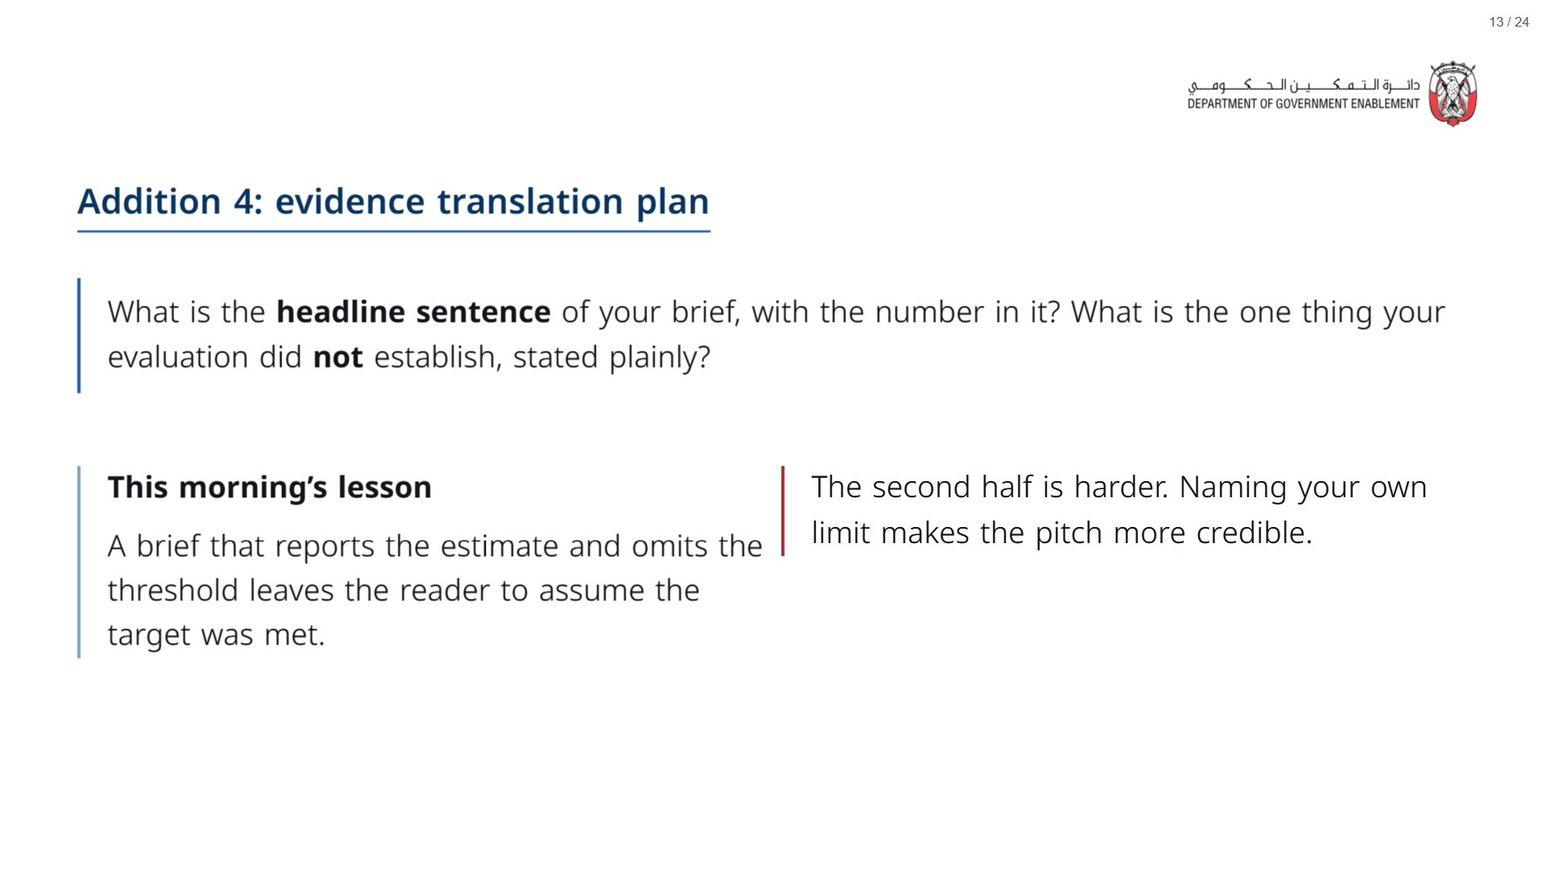

Slide 14
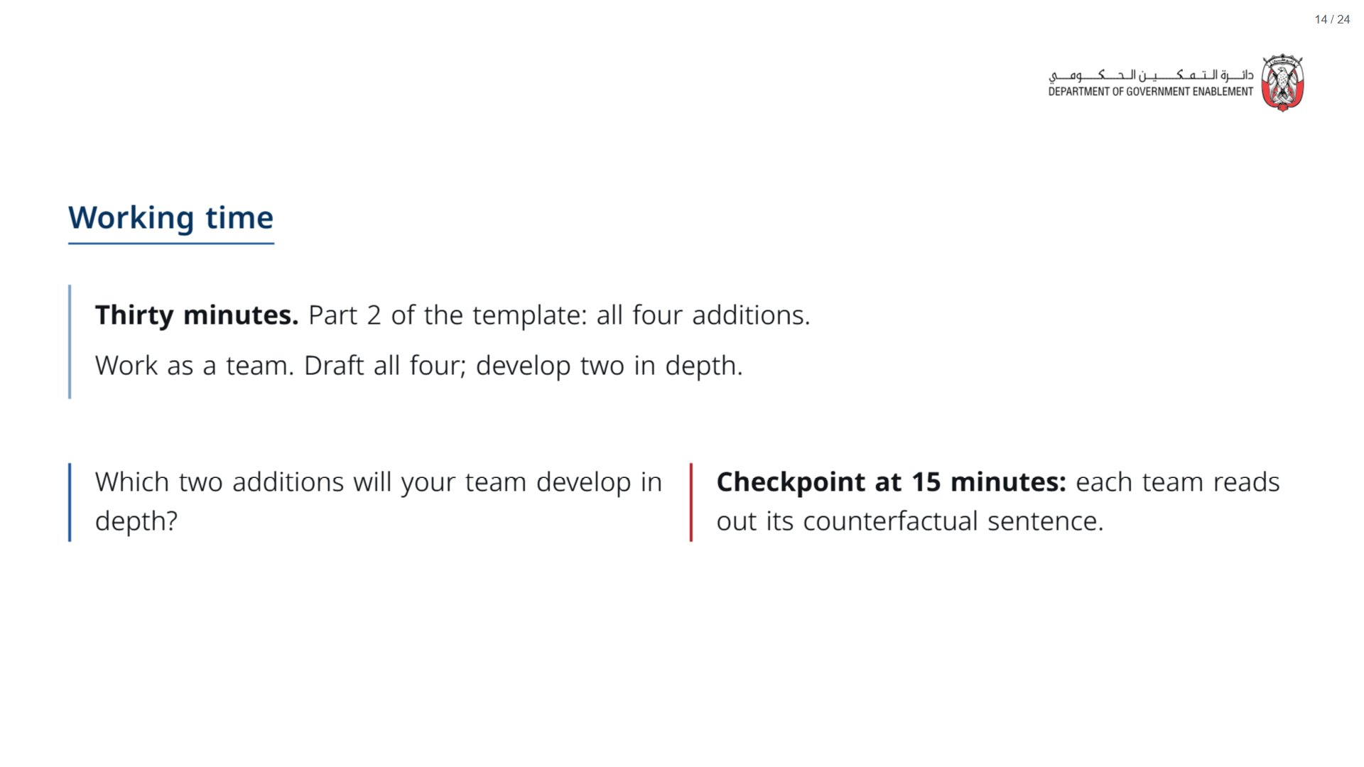
Notes:
Paper (Oct15_session3_materials.docx): Teams turn to Part 2 of the Design Update (pack page 2).
At 15 minutes, stop the room for the checkpoint: each team reads out its counterfactual sentence. If a sentence does not name who the comparison group is, say so and move on.
span.MJX_Assistive_MathML {
position:absolute!important;
clip: rect(1px, 1px, 1px, 1px);
padding: 1px 0 0 0!important;
border: 0!important;
height: 1px!important;
width: 1px!important;
overflow: hidden!important;
display:block!important;
}

Slide 15
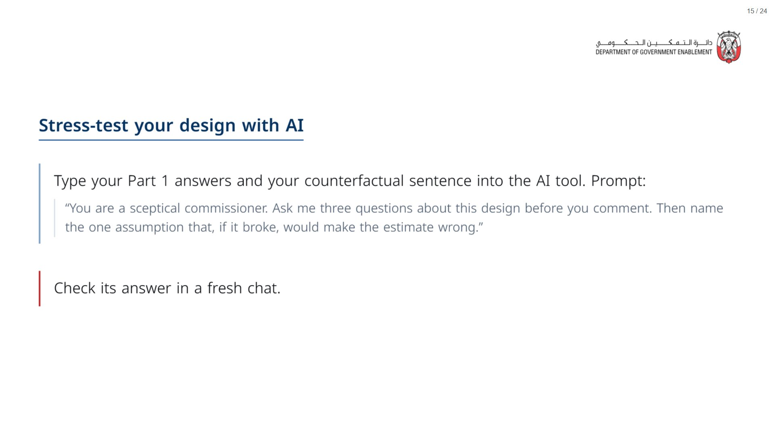
Notes:
Paper (Oct15_session3_materials.docx): Hand out the AI prompt cards (pack page 4), one per team. This runs inside the Part 2 working time; one team member runs it while the others keep drafting.
span.MJX_Assistive_MathML {
position:absolute!important;
clip: rect(1px, 1px, 1px, 1px);
padding: 1px 0 0 0!important;
border: 0!important;
height: 1px!important;
width: 1px!important;
overflow: hidden!important;
display:block!important;
}

Slide 16
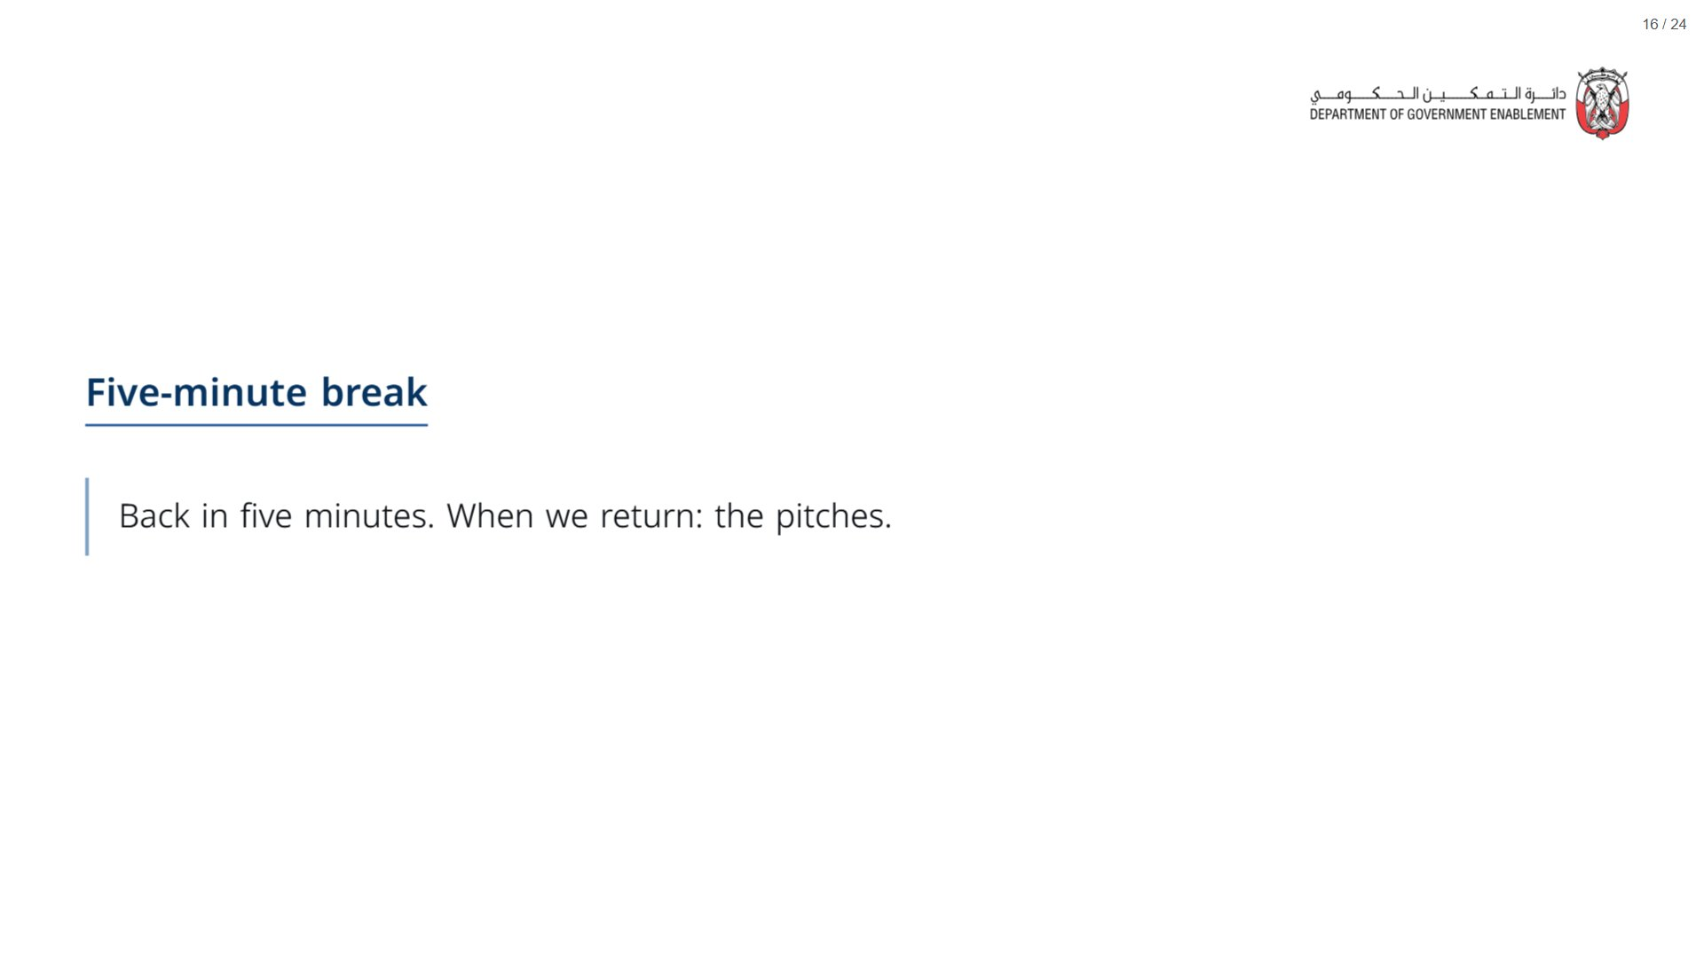

Slide 17

Notes:
About 30 minutes: 5 of set-up, then three teams at 5 minutes of pitch and 3 of feedback.
span.MJX_Assistive_MathML {
position:absolute!important;
clip: rect(1px, 1px, 1px, 1px);
padding: 1px 0 0 0!important;
border: 0!important;
height: 1px!important;
width: 1px!important;
overflow: hidden!important;
display:block!important;
}

Slide 18
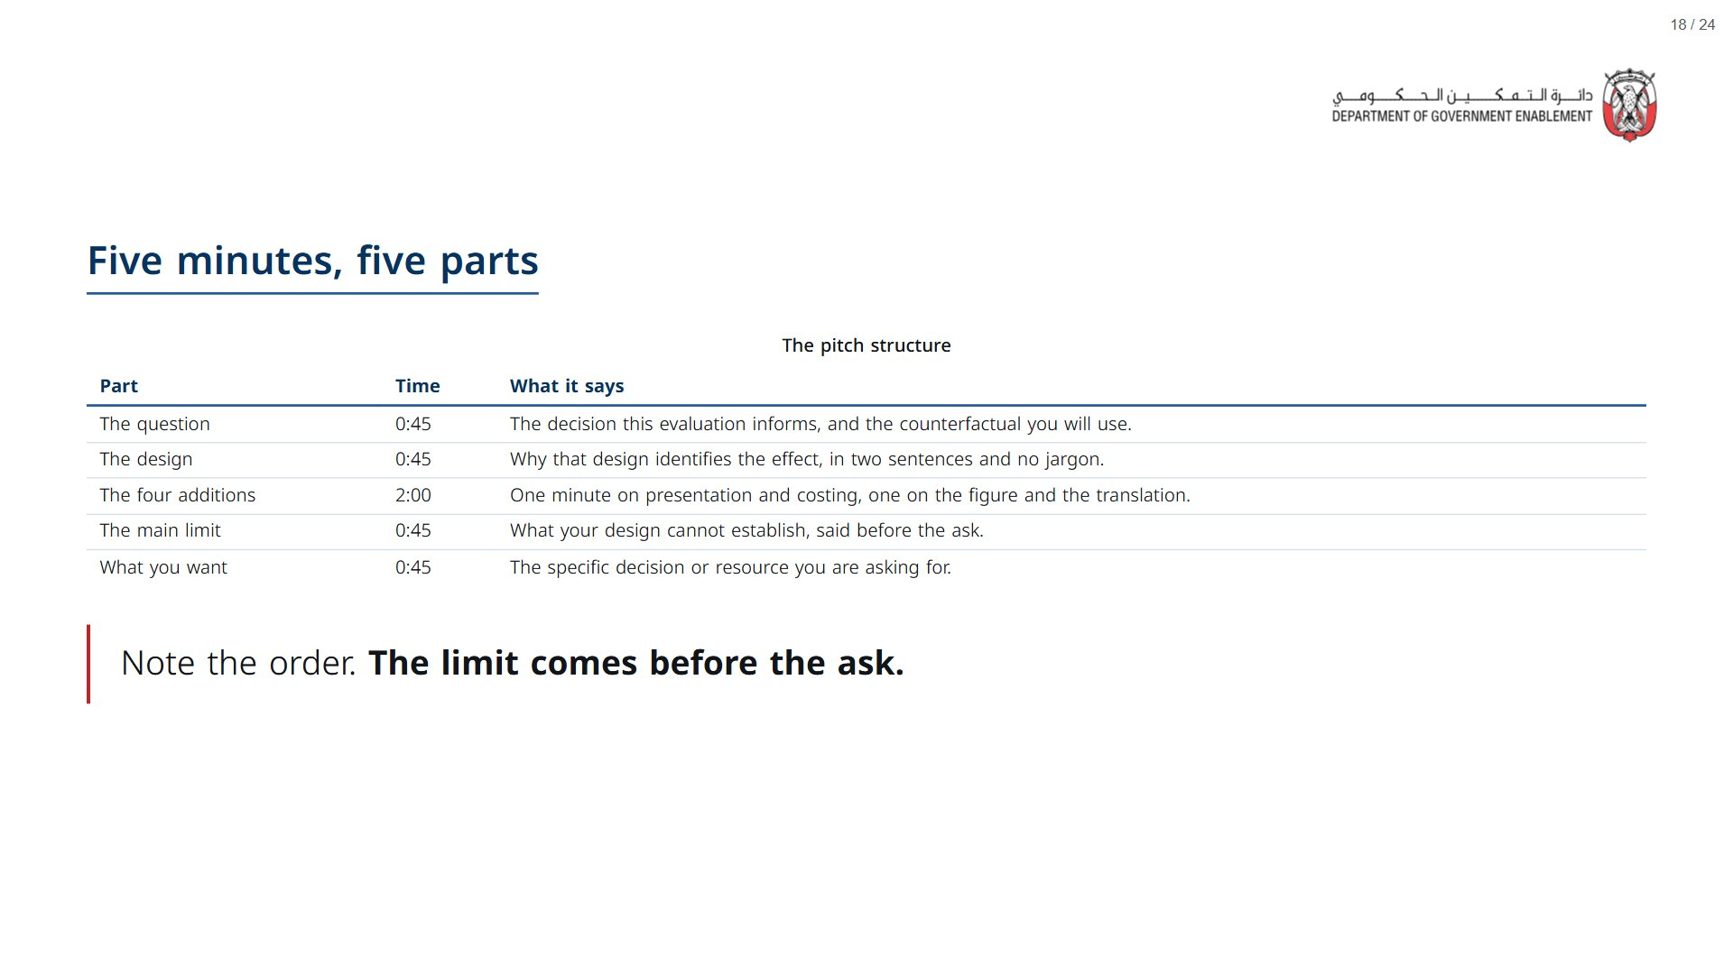
Notes:
Paper (Oct15_session3_materials.docx): Teams turn to Part 3 of the Design Update (pack page 3) to plan the pitch.
span.MJX_Assistive_MathML {
position:absolute!important;
clip: rect(1px, 1px, 1px, 1px);
padding: 1px 0 0 0!important;
border: 0!important;
height: 1px!important;
width: 1px!important;
overflow: hidden!important;
display:block!important;
}

Slide 19
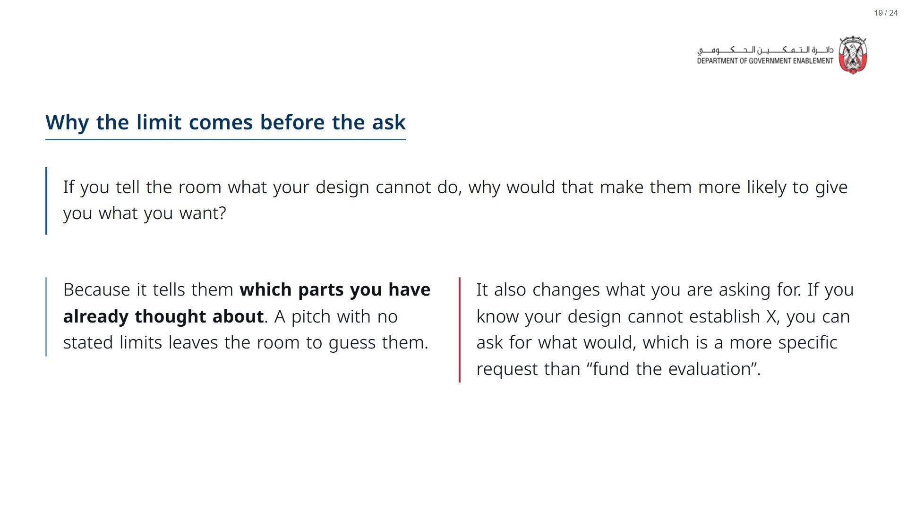

Slide 20
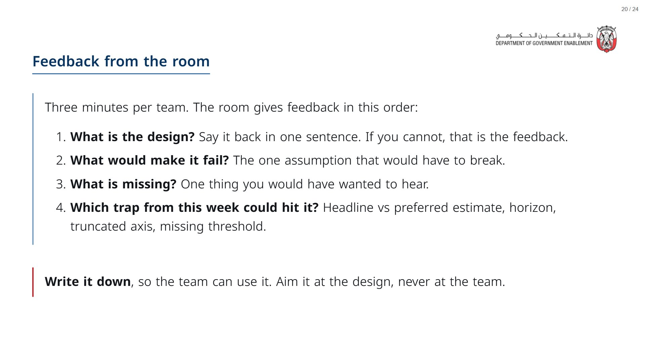
Notes:
The first question is a check: if the room cannot say the design back in one sentence, the pitch did not land. That is useful feedback.
Paper (Oct15_session3_materials.docx): Hand out the feedback slips (pack page 5), one slip per participant for each other team. Call time at 5:00; feedback in the fixed order.
span.MJX_Assistive_MathML {
position:absolute!important;
clip: rect(1px, 1px, 1px, 1px);
padding: 1px 0 0 0!important;
border: 0!important;
height: 1px!important;
width: 1px!important;
overflow: hidden!important;
display:block!important;
}

Slide 21
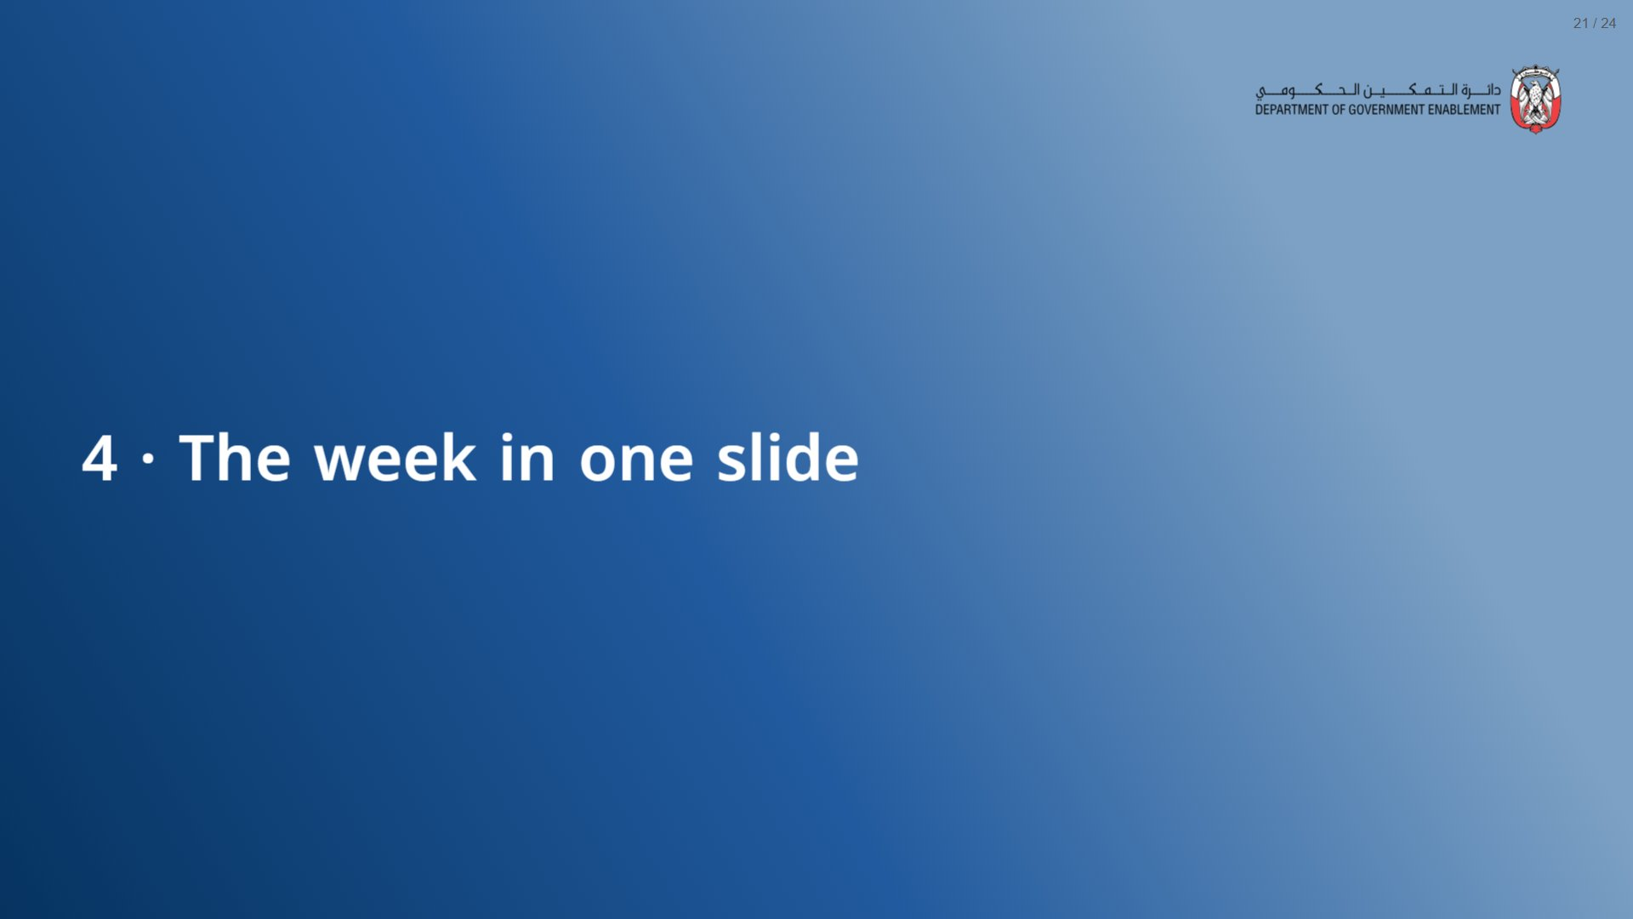
Notes:
About 10 minutes.
span.MJX_Assistive_MathML {
position:absolute!important;
clip: rect(1px, 1px, 1px, 1px);
padding: 1px 0 0 0!important;
border: 0!important;
height: 1px!important;
width: 1px!important;
overflow: hidden!important;
display:block!important;
}

Slide 22
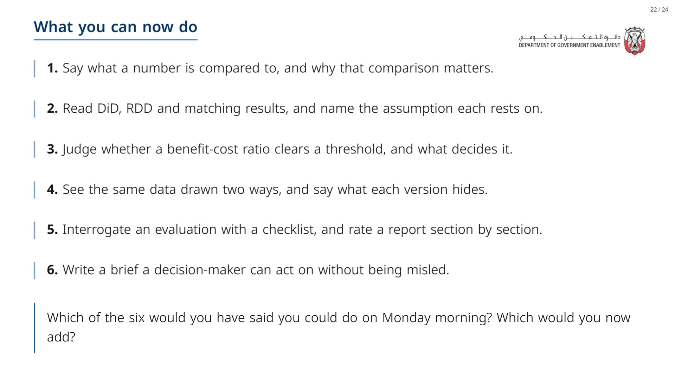

Slide 23
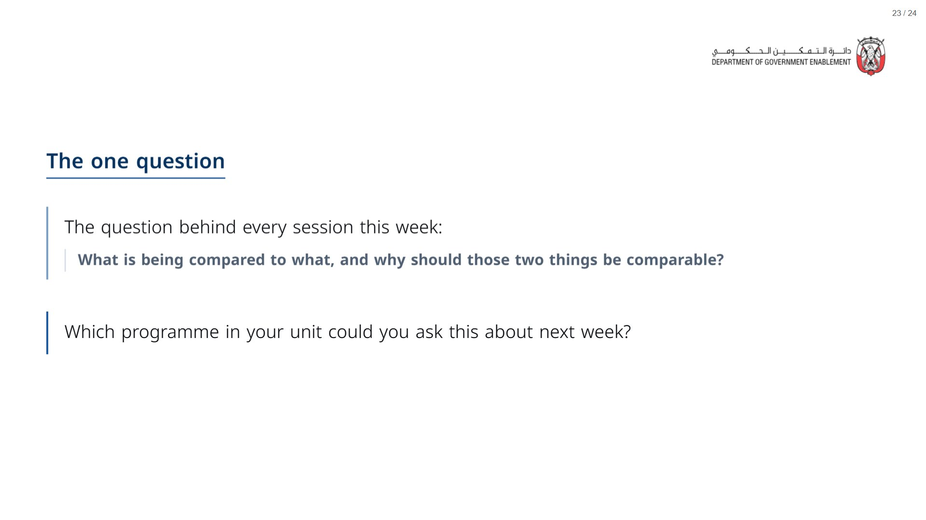
Notes:
Paper (Oct15_session3_materials.docx): Hand out the take-away cards (pack page 6), one per participant. Give a minute to fill in the card’s last line (the first evaluation decision at your desk), then take two or three examples on the thank-you slide.
span.MJX_Assistive_MathML {
position:absolute!important;
clip: rect(1px, 1px, 1px, 1px);
padding: 1px 0 0 0!important;
border: 0!important;
height: 1px!important;
width: 1px!important;
overflow: hidden!important;
display:block!important;
}

Slide 24
