Slide 1
Spot the Problem
Module 2 · Day 1, Session 3: Naive Comparisons and Reading an RCT
3ie

Slide 2
What this session gives you
By the end of this session you will be able to:
Put Session 1’s question, compared to what?, to work on two comparisons that both look convincing
Name the hidden problem in a before-and-after claim and in a with-and-without claim
Explain, in plain terms, how randomisation removes the difference between the groups
Read a randomised result: which number is the impact, and does it clear the decision rule
Notes:
0:00 · One minute. This is the last session of Day 1 and the pay-off for Session 1. Today they learn to distrust two comparisons they will see constantly, then meet the one design that fixes them.

Slide 3
1 · Two comparisons, both convincing 18 min

Slide 4
The GreenWaste programme
The GreenWaste Program helped businesses cut waste-management costs. A pilot ran, data was collected before and after, and now someone has to decide whether to take it national.
The bar it has to clear is fixed for the whole week at 1,000 AED.
Notes:
0:01 · Land the decision rule now and repeat it all afternoon. Every number today gets judged against 1,000 AED, not against zero.

Slide 5
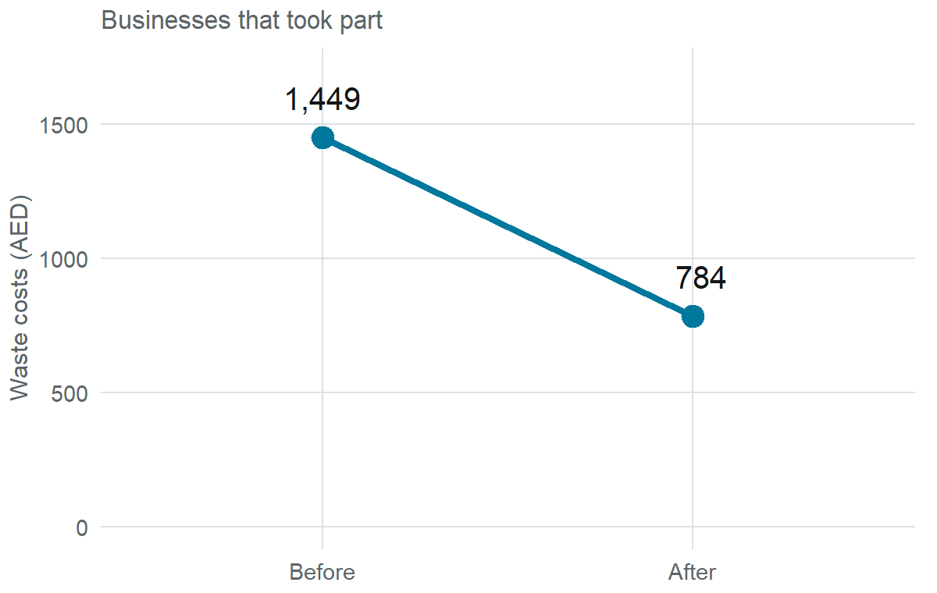
Comparison A: before and after
Businesses that took part paid 1,449 AED before and 784 AED after.
-665 AED
Fall in costs, before to after
The programme looks like it cut costs by 665 AED.
Notes:
0:03 · Say the story the way an evaluator might: “costs fell by 665 after we ran the programme.” Do not challenge it yet.

Slide 6
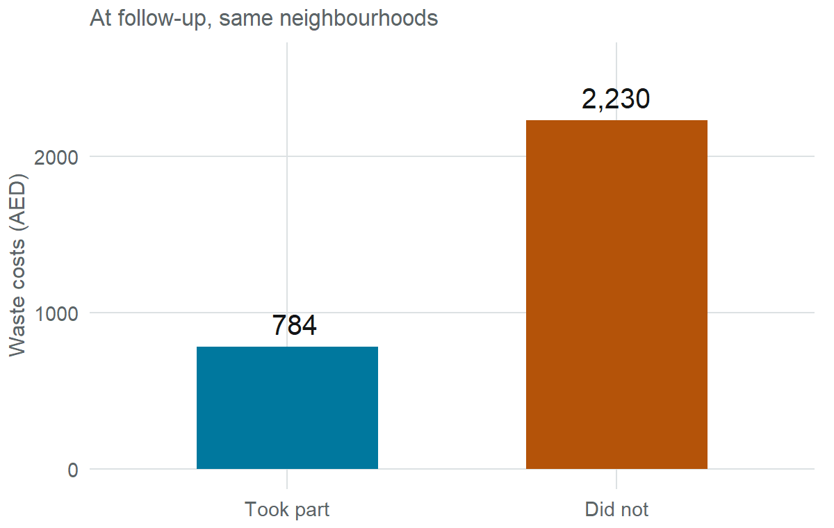
Comparison B: with and without
At the end, businesses that took part paid 784 AED; those that did not paid 2,230 AED.
-1,446 AED
Gap between the two groups
This comparison makes the programme look more than twice as good.
Notes:
0:05 · Same programme, a much bigger number. Note the two numbers out loud: minus 665 from A, minus 1,446 from B. Hold the tension.

Slide 7
[MENTI PLACEHOLDER] Which would you trust?
Both comparisons say GreenWaste worked. Which would you trust more, and why?
Before-and-after · With-and-without · Neither on its own
Live poll. Let the room commit before anything is revealed. Take two or three “why” answers out loud, do not correct them yet.
Notes:
0:07 · Resist explaining. The whole point is that they pick one, then discover in Section 2 that both are biased. A split room is the ideal starting point.

Slide 8
[MENTI PLACEHOLDER] What might be wrong?
Open text, shown as a live word cloud: in one phrase, what might be wrong with each of these comparisons?
Notes:
0:09 · Collect the words. If “other things changed” and “different groups” surface, you have the two answers already; use their words in the next section.

Slide 9
2 · The hidden problem in each 15 min

Slide 10
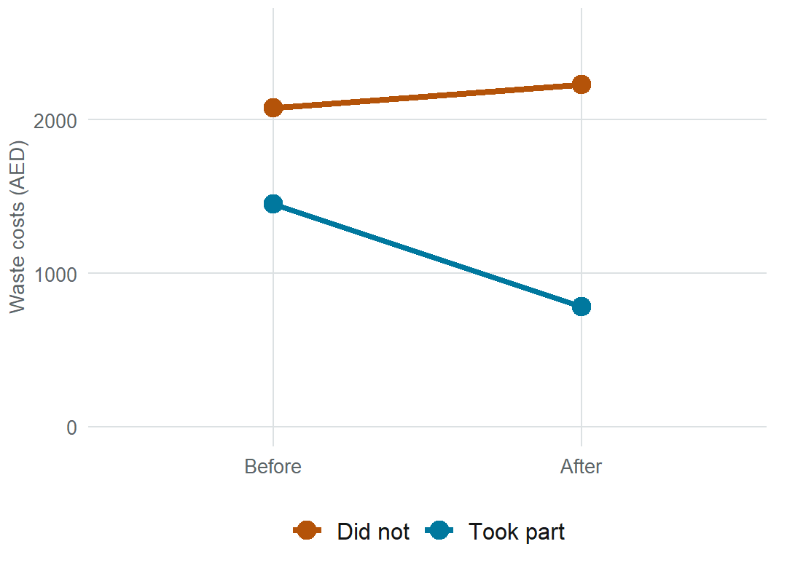
Before-and-after compares to the past
A before-and-after number compares the programme to what came before, not to what would have happened anyway. Anything else that changed over the same period is included in that number.
Over these same two rounds, similar businesses that did not take part saw costs move from 2,079 to 2,230 AED on their own. Time was not standing still, so a plain before-and-after does not tell you what the programme alone did.
Notes:
0:10 · The comparison group’s costs drifted up. So the eligible group’s own costs would probably not have stayed flat either. A raw before-and-after therefore understates the true reduction. Keep it intuitive, no DiD arithmetic yet.

Slide 11
With-and-without compares different groups
A with-and-without number compares people who took part to people who did not. But the two groups were already different before the programme started. The businesses that did not take part were not eligible: they were larger, less efficient, more costly to begin with.
So the -1,446 AED gap mixes two things together: any real effect of the programme, and the head start the eligible group already had. It overestimates the effect of the programme.
Notes:
0:13 · This is selection. The “without” group is not a stand-in for what the “with” group would have looked like, because they were never comparable. Overstates.

Slide 12
Two biases, opposite directions
The truth is not halfway by coincidence. Each naive comparison is wrong for a different reason, and they are incorrect in opposite directions.
Notes:
0:15 · Foreshadow: minus 665 and minus 1,446 bracket something. In a few minutes a fair comparison lands between them, near minus 1,000.

Slide 13
.ask On your desk
Think of an evaluation you have received. Was its headline a before-and-after number, or a with-and-without one? Which of these two problems could it have had?
Ninety seconds with your neighbour. Two or three examples to the room.
Notes:
0:16 · Short and personal. Makes the trap concrete before the break.

Slide 14
Break 5 min

Slide 15
Five-minute break
Back in five minutes. When we return: the one design that removes the difference between the groups.
Notes:
0:18 · Hard stop at 5 minutes. Resume promptly.

Slide 16
3 · How randomisation fixes it 15 min

Slide 17
Random draw
Both problems come from the same root: the group that took part and the group that did not were not comparable. Randomisation fixes it at the source. Decide who is offered the programme by random draw, not by who is eligible, keen, or easy to reach.
Same on average, even on what we cannot measure
Notes:
0:19 · The one sentence to remember. Random assignment balances the things we can see and the things we cannot: motivation, management quality, luck.

Slide 18
Why it works: two people versus two crowds
Pick two people at random from this room. They could differ in almost every way. Neither is a fair stand-in for the other.
Pick two large groups at random. On average they look alike: same mix of ages, sizes, experience, and the same mix of things you never measured. Any leftover difference is small and down to chance.

Slide 19
So when we compare two large randomly-formed groups, any real gap in the outcome is the programme, not some other factor that could give one group a head start over the other.
Notes:
0:21 · This is the whole intuition for an RCT. Numbers are not needed here; the crowd-versus-pair contrast does the work.

Slide 20
[MENTI PLACEHOLDER] True or false?
Randomisation makes the two groups similar only on things we can measure.
With enough units, random assignment balances unmeasured things too.
A randomised comparison still needs the groups to have started out alike.
Live quiz, revealed one at a time. (1) False (2) True (3) It creates that, which is the point.
Notes:
0:24 · Item 1 is the common misconception; spend the most time there.

Slide 21
4 · Reading the randomised result 18 min

Slide 22
First check: did the random draw work?
Characteristic | Treated | Control | Difference | p-value
Manager age | 41.7 | 42.3 | -0.64 | 0.09
Manager education | 3.0 | 2.8 | 0.16 | 0.02
Foreign owned | 0.4 | 0.4 | 0.01 | 0.49
Distance to recycling centre | 109.2 | 106.3 | 2.91 | 0.01
Staff size | 5.8 | 5.7 | 0.06 | 0.26
Check the two groups really did start out alike. A balance table compares them on their starting characteristics: read for whether the differences are small, with p-values that are not tiny.
# Compare treated vs control neighbourhoods on each starting characteristic
df %>%
filter(round == 0, eligible == 1) %>%
select(treatment_neighborhood, age_manager, educ_manager,
staff_size, foreign_owned, recycling_center_distance) %>%
pivot_longer(-treatment_neighborhood) %>%
group_by(name) %>%
reframe(tidy(lm_robust(value ~ treatment_neighborhood))) %>%
filter(term == "treatment_neighborhood")
Notes:
0:25 · Walk one row aloud, e.g. manager age. Treated and control almost identical, p-value not small. Say what a small p-value here would have meant: a failed draw. The code above is the same short, checkable calculation that produced the table.

Slide 23
The estimate
# Compare costs in treated vs control
# neighbourhoods at follow-up, among
# eligible businesses
lm_robust(
waste_management_costs ~
treatment_neighborhood,
data = filter(df, round == 1,
eligible == 1),
clusters = neighborhood_identifier)
 | Follow-up
Treated vs. control | −1014.078***
 | (39.889)
Control group average | 1798.055***
 | (30.912)
Num.Obs. | 5628
R2 | 0.300
+ p < 0.1, * p < 0.05, ** p < 0.01, *** p < 0.001
Notes:
0:31 · One estimate, no covariate model, no robustness zoo. Point to the “Treated vs. control” row: that number is the impact. Next slide names the mis-reads.

Slide 24
Which number is the impact?
The impact is the “Treated vs. control” row: about -1,014 AED. That is the whole result. Everything else is supporting detail.
Not the “control group average” (1,798): that is just where the comparison group sat, not an effect.
Not the stars on their own: they say the effect is unlikely to be zero, not that it is big enough to matter.
Notes:
0:33 · The two classic mis-reads: quoting the intercept as if it were the effect, and treating significance as sufficiency. Both come back on Day 2.

Slide 25
Does it clear the rule?
-1,014 AED
Estimated cut in costs (95% CI: -1,093 to -935)
1,000The rule: cut by at least
1,014Estimated cut
YesClears the bar
The randomised estimate is about 1,014 AED, and the confidence interval stays beyond the 1,000 AED bar. On this evidence, GreenWaste clears the rule.
Notes:
0:35 · Say it plainly: this design says scale up. Do not mention that other methods will disagree; that is Day 2’s reveal. Just note the interval sits past the bar, so it is not a borderline call.

Slide 26
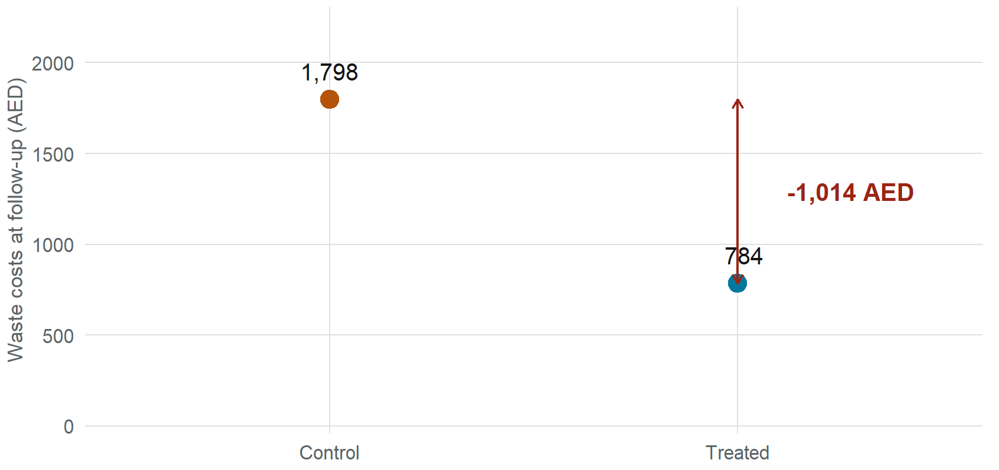
The picture
Notes:
0:37 · The gap between two comparable groups is the effect. Contrast in one line with the two naive charts from Section 1: same programme, but now the comparison is fair.

Slide 27
5 · AI Snapshot 18 min

Slide 28
Asking AI to explain the pitfall
Suppose we ask AI: “Explain in plain language why a before-and-after comparison can be misleading.” Here is the kind of answer it might give. Some of what it says may be wrong.
A before-and-after comparison looks at the outcome before a programme and after it, and treats the difference as the programme’s effect. It can mislead because if the numbers changed, the programme is what changed them.
The fix is simple: as long as you measure the same group before and after, a before-and-after comparison gives you the true effect. To be safe, you can also run a statistical test, and if the change is significant then the programme worked.
In this case costs fell, so we can conclude the programme caused the full fall of 665 AED.
In your groups, mark anything that looks wrong. Three minutes.
Notes:
0:38 · Hand out the printed copy. This is a placeholder example, invented for now. Standing task: when Fiona runs this prompt herself and the model slips, screenshot it into AI_failure_exs/ and swap the real capture in. Real captures beat invented ones.

Slide 29
What might be wrong here
1 · It assumed away the whole problem. “If the numbers changed, the programme changed them” ignores everything else that moved over the same period.
2 · It called before-and-after a true-effect method. It is exactly the comparison we just showed is biased. There is no comparison group in it.
3 · It confused significant with correct. A significant before-and-after change is still a biased number. Significance does not repair the design.
4 · It quoted the 665 as the causal effect. That is the naive figure. The fair estimate is about 1,014 AED, and the model had no way to know that.
Notes:
0:43 · Take them in order. Error 2 is the dangerous one: the model recommended the exact design the session exists to warn against, in fluent, confident prose.

Slide 30
Fluent, confident, and wrong
Notice: nothing in the tone flags the invented parts. No hedge, no hesitation.
The wrong sentences read exactly like the right ones. In a briefing note you would not be able to tell them apart. Fluency is not accuracy, and confidence is not a signal.
Notes:
0:45 · The meta-point. If they remember one thing about AI this week, this is it.

Slide 31
The same question, a better prompt
What people type
“Explain why a before-and-after comparison can be misleading.”
No context about the case
No decision rule
No invitation to say what it is unsure of
What to type instead
I am a commissioner, not an analyst. A programme’s costs fell from 1,449 to 784 AED after it ran, before-and-after, with no comparison group. Our decision rule: it must cut costs by at least 1,000 AED to justify scale-up.
Before you answer, ask me any questions you need about what else changed over the same period and who was in each group.
Then explain, in plain language: what this before-and-after number can and cannot tell me, and what comparison I would need to trust it.
Notes:
0:47 · The highest-leverage line is “ask me any questions before you answer.” It turns the model from a guesser into an interviewer. Walk through each element.

Slide 32
Your turn
In your groups:
Run the short prompt. Read what you get.
Run the full prompt card. Answer the questions it asks you.
Compare: what did the second answer add, remove, or hedge?
Paste the second answer into a fresh chat and ask: “Review this for errors and overstatement.”
Step 4 matters: a clean second conversation catches what the first is already committed to.
Notes:
0:49 to 0:55 · Six minutes of group work. Circulate, collect one good and one bad example for the debrief. Screenshot any genuinely new failure for the library.

Slide 33
Debrief
What did AI overstate?
What did it soften or leave out?
Did it invent anything: a test, a number, a caveat?
Two habits, every time: tell the AI your decision rule, and make it ask you questions before it answers.
Notes:
0:56 · Keep it to two minutes. Land the two habits; they recur every session.

Slide 34
6 · The real case: Abu Dhabi Police 15 min

Slide 35
[PLACEHOLDER] The Abu Dhabi Police evaluation
The same reading skills, now on a real Abu Dhabi case. The Police ran a randomised evaluation of [programme name]. You saw its descriptive results in Session 2; here you read its randomised estimate.
[PLACEHOLDER] Figures below are dummy values, marked, until the real findings are loaded. Nothing here is a real result yet.
Notes:
0:58 · Bridge from Session 2: same programme, now the causal question. Flag that the numbers are placeholders so nothing fake is ever read as real.

Slide 36
[PLACEHOLDER] Read it in three steps
Using the printed output, in your groups:
Balance: did the two groups start out alike? Where do you look?
The estimate: which single number is the impact? Which numbers are not?
The rule: does the estimate, and its confidence interval, clear the bar?
[PLACEHOLDER] Then: what is the one thing you would ask the evaluator before acting on this number?
Notes:
1:00 · Same three-step reading they just used on GreenWaste. When the real data lands, replace this with the actual table and a short worked read.

Slide 37
.ask Group interpretation
Each group reports back: does this evaluation clear the bar, and how confident are you? What would change your mind?
Two minutes per group. Look for groups that quote the intercept, or that read the stars as the whole answer: those are today’s traps in the wild.
Notes:
1:03 · Keep report-backs tight. This is where you see whether the reading skills landed.

Slide 38
7 · Close 6 min

Slide 39
Three questions to ask the evaluator
Take these back to your desk. For any headline number:
Notes:
1:04 · The standing closing slide, tuned to today. These three questions carry straight into Day 2.

Slide 40
Key takeaways
Before-and-after folds in everything else that changed. It can understate.
With-and-without compares groups that already differed. It can overstate.
Randomisation makes the groups alike on average, even on what we cannot measure.
Read for the one number that is the impact, and judge it against the rule, not zero.
Notes:
1:06 · Close Day 1 here. Tomorrow: what to do when you cannot draw lots. Same programme, methods that try to rebuild a fair comparison.

