Slide 1
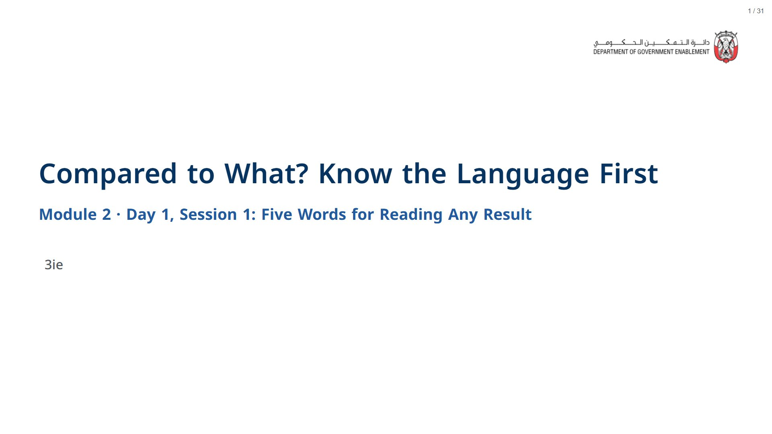

Slide 2
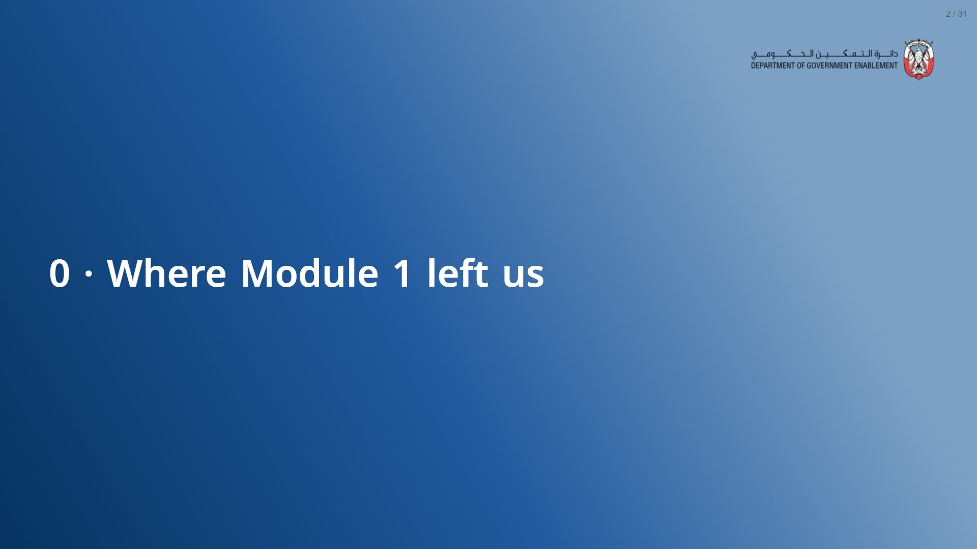

Slide 3
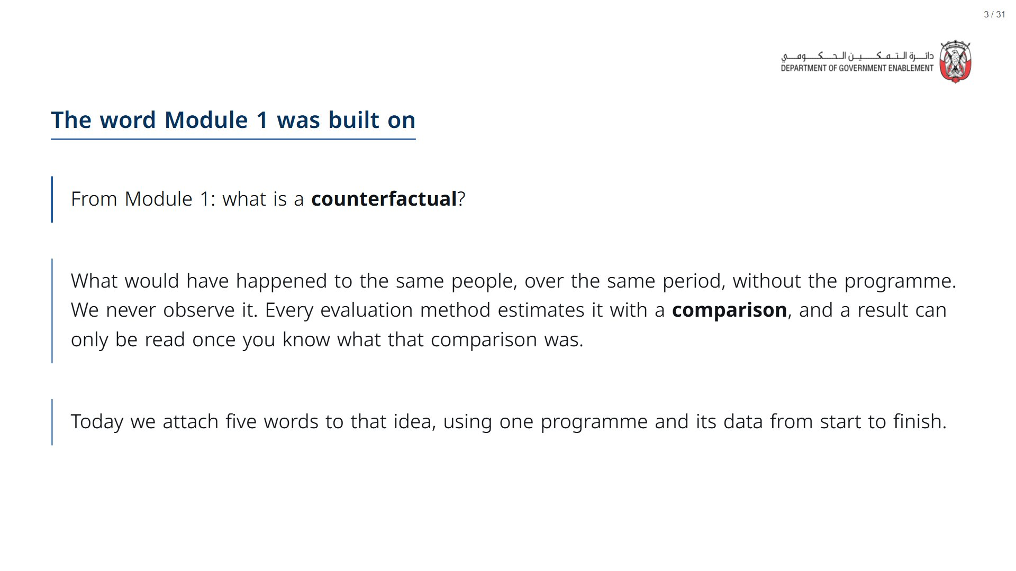
Notes:
About 3 minutes. Recall only; Module 1 taught this. Open the deck a couple of minutes before the session starts: R and its statistics package take about a minute to load in the browser, after which every live cell runs in a few seconds.
span.MJX_Assistive_MathML {
position:absolute!important;
clip: rect(1px, 1px, 1px, 1px);
padding: 1px 0 0 0!important;
border: 0!important;
height: 1px!important;
width: 1px!important;
overflow: hidden!important;
display:block!important;
}

Slide 4


Slide 5
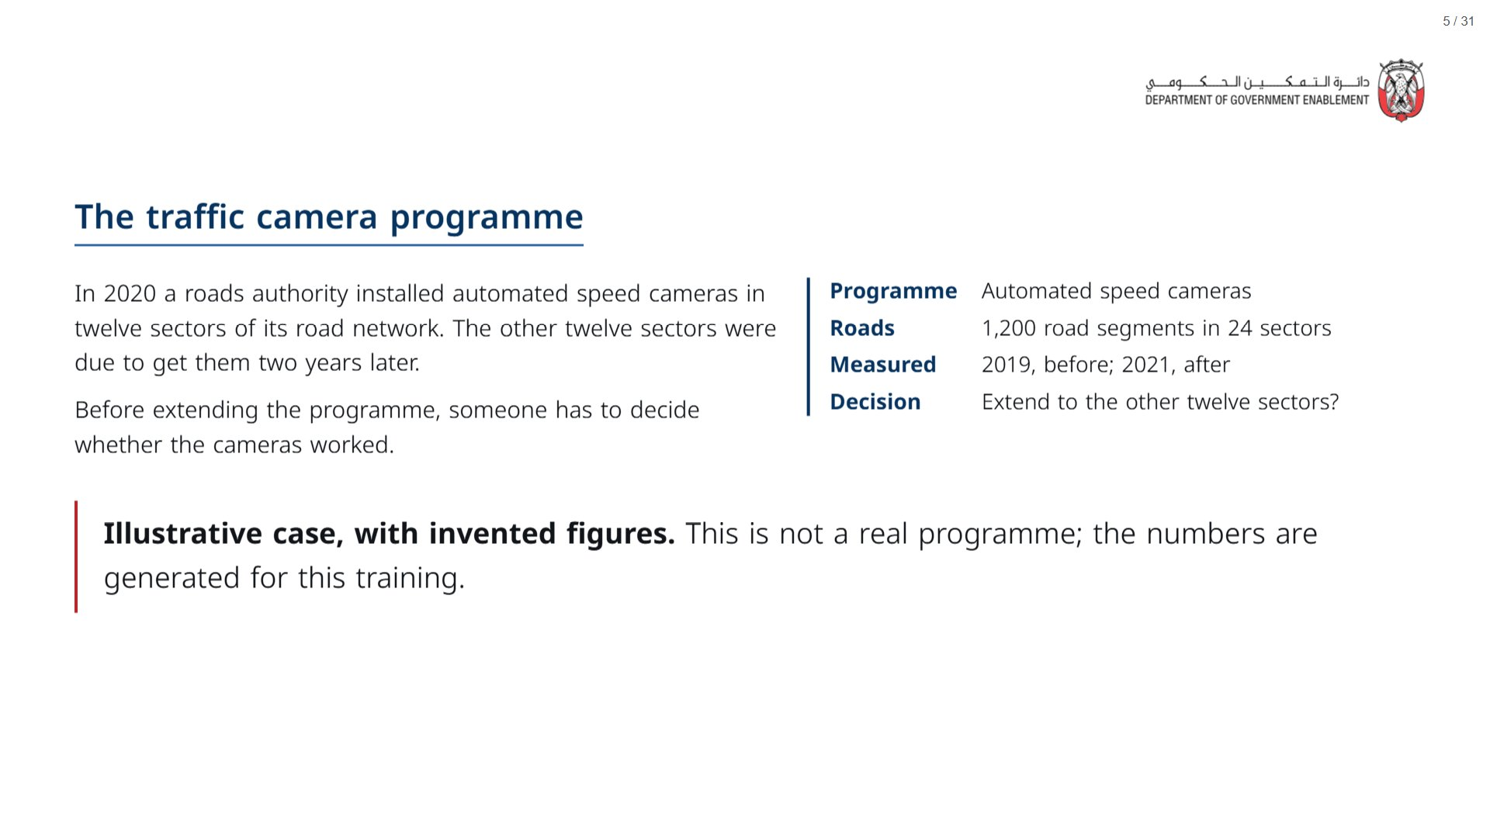

Slide 6
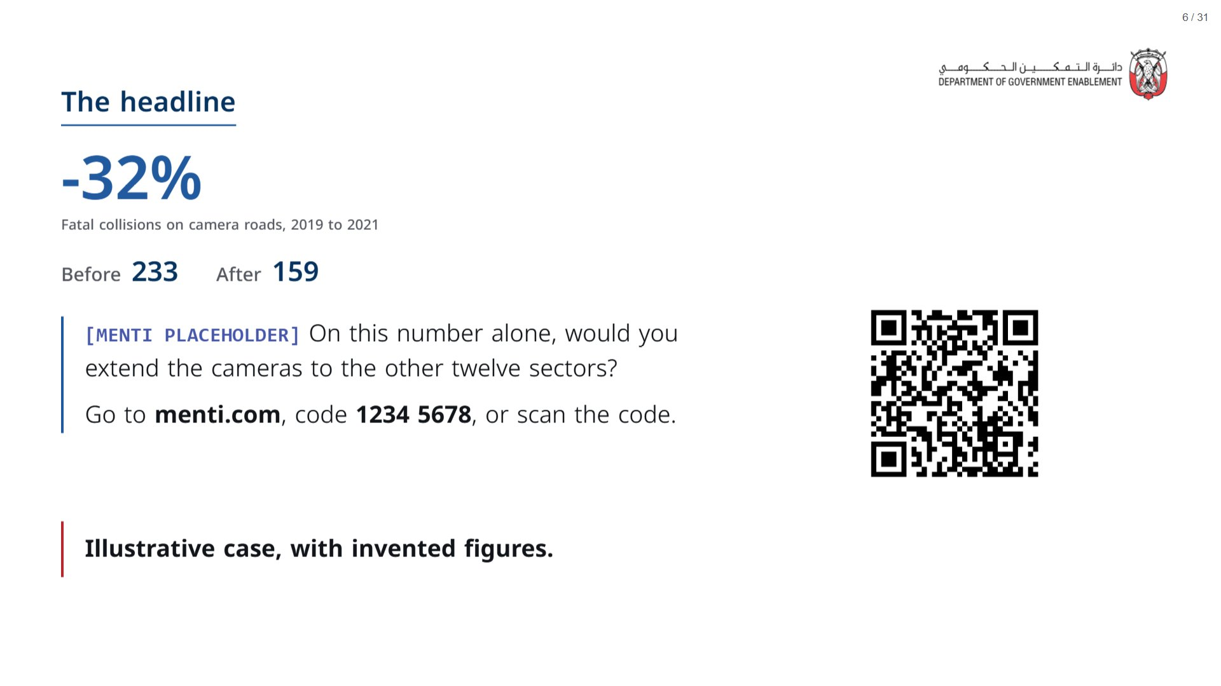

Slide 7
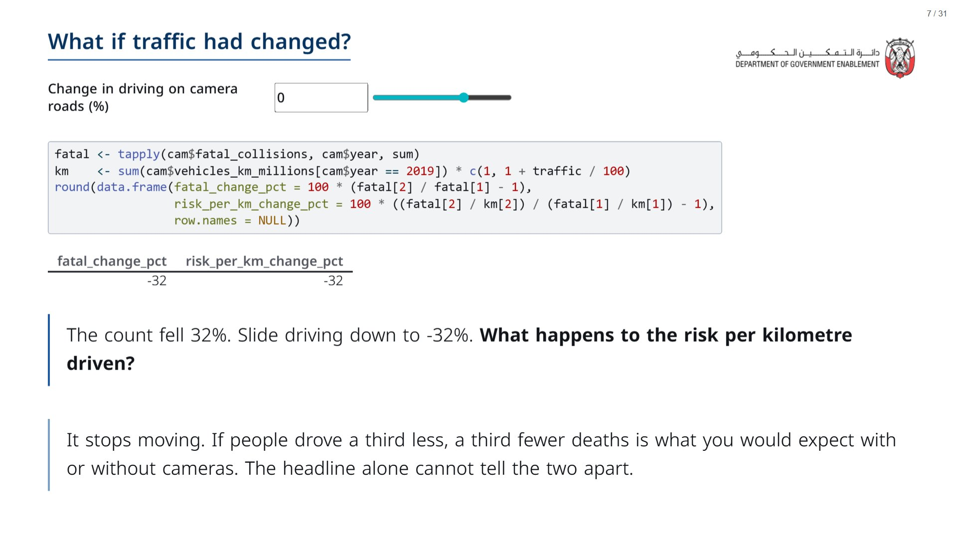

Slide 8
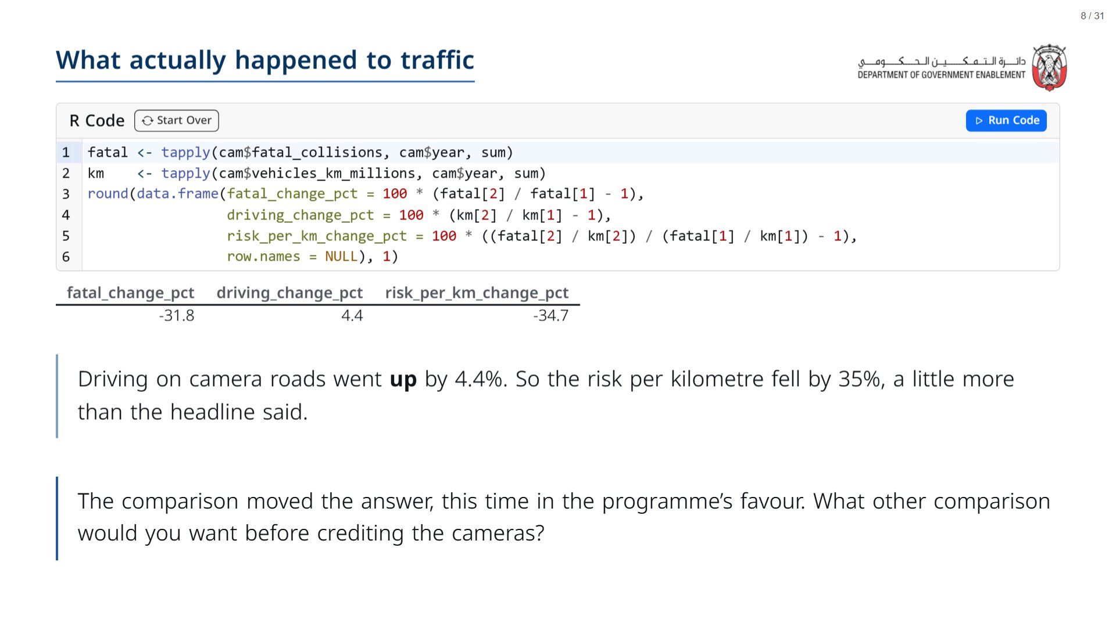
Notes:
Take answers. If someone says “roads without cameras”, say that is exactly where Session 2 goes, and leave it there. Then a show of hands: who would now change their vote from the headline slide? Take one reason from someone who changed and one from someone who did not. Do not show the comparison roads’ collisions here: Session 2’s last section depends on it.
span.MJX_Assistive_MathML {
position:absolute!important;
clip: rect(1px, 1px, 1px, 1px);
padding: 1px 0 0 0!important;
border: 0!important;
height: 1px!important;
width: 1px!important;
overflow: hidden!important;
display:block!important;
}

Slide 9
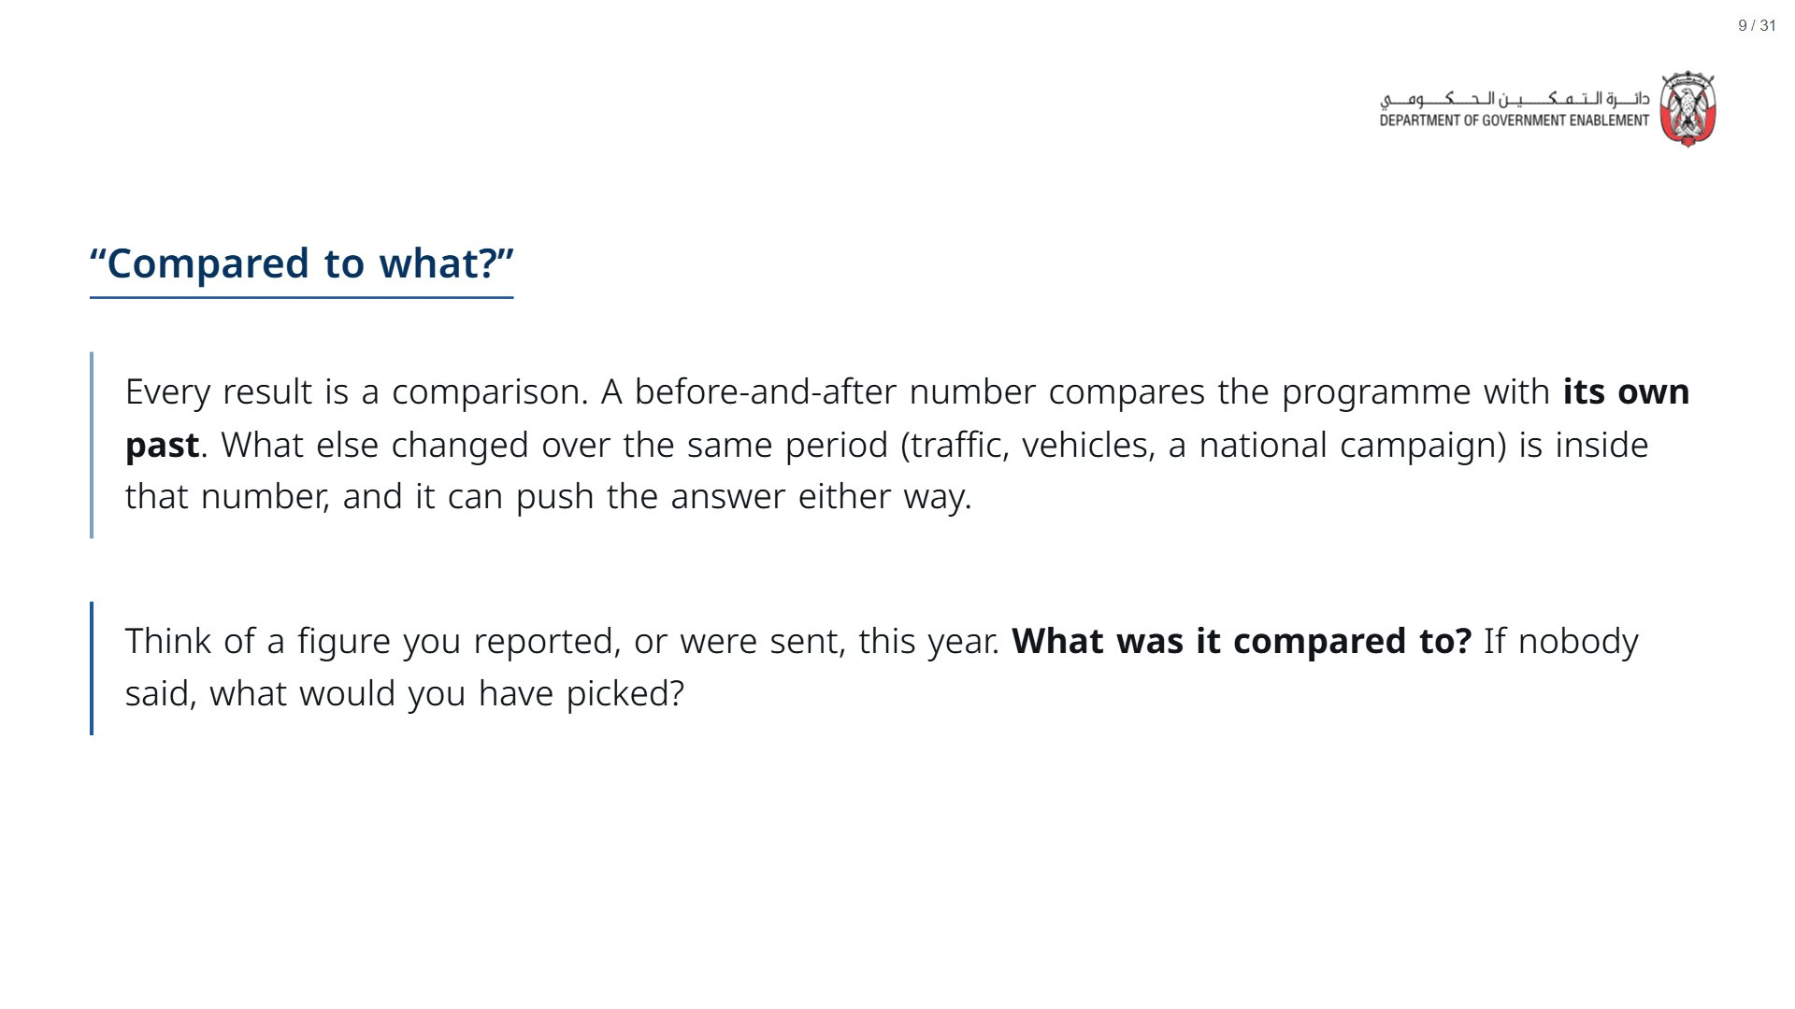

Slide 10
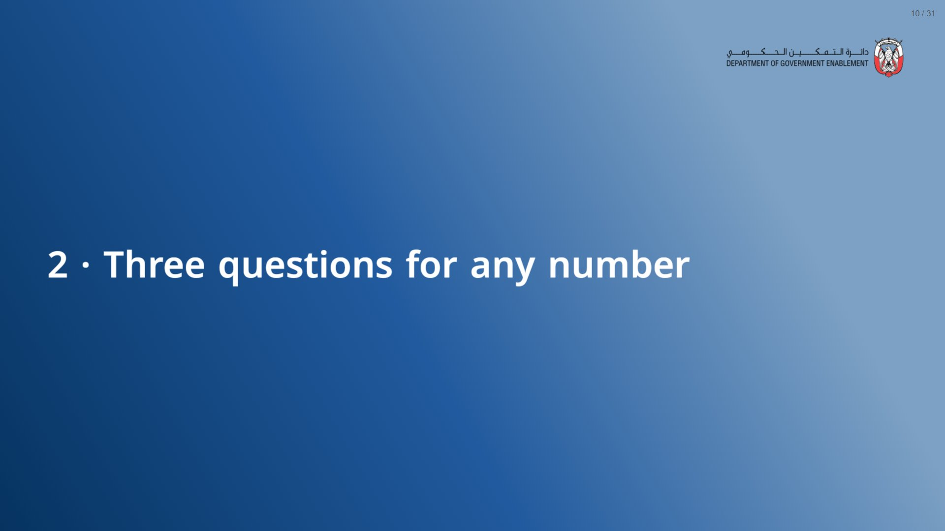

Slide 11
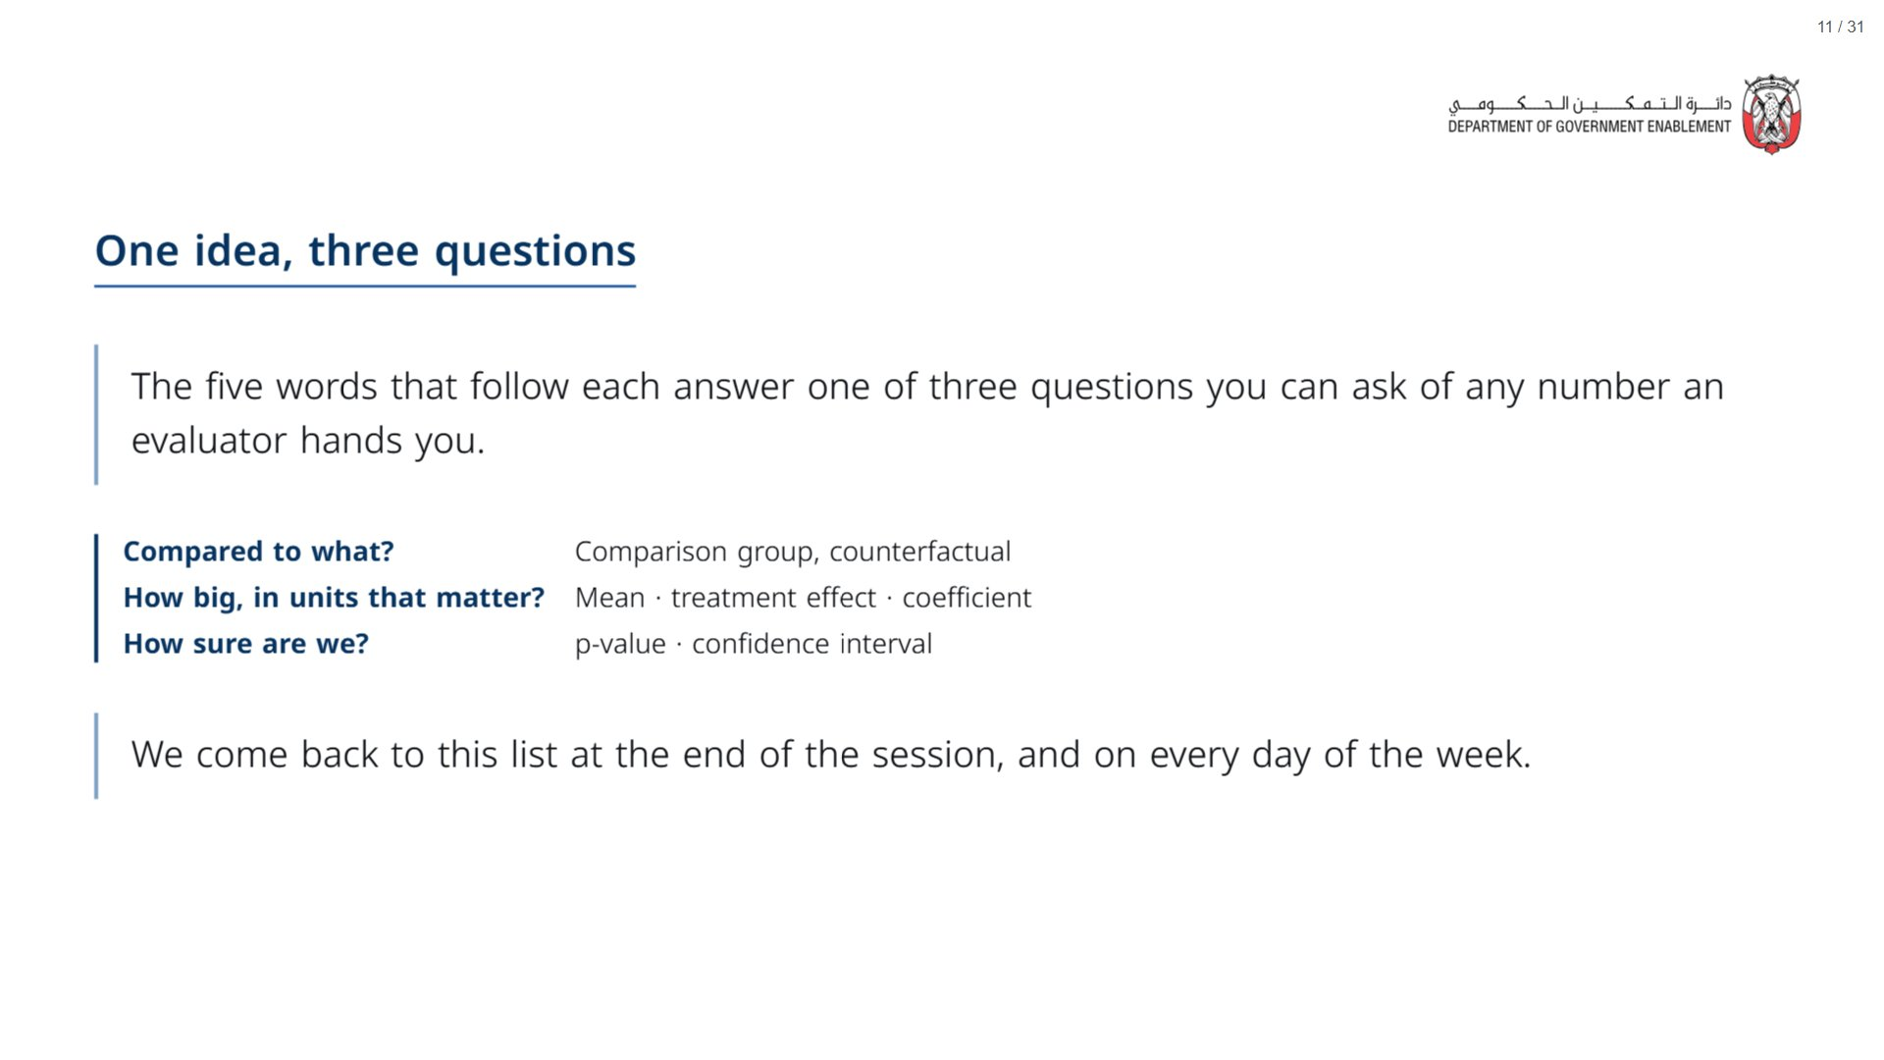

Slide 12


Slide 13
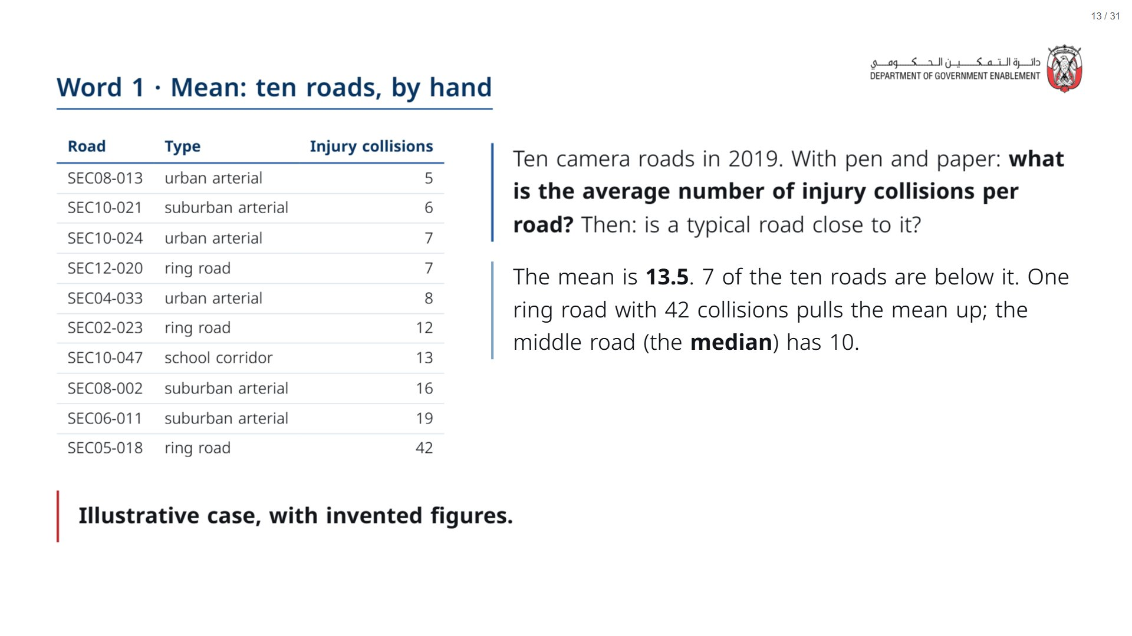
Notes:
Paper (Oct12_session1_materials.docx): Hand out the ten-roads worksheet (pack page 1, one per participant; the speed table is on the back). Give two minutes before the reveal.
span.MJX_Assistive_MathML {
position:absolute!important;
clip: rect(1px, 1px, 1px, 1px);
padding: 1px 0 0 0!important;
border: 0!important;
height: 1px!important;
width: 1px!important;
overflow: hidden!important;
display:block!important;
}

Slide 14
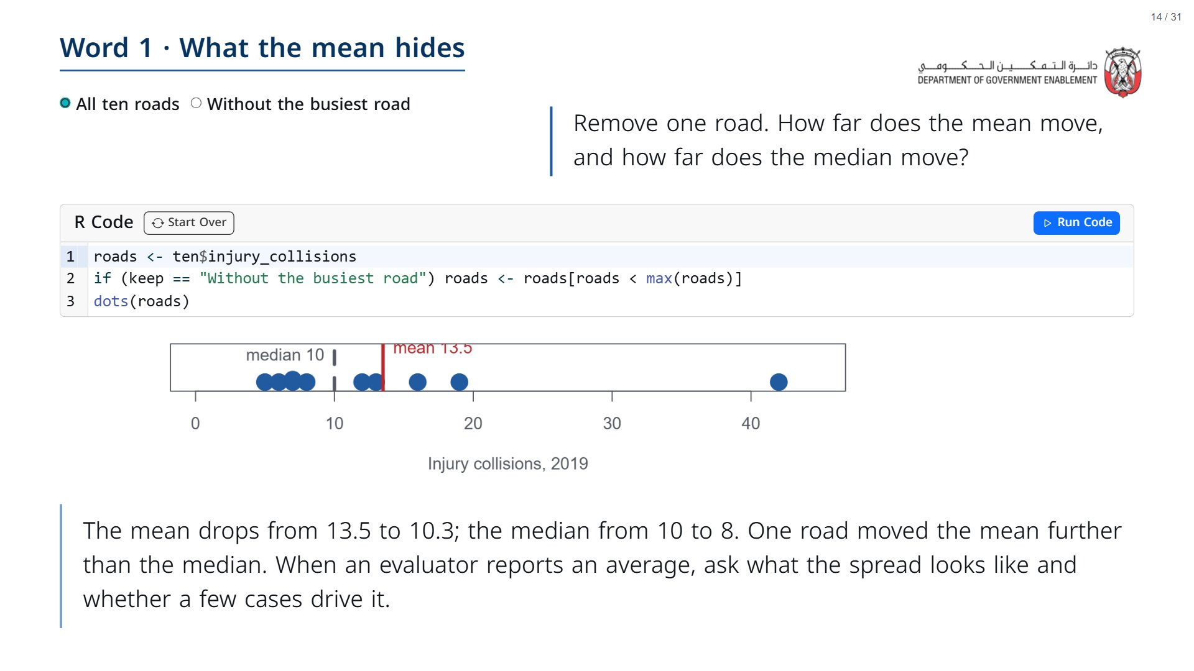

Slide 15
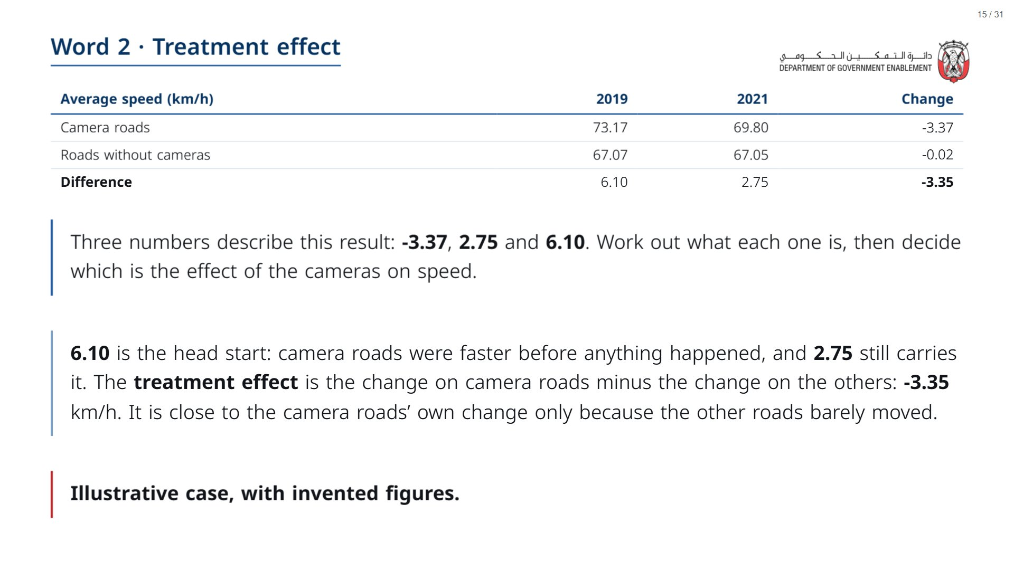
Notes:
Paper (Oct12_session1_materials.docx): Participants turn the worksheet over: part 2, the speed table. They fill the blank cells before you reveal them.
span.MJX_Assistive_MathML {
position:absolute!important;
clip: rect(1px, 1px, 1px, 1px);
padding: 1px 0 0 0!important;
border: 0!important;
height: 1px!important;
width: 1px!important;
overflow: hidden!important;
display:block!important;
}

Slide 16
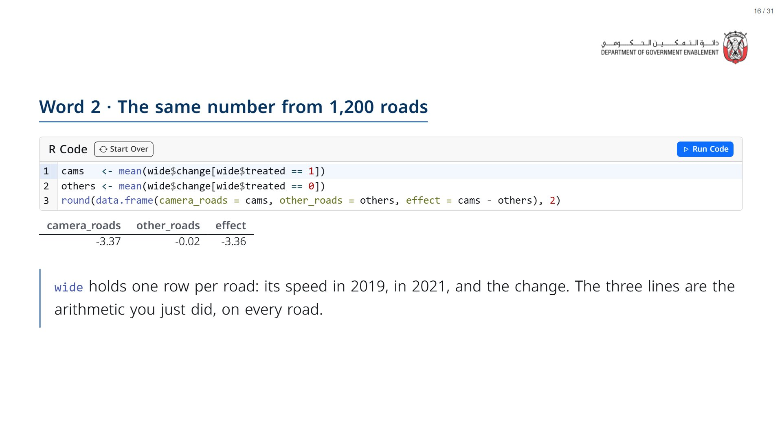

Slide 17
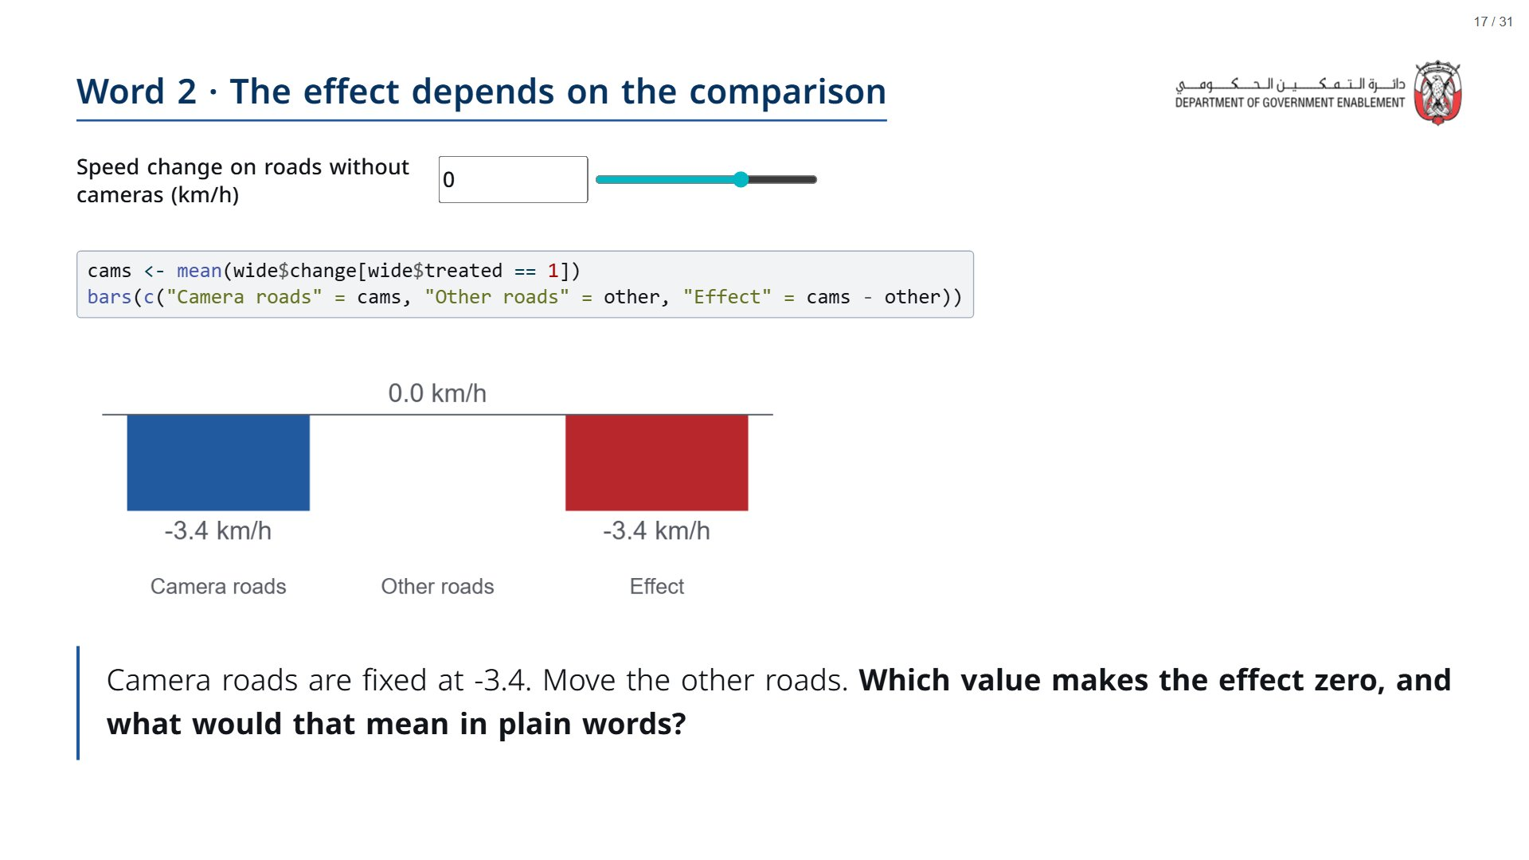

Slide 18
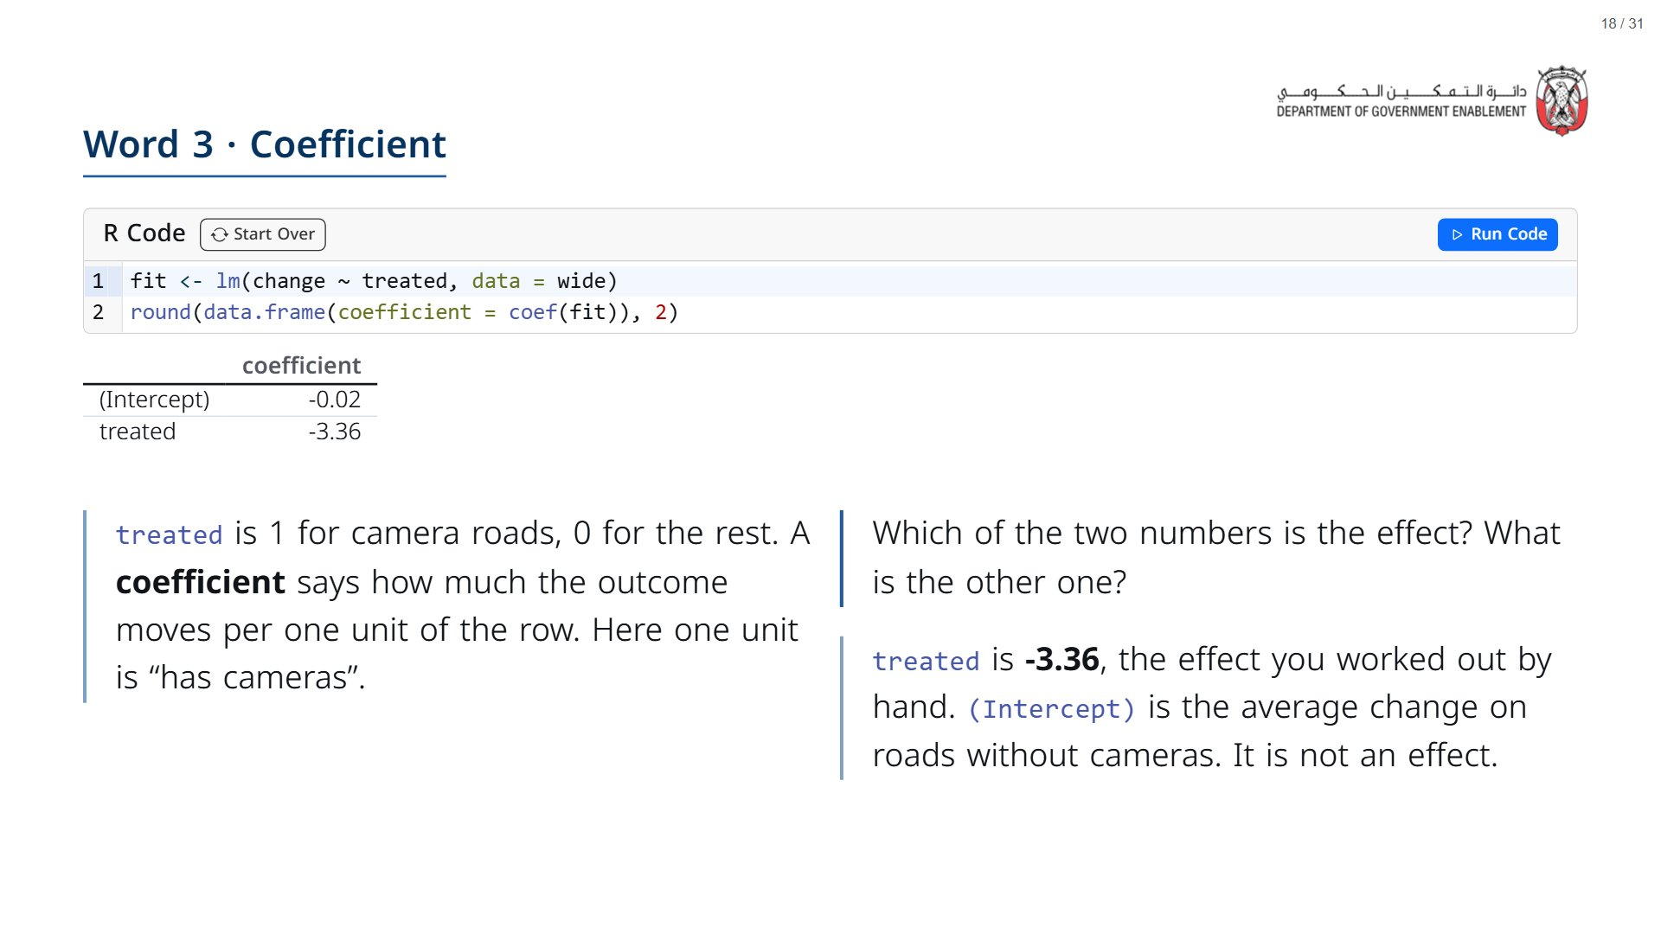

Slide 19
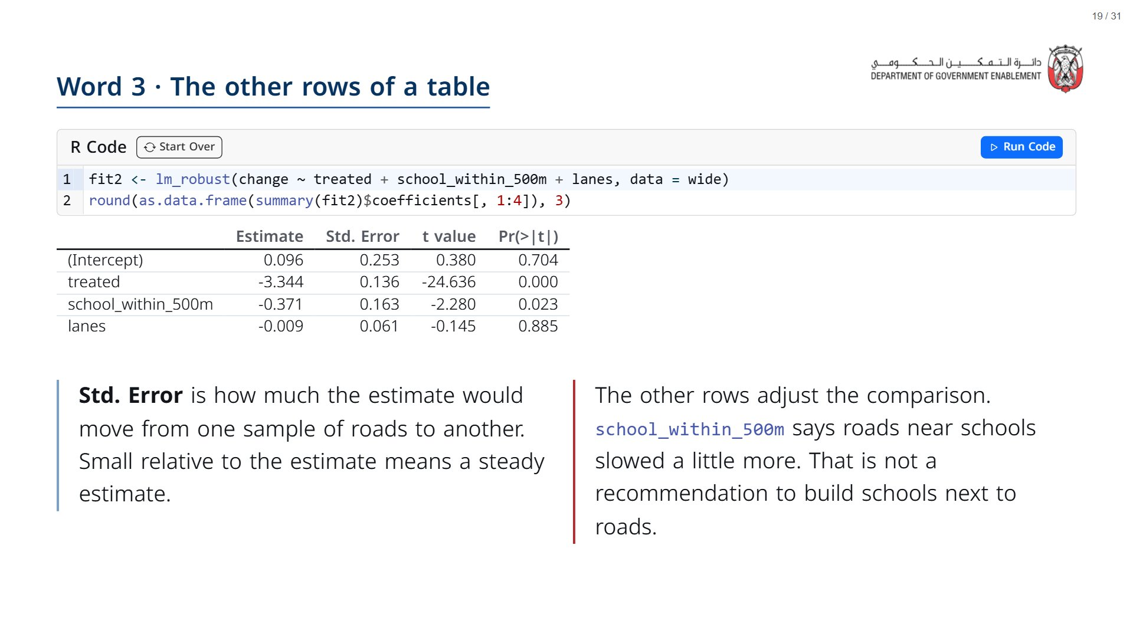

Slide 20
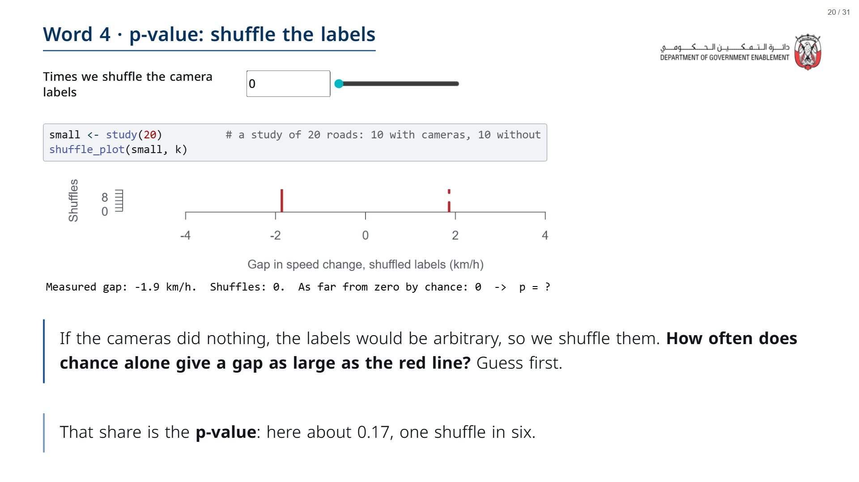
Notes:
Start at 0 shuffles; the red line is this 20-road study’s gap (-1.9). Slide up. At 1,000 shuffles p is about 0.17: chance produces a gap this big about one time in six. Keep that number for two slides from now.
span.MJX_Assistive_MathML {
position:absolute!important;
clip: rect(1px, 1px, 1px, 1px);
padding: 1px 0 0 0!important;
border: 0!important;
height: 1px!important;
width: 1px!important;
overflow: hidden!important;
display:block!important;
}

Slide 21
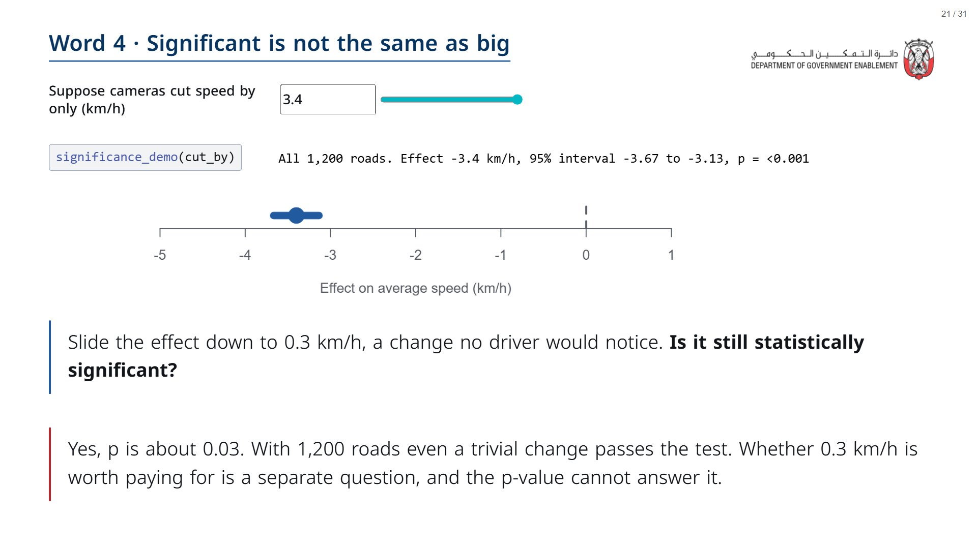

Slide 22
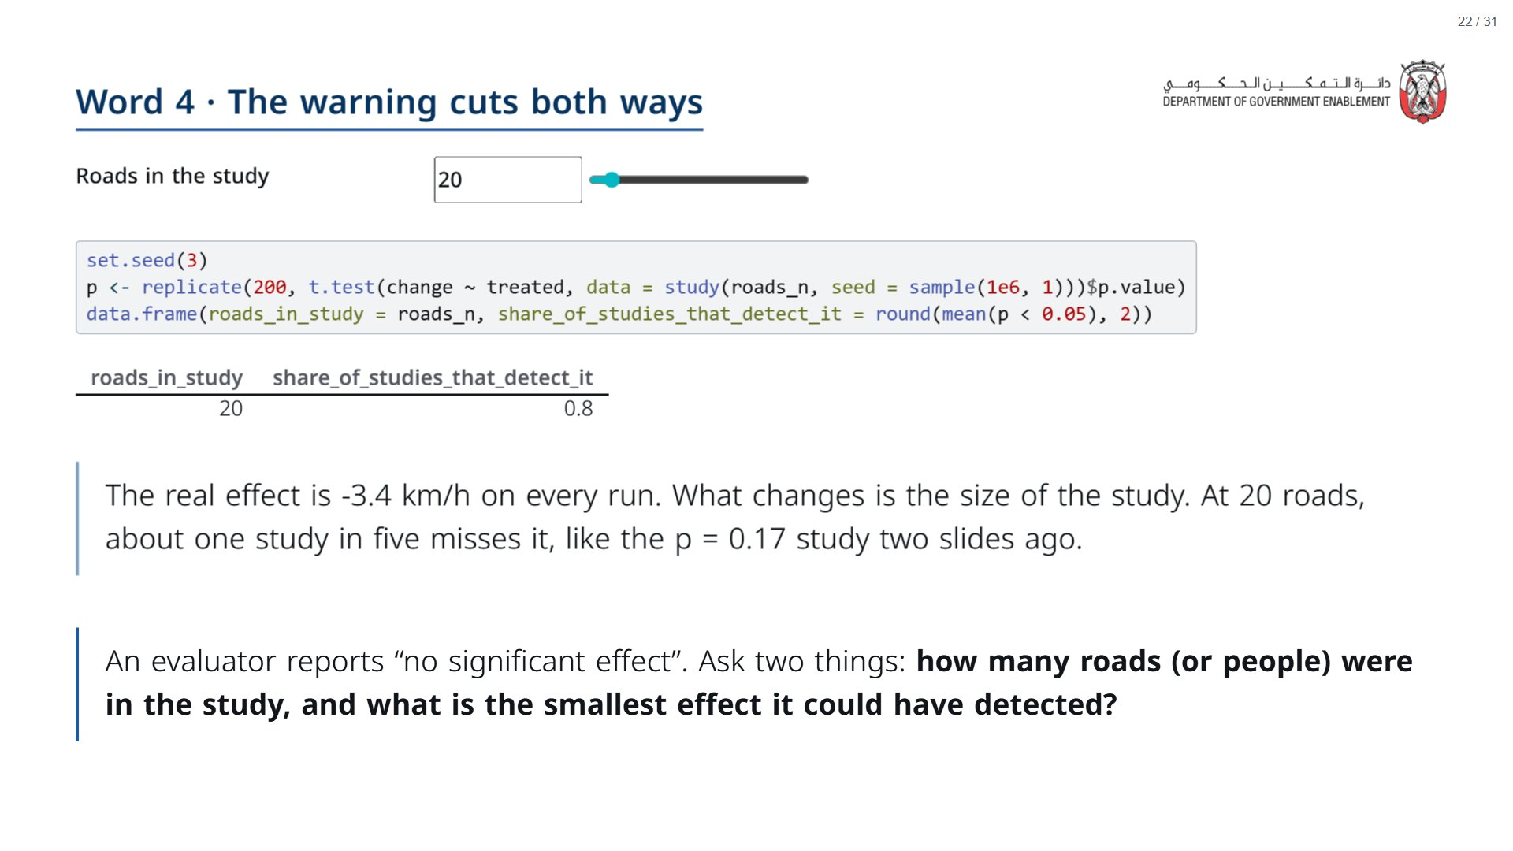

Slide 23
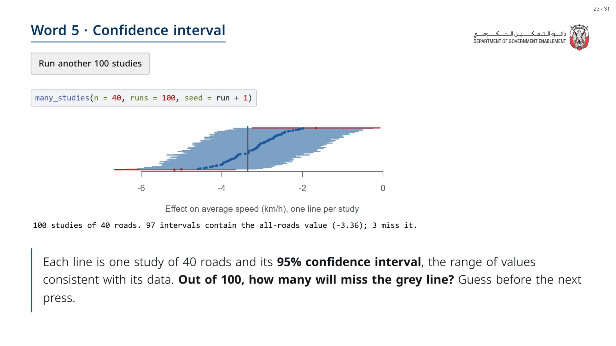
Notes:
About 95 of 100 lines cross the grey line (the all-roads value), and about 5 miss (red). That is what “95%” refers to: the method, over many studies, not the probability for any one interval. Press the button two or three times.
span.MJX_Assistive_MathML {
position:absolute!important;
clip: rect(1px, 1px, 1px, 1px);
padding: 1px 0 0 0!important;
border: 0!important;
height: 1px!important;
width: 1px!important;
overflow: hidden!important;
display:block!important;
}

Slide 24
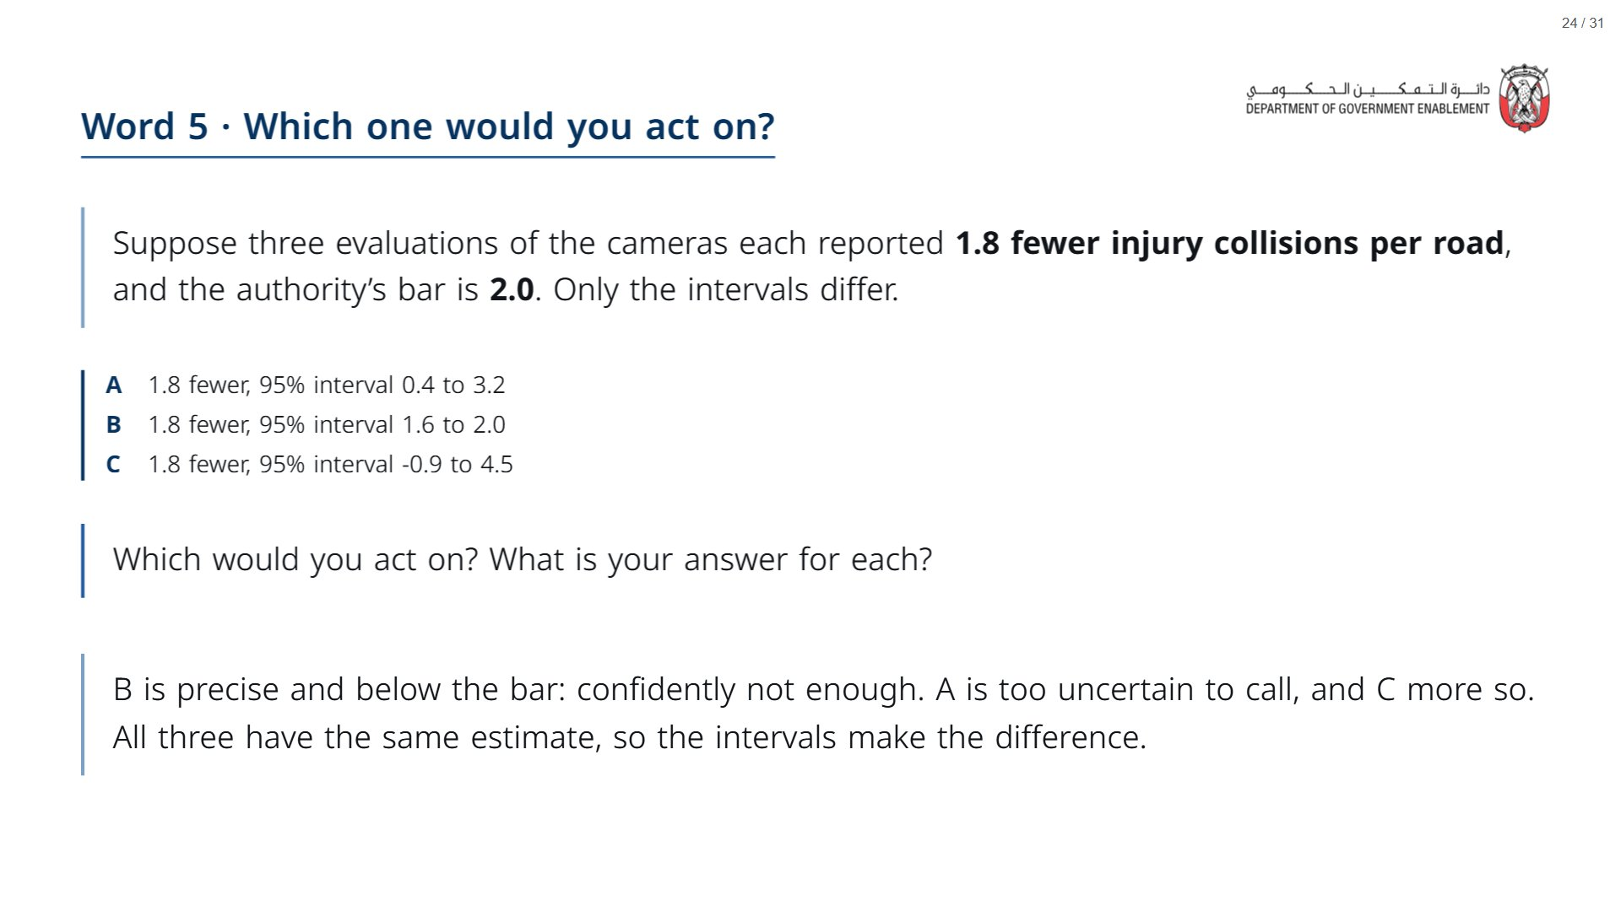
Notes:
These three results are invented for this exercise; they are not the programme’s result, which Session 2 and Day 2 estimate from the data.
Paper (Oct12_session1_materials.docx): Part 3 of the worksheet: everyone ticks act / do not act / cannot tell yet for A, B and C before the reveal.
span.MJX_Assistive_MathML {
position:absolute!important;
clip: rect(1px, 1px, 1px, 1px);
padding: 1px 0 0 0!important;
border: 0!important;
height: 1px!important;
width: 1px!important;
overflow: hidden!important;
display:block!important;
}

Slide 25


Slide 26
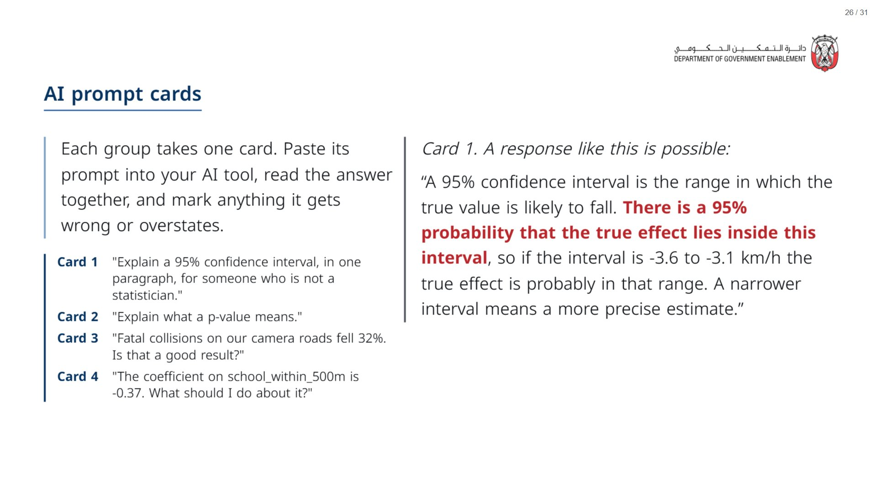
Notes:
Paper (Oct12_session1_materials.docx): Hand out one set of the four prompt cards per group (pack page 3, cut); each group takes one card.
span.MJX_Assistive_MathML {
position:absolute!important;
clip: rect(1px, 1px, 1px, 1px);
padding: 1px 0 0 0!important;
border: 0!important;
height: 1px!important;
width: 1px!important;
overflow: hidden!important;
display:block!important;
}

Slide 27
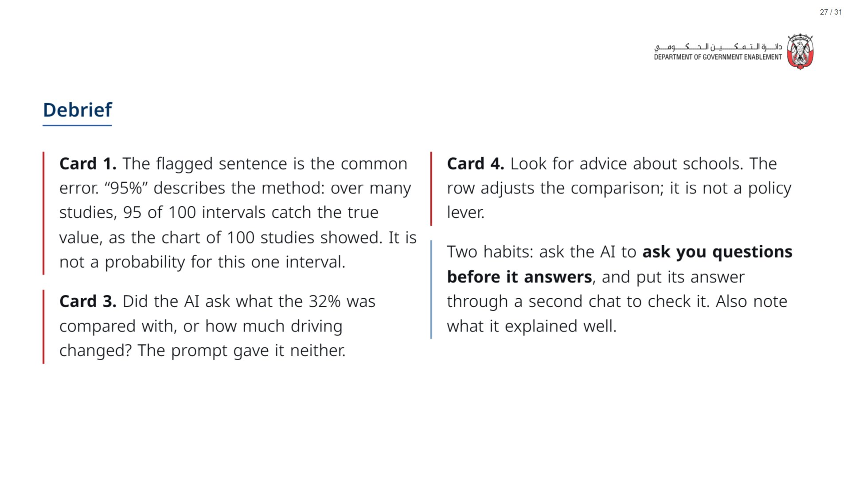

Slide 28


Slide 29
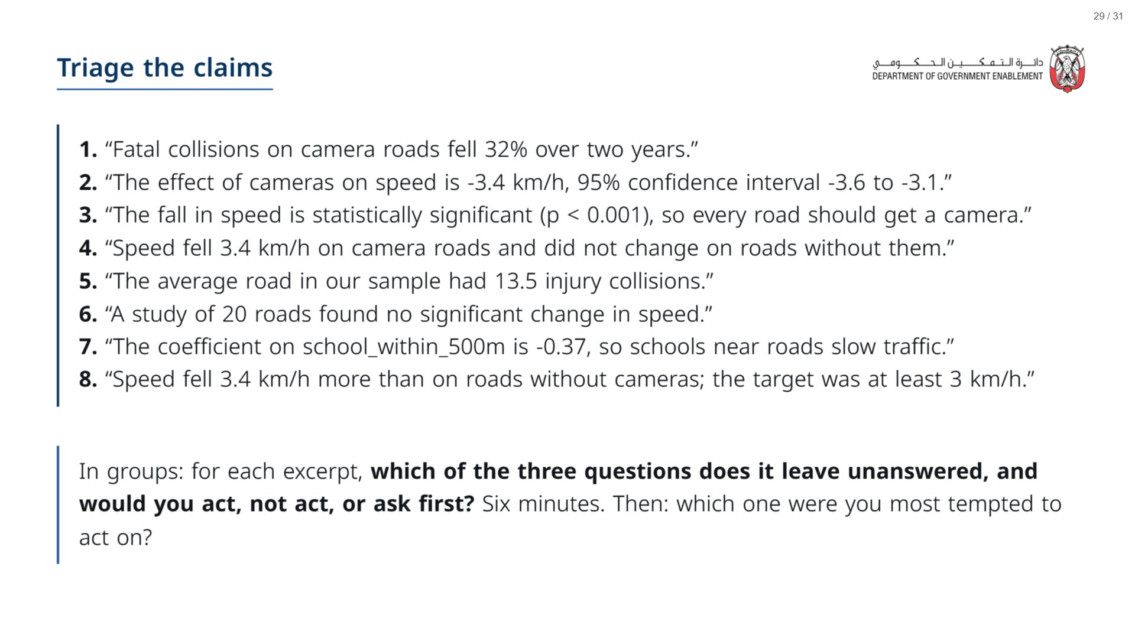
Notes:
Target in excerpt 8 is invented for the exercise. Key: 1 compared to what (ask first); 2 how big in units that matter, speed not collisions (ask first); 3 significance is not a decision rule (do not act); 4 how sure, no interval (ask first); 5 one road pulls the mean (ask for the spread); 6 too small to see anything (do not conclude “no effect”); 7 not a policy lever (do not act); 8 comparison, effect and bar (act). Groups usually split on 2 and 4: take one group’s reasoning for each.
Paper (Oct12_session1_materials.docx): Hand out the triage sheet (pack page 4, one per group) and one set of excerpt slips per group (page 5, cut).
span.MJX_Assistive_MathML {
position:absolute!important;
clip: rect(1px, 1px, 1px, 1px);
padding: 1px 0 0 0!important;
border: 0!important;
height: 1px!important;
width: 1px!important;
overflow: hidden!important;
display:block!important;
}

Slide 30


Slide 31
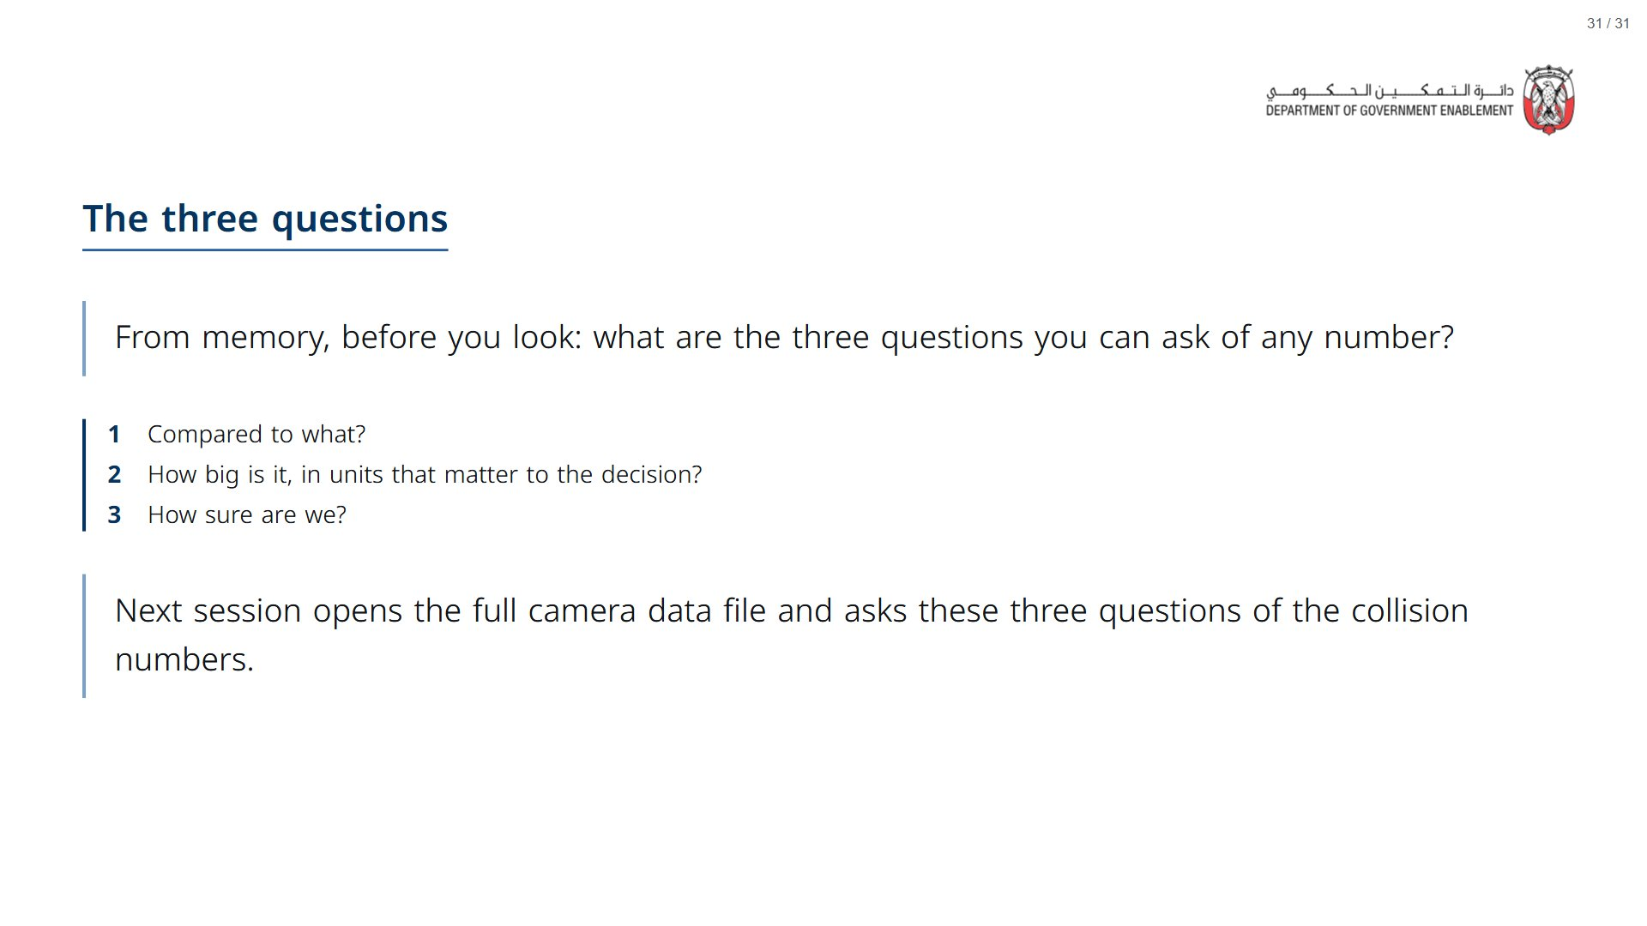
Notes:
If there is time: ask the room for a better way to ask AI about one of today’s words. For example: “I make policy decisions using impact evaluations. How should I read a confidence interval when I compare an estimate with a decision threshold? Ask me questions first.” Saying who you are and why you ask usually gets a more useful answer.
Paper (Oct12_session1_materials.docx): Hand out the take-away cards (pack page 6). Give a minute to fill in “On my desk” on the card, then take two or three examples from the room.
span.MJX_Assistive_MathML {
position:absolute!important;
clip: rect(1px, 1px, 1px, 1px);
padding: 1px 0 0 0!important;
border: 0!important;
height: 1px!important;
width: 1px!important;
overflow: hidden!important;
display:block!important;
}

