Slide 1
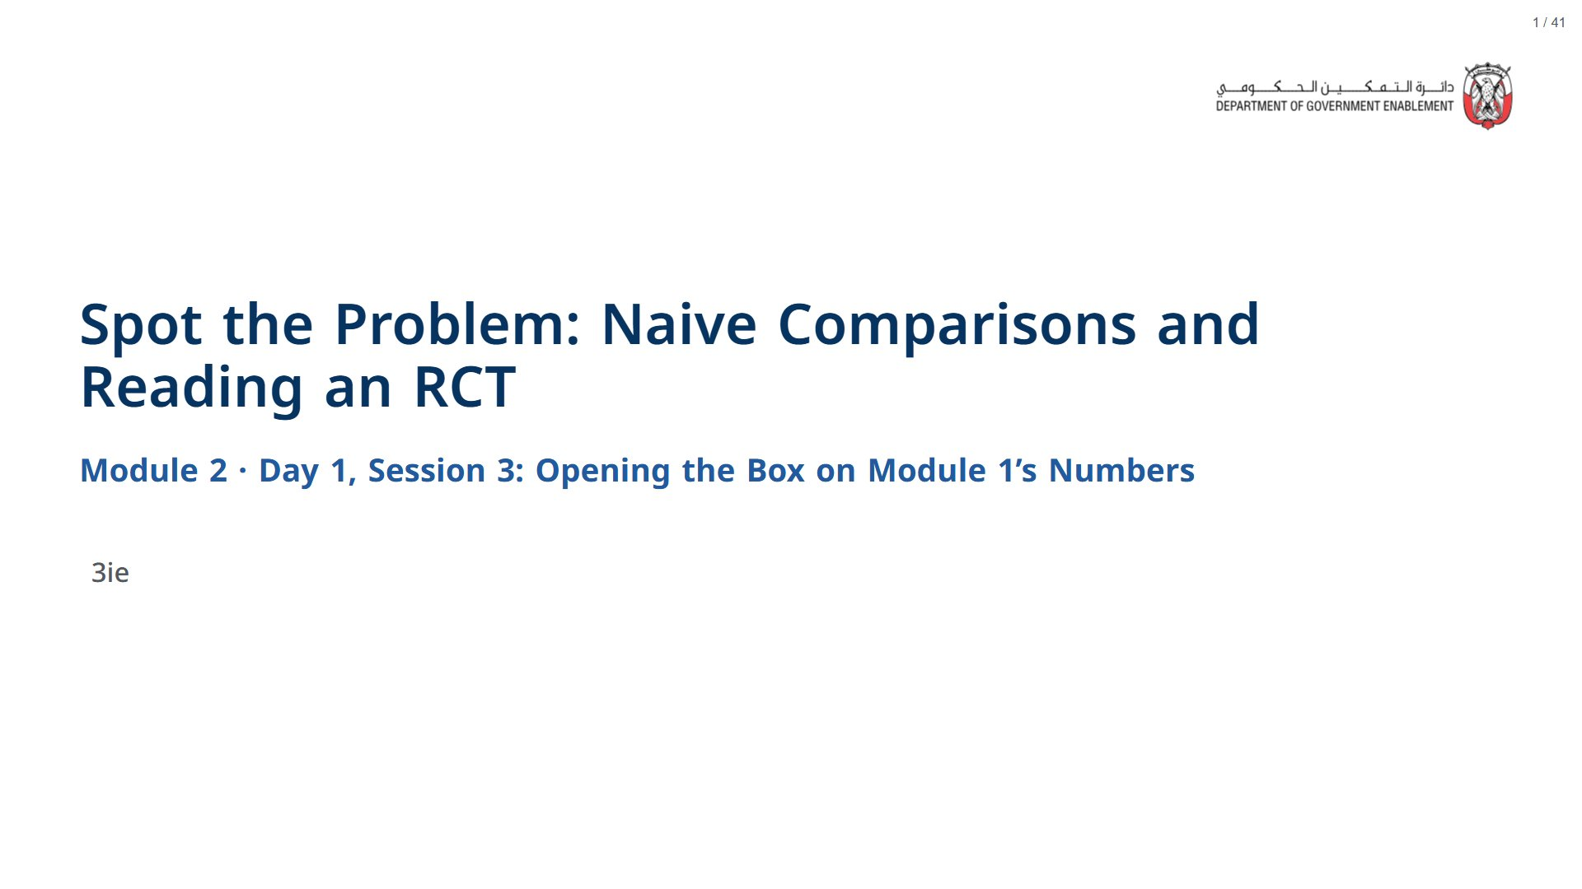

Slide 2
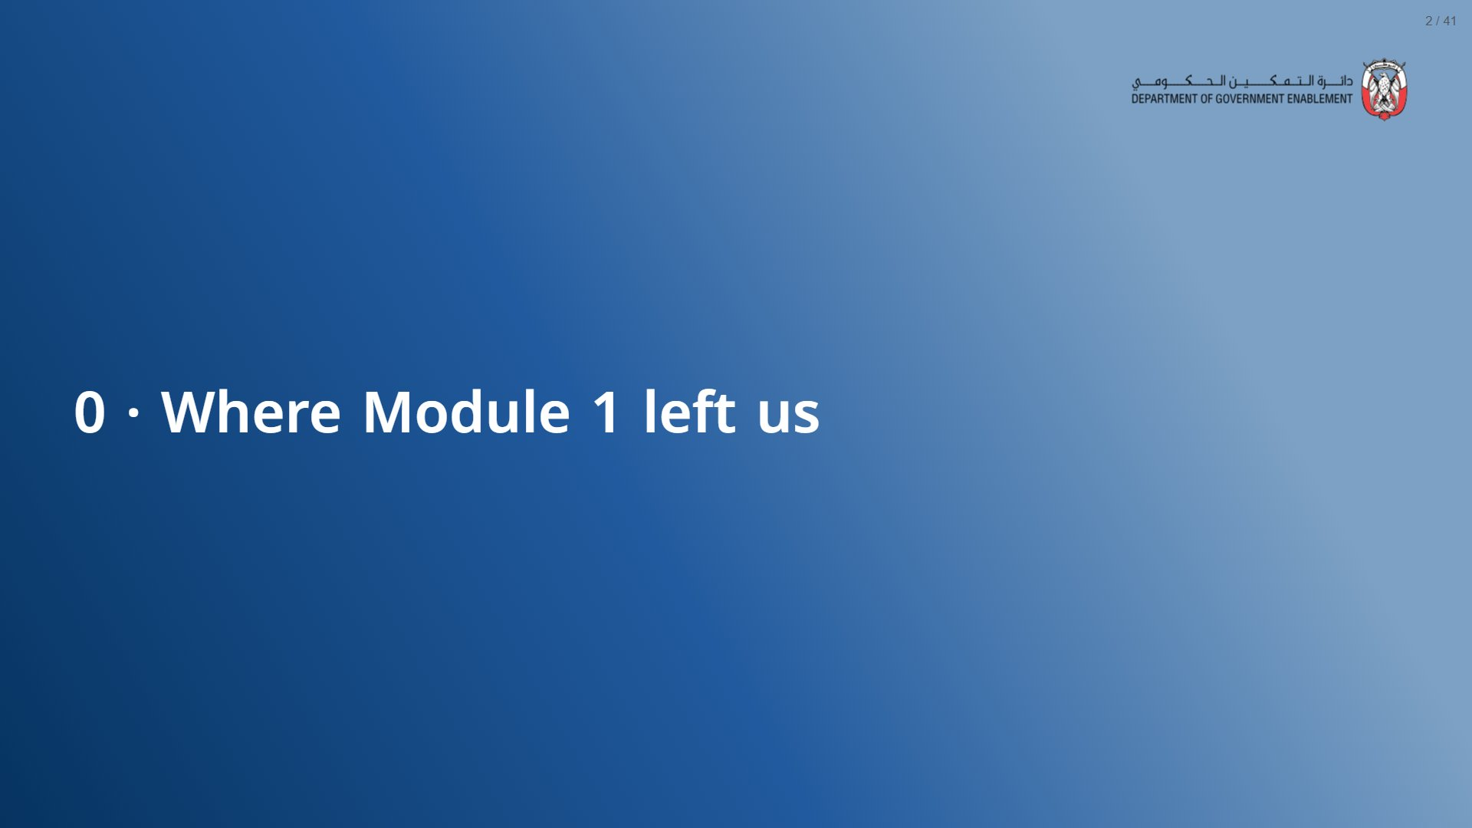

Slide 3
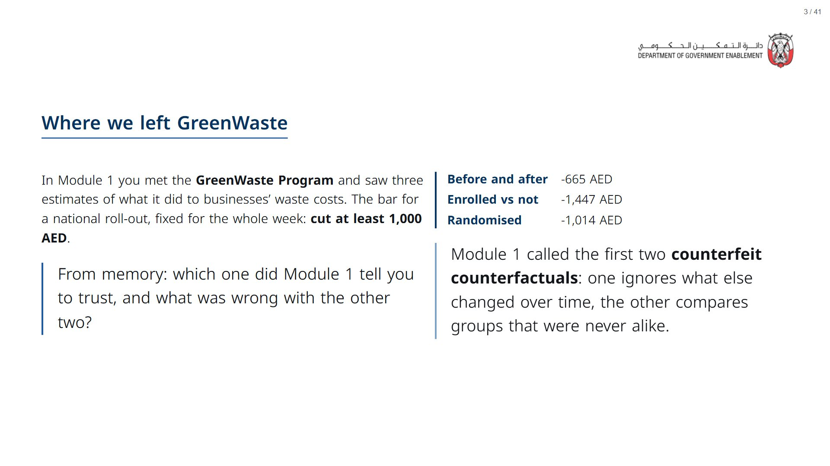
Notes:
~3 min. Pure recall; do not re-teach. Take two answers, then reveal the panel. Open the deck a couple of minutes before the session starts: R and its statistics package take about a minute to load in the browser, after which every live cell runs in a few seconds.
Paper (Oct12_session3_materials.docx): Hand out the session tracker (pack page 1, one per participant); they fill in each row as the number is rebuilt live.
span.MJX_Assistive_MathML {
position:absolute!important;
clip: rect(1px, 1px, 1px, 1px);
padding: 1px 0 0 0!important;
border: 0!important;
height: 1px!important;
width: 1px!important;
overflow: hidden!important;
display:block!important;
}

Slide 4
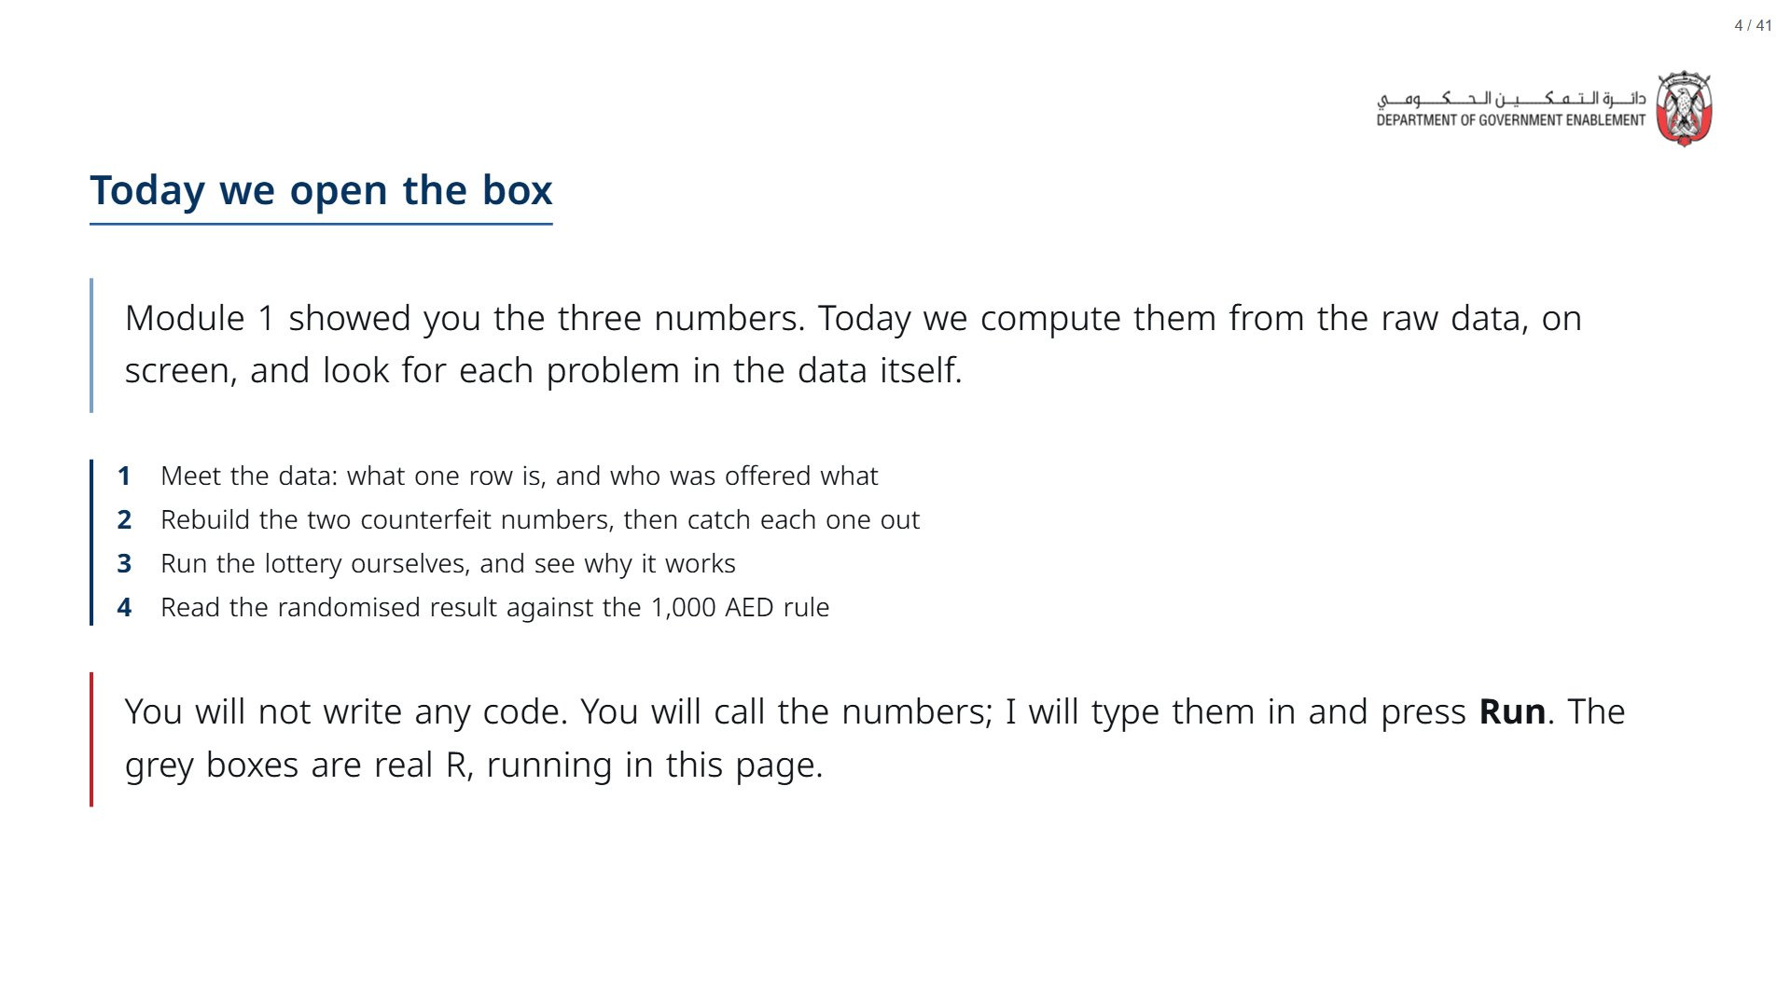

Slide 5


Slide 6
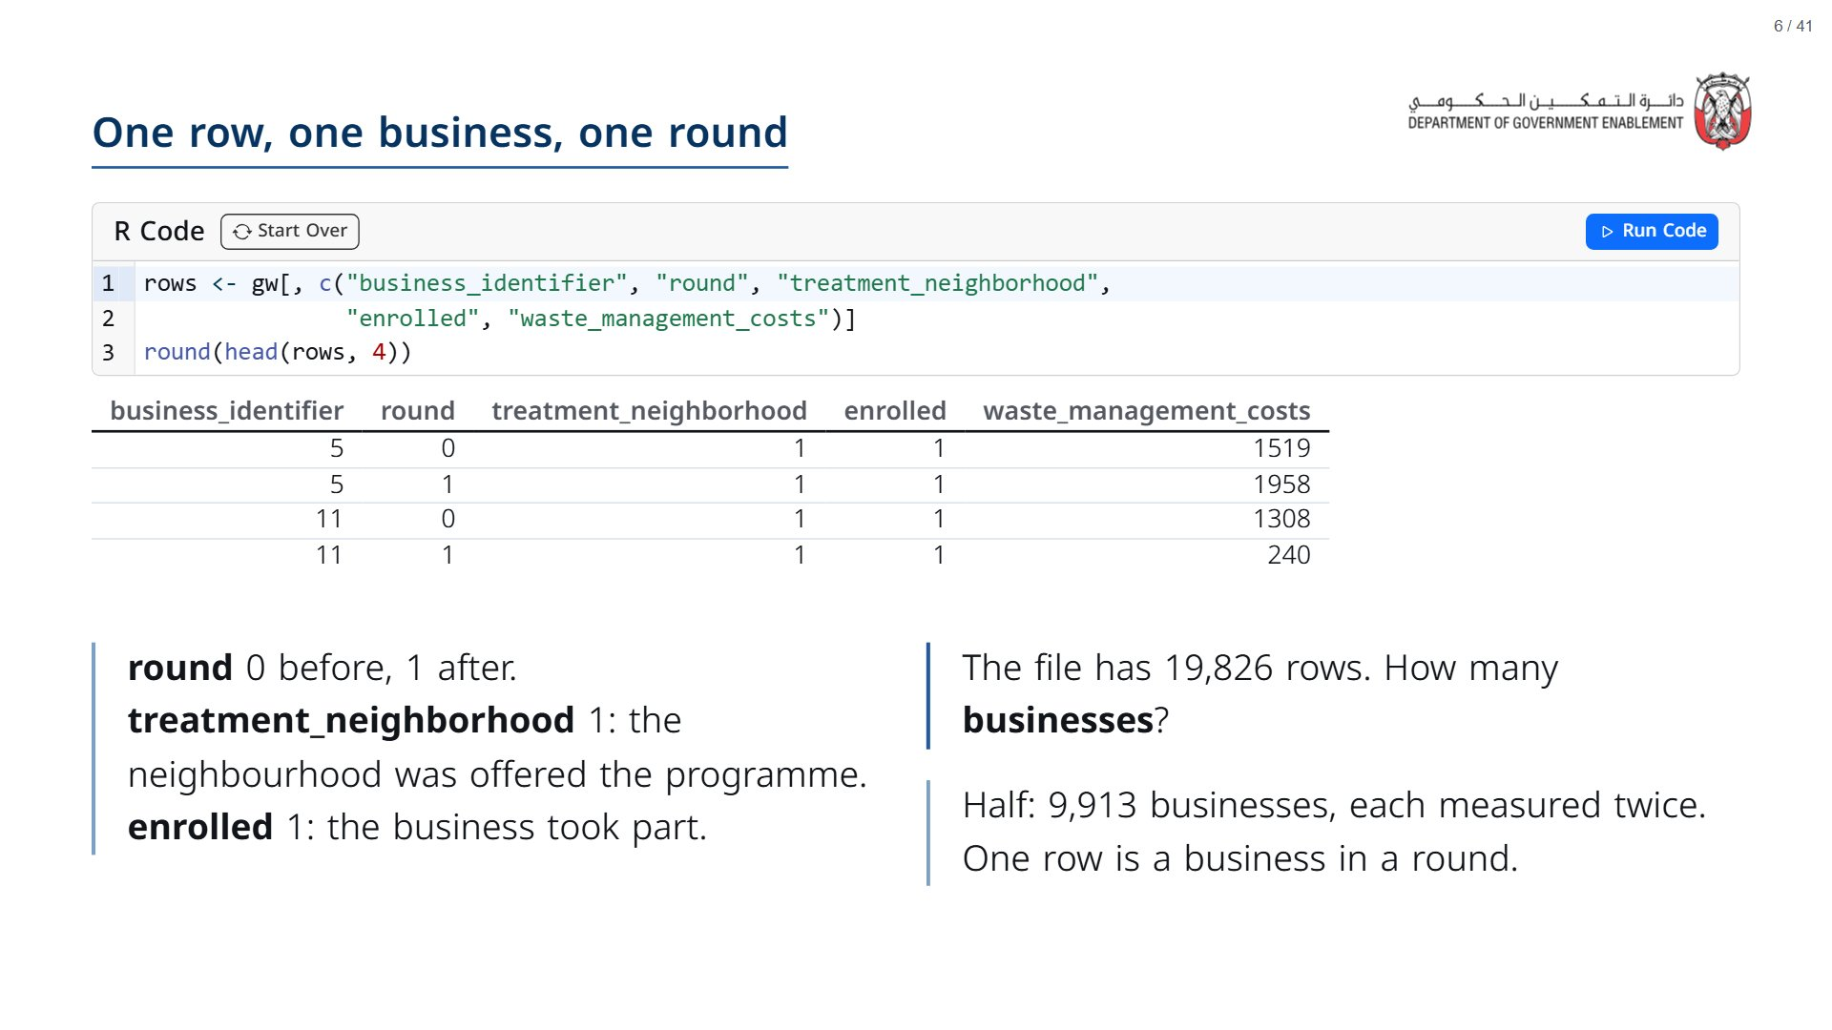

Slide 7
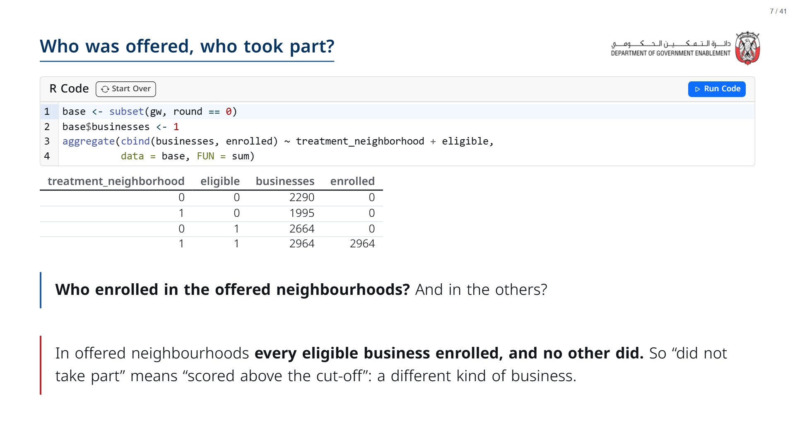

Slide 8
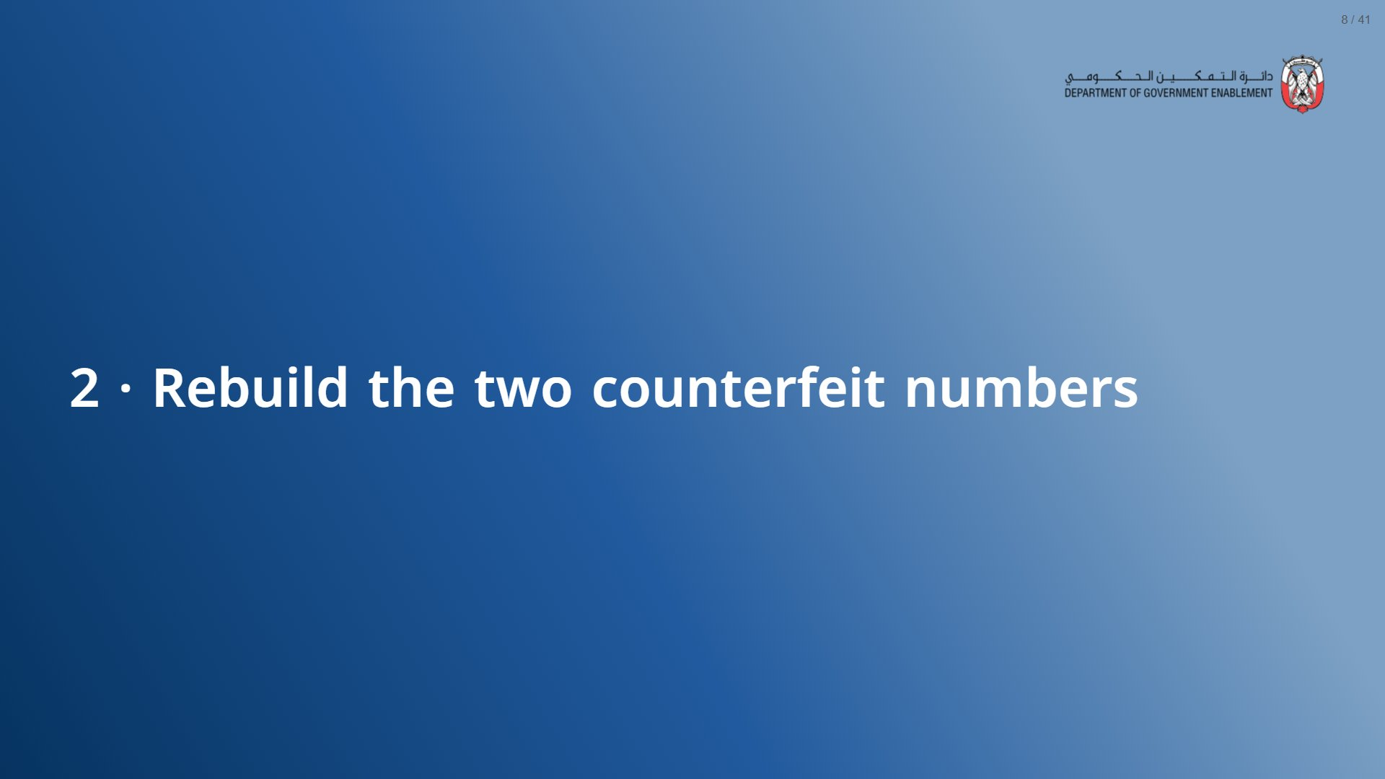

Slide 9
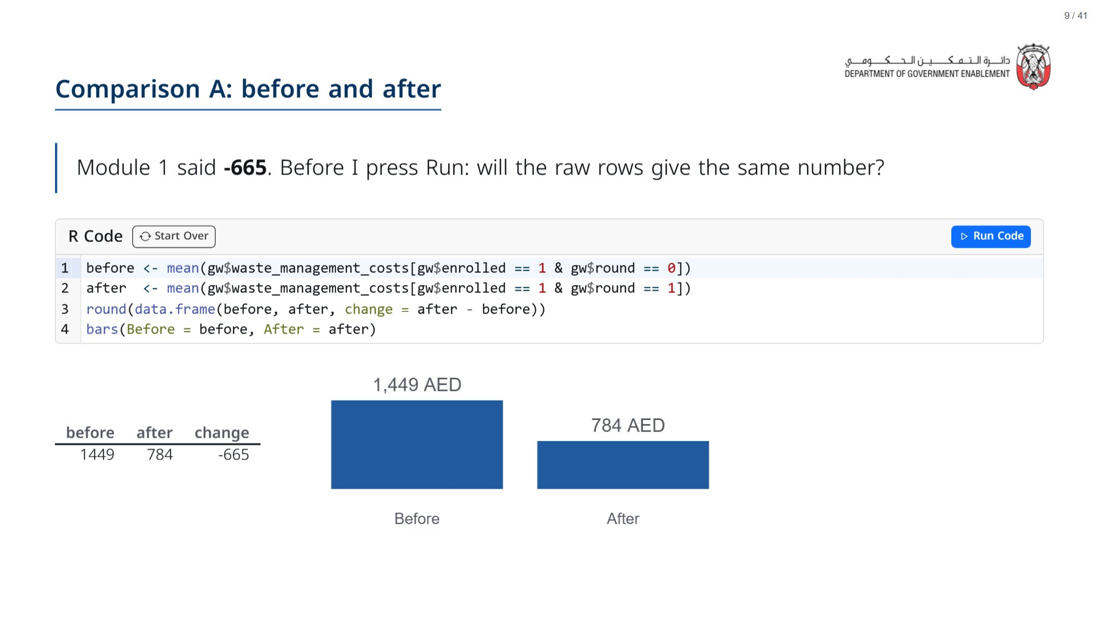
Notes:
Press Run live. The room should see -665 appear. Point at each line as you read it aloud in plain words.
span.MJX_Assistive_MathML {
position:absolute!important;
clip: rect(1px, 1px, 1px, 1px);
padding: 1px 0 0 0!important;
border: 0!important;
height: 1px!important;
width: 1px!important;
overflow: hidden!important;
display:block!important;
}

Slide 10
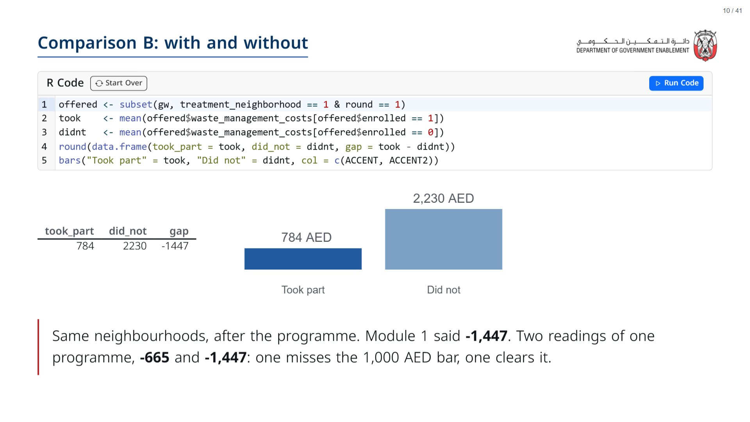

Slide 11
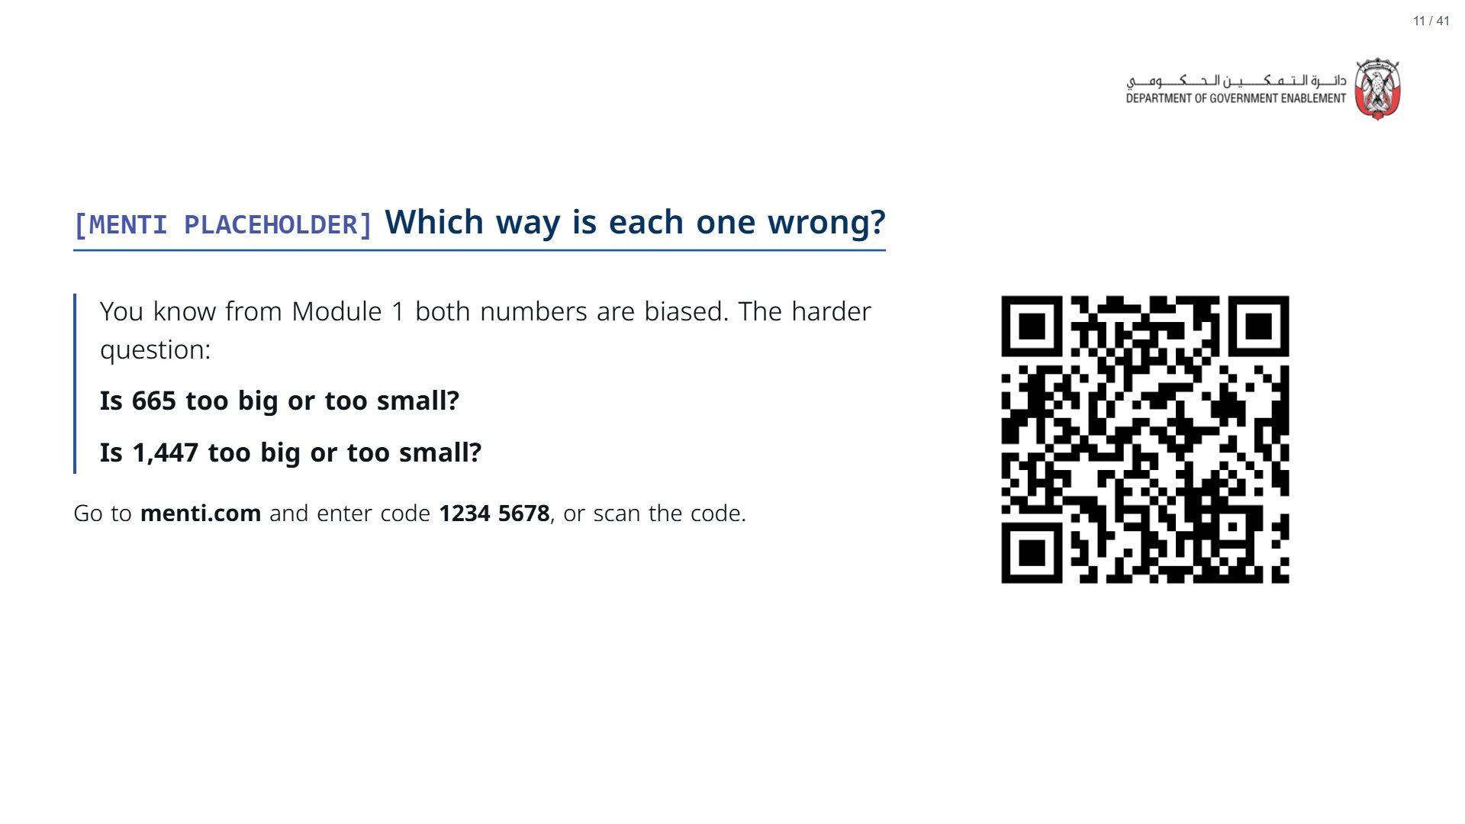
Notes:
~4 min. Do not settle it. The next three slides answer it from the data.
span.MJX_Assistive_MathML {
position:absolute!important;
clip: rect(1px, 1px, 1px, 1px);
padding: 1px 0 0 0!important;
border: 0!important;
height: 1px!important;
width: 1px!important;
overflow: hidden!important;
display:block!important;
}

Slide 12
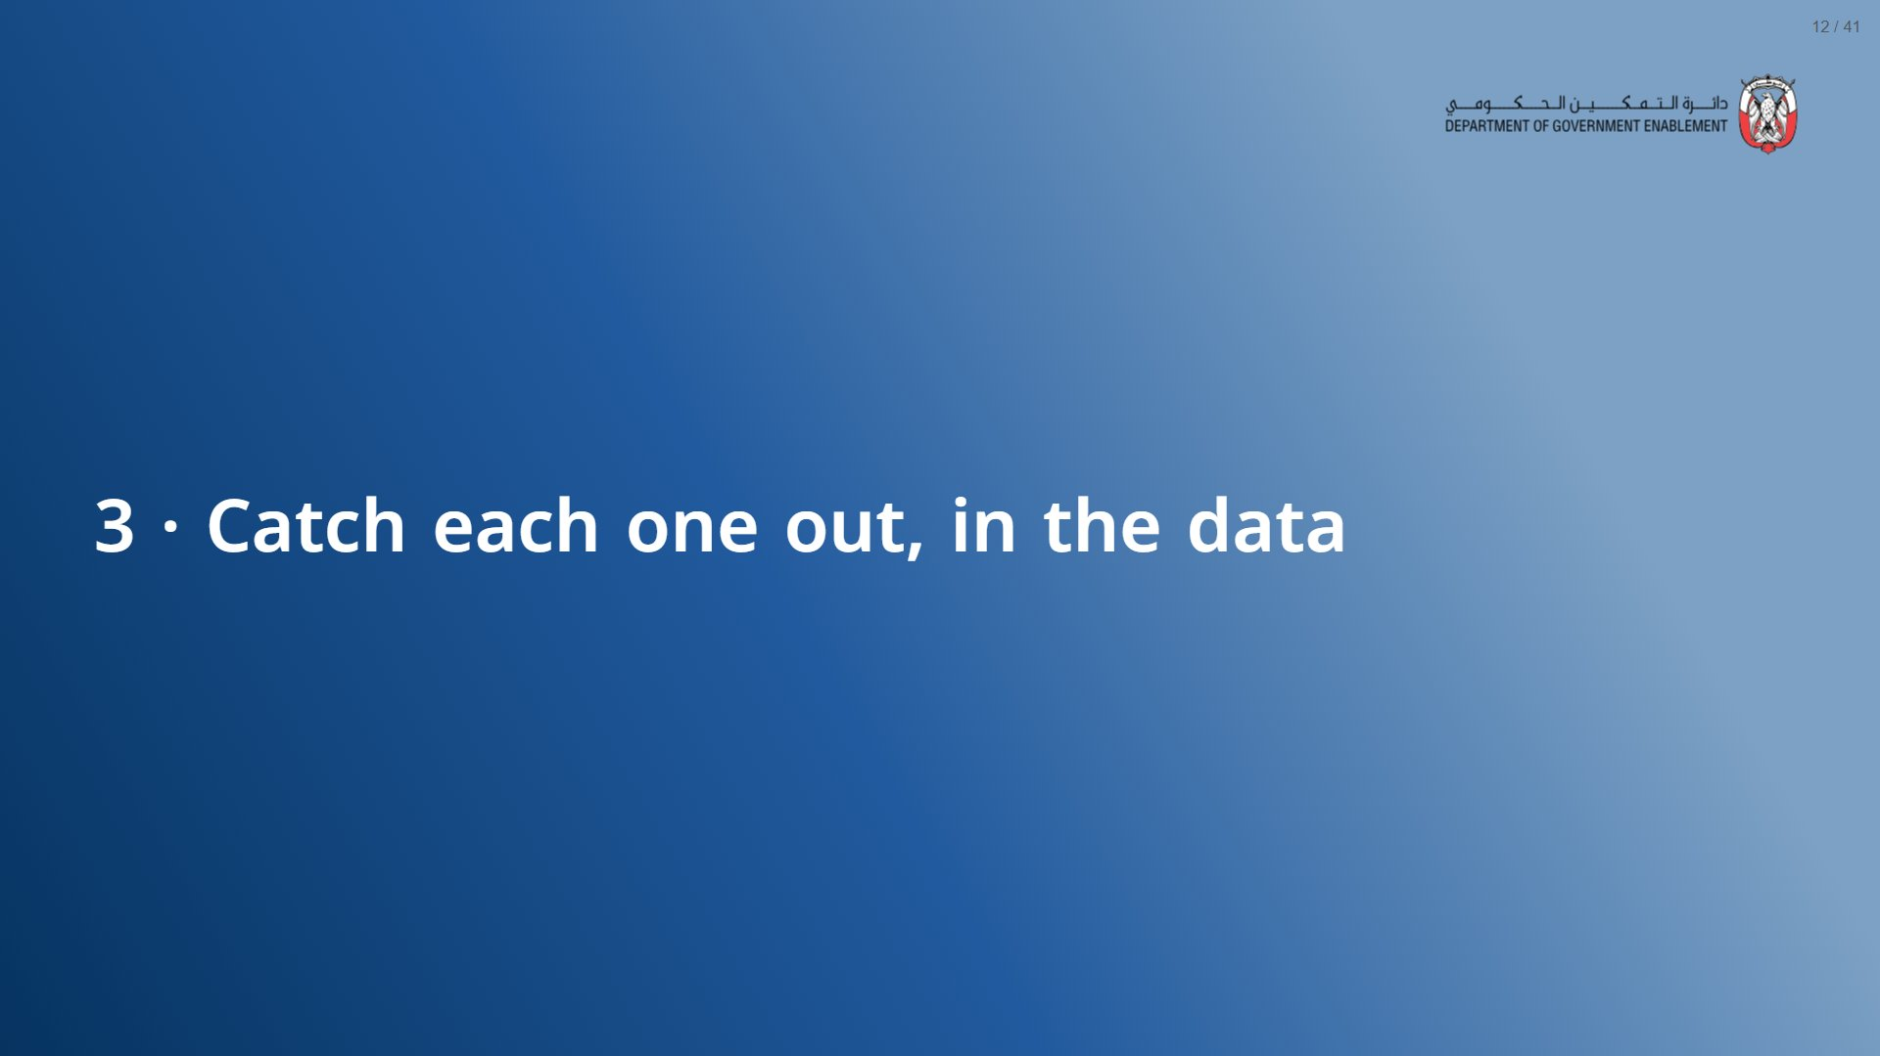

Slide 13
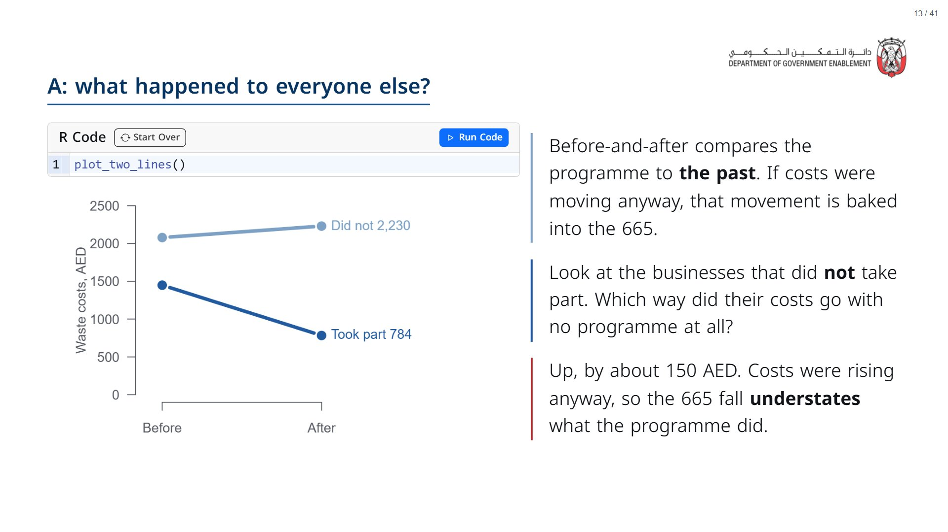

Slide 14
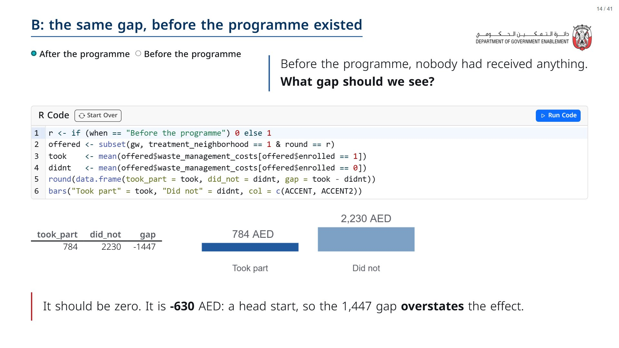

Slide 15
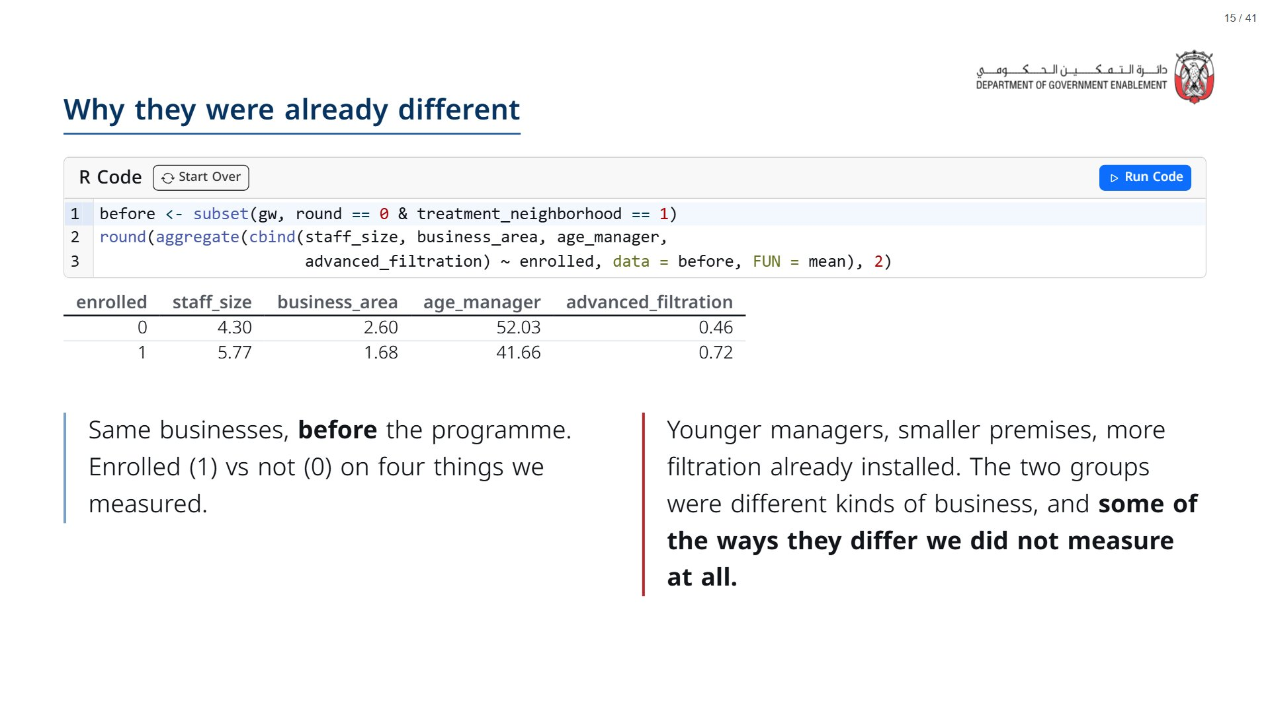

Slide 16
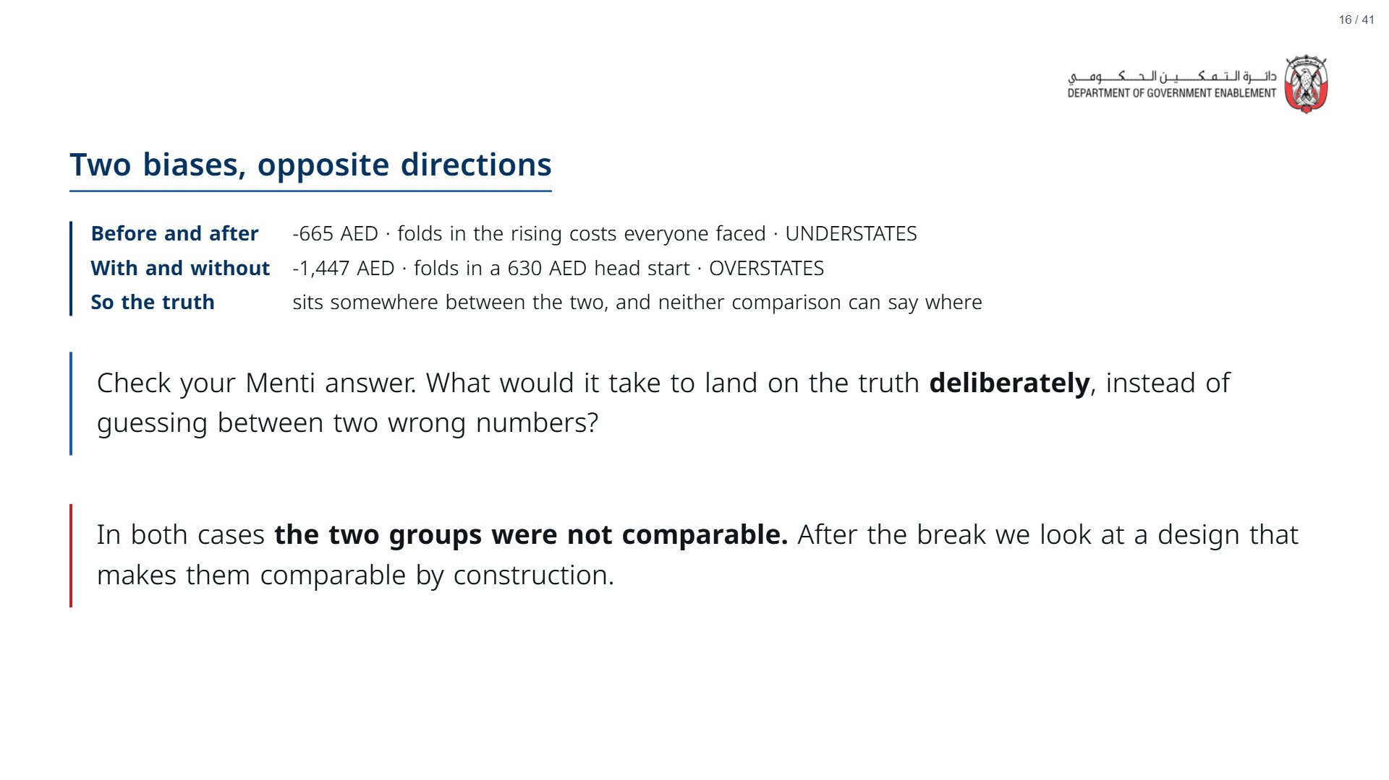
Notes:
Paper (Oct12_session3_materials.docx): Tracker check: every row should now say too big or too small, with a reason.
span.MJX_Assistive_MathML {
position:absolute!important;
clip: rect(1px, 1px, 1px, 1px);
padding: 1px 0 0 0!important;
border: 0!important;
height: 1px!important;
width: 1px!important;
overflow: hidden!important;
display:block!important;
}

Slide 17
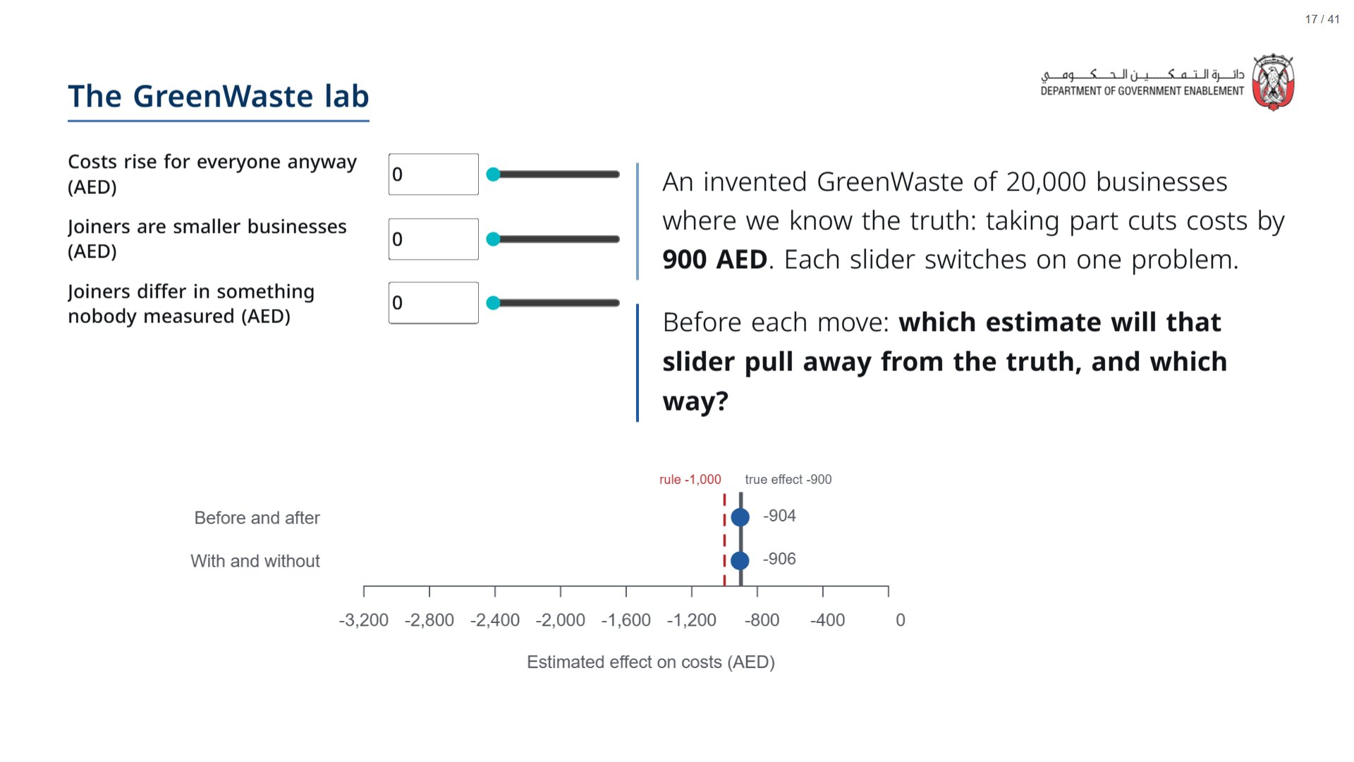
Notes:
About 5 minutes. With every slider at zero both estimates sit on the truth: a naive comparison is only wrong when the world has these problems, and the real GreenWaste had them. Move one slider at a time and take a call first. “Costs rise anyway” moves only before-and-after (towards zero, as in the real data, where costs rose about 150 AED). The two “joiners differ” sliders move only with-and-without, and make it look bigger than the truth, as the 1,447 did. Leave the sliders where the room ends up; the lab comes back after the lottery.
span.MJX_Assistive_MathML {
position:absolute!important;
clip: rect(1px, 1px, 1px, 1px);
padding: 1px 0 0 0!important;
border: 0!important;
height: 1px!important;
width: 1px!important;
overflow: hidden!important;
display:block!important;
}

Slide 18


Slide 19
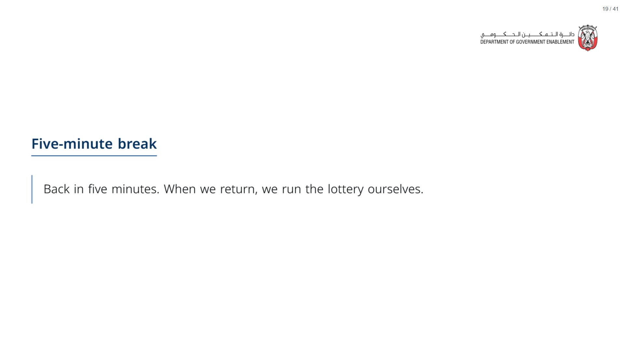

Slide 20


Slide 21
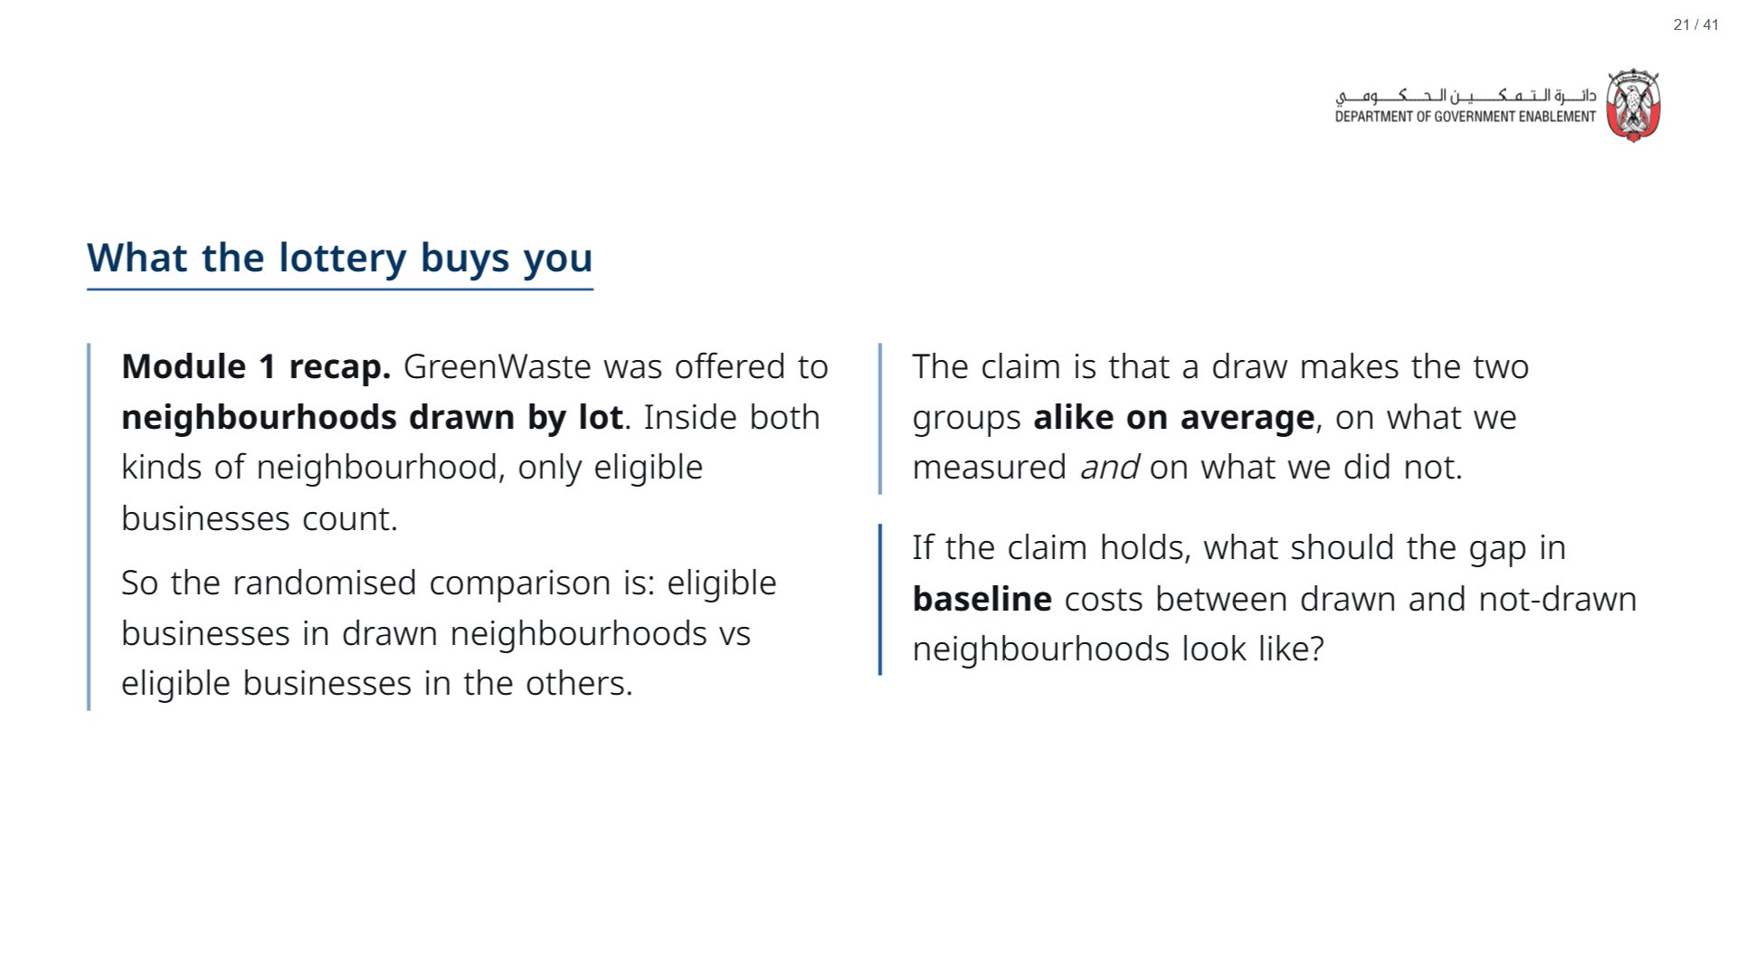

Slide 22
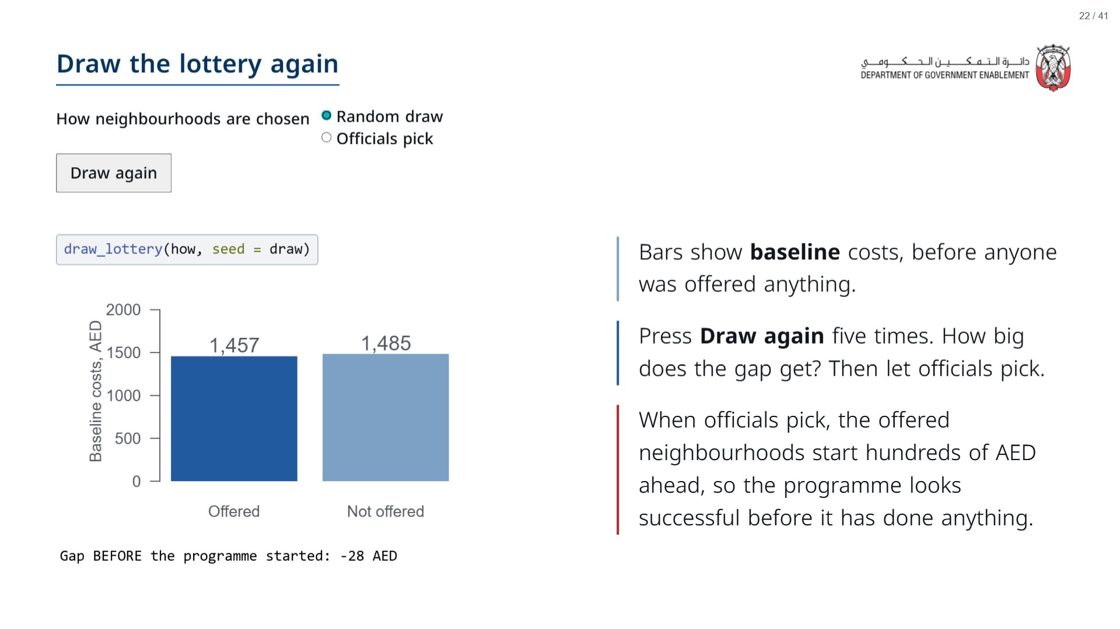
Notes:
Paper (Oct12_session3_materials.docx): Tracker: record the largest gap after five draws, then the gap when officials pick.
span.MJX_Assistive_MathML {
position:absolute!important;
clip: rect(1px, 1px, 1px, 1px);
padding: 1px 0 0 0!important;
border: 0!important;
height: 1px!important;
width: 1px!important;
overflow: hidden!important;
display:block!important;
}

Slide 23
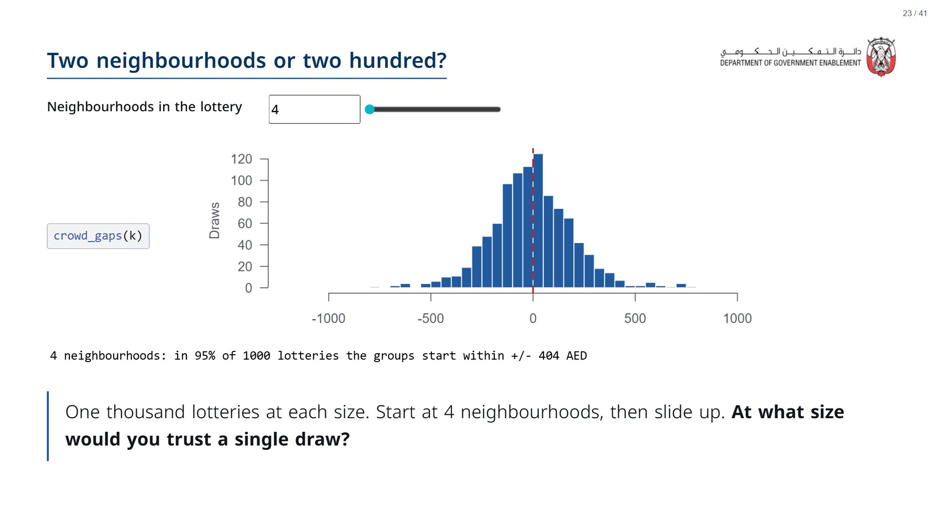
Notes:
At 4 the gaps run to hundreds of AED either way; at ~196 almost every draw starts within a few dozen. This is “two people versus two crowds” from Module 1, seen in the data. The same holds for characteristics nobody measured.
span.MJX_Assistive_MathML {
position:absolute!important;
clip: rect(1px, 1px, 1px, 1px);
padding: 1px 0 0 0!important;
border: 0!important;
height: 1px!important;
width: 1px!important;
overflow: hidden!important;
display:block!important;
}

Slide 24
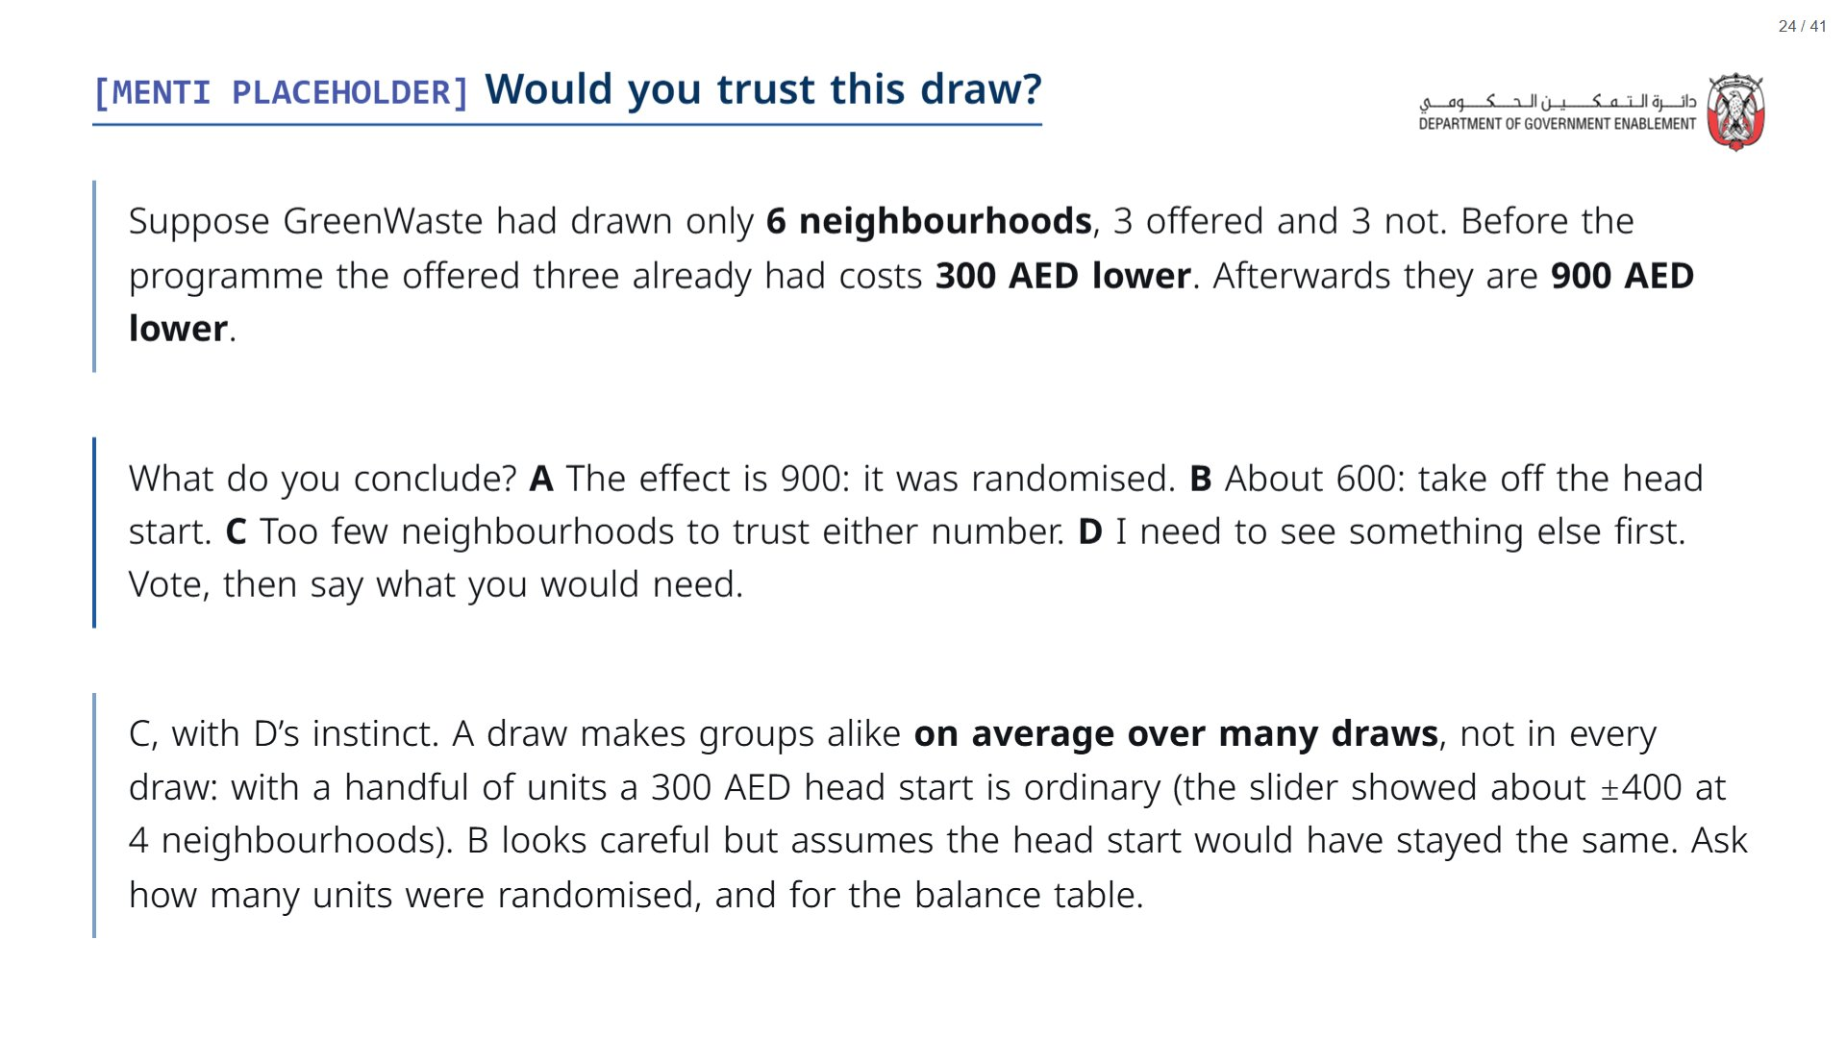
Notes:
This asks the room to apply what the two lottery slides showed to a result they might be handed. Expect a split between A and B; let one person from each argue before revealing.
span.MJX_Assistive_MathML {
position:absolute!important;
clip: rect(1px, 1px, 1px, 1px);
padding: 1px 0 0 0!important;
border: 0!important;
height: 1px!important;
width: 1px!important;
overflow: hidden!important;
display:block!important;
}

Slide 25
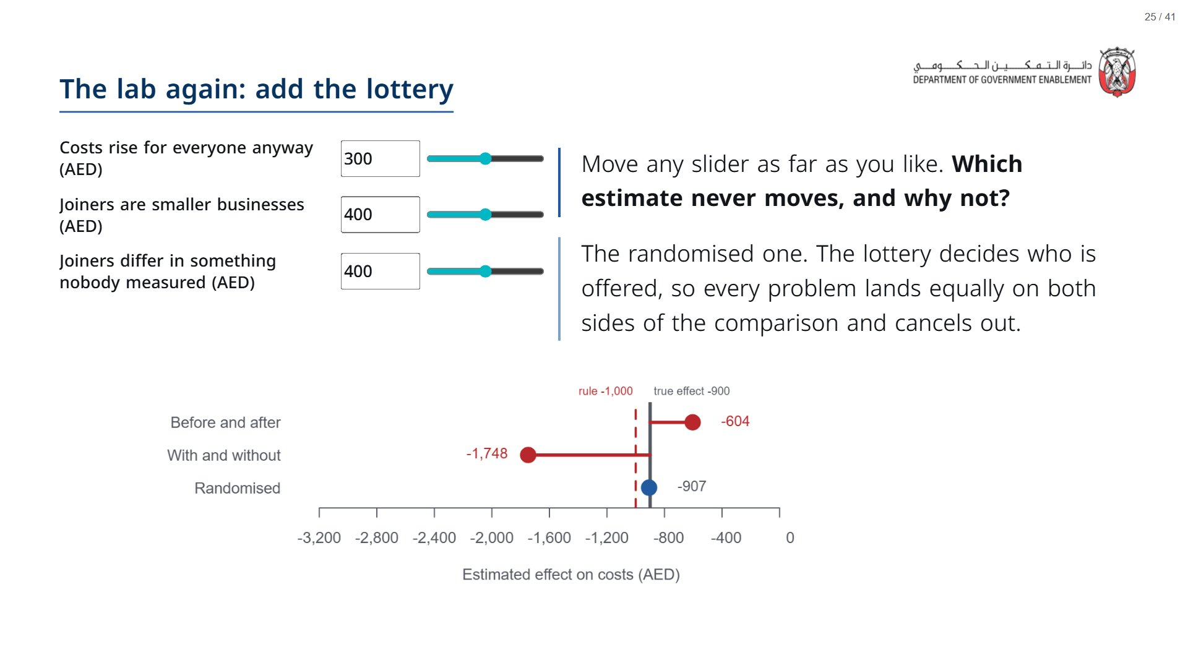
Notes:
About 3 minutes. The sliders start with all three problems switched on. This chart comes back in every method session with one more method added: difference-in-differences tomorrow morning, then regression discontinuity, then matching. Each new method will survive some sliders and not others; only the lottery survives them all.
span.MJX_Assistive_MathML {
position:absolute!important;
clip: rect(1px, 1px, 1px, 1px);
padding: 1px 0 0 0!important;
border: 0!important;
height: 1px!important;
width: 1px!important;
overflow: hidden!important;
display:block!important;
}

Slide 26


Slide 27
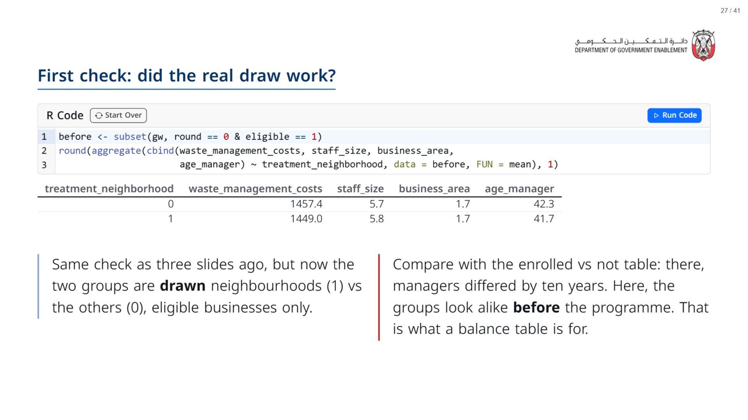

Slide 28
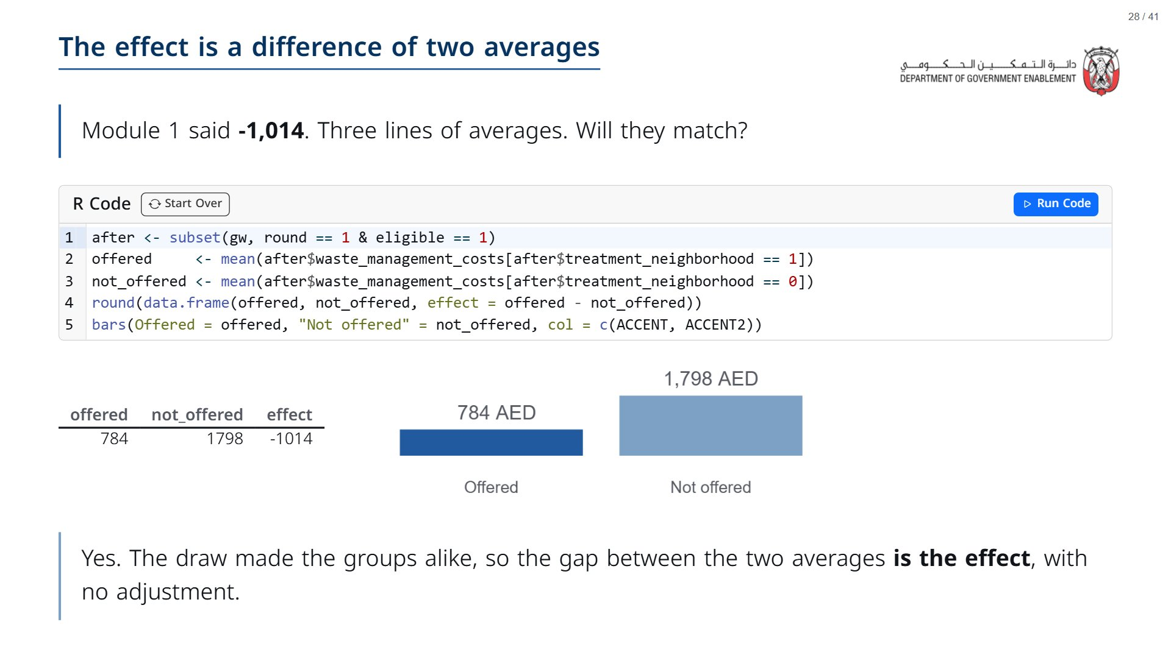

Slide 29
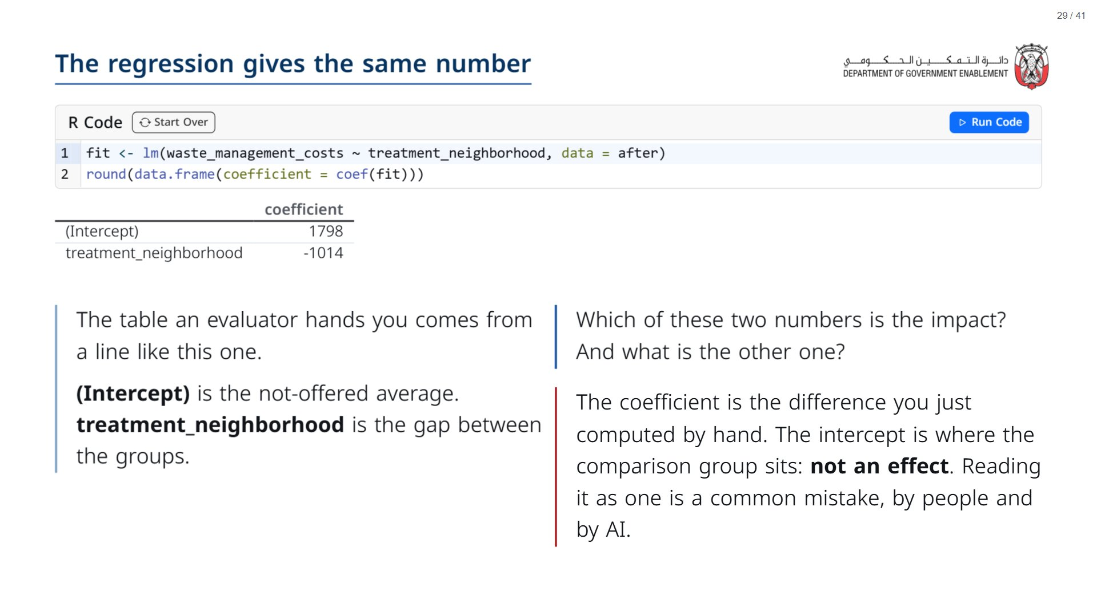

Slide 30
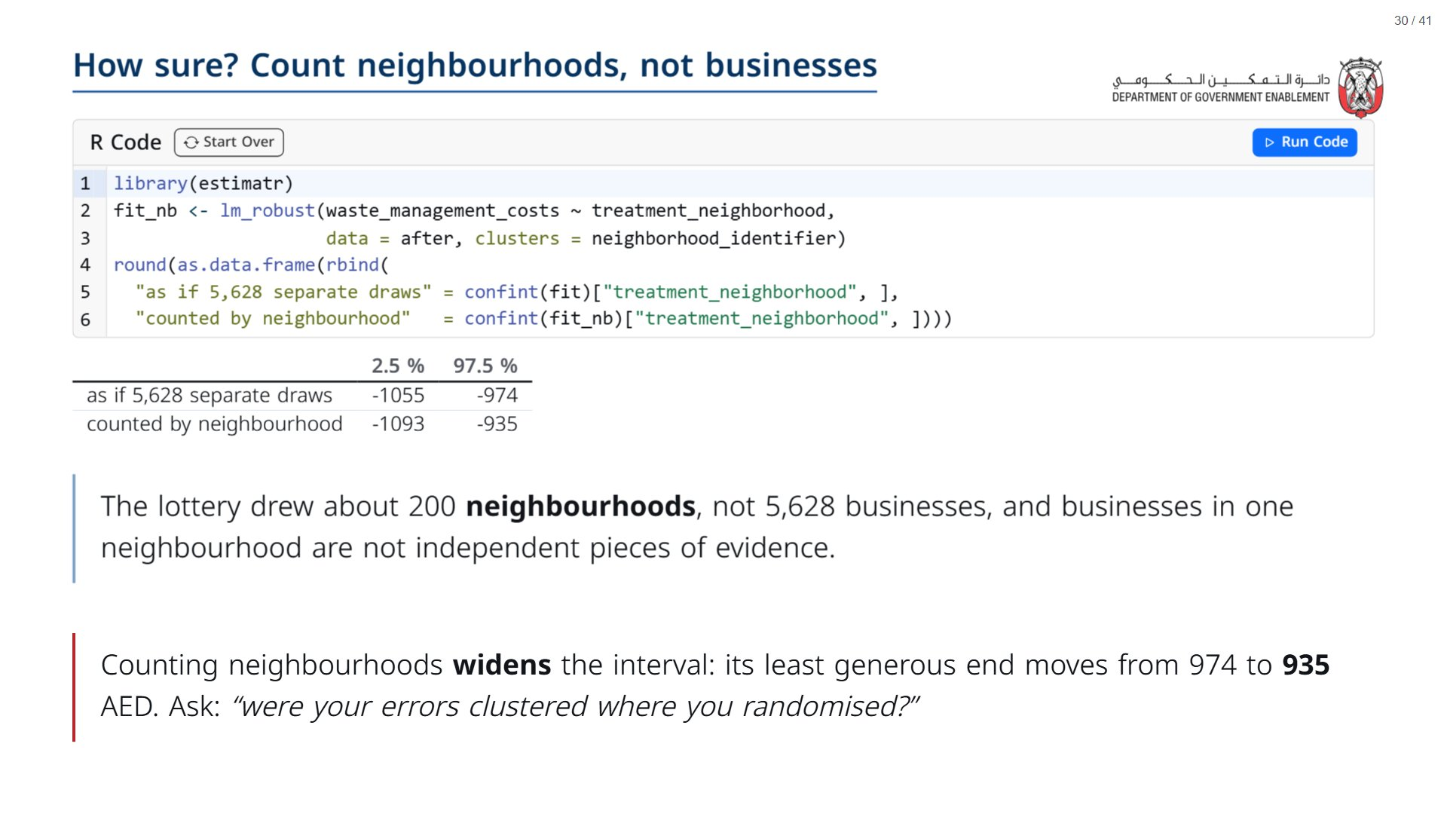
Notes:
Paper (Oct12_session3_materials.docx): Tracker: record the interval counted by neighbourhood and whether it clears 1,000 AED.
span.MJX_Assistive_MathML {
position:absolute!important;
clip: rect(1px, 1px, 1px, 1px);
padding: 1px 0 0 0!important;
border: 0!important;
height: 1px!important;
width: 1px!important;
overflow: hidden!important;
display:block!important;
}

Slide 31
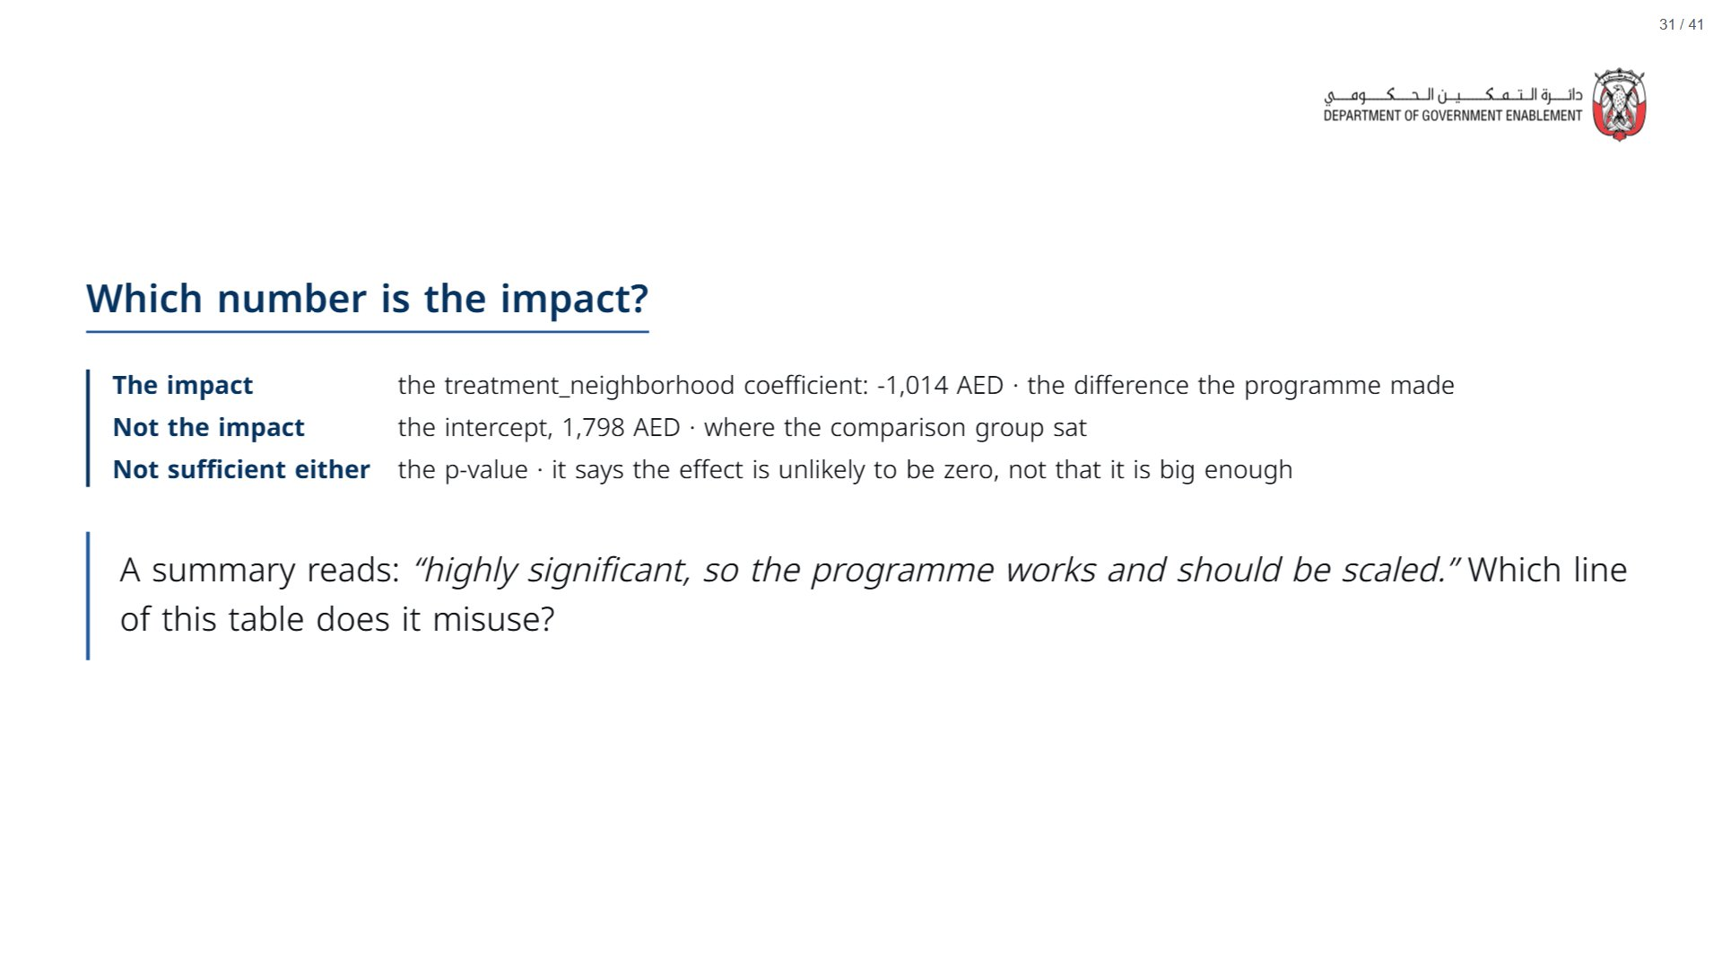

Slide 32
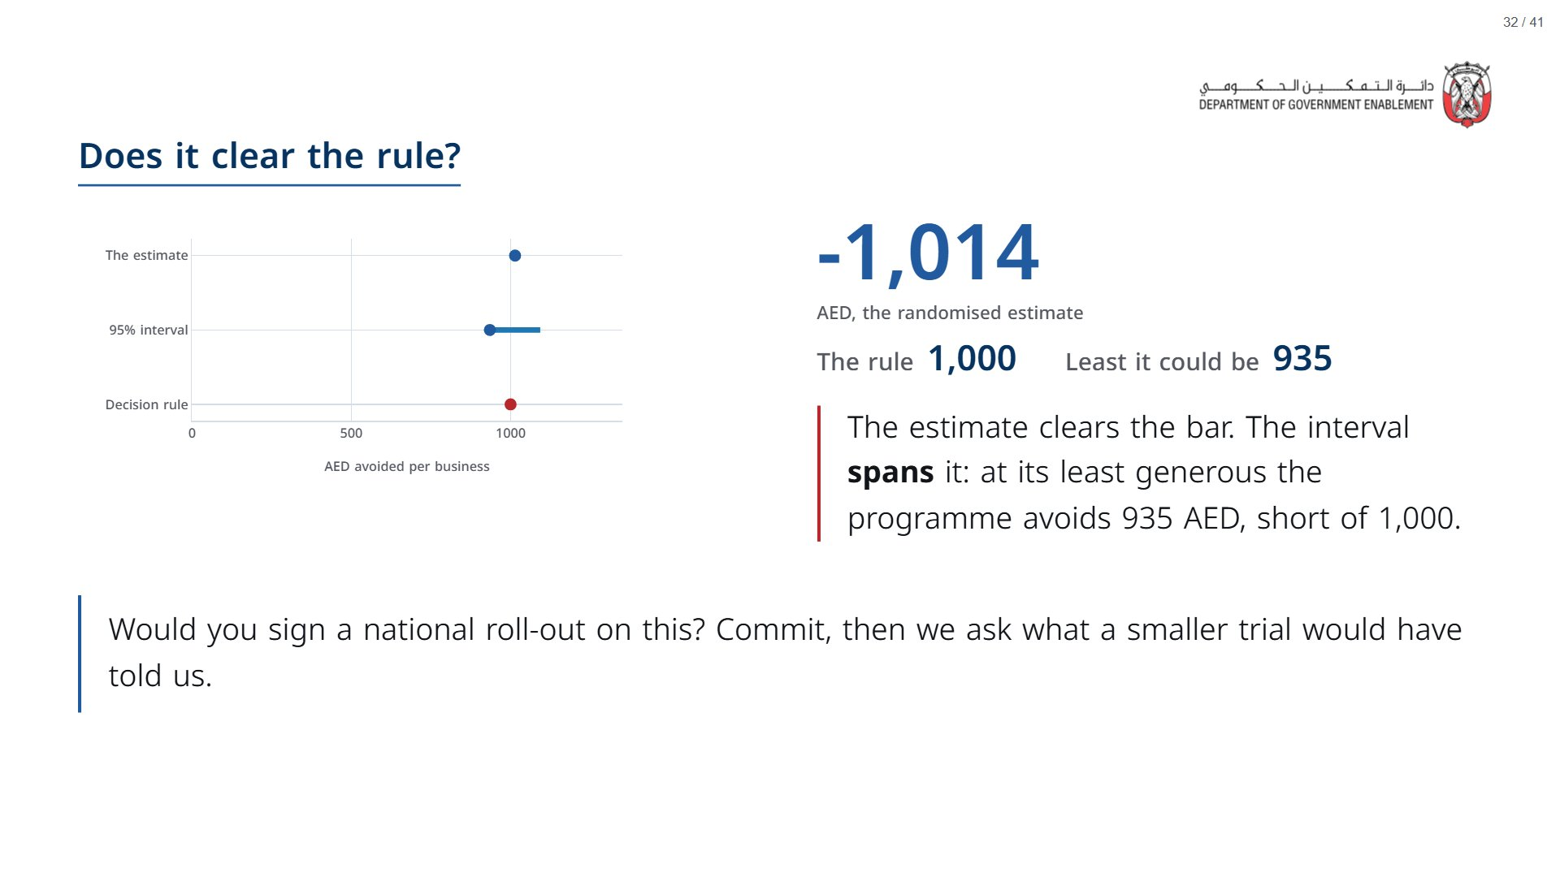

Slide 33
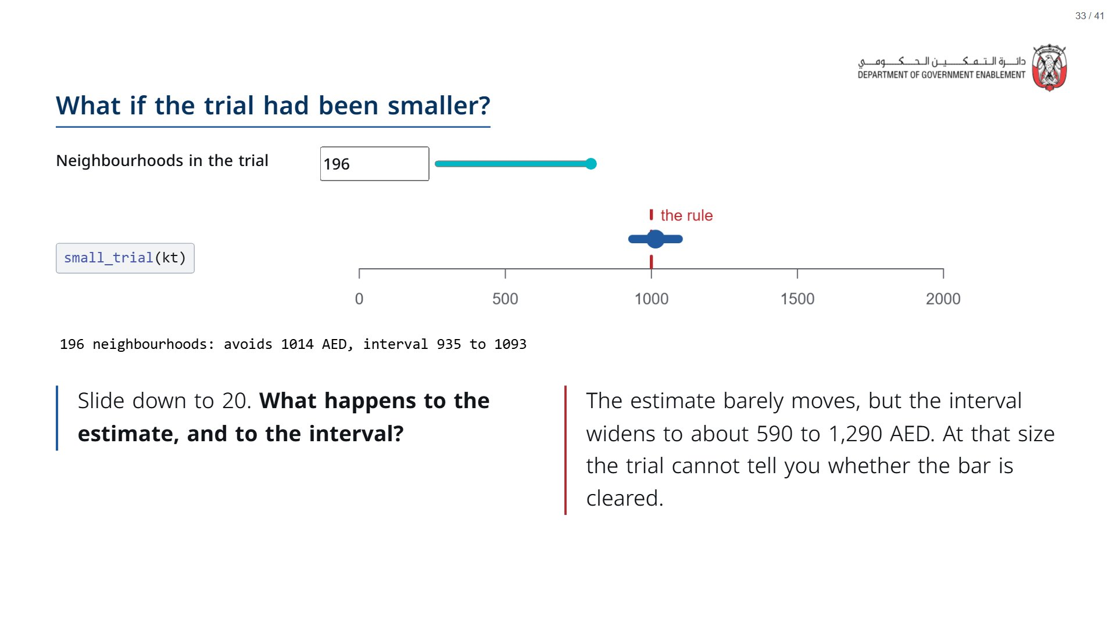
Notes:
Same seed each time, so the subset at a given size is stable while you talk. Measured: 196 neighbourhoods 1,014 [935, 1,093]; 60 gives 1,022 [864, 1,179]; 20 gives 940 [591, 1,289]. Link back to Session 1: a study that is too small may fail to find a real effect.
span.MJX_Assistive_MathML {
position:absolute!important;
clip: rect(1px, 1px, 1px, 1px);
padding: 1px 0 0 0!important;
border: 0!important;
height: 1px!important;
width: 1px!important;
overflow: hidden!important;
display:block!important;
}

Slide 34


Slide 35
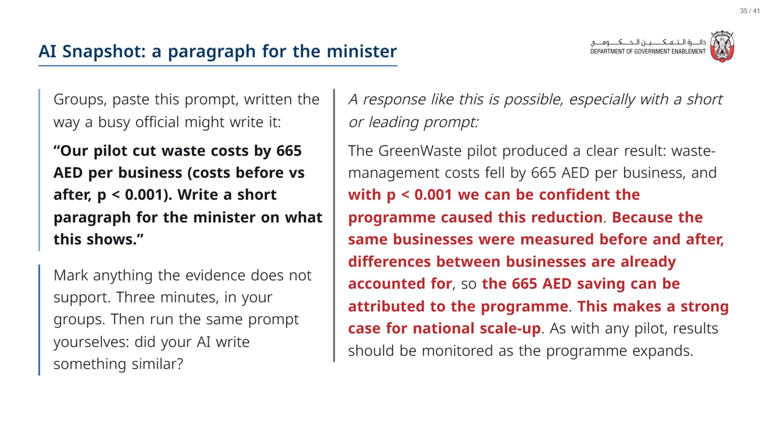
Notes:
Paper (Oct12_session3_materials.docx): Hand out the AI handout (pack page 2, one per pair). The better prompt is printed below the flawed paragraph.
span.MJX_Assistive_MathML {
position:absolute!important;
clip: rect(1px, 1px, 1px, 1px);
padding: 1px 0 0 0!important;
border: 0!important;
height: 1px!important;
width: 1px!important;
overflow: hidden!important;
display:block!important;
}

Slide 36
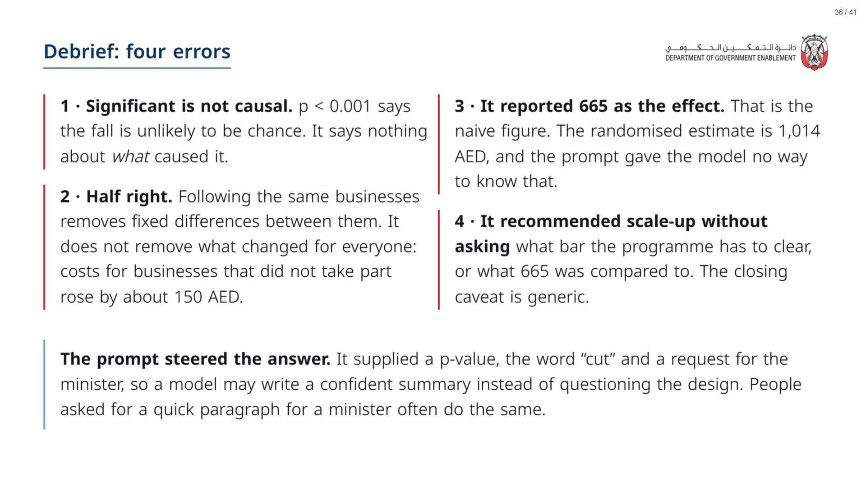

Slide 37
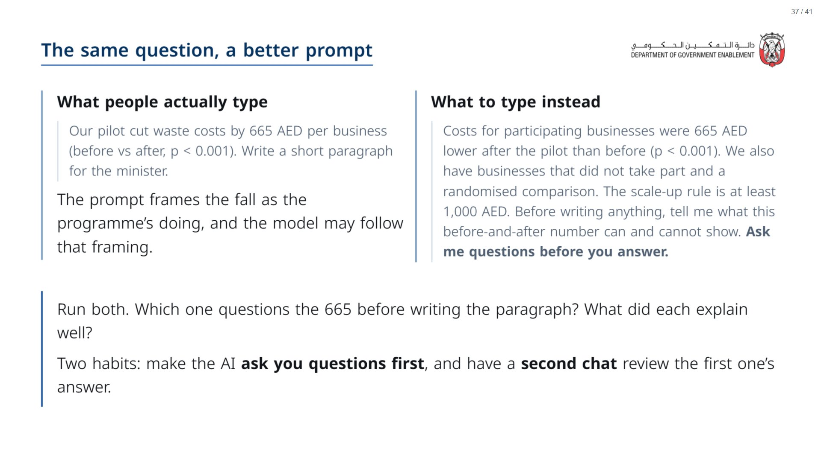
Notes:
If someone asks why we did not simply ask the AI to explain before-and-after bias: current models answer that general question well. The short prompt is closer to what people type when they are busy.
span.MJX_Assistive_MathML {
position:absolute!important;
clip: rect(1px, 1px, 1px, 1px);
padding: 1px 0 0 0!important;
border: 0!important;
height: 1px!important;
width: 1px!important;
overflow: hidden!important;
display:block!important;
}

Slide 38


Slide 39
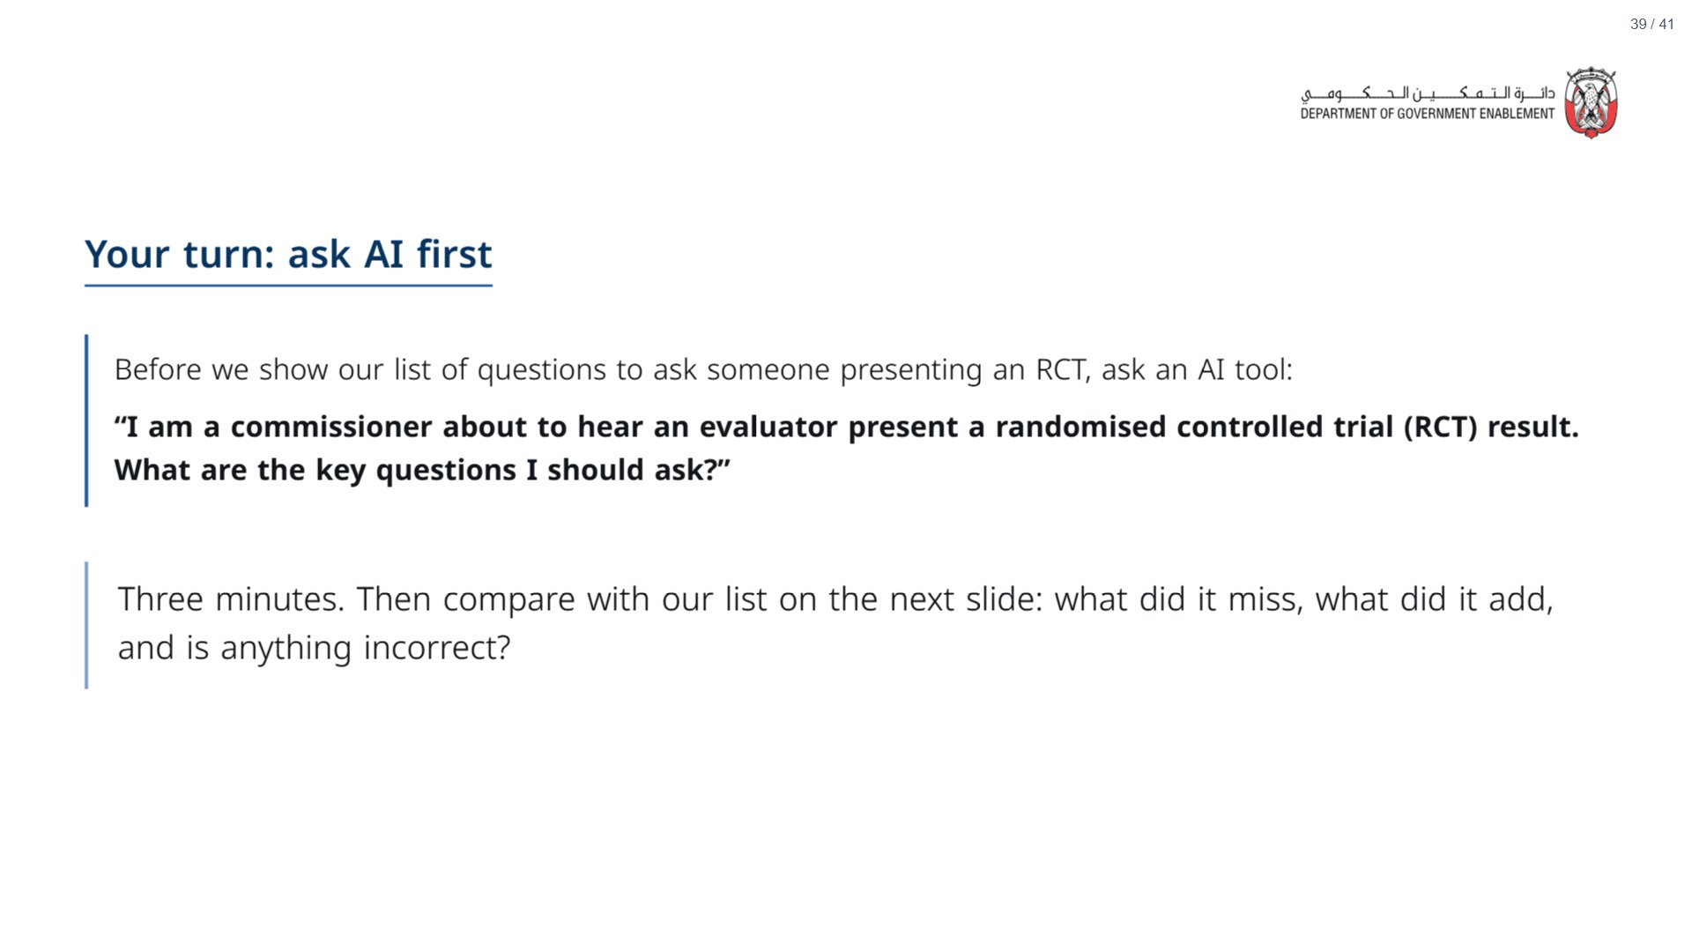
Notes:
OPTIONAL. If time is short, skip this slide and go straight to the questions on the next one. If you run it: give three minutes, then reveal the list and ask what the AI missed, what it added that is worth keeping, and whether anything it suggested was incorrect.
span.MJX_Assistive_MathML {
position:absolute!important;
clip: rect(1px, 1px, 1px, 1px);
padding: 1px 0 0 0!important;
border: 0!important;
height: 1px!important;
width: 1px!important;
overflow: hidden!important;
display:block!important;
}

Slide 40
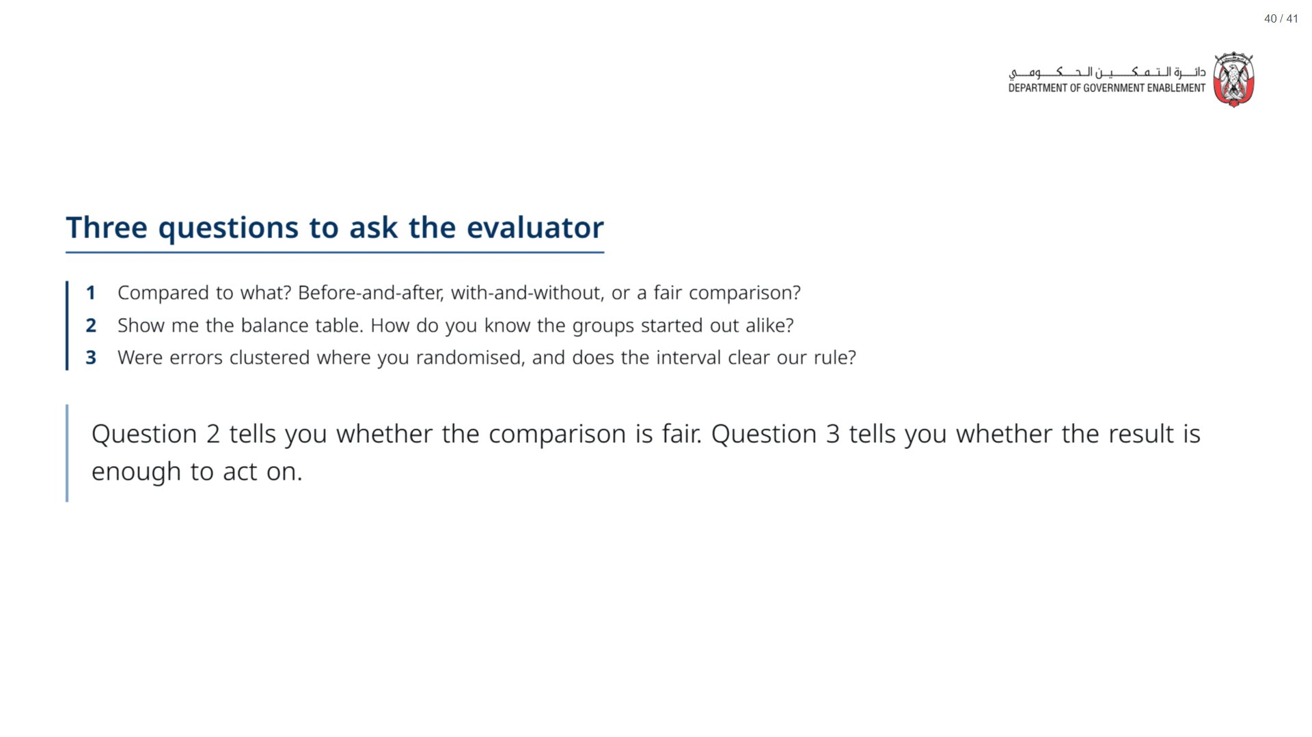
Notes:
Paper (Oct12_session3_materials.docx): Hand out the take-away cards (pack page 3). Give a minute to fill in “On my desk” on the card, then take two or three examples from the room.
span.MJX_Assistive_MathML {
position:absolute!important;
clip: rect(1px, 1px, 1px, 1px);
padding: 1px 0 0 0!important;
border: 0!important;
height: 1px!important;
width: 1px!important;
overflow: hidden!important;
display:block!important;
}

Slide 41
