Slide 1
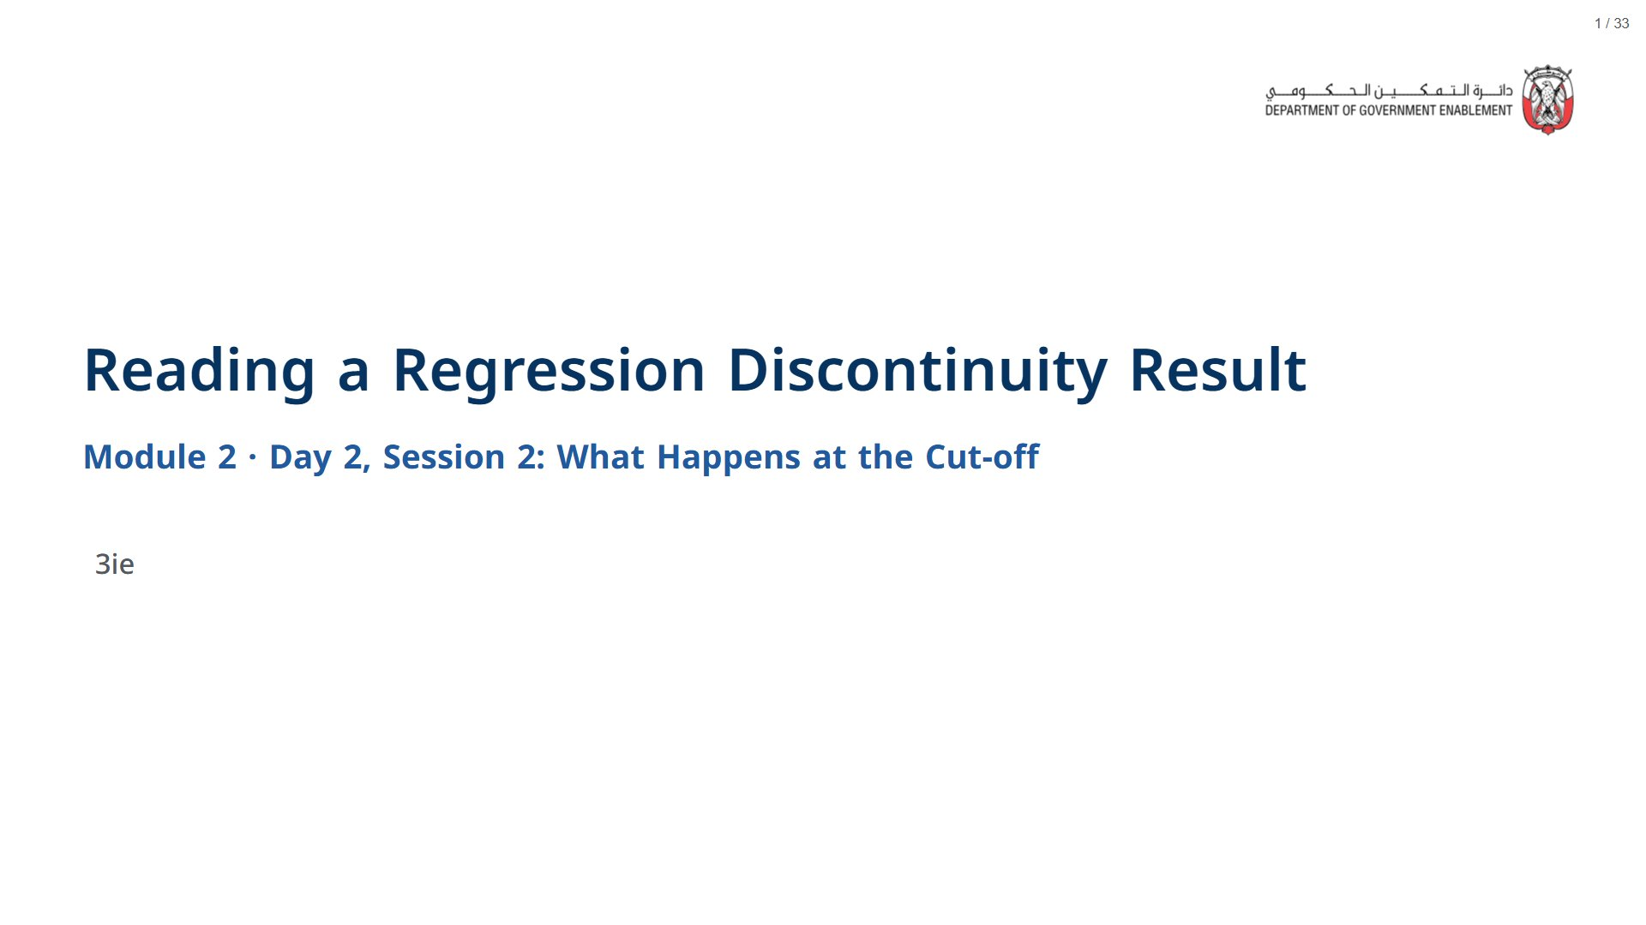

Slide 2
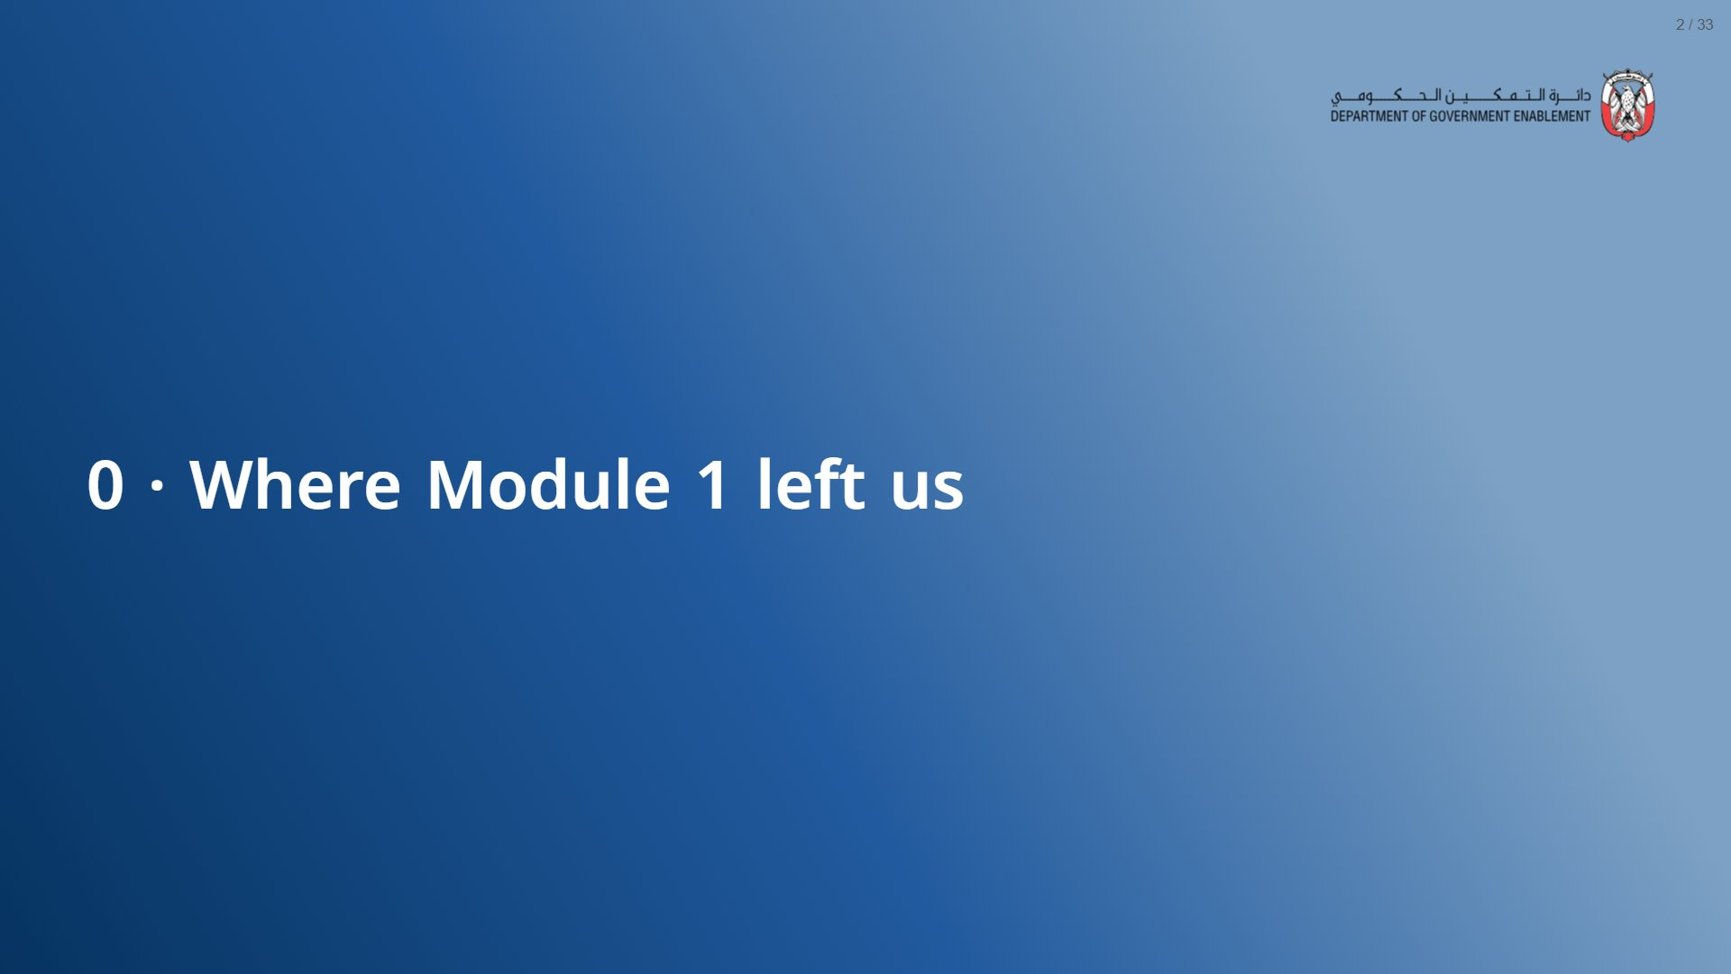

Slide 3
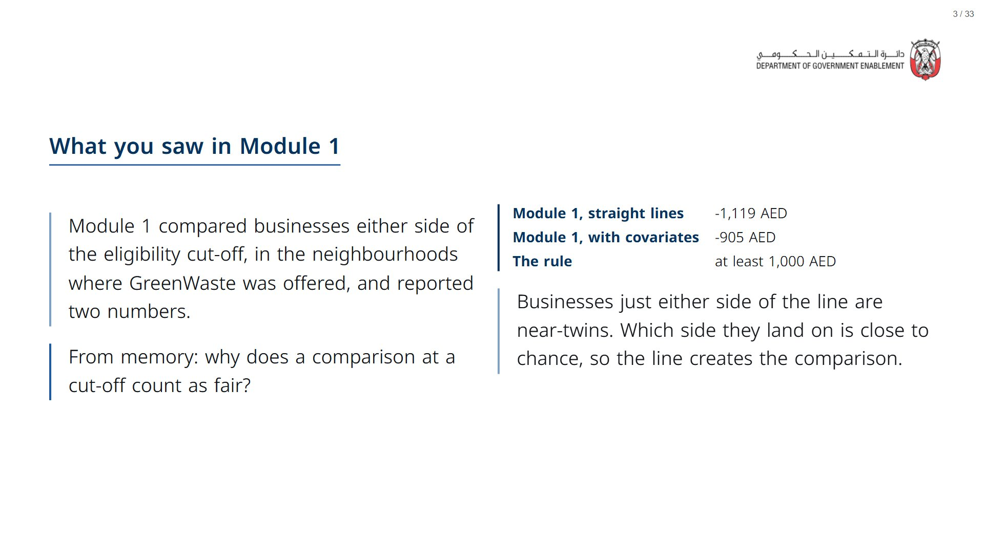
Notes:
About 3 minutes, recall only. Open the deck a couple of minutes before the session: R and its statistics package take about a minute to load in the browser, after which every live cell runs in a few seconds.
span.MJX_Assistive_MathML {
position:absolute!important;
clip: rect(1px, 1px, 1px, 1px);
padding: 1px 0 0 0!important;
border: 0!important;
height: 1px!important;
width: 1px!important;
overflow: hidden!important;
display:block!important;
}

Slide 4
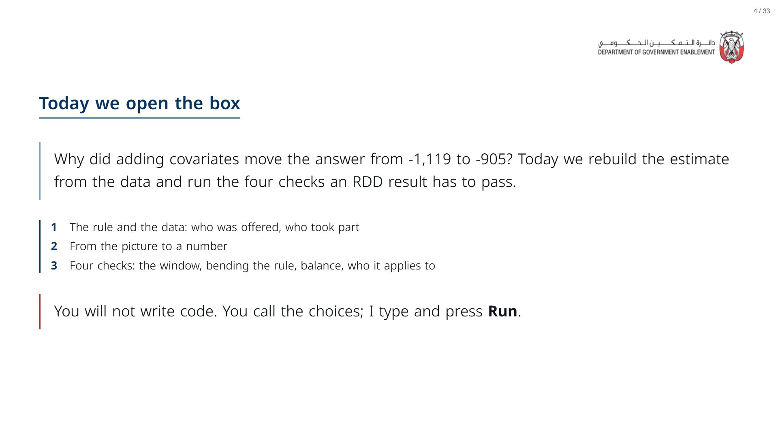

Slide 5


Slide 6
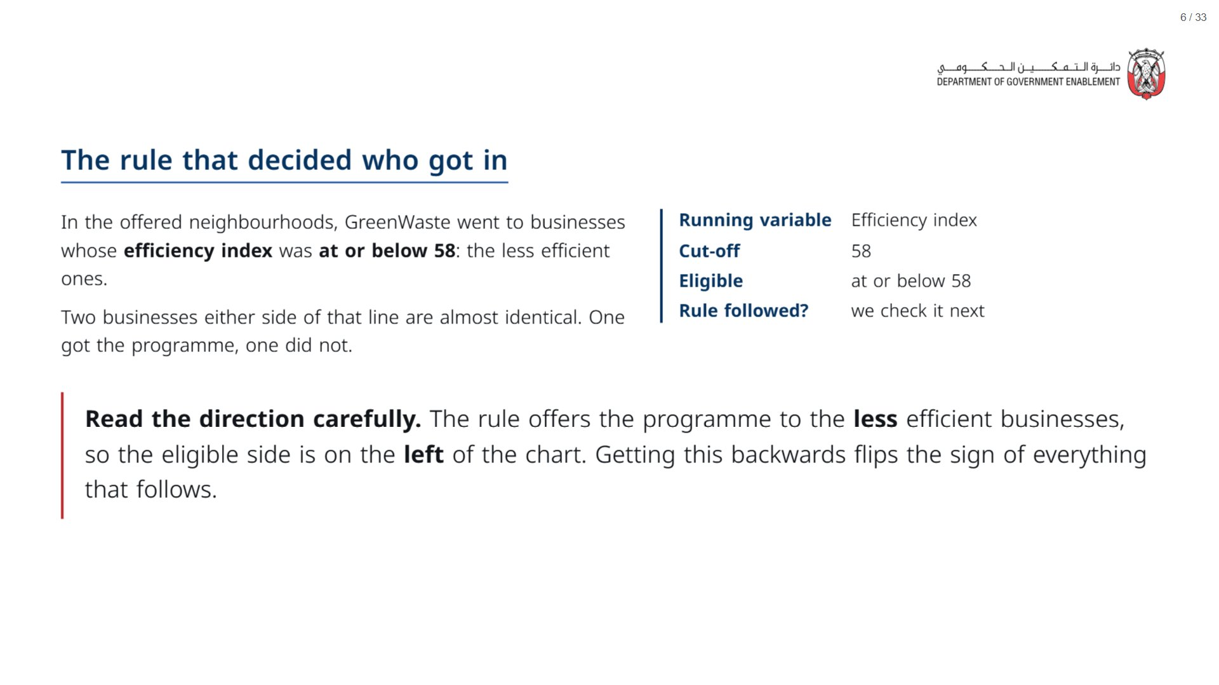

Slide 7
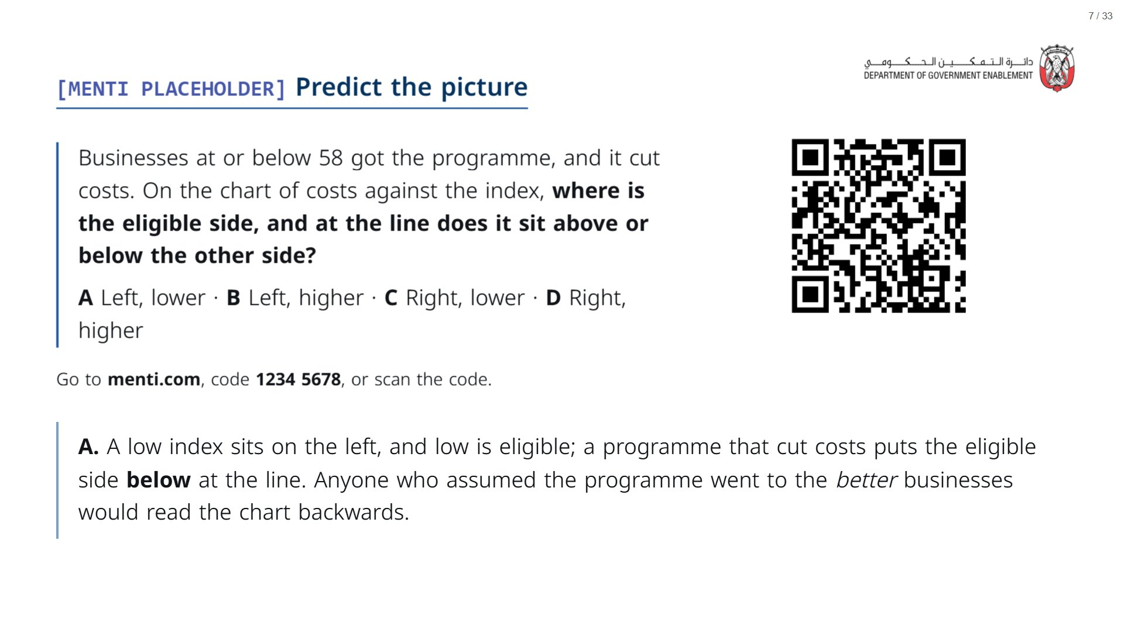
Notes:
Two predictions in one vote: the direction of the rule and the sign of the effect. Keep the result on screen and point back to it on the next chart.
span.MJX_Assistive_MathML {
position:absolute!important;
clip: rect(1px, 1px, 1px, 1px);
padding: 1px 0 0 0!important;
border: 0!important;
height: 1px!important;
width: 1px!important;
overflow: hidden!important;
display:block!important;
}

Slide 8
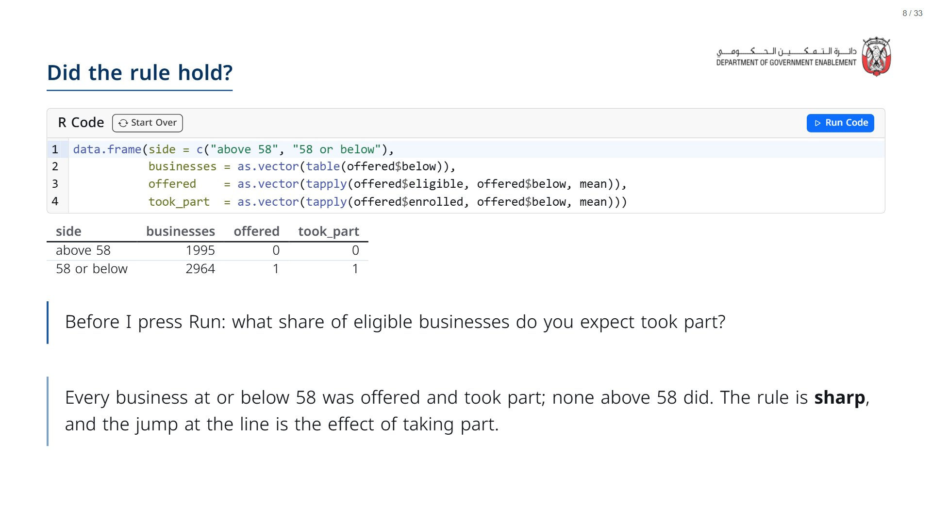
Notes:
Read the two rows aloud. offered and took_part are shares: 1 means every business on that side, 0 means none.
span.MJX_Assistive_MathML {
position:absolute!important;
clip: rect(1px, 1px, 1px, 1px);
padding: 1px 0 0 0!important;
border: 0!important;
height: 1px!important;
width: 1px!important;
overflow: hidden!important;
display:block!important;
}

Slide 9
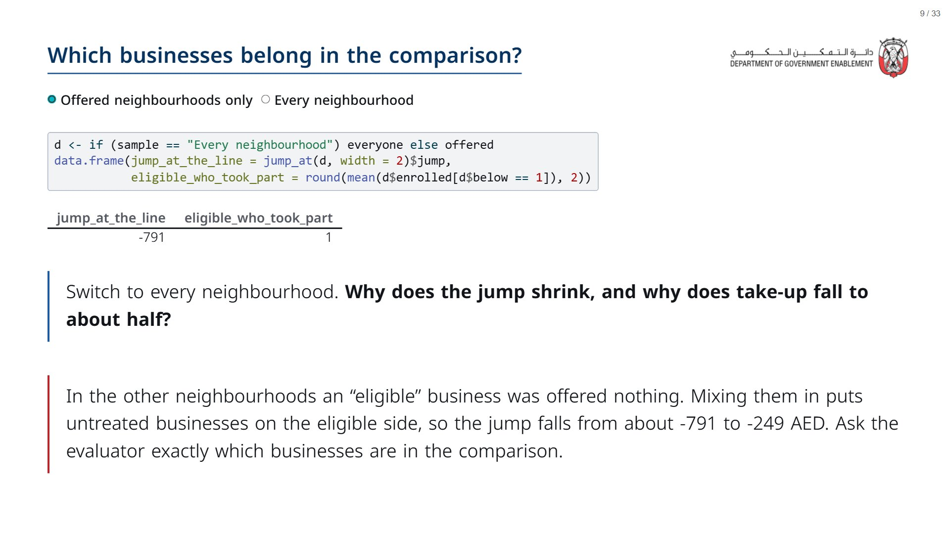
Notes:
An earlier version of this deck made this mistake and reported -249. Module 1 used the offered neighbourhoods only.
span.MJX_Assistive_MathML {
position:absolute!important;
clip: rect(1px, 1px, 1px, 1px);
padding: 1px 0 0 0!important;
border: 0!important;
height: 1px!important;
width: 1px!important;
overflow: hidden!important;
display:block!important;
}

Slide 10
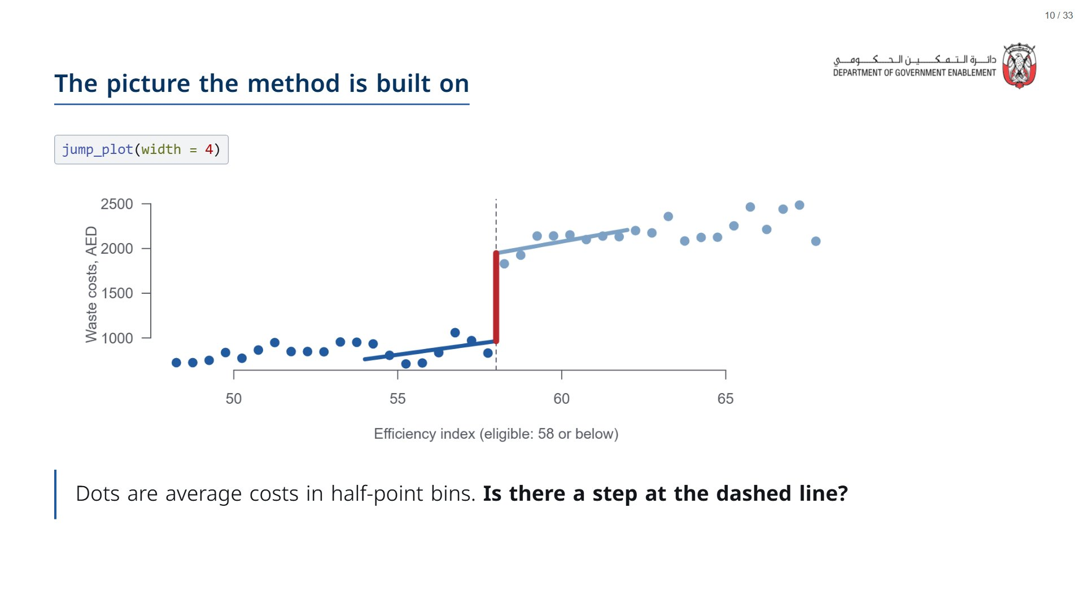

Slide 11


Slide 12
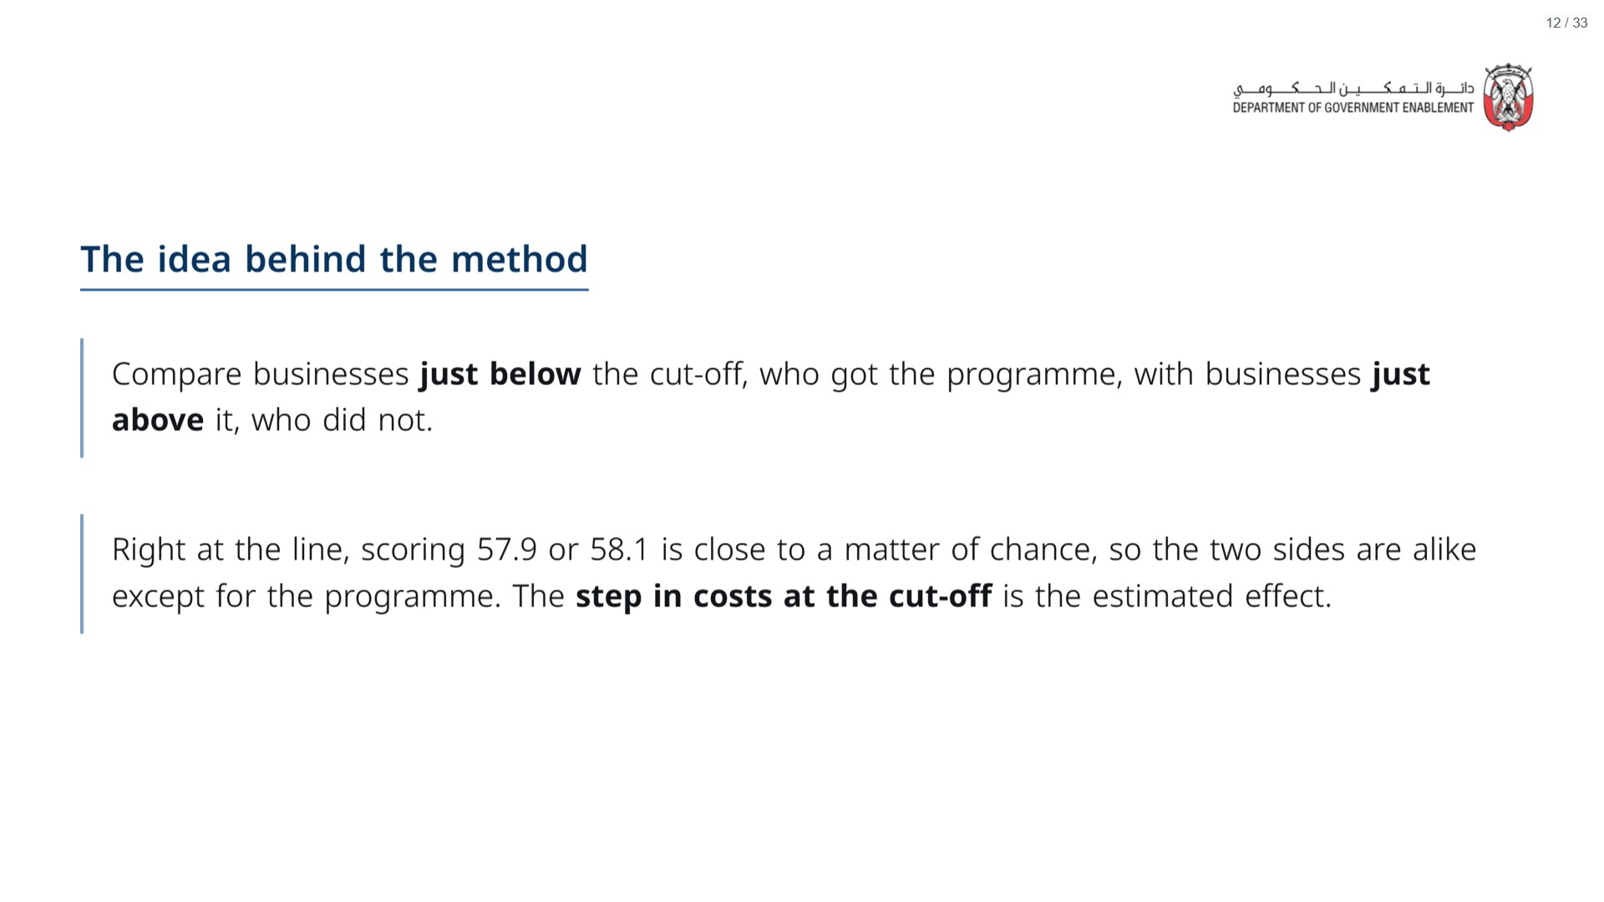
Notes:
Point back at the previous chart: the step is the gap between the two clouds of dots at the dashed line.
span.MJX_Assistive_MathML {
position:absolute!important;
clip: rect(1px, 1px, 1px, 1px);
padding: 1px 0 0 0!important;
border: 0!important;
height: 1px!important;
width: 1px!important;
overflow: hidden!important;
display:block!important;
}

Slide 13
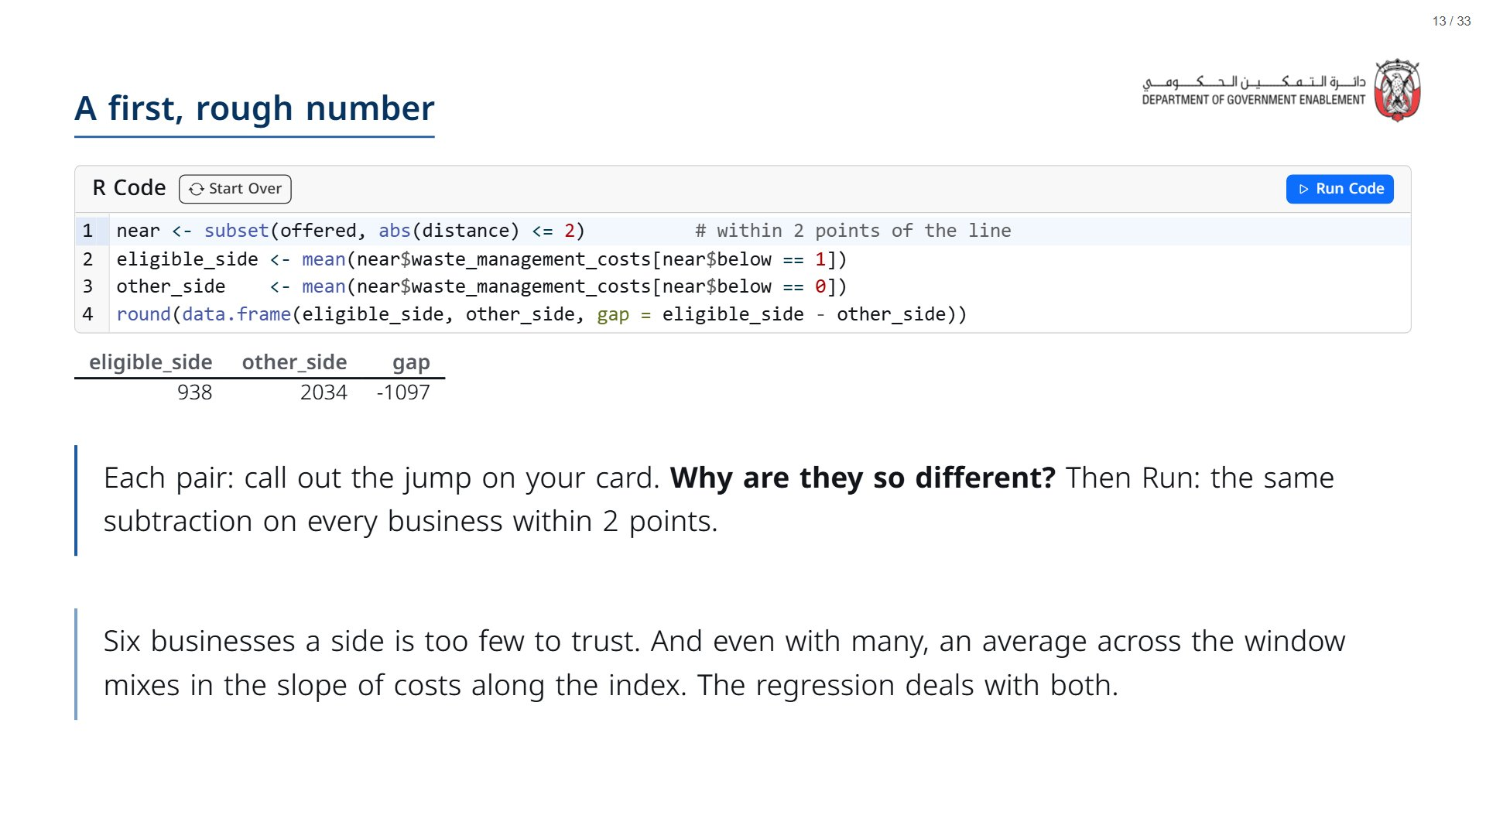
Notes:
Paper (Oct13_session2_materials.docx): Before pressing Run, hand out the jump cards (pack pages 1-4, four different cards A-D; neighbouring pairs get different cards). Pairs average six businesses on each side and subtract. Write every pair’s jump on the flipchart (they range from about -170 to -1,260), ask why they differ, then press Run: the regression uses the 773 businesses within two points.
span.MJX_Assistive_MathML {
position:absolute!important;
clip: rect(1px, 1px, 1px, 1px);
padding: 1px 0 0 0!important;
border: 0!important;
height: 1px!important;
width: 1px!important;
overflow: hidden!important;
display:block!important;
}

Slide 14
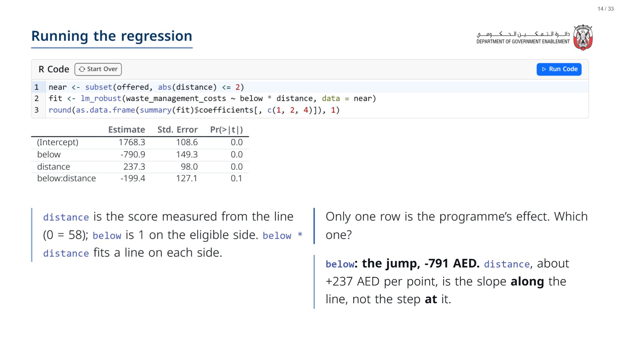

Slide 15
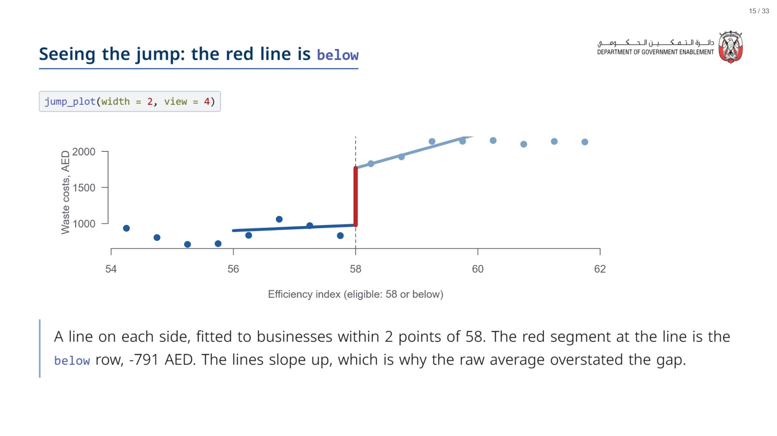

Slide 16
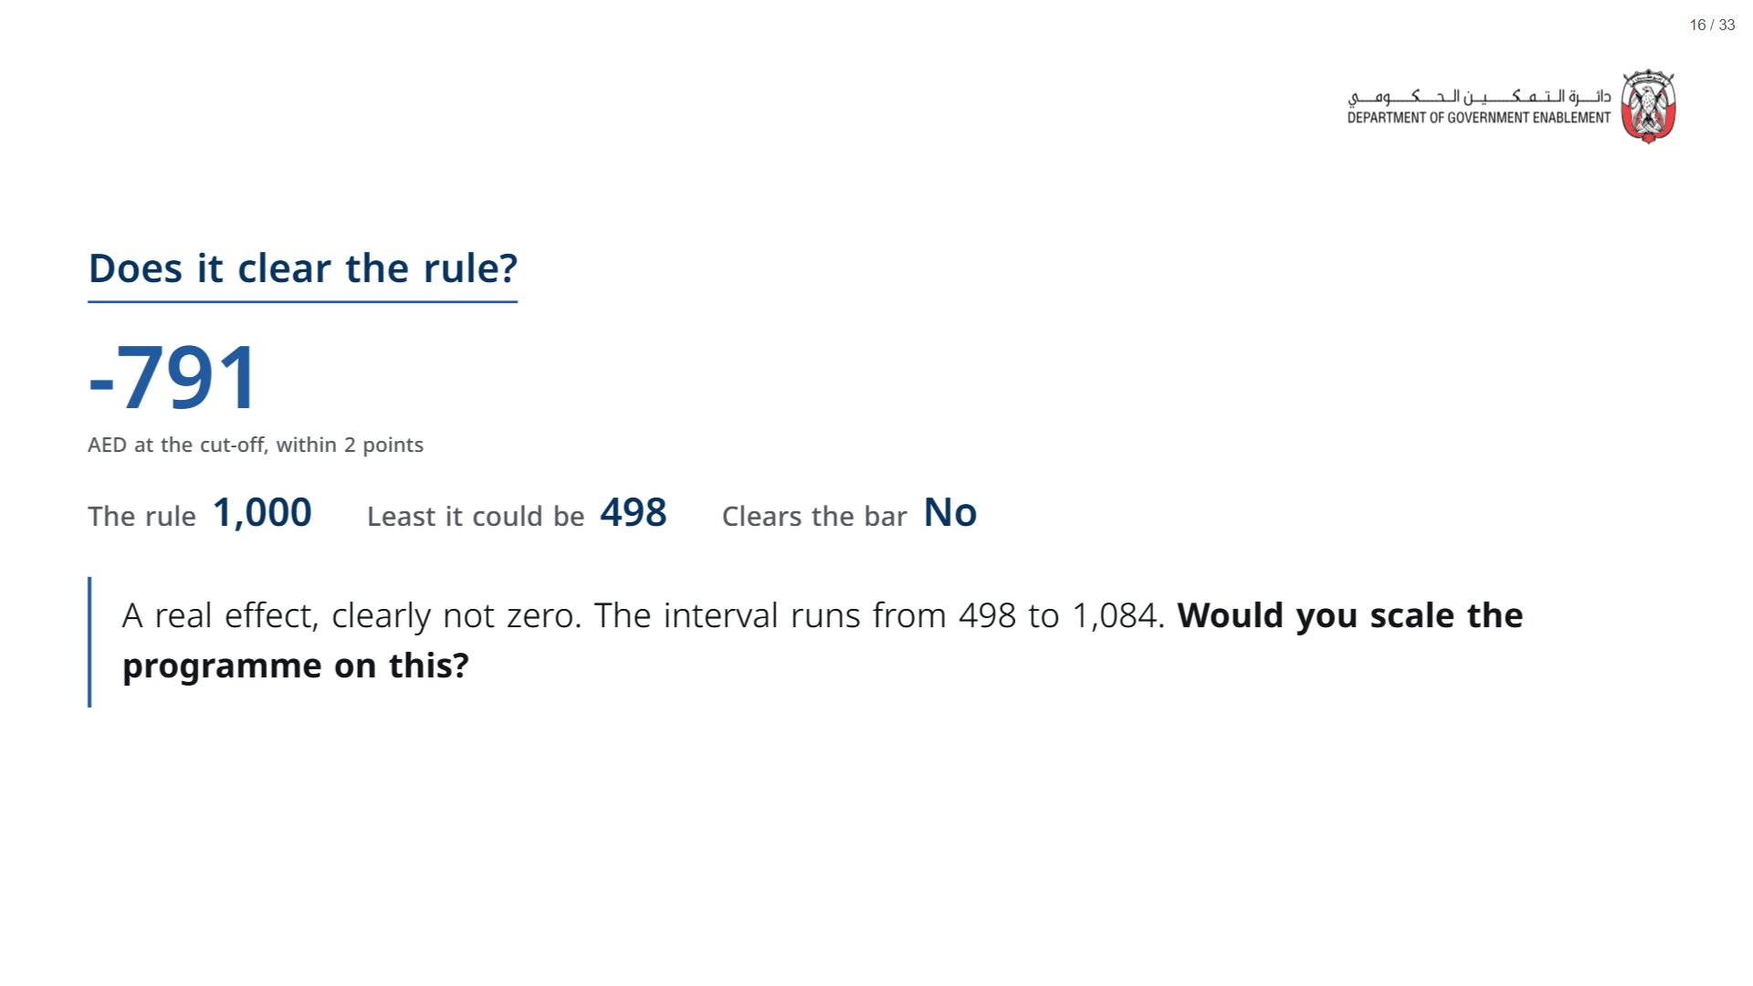
Notes:
The interval is wide because only 773 businesses sit within 2 points. Check 1 shows how the answer moves with that choice.
span.MJX_Assistive_MathML {
position:absolute!important;
clip: rect(1px, 1px, 1px, 1px);
padding: 1px 0 0 0!important;
border: 0!important;
height: 1px!important;
width: 1px!important;
overflow: hidden!important;
display:block!important;
}

Slide 17


Slide 18
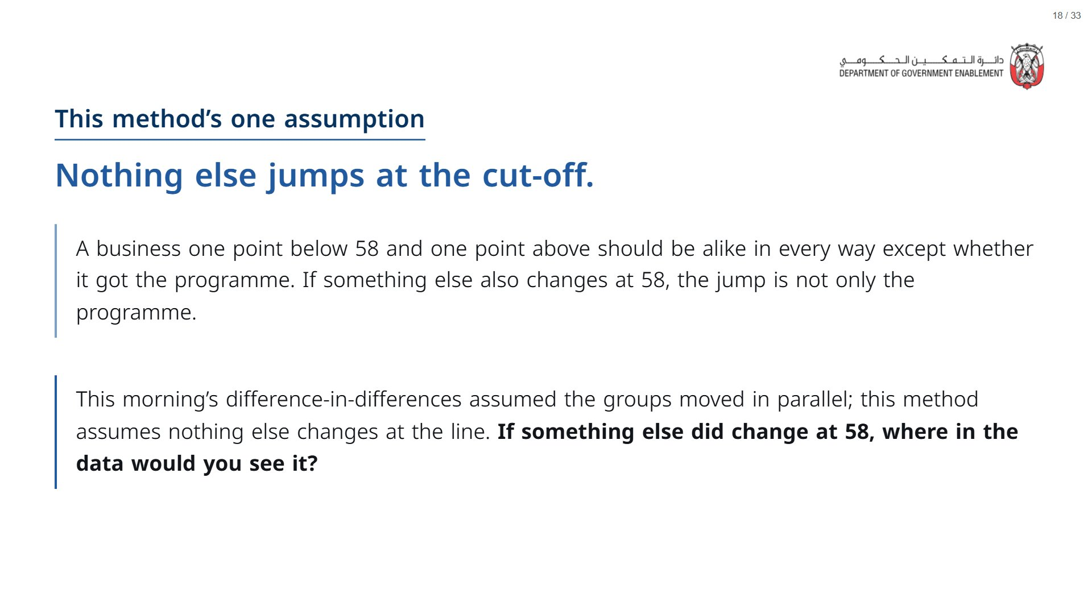
Notes:
Paper (Oct13_session2_materials.docx): Hand out the four-checks scorecard (pack page 5, one per group). Groups mark each check as you run it, starting with check 0 (who is compared) from Section 1.
span.MJX_Assistive_MathML {
position:absolute!important;
clip: rect(1px, 1px, 1px, 1px);
padding: 1px 0 0 0!important;
border: 0!important;
height: 1px!important;
width: 1px!important;
overflow: hidden!important;
display:block!important;
}

Slide 19
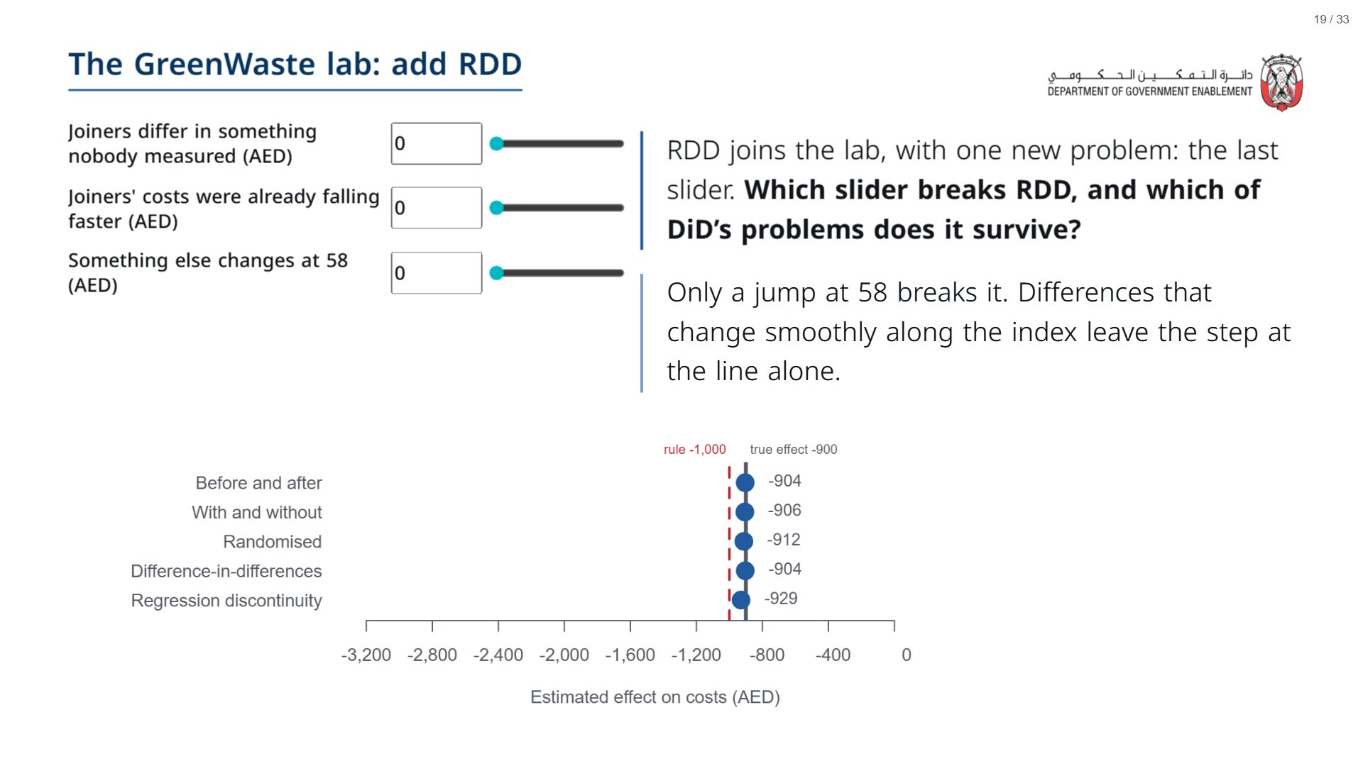
Notes:
About 5 minutes, before the four checks. The first two sliders break with-and-without, and the middle one breaks DiD; RDD stays on -900 for both, because neither changes suddenly at 58. The last slider is this method’s one assumption: if something else changes at the cut-off, the jump is not only the programme. Check 3 finds exactly that in the real data: manager age jumps at 58.
span.MJX_Assistive_MathML {
position:absolute!important;
clip: rect(1px, 1px, 1px, 1px);
padding: 1px 0 0 0!important;
border: 0!important;
height: 1px!important;
width: 1px!important;
overflow: hidden!important;
display:block!important;
}

Slide 20
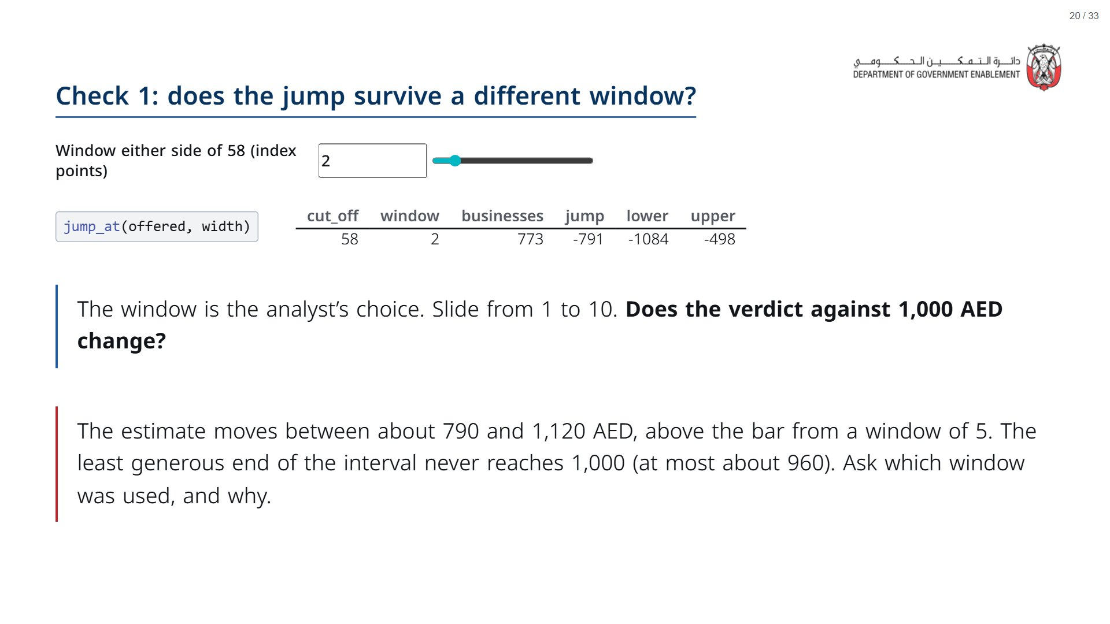

Slide 21
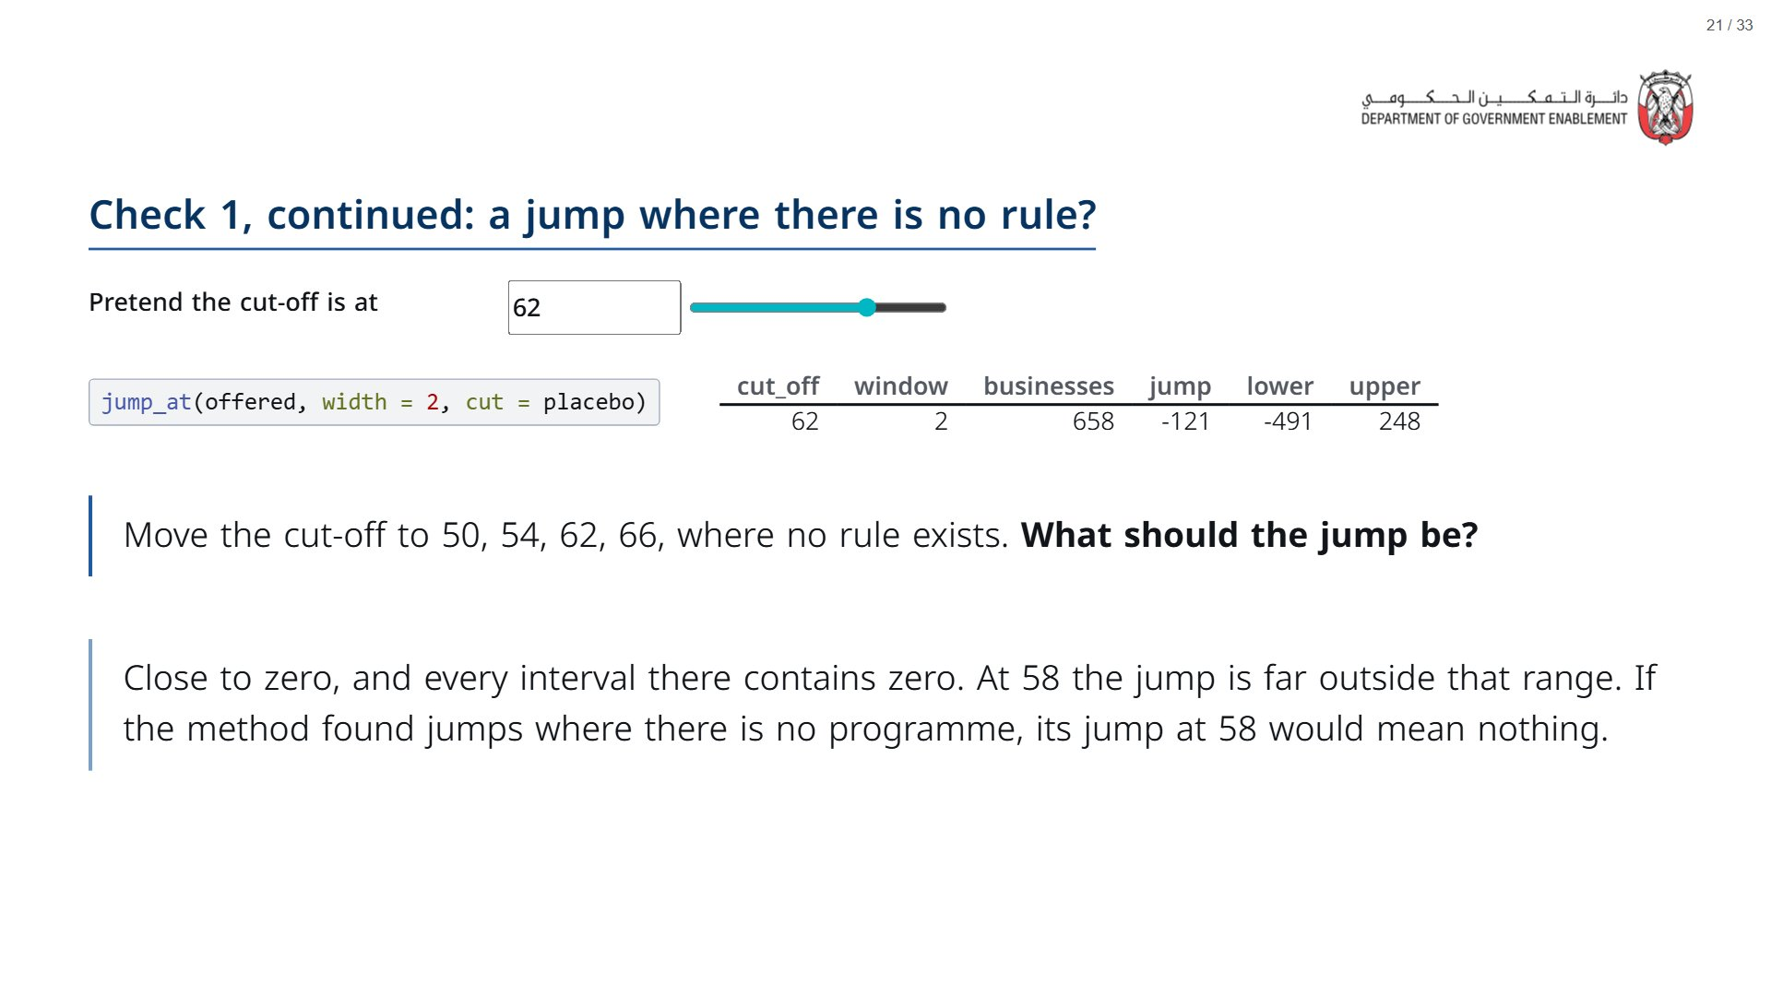

Slide 22
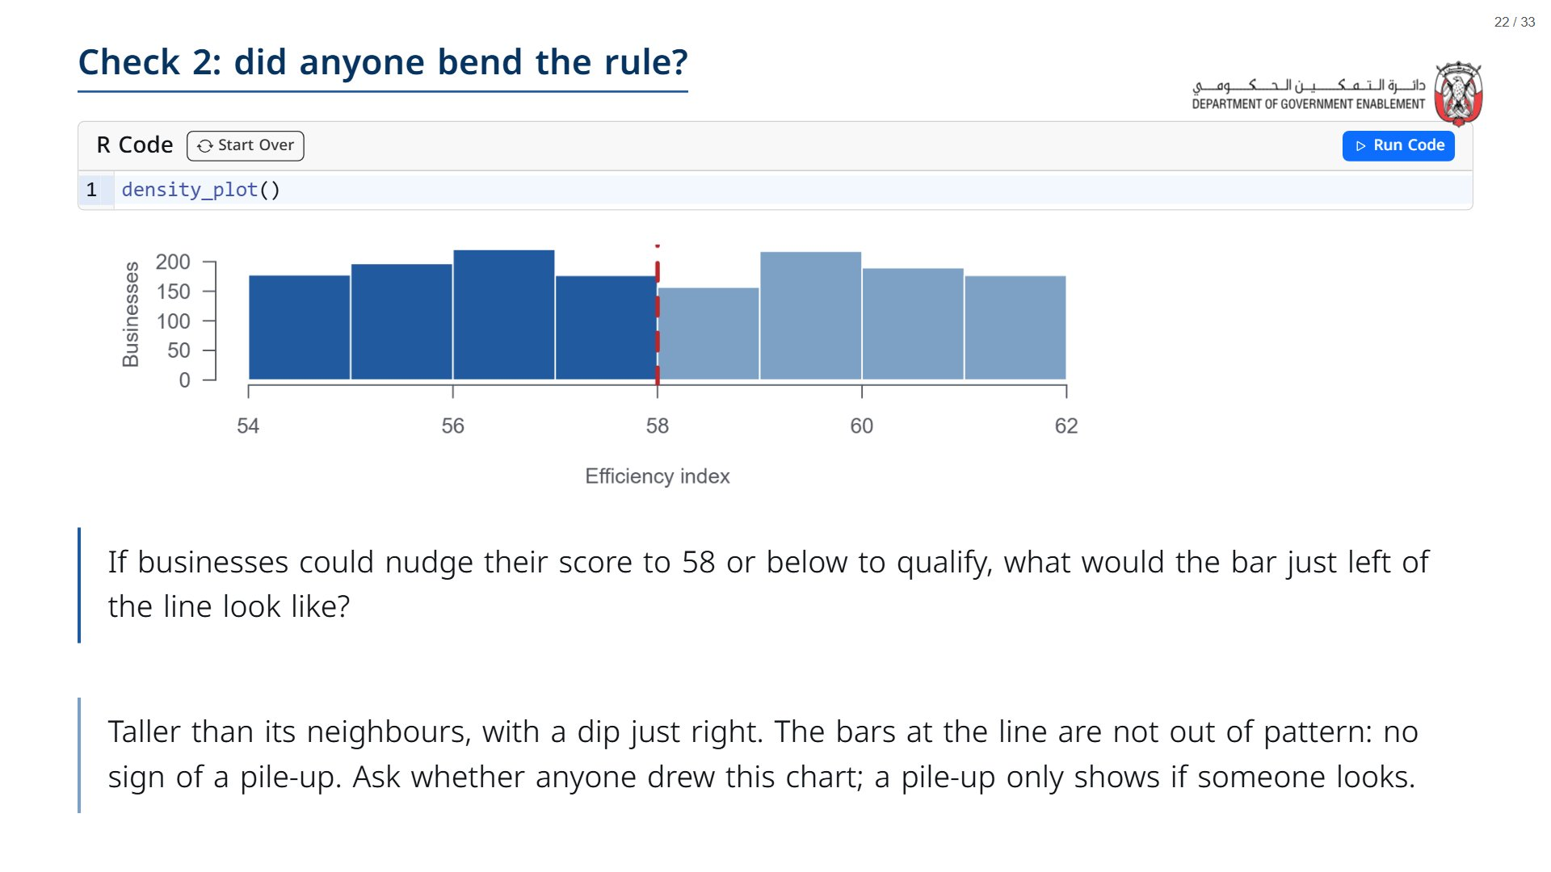

Slide 23
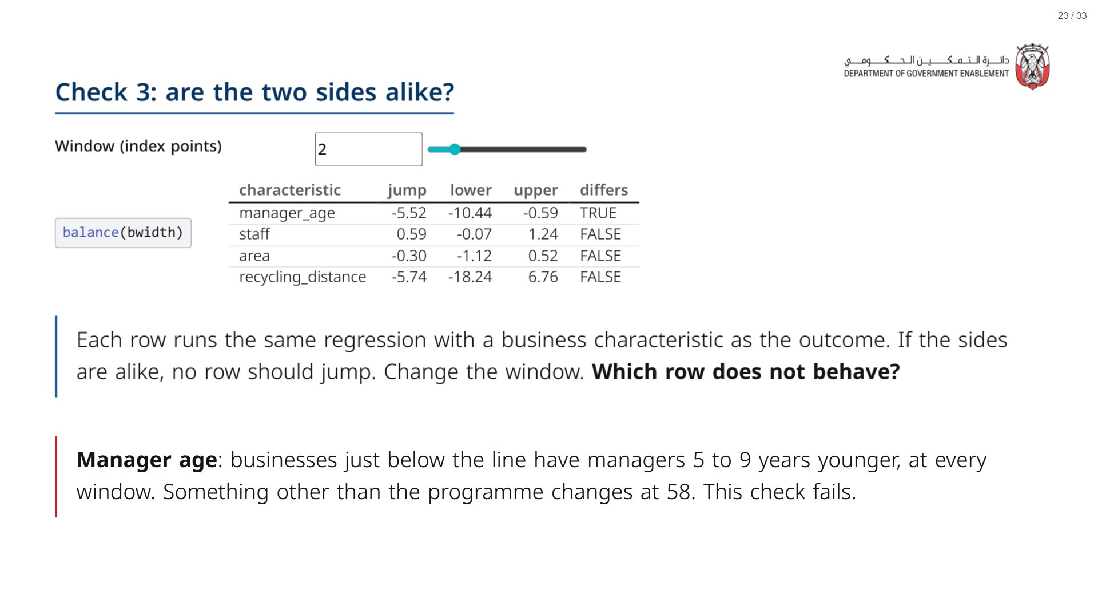

Slide 24
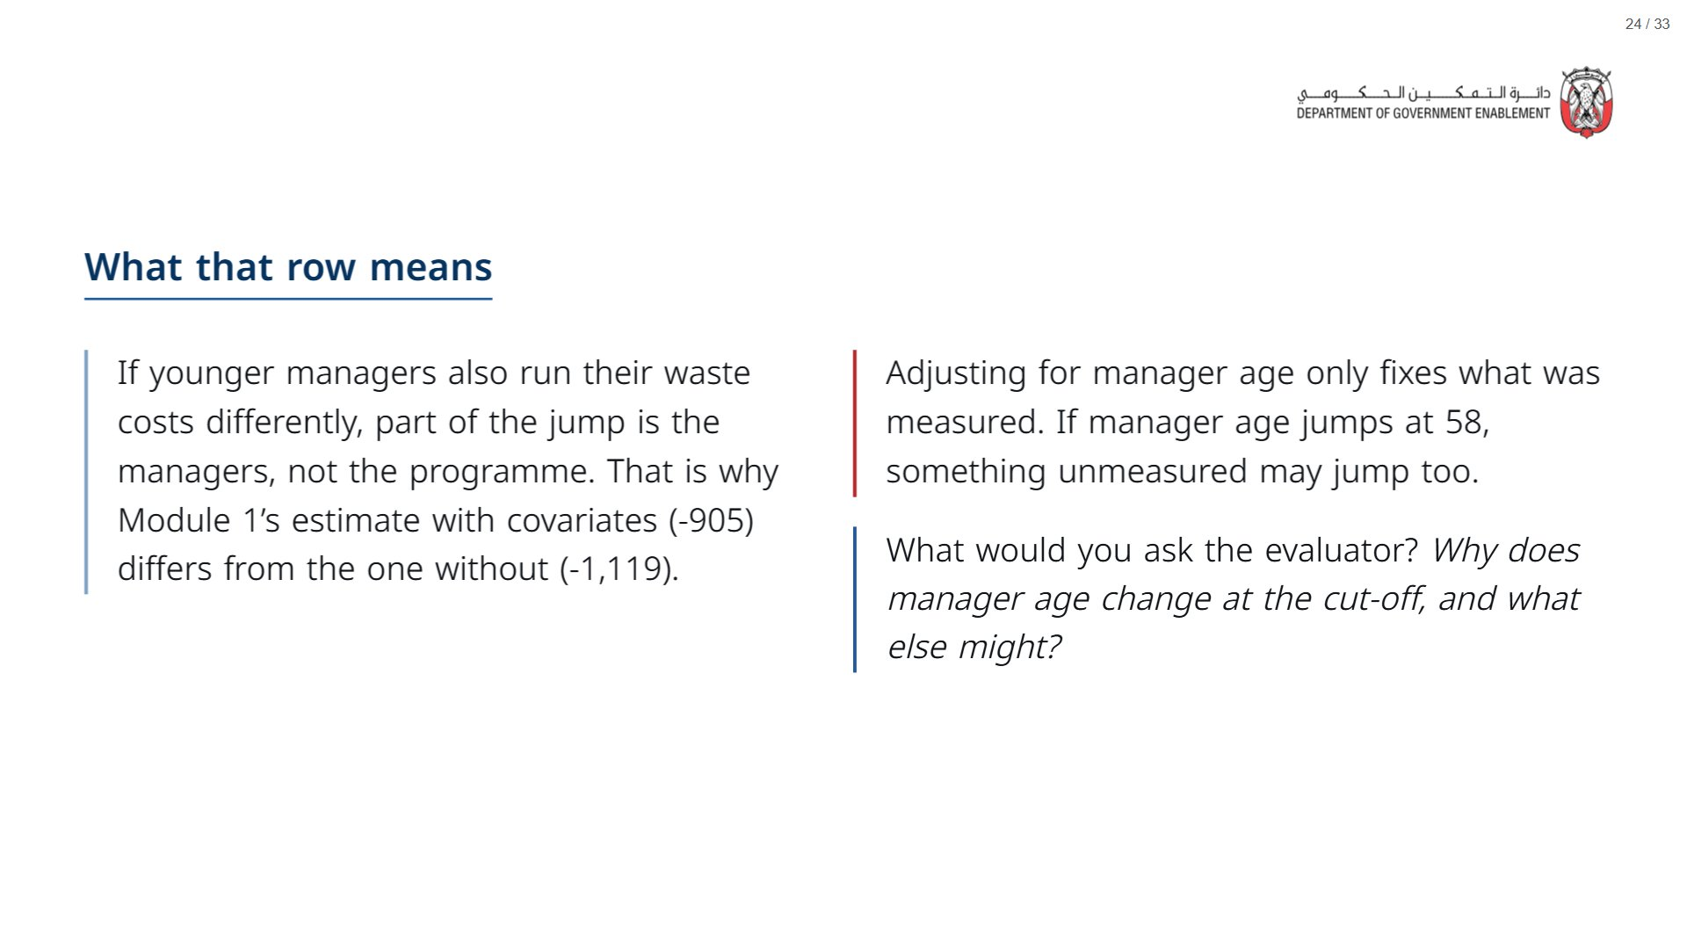

Slide 25
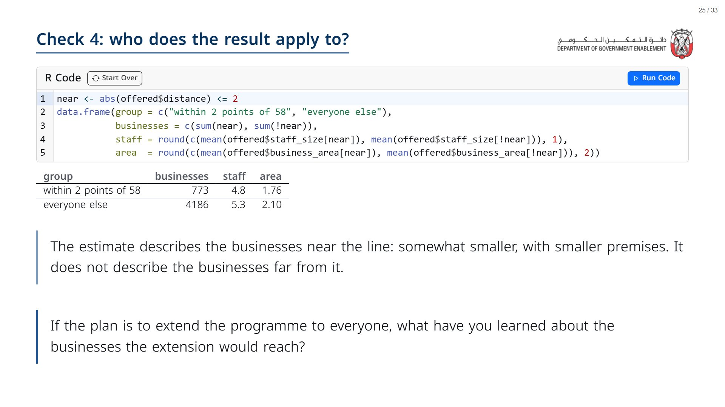

Slide 26


Slide 27
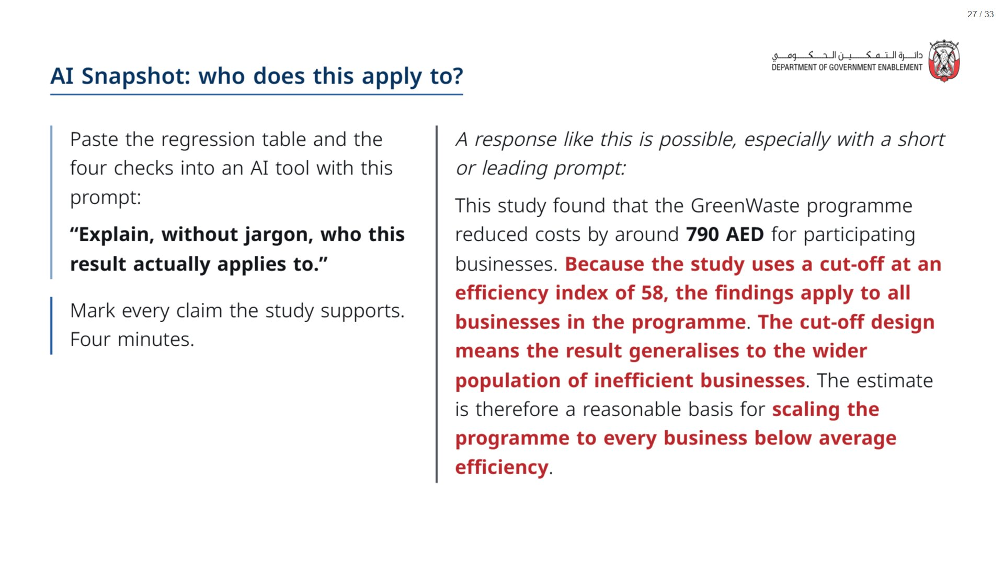
Notes:
Paper (Oct13_session2_materials.docx): Hand out the AI handout (pack page 6, one per group).
span.MJX_Assistive_MathML {
position:absolute!important;
clip: rect(1px, 1px, 1px, 1px);
padding: 1px 0 0 0!important;
border: 0!important;
height: 1px!important;
width: 1px!important;
overflow: hidden!important;
display:block!important;
}

Slide 28
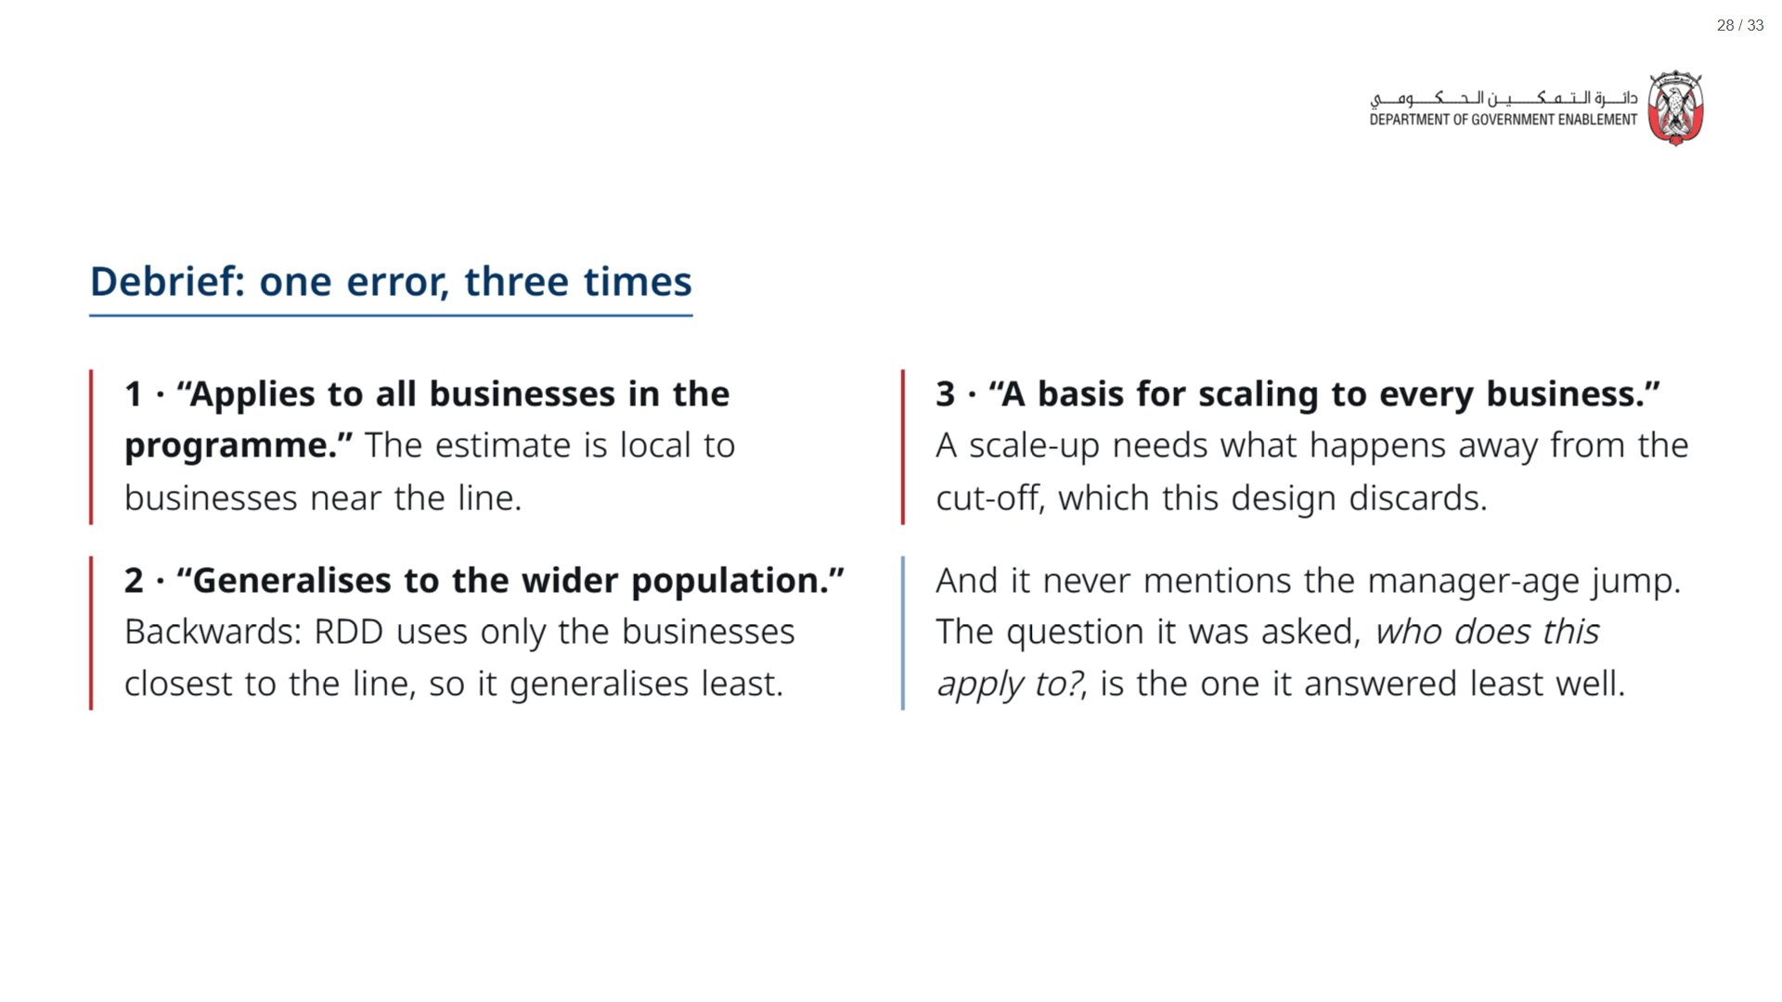

Slide 29
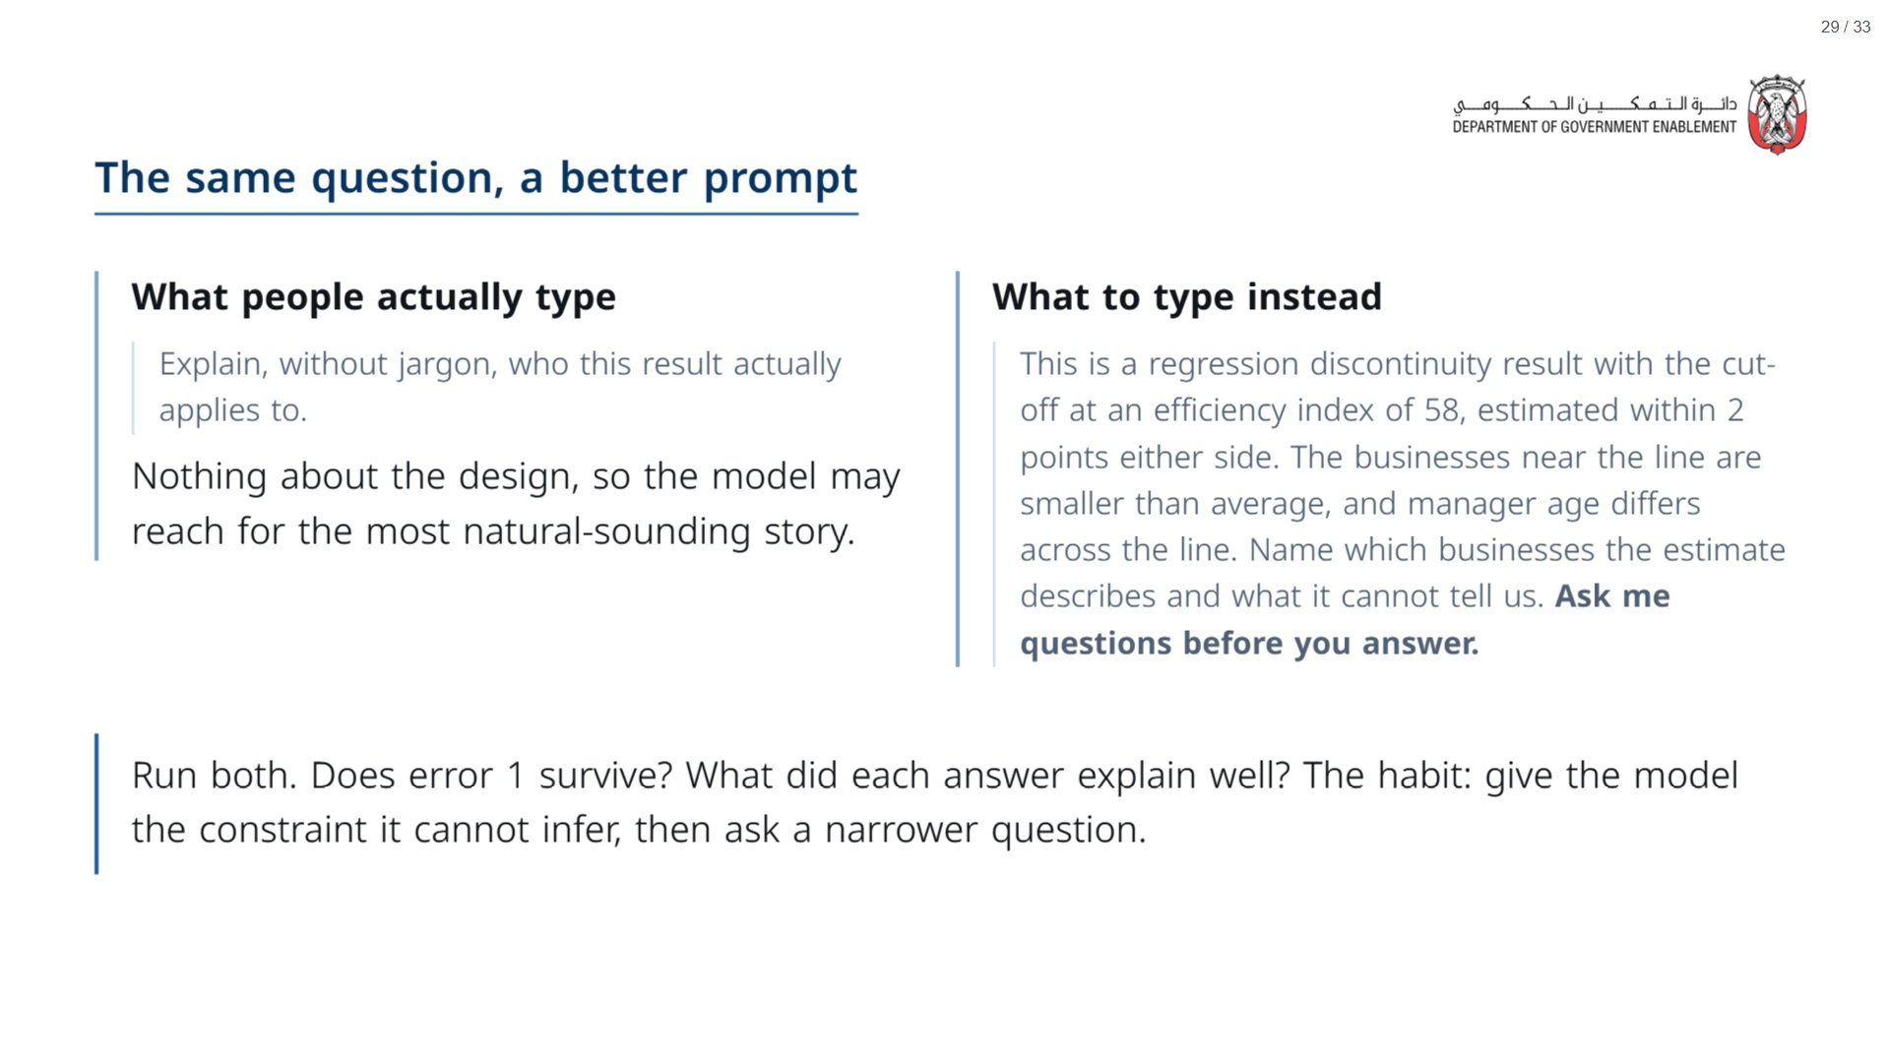

Slide 30


Slide 31
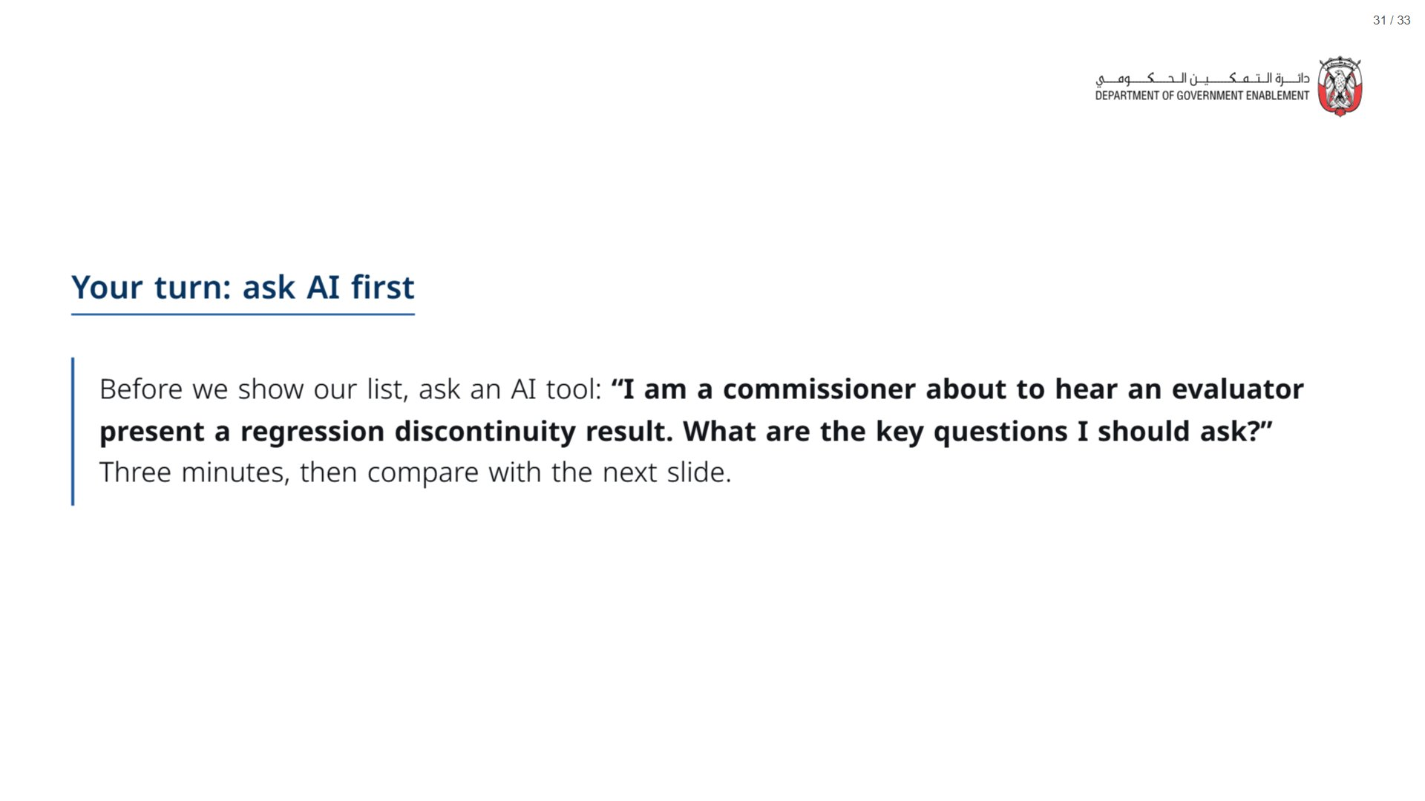
Notes:
Optional. If time is short, skip to the next slide. If you run it, ask what the AI missed, what it added that is worth keeping, and whether anything was wrong.
span.MJX_Assistive_MathML {
position:absolute!important;
clip: rect(1px, 1px, 1px, 1px);
padding: 1px 0 0 0!important;
border: 0!important;
height: 1px!important;
width: 1px!important;
overflow: hidden!important;
display:block!important;
}

Slide 32
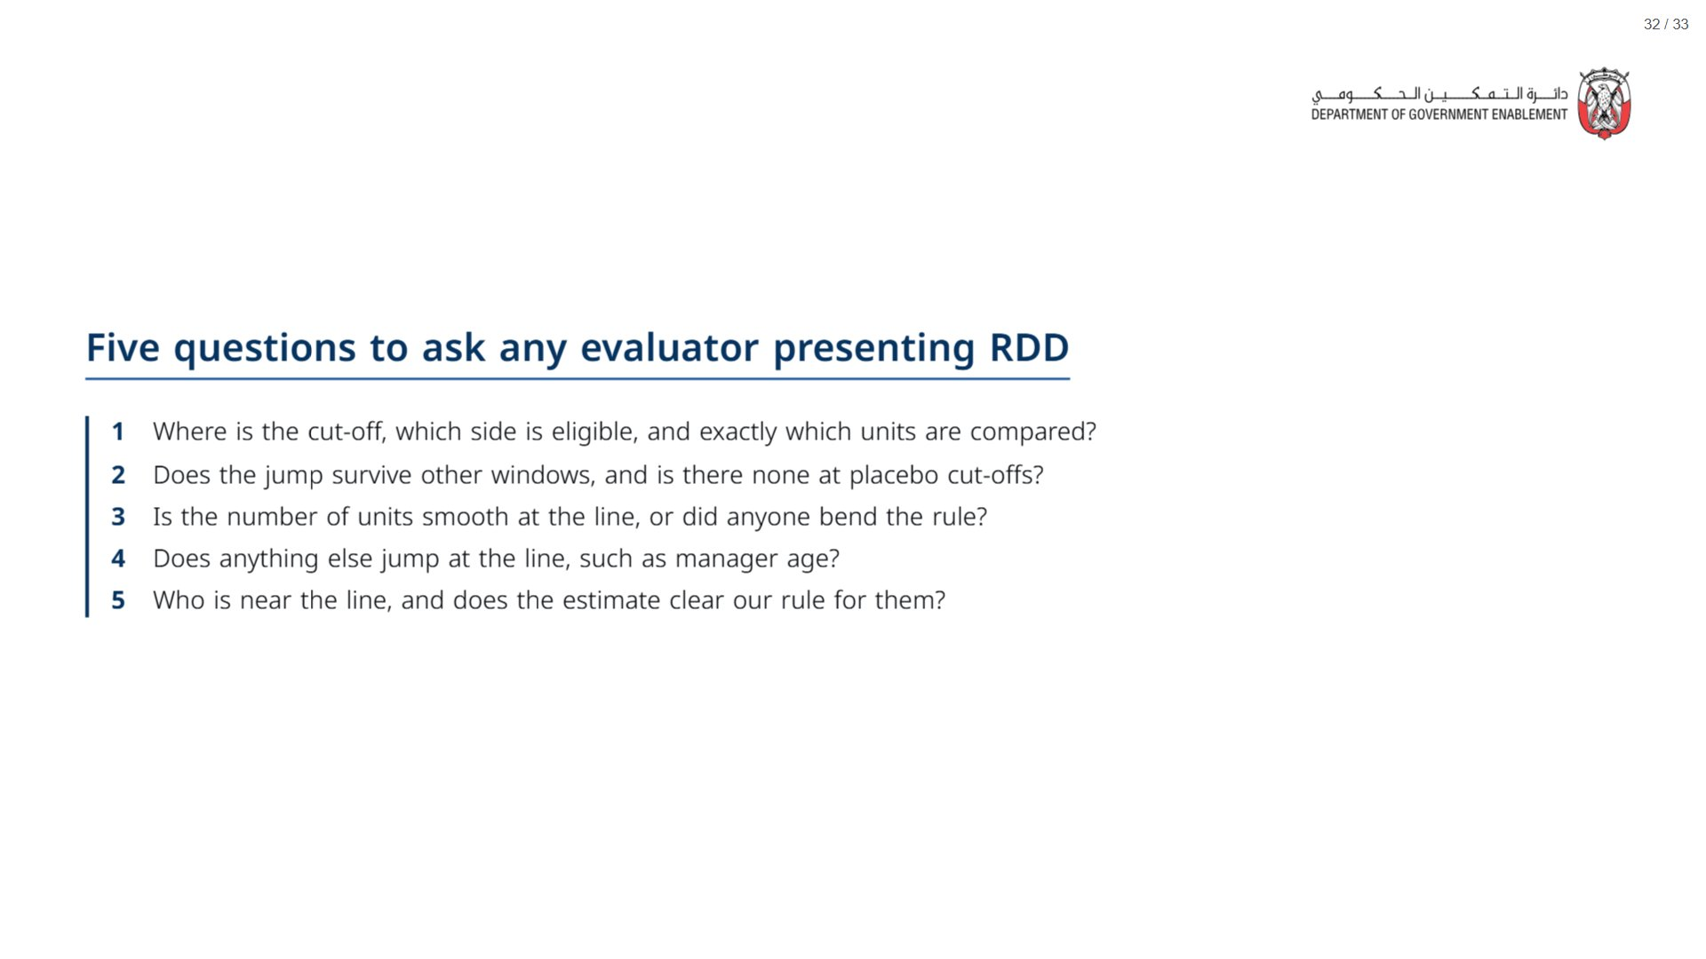
Notes:
Paper (Oct13_session2_materials.docx): Hand out the take-away cards (pack page 7). Give a minute to fill in “On my desk” on the card, then take two or three examples from the room.
span.MJX_Assistive_MathML {
position:absolute!important;
clip: rect(1px, 1px, 1px, 1px);
padding: 1px 0 0 0!important;
border: 0!important;
height: 1px!important;
width: 1px!important;
overflow: hidden!important;
display:block!important;
}

Slide 33
