Slide 1
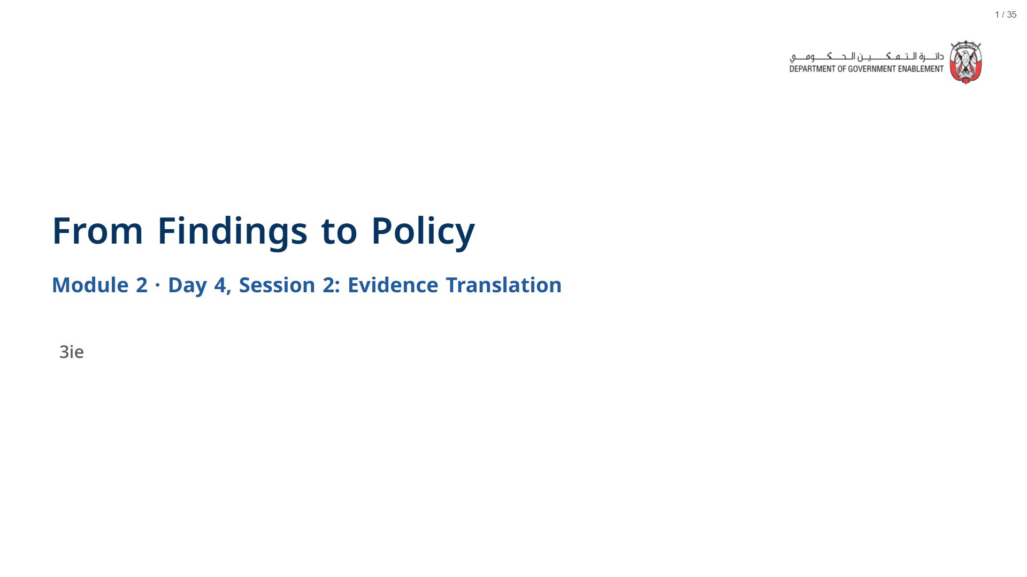

Slide 2


Slide 3
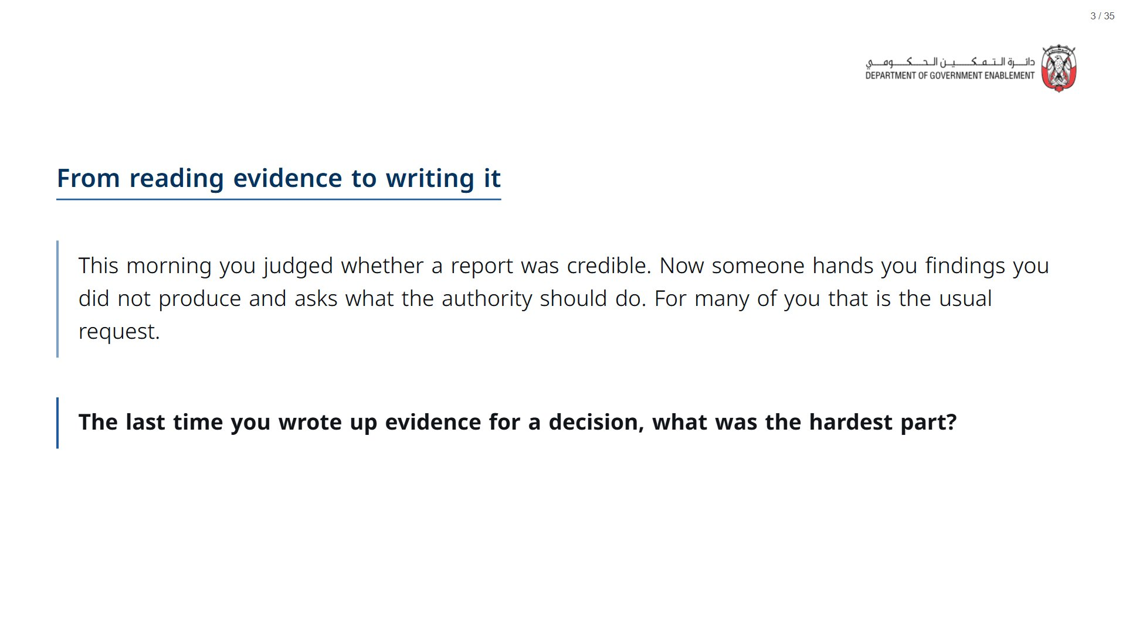
Notes:
Open the deck a couple of minutes before the session starts: R takes about a minute to load in the browser, after which every live cell runs in a few seconds.
span.MJX_Assistive_MathML {
position:absolute!important;
clip: rect(1px, 1px, 1px, 1px);
padding: 1px 0 0 0!important;
border: 0!important;
height: 1px!important;
width: 1px!important;
overflow: hidden!important;
display:block!important;
}

Slide 4
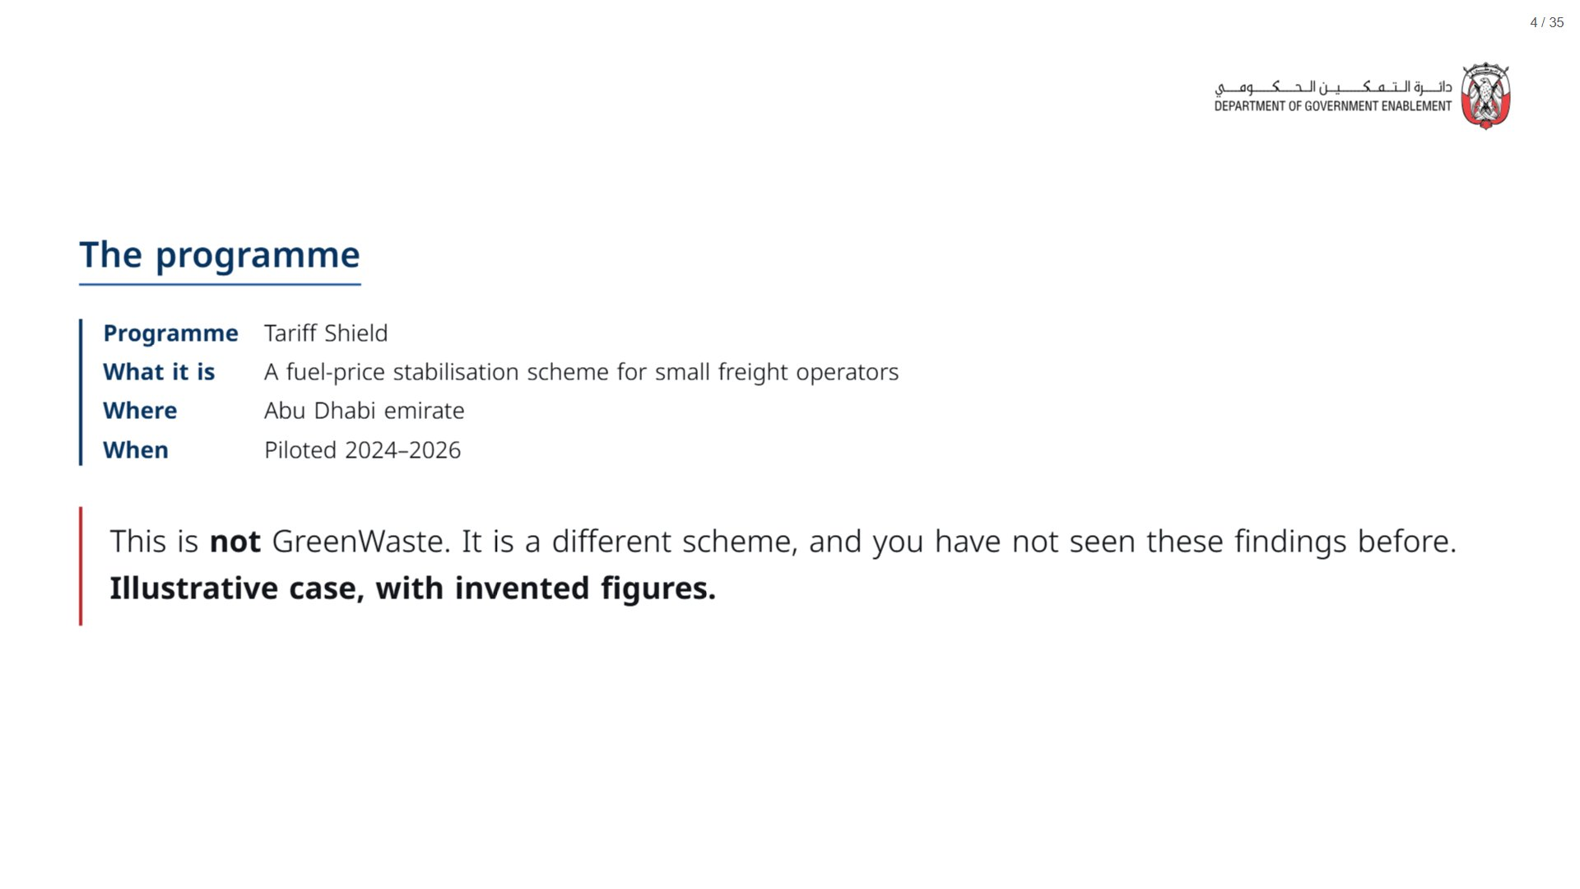

Slide 5
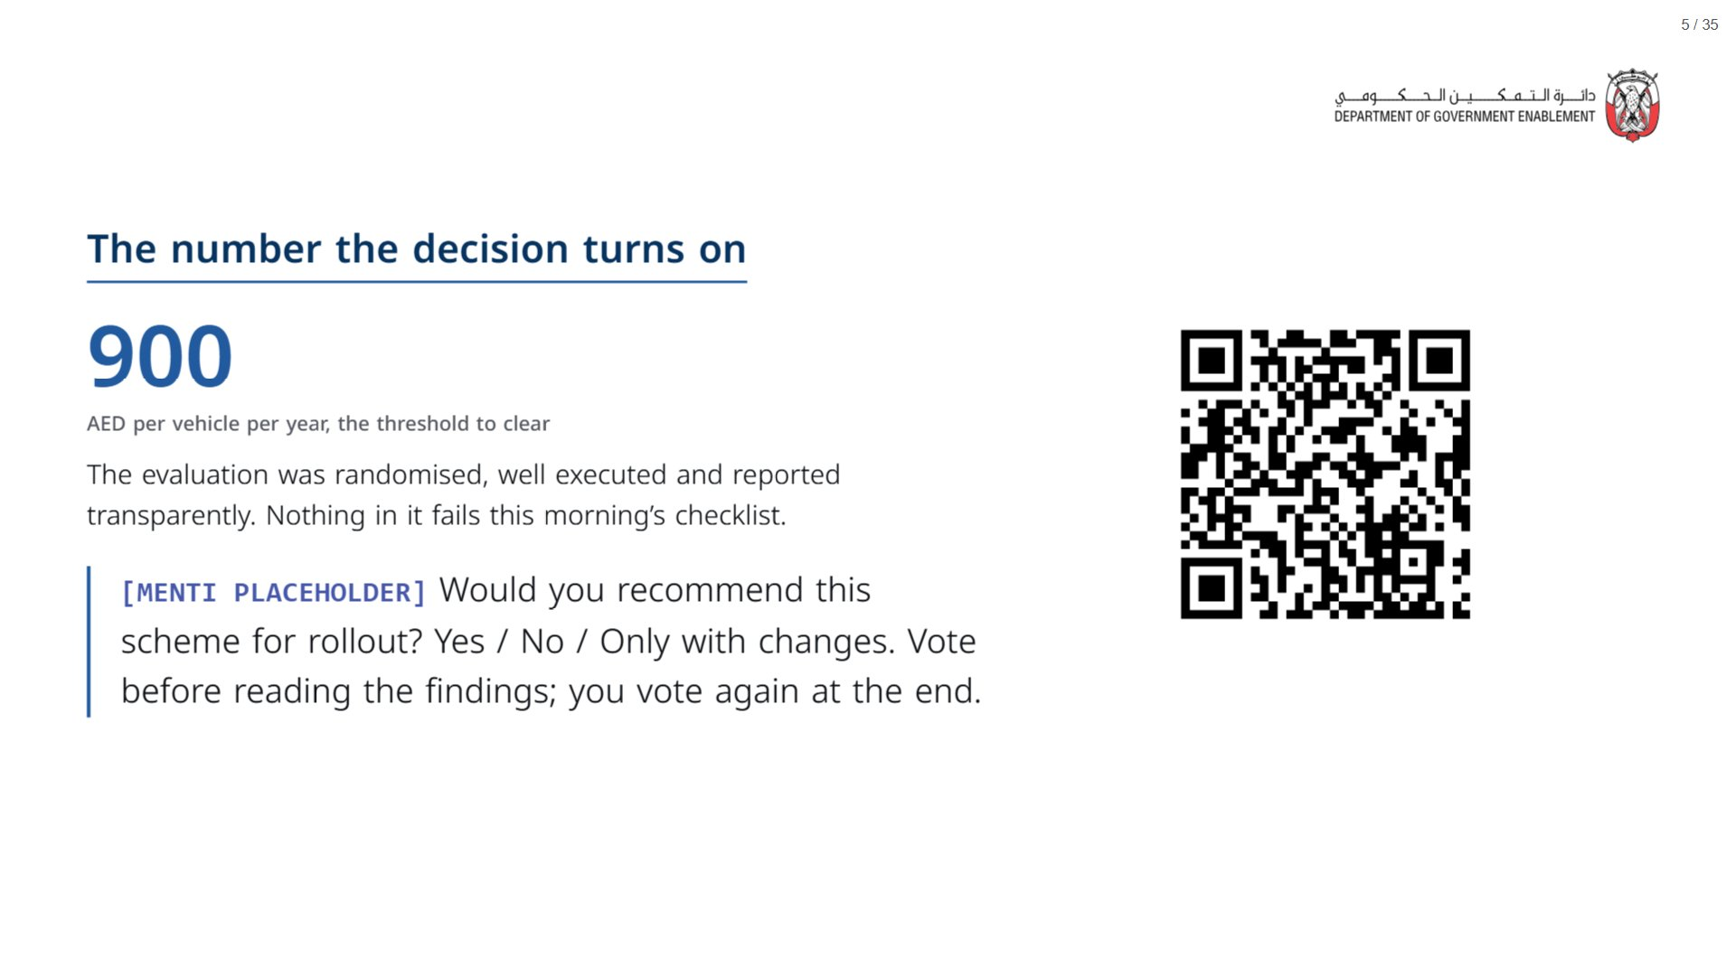

Slide 6


Slide 7
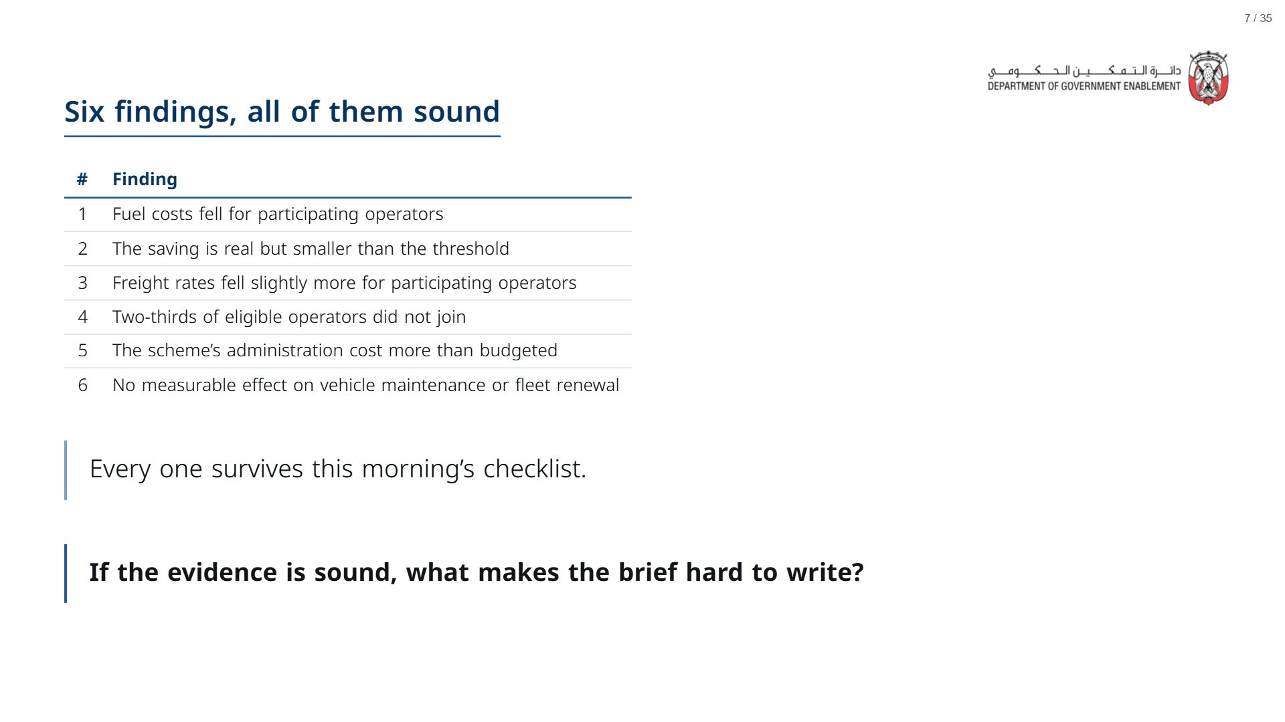
Notes:
Paper (Oct15_session2_materials.docx): Hand out the findings pack (Oct15_session2_findings.docx), one per participant.
span.MJX_Assistive_MathML {
position:absolute!important;
clip: rect(1px, 1px, 1px, 1px);
padding: 1px 0 0 0!important;
border: 0!important;
height: 1px!important;
width: 1px!important;
overflow: hidden!important;
display:block!important;
}

Slide 8
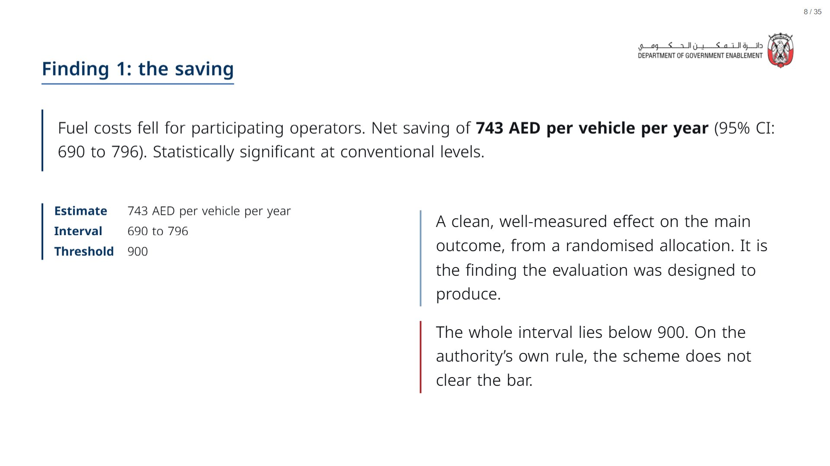

Slide 9
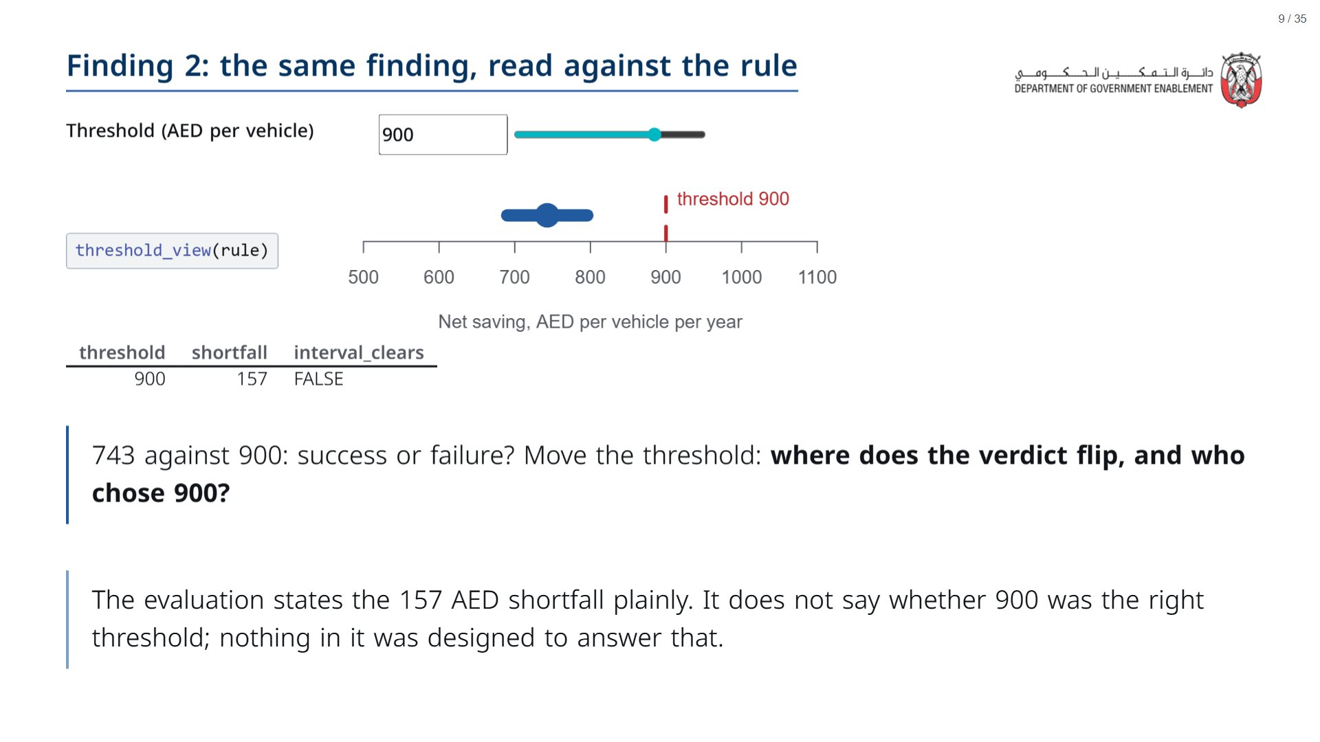

Slide 10
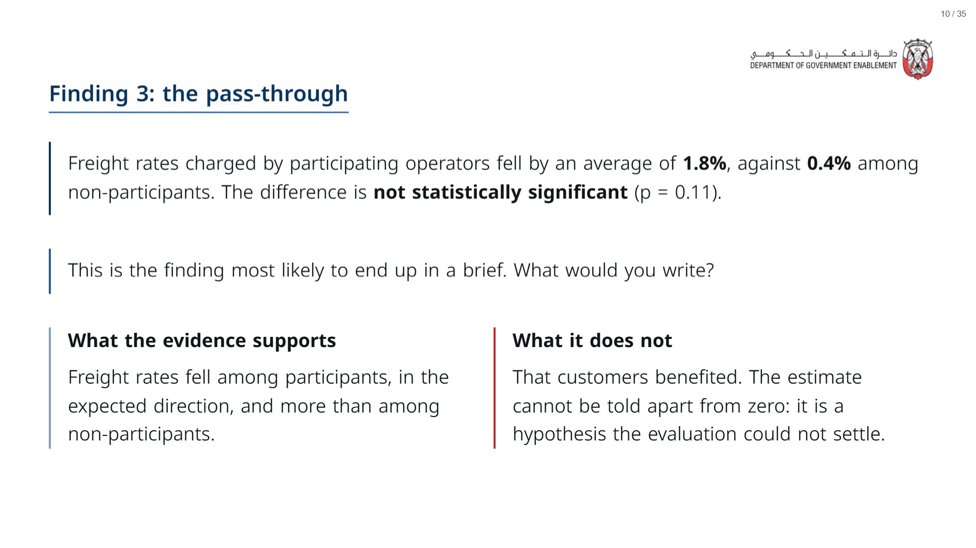

Slide 11
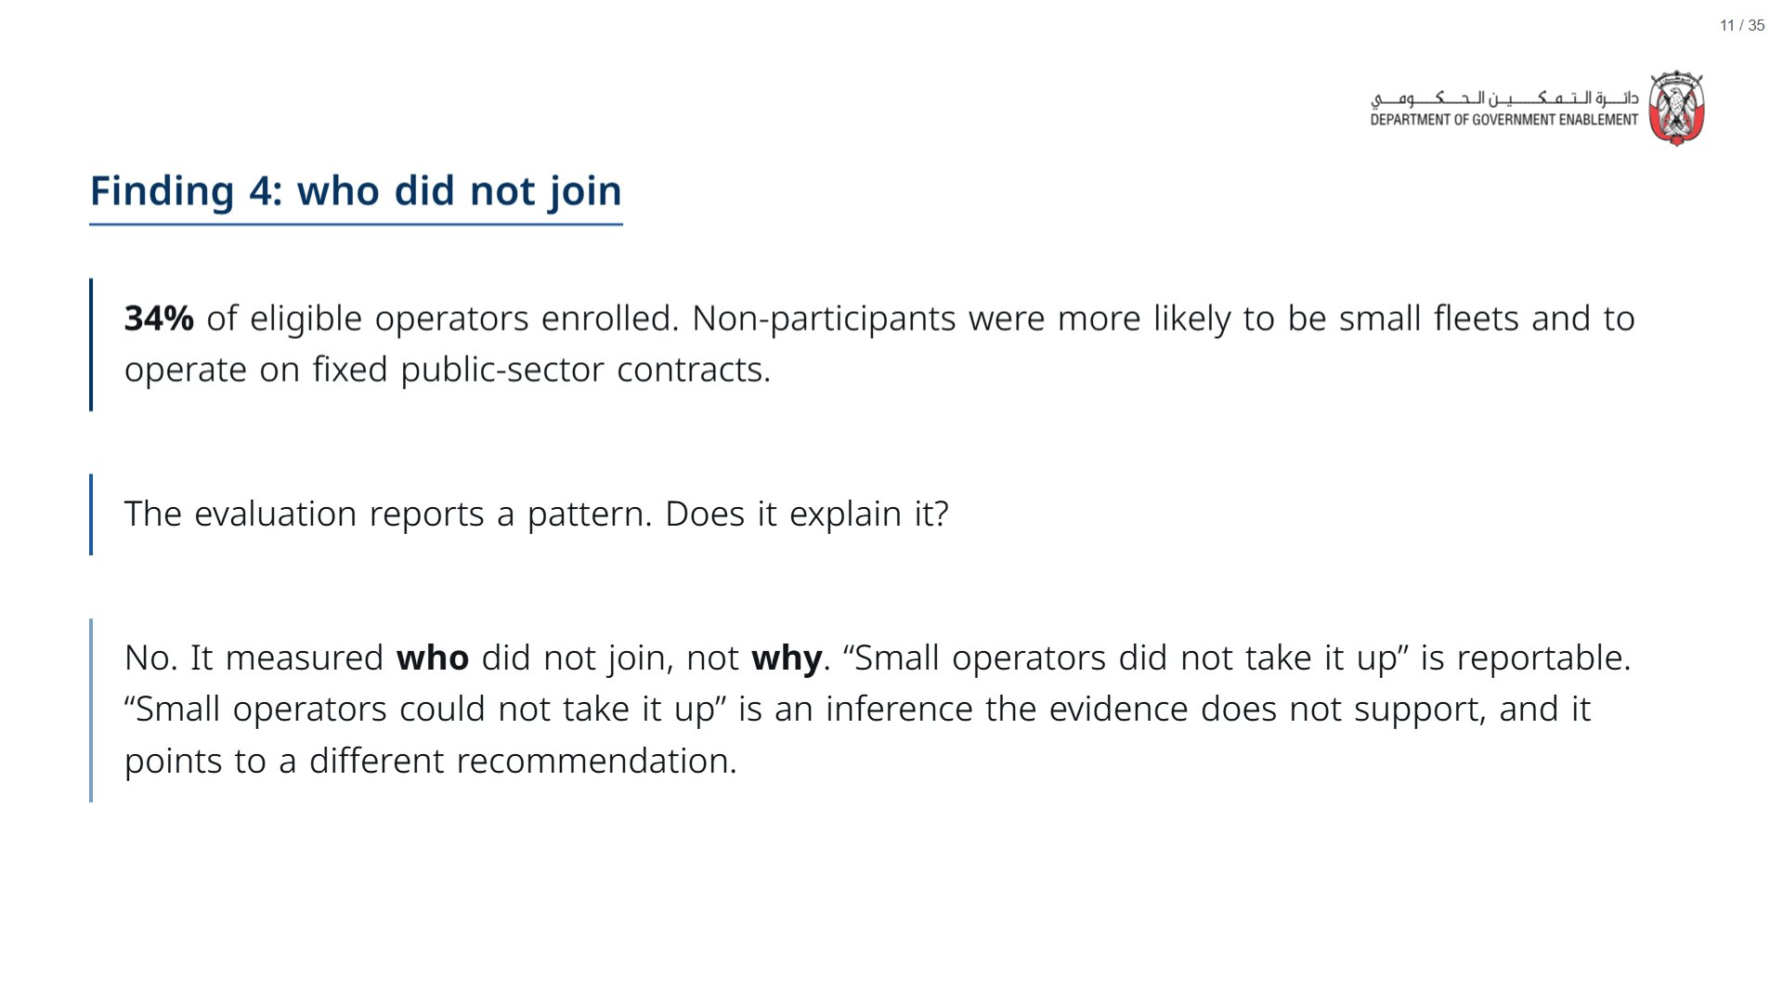

Slide 12
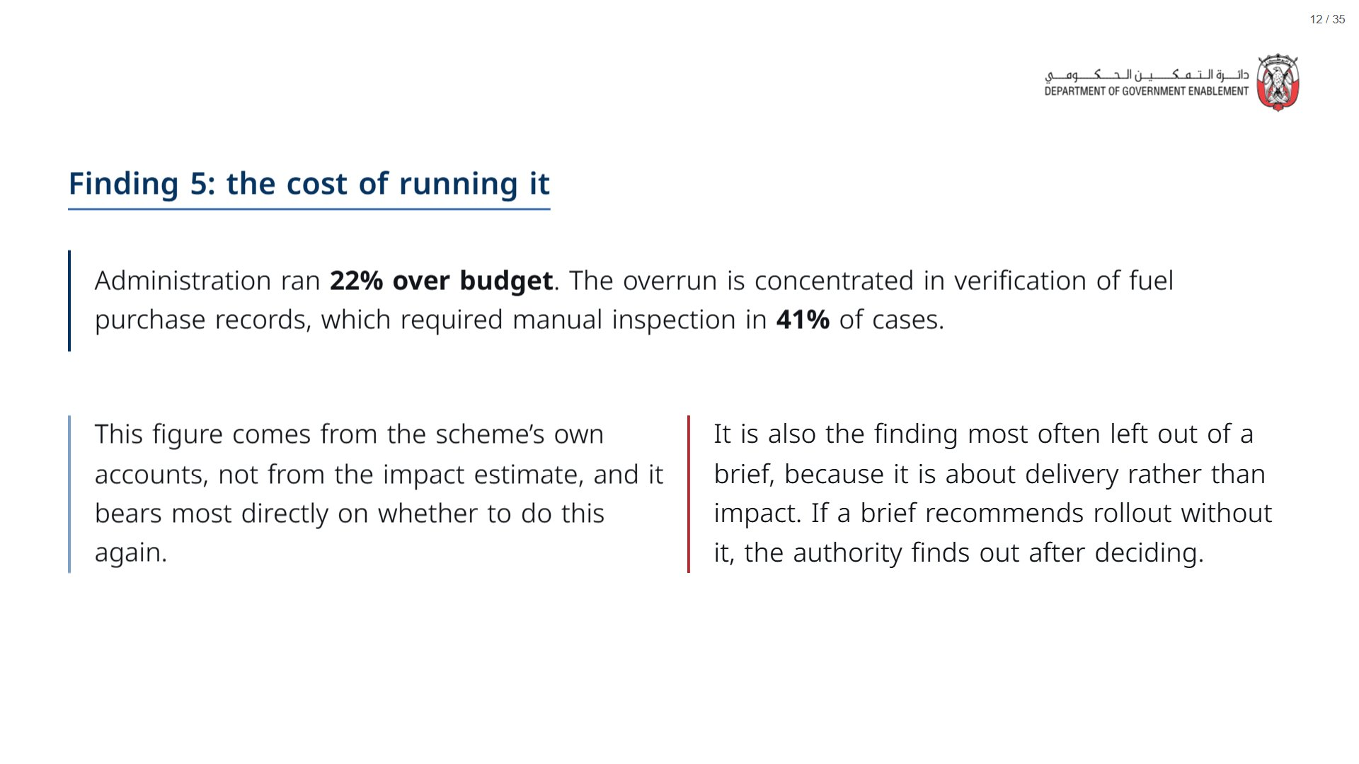

Slide 13
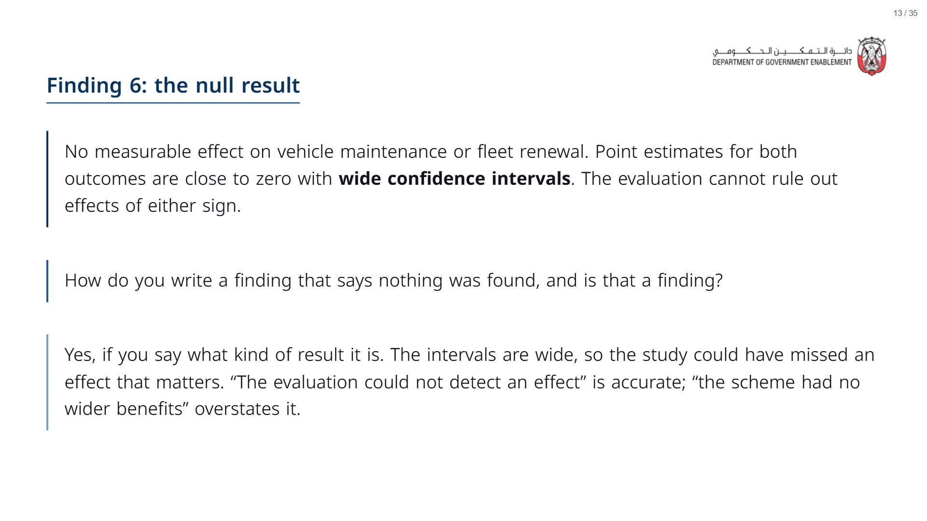

Slide 14


Slide 15
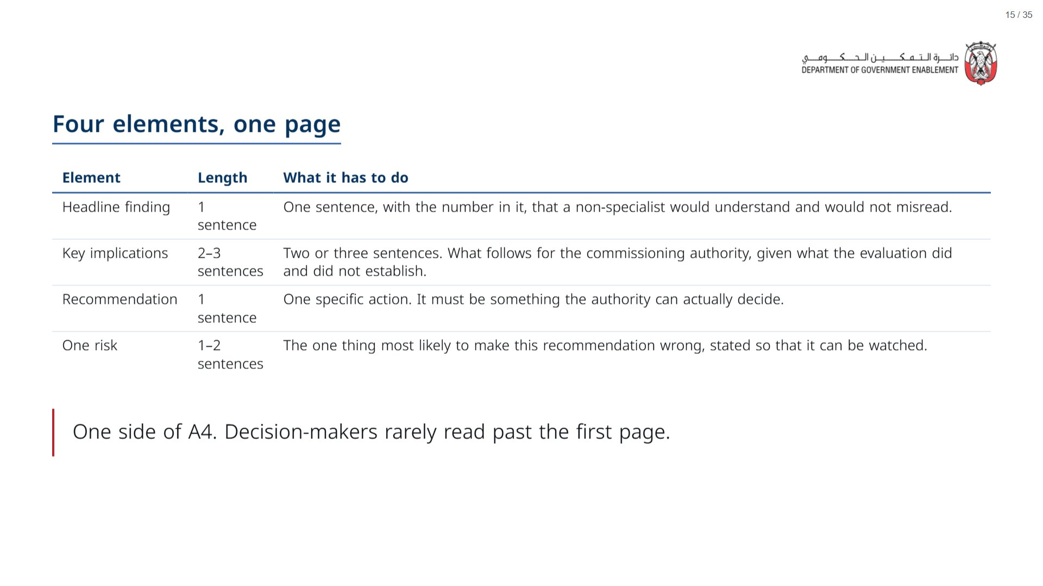
Notes:
Paper (Oct15_session2_materials.docx): Hand out the brief template (Oct15_session2_brief_template.docx), one per pair.
span.MJX_Assistive_MathML {
position:absolute!important;
clip: rect(1px, 1px, 1px, 1px);
padding: 1px 0 0 0!important;
border: 0!important;
height: 1px!important;
width: 1px!important;
overflow: hidden!important;
display:block!important;
}

Slide 16
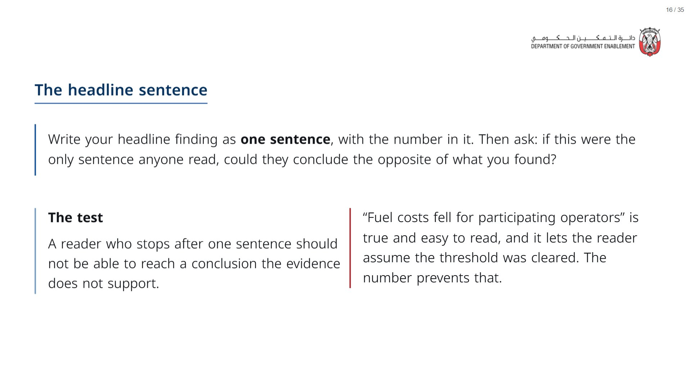

Slide 17
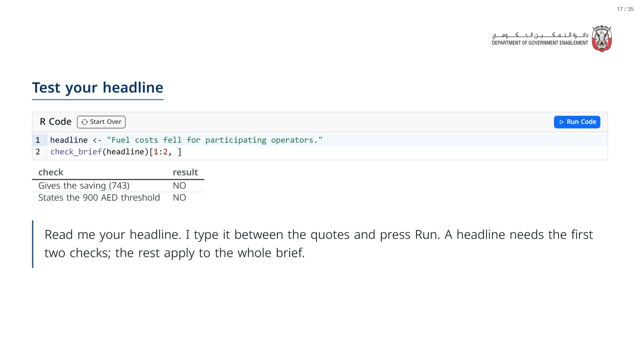
Notes:
Take three or four headlines from the room. The check is a word search, so it can be fooled: a sentence can contain “900” and still mislead. Use it to start the discussion, not to settle it.
span.MJX_Assistive_MathML {
position:absolute!important;
clip: rect(1px, 1px, 1px, 1px);
padding: 1px 0 0 0!important;
border: 0!important;
height: 1px!important;
width: 1px!important;
overflow: hidden!important;
display:block!important;
}

Slide 18
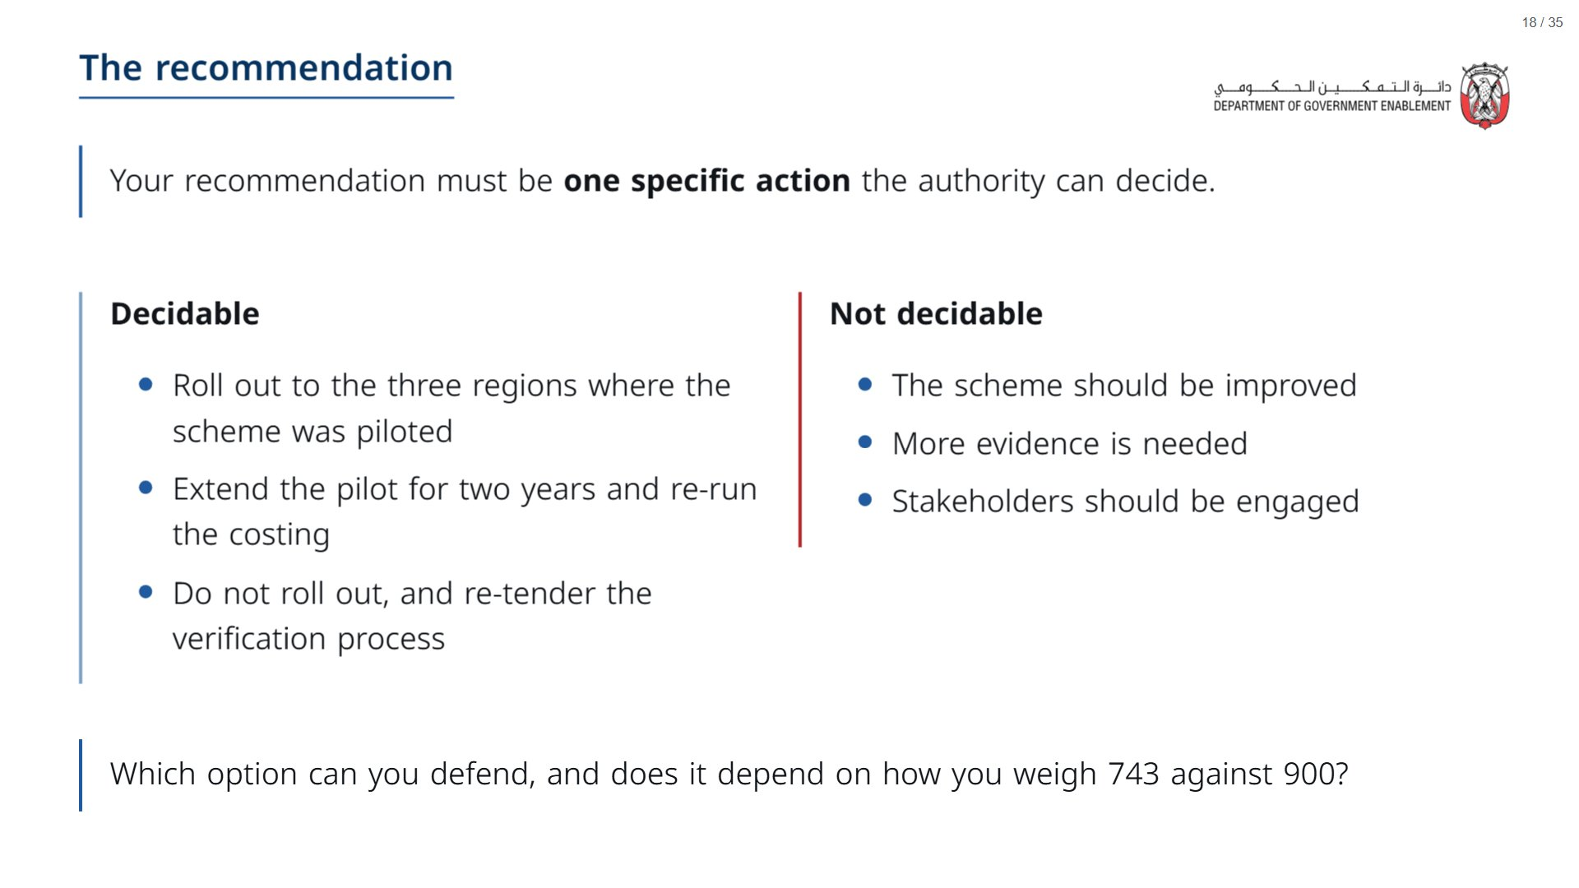

Slide 19
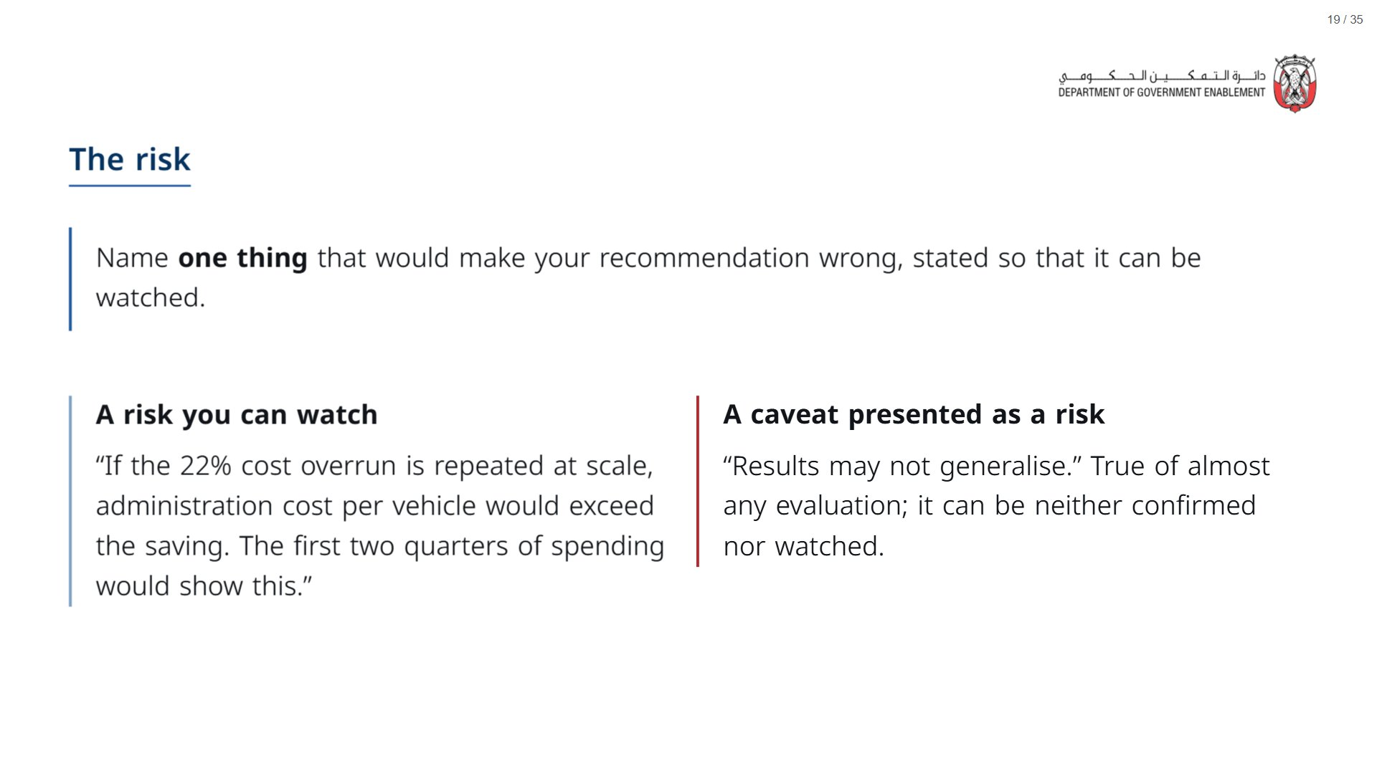

Slide 20
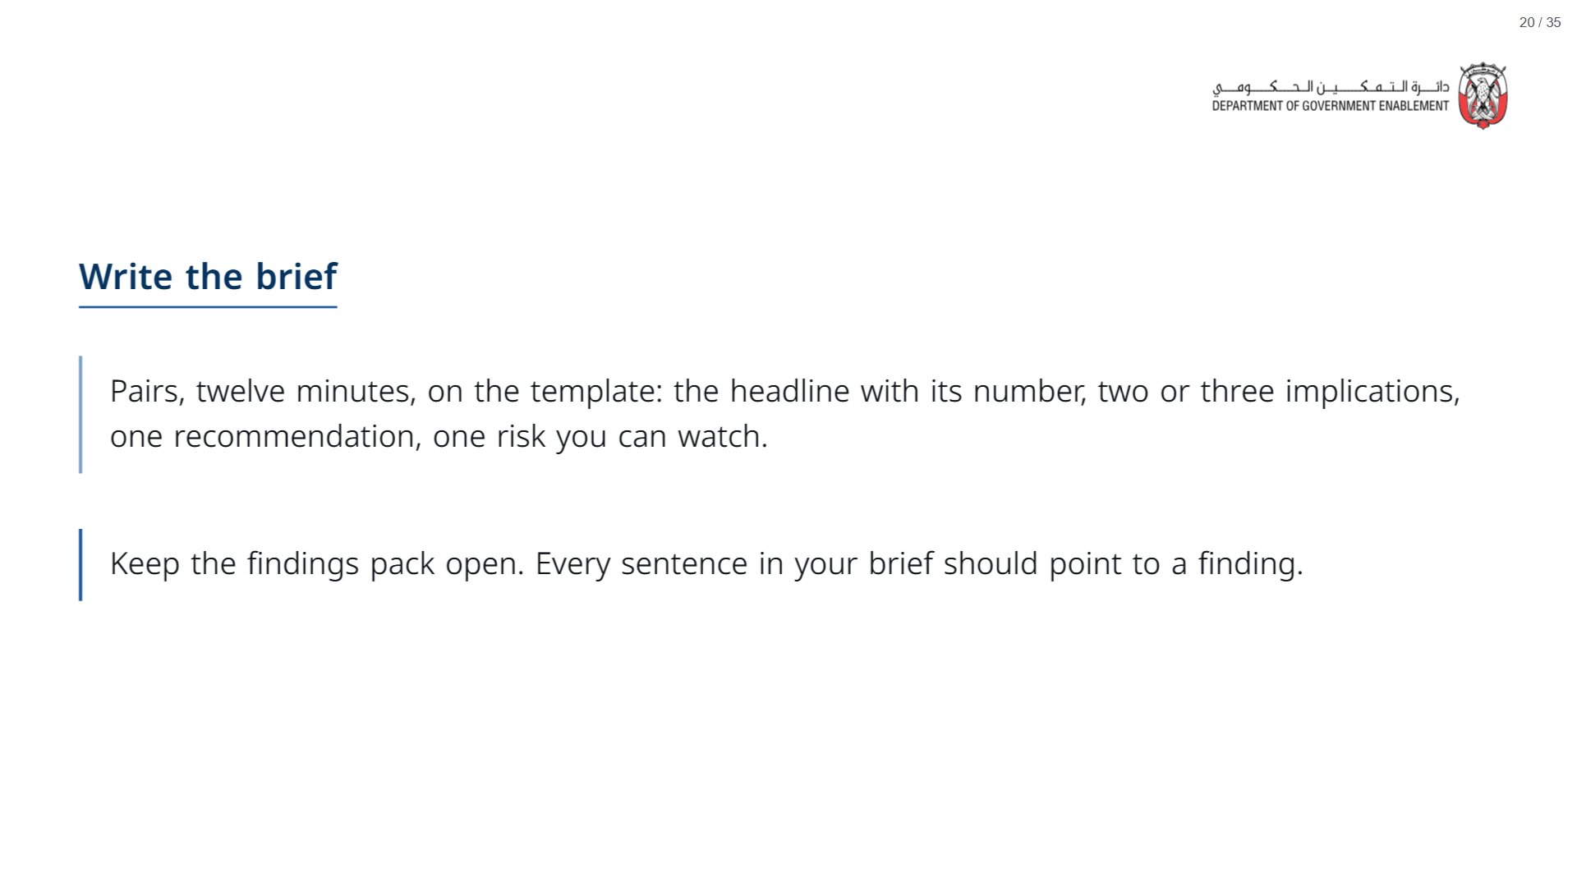
Notes:
Walk the room. If a pair is stuck, ask them to write the recommendation first and work back to the headline.
span.MJX_Assistive_MathML {
position:absolute!important;
clip: rect(1px, 1px, 1px, 1px);
padding: 1px 0 0 0!important;
border: 0!important;
height: 1px!important;
width: 1px!important;
overflow: hidden!important;
display:block!important;
}

Slide 21


Slide 22
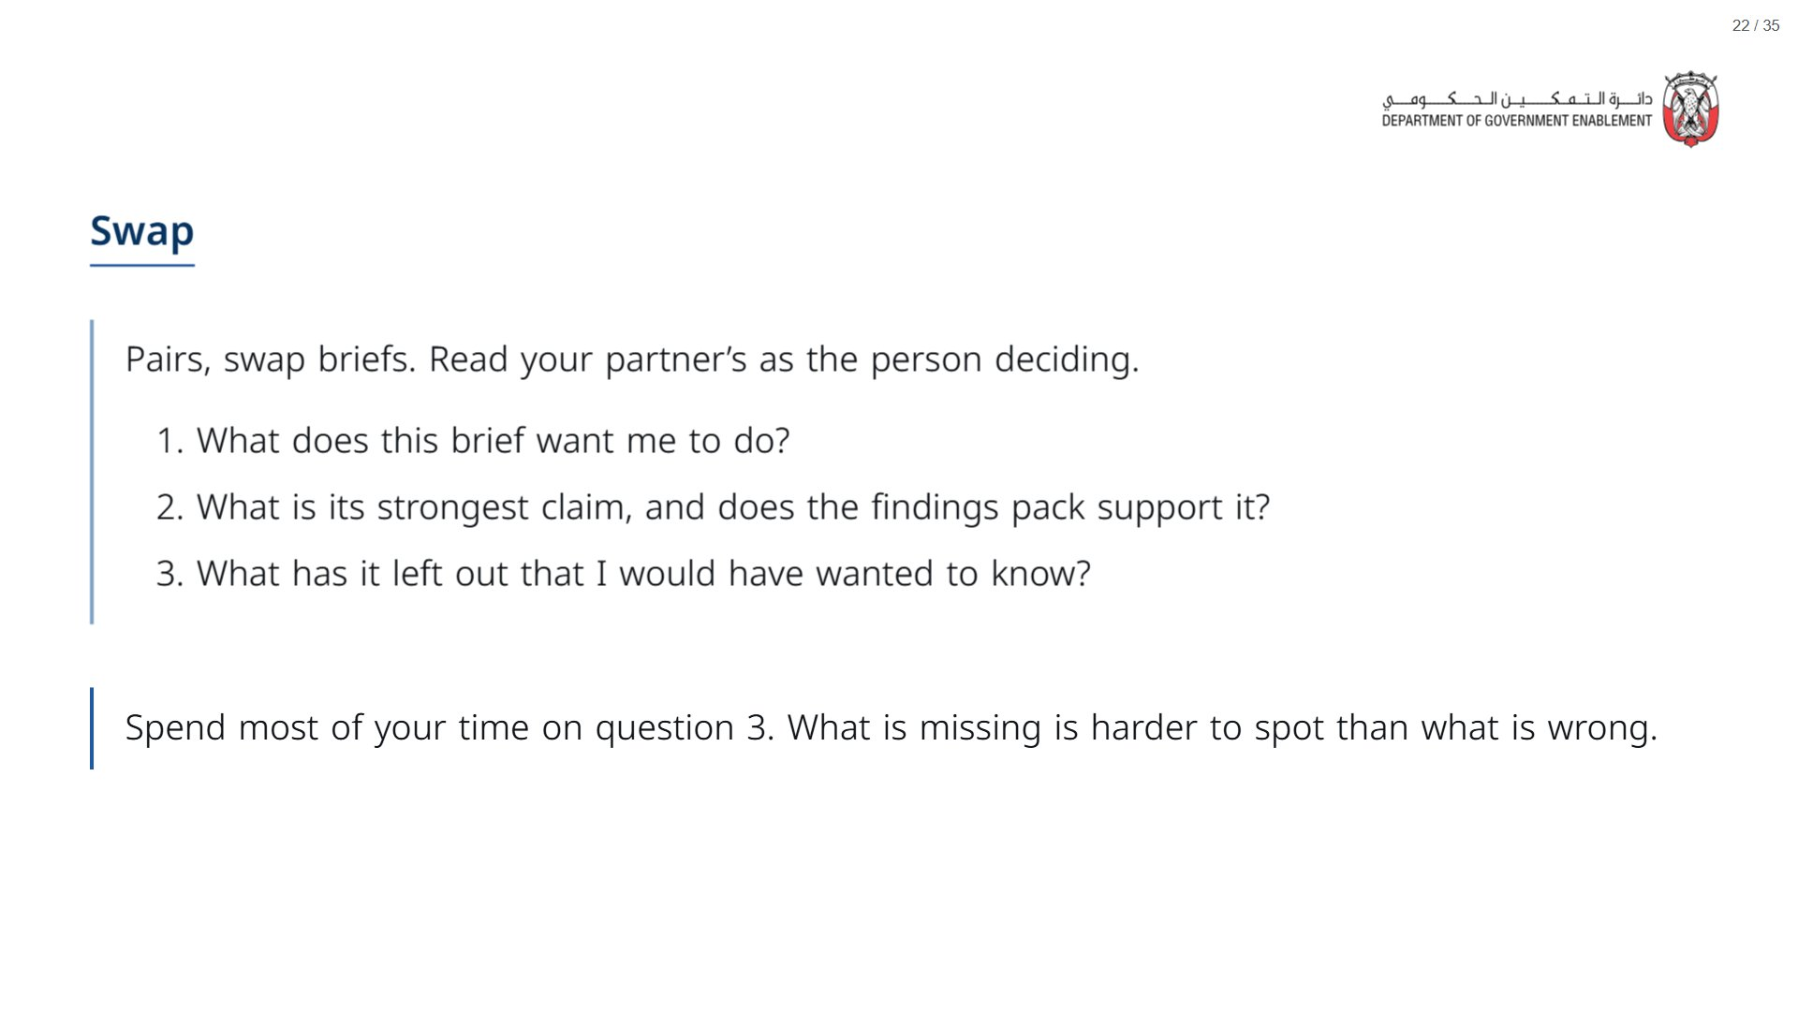
Notes:
Paper (Oct15_session2_materials.docx): Hand out the peer-critique sheet (pack page 1), one per pair.
span.MJX_Assistive_MathML {
position:absolute!important;
clip: rect(1px, 1px, 1px, 1px);
padding: 1px 0 0 0!important;
border: 0!important;
height: 1px!important;
width: 1px!important;
overflow: hidden!important;
display:block!important;
}

Slide 23
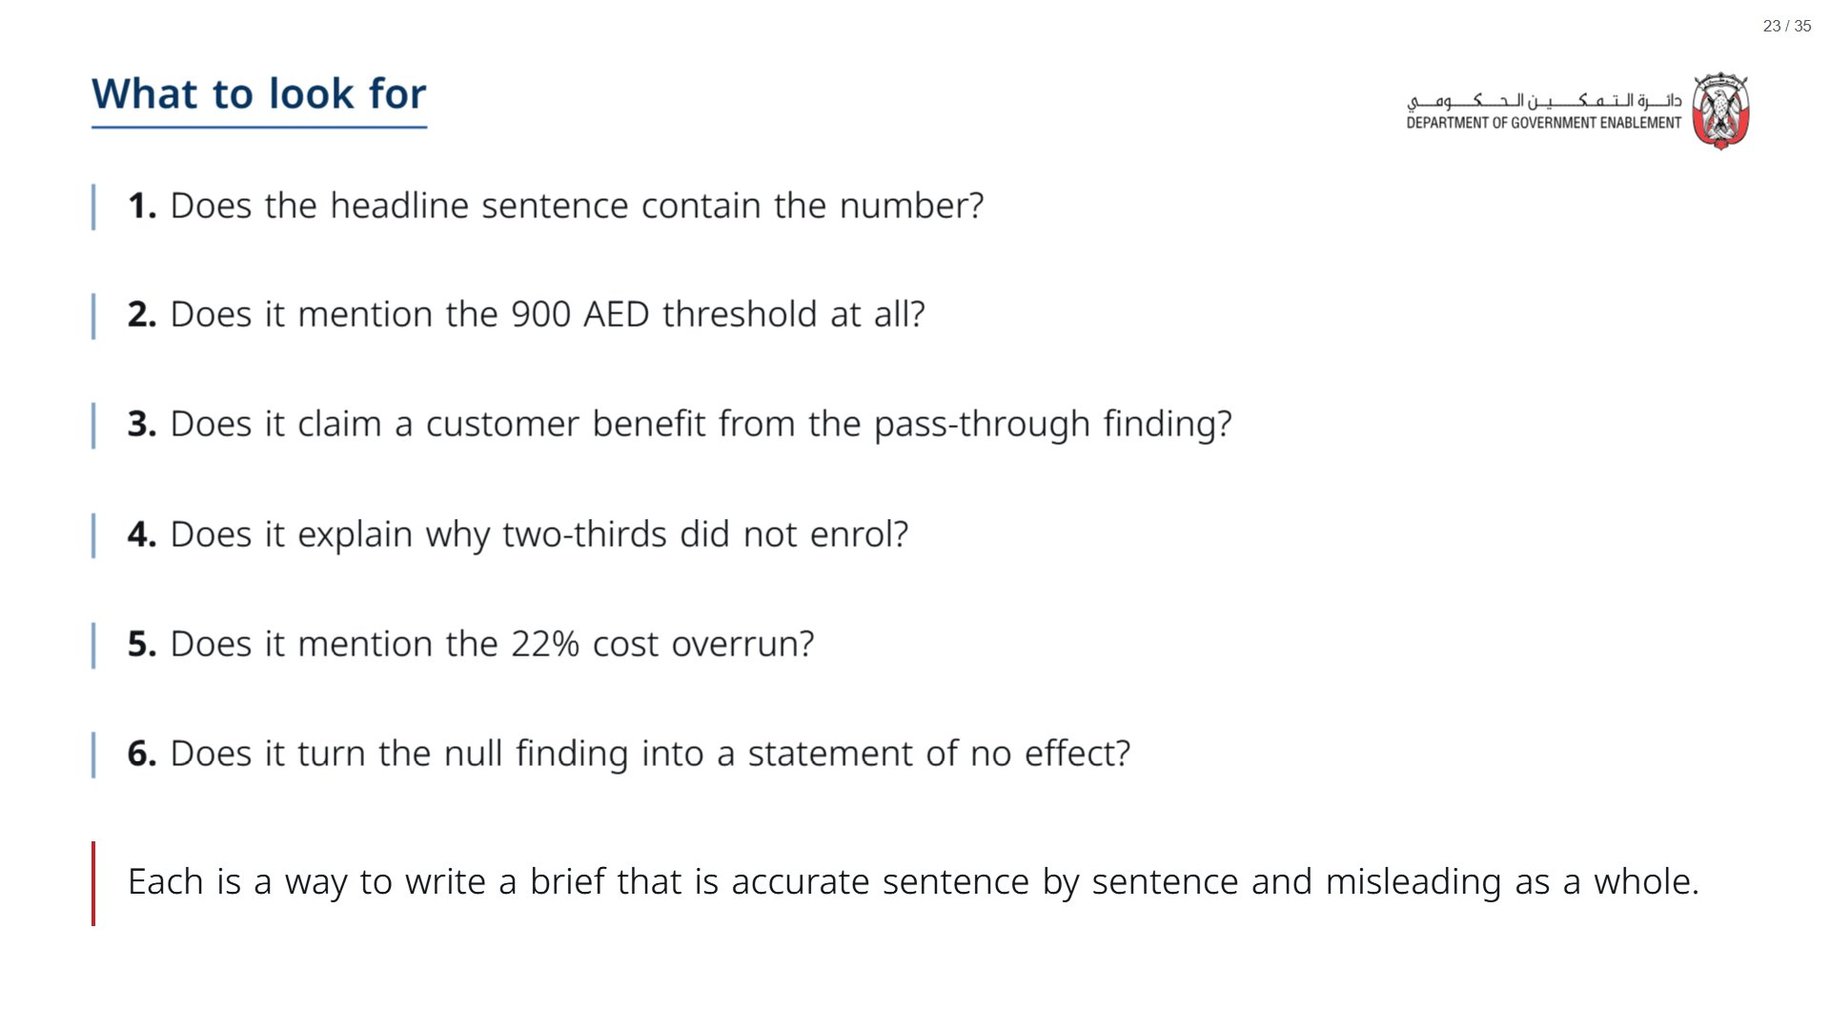

Slide 24
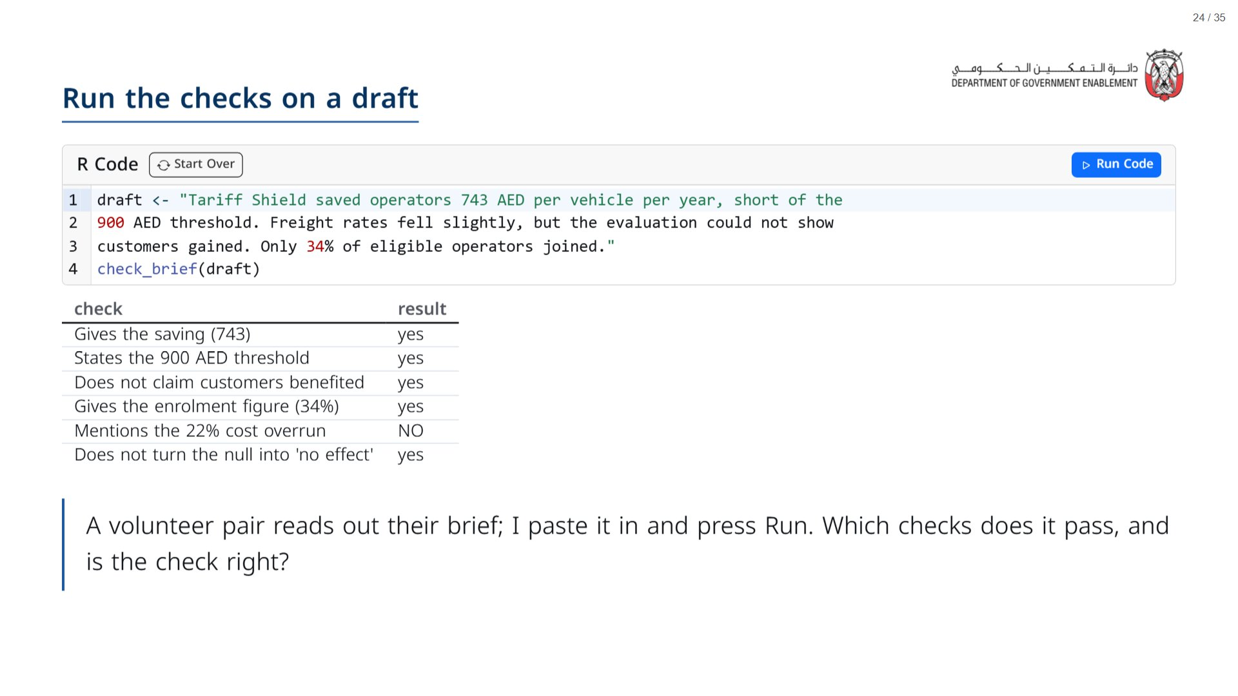
Notes:
The default draft passes five checks and misses the cost overrun, which is the point to draw out. The word search misreads some phrasing (for example “customers did not benefit” contains “customers benefit”): say so if it happens, and let the room judge.
span.MJX_Assistive_MathML {
position:absolute!important;
clip: rect(1px, 1px, 1px, 1px);
padding: 1px 0 0 0!important;
border: 0!important;
height: 1px!important;
width: 1px!important;
overflow: hidden!important;
display:block!important;
}

Slide 25
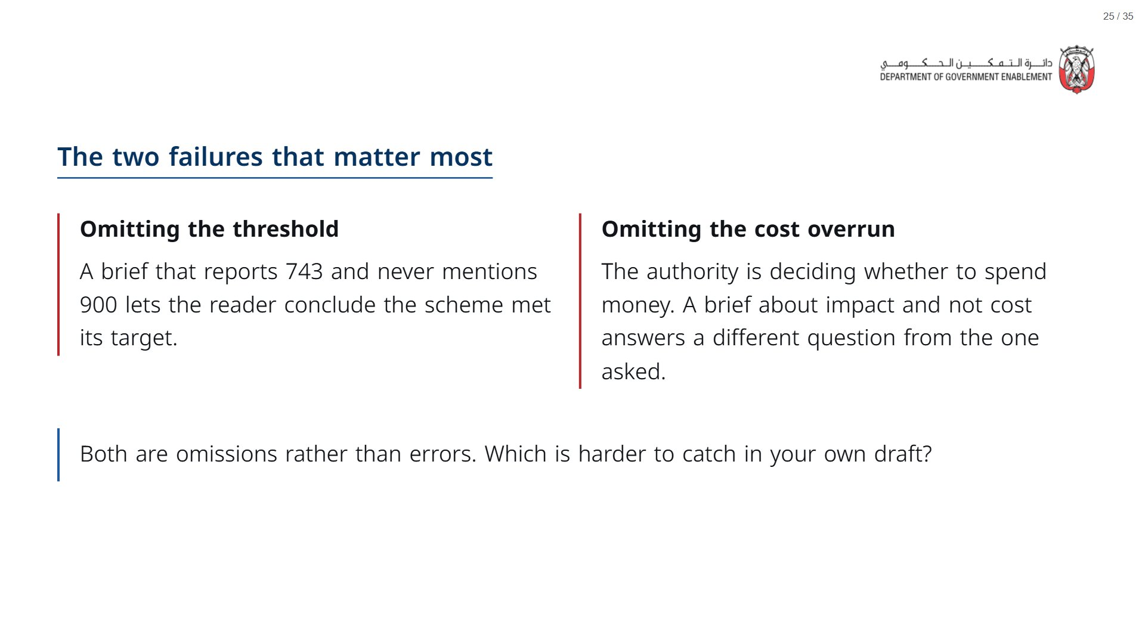

Slide 26
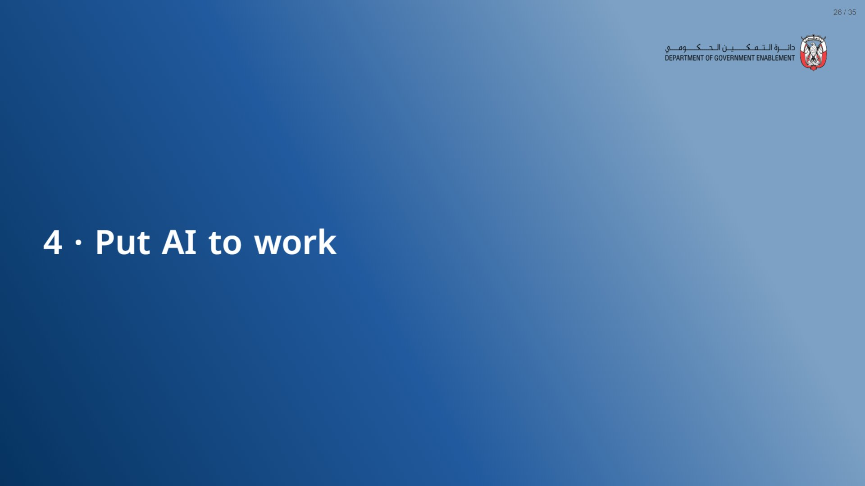

Slide 27
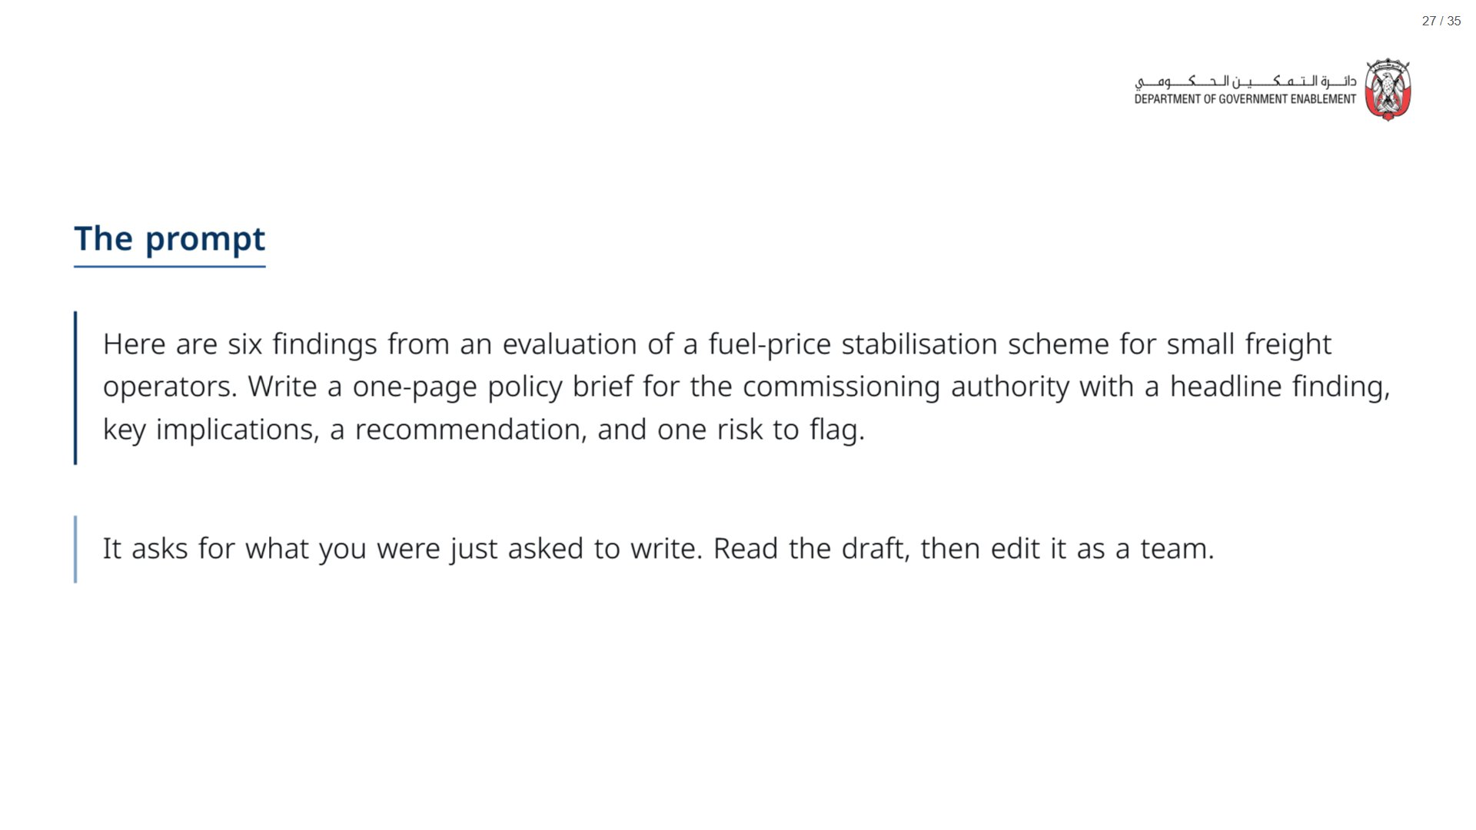

Slide 28
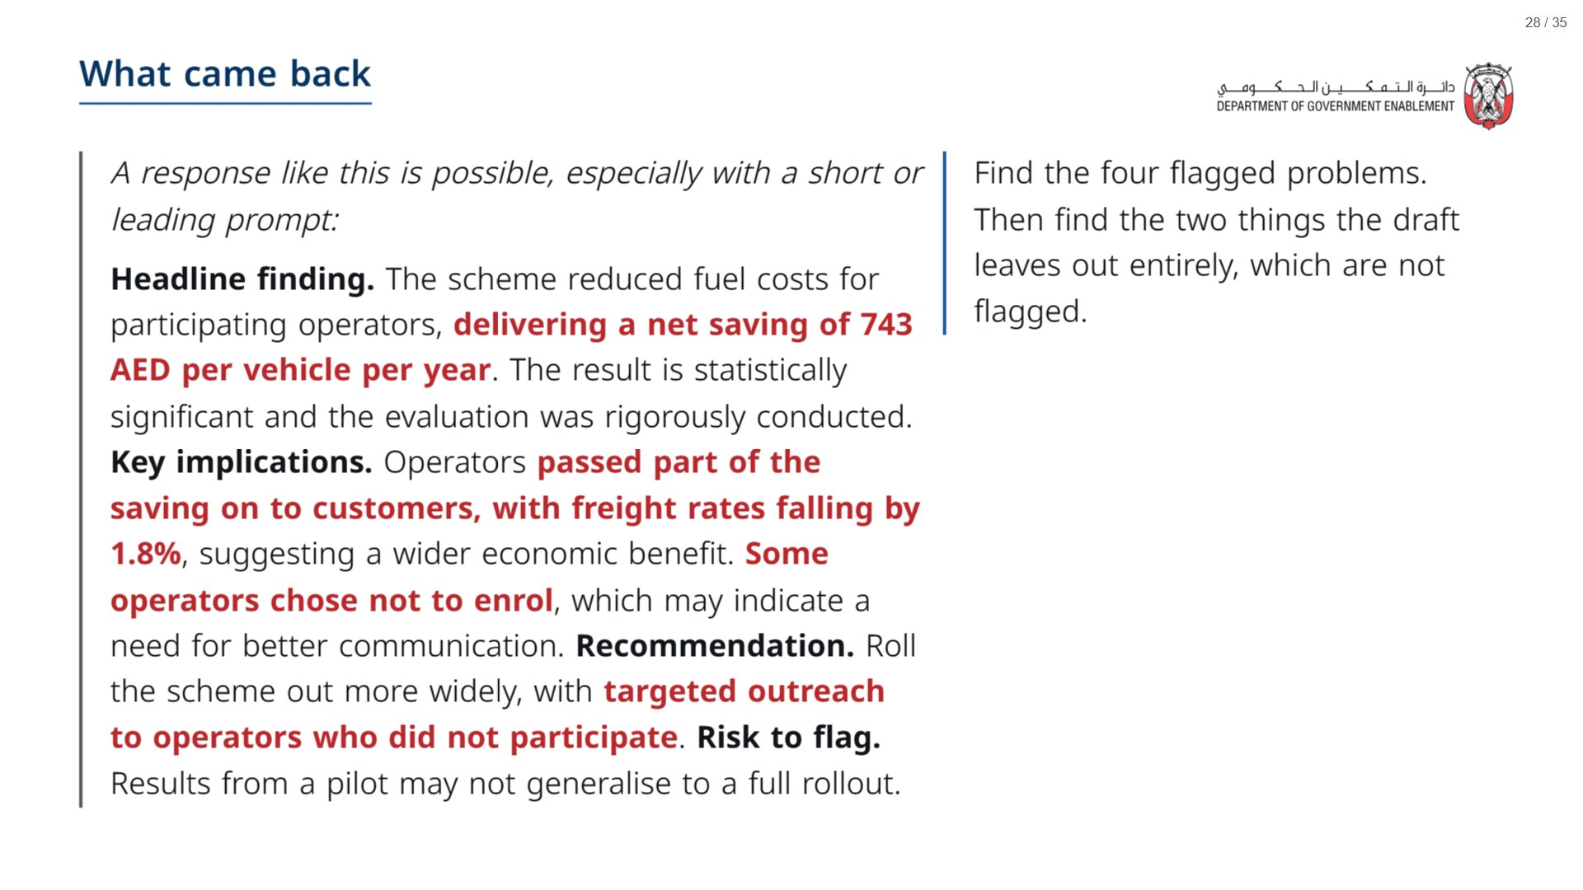
Notes:
Paper (Oct15_session2_materials.docx): Hand out the AI draft (pack page 2), one per group; they edit it on paper before you run the checker.
span.MJX_Assistive_MathML {
position:absolute!important;
clip: rect(1px, 1px, 1px, 1px);
padding: 1px 0 0 0!important;
border: 0!important;
height: 1px!important;
width: 1px!important;
overflow: hidden!important;
display:block!important;
}

Slide 29
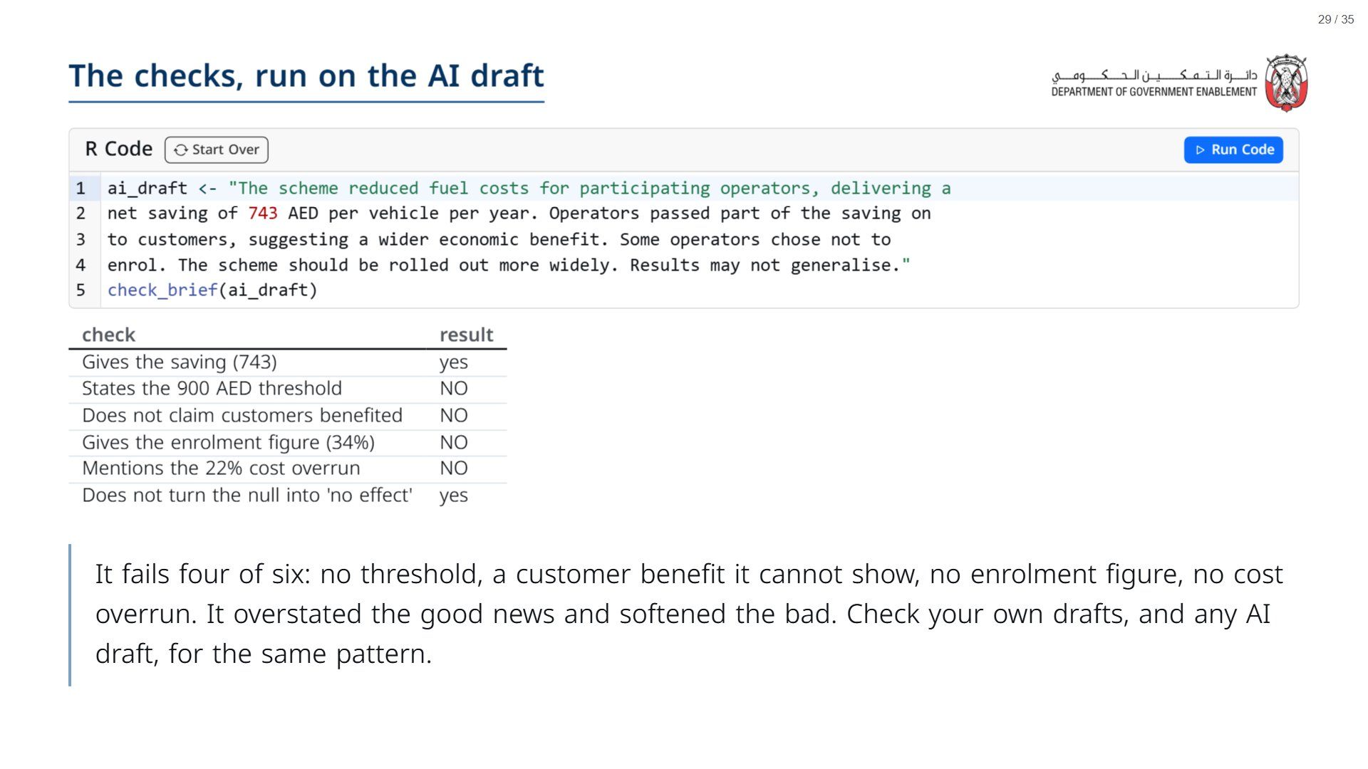

Slide 30
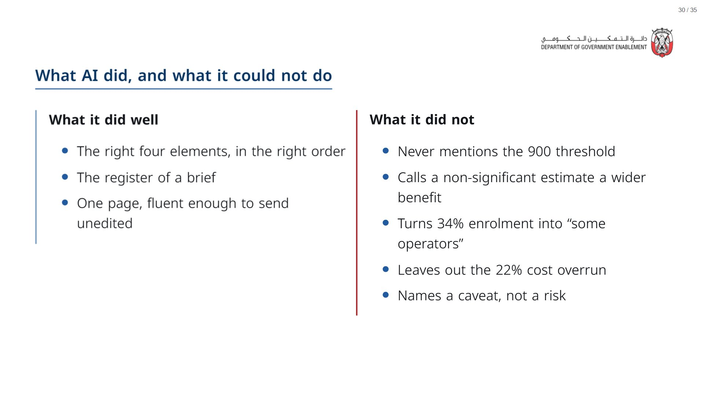

Slide 31
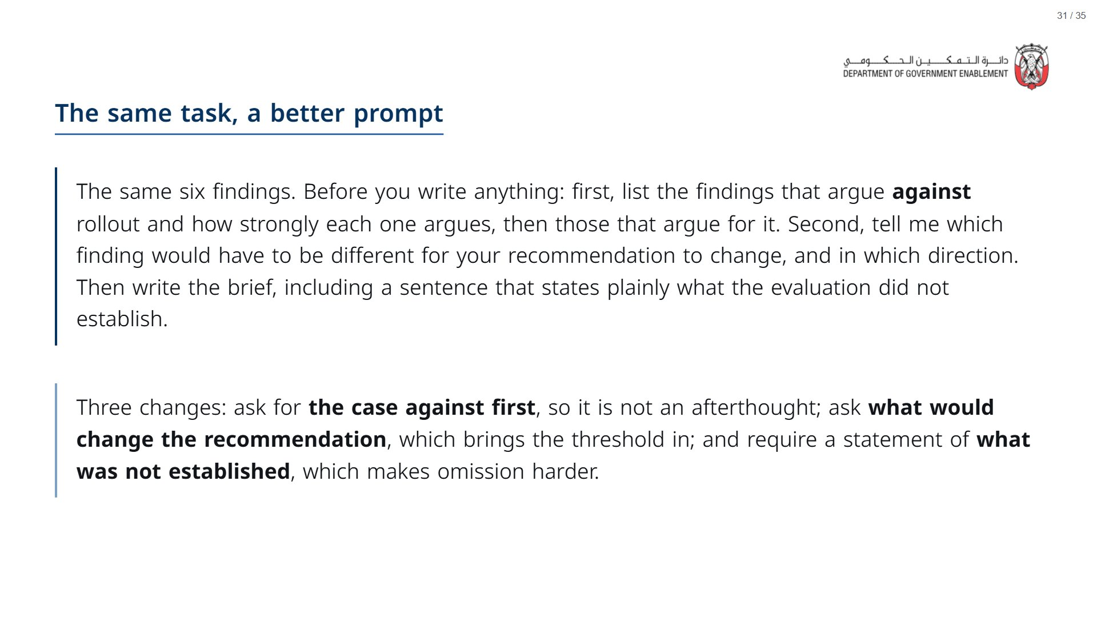

Slide 32


Slide 33
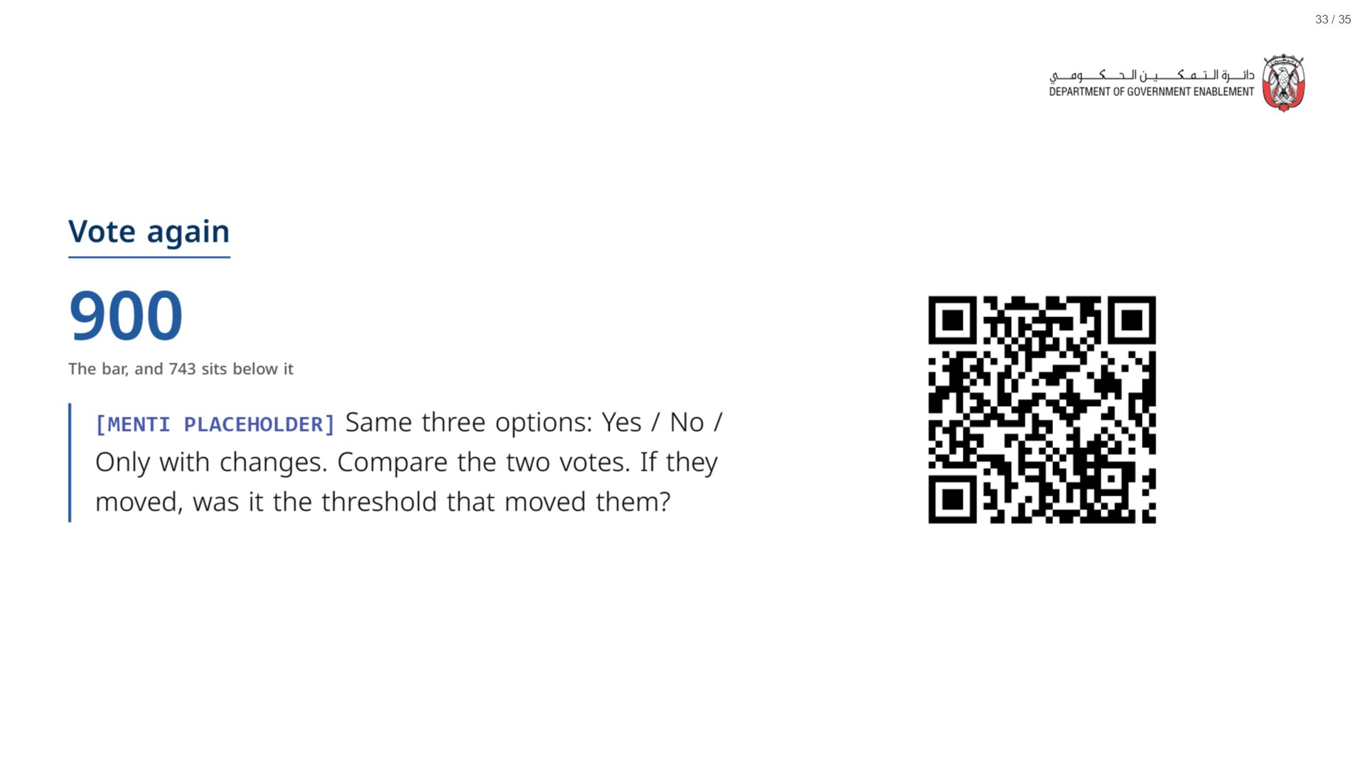

Slide 34
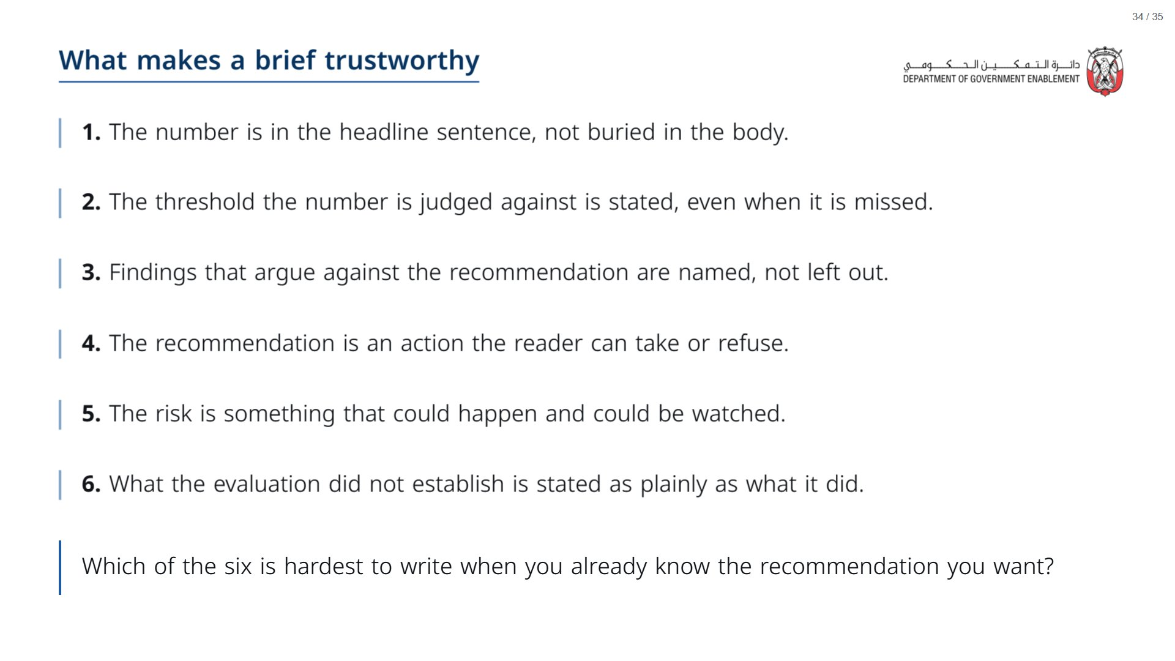
Notes:
Paper (Oct15_session2_materials.docx): Hand out the take-away cards (pack page 3). Give a minute to fill in “On my desk” on the card, then take two or three examples from the room.
span.MJX_Assistive_MathML {
position:absolute!important;
clip: rect(1px, 1px, 1px, 1px);
padding: 1px 0 0 0!important;
border: 0!important;
height: 1px!important;
width: 1px!important;
overflow: hidden!important;
display:block!important;
}

Slide 35
