Slide 1
Introduction to Impact Evaluation
Econometrics with R Dr. Lucas Sempé

Slide 2
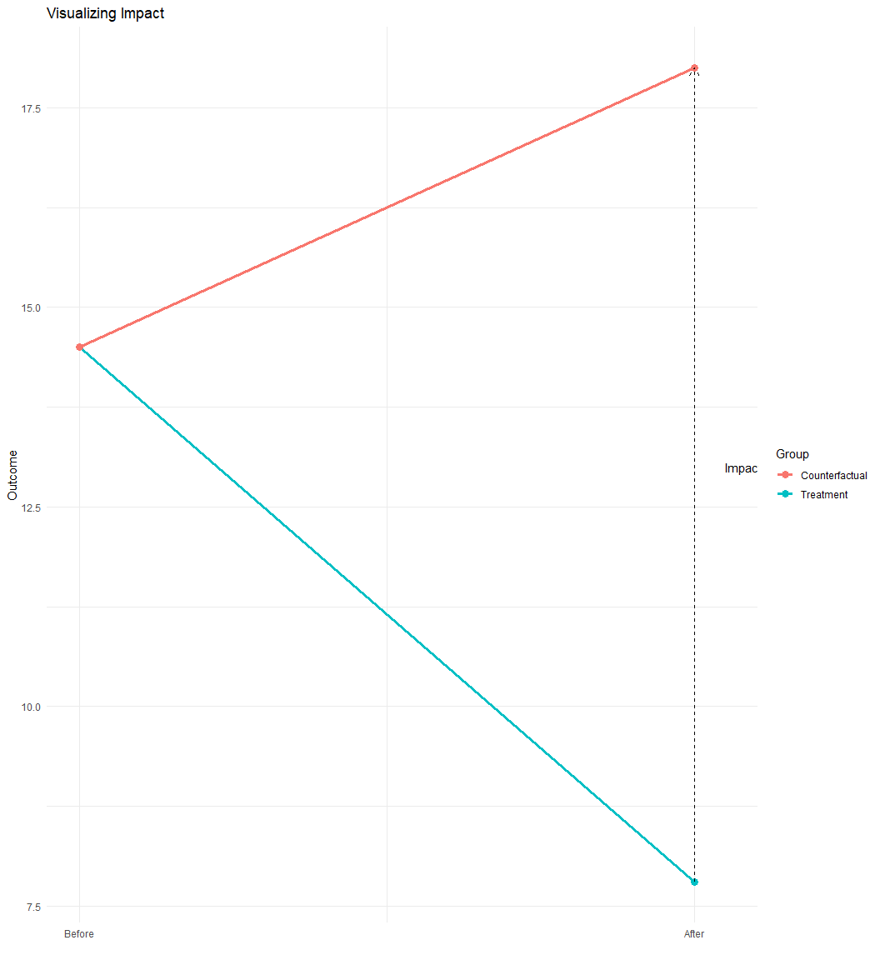
What is Impact Evaluation?
Objective: Measure causal effects of programs or policies
Challenge: Identifying what would have happened without the intervention
Counterfactual: The state of the world that would have occurred in absence of the intervention
Impact: The difference between the actual outcome and the counterfactual
Impact = Actual - Counterfactual

Slide 3
The Fundamental Problem of Causal Inference
We cannot observe the same unit in both treatment and control states simultaneously.
For each unit, we observe either:
The outcome with the intervention
The outcome without the intervention
The challenge: How do we estimate the counterfactual?

Slide 4
Example: Waste management system
Government program subsidizing waste management new technologies
Goal: Reduce waste management costs
Policy question: Should the program be scaled up nationally?
Decision criterion: Program must reduce waste management at least $10,000

Slide 5
Key Variables in Our Example Dataset
Outcome Variable:
waste_management_costs: Waste managament incurred monthly per industry (USD)
Treatment Variables:
treatment_zone: Area selected for program (0/1)
enrolled: Industry enrolled in program (0/1)
eligible: Industry eligible for program (0/1)
Other Variables:
round: Survey round (0=baseline, 1=follow-up)
efficiency_index: Score based on industry characteristics
Leadership Demographics: Age, education, gender, etc.
recycling_center_distance: Distance to nearest recycling centre

Slide 6
Overview of Impact Evaluation Methods
Experimental Methods:
Randomized assignment (gold standard)
Quasi-Experimental Methods:
Instrumental Variables
Regression Discontinuity
Difference-in-Differences
Matching Methods

Slide 7
Naive Approaches to Estimating Impact
Before-After Comparison
Compare outcomes of beneficiaries before and after the program
Problem: Cannot distinguish program effects from other changes over time
With-Without Comparison
Compare beneficiaries to non-beneficiaries
Problem: Selection bias if those who receive the program are systematically different

Slide 8
Before-After Comparison (Example)
# Let's start by uploading our data. # It is important to know in which folder your dataset is so you can use the right path. df <- read.csv("./evaluation_data.csv") # We multiply the outcome variable by 1,000 df$waste_management_costs<-df$waste_management_costs*1000
# Compare waste management costs before and after for enrolled industries m_ba1 <- lm_robust(waste_management_costs ~ round, clusters = zone_identifier, data = df %>% dplyr::filter(treatment_zone ==1 & enrolled ==1))
Problems:
External factors also change over time (e.g., economic conditions, other government programs)
Cannot attribute all changes to the program

Slide 9
With-Without Comparison (HISP Example)
# Compare enrolled vs. non-enrolled households after program implementation m_ba2 <- lm_robust(waste_management_costs ~ enrolled, clusters = zone_identifier, data = df %>% filter(treatment_zone==1 & round ==1))
Problems:
Selection bias: Enrolled industries differ from non-enrolled
Cannot attribute all differences to the program

Slide 10
Compare results
(Intercept) | 14489.694*** | 22304.911***
 | (145.961) | (337.418)
round | -6649.515***
 | (230.017)
enrolled |  | -14464.732***
 |  | (330.470)
Num.Obs. | 5929 | 4960
R2 | 0.211 | 0.327
p < 0.1, * p < 0.05, ** p < 0.01, *** p < 0.001

Slide 11
Course Outline
Introduction to Impact Evaluation ← You are here
Randomized Assignment
Instrumental Variables
Regression Discontinuity Designs
Difference-in-Differences
Matching Methods

Slide 12
Key Takeaways
Impact evaluation measures the causal effect of programs or policies
The central challenge is estimating the counterfactual
Naive before-after or with-without comparisons are susceptible to bias
Various experimental and quasi-experimental methods address these challenges
The example will illustrate these methods throughout the course

Slide 13
Next Session
Randomized Assignment: The gold standard for causal inference
How randomization creates comparable groups
Implementing and analyzing randomized evaluations
Interpreting results with confidence

