Slide 1
Matching Methods
Econometrics with R
Dr. Lucas Sempé

Slide 2
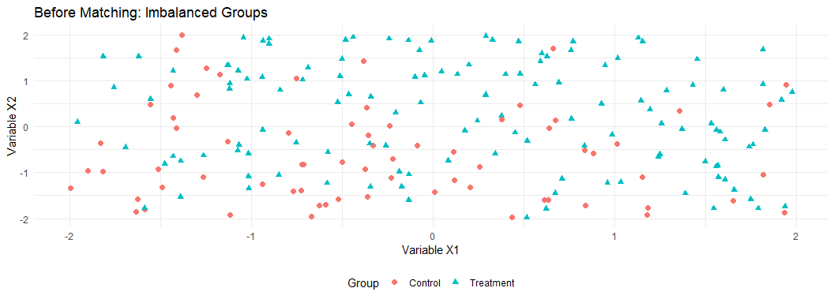
Matching Methods: Overview
Core idea: Create comparable treatment and control groups based on observable characteristics
Setting: When treatment assignment is related to observable factors
Advantage: Reduces selection bias from observable differences
Assumption: No unobserved differences affecting both treatment and outcomes
Types: Exact matching, propensity score matching, nearest neighbor, etc.

Slide 3
Why Matching?
Problem: Selection bias
Treatment group systematically differs from control group
Direct comparison leads to biased impact estimates
Solution: Matching
Select control units similar to treated units
Create balance on observable characteristics
Approximates an experimental setting

Slide 4
Preparing the Data
Converting from long to wide format:
# Create a wide-format dataset
df_w <- df %>%
# Then create wide format
pivot_wider(
id_cols = c(zone_identifier, facility_identifier, treatment_zone,
promotion_zone, eligible, enrolled, enrolled_rp),
names_from = round, # variable that determines new columns
# variables that should be made "wide"
values_from = c(waste_management_costs,
efficiency_index, age_manager, age_deputy,
educ_manager, educ_deputy, female_manager,
foreign_owned, staff_size, advanced_filtration,
water_treatment_system, facility_area,
recycling_center_distance, recycling_compliance)) %>%
# remove the industries that has missing values
# as missing values are not allowed when using matchit
filter(!is.na(waste_management_costs_0))
# Also check the first few rows to confirm format
head(select(df_w, facility_identifier, enrolled,
waste_management_costs_0, waste_management_costs_1))
# A tibble: 6 × 4
facility_identifier enrolled waste_management_costs_0 waste_management_costs_1
<int> <int> <dbl> <dbl>
1 5 1 1519. 1958.
2 11 1 1308. 240.
3 13 1 1529. 0
4 16 1 1131. 2003.
5 21 1 1122. 1666.
6 22 1 888. 11.6

Slide 5
Propensity Score Matching (PSM)
Propensity Score Matching (PSM) is when we predict the probability of each unit receiving treatment and then compare those with similar propensity scores. There are two scenarios for predicting enrollment:
Limited set of variables:
  Only age and education of facility manager
Full set of variables:
  All available baseline characteristics

Slide 6
Estimating Propensity Scores
# Limited set of variables
psm_r <- matchit(enrolled ~ age_manager_0 + educ_manager_0,
data = df_w %>% dplyr::select(-recycling_compliance_0,
-recycling_compliance_1),
distance = "glm",
link = "probit")
# Full set of variables
psm_ur <- matchit(enrolled ~ age_manager_0 + educ_manager_0 +
age_deputy_0 + educ_deputy_0 +
female_manager_0 + foreign_owned_0 + staff_size_0 +
advanced_filtration_0 + water_treatment_system_0 +
facility_area_0 + recycling_center_distance_0,
data = df_w %>% dplyr::select(-recycling_compliance_0,
-recycling_compliance_1),
distance = "glm",link = "probit")

Slide 7
Propensity Score Models
 | Limited Set | Full Set
Age (Manager) at Baseline | -0.021 | -0.013
 | (0.001) | (0.002)
Education (Manager) at Baseline | -0.041 | -0.022
 | (0.006) | (0.006)
Age (Deputy) at Baseline |  | -0.008
 |  | (0.002)
Education (Deputy) at Baseline |  | -0.016
 |  | (0.007)
Female Manager at Baseline |  | -0.020
 |  | (0.052)
Foreign Owned at Baseline |  | 0.161
 |  | (0.031)
Number of Staff at Baseline |  | 0.119
 |  | (0.007)
Advanced Filtration at Baseline |  | 0.376
 |  | (0.031)
Water Treatment System at Baseline |  | -0.125
 |  | (0.029)
Facility Area at Baseline |  | -0.028
 |  | (0.005)
Distance From Recycling Center |  | 0.002
 |  | (0.000)
Num.Obs. | 9913 | 9913
AIC | 11658.4 | 11037.0
BIC | 11680.0 | 11123.5
Log.Lik. | -5826.175 | -5506.520
F | 211.091 | 87.937
RMSE | 0.45 | 0.43
# Create a model summary table
modelsummary(list("Limited Set" = psm_r$model,
"Full Set" = psm_ur$model),
coef_map = c('age_manager_0' = "Age (Manager) at Baseline",
'educ_manager_0' = "Education (Manager) at Baseline",
'age_deputy_0' = "Age (Deputy) at Baseline",
'educ_deputy_0' = "Education (Deputy) at Baseline",
'female_manager_0' = "Female Manager at Baseline",
'foreign_owned_0' = "Foreign Owned at Baseline",
'staff_size_0' = "Number of Staff at Baseline",
'advanced_filtration_0' = "Advanced Filtration at Baseline",
'water_treatment_system_0' = "Water Treatment System at Baseline",
'facility_area_0' = "Facility Area at Baseline",
'recycling_center_distance_0' = "Distance From Recycling Center"),
title = "Estimating the Propensity Score Based on Baseline Characteristics")
Estimating the Propensity Score Based on Baseline Characteristics

Slide 8
Interpreting the Propensity Score Models
Which characteristics predict program enrollment?
Are facilities with certain characteristics more likely to enroll?
Does this align with program objectives?

Slide 9
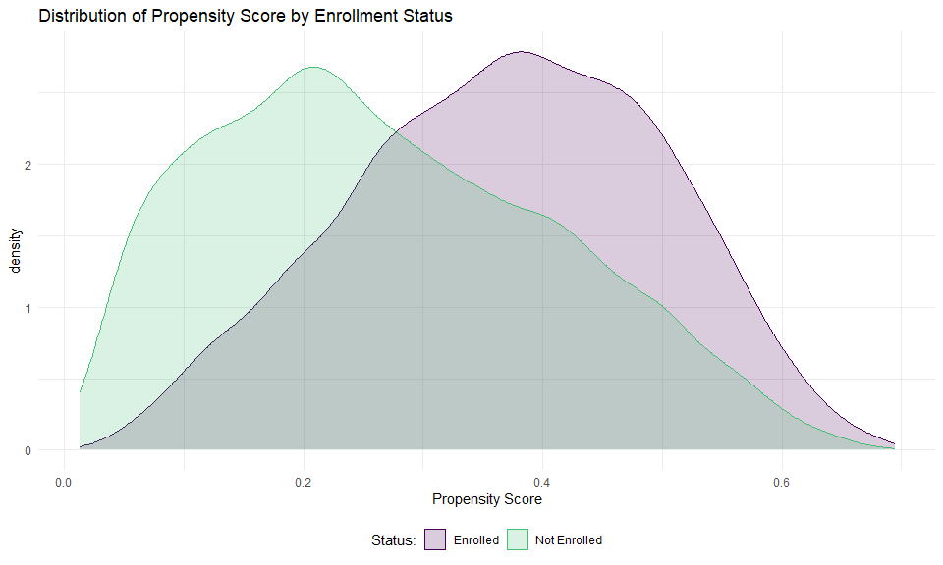
Checking Common Support
Let’s plot the distribution of propensity scores by enrollment status:
# Add propensity scores to our dataset
df_w <- df_w %>%
mutate(ps_ur = psm_ur$model$fitted.values)
# Plot the distribution
df_w %>%
mutate(enrolled_lab = ifelse(enrolled == 1, "Enrolled", "Not Enrolled")) %>%
ggplot(aes(x = ps_ur,
group = enrolled_lab, colour = enrolled_lab, fill = enrolled_lab)) +
geom_density(alpha = 0.2) +
xlab("Propensity Score") +
labs(title = "Distribution of Propensity Score by Enrollment Status") +
scale_fill_viridis_d("Status:", end = 0.7) +
scale_colour_viridis_d("Status:", end = 0.7) +
theme_minimal() +
theme(legend.position = "bottom")

Slide 10
What is Common Support?
Common support = overlap in propensity scores between groups
Essential for valid comparisons
Without common support, we can’t find comparable units

Slide 11
Checking Balance Before Matching
 | Means Treated | Means Control | Std. Mean Diff. | Var. Ratio | eCDF Mean | eCDF Max | Std. Pair Dist.
distance | 0.3694119 | 0.2683525 | 0.7780852 | 0.8189848 | 0.2003240 | 0.3118783 | NA
age_manager_0 | 41.6565796 | 48.1384372 | -0.4731180 | 0.7797904 | 0.0881294 | 0.2074113 | NA
educ_manager_0 | 2.9711803 | 2.7744736 | 0.0742925 | 0.8959873 | 0.0218441 | 0.0622731 | NA
age_deputy_0 | 36.8363698 | 41.6117427 | -0.4098452 | 0.8042407 | 0.0647834 | 0.2100395 | NA
educ_deputy_0 | 2.7032726 | 2.5810189 | 0.0494165 | 0.9256881 | 0.0141252 | 0.0689847 | NA
female_manager_0 | 0.0732119 | 0.1100878 | -0.1415669 | NA | 0.0368759 | 0.0368759 | NA
foreign_owned_0 | 0.4291498 | 0.3203339 | 0.2198503 | NA | 0.1088159 | 0.1088159 | NA
staff_size_0 | 5.7699055 | 4.9263203 | 0.4225943 | 0.8029708 | 0.0651539 | 0.1833283 | NA
advanced_filtration_0 | 0.7216599 | 0.5533170 | 0.3756130 | NA | 0.1683429 | 0.1683429 | NA
water_treatment_system_0 | 0.5735493 | 0.6340481 | -0.1223283 | NA | 0.0604988 | 0.0604988 | NA
facility_area_0 | 1.6771255 | 2.2511153 | -0.2172044 | 0.6390513 | 0.0240692 | 0.0881821 | NA
recycling_center_distance_0 | 109.2043122 | 103.6626222 | 0.1323667 | 0.9916816 | 0.0395806 | 0.0829805 | NA
kableExtra::kable(summary(psm_ur)$sum.all,
caption = "Balance Before Matching") %>%
kable_styling(font_size = 10)
Balance Before Matching

Slide 12
Checking Balance After Matching
 | Means Treated | Means Control | Std. Mean Diff. | Var. Ratio | eCDF Mean | eCDF Max | Std. Pair Dist.
distance | 0.3694119 | 0.3687162 | 0.0053561 | 1.0138523 | 0.0007394 | 0.0084345 | 0.0055861
age_manager_0 | 41.6565796 | 41.7867746 | -0.0095031 | 1.0867281 | 0.0114843 | 0.0381242 | 0.9086975
educ_manager_0 | 2.9711803 | 2.9549320 | 0.0061367 | 0.9271782 | 0.0094467 | 0.0239541 | 1.0892771
age_deputy_0 | 36.8363698 | 36.9915655 | -0.0133196 | 1.1143952 | 0.0104041 | 0.0371120 | 0.9332429
educ_deputy_0 | 2.7032726 | 2.7128880 | -0.0038867 | 0.8918377 | 0.0072981 | 0.0215924 | 1.0663763
female_manager_0 | 0.0732119 | 0.0732119 | 0.0000000 | NA | 0.0000000 | 0.0000000 | 0.1288799
foreign_owned_0 | 0.4291498 | 0.4234143 | 0.0115879 | NA | 0.0057355 | 0.0057355 | 0.9031755
staff_size_0 | 5.7699055 | 5.7884615 | -0.0092956 | 0.8691665 | 0.0105626 | 0.0229420 | 0.9946331
advanced_filtration_0 | 0.7216599 | 0.7253711 | -0.0082806 | NA | 0.0037112 | 0.0037112 | 0.6857819
water_treatment_system_0 | 0.5735493 | 0.5732119 | 0.0006822 | NA | 0.0003374 | 0.0003374 | 0.9816638
facility_area_0 | 1.6771255 | 1.7010796 | -0.0090645 | 1.0159498 | 0.0045968 | 0.0276653 | 0.8103167
recycling_center_distance_0 | 109.2043122 | 108.5100383 | 0.0165832 | 0.9993878 | 0.0104486 | 0.0485830 | 1.0886493
kableExtra::kable(summary(psm_ur)$sum.matched,
caption = "Balance After Matching") %>%
kable_styling(font_size = 10)
Balance After Matching

Slide 13
Understanding Balance
Mean Diff should be closer to zero after matching
Standardized mean differences (not shown) should be < 0.25
Good balance ensures we’re comparing similar facilities

Slide 14
Estimating Program Impact
First, extract the matched dataset:
# Extract matched datasets
match_df_r <- match.data(psm_r) # Limited set
match_df_ur <- match.data(psm_ur) # Full set

Slide 15
Regression with Matched Data
 | Limited Set | Full Set
(Intercept) | 1900.249 | 1784.038
 | (30.125) | (28.583)
enrolled | -1116.272 | -1000.061
 | (38.359) | (36.900)
Num.Obs. | 5928 | 5928
R2 | 0.300 | 0.280
R2 Adj. | 0.300 | 0.280
AIC | 96836.9 | 96118.5
BIC | 96857.0 | 96138.5
RMSE | 852.62 | 802.49
Std.Errors | by: zone_identifier | by: zone_identifier
# Regression with matched data
out_lm_r <- lm_robust(waste_management_costs_1 ~ enrolled,
data = match_df_r, weights = weights,
clusters = zone_identifier)
out_lm_ur <- lm_robust(waste_management_costs_1 ~ enrolled,
data = match_df_ur, weights = weights,
clusters = zone_identifier)
# Show results
modelsummary(list("Limited Set" = out_lm_r,
"Full Set" = out_lm_ur),
title = "Impact on Waste Management Costs: Matching Approach")
Impact on Waste Management Costs: Matching Approach

Slide 16
# # Simplified version
#
# library(tinytable)
#
# modelsummary(
# list("Limited Covs PSM" = out_lm_r, "All Covs PSM"= out_lm_ur),
# stars = TRUE,
# gof_map = c("nobs"),
# title = "Matching Regression Results",
# coef_map = c(
# "enrolled" = "Matching Effect",
# "(Intercept)" = "(Intercept)"
# ),
# coef_omit = NULL,
# notes = "Standard errors are in parenthesis",
# output = "tinytable"
# ) |>
# style_tt(bootstrap_class = "table caption-top")
# ## Output for case study
# library(flextable)
# library(officer)
#
# # Build the table as a flextable (editable in Word/PowerPoint)
# ft <- modelsummary(
# list("Limited Covs PSM" = out_lm_r, "All Covs PSM"= out_lm_ur),
# stars = TRUE,
# gof_map = c("nobs"),
# title = "Matching Regression Results",
# coef_map = c(
# "enrolled" = "Matching Effect",
# "(Intercept)" = "(Intercept)"
# ),
# notes = "Standard errors are in parentheses",
# fmt = 2,
# output = "flextable"
# )
#
# # let flextable size to content, then stretch to a target width
# ft <- autofit(ft)
# ft <- fit_to_width(ft, max_width = 9) # inches; ~content area on a PPT slide
# ft <- width(ft, j = 1, width = 2.5) # widen the left/stub column (adjust as needed)
#
# ## 1) Save to Word (.docx)
# doc <- read_docx()
# doc <- body_add_flextable(doc, ft)
# print(doc, target = "C:/Users/FionaKastel/OneDrive - 3ie/Documents/GitHub/R-course/sessions_in_Abu_Dhabi/case_study_outputs/session10_PSM.docx")

Slide 17
Matched Difference-in-Differences
Combine matching with difference-in-differences:
# Merge matching weights back into long format
df_long_match_r <- df %>%
left_join(match_df_r %>% dplyr::select(facility_identifier, weights)) %>%
filter(!is.na(weights))
df_long_match_ur <- df %>%
left_join(match_df_ur %>% dplyr::select(facility_identifier, weights)) %>%
filter(!is.na(weights))

Slide 18
Difference-in-Differences Results
 | Limited Set | Full Set
Enrollment | -144.185 | -54.474
 | (26.444) | (23.703)
Round | 307.094 | 280.594
 | (23.581) | (22.671)
Enrollment × Round | -972.086 | -945.587
 | (30.155) | (29.768)
Num.Obs. | 11856 | 11856
R2 | 0.260 | 0.240
R2 Adj. | 0.260 | 0.240
AIC | 188583.0 | 187359.8
BIC | 188619.9 | 187396.7
RMSE | 687.94 | 653.35
Std.Errors | by: zone_identifier | by: zone_identifier
# Run DiD regression
did_reg_r <- lm_robust(waste_management_costs ~ enrolled * round,
data = df_long_match_r, weights = weights,
clusters = zone_identifier)
did_reg_ur <- lm_robust(waste_management_costs ~ enrolled * round,
data = df_long_match_ur, weights = weights,
clusters = zone_identifier)
# Show results
modelsummary(list("Limited Set" = did_reg_r,
"Full Set" = did_reg_ur),
coef_map = c('enrolled' = "Enrollment",
'round' = "Round",
'enrolled:round' = "Enrollment × Round"),
title = "Impact on Waste Management Costs: Matched DiD Approach")
Impact on Waste Management Costs: Matched DiD Approach

Slide 19
Interpretation of Results
Enrolled coefficient: Baseline difference between groups
Round coefficient: Time trend for all facilities
Enrollment × Round: The program’s causal effect
Note
The interaction coefficient (Enrollment × Round) represents our estimate of the causal impact of the program on waste management costs.

Slide 20
Advantages of Matching
Reduces selection bias
Makes treatment and control groups comparable
Can combine with difference-in-differences for robust estimation
Works even without baseline randomization

Slide 21
Limitations of Matching
Only controls for observed variables
Cannot account for unobserved confounders
Requires good data on pre-treatment characteristics
Common support may be limited in some contexts

Slide 22
Summary
Propensity Score Matching helps create comparable groups
First estimate propensity scores based on baseline characteristics
Check for common support and balance after matching
Combine with regression or difference-in-differences to estimate impacts
Interpret results with appropriate caution about unobserved confounders

Slide 23
Resources for Further Learning
Ho, Imai, King, and Stuart (2007): “Matching as Nonparametric Preprocessing for Reducing Model Dependence in Parametric Causal Inference”
Stuart (2010): “Matching Methods for Causal Inference: A Review and a Look Forward”
The MatchIt package documentation: https://kosukeimai.github.io/MatchIt/
“Mastering Metrics” by Angrist and Pischke (Chapter 3)

Slide 24
Thank You!

