Slide 1
Introduction to Impact Evaluation
Econometrics with R
Dr. Lucas Sempé

Slide 2
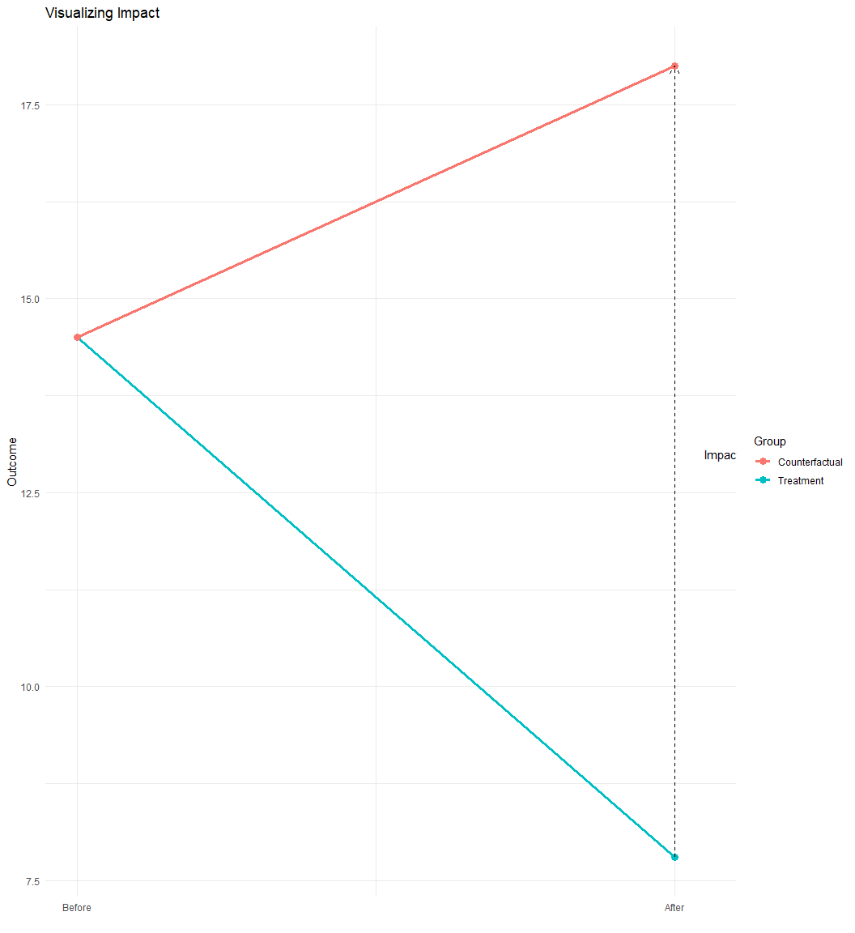
What is Impact Evaluation?
Objective: Measure causal effects of programs or policies
Challenge: Identifying what would have happened without the intervention
Counterfactual: The state of the world that would have occurred in absence of the intervention
Impact: The difference between the actual outcome and the counterfactual
Impact = Actual - Counterfactual

Slide 3
The Fundamental Problem of Causal Inference
We cannot observe the same unit in both treatment and control states simultaneously.
For each unit, we observe either:
  The outcome with the intervention
  The outcome without the intervention
The challenge: How do we estimate the counterfactual?

Slide 4
Example: Waste management system
Government program subsidizing innovative waste management technologies
Goal: Reduce waste management costs
Policy question: Should the program be scaled up nationally?
Decision criterion: Program must reduce waste management costs by at least 1,000 AED per year

Slide 5
Key Variables in Our Example Dataset
Outcome Variable:
waste_management_costs: Waste management costs incurred yearly per business (AED)
Treatment Variables:
treatment_zone: Area selected for program (0/1)
enrolled: Business offered the program (0/1)
eligible: Business eligible for the program (0/1)
Other Variables:
round: Survey round (0=baseline, 1=follow-up)
efficiency_index: Score based on industry characteristics
Leadership Demographics: Age, education, gender, etc.
recycling_center_distance: Distance to nearest recycling centre

Slide 6
Overview of Impact Evaluation Methods
Experimental Methods:
Randomized assignment (gold standard)
Quasi-Experimental Methods:
Instrumental Variables
Regression Discontinuity
Difference-in-Differences
Matching Methods

Slide 7
Naive Approaches to Estimating Impact
Before-After Comparison
  Compare outcomes of beneficiaries before and after the program
  Problem: Cannot distinguish program effects from other changes over time
With-Without Comparison
  Compare beneficiaries to non-beneficiaries
  Problem: Selection bias if those who receive the program are systematically different

Slide 8
Before-After Comparison (Example)
# Let's start by uploading our data.
# It is important to know in which folder your dataset is so you can use the right path.
df <- read.csv("./evaluation_data.csv")
# We multiply the outcome variable by 100
df$waste_management_costs<-df$waste_management_costs*100
# New data, with new variable names
# df <- read.csv("./evaluation_data_GreenWaste.csv")
# Compare waste management costs before and after for enrolled industries
# Fit a linear regression model using 'lm_robust' from the 'estimatr' package
# 'lm_robust' gives regression results with robust (heteroskedasticity-consistent) standard errors
# Formula: outcome variable ~ explanatory variable
# Clustered standard errors at the 'zone_identifier' level
# Filter df to only run the regression on industries in treatment zones AND enrolled
m_ba1 <- lm_robust(waste_management_costs ~ round,
clusters = zone_identifier,
data = df %>% dplyr::filter(treatment_zone ==1 & enrolled ==1))
Discussion
Is this effect due to the program? What are some other external factors that may cause a change in costs for waste management over time?
Problems:
External factors also change over time
Cannot attribute all changes to the program

Slide 9
With-Without Comparison (HISP Example)
# Compare enrolled vs. non-enrolled households after program implementation
# Use lm_robust as before, with clustered std errors
# This time, we filter df to run the regression on industries in treatment zones AND after the intervention, in the follow-up survey round
m_ba2 <- lm_robust(waste_management_costs ~ enrolled,
clusters = zone_identifier,
data = df %>% filter(treatment_zone==1 & round ==1))
Discussion
Are the enrolled industries the same as those that were not enrolled in the program? How might they be different from one another?
Problems:
Selection bias: Enrolled industries differ from non-enrolled
Cannot attribute all differences to the program

Slide 10
Compare results
 | Before-After | With-Without
(Intercept) | 1448.969*** | 2230.491***
 | (14.596) | (33.742)
round | -664.952***
 | (23.002)
enrolled |  | -1446.473***
 |  | (33.047)
Num.Obs. | 5929 | 4960
R2 | 0.211 | 0.327
p < 0.1, * p < 0.05, ** p < 0.01, *** p < 0.001

Slide 11
Conditions for Impact Evaluation
Condition | Description
Intervention | The project, program or policy which is the subject of the impact evaluation. Should be clearly defined, with a known start time and duration as well as clearly defined eligibility criteria.
Outcome(s) | One or more clearly defined, observable, and measurable outcomes of interest.
Problem Diagnosis | A proposed program or intervention should be developed based on a sound analysis of a particular social or development need and the binding constraints and root causes (i.e., to ensure the solution matches the problem).
Theory of Change | A sound, well-constructed theory of change explaining expected causal pathways linking inputs, outputs, and outcomes, including a description and key assumptions associated with each causal step.
Sufficient dose and duration | The intervention should be of a sufficient scope, scale, and duration to theoretically produce the intended effect within the time frame of observation.
Counterfactual | A clearly defined hypothetical counterfactual, operationalized using a credible identification strategy.
Data Quality | Reasonably accurate, complete data, with minimal or no systematic bias.
Data Sufficiency | Sufficient data to enable statistical comparison of outcomes between intervention and comparison groups.
There are certain practical considerations and conditions that need to be met in order to conduct an impact evaluation.
Conditions for a Credible Impact Evaluation

Slide 12
Course Outline
Introduction to Impact Evaluation ← You are here
Randomized Assignment
Instrumental Variables
Regression Discontinuity Designs
Difference-in-Differences
Matching Methods

Slide 13
Key Takeaways
Impact evaluation measures the causal effect of programs or policies
The central challenge is estimating the counterfactual
Naive before-after or with-without comparisons are susceptible to bias
Various experimental and quasi-experimental methods address these challenges
The example will illustrate these methods throughout the course

Slide 14
Next Session
Randomized Assignment: The gold standard for causal inference
How randomization creates comparable groups
Implementing and analyzing randomized evaluations
Interpreting results with confidence

