Slide 1
Randomized Assignment
Econometrics with R
Dr. Lucas Sempé

Slide 2
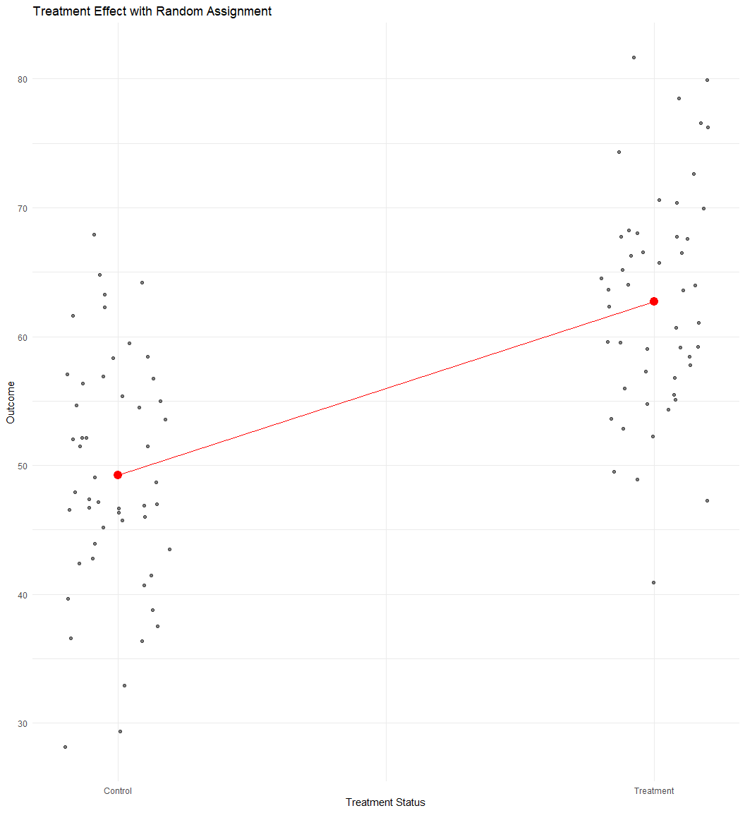
Randomized Assignment: The Gold Standard
Core idea: Randomly select who receives the treatment
Result: Treatment and control groups are statistically identical (in expectation)
Advantage: Differences in outcomes can be attributed to the program
Why it works: Randomization creates a valid counterfactual
Types: Encouragement, lottery, phase-in, etc.

Slide 3
Why Does Randomization Work? How Does it Create a Valid Counterfactual?
Let’s think through an example.
If we randomly choose two people from this room, they will likely have very different characteristics (observable ones such as age, sex, education, and unobservable ones such as innate abilities, motivation, ideas, etc.). They may not have anything in common at all. They would not make good counterfactuals for each other.
However, something different happens when we randomly choose large groups of people. If we were to randomly choose two groups of 1,000 people from across the country, with every person having an equal chance of being chosen, these groups will, on average, have statistically equivalent characteristics. If you remember from statistics class, a random sample represents the population from which it is drawn. Therefore, two large random samples will have statistically equivalent characteristics that represent the population from which they were drawn. We would expect these groups to have:
  Approximately the same average age, sex composition, average level of educational attainment, same average income
  And they will be approximately equal in characteristics we can’t directly observe or measure: approximately the same ability, the same motivation, etc.
Any slight differences will be statistically insignificant
In short: - If groups are big enough and random assignment is used, the groups will be equivalent on average, even on characteristics we cannot observe.

Slide 4
Implementing Randomized Assignment
Define population of eligible units
Decide on level of randomization (individuals, households, villages)
Determine sample size (power calculations)
Randomly select units to receive treatment
Verify balance between treatment and control groups
Implement program and collect data

Slide 5
Fictional Case Study: Randomized Industries
Program was implemented as a pilot in 100 industries randomly selected from all industries
100 additional randomly selected industries serve as controls
This design ensures that treatment and control industries are statistically identical
Only industries below certain degree of efficiency in treatment industries were eligible

Slide 6
Verifying Balance at Baseline
Results show most characteristics are balanced
Small differences in education of industry manager and distance to recycling centre
With many characteristics, some differences by chance are expected
# Check if treatment and control industries are balanced at baseline
# Step 1: Filter to only keep baseline (pre-intervention) observations
# Step 2: Select relevant baseline variables to test for balance
# Step 3: Reshape data to long format using pivot_longer() so that we have one row per variable per industry, keeping treatment assignment
# Step 4: Group by each baseline variable
# Step 5: For each variable, run a simple regression of the baseline variable on treat assignment
# Step 6: Only keep the coefficient for 'treatment_zone' since we are interested in differences between treatment and control
# Step 7: Select key results to display (variable name, estimated difference, standard error, and p-value)
df %>%
filter(round == 0) %>%
select(treatment_zone, age_manager, age_deputy,
educ_manager, educ_deputy,
female_manager, foreign_owned, staff_size,
advanced_filtration, water_treatment_system,
facility_area, recycling_center_distance) %>%
pivot_longer(-c("treatment_zone")) %>%
group_by(name) %>%
do(tidy(lm_robust(value ~ treatment_zone, data = .))) %>%
filter(term == "treatment_zone") %>%
select(name, estimate, std.error, p.value)
Variable | Diff Treat/Control | Std. Error | P-value
Advanced Filtration | -0.01 | 0.01 | 0.28
Deputy Age | -0.04 | 0.31 | 0.90
Manager Age | -0.64 | 0.38 | 0.09
Deputy Education | 0.03 | 0.07 | 0.67
Manager Education | 0.16 | 0.07 | 0.02
Business Area | -0.04 | 0.07 | 0.57
Female Manager | 0.00 | 0.01 | 0.56
Foreign Owned | 0.01 | 0.01 | 0.49
Distance from Nearest Recycling Center | 2.91 | 1.13 | 0.01
Staff Size | 0.06 | 0.05 | 0.26
Water Treatment System | 0.01 | 0.01 | 0.26
**Diff in Treat and Control Baseline Characteristics**

Slide 7
Estimating Program Impact: Simple Comparison of Means
# Compare waste expenditures in treatment and control industries at follow-up
# Regression at baseline: are waste expenditures different between treatment and control groups before intervention?
out_round0 <- lm_robust(waste_management_costs ~ treatment_zone,
data = df %>% filter(round == 0 & eligible ==1),
clusters = zone_identifier)
# Regression at follow-up: are waste expenditures different between treatment and control groups after intervention?
out_round1 <- lm_robust(waste_management_costs ~ treatment_zone,
data = df %>% filter(round == 1 & eligible ==1),
clusters = zone_identifier)
 | Round 0 | Round 1
(Intercept) | 1457.385*** | 1798.055***
 | (15.726) | (30.912)
treatment_zone | −8.415 | −1014.037***
 | (21.456) | (39.890)
Num.Obs. | 5628 | 5629
R2 | 0.000 | 0.300
R2 Adj. | −0.000 | 0.300
+ p < 0.1, * p < 0.05, ** p < 0.01, *** p < 0.001

Slide 8
Using Regression Analysis
# Compare waste expenditures in T and C industries at follow-up with additional covariates
out_round2 <- lm_robust(waste_management_costs ~ treatment_zone +
age_manager + age_deputy +
female_manager + foreign_owned +
staff_size +
advanced_filtration + facility_area +
recycling_center_distance,
data = df %>% filter(round == 1 & eligible ==1),
clusters = zone_identifier)
 | No covariate adj. | With covariate adj.
(Intercept) | 1798.055*** | 2722.356***
 | (30.912) | (70.976)
treatment_zone | −1014.037*** | −1001.150***
 | (39.890) | (34.588)
age_manager |  | 4.470**
 |  | (1.491)
age_deputy |  | 0.568
 |  | (1.656)
female_manager |  | 65.686
 |  | (45.064)
foreign_owned |  | −186.650***
 |  | (35.774)
staff_size |  | −159.393***
 |  | (6.565)
advanced_filtration |  | −184.731***
 |  | (27.952)
facility_area |  | 4.007
 |  | (3.836)
recycling_center_distance |  | −0.252
 |  | (0.426)
Num.Obs. | 5629 | 5629
R2 | 0.300 | 0.429
R2 Adj. | 0.300 | 0.428
+ p < 0.1, * p < 0.05, ** p < 0.01, *** p < 0.001

Slide 9
Why Covariates Don’t Change the Estimate Much
In randomized experiments:
Treatment assignment is independent of observed and unobserved characteristics
Control variables are uncorrelated with treatment status (in expectation)
Including controls may:
  Increase precision (reduce standard errors)
  Account for any chance imbalances
  But should not substantially change the point estimate

Slide 10
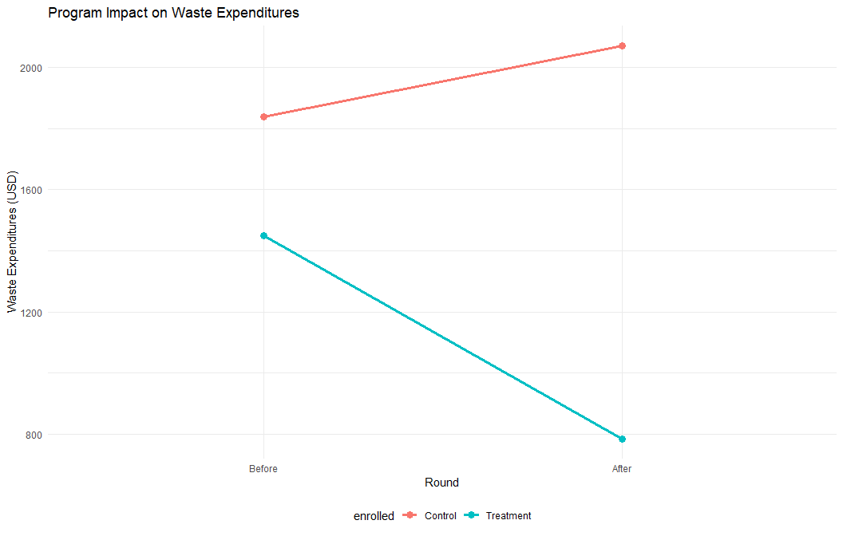
Visualizing the Results
# Step 1: Group the data by enrollment status (treatment vs. control) and round (before vs. after)
# Step 2: Relabel variables to make the plot labels easier to understand ("0" becomes "Control" or "Before", "1" becomes "Treatment" or "After")
# Step 3: Summarize the data by calculating the average waste management cost for each group and time period
# Step 4: Plot the average costs over time, drawing separate lines for treatment and control groups
#Step 5: Customize the plot with titles, axis labels, colors, and a clean minimal theme
df %>% group_by(enrolled, round) %>%
mutate(enrolled = recode(as.factor(enrolled), `0` = "Control", `1` = "Treatment"),
round = recode(as.factor(round), `0` = "Before", `1` = "After")) %>%
summarise(waste_management_costs = mean(waste_management_costs)) %>%
ggplot(aes(x = round, y = waste_management_costs, group = enrolled, color = enrolled)) +
geom_line(size = 1.2) + geom_point(size = 3) +
labs(title = "Program Impact on Waste Expenditures", x = "Round",
y = "Waste Expenditures (USD)") +
theme_minimal() + theme(legend.position = "bottom")

Slide 11
Strength of the Results
Internal validity: Strong - randomization ensures that the impact is attributable to the program
External validity: Limited to similar contexts
Precision: High - narrow confidence intervals
Policy relevance: Impact exceeds the 1,000 AED threshold

Slide 12
From Analysis to Policy Decision
Policy question: Should the Programe be scaled up nationally?
Decision criterion: Program must reduce waste expenditures by at least 1,000 AED.
Results from randomized evaluation:
Impact: -1,014 (95% CI: [-1,093, -935])
Exceeds threshold of 1,000 AED reduction
Recommendation: The program should be scaled up nationally.

Slide 13
Limitations of Randomized Assignment
Ethical concerns
  Denying benefits to control group
  Informed consent issues
Practical challenges
  Political constraints
  Implementation costs
  Scale vs. pilot differences
Technical issues
  Spillover effects
  Hawthorne effects
  Attrition and non-compliance
  External validity
Timing
  Long-term outcomes
  Delay in results for urgent policies

Slide 14
Types of Randomization
Different types of randomization can help address some of the ethical and practical challenges.
Lottery
  Use random number generator to select eligible units to receive treatment.
  Useful when there are insufficient resources to meet demand and is logistically simple.
  Some eligible units do not receive treatment (control).
Multiple Treatments
  Randomly assign units to different treatment arms.
  Useful when we are interested in the comparative effectiveness of different intervention approaches or methods of service delivery.
  Complex to implement and requires even larger sample.
Phase-in
  Randomly assign units to receive treatment at different times.
  Useful when we want all eligible units to receive treatment eventually, and can help us understand impact of program over time.
  Susceptible to anticipation bias.
Encouragement
  Treatment is randomly encouraged rather than assigned.
  Useful when we want all units to have the option to receive treatment, and can help us understand if encouragement mechanisms improve outcomes.
  Requires larger sample and assesses impact only for those that respond to encouragement.
  Instrumental variables, covered in the next session, is an example of this

Slide 15
When Randomization Isn’t Possible
When randomization is not feasible, we can use quasi-experimental methods:
Instrumental Variables: Using random encouragement
Regression Discontinuity: Exploiting eligibility thresholds
Difference-in-Differences: Comparing changes over time
Matching Methods: Creating comparable groups

Slide 16
Key Takeaways
Randomization creates comparable treatment and control groups
With randomization, differences in outcomes can be attributed to the program
Including covariates doesn’t substantially change estimates but can improve precision
The program reduces waste expenditures by 1,014 AED, exceeding the threshold
Based on the randomized evaluation, HISP should be scaled up nationally

Slide 17
Next Session
Instrumental Variables: Leveraging randomized promotion to evaluate programs with imperfect compliance

