Slide 1
Regression Discontinuity Design
Econometrics with R
Dr. Lucas Sempé

Slide 2
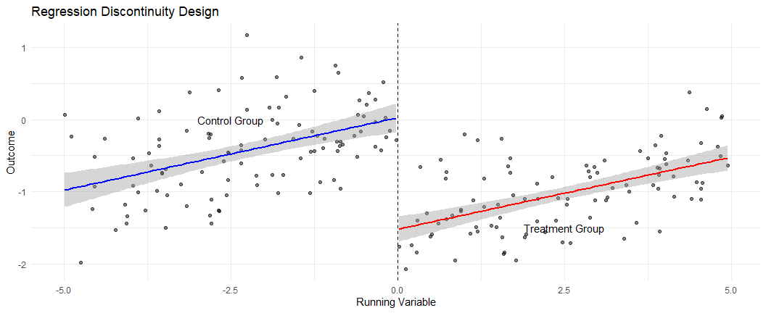
Regression Discontinuity Design: Overview
Core idea: Compare units just above and below an eligibility threshold
Setting: Assignment based on a continuous “running variable”
Advantage: Credible causal inference from non-experimental data
Assumption: Units close to threshold are similar across all characteristics (observable and un-observable) except for treatment status and this threshold cannot be manipulated by others and is not being used by other projects provided to the same group
Types: Sharp RDD (deterministic cutoff) vs. Fuzzy RDD (probabilistic cutoff)

Slide 3
Case: Efficiency Index Threshold
Program targets industries using a national efficiency index
Index assigns scores from 20 to 100 based on industry characteristics
Official efficiency line set at 58
Industries with score ≤ 58 are eligible for HISP
Only eligible industries in treatment zones enrolled

Slide 4
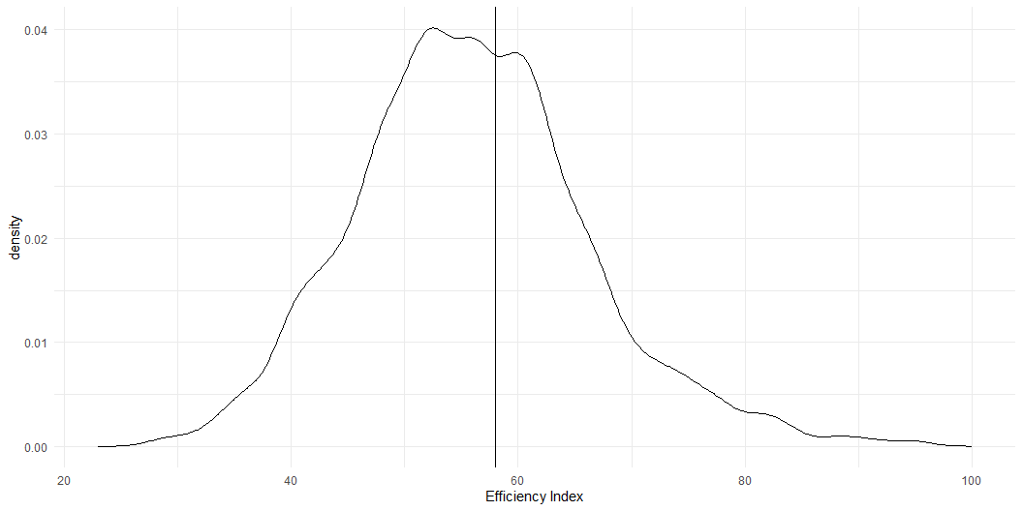
Checking for Manipulation
Before applying RDD, we must check for manipulation of the eligibility index:
# Plot density of efficiency index
ggplot(df_treat, aes(x = efficiency_index )) +
geom_vline(xintercept = 58) +
geom_density() +
labs(x = "Efficiency Index") + theme_minimal()

Slide 5
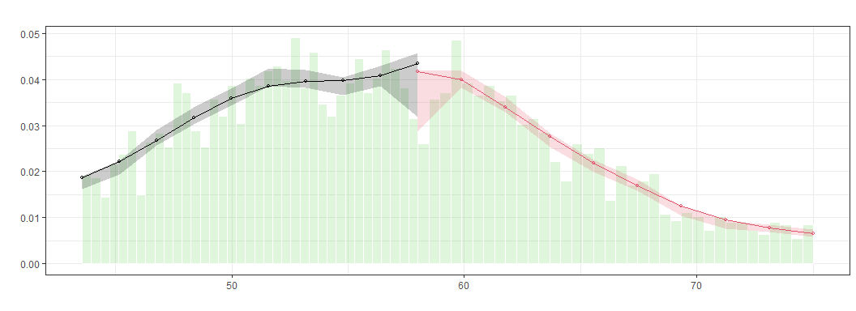
No evidence of “bunching” just below cutoff
Formal McCrary density test confirms
Households do not appear to manipulate their scores

Slide 6
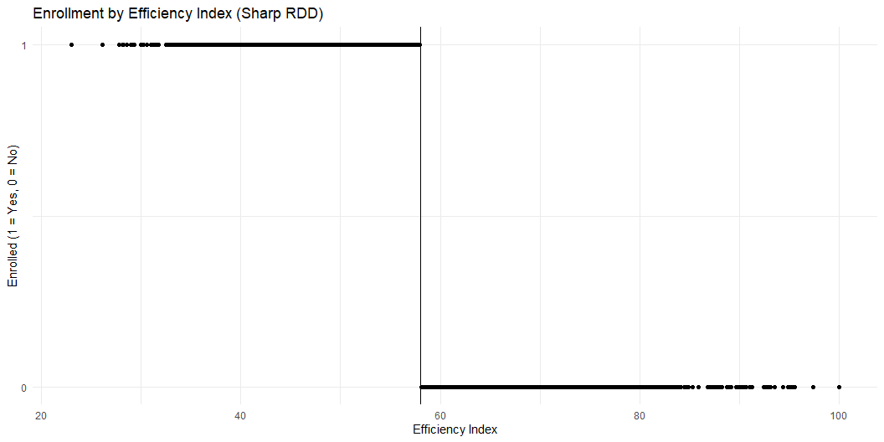
Verifying Compliance (Sharp RDD)
Perfect compliance with eligibility rules
All Industries with score ≤ 58 enrolled
No Industries with score > 58 enrolled
This is a “sharp” RDD with deterministic assignment
# Check if eligibility rules were followed
ggplot(df_treat, aes(y = enrolled, x = efficiency_index)) +
geom_vline(xintercept = 58) +
geom_point() +
labs(title = "Enrollment by Efficiency Index (Sharp RDD)",
x = "Efficiency Index",
y = "Enrolled (1 = Yes, 0 = No)") +
scale_y_continuous(breaks = c(0, 1)) +
theme_minimal()

Slide 7
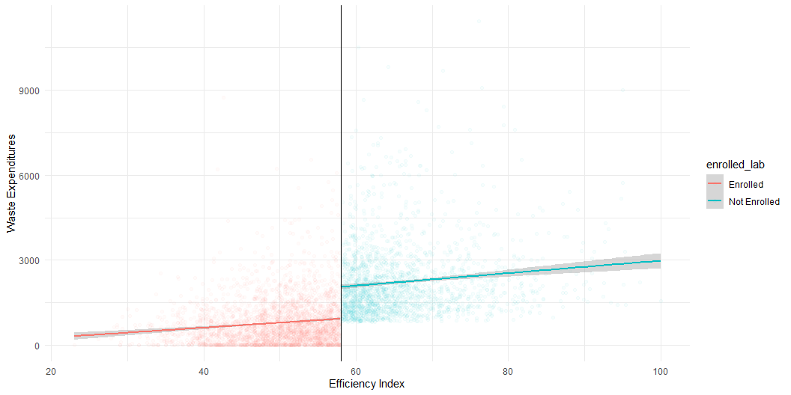
Visualizing the RDD Relationship
Clear discontinuity at cutoff (58)
Waste expenditures jump higher above the threshold
Linear relationship within each group
Visual evidence of program impact
# Plot relationship between efficiency index and waste expenditures
df_treat %>%
filter(round == 1) %>%
mutate(enrolled_lab = ifelse(enrolled == 1, "Enrolled", "Not Enrolled")) %>%
ggplot(aes(x = efficiency_index, y = waste_management_costs,
group = enrolled_lab, colour = enrolled_lab)) +
geom_point(alpha = 0.03) +
geom_smooth(method = "lm") +
geom_vline(xintercept = 58) +
labs(x = "Efficiency Index", y = "Waste Expenditures") + theme_minimal()

Slide 8
Estimating the RDD Impact
# Prepare data by centering the running variable
df_treat <- df_treat %>%
mutate(efficiency_index_c0 = efficiency_index - 58)
# Basic RDD regression with covariates
out_rdd <- lm_robust(waste_management_costs ~
efficiency_index_c0 * enrolled +
age_manager + age_deputy +
female_manager + foreign_owned +
staff_size +
advanced_filtration + facility_area +
recycling_center_distance,
data = df_treat %>% filter(round == 1))
 | Sharp RDD
enrolled | −905.137***
 | (44.375)
Num.Obs. | 4960
R2 | 0.457
R2 Adj. | 0.456
+ p < 0.1, * p < 0.05, ** p < 0.01, *** p < 0.001

Slide 9
Quadratic and polinomial models
In Regression Discontinuity Designs (RDD), the relationship between the running variable and the outcome might not be perfectly linear. To make sure the results are robust, we estimate:
A quadratic model (2nd degree polynomial) — allowing for a curved relationship.
A cubic model (3rd degree polynomial) — allowing for even more flexibility in curvature.
This helps test whether the RDD results are sensitive to how we model the relationship near the cutoff.

Slide 10
# Quadratic RDD model:
# Include efficiency_index_c0 and its square (efficiency_index_c0^2)
# Interact them with treatment (enrolled) to allow for different slopes
# and curves on each side of the cutoff
out_rdd_quadratic <- lm_robust(waste_management_costs ~
efficiency_index_c0 * enrolled +
enrolled * I(efficiency_index_c0^2) +
age_manager + age_deputy +
female_manager + foreign_owned +
staff_size +
advanced_filtration + facility_area +
recycling_center_distance,
data = df_treat %>% filter(round == 1))
# Cubic RDD model:
# Same as above, but also add a cubic (efficiency_index_c0^3) term
# for even more flexible modeling of the relationship
out_rdd_cubic <- lm_robust(waste_management_costs ~
efficiency_index_c0 * enrolled +
enrolled * I(efficiency_index_c0^2) +
enrolled * I(efficiency_index_c0^3) +
age_manager + age_deputy +
female_manager + foreign_owned +
staff_size +
advanced_filtration + facility_area +
recycling_center_distance,
data = df_treat %>% filter(round == 1))
 | Quadratic RDD | Cubic RDD
enrolled | −945.768*** | −893.428***
 | (60.990) | (75.703)
Num.Obs. | 4960 | 4960
R2 | 0.457 | 0.457
R2 Adj. | 0.456 | 0.456
+ p < 0.1, * p < 0.05, ** p < 0.01, *** p < 0.001

Slide 11
Robustness Checks for RDD
1. Bandwidth selection
# Restrict to observations near cutoff
out_rdd5 <- lm_robust(
waste_management_costs ~
enrolled * efficiency_index_c0 +
age_manager + age_deputy +
female_manager + foreign_owned +
staff_size +
advanced_filtration + facility_area +
recycling_center_distance,
data = df_treat %>%
filter(round == 1 &
abs(efficiency_index_c0) <= 53))
2. Placebo tests
Test for “effects” at fake cutoff points
Examine outcomes that shouldn’t be affected
 | Restricted RDD
enrolled | −905.137***
 | (44.375)
Num.Obs. | 4960
R2 | 0.457
R2 Adj. | 0.456
+ p < 0.1, * p < 0.05, ** p < 0.01, *** p < 0.001

Slide 12
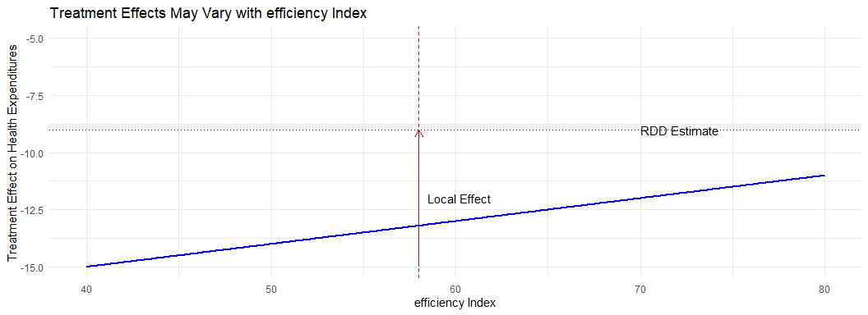
Local Treatment Effect in RDD
RDD estimates are local to the threshold
They represent the effect for industries with scores near 58
Industries at the margin of eligibility
Less representative of very low efficiency (low scores)
External validity depends on whether effects vary with efficiency level

Slide 13
RDD vs. Other Methods
RDD:
Effect: -905 AED
Local to cutoff
Uses eligibility threshold
Sharp discontinuity
Recommendation: Do not scale up
IV:
Effect: -1,033 AED
Effect on compliers
Uses randomized promotion
Fuzzy take-up
Recommendation: Scale up nationally

Slide 14
Why the differences?
Different populations (local vs. compliers vs. average)
Different estimation methods
Different precision levels

Slide 15
When to Use RDD
Use when:
Clear eligibility threshold exists
Running variable is continuous and measured precisely
Units cannot precisely manipulate their position around threshold
We have sufficient participants/units within the bandwidth that we set
Interest in effects for marginal participants
Common applications:
Test score cutoffs for educational programs
Income thresholds for social programs
Age eligibility for services
Geographic boundaries for policies

Slide 16
Implementing RDD in R
# Basic steps for RDD analysis
# Step 1: Check for manipulation
library(rddensity)
rdd_test <- rddensity(data$running_var, c = cutoff)
rdplotdensity(rdd_test, data$running_var)
# Step 2: Center the running variable
data$centered_var <- data$running_var - cutoff
# Step 3: Estimate RDD effect (parametric)
model <- lm_robust(
outcome ~ centered_var * treatment + controls,
data = data
)
# Step 4: Non-parametric approach
library(rdrobust)
rd_robust <- rdrobust(
y = data$outcome,
x = data$running_var,
c = cutoff
)

Slide 17
Common Pitfalls in RDD Analysis
Manipulation of the running variable
  Units strategically position themselves around threshold
  Check density for unusual bunching
Inappropriate bandwidth
  Too wide: Bias from including dissimilar units
  Too narrow: Imprecision from small sample
  Use data-driven bandwidth selection methods
Misspecification of functional form
  Linear may not capture true relationship
  Check robustness to different specifications
Multiple cutoffs or treatments
  Other policies may use the same threshold
  Separate effects of different treatments

Slide 18
From Analysis to Policy Decision
Policy question: Should the Program be scaled up nationally?
Decision criterion: Program must reduce waste expenditures by at least 1,000 AED.
Results from RDD estimation:
Effect: -905 AED (95% CI: [-818, -992])
Point estimate below the 1,000 AED threshold
Effect applies to industries near the efficiency threshold
Recommendation: Based on the RDD estimate, the program should not be scaled up nationally.

Slide 19
Key Takeaways
RDD exploits discontinuities at eligibility thresholds to estimate causal effects
Units just above and below the threshold are comparable except for treatment
RDD estimates are local to the cutoff and may not generalize to units far from threshold
Multiple specifications yield consistent estimates of approximately 905 AED reduction
RDD estimate is slightly below the 1,000 AED threshold for scaling up GreenWaste

Slide 20
Next Session
Difference-in-Differences: Comparing changes over time between treatment and comparison groups

