Slide 1
Matching Methods
Econometrics with R
Dr. Lucas Sempé

Slide 2
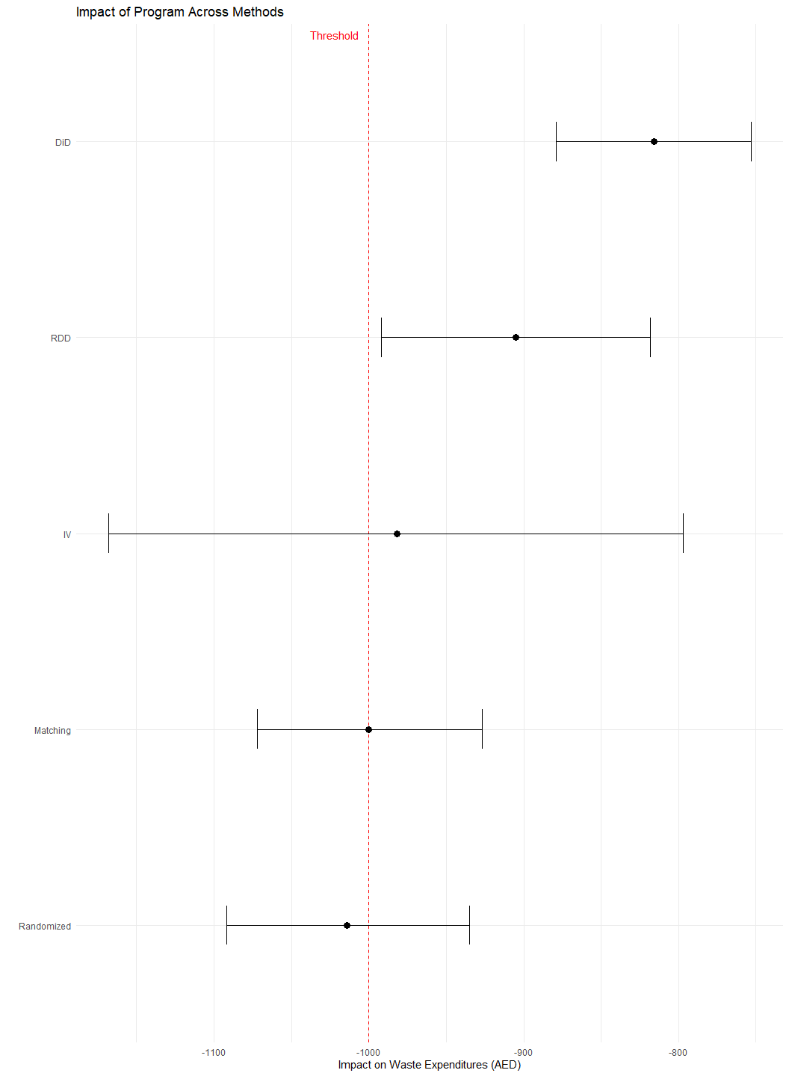
Recap: The Program Evaluation Challenge
Waste recycling Program subsidizes waste recycling plants for industries
Program goal: Reduce waste management costs
Decision criterion: Reduce expenditures by at least 1,000 AED
Evaluation approaches:
  ✅ Randomized Assignment
  ✅ Instrumental Variables
  ✅ Regression Discontinuity
  ✅ Difference-in-Differences
  ✅ Matching

Slide 3
Synthesis of Results Across Methods
Method | Estimate | 95% CI | Key Assumption | Population
Randomized Assignment | -1,014 | [-1,092, -935] | Random assignment | All eligible
Instrumental Variables | -982 | [-1,168, -797] | Exclusion restriction | Compliers
Regression Discontinuity | -905 | [-992, -818] | No manipulation at threshold | At threshold
Difference-in-Differences | -816 | [-879, -753] | Parallel trends | All enrolled
Matching (Full) | -1,000 | [-1,072, -927] | Selection on observables | Matched enrolled
Synthesis of Impact Evaluation Results

Slide 4
Differences in estimates reflect different methods and populations
Randomized assignment is the gold standard
Quasi-experimental methods provide valuable complementary evidence
Triangulation of methods strengthens overall conclusions

Slide 5
Explaining Differences in Results
Estimation Differences:
Different identification strategies
Different modeling approaches
Different standard errors
Population Differences:
RDD: Households near poverty threshold
IV: Compliers who respond to promotion
DiD/Matching: Enrolled households
Randomized: All eligible households
Treatment Effect Heterogeneity:
Impact may vary across different types of households
E.g., poorer households may benefit more
Methods capture effects for different subpopulations
Data and Implementation:
Sample restrictions
Variable inclusion
Specification choices

Slide 6
Understanding R Implementation Across Methods
Method | Key Functions | Key Packages | Data Structure
Randomized Assignment | lm_robust() | estimatr | Cross-sectional
Instrumental Variables | iv_robust() | estimatr, AER | Cross-sectional
Regression Discontinuity | lm_robust(), rdrobust() | estimatr, rdrobust | Cross-sectional
Difference-in-Differences | lm_robust(), feols() | estimatr, fixest, did | Panel/repeated cross-section
Matching | matchit(), lm_robust() | MatchIt, estimatr | Cross-sectional
R Implementation of Impact Evaluation Methods

Slide 7
Common infrastructure: tidyverse for data manipulation
Robust standard errors essential for all methods
Modern implementations leverage recent methodological advances
Fixed effects approaches common in many methods

Slide 8
Common Analytical Steps Across Methods
Data Preparation
  Identifying treatment and outcome variables
  Creating necessary indicators or transformations
  Handling missing data and outliers
Model Specification
  Choosing appropriate functional form
  Selecting control variables
  Determining clustering level for standard errors
Assumption Validation
  Testing method-specific assumptions
  Assessing threats to validity
  Examining balance or pre-trends
Robustness Checks
  Alternative specifications
  Placebo tests
  Subsample analysis
Interpretation
  Statistical vs. practical significance
  Population to which results apply
  Policy implications

Slide 9
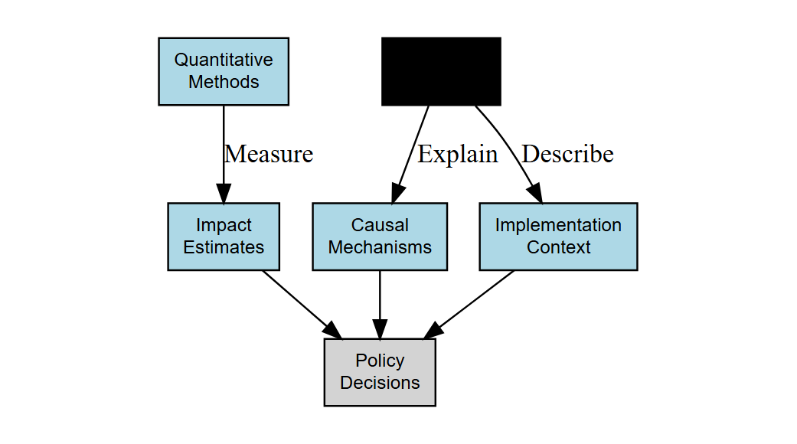
Integrating Qualitative and Quantitative Evidence
Beyond Impact Estimates:
Implementation context
Participant experiences
Unexpected outcomes
Mechanisms of impact
Mixed Methods Approach:
Impact evaluation: If it works
Process evaluation: How it works
Both needed for informed policy

Slide 10
Assessing External Validity
Will results generalize?
Sample vs. Population
  How representative is the evaluation sample?
  Which characteristics matter for generalizability?
Scale Effects
  Will effects change at larger scale?
  Are there general equilibrium effects?
Context Dependence
  Which contextual factors matter?
  How similar are implementation conditions?
Improving External Validity:
Stratified sampling designs
  Ensure representative samples
  Enable subgroup analysis
Multi-site trials
  Test in varied contexts
  Identify context dependencies
Structural modeling
  Explore mechanisms
  Simulate counterfactual scenarios
Meta-analysis
  Synthesize multiple studies
  Identify patterns across contexts

Slide 11
Cost-Effectiveness Analysis
Beyond impact: Is the program worth its cost?

Slide 12
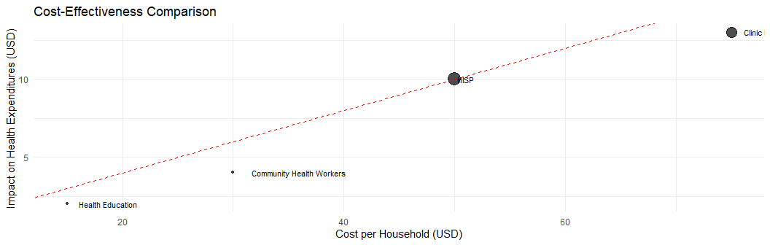
Steps in Cost-Effectiveness Analysis:
Calculate total program costs
  Implementation costs
  Administrative costs
  Opportunity costs
Express impact in standardized units
  Per beneficiary
  Per dollar spent
  Compared to alternatives
Comparing Interventions:

Slide 13
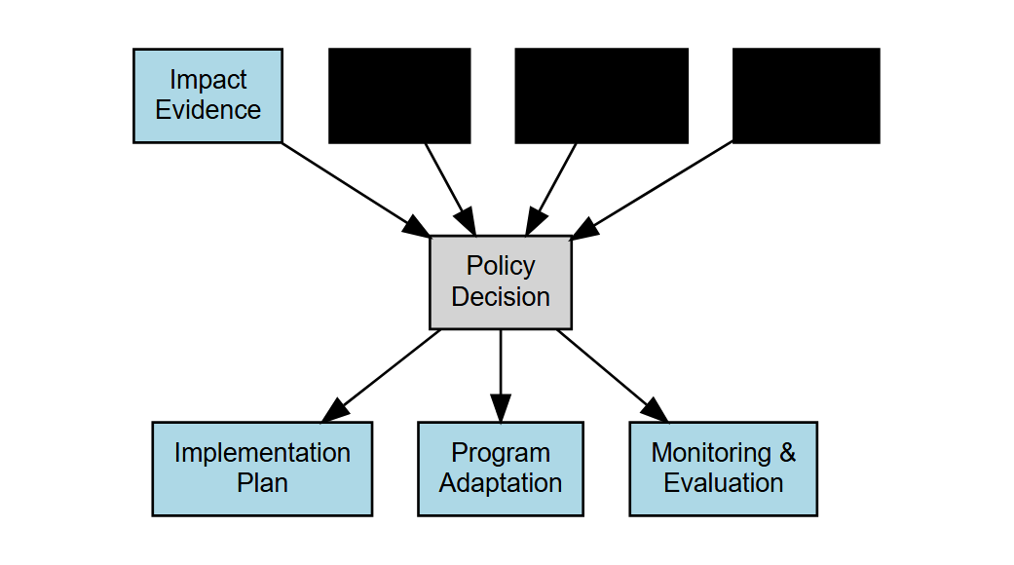
From Evidence to Policy Action
Policy Decision Making:
Statistical significance vs. practical significance
Weighing uncertain evidence
Value judgments: What outcomes matter?
Resource constraints and opportunity costs
Political feasibility
Implementation Considerations:
Design features to maintain or improve
Necessary adaptations for scale-up
Capacity requirements
Monitoring systems

Slide 14
Ethical Considerations in Impact Evaluation
Research Ethics:
Informed consent
Confidentiality and privacy
Equitable subject selection
IRB approval and oversight
Program Ethics:
Denying benefits to control group
Targeting most vulnerable
Balancing rigor with timely information
Transparency in findings
Ethical Frameworks:
Consequentialist
  Benefits outweigh harms
  Long-term social good
Rights-based
  Protection of individual rights
  Informed consent
  Equitable treatment
Virtue Ethics
  Researcher integrity
  Stakeholder engagement
  Responsible use of findings

Slide 15
Building an Impact Evaluation Mindset
Key principles for evaluation practitioners:
Counterfactual thinking
  Always ask: “Compared to what?”
  Identify appropriate comparison groups
Methodological pluralism
  Choose methods to fit the context
  Triangulate with multiple approaches
Assumption transparency
  Clarify what must be true for results to be valid
  Test assumptions where possible
Effect heterogeneity awareness
  Look beyond average effects
  Identify who benefits most/least
Implementation sensitivity
  Programs are complex interventions
  Context and implementation quality matter

Slide 16
R Skills for Impact Evaluation
Core Competencies:
Data manipulation with tidyverse
Regression analysis with estimatr
Data visualization with ggplot2
Reproducible workflows with R Markdown/Quarto
Method-Specific Packages:
MatchIt for matching
rdrobust for RDD
AER and ivpack for IV
did and fixest for DiD
Advanced Skills:
Power analysis with pwr
Robust standard errors with sandwich
Sensitivity analysis with sensemakr
Causal forests with grf
Synthetic control with Synth
Mediation analysis with mediation
Bayesian modeling with brms
Interactive apps with shiny

Slide 17
Resources for Further Learning
Books:
Gertler et al. “Impact Evaluation in Practice”
Angrist & Pischke “Mostly Harmless Econometrics”
Cunningham “Causal Inference: The Mixtape”
Huntington-Klein “The Effect”
Online Courses:
J-PAL’s “Evaluating Social Programs”
World Bank’s “Impact Evaluation Methods”
DataCamp’s “Causal Inference with R”
Websites & Communities:
3ie (International Initiative for Impact Evaluation)
J-PAL (Abdul Latif Jameel Poverty Action Lab)
World Bank DIME (Development Impact Evaluation)
R for Data Science Community
Stack Overflow for R questions
Journals:
Journal of Development Effectiveness
Journal of Policy Analysis and Management
American Economic Journal: Applied Economics

Slide 18
Course Summary
What we’ve learned:
Causal inference fundamentals
  The counterfactual framework
  Selection bias and confounding
  Experimental and quasi-experimental approaches
Method-specific knowledge
  When and how to apply each method
  Key assumptions and limitations
  Implementation in R
Practical skills
  Data preprocessing and analysis
  Results interpretation
  Policy recommendations

Slide 19
Thank You!
Questions for discussion:
How would you design the national scale-up of the Program?
What additional data would you collect during scale-up?
How would you evaluate the long-term impacts?
What complementary interventions might enhance the Program’s effects?
Contact information: - Email: lsempe@3ieimpact.org - Website: www.3ieimpact.org - GitHub: github.com/lsempe77

