Slide 1
Learning R
Session 1: Foundations of R Programming

Slide 2
Part A: Getting Started with R

Slide 3
Welcome to R!
R is a powerful programming language for:
Statistical computing
Data analysis
Data visualization
Machine learning

Slide 4
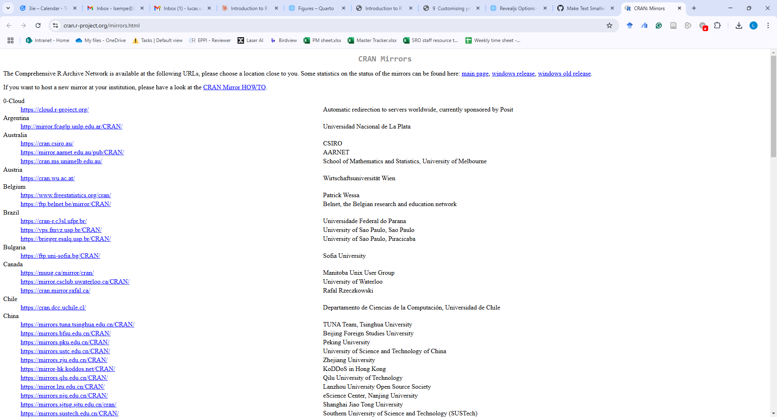
Let’s install R!

Slide 5
For downloading R: https://cran.r-project.org/mirrors.html

Slide 6
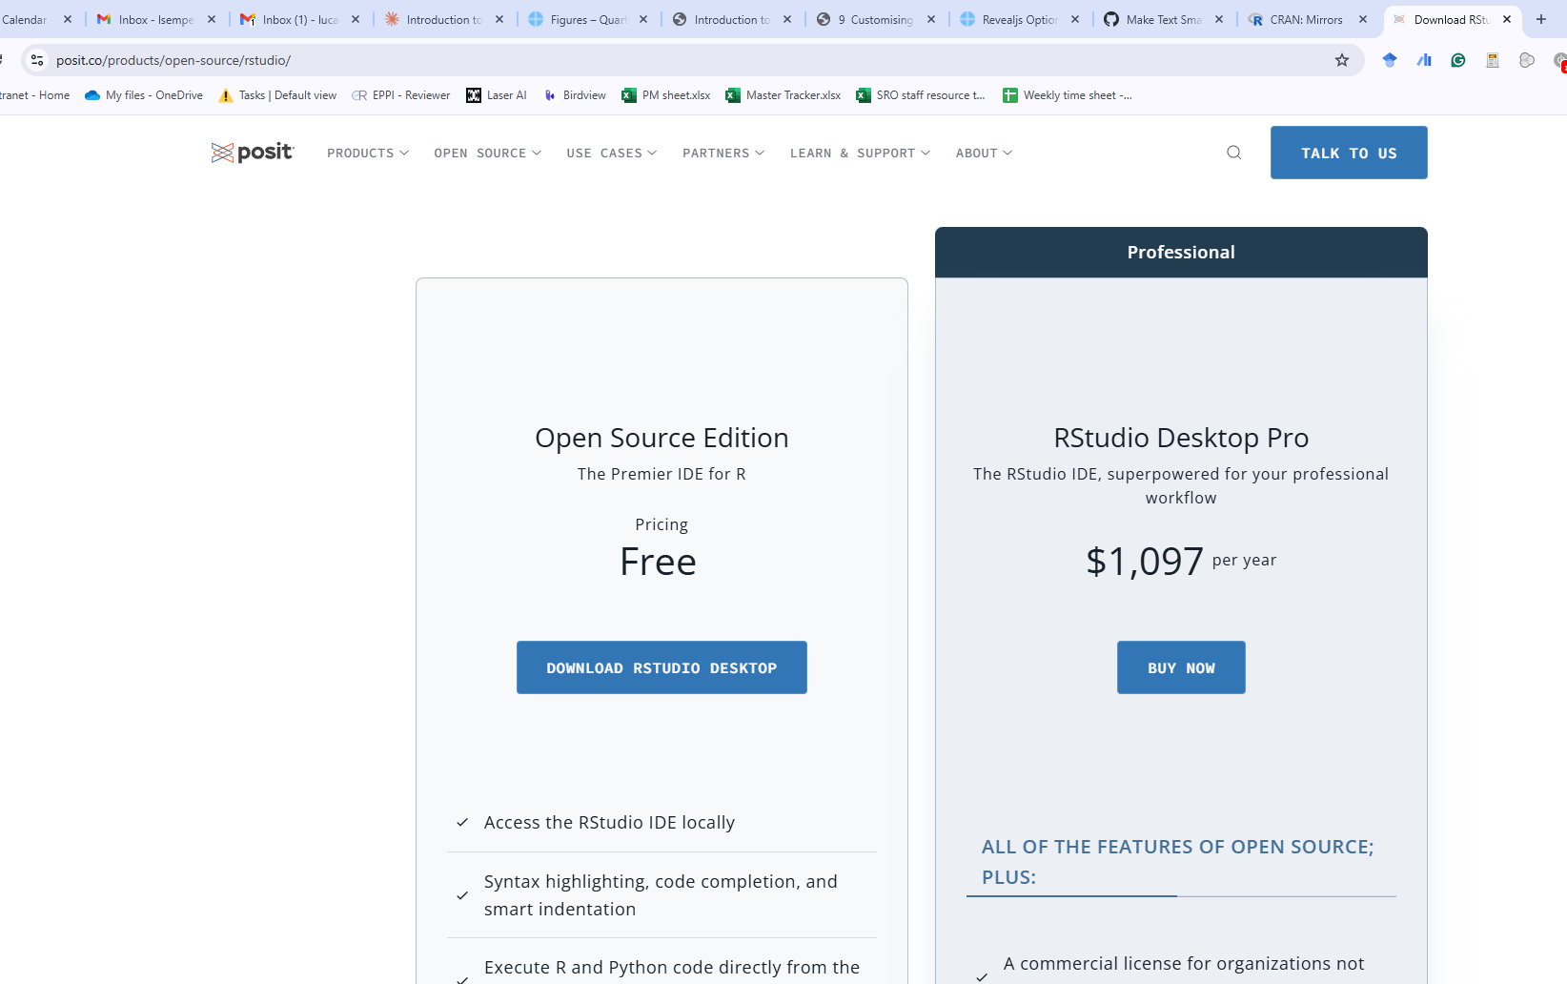
Let’s install R Studio!

Slide 7
For downloading R Studio: https://posit.co/products/open-source/rstudio/

Slide 8
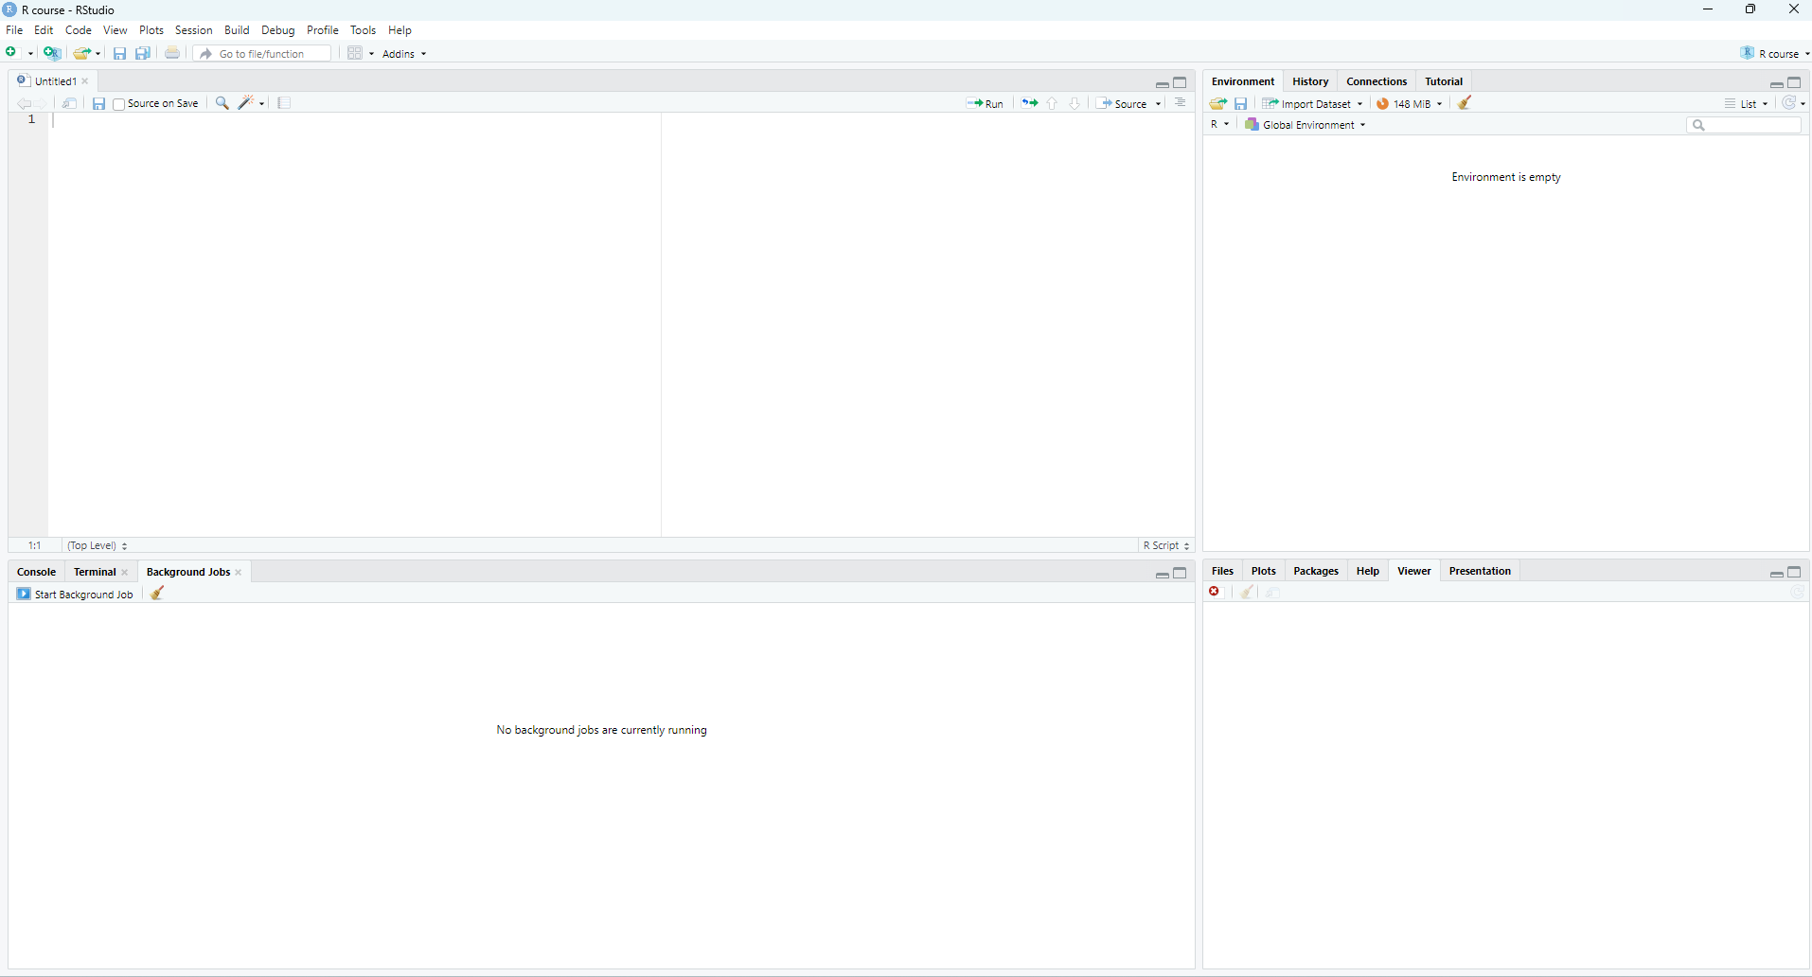
RStudio Interface

Slide 9
Script Editor (top-left)
Console (bottom-left)
Environment (top-right)
Files/Plots/Help (bottom-right)
See this video for a how to: R Studio

Slide 10
Creating Your First Project
File → New Project
Choose Directory Location
Name Your Project
Click “Create Project”
Tip
See this video for a how to: R Studio Project
Projects help organize your work and make it reproducible!

Slide 11
Data Types
Let’s understand data types:
Numeric
x <- 42 class(x)
[1] "numeric"
Character
name <- "UAE" class(name)
[1] "character"
Logical
is_fun <- TRUE class(is_fun)
[1] "logical"

Slide 12
🔨 Practice Time!
Try these exercises in your console:
Create a numeric variable called Time_to_travel_home with the time you spend travelling
Create a character variable Where_do_I_work
Create a logical variable Learning_impact_evaluation
Use class() to check their types

Slide 13
🔨 Results
Time_to_travel_home <- Where_do_I_work <- Learning_impact_evaluation <-
Warning
Watch out for this common mistakes!
Time to travel home <- 45 Where do I work == ADEO Learning-impact-evaluation <- TRUE

Slide 14
Part B: Working with Data

Slide 15
Vectors in R
Vectors are one-dimensional arrays:
# Creating vectors numbers <- c(1, 2, 3, 4, 5) gulf_countries <- c("UAE", "Saudi Arabia", "Oman") logical_values <- c(TRUE, FALSE, TRUE)
Important
Try this vector operations!
numbers + 2 numbers * 2 gulf_countries * 2

Slide 16
🔨 Practice Time: Vectors
Create these vectors and perform operations:
# Create a vector of 5 numbers numbers <- # Create a vector of 3 cities in UAE cities <- # Multiple your vector with numbers by 10

Slide 17
Built-in Functions (1)
R has many useful built-in functions:
# Statistical functions numbers <- c(1, 2, 3, 4, 5) mean(numbers)
[1] 3
sum(numbers)
[1] 15
max(numbers)
[1] 5
min(numbers)
[1] 1

Slide 18
Built-in Functions (2)
# Character functions text <- "United Arab Emirates" toupper(text)
[1] "UNITED ARAB EMIRATES"
nchar(text)
[1] 20

Slide 19
Getting Help in R
Three ways to get help:
Use ? before function name:
?mean
Use help():
help(sum)
Use examples:
example(max)

Slide 20
Installing Packages
Packages extend R’s functionality:
# Install a package install.packages("tidyverse") # Load a package library(tidyverse)
Warning
Run install.packages() once per computer Run library() in each new session

Slide 21
Part C: Working with Data Frames

Slide 22
Creating Data Frames
Data frames are 2-dimensional data structures:
# Create a simple data frame df <- data.frame( emirate = c("Abu Dhabi", "Dubai", "Ajman", "Fujairah","Sharjah","Ras Al Khaimah","Umm Al Quwain"), area = c(67340,259,4114,1450,1684,2590,720), international_airport = c(TRUE, TRUE, FALSE, TRUE, TRUE, FALSE, FALSE) )
Let’s see the dataframe:
# View the data frame df
emirate area international_airport 1 Abu Dhabi 67340 TRUE 2 Dubai 259 TRUE 3 Ajman 4114 FALSE 4 Fujairah 1450 TRUE 5 Sharjah 1684 TRUE 6 Ras Al Khaimah 2590 FALSE 7 Umm Al Quwain 720 FALSE

Slide 23
Reading Data into R
If we want to import real data:
# Read CSV file data <- read.csv("your_file.csv") # Read tab-delimited file data <- read.table("your_file.txt", header = TRUE, sep = "\t") # Read excel file library(readxl) data <- read_excel("your_file.xlsx")

Slide 24
🔨 Practice Time: Reading Data
Download and read the iris dataset:
# Built-in dataset data(iris) variable.names(iris)
[1] "Sepal.Length" "Sepal.Width" "Petal.Length" "Petal.Width" "Species"
iris
Sepal.Length Sepal.Width Petal.Length Petal.Width Species 1 5.1 3.5 1.4 0.2 setosa 2 4.9 3.0 1.4 0.2 setosa 3 4.7 3.2 1.3 0.2 setosa 4 4.6 3.1 1.5 0.2 setosa 5 5.0 3.6 1.4 0.2 setosa 6 5.4 3.9 1.7 0.4 setosa 7 4.6 3.4 1.4 0.3 setosa 8 5.0 3.4 1.5 0.2 setosa 9 4.4 2.9 1.4 0.2 setosa 10 4.9 3.1 1.5 0.1 setosa 11 5.4 3.7 1.5 0.2 setosa 12 4.8 3.4 1.6 0.2 setosa 13 4.8 3.0 1.4 0.1 setosa 14 4.3 3.0 1.1 0.1 setosa 15 5.8 4.0 1.2 0.2 setosa 16 5.7 4.4 1.5 0.4 setosa 17 5.4 3.9 1.3 0.4 setosa 18 5.1 3.5 1.4 0.3 setosa 19 5.7 3.8 1.7 0.3 setosa 20 5.1 3.8 1.5 0.3 setosa 21 5.4 3.4 1.7 0.2 setosa 22 5.1 3.7 1.5 0.4 setosa 23 4.6 3.6 1.0 0.2 setosa 24 5.1 3.3 1.7 0.5 setosa 25 4.8 3.4 1.9 0.2 setosa 26 5.0 3.0 1.6 0.2 setosa 27 5.0 3.4 1.6 0.4 setosa 28 5.2 3.5 1.5 0.2 setosa 29 5.2 3.4 1.4 0.2 setosa 30 4.7 3.2 1.6 0.2 setosa 31 4.8 3.1 1.6 0.2 setosa 32 5.4 3.4 1.5 0.4 setosa 33 5.2 4.1 1.5 0.1 setosa 34 5.5 4.2 1.4 0.2 setosa 35 4.9 3.1 1.5 0.2 setosa 36 5.0 3.2 1.2 0.2 setosa 37 5.5 3.5 1.3 0.2 setosa 38 4.9 3.6 1.4 0.1 setosa 39 4.4 3.0 1.3 0.2 setosa 40 5.1 3.4 1.5 0.2 setosa 41 5.0 3.5 1.3 0.3 setosa 42 4.5 2.3 1.3 0.3 setosa 43 4.4 3.2 1.3 0.2 setosa 44 5.0 3.5 1.6 0.6 setosa 45 5.1 3.8 1.9 0.4 setosa 46 4.8 3.0 1.4 0.3 setosa 47 5.1 3.8 1.6 0.2 setosa 48 4.6 3.2 1.4 0.2 setosa 49 5.3 3.7 1.5 0.2 setosa 50 5.0 3.3 1.4 0.2 setosa 51 7.0 3.2 4.7 1.4 versicolor 52 6.4 3.2 4.5 1.5 versicolor 53 6.9 3.1 4.9 1.5 versicolor 54 5.5 2.3 4.0 1.3 versicolor 55 6.5 2.8 4.6 1.5 versicolor 56 5.7 2.8 4.5 1.3 versicolor 57 6.3 3.3 4.7 1.6 versicolor 58 4.9 2.4 3.3 1.0 versicolor 59 6.6 2.9 4.6 1.3 versicolor 60 5.2 2.7 3.9 1.4 versicolor 61 5.0 2.0 3.5 1.0 versicolor 62 5.9 3.0 4.2 1.5 versicolor 63 6.0 2.2 4.0 1.0 versicolor 64 6.1 2.9 4.7 1.4 versicolor 65 5.6 2.9 3.6 1.3 versicolor 66 6.7 3.1 4.4 1.4 versicolor 67 5.6 3.0 4.5 1.5 versicolor 68 5.8 2.7 4.1 1.0 versicolor 69 6.2 2.2 4.5 1.5 versicolor 70 5.6 2.5 3.9 1.1 versicolor 71 5.9 3.2 4.8 1.8 versicolor 72 6.1 2.8 4.0 1.3 versicolor 73 6.3 2.5 4.9 1.5 versicolor 74 6.1 2.8 4.7 1.2 versicolor 75 6.4 2.9 4.3 1.3 versicolor 76 6.6 3.0 4.4 1.4 versicolor 77 6.8 2.8 4.8 1.4 versicolor 78 6.7 3.0 5.0 1.7 versicolor 79 6.0 2.9 4.5 1.5 versicolor 80 5.7 2.6 3.5 1.0 versicolor 81 5.5 2.4 3.8 1.1 versicolor 82 5.5 2.4 3.7 1.0 versicolor 83 5.8 2.7 3.9 1.2 versicolor 84 6.0 2.7 5.1 1.6 versicolor 85 5.4 3.0 4.5 1.5 versicolor 86 6.0 3.4 4.5 1.6 versicolor 87 6.7 3.1 4.7 1.5 versicolor 88 6.3 2.3 4.4 1.3 versicolor 89 5.6 3.0 4.1 1.3 versicolor 90 5.5 2.5 4.0 1.3 versicolor 91 5.5 2.6 4.4 1.2 versicolor 92 6.1 3.0 4.6 1.4 versicolor 93 5.8 2.6 4.0 1.2 versicolor 94 5.0 2.3 3.3 1.0 versicolor 95 5.6 2.7 4.2 1.3 versicolor 96 5.7 3.0 4.2 1.2 versicolor 97 5.7 2.9 4.2 1.3 versicolor 98 6.2 2.9 4.3 1.3 versicolor 99 5.1 2.5 3.0 1.1 versicolor 100 5.7 2.8 4.1 1.3 versicolor 101 6.3 3.3 6.0 2.5 virginica 102 5.8 2.7 5.1 1.9 virginica 103 7.1 3.0 5.9 2.1 virginica 104 6.3 2.9 5.6 1.8 virginica 105 6.5 3.0 5.8 2.2 virginica 106 7.6 3.0 6.6 2.1 virginica 107 4.9 2.5 4.5 1.7 virginica 108 7.3 2.9 6.3 1.8 virginica 109 6.7 2.5 5.8 1.8 virginica 110 7.2 3.6 6.1 2.5 virginica 111 6.5 3.2 5.1 2.0 virginica 112 6.4 2.7 5.3 1.9 virginica 113 6.8 3.0 5.5 2.1 virginica 114 5.7 2.5 5.0 2.0 virginica 115 5.8 2.8 5.1 2.4 virginica 116 6.4 3.2 5.3 2.3 virginica 117 6.5 3.0 5.5 1.8 virginica 118 7.7 3.8 6.7 2.2 virginica 119 7.7 2.6 6.9 2.3 virginica 120 6.0 2.2 5.0 1.5 virginica 121 6.9 3.2 5.7 2.3 virginica 122 5.6 2.8 4.9 2.0 virginica 123 7.7 2.8 6.7 2.0 virginica 124 6.3 2.7 4.9 1.8 virginica 125 6.7 3.3 5.7 2.1 virginica 126 7.2 3.2 6.0 1.8 virginica 127 6.2 2.8 4.8 1.8 virginica 128 6.1 3.0 4.9 1.8 virginica 129 6.4 2.8 5.6 2.1 virginica 130 7.2 3.0 5.8 1.6 virginica 131 7.4 2.8 6.1 1.9 virginica 132 7.9 3.8 6.4 2.0 virginica 133 6.4 2.8 5.6 2.2 virginica 134 6.3 2.8 5.1 1.5 virginica 135 6.1 2.6 5.6 1.4 virginica 136 7.7 3.0 6.1 2.3 virginica 137 6.3 3.4 5.6 2.4 virginica 138 6.4 3.1 5.5 1.8 virginica 139 6.0 3.0 4.8 1.8 virginica 140 6.9 3.1 5.4 2.1 virginica 141 6.7 3.1 5.6 2.4 virginica 142 6.9 3.1 5.1 2.3 virginica 143 5.8 2.7 5.1 1.9 virginica 144 6.8 3.2 5.9 2.3 virginica 145 6.7 3.3 5.7 2.5 virginica 146 6.7 3.0 5.2 2.3 virginica 147 6.3 2.5 5.0 1.9 virginica 148 6.5 3.0 5.2 2.0 virginica 149 6.2 3.4 5.4 2.3 virginica 150 5.9 3.0 5.1 1.8 virginica

Slide 25
Basic Data Inspection (1)
# First few rows head(iris)
Sepal.Length Sepal.Width Petal.Length Petal.Width Species 1 5.1 3.5 1.4 0.2 setosa 2 4.9 3.0 1.4 0.2 setosa 3 4.7 3.2 1.3 0.2 setosa 4 4.6 3.1 1.5 0.2 setosa 5 5.0 3.6 1.4 0.2 setosa 6 5.4 3.9 1.7 0.4 setosa
# Last few rows tail(iris)
Sepal.Length Sepal.Width Petal.Length Petal.Width Species 145 6.7 3.3 5.7 2.5 virginica 146 6.7 3.0 5.2 2.3 virginica 147 6.3 2.5 5.0 1.9 virginica 148 6.5 3.0 5.2 2.0 virginica 149 6.2 3.4 5.4 2.3 virginica 150 5.9 3.0 5.1 1.8 virginica

Slide 26
Basic Data Inspection (2)
Essential functions for data exploration:
# Structure of the data str(iris)
'data.frame': 150 obs. of 5 variables: $ Sepal.Length: num 5.1 4.9 4.7 4.6 5 5.4 4.6 5 4.4 4.9 ... $ Sepal.Width : num 3.5 3 3.2 3.1 3.6 3.9 3.4 3.4 2.9 3.1 ... $ Petal.Length: num 1.4 1.4 1.3 1.5 1.4 1.7 1.4 1.5 1.4 1.5 ... $ Petal.Width : num 0.2 0.2 0.2 0.2 0.2 0.4 0.3 0.2 0.2 0.1 ... $ Species : Factor w/ 3 levels "setosa","versicolor",..: 1 1 1 1 1 1 1 1 1 1 ...
# Statistical summary summary(iris)
Sepal.Length Sepal.Width Petal.Length Petal.Width Min. :4.300 Min. :2.000 Min. :1.000 Min. :0.100 1st Qu.:5.100 1st Qu.:2.800 1st Qu.:1.600 1st Qu.:0.300 Median :5.800 Median :3.000 Median :4.350 Median :1.300 Mean :5.843 Mean :3.057 Mean :3.758 Mean :1.199 3rd Qu.:6.400 3rd Qu.:3.300 3rd Qu.:5.100 3rd Qu.:1.800 Max. :7.900 Max. :4.400 Max. :6.900 Max. :2.500 Species setosa :50 versicolor:50 virginica :50

Slide 27
Creating columns
iris$sepal.area <- iris$Sepal.Length * iris$Sepal.Width mean(iris$sepal.area)
[1] 17.82287

Slide 28
Final Exercise
Create a complete analysis:
Create a new script file
Load the mtcars dataset
Calculate mean of the first 3 numeric columns
Create a new column for computing mph / hp
# Your code here! data(mtcars) head(mtcars) # Calculate means # ... # Create new column # ...

Slide 29
Thank You!

Slide 30
Resources for Learning More
Installing R and RStudio
R for Data Science
RStudio Cheat Sheets
R Documentation

