Slide 1
Learning R
Session 3: Data Visualization and Basic Statistics in R

Slide 2
Part A: Basic Statistical Concepts

Slide 3
Welcome to Basic Statistics in R!
Statistics help us summarize, interpret, and analyze data. In this session we will learn how to do basic versions of the following in R:
Descriptive statistics
Probability distributions
Hypothesis testing

Slide 4
Dataset
In this session, let’s use a different dataset. We are going to use the gapminder data which is stored within the gapminder package in R.
#install.packages("gapminder") library(gapminder) library(tidyverse) # View data head(gapminder)
# A tibble: 6 × 6 country continent year lifeExp pop gdpPercap <fct> <fct> <int> <dbl> <int> <dbl> 1 Afghanistan Asia 1952 28.8 8425333 779. 2 Afghanistan Asia 1957 30.3 9240934 821. 3 Afghanistan Asia 1962 32.0 10267083 853. 4 Afghanistan Asia 1967 34.0 11537966 836. 5 Afghanistan Asia 1972 36.1 13079460 740. 6 Afghanistan Asia 1977 38.4 14880372 786.

Slide 5
Descriptive Statistics (I)
As we learned in the first session, we can use R’s built-in functions to get key statistics.
# Summary statistics of all variables summary(gapminder)
country continent year lifeExp Afghanistan: 12 Africa :624 Min. :1952 Min. :23.60 Albania : 12 Americas:300 1st Qu.:1966 1st Qu.:48.20 Algeria : 12 Asia :396 Median :1980 Median :60.71 Angola : 12 Europe :360 Mean :1980 Mean :59.47 Argentina : 12 Oceania : 24 3rd Qu.:1993 3rd Qu.:70.85 Australia : 12 Max. :2007 Max. :82.60 (Other) :1632 pop gdpPercap Min. :6.001e+04 Min. : 241.2 1st Qu.:2.794e+06 1st Qu.: 1202.1 Median :7.024e+06 Median : 3531.8 Mean :2.960e+07 Mean : 7215.3 3rd Qu.:1.959e+07 3rd Qu.: 9325.5 Max. :1.319e+09 Max. :113523.1
# Mean and standard deviation of pop mean(gapminder$pop)
[1] 29601212
sd(gapminder$pop)
[1] 106157897

Slide 6
Descriptive Statistics (II)
We can also use dplyr to view summary statistics of key variables in our dataset. Dplyr’s functionality makes it easier to layer multiple commands and view stats by a particular variable or subgroup.
# Compute mean, count, and std dev of pop - these will match our previous estimates gapminder %>% summarize(mean_pop = mean(pop), n=n(), sd=sd(pop))
# A tibble: 1 × 3 mean_pop n sd <dbl> <int> <dbl> 1 29601212. 1704 106157897.
# Compute mean pop by country gapminder %>% group_by(country) %>% summarize(mean_pop = mean(pop))
# A tibble: 142 × 2 country mean_pop <fct> <dbl> 1 Afghanistan 15823715. 2 Albania 2580249. 3 Algeria 19875406. 4 Angola 7309390. 5 Argentina 28602240. 6 Australia 14649312. 7 Austria 7583298. 8 Bahrain 373913. 9 Bangladesh 90755395. 10 Belgium 9725119. # ℹ 132 more rows

Slide 7
Part B: Introduction to ggplot2

Slide 8
What is ggplot2?
ggplot2 is a powerful data visualization package in R. As with the other packages we have worked with, we need to make sure we have installed ggplot (which we only need to do once). Then we need to make sure to load in the library in order to be able to use it.
# Install and load ggplot2 #install.packages("ggplot2") library(ggplot2)

Slide 9
The Grammar of Graphics
The Grammar of Graphics provides a structured way to create visualizations.
Charts in R using ggplot have a basic structure that we can build on. We need data, which must be in a data frame format. We first need to tell ggplot where our data is stored. Then, we choose the type of graph, or geom, and we add it. From there, we can add more characteristics to the chart, such as adjusted scales, titles and labels.
Let’s say we want to plot a histogram of life expectancy. We will create an object that contains the basic information and build our chart from there.

Slide 10
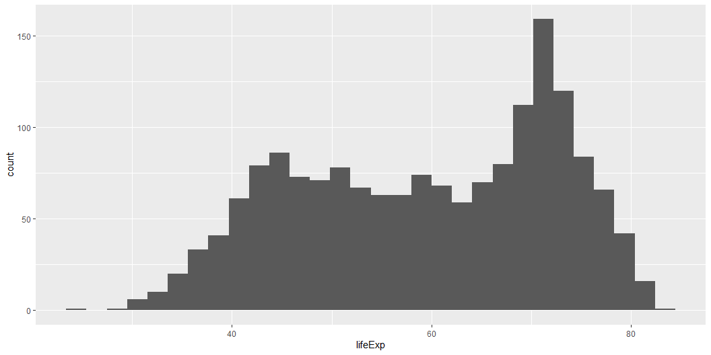
The Grammar of Graphics
First we tell the ggplot() function what the data is that we will use.
Now ggplot knows our data but we still need to specify which variables should be represented by which visual elements in the chart (this is known as mapping), and then we need to chose which type of chart we want. Mappings are specified by the aes() function and plot types (such as geom_histogram()) are added to that.
ggplot(data = gapminder)+ geom_histogram(aes(x = lifeExp))

Slide 11
Basic Plot Types

Slide 12
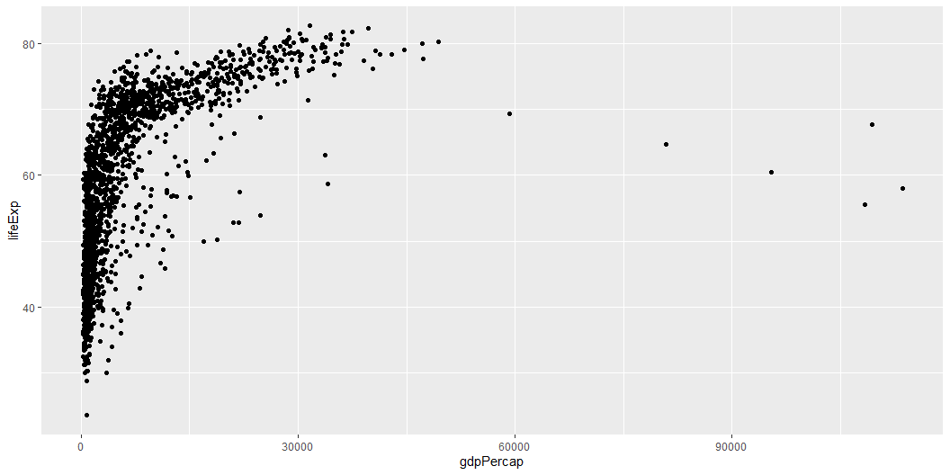
Scatter Plot
Let’s say we want to plot life expectancy and GDP per-capita. We can do this with a scatter plot, specified by geom_point().
ggplot(gapminder) + geom_point(aes(x = gdpPercap, y = lifeExp))

Slide 13
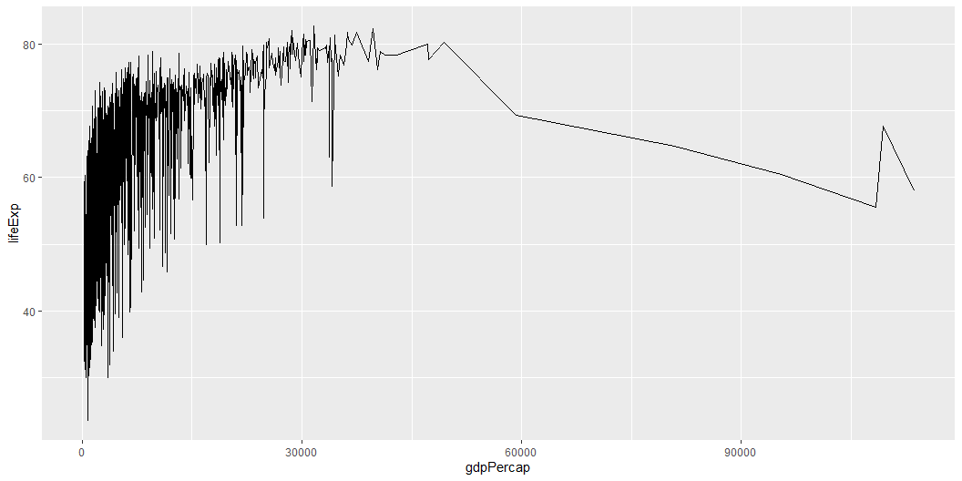
Line Plot
We can visualize the same information as a line plot.
ggplot(gapminder, aes(x = gdpPercap, y = lifeExp)) + geom_line()

Slide 14
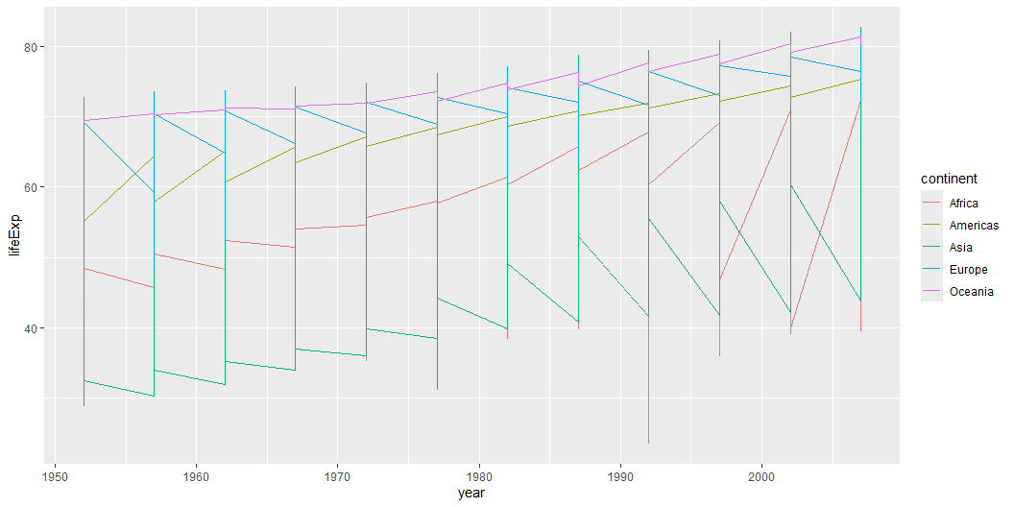
Line Plot
We can also visualize the life expectancy of each continent over time.
# Create a naive line plot ggplot(gapminder, aes(x = year, y = lifeExp, group = continent, color = continent)) + geom_line()

Slide 15
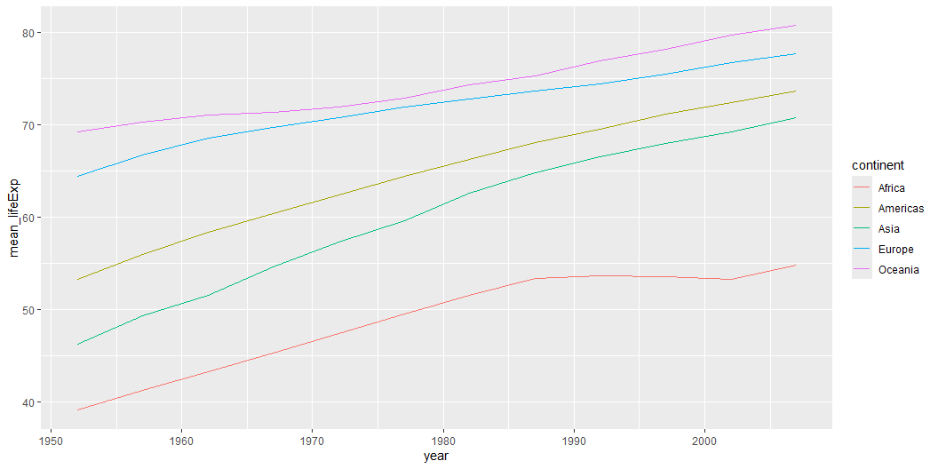
This looks odd. What’s wrong with this graph? Let’s try and fix it.
# We have multiple values per year in each continent (each country has its own value) # First, we need to get the mean life expectancy each year for each continent gapminder_continent <- gapminder %>% group_by(continent, year) %>% summarize(mean_lifeExp = mean(lifeExp), .groups = "drop") # Create the line plot ggplot(gapminder_continent, aes(x = year, y = mean_lifeExp, group = continent, color = continent)) + geom_line()

Slide 16
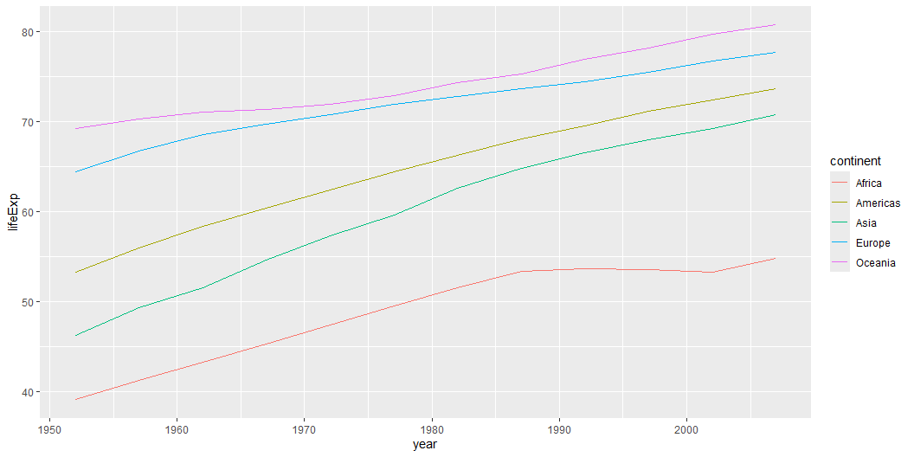
# We can also use ggplot's stat_summary to simplify this into one step ggplot(gapminder, aes(x = year, y = lifeExp, group = continent, color = continent)) + stat_summary(fun = mean, geom = "line")

Slide 17
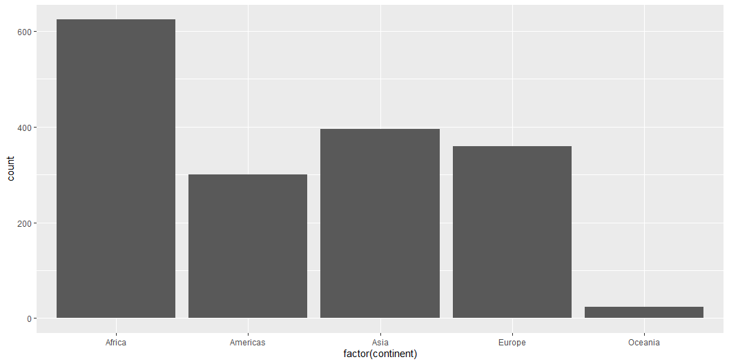
Bar Plot
A bar plot is commonly used to display categorical information. For instance, we can visualize how often each continent appears in the data.
ggplot(gapminder, aes(x = factor(continent))) + geom_bar()

Slide 18
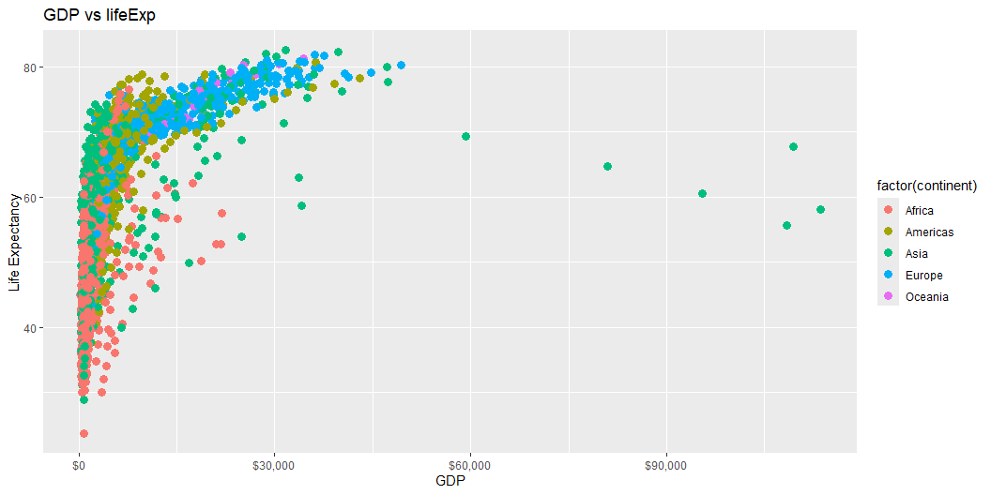
Customizing Aesthetics
There are many ways we can modify colors, shapes, and labels. Refer to this guide for more information on color options: https://ggplot2.tidyverse.org/reference/aes_colour_fill_alpha.html and this one on label and scale options: https://ggplot2-book.org/scales-guides
plot <- ggplot(gapminder, aes(x = gdpPercap, y = lifeExp, color = factor(continent))) + geom_point(size = 3) + labs(title = "GDP vs lifeExp", x = "GDP", y = "Life Expectancy") # Change label formatting to dollars plot + scale_x_continuous(labels = scales::label_dollar())

Slide 19
🔨 Practice Time!
Try recreating the above graph and then change the features:
Recreate the graph above.
Change the x labels to be more frequent using the breaks feature within scale_x_continuous().
Use the alpha aesthetic to adjust transparency, making points for Africa darker and all other continents lighter.
Filter and display GDP and life expectancy only in Africa.
Filter and display GDP and life expectancy only in 2007 for all continents.

Slide 20
🔨 Results
# load in gapminder dataset library(gapminder) # Recreate the original scatter plot ggplot(gapminder, aes(x = gdpPercap, y = lifeExp, color = continent)) + geom_point() # Change x and y labels to have more frequent breaks ggplot(gapminder, aes(x = gdpPercap, y = lifeExp, color = continent)) + geom_point() + scale_x_continuous(breaks = seq(0, 120000, by = 10000)) # Use the alpha aesthetic to change transparency of some of the points ggplot(gapminder, aes(x = gdpPercap, y = lifeExp, color = continent, alpha = continent)) + geom_point() + scale_alpha_manual(values = c("Europe" = 0.2, "Asia" = 0.2, "Africa" = 1, "Americas" = 0.2, "Oceania" = 0.2)) # Filter to display GDP and life expectancy to only in Africa gapminder %>% filter(continent == "Africa") %>% ggplot(aes(x = gdpPercap, y = lifeExp, color = continent)) + geom_point(colour="blue") # Filter to display GDP and life expectancy only in 2007 gapminder %>% filter(year == 2007) %>% ggplot(aes(x = gdpPercap, y = lifeExp, color = continent)) + geom_point()

Slide 21
Part C: Advanced Plotting Techniques

Slide 22
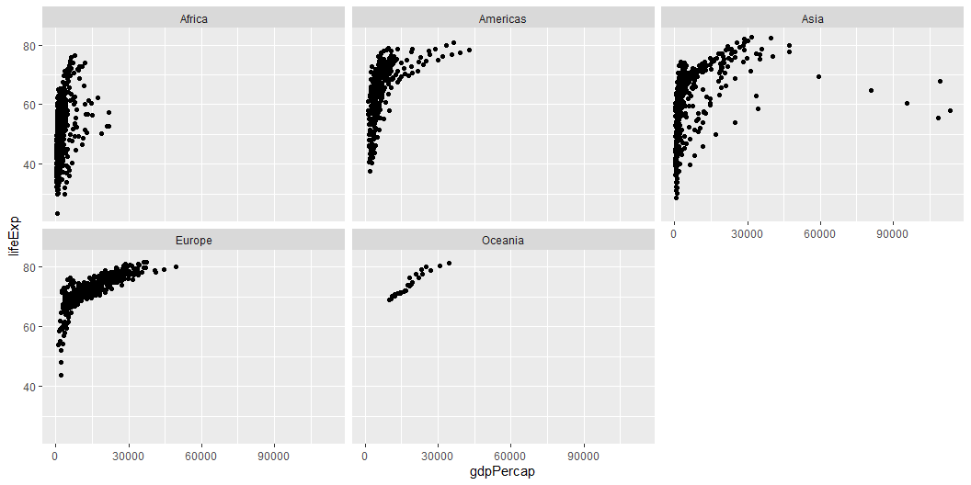
Faceting: Multiple Plots
There are some cases in which we want to visualize multiple plots at once, for instance, for multiple groups. Faceting allows us to easily lay out multiple plots in a panel.
Let’s revisit our scatterplot of gdpPercap vs lifeExp. We can facet it by the variable continent using facet_wrap.
ggplot(gapminder, aes(x = gdpPercap, y = lifeExp)) + geom_point() + facet_wrap(~ continent)

Slide 23
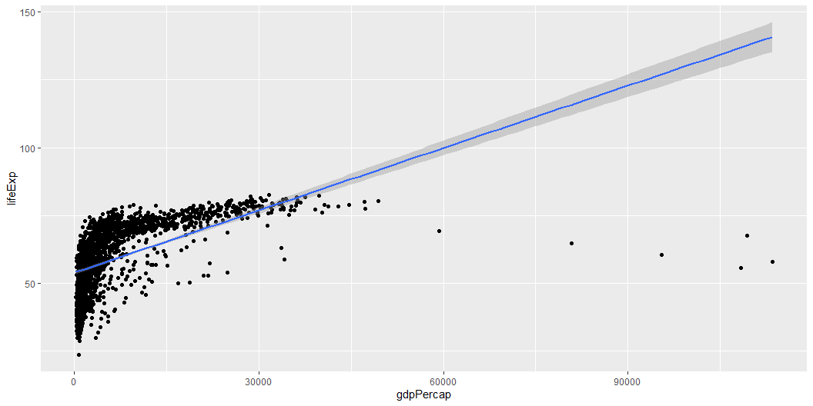
Adding Statistical Layers
Overlay trend lines or confidence intervals.
ggplot(gapminder, aes(x = gdpPercap, y = lifeExp)) + geom_point() + geom_smooth(method = "lm", se = TRUE)

Slide 24
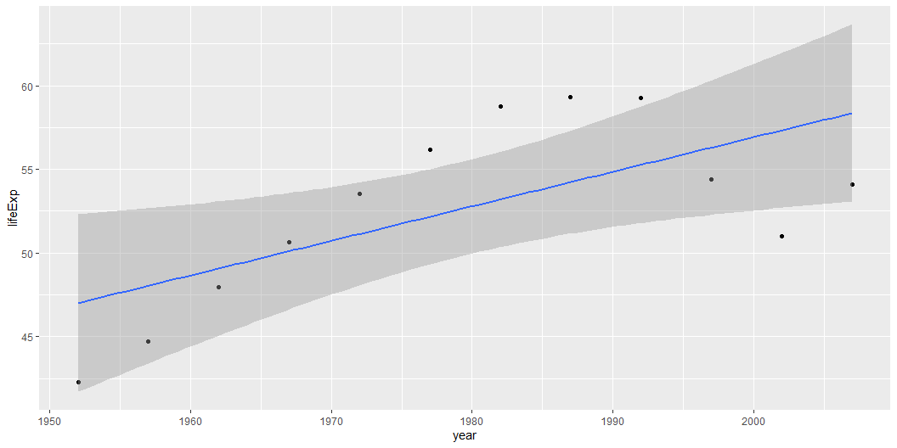
We can also display one countries’ life expectancy over time.
gapminder %>% filter(country == "Kenya") %>% ggplot(aes(x = year, y = lifeExp)) + geom_point() + # Scatter plot geom_smooth(method = "lm", se = TRUE)

Slide 25
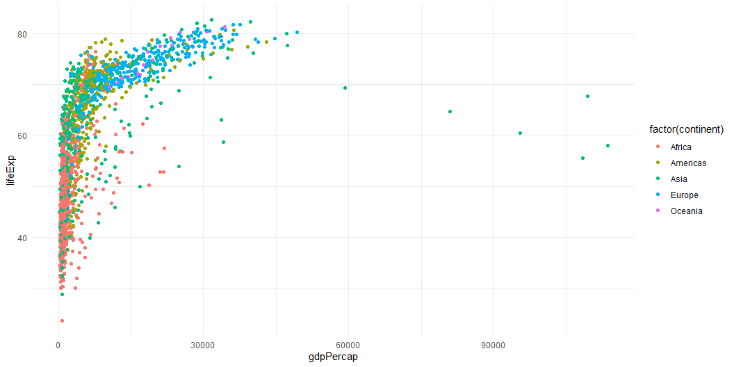
Themes and Color Schemes
Customize the appearance of plots. For instance, theme_minimal() provides a cleaner look, without background annotations. Explore this resource for other themes to find the ones you like best: https://ggplot2.tidyverse.org/reference/ggtheme.html
ggplot(gapminder, aes(x = gdpPercap, y = lifeExp, color = factor(continent))) + geom_point() + theme_minimal()

Slide 26
🔨 Final Exercise
Try completing the following exercise using the gapminder dataset:
Load the gapminder dataset (in this case, load in the package).
Create a data frame that contains only observations for the year 2007, which we will use from now on.
Compute the mean and median of gdpPercap for each continent.
Create a histogram of lifeExp to visualize its distribution.
Perform a hypothesis test to check if the average lifeExp in Europe is significantly different from the global average.
Generate a scatter plot of gdpPercap vs lifeExp, coloring points by continent.
# Load in data library(gapminder) # View data

Slide 27
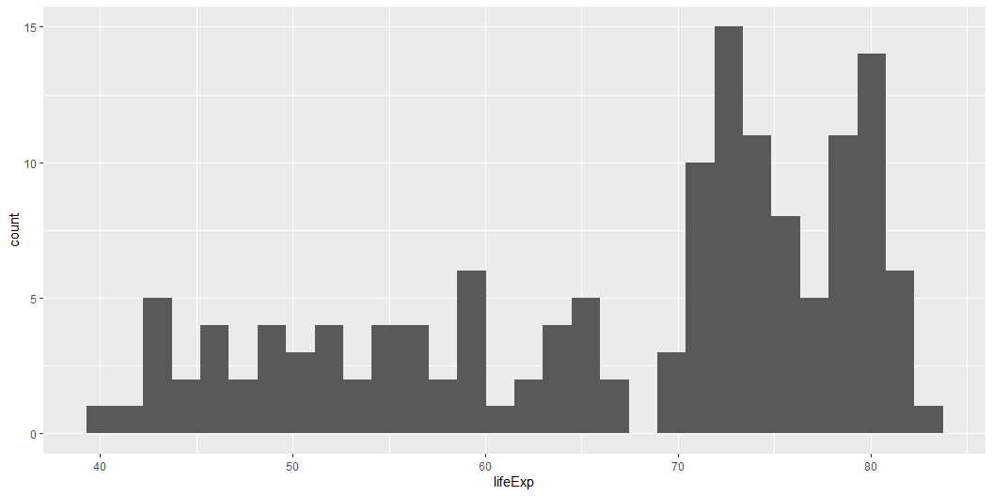
Example solution:
# Load necessary libraries library(dplyr) library(ggplot2) library(gapminder) # Filter for 2007 gapminder_2007 <- gapminder %>% filter(year==2007) # Compute mean and median GDP per continent gapminder_2007 %>% group_by(continent) %>% summarize(mean_gdp = mean(gdpPercap), median_gdp = median(gdpPercap))
# A tibble: 5 × 3 continent mean_gdp median_gdp <fct> <dbl> <dbl> 1 Africa 3089. 1452. 2 Americas 11003. 8948. 3 Asia 12473. 4471. 4 Europe 25054. 28054. 5 Oceania 29810. 29810.
# Create histogram of life expectancy ggplot(gapminder_2007, aes(x = lifeExp)) + geom_histogram()

Slide 28
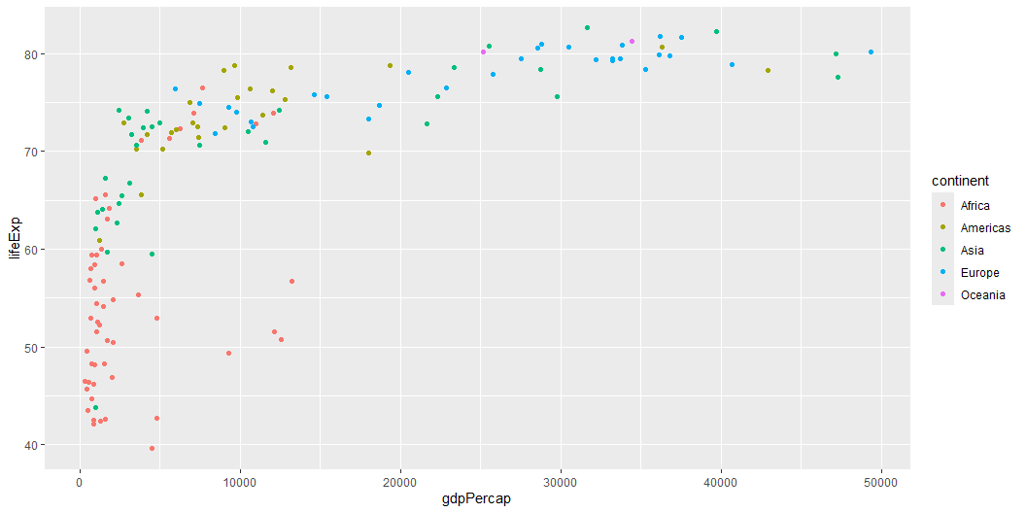
# Hypothesis test: Is Europe's life expectancy different from the global average? t.test(gapminder_2007$lifeExp[gapminder_2007$continent == "Europe"], mu = mean(gapminder_2007$lifeExp))
One Sample t-test data: gapminder_2007$lifeExp[gapminder_2007$continent == "Europe"] t = 19.56, df = 29, p-value < 2.2e-16 alternative hypothesis: true mean is not equal to 67.00742 95 percent confidence interval: 76.53592 78.76128 sample estimates: mean of x 77.6486
# Scatter plot of GDP per capita vs Life Expectancy ggplot(gapminder_2007, aes(x = gdpPercap, y = lifeExp, color = continent)) + geom_point()

Slide 29
Thank You!

Slide 30
Additional Resources
ggplot2 Documentation
R for Data Science
ggplot2 Cheatsheet
Grammar of Graphics

Slide 31
Additional learning!

Slide 32
Basic Probability Distributions (I)
Probability distributions describe how values are distributed within a dataset. They are used to model different types of data in statistics. Some common probability distributions include:
Normal Distribution: A symmetric, bell-shaped distribution common in natural and social sciences.
Uniform Distribution: All values within a specified range occur with equal probability.
Binomial Distribution: Used for binary outcomes, such as success/failure.
Below are examples of generating and visualizing random probability distributions in R. We will discuss the specific features of ggplot in a moment. For now, use the visualizations to understand how these distributions are different.
# Normal distribution normal_data <- rnorm(1000, mean = 50, sd = 10) # Uniform distribution uniform_data <- runif(1000, min = 0, max = 100) # Binomial distribution binom_data <- rbinom(1000, size = 1, prob = 0.5)

Slide 33
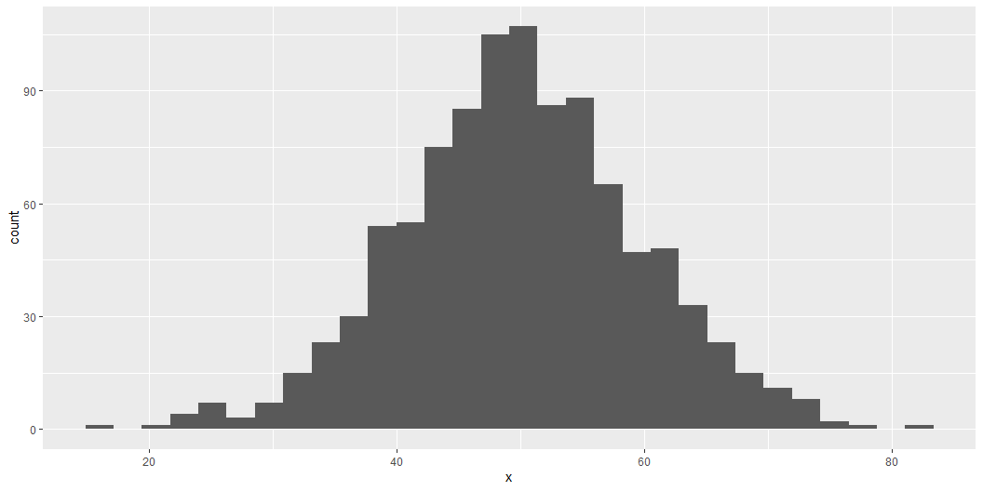
Basic Probability Distributions (II)
ggplot(data.frame(x = normal_data), aes(x = x)) + geom_histogram()

Slide 34
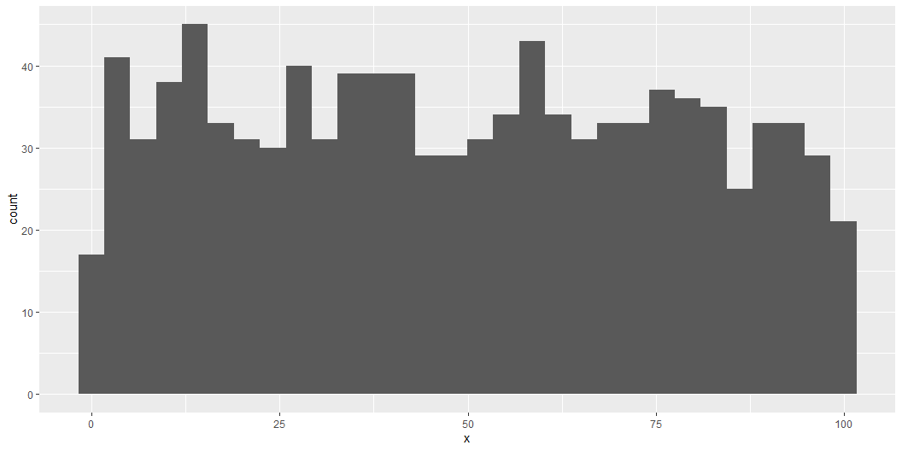
ggplot(data.frame(x = uniform_data), aes(x = x)) + geom_histogram()

Slide 35
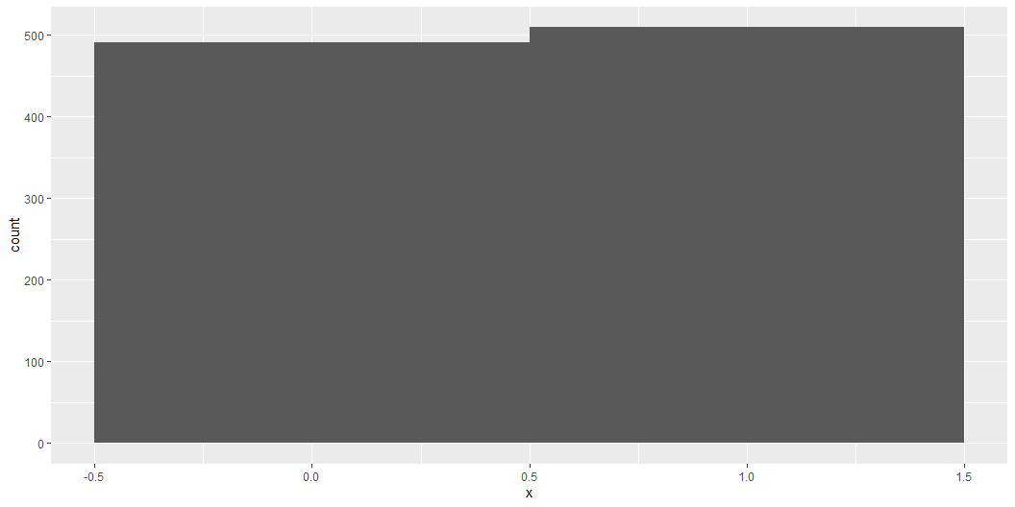
ggplot(data.frame(x = binom_data), aes(x = x)) + geom_histogram(bins = 2)

Slide 36
Simple Hypothesis Testing
Hypothesis testing is a statistical method used to make inferences about a population based on a sample. It helps determine if an observed effect is statistically significant or if it could have occurred by chance.
When and Why Do We Use Hypothesis Testing?
When we want to compare sample data against a known value or another dataset.
To test assumptions in scientific studies, such as “Is the average life expectancy significantly different from a specific value?”
Steps in Hypothesis Testing:
Define Null and Alternative Hypotheses:
Null Hypothesis (H₀): Assumes no effect or difference.
Alternative Hypothesis (H₁): Assumes a significant effect or difference.
Choose a Significance Level (α): Commonly set at 0.05.
Select a Statistical Test: T-tests, Chi-square tests, ANOVA, etc.
Compute the Test Statistic: Using R functions like t.test().
Compare with the Critical Value/P-value: If p < α, reject the null hypothesis.
Example: Testing if the mean lifeExp differs significantly from 20. Is the life expectancy statistically significantly different from 20?
# One-sample t-test t.test(gapminder$lifeExp, mu = 20)
One Sample t-test data: gapminder$lifeExp t = 126.15, df = 1703, p-value < 2.2e-16 alternative hypothesis: true mean is not equal to 20 95 percent confidence interval: 58.86070 60.08818 sample estimates: mean of x 59.47444
In hypothesis testing, the result is considered statistically different from 20 if the p-value from the t-test is less than the chosen significance level (commonly 0.05).
If p < 0.05, we reject the null hypothesis (H₀), meaning the mean lifeExp is significantly different from 20.
If p ≥ 0.05, we fail to reject the null hypothesis, meaning there is not enough evidence to conclude a significant difference.

