Slide 1
Matching Methods
Econometrics with R Dr. Lucas Sempé

Slide 2
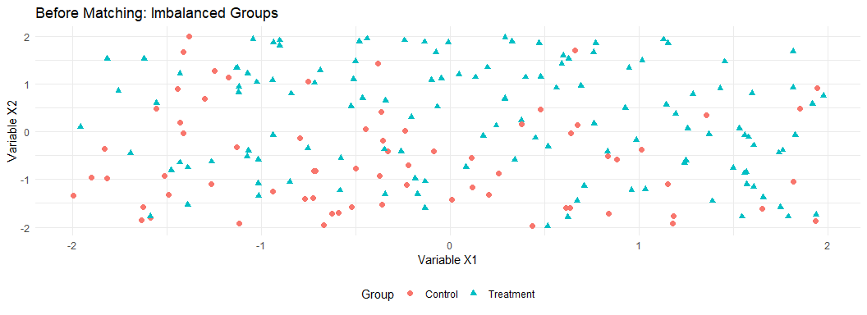
Matching Methods: Overview
Core idea: Create comparable treatment and control groups based on observable characteristics
Setting: When treatment assignment is related to observable factors
Advantage: Reduces selection bias from observable differences
Assumption: No unobserved differences affecting both treatment and outcomes
Methods: Exact matching, propensity score matching, nearest neighbor, etc.

Slide 3
Why Matching?
Problem: Selection bias
Treatment group systematically differs from control group
Direct comparison leads to biased impact estimates
Solution: Matching
Select control units similar to treated units
Create balance on observable characteristics
Approximates an experimental setting

Slide 4
Preparing the Data
Converting from long to wide format:
# Create a wide-format dataset df_w <- df %>% # Then create wide format pivot_wider( id_cols = c(zone_identifier, facility_identifier, treatment_zone, promotion_zone, eligible, enrolled, enrolled_rp), names_from = round, # variable that determines new columns # variables that should be made "wide" values_from = c(waste_management_costs, efficiency_index, age_manager, age_deputy, educ_manager, educ_deputy, female_manager, foreign_owned, staff_size, advanced_filtration, water_treatment_system, facility_area, recycling_center_distance, recycling_compliance)) %>% # remove the industries that has missing values # as missing values are not allowed when using matchit filter(!is.na(waste_management_costs_0)) # Also check the first few rows to confirm format head(select(df_w, facility_identifier, enrolled, waste_management_costs_0, waste_management_costs_1))
# A tibble: 6 × 4 facility_identifier enrolled waste_management_costs_0 waste_management_costs_1 <int> <int> <dbl> <dbl> 1 5 1 15185. 19581. 2 11 1 13076. 2399. 3 13 1 15286. 0 4 16 1 11312. 20027. 5 21 1 11224. 16665. 6 22 1 8877. 116.

Slide 5
Propensity Score Matching
Two scenarios for predicting enrollment:
Limited set of variables:
Only age and education of facility manager
Full set of variables:
All available baseline characteristics

Slide 6
Estimating Propensity Scores
# Limited set of variables psm_r <- matchit(enrolled ~ age_manager_0 + educ_manager_0, data = df_w %>% dplyr::select(-recycling_compliance_0, -recycling_compliance_1), distance = "glm", link = "probit") # Full set of variables psm_ur <- matchit(enrolled ~ age_manager_0 + educ_manager_0 + age_deputy_0 + educ_deputy_0 + female_manager_0 + foreign_owned_0 + staff_size_0 + advanced_filtration_0 + water_treatment_system_0 + facility_area_0 + recycling_center_distance_0, data = df_w %>% dplyr::select(-recycling_compliance_0, -recycling_compliance_1), distance = "glm",link = "probit")

Slide 7
Propensity Score Models
 | Limited Set | Full Set
Age (Manager) at Baseline | -0.021 | -0.013
 | (0.001) | (0.002)
Education (Manager) at Baseline | -0.041 | -0.022
 | (0.006) | (0.006)
Age (Deputy) at Baseline |  | -0.008
 |  | (0.002)
Education (Deputy) at Baseline |  | -0.016
 |  | (0.007)
Female Manager at Baseline |  | -0.020
 |  | (0.051)
Foreign Owned at Baseline |  | 0.161
 |  | (0.031)
Number of Staff at Baseline |  | 0.119
 |  | (0.007)
Advanced Filtration at Baseline |  | 0.376
 |  | (0.031)
Water Treatment System at Baseline |  | -0.125
 |  | (0.029)
Facility Area at Baseline |  | -0.028
 |  | (0.005)
Distance From Recycling Center |  | 0.002
 |  | (0.000)
Num.Obs. | 9913 | 9913
F | 211.015 | 89.077
RMSE | 0.45 | 0.43
# Create a model summary table modelsummary(list("Limited Set" = psm_r$model, "Full Set" = psm_ur$model), coef_map = c('age_manager_0' = "Age (Manager) at Baseline", 'educ_manager_0' = "Education (Manager) at Baseline", 'age_deputy_0' = "Age (Deputy) at Baseline", 'educ_deputy_0' = "Education (Deputy) at Baseline", 'female_manager_0' = "Female Manager at Baseline", 'foreign_owned_0' = "Foreign Owned at Baseline", 'staff_size_0' = "Number of Staff at Baseline", 'advanced_filtration_0' = "Advanced Filtration at Baseline", 'water_treatment_system_0' = "Water Treatment System at Baseline", 'facility_area_0' = "Facility Area at Baseline", 'recycling_center_distance_0' = "Distance From Recycling Center"), title = "Estimating the Propensity Score Based on Baseline Characteristics")
Estimating the Propensity Score Based on Baseline Characteristics

Slide 8
Interpreting the Propensity Score Models
Which characteristics predict program enrollment?
Are facilities with certain characteristics more likely to enroll?
Does this align with program objectives?

Slide 9
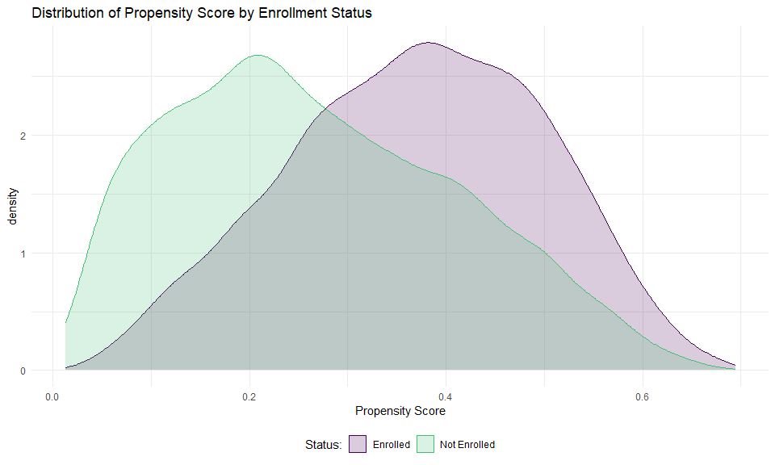
Checking Common Support
Let’s plot the distribution of propensity scores by enrollment status:
# Add propensity scores to our dataset df_w <- df_w %>% mutate(ps_ur = psm_ur$model$fitted.values) # Plot the distribution df_w %>% mutate(enrolled_lab = ifelse(enrolled == 1, "Enrolled", "Not Enrolled")) %>% ggplot(aes(x = ps_ur, group = enrolled_lab, colour = enrolled_lab, fill = enrolled_lab)) + geom_density(alpha = 0.2) + xlab("Propensity Score") + labs(title = "Distribution of Propensity Score by Enrollment Status") + scale_fill_viridis_d("Status:", end = 0.7) + scale_colour_viridis_d("Status:", end = 0.7) + theme_minimal() + theme(legend.position = "bottom")

Slide 10
What is Common Support?
Common support = overlap in propensity scores between groups
Essential for valid comparisons
Without common support, we can’t find comparable units

Slide 11
Checking Balance Before Matching
 | Means Treated | Means Control | Std. Mean Diff. | Var. Ratio | eCDF Mean | eCDF Max | Std. Pair Dist.
distance | 0.3694119 | 0.2683525 | 0.7780852 | 0.8189848 | 0.2003240 | 0.3118783 | NA
age_manager_0 | 41.6565796 | 48.1384372 | -0.4731180 | 0.7797904 | 0.0881294 | 0.2074113 | NA
educ_manager_0 | 2.9711803 | 2.7744736 | 0.0742925 | 0.8959873 | 0.0218441 | 0.0622731 | NA
age_deputy_0 | 36.8363698 | 41.6117427 | -0.4098452 | 0.8042407 | 0.0647834 | 0.2100395 | NA
educ_deputy_0 | 2.7032726 | 2.5810189 | 0.0494165 | 0.9256881 | 0.0141252 | 0.0689847 | NA
female_manager_0 | 0.0732119 | 0.1100878 | -0.1415669 | NA | 0.0368759 | 0.0368759 | NA
foreign_owned_0 | 0.4291498 | 0.3203339 | 0.2198503 | NA | 0.1088159 | 0.1088159 | NA
staff_size_0 | 5.7699055 | 4.9263203 | 0.4225943 | 0.8029708 | 0.0651539 | 0.1833283 | NA
advanced_filtration_0 | 0.7216599 | 0.5533170 | 0.3756130 | NA | 0.1683429 | 0.1683429 | NA
water_treatment_system_0 | 0.5735493 | 0.6340481 | -0.1223283 | NA | 0.0604988 | 0.0604988 | NA
facility_area_0 | 1.6771255 | 2.2511153 | -0.2172044 | 0.6390513 | 0.0240692 | 0.0881821 | NA
recycling_center_distance_0 | 109.2043122 | 103.6626222 | 0.1323667 | 0.9916816 | 0.0395806 | 0.0829805 | NA
kableExtra::kable(summary(psm_ur)$sum.all, caption = "Balance Before Matching") %>% kable_styling(font_size = 10)
Balance Before Matching

Slide 13
Checking Balance After Matching
 | Means Treated | Means Control | Std. Mean Diff. | Var. Ratio | eCDF Mean | eCDF Max | Std. Pair Dist.
distance | 0.3694119 | 0.3687162 | 0.0053561 | 1.0138523 | 0.0007394 | 0.0084345 | 0.0055861
age_manager_0 | 41.6565796 | 41.7867746 | -0.0095031 | 1.0867281 | 0.0114843 | 0.0381242 | 0.9086975
educ_manager_0 | 2.9711803 | 2.9549320 | 0.0061367 | 0.9271782 | 0.0094467 | 0.0239541 | 1.0892771
age_deputy_0 | 36.8363698 | 36.9915655 | -0.0133196 | 1.1143952 | 0.0104041 | 0.0371120 | 0.9332429
educ_deputy_0 | 2.7032726 | 2.7128880 | -0.0038867 | 0.8918377 | 0.0072981 | 0.0215924 | 1.0663763
female_manager_0 | 0.0732119 | 0.0732119 | 0.0000000 | NA | 0.0000000 | 0.0000000 | 0.1288799
foreign_owned_0 | 0.4291498 | 0.4234143 | 0.0115879 | NA | 0.0057355 | 0.0057355 | 0.9031755
staff_size_0 | 5.7699055 | 5.7884615 | -0.0092956 | 0.8691665 | 0.0105626 | 0.0229420 | 0.9946331
advanced_filtration_0 | 0.7216599 | 0.7253711 | -0.0082806 | NA | 0.0037112 | 0.0037112 | 0.6857819
water_treatment_system_0 | 0.5735493 | 0.5732119 | 0.0006822 | NA | 0.0003374 | 0.0003374 | 0.9816638
facility_area_0 | 1.6771255 | 1.7010796 | -0.0090645 | 1.0159498 | 0.0045968 | 0.0276653 | 0.8103167
recycling_center_distance_0 | 109.2043122 | 108.5100383 | 0.0165832 | 0.9993878 | 0.0104486 | 0.0485830 | 1.0886493
kableExtra::kable(summary(psm_ur)$sum.matched, caption = "Balance After Matching") %>% kable_styling(font_size = 10)
Balance After Matching

Slide 15
Understanding Balance
Mean Diff should be closer to zero after matching
Standardized mean differences (not shown) should be < 0.25
Good balance ensures we’re comparing similar facilities

Slide 16
Estimating Program Impact
First, extract the matched dataset:
# Extract matched datasets match_df_r <- match.data(psm_r) # Limited set match_df_ur <- match.data(psm_ur) # Full set

Slide 17
Regression with Matched Data
 | Limited Set | Full Set
(Intercept) | 19002.488 | 17840.381
 | (301.249) | (285.834)
enrolled | -11162.715 | -10000.607
 | (383.590) | (368.996)
Num.Obs. | 5928 | 5928
R2 | 0.300 | 0.280
R2 Adj. | 0.300 | 0.280
AIC | 124136.4 | 123417.9
BIC | 124156.4 | 123438.0
RMSE | 8526.20 | 8024.86
Std.Errors | by: zone_identifier | by: zone_identifier
# Regression with matched data out_lm_r <- lm_robust(waste_management_costs_1 ~ enrolled, data = match_df_r, weights = weights, clusters = zone_identifier) out_lm_ur <- lm_robust(waste_management_costs_1 ~ enrolled, data = match_df_ur, weights = weights, clusters = zone_identifier) # Show results modelsummary(list("Limited Set" = out_lm_r, "Full Set" = out_lm_ur), title = "Impact on Waste Management Costs: Matching Approach")
Impact on Waste Management Costs: Matching Approach

Slide 18
Matched Difference-in-Differences
Combine matching with difference-in-differences:
# Merge matching weights back into long format df_long_match_r <- df %>% left_join(match_df_r %>% dplyr::select(facility_identifier, weights)) %>% filter(!is.na(weights)) df_long_match_ur <- df %>% left_join(match_df_ur %>% dplyr::select(facility_identifier, weights)) %>% filter(!is.na(weights))

Slide 19
Difference-in-Differences Results
 | Limited Set | Full Set
Enrollment | -1441.854 | -544.742
 | (264.445) | (237.034)
Round | 3070.940 | 2805.945
 | (235.805) | (226.712)
Enrollment × Round | -9720.861 | -9455.866
 | (301.548) | (297.682)
Num.Obs. | 11856 | 11856
R2 | 0.260 | 0.240
R2 Adj. | 0.260 | 0.240
AIC | 243181.9 | 241958.7
BIC | 243218.8 | 241995.6
RMSE | 6879.39 | 6533.53
Std.Errors | by: zone_identifier | by: zone_identifier
# Run DiD regression did_reg_r <- lm_robust(waste_management_costs ~ enrolled * round, data = df_long_match_r, weights = weights, clusters = zone_identifier) did_reg_ur <- lm_robust(waste_management_costs ~ enrolled * round, data = df_long_match_ur, weights = weights, clusters = zone_identifier) # Show results modelsummary(list("Limited Set" = did_reg_r, "Full Set" = did_reg_ur), coef_map = c('enrolled' = "Enrollment", 'round' = "Round", 'enrolled:round' = "Enrollment × Round"), title = "Impact on Waste Management Costs: Matched DiD Approach")
Impact on Waste Management Costs: Matched DiD Approach

Slide 20
Interpretation of Results
Enrolled coefficient: Baseline difference between groups
Round coefficient: Time trend for all facilities
Enrollment × Round: The program’s causal effect
Note
The interaction coefficient (Enrollment × Round) represents our estimate of the causal impact of the program on waste management costs.

Slide 21
Advantages of Matching
Reduces selection bias
Makes treatment and control groups comparable
Can combine with difference-in-differences for robust estimation
Works even without baseline randomization

Slide 22
Limitations of Matching
Only controls for observed variables
Cannot account for unobserved confounders
Requires good data on pre-treatment characteristics
Common support may be limited in some contexts

Slide 23
Summary
Propensity Score Matching helps create comparable groups
First estimate propensity scores based on baseline characteristics
Check for common support and balance after matching
Combine with regression or difference-in-differences to estimate impacts
Interpret results with appropriate caution about unobserved confounders

Slide 24
Resources for Further Learning
Ho, Imai, King, and Stuart (2007): “Matching as Nonparametric Preprocessing for Reducing Model Dependence in Parametric Causal Inference”
Stuart (2010): “Matching Methods for Causal Inference: A Review and a Look Forward”
The MatchIt package documentation: https://kosukeimai.github.io/MatchIt/
“Mastering Metrics” by Angrist and Pischke (Chapter 3)

Slide 25
Thank You!

Slide 26
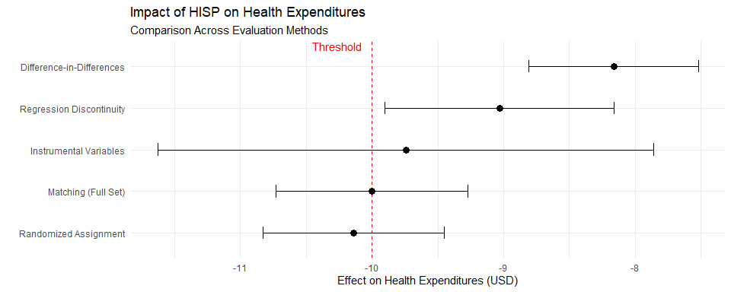
Comparative Results Across Methods

Slide 27
Final Policy Recommendation
Methods produce consistent results in the range of -$8.16 to -$10.14
Randomized assignment (gold standard): -$10.14
Most quasi-experimental methods: Effect slightly below $10
Given uncertainty in estimates and consistency in direction, HISP shows promising results
RECOMMENDATION: The preponderance of evidence suggests HISP reduces health expenditures by approximately $10, which meets the threshold criterion. Given the consistency across methods and the gold-standard randomized result, HISP should be scaled up nationally.

Slide 28
Conclusion: Choosing the Right Method
Method | When to Use | Key Assumption | Strengths | Limitations
Randomized | Feasible to randomize | Random assignment | Gold standard; controls for all confounders | Implementation challenges; external validity
IV | Imperfect compliance; valid instrument exists | Exclusion restriction | Addresses selection; natural experiments | Local effect; requires strong instrument
RDD | Clear eligibility threshold | No manipulation of running variable | Credible quasi-experimental design | Local to threshold; requires threshold
DiD | Panel data; non-random assignment | Parallel trends | Controls for fixed differences and time trends | Cannot address time-varying confounders
Matching | Rich observational data | Selection on observables | Uses existing data; intuitive | Cannot address unobserved confounders

Slide 29
Next Steps in Impact Evaluation
Heterogeneity analysis
Does impact vary across subgroups?
Who benefits most from HISP?
Cost-effectiveness analysis
Beyond impact, is HISP cost-effective?
How does it compare to alternative programs?
Implementation research
What factors affect successful implementation?
How to optimize national scale-up?
Long-term follow-up
Do impacts persist over time?
Are there additional benefits or unintended consequences?

Slide 30
Key Course Takeaways
Impact evaluation requires identifying a valid counterfactual
Randomized experiments provide the most credible counterfactual
Quasi-experimental methods can provide rigorous evidence when randomization isn’t possible
Multiple methods with consistent results strengthen the evidence base
Statistical significance must be paired with policy significance
The choice of method depends on context, data, and research question
R provides powerful tools for implementing all these methods

Slide 31
Thank You!
Additional Resources:
Gertler, P. J., et al. (2016). Impact Evaluation in Practice, Second Edition. World Bank.
Angrist, J. D., & Pischke, J. S. (2008). Mostly Harmless Econometrics. Princeton University Press.
Cunningham, S. (2021). Causal Inference: The Mixtape. Yale University Press.
R packages: estimatr, MatchIt, rdrobust, did, fixest, AER

