Slide 1
Randomized Assignment
Econometrics with R Dr. Lucas Sempé

Slide 2
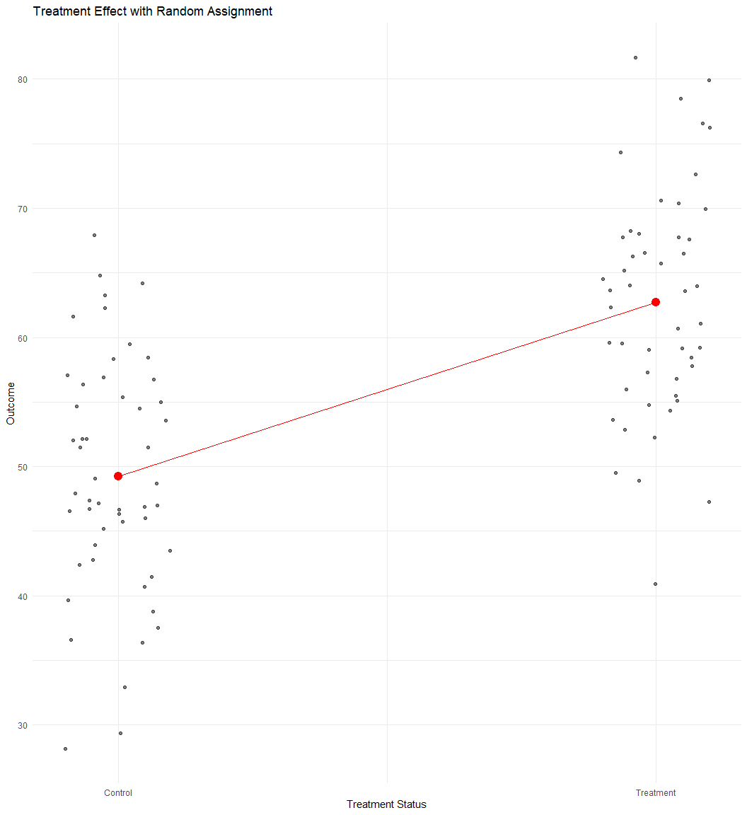
Randomized Assignment: The Gold Standard
Core idea: Randomly select who receives the treatment
Result: Treatment and control groups are statistically identical (in expectation)
Advantage: Differences in outcomes can be attributed to the program
Why it works: Randomization creates a valid counterfactual

Slide 3
Implementing Randomized Assignment
Define population of eligible units
Decide on level of randomization (individuals, households, villages)
Determine sample size (power calculations)
Randomly select units to receive treatment
Verify balance between treatment and control groups
Implement program and collect data

Slide 4
Fictional Case Study: Randomized Industries
Program was implemented as a pilot in 100 industries randomly selected from all industries
100 additional randomly selected industries serve as controls
This design ensures that treatment and control industries are statistically identical
Only industries below certain degree of efficiency in treatment industries were eligible

Slide 5
Verifying Balance at Baseline
Results show most characteristics are balanced
Small differences in education of industry manager and distance to recycling centre
With many characteristics, some differences by chance are expected
# Check if treatment and control industries are balanced at baseline df %>% filter(round == 0) %>% select(treatment_zone, age_manager, age_deputy, educ_manager, educ_deputy, female_manager, foreign_owned, staff_size, advanced_filtration, water_treatment_system, facility_area, recycling_center_distance) %>% pivot_longer(-c("treatment_zone")) %>% group_by(name) %>% do(tidy(lm_robust(value ~ treatment_zone, data = .))) %>% filter(term == "treatment_zone") %>% select(name, estimate, std.error, p.value)
name | estimate | std.error | p.value
advanced_filtration | 0.03 | 0.01 | 0.00
age_deputy | -0.51 | 0.26 | 0.05
age_manager | -0.74 | 0.31 | 0.02
educ_deputy | 0.00 | 0.05 | 1.00
educ_manager | 0.06 | 0.06 | 0.26
facility_area | -0.07 | 0.06 | 0.30
female_manager | 0.00 | 0.01 | 0.49
foreign_owned | 0.02 | 0.01 | 0.01
recycling_center_distance | 3.31 | 0.84 | 0.00
staff_size | 0.00 | 0.04 | 0.97
water_treatment_system | 0.00 | 0.01 | 0.76

Slide 6
Estimating Program Impact: Simple Comparison of Means
# Compare waste expenditures in treatment and control industries at follow-up out_round0 <- lm_robust(waste_management_costs ~ treatment_zone, data = df %>% filter(round == 0 & eligible ==1), clusters = zone_identifier) out_round1 <- lm_robust(waste_management_costs ~ treatment_zone, data = df %>% filter(round == 1 & eligible ==1), clusters = zone_identifier)
 | Round 0 | Round 1
(Intercept) | 14573.847*** | 17980.550***
 | (157.259) | (309.123)
treatment_zone | −84.153 | −10140.371***
 | (214.558) | (398.899)
Num.Obs. | 5628 | 5629
R2 | 0.000 | 0.300
R2 Adj. | 0.000 | 0.300
+ p < 0.1, * p < 0.05, ** p < 0.01, *** p < 0.001

Slide 7
Using Regression Analysis
# Compare waste expenditures in T and C industries at follow-up out_round2 <- lm_robust(waste_management_costs ~ treatment_zone + age_manager + age_deputy + female_manager + foreign_owned + staff_size + advanced_filtration + facility_area + recycling_center_distance, data = df %>% filter(round == 1 & eligible ==1), clusters = zone_identifier)
 | No covariate adj. | With covariate adj.
(Intercept) | 17980.550*** | 27223.565***
 | (309.123) | (709.757)
treatment_zone | −10140.371*** | −10011.495***
 | (398.899) | (345.884)
age_manager |  | 44.704**
 |  | (14.910)
age_deputy |  | 5.676
 |  | (16.558)
female_manager |  | 656.864
 |  | (450.642)
foreign_owned |  | −1866.504***
 |  | (357.736)
staff_size |  | −1593.934***
 |  | (65.646)
advanced_filtration |  | −1847.307***
 |  | (279.524)
facility_area |  | 40.065
 |  | (38.362)
recycling_center_distance |  | −2.517
 |  | (4.263)
Num.Obs. | 5629 | 5629
R2 | 0.300 | 0.429
R2 Adj. | 0.300 | 0.428
+ p < 0.1, * p < 0.05, ** p < 0.01, *** p < 0.001
Treatment effect remains stable with addition of control variables
Controls improve precision (smaller standard errors)
Adding controls increases R² from 0.30 to 0.43

Slide 8
Why Covariates Don’t Change the Estimate Much
In randomized experiments:
Treatment assignment is independent of observed and unobserved characteristics
Control variables are uncorrelated with treatment status (in expectation)
Including controls may:
Increase precision (reduce standard errors)
Account for any chance imbalances
But should not substantially change the point estimate

Slide 9
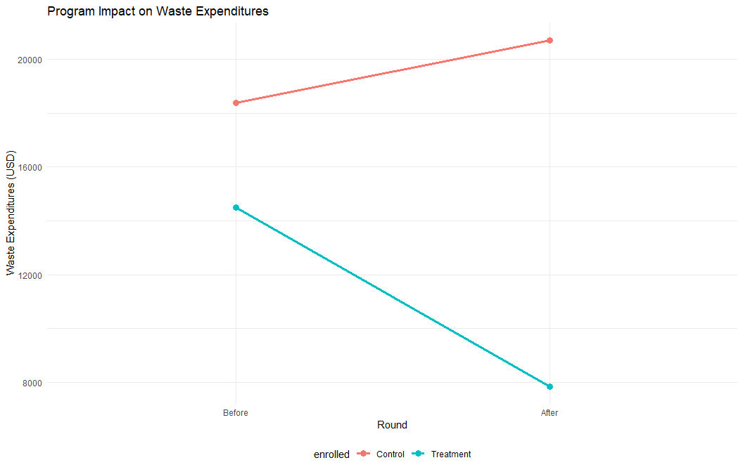
Visualizing the Results
df %>% group_by(enrolled, round) %>% mutate(enrolled = recode(as.factor(enrolled), `0` = "Control", `1` = "Treatment"), round = recode(as.factor(round), `0` = "Before", `1` = "After")) %>% summarise(waste_management_costs = mean(waste_management_costs)) %>% ggplot(aes(x = round, y = waste_management_costs, group = enrolled, color = enrolled)) + geom_line(size = 1.2) + geom_point(size = 3) + labs(title = "Program Impact on Waste Expenditures", x = "Round", y = "Waste Expenditures (USD)") + theme_minimal() + theme(legend.position = "bottom")

Slide 10
Strength of the Results
Internal validity: Strong - randomization ensures that the impact is attributable to the program
External validity: Limited to similar contexts
Precision: High - narrow confidence intervals
Policy relevance: Impact exceeds the $10,000 threshold

Slide 11
From Analysis to Policy Decision
Policy question: Should the Programe be scaled up nationally?
Decision criterion: Program must reduce health expenditures by at least $10,000.
Results from randomized evaluation:
Impact: -$10,140 (95% CI: [-$10,930, -$9,350])
Exceeds threshold of $10,000 reduction
Recommendation: The program should be scaled up nationally.

Slide 12
Limitations of Randomized Assignment
Ethical concerns
Denying benefits to control group
Informed consent issues
Practical challenges
Political constraints
Implementation costs
Scale vs. pilot differences
Technical issues
Spillover effects
Hawthorne effects
Attrition and non-compliance
External validity
Timing
Long-term outcomes
Delay in results for urgent policies

Slide 13
When Randomization Isn’t Possible
When randomization is not feasible, we can use quasi-experimental methods:
Instrumental Variables: Using random encouragement
Regression Discontinuity: Exploiting eligibility thresholds
Difference-in-Differences: Comparing changes over time
Matching Methods: Creating comparable groups

Slide 14
Key Takeaways
Randomization creates comparable treatment and control groups
With randomization, differences in outcomes can be attributed to the program
Including covariates doesn’t substantially change estimates but can improve precision
The Programm reduces waste expenditures by $10,140, exceeding the threshold
Based on the randomized evaluation, HISP should be scaled up nationally

Slide 15
Next Session
Instrumental Variables: Leveraging randomized promotion to evaluate programs with imperfect compliance

