Slide 1
Difference-in-differences Design
Econometrics with R Dr. Lucas Sempé

Slide 2
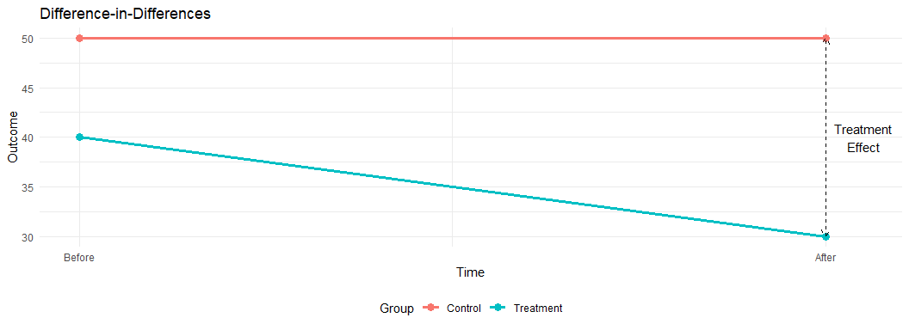
Difference-in-Differences: Overview
Core idea: Compare changes over time between treated and untreated groups
Setting: Panel or repeated cross-sectional data with pre/post periods
Advantage: Controls for time-invariant differences between groups
Identification: Relies on “parallel trends” assumption
Applications: Widely used for policy evaluation

Slide 3
How DiD Works
Difference-in-Differences = (TreatAfter - TreatBefore) - (ControlAfter - ControlBefore)

Slide 4
First Difference:
Within treatment group over time
Controls for time-invariant characteristics
But confounded by time trends
Second Difference:
Between the first differences
Controls for time trends affecting both groups
Isolates the treatment effect
Group | Before | After | Difference
Treatment | 40 | 30 | -10
Control | 50 | 50 | 0
Difference | -10 | -20 | -10
DiD Calculation Example

Slide 5
Program Case: DiD Setup
We compare changes in waste expenditures for enrolled vs. non-enrolled industries
Both groups are in treatment zones (where Program was offered)
We have data for two periods: before and after Program implementation
DiD can help address selection bias if trends would be parallel without Program

Slide 6
Implementing DiD with Regression
# DiD regression without covariates out_did <- lm_robust(waste_management_costs ~ round * enrolled, data = df %>% filter(treatment_zone == 1), clusters = zone_identifier) # DiD regression with covariates out_did_wcov <- lm_robust(waste_management_costs ~ round * enrolled + age_manager + age_deputy + female_manager + foreign_owned + staff_size + advanced_filtration + facility_area + recycling_center_distance, data = df %>% filter(treatment_zone == 1), clusters = zone_identifier)
Where:
round: Time indicator (0=before, 1=after)
enrolled: Treatment indicator (1=enrolled, 0=not enrolled)
round:enrolled: Interaction term capturing the DiD effect

Slide 7
Interpreting DiD Regression Coefficients
In the model: $Y=β_{0}+β_{1}\text{Round}+β_{2}\text{Enrolled}+β_{3}\left(\text{Round}×\text{Enrolled}\right)+ε$

Slide 8
$β_{0}$: Baseline outcome for non-enrolled group
$β_{1}$: Time trend (change for non-enrolled)
$β_{2}$: Baseline difference between groups
$β_{3}$: DiD estimate (treatment effect)
Period | Not Enrolled | Enrolled | Difference
Before (Round=0) | β₀ | β₀ + β₂ | β₂
After (Round=1) | β₀ + β₁ | β₀ + β₁ + β₂ + β₃ | β₂ + β₃
Difference | β₁ | β₁ + β₃ | β₃
Interpretation of DiD Coefficients

Slide 9
DiD Results for Program
 | No covariate adj. | With covariate adj.
(Intercept) | 20791.494*** | 27500.322***
 | (173.606) | (467.392)
round | 1513.416*** | 1449.254***
 | (359.640) | (358.257)
enrolled | −6301.800*** | −1572.721***
 | (194.487) | (129.370)
round × enrolled | −8162.931*** | −8161.809***
 | (320.819) | (321.221)
age_manager |  | 78.450***
 |  | (11.071)
age_deputy |  | −15.593
 |  | (12.899)
female_manager |  | 1050.098**
 |  | (320.100)
foreign_owned |  | −2234.127***
 |  | (234.660)
staff_size |  | −1985.216***
 |  | (39.070)
advanced_filtration |  | −2333.287***
 |  | (154.610)
facility_area |  | 96.680**
 |  | (29.450)
recycling_center_distance |  | −2.503
 |  | (3.113)
Num.Obs. | 9919 | 9919
R2 | 0.344 | 0.551
R2 Adj. | 0.343 | 0.550
+ p < 0.1, * p < 0.05, ** p < 0.01, *** p < 0.001
Interpretation:
Initial difference: Enrolled industries spent $6301.8 less at baseline
Time trend: Non-enrolled industries increased spending by $1513.4
Treatment effect: Program reduced expenditures by $8162.9
Result is statistically significant but below the $10,000 threshold

Slide 10
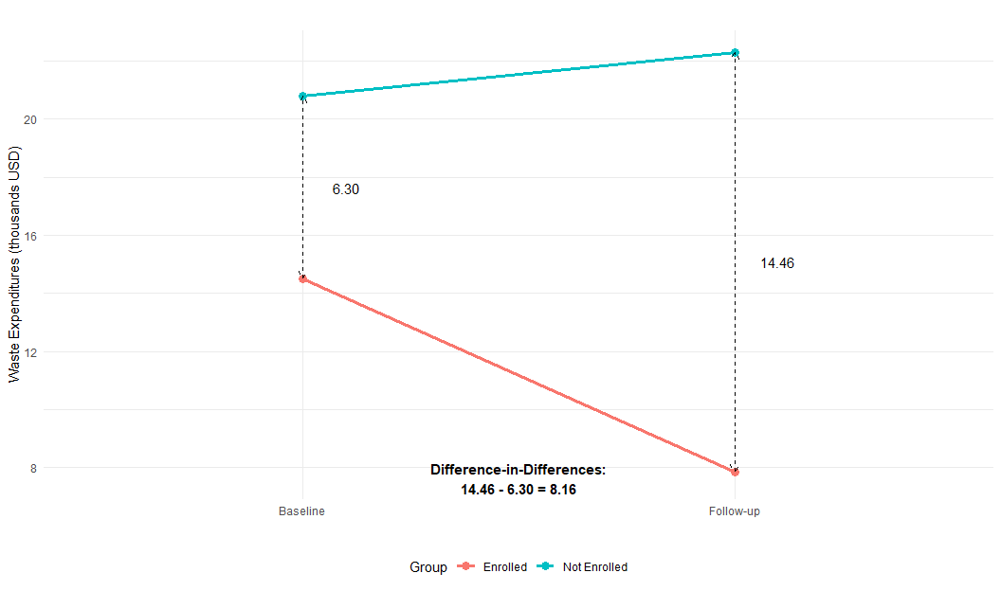
Visualizing the DiD Result

Slide 11
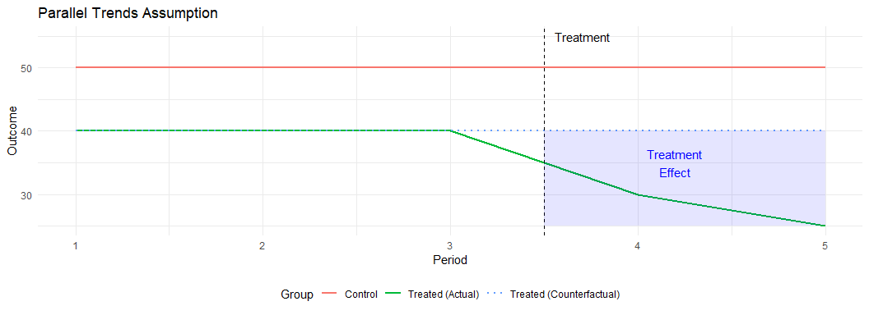
The Parallel Trends Assumption
The key identifying assumption in DiD:
In the absence of treatment, the difference between treatment and control groups would remain constant over time
Cannot be directly tested in the post-treatment period
Can examine pre-treatment trends if multiple periods available
Can also use placebo tests with different groups or outcomes

Slide 12
Threats to the Parallel Trends Assumption
Differential time shocks
Events affecting one group but not the other
Example: Other policies targeting the same population
Compositional changes
Changes in group makeup over time
Example: Selective migration or attrition
Anticipation effects
Behavior changes before treatment starts
Example: Postponing healthcare in anticipation of insurance
Feedback effects
Treatment affects the control group
Example: Spillovers or general equilibrium effects

Slide 13
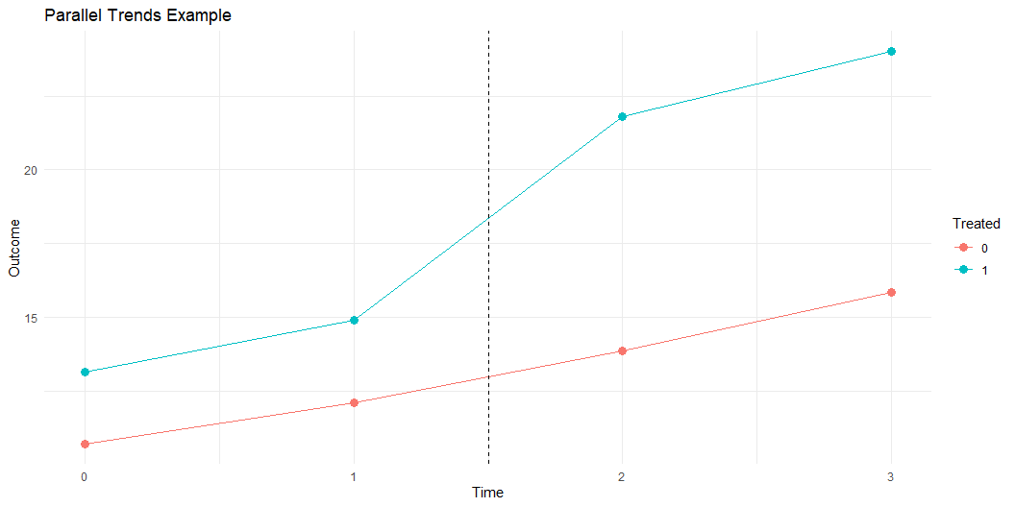
Testing Parallel Pre-Trends
# Create simple dataset with 20 observations did_data <- data.frame( # 4 time periods (0-3), treatment in period 2 time = rep(0:3, 5), # 10 units (5 treated, 5 control) unit = rep(1:10, each = 4), # Treatment indicator treated = rep(c(rep(0, 5), rep(1, 5)), each = 4), # Period indicator (pre/post) post = rep(c(0,0,1,1), 10) ) # Base outcome - parallel trends did_data$y_parallel <- 10 + 2*did_data$time + 3*did_data$treated + 5*(did_data$post*did_data$treated) + rnorm(40, 0, 1) # Non-parallel trends did_data$y_nonparallel <- did_data$y_parallel + 2*did_data$time*did_data$treated

Slide 14
Variants of DiD
Two-way fixed effects (TWFE)
lm(outcome ~ treated*post + unit_fe + time_fe, data = data)
Staggered adoption
Treatment implemented at different times
Recent methods: Callaway & Sant’Anna, Sun & Abraham
Triple differences (DDD)
Additional comparison dimension
Further controls for potential confounders
Synthetic control
Weighted combination of control units
Data-driven approach to creating the counterfactual

Slide 15
DiD vs. Other Methods
DiD:
Effect: -$8.16
Uses longitudinal data
Addresses selection bias
Requires parallel trends
Recommendation: Do not scale up
RDD:
Effect: -$9.03
Uses eligibility threshold
Local to cutoff
Sharp discontinuity
Recommendation: Do not scale up

Slide 16
Why the difference with randomized results?
Selection bias not fully addressed by DiD
Non-enrolled industries may have different trends
Parallel trends assumption may not hold

Slide 17
When to Use DiD
Use when:
Panel or repeated cross-sectional data available
Pre-treatment data exists for both groups
Parallel trends assumption is plausible
Selection based on time-invariant factors
Common applications:
Policy changes affecting some groups but not others
Phased program implementation
Natural experiments creating treatment/control groups

Slide 18
Implementing DiD in R
# Basic DiD implementation # Step 1: Basic DiD regression did_model <- lm( outcome ~ treatment*post + controls, data = data ) # Step 2: With fixed effects library(fixest) did_fe <- feols( outcome ~ treatment*post | unit + time, data = data, cluster = "group_id" ) # Step 3: Staggered adoption with modern methods library(did) staggered_did <- att_gt( yname = "outcome", tname = "time", idname = "id", gname = "first_treated", data = data )

Slide 19
Common Pitfalls in DiD Analysis
Violation of parallel trends
Most crucial assumption
Test with pre-treatment data when possible
Serial correlation
Outcomes correlated over time
Use clustered standard errors
Improper handling of covariates
Time-varying controls may be affected by treatment
Better to use baseline covariates interacted with time
Heterogeneous treatment effects over time
Effects that grow or fade
Consider event study design

Slide 20
From Analysis to Policy Decision
Policy question: Should the Program be scaled up nationally?
Decision criterion: Program must reduce industries expenditures by at least $10,000.
Results from DiD estimation:
Effect: $-8163 (95% CI: [ $-7534, $-8792])
Point estimate below the $10,000 threshold
Effect robust to inclusion of covariates
Recommendation: Based on the DiD estimate, Program should not be scaled up nationally.

Slide 21
Key Takeaways
DiD compares changes over time between treatment and control groups
DiD controls for time-invariant differences between groups
The key assumption is parallel trends in the absence of treatment
The Program reduced waste expenditures by $8163 according to DiD
This estimate is below the $10,000 threshold for scaling up nationally

Slide 22
Next Session
Matching Methods: Creating comparable treatment and control groups based on observable characteristics

