Slide 1
Matching Methods
Econometrics with R Dr. Lucas Sempé

Slide 2
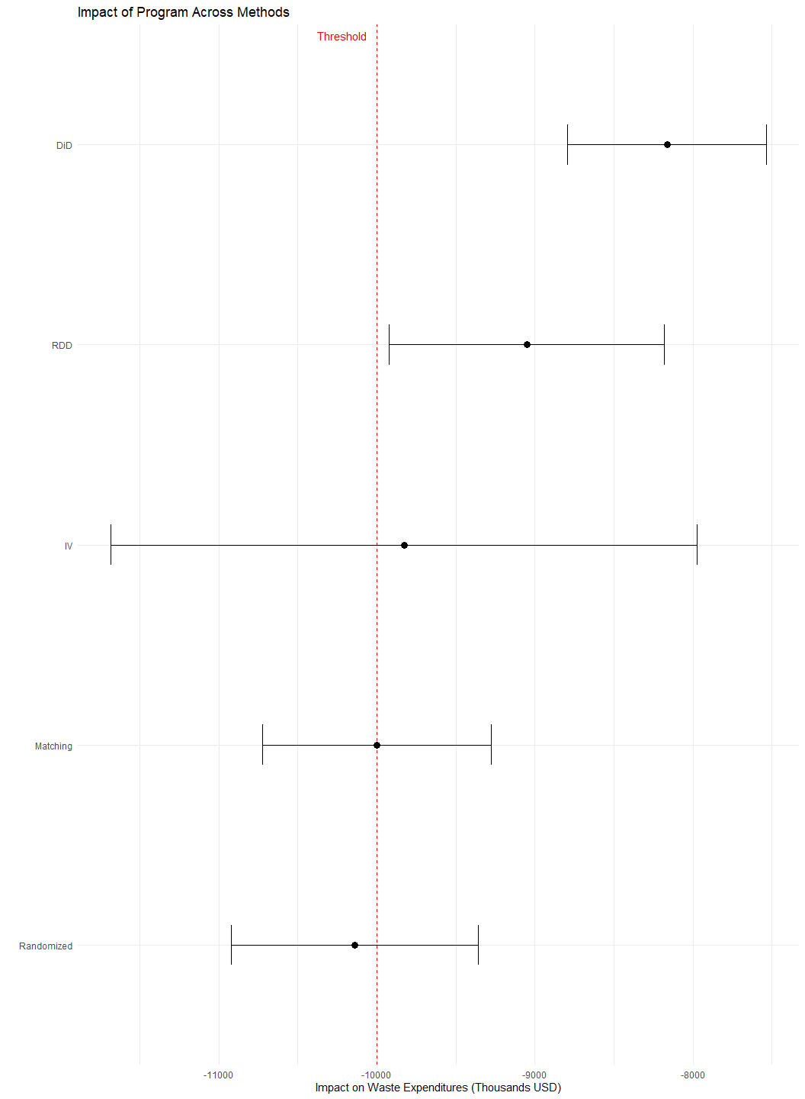
Recap: The Program Evaluation Challenge
Waste recycling Program subsidizes waste recycling plants for industries
Program goal: Reduce waste management costs
Decision criterion: Reduce expenditures by at least $10,000
Evaluation approaches:
✅ Randomized Assignment
✅ Instrumental Variables
✅ Regression Discontinuity
✅ Difference-in-Differences
✅ Matching

Slide 3
Synthesis of Results Across Methods
Method | Estimate | 95% CI | Key Assumption | Population
Randomized Assignment | -10,140 | [-10,922, -9,358] | Random assignment | All eligible
Instrumental Variables | -9,829 | [-11,684, -7,973] | Exclusion restriction | Compliers
Regression Discontinuity | -9,051 | [-9,921, -8,181] | No manipulation at threshold | At threshold
Difference-in-Differences | -8,163 | [-8,792, -7,534] | Parallel trends | All enrolled
Matching (Full) | -10,000 | [-10,723, -9,277] | Selection on observables | Matched enrolled
Synthesis of Impact Evaluation Results

Slide 4
Differences in estimates reflect different methods and populations
Randomized assignment is the gold standard
Quasi-experimental methods provide valuable complementary evidence
Triangulation of methods strengthens overall conclusions

Slide 5
Explaining Differences in Results
Estimation Differences:
Different identification strategies
Different modeling approaches
Different standard errors
Population Differences:
RDD: Households near poverty threshold
IV: Compliers who respond to promotion
DiD/Matching: Enrolled households
Randomized: All eligible households
Treatment Effect Heterogeneity:
Impact may vary across different types of households
E.g., poorer households may benefit more
Methods capture effects for different subpopulations
Data and Implementation:
Sample restrictions
Variable inclusion
Specification choices

Slide 6
Understanding R Implementation Across Methods
Method | Key Functions | Key Packages | Data Structure
Randomized Assignment | lm_robust() | estimatr | Cross-sectional
Instrumental Variables | iv_robust() | estimatr, AER | Cross-sectional
Regression Discontinuity | lm_robust(), rdrobust() | estimatr, rdrobust | Cross-sectional
Difference-in-Differences | lm_robust(), feols() | estimatr, fixest, did | Panel/repeated cross-section
Matching | matchit(), lm_robust() | MatchIt, estimatr | Cross-sectional
R Implementation of Impact Evaluation Methods

Slide 7
Common infrastructure: tidyverse for data manipulation
Robust standard errors essential for all methods
Modern implementations leverage recent methodological advances
Fixed effects approaches common in many methods

Slide 8
Common Analytical Steps Across Methods
Data Preparation
Identifying treatment and outcome variables
Creating necessary indicators or transformations
Handling missing data and outliers
Model Specification
Choosing appropriate functional form
Selecting control variables
Determining clustering level for standard errors
Assumption Validation
Testing method-specific assumptions
Assessing threats to validity
Examining balance or pre-trends
Robustness Checks
Alternative specifications
Placebo tests
Subsample analysis
Interpretation
Statistical vs. practical significance
Population to which results apply
Policy implications

Slide 9
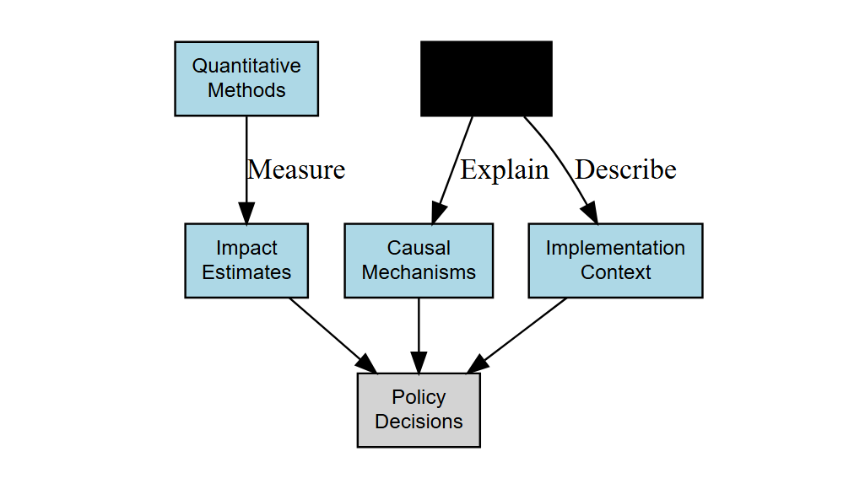
Integrating Qualitative and Quantitative Evidence
Beyond Impact Estimates:
Implementation context
Participant experiences
Unexpected outcomes
Mechanisms of impact
Mixed Methods Approach:
Impact evaluation: If it works
Process evaluation: How it works
Both needed for informed policy

Slide 10
Assessing External Validity
Will results generalize?
Sample vs. Population
How representative is the evaluation sample?
Which characteristics matter for generalizability?
Scale Effects
Will effects change at larger scale?
Are there general equilibrium effects?
Context Dependence
Which contextual factors matter?
How similar are implementation conditions?
Improving External Validity:
Stratified sampling designs
Ensure representative samples
Enable subgroup analysis
Multi-site trials
Test in varied contexts
Identify context dependencies
Structural modeling
Explore mechanisms
Simulate counterfactual scenarios
Meta-analysis
Synthesize multiple studies
Identify patterns across contexts

Slide 11
Cost-Effectiveness Analysis
Beyond impact: Is the program worth its cost?

Slide 12
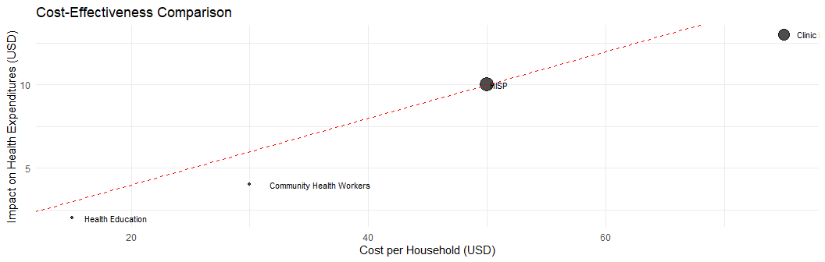
Steps in Cost-Effectiveness Analysis:
Calculate total program costs
Implementation costs
Administrative costs
Opportunity costs
Express impact in standardized units
Per beneficiary
Per dollar spent
Compared to alternatives
Comparing Interventions:

Slide 13
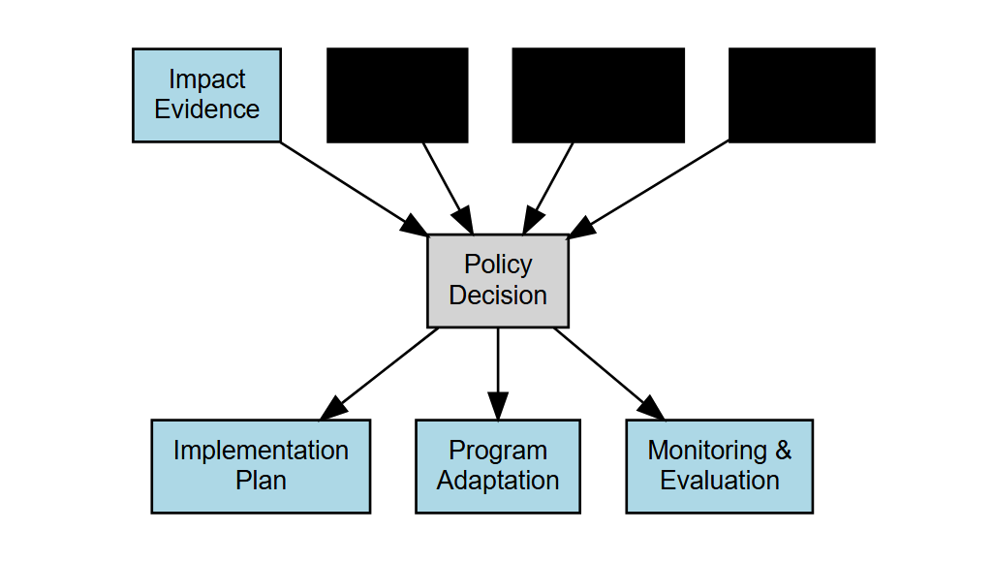
From Evidence to Policy Action
Policy Decision Making:
Statistical significance vs. practical significance
Weighing uncertain evidence
Value judgments: What outcomes matter?
Resource constraints and opportunity costs
Political feasibility
Implementation Considerations:
Design features to maintain or improve
Necessary adaptations for scale-up
Capacity requirements
Monitoring systems

Slide 14
Ethical Considerations in Impact Evaluation
Research Ethics:
Informed consent
Confidentiality and privacy
Equitable subject selection
IRB approval and oversight
Program Ethics:
Denying benefits to control group
Targeting most vulnerable
Balancing rigor with timely information
Transparency in findings
Ethical Frameworks:
Consequentialist
Benefits outweigh harms
Long-term social good
Rights-based
Protection of individual rights
Informed consent
Equitable treatment
Virtue Ethics
Researcher integrity
Stakeholder engagement
Responsible use of findings

Slide 15
Building an Impact Evaluation Mindset
Key principles for evaluation practitioners:
Counterfactual thinking
Always ask: “Compared to what?”
Identify appropriate comparison groups
Methodological pluralism
Choose methods to fit the context
Triangulate with multiple approaches
Assumption transparency
Clarify what must be true for results to be valid
Test assumptions where possible
Effect heterogeneity awareness
Look beyond average effects
Identify who benefits most/least
Implementation sensitivity
Programs are complex interventions
Context and implementation quality matter

Slide 16
R Skills for Impact Evaluation
Core Competencies:
Data manipulation with tidyverse
Regression analysis with estimatr
Data visualization with ggplot2
Reproducible workflows with R Markdown/Quarto
Method-Specific Packages:
MatchIt for matching
rdrobust for RDD
AER and ivpack for IV
did and fixest for DiD
Advanced Skills:
Power analysis with pwr
Robust standard errors with sandwich
Sensitivity analysis with sensemakr
Causal forests with grf
Synthetic control with Synth
Mediation analysis with mediation
Bayesian modeling with brms
Interactive apps with shiny

Slide 17
Resources for Further Learning
Books:
Gertler et al. “Impact Evaluation in Practice”
Angrist & Pischke “Mostly Harmless Econometrics”
Cunningham “Causal Inference: The Mixtape”
Huntington-Klein “The Effect”
Online Courses:
J-PAL’s “Evaluating Social Programs”
World Bank’s “Impact Evaluation Methods”
DataCamp’s “Causal Inference with R”
Websites & Communities:
3ie (International Initiative for Impact Evaluation)
J-PAL (Abdul Latif Jameel Poverty Action Lab)
World Bank DIME (Development Impact Evaluation)
R for Data Science Community
Stack Overflow for R questions
Journals:
Journal of Development Effectiveness
Journal of Policy Analysis and Management
American Economic Journal: Applied Economics

Slide 18
Course Summary
What we’ve learned:
Causal inference fundamentals
The counterfactual framework
Selection bias and confounding
Experimental and quasi-experimental approaches
Method-specific knowledge
When and how to apply each method
Key assumptions and limitations
Implementation in R
Practical skills
Data preprocessing and analysis
Results interpretation
Policy recommendations

Slide 19
Thank You!
Questions for discussion:
How would you design the national scale-up of the Program?
What additional data would you collect during scale-up?
How would you evaluate the long-term impacts?
What complementary interventions might enhance the Program’s effects?
Contact information: - Email: lsempe@3ieimpact.org - Website: www.3ieimpact.org - GitHub: github.com/lsempe77

