Slide 1
x86 HW4
2019. 05. 31
Jeon Jae Wook
Sungkyunkwan Univ.

Slide 2
Contents
Describe about 3rd Homework
4th Homework

Slide 3
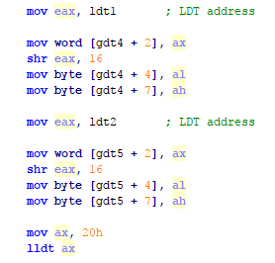
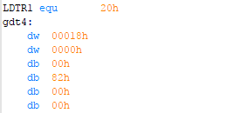
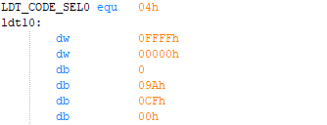
Describe about 3rd Homework
Make Local Descriptor Table(LDT)
Make a System Descriptor(LDT) in GDT
Load System segment selector (LDTR)
Load segment selector into LDTR
Base Address 15:0
Base Address 23:16
Base Address 31:24

Slide 4
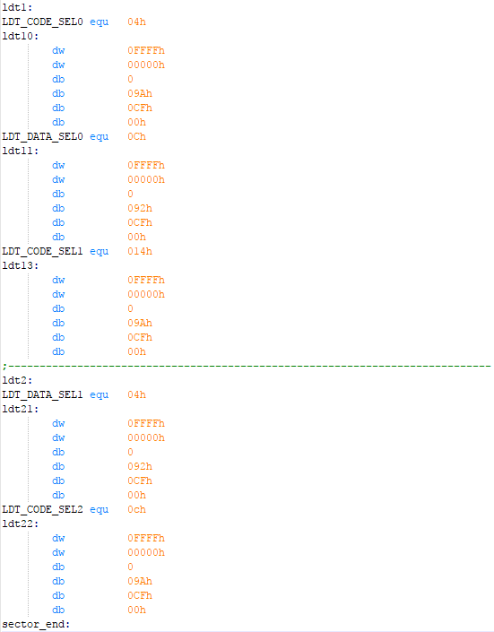
Describe about 3rd Homework
Local Descriptor Table

Slide 5
Describe about 3rd Homework
Far jump and call
Far jump
Jump to New EIP with New CS selector
Far call
Push EIP and CS selector of calling procedure
Jump to New EIP with New CS selector
Far return
Pop EIP and CS selector in stack
Jump to Old EIP with Old CS selector
Near return
Pop EIP in stack
Jump to Old EIP
Do not pop CS selector in stack

Slide 7
4th Homework
4th Homework Describe
Make tasks with TSS and LDT
Make TSS field
Make TSS descriptor in GDT
Make LDTR descriptor in GDT
Make LDT
Task Switching using CALL / IRET instruction
Initialize each TSS field
Load TSS selector into Task Register
Make one Task Gate descriptor in GDT
Switch task
Not use Task Gate
Use Task Gate

Slide 8
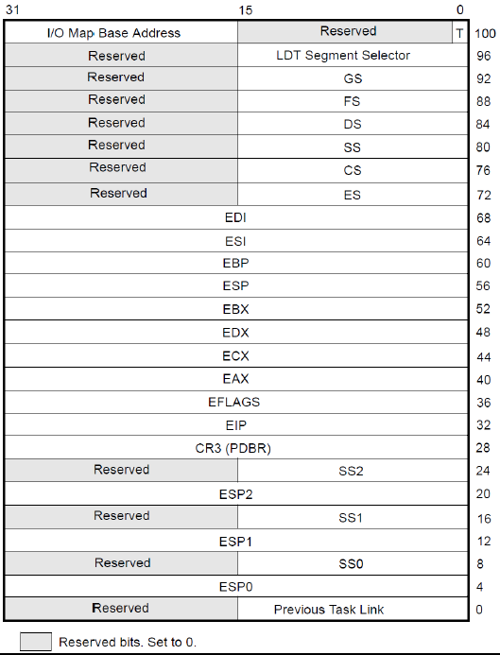
4th Homework
Make tasks with TSS and LDT
Make TSS field
First, set all values of TSS field to 0
This would be initialized before task switching
The registers are stored in here when task switching
Make 3 TSS for each task

Slide 9
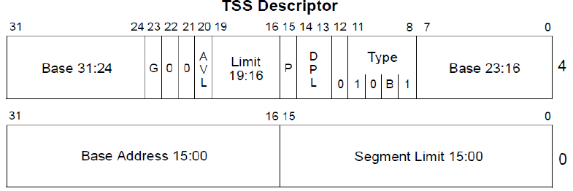
4th Homework
Make tasks with TSS and LDT
Make TSS descriptor in GDT
Base address : 0x00000000
Limit : 0x68
Type : System Descriptor, 32 bit TSS, Available
Other Information
In IA-32mode
Descriptor Privilege Level is 0
Present in Memory
Limit is interpreted in byte units
Not available for use by system software

Slide 10
4th Homework
Make tasks with TSS and LDT
Make LDTR descriptor in GDT
Base address : base address of LDT1, LDT2, and LDT3, respectively
Limit : limit address of LDT1, LDT2, and LDT3, respectively
Type : System Descriptor, LDT
Other Information
In IA-32mode
Descriptor Privilege Level is 0
Present in Memory
Limit is interpreted in byte units
Not available for use by system software
Make 3 LDTR descriptors in GDT
Each LDT is used in each task
Make LDT
Make descriptors in each LDT

Slide 11
4th Homework
Code Segment Descriptor
Base Address : 0x00000000 / Limit : 0xFFFFFFFF
Type : non-conforming, execute/read, not accessed
Other Information
In IA-32 mode and 32-bit code segments
Descriptor Privilege Level is 0
Present in Memory
Limit is interpreted in 4-Kbyte units
Not available for use by system software
Data Segment Descriptor
Base Address : 0x00000000 / Limit : 0xFFFFFFFF
Type : expand up, read/write, not accessed
Other Information
In IA-32 mode and 32-bit data segments
Descriptor Privilege Level is 0
Present in Memory
Limit is interpreted in 4-Kbyte units
Not available for use by system software

Slide 12
4th Homework
Global Descriptor Table
Index | Segment Selector | TYPE
0 | - | NULL Descriptor
1 | SYS_CODE_SEL | Code Segment Descriptor
2 | SYS_DATA_SEL | Data Segment Descriptor
3 | VIDEO_SEL | Data Segment Descriptor
4 | TSS1Selector | System Descriptor(TSS Descriptor)
5 | TSS2Selector | System Descriptor(TSS Descriptor)
6 | TSS3Selector | System Descriptor(TSS Descriptor)
7 | LDTR1 | System Descriptor(LDT)
8 | LDTR2 | System Descriptor(LDT)
9 | LDTR3 | System Descriptor(LDT)
10 | Task_Gate_Descriptor | System Descriptor(Task Gate)

Slide 13
4th Homework
Local Descriptor Table 1
Local Descriptor Table 2
Local Descriptor Table 3
Index | Segment Selector | TYPE
0 | LDT_DATA_SEL1 | Data Segment Descriptor
1 | LDT_CODE_SEL1 | Code Segment Descriptor
Index | Segment Selector | TYPE
0 | LDT_DATA_SEL2 | Data Segment Descriptor
1 | NULL0 | -
2 | LDT_CODE_SEL2 | Code Segment Descriptor
Index | Segment Selector | TYPE
0 | LDT_DATA_SEL3 | Data Segment Descriptor
1 | LDT_CODE_SEL3_0 | Code Segment Descriptor
2 | NULL1 | -
3 | LDT_CODE_SEL3_1 | Code Segment Descriptor

Slide 14
4th Homework
Task Switching using CALL / IRET instruction
Initialize each TSS field
TSS1
LDT Segment Selector : LDTR1
CS : Code segment selector of LDT1
DS, SS : Data segment selector of LDT1
ES : Video segment selector of GDT
EIP : task1
ESP : 0xA000
TSS2
LDT Segment Selector : LDTR2
CS : Code segment selector of LDT2
DS, SS : Data segment selector of LDT2
ES : Video segment selector of GDT
EIP : task2
ESP : 0xB000

Slide 15
4th Homework
Task Switching using CALL / IRET instruction
Initialize each TSS field
TSS3
LDT Segment Selector : LDTR3
CS : Code segment selector 0 of LDT3
DS, SS : Data segment selector of LDT3
ES : Video segment selector of GDT
EIP : task3
ESP : 0xC000

Slide 16
4th Homework
Task Switching using JUMP instruction
(Task0) → Task1
Use JUMP instruction
(Task0) →Task1 : Use Task Selector
Task Switching using CALL / IRET instruction
Task1 → Task2 → Task3
Use CALL instruction
Task1 → Task2 : Use Task Selector
Task2 → Task3 : Use Task Gate Descriptor1
Task3_Next → Task2 → Task1
Use IRET instruction
Transfer control (move other code segment)
Jump
Task3 → Task3_Next
Using LDT_CODE_SEL3_1 in LDT 3

Slide 17
4th Homework
Print Strings
Task1
“Task Switching Start” → Just after task1 execute
“Task1 switched BACK from Task2” → Just after return from task2
Task2
“Task2 switched from Task1” → Just after switching from task1
“Task2 switched BACK from Task3” → Just after return from task3
Task3
“Task3 switched from Task2” → Just after switching from task2
“Jumped to Task3_Next with LDT_CODE_SEL3_1” → Jump to another code segment in LDT3

Slide 18
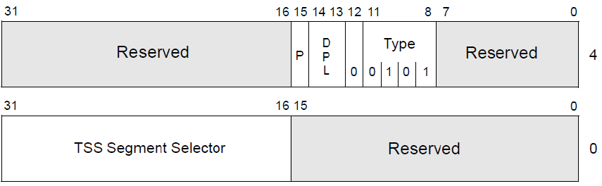
4th Homework
Task switching using Task Gate
Make Task Gate descriptor1 in GDT
TSS Segment Selector : TSS3Selector
Type : System Descriptor, Task Gate
Other Information
Descriptor Privilege Level is 0
Present in Memory

Slide 19
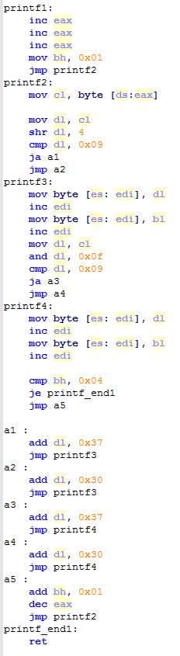
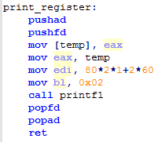
4th Homework
print_register
call print_register
Print the register on VMware
Print EAX register value

Slide 20
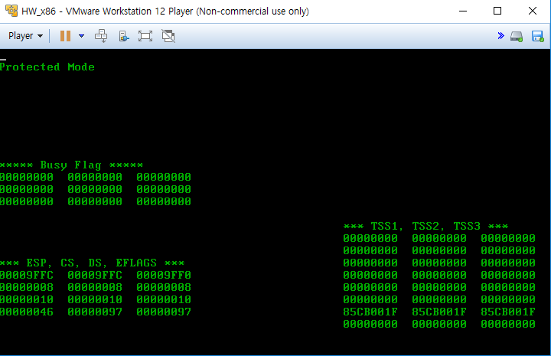
4th Homework
Initial program

Slide 21
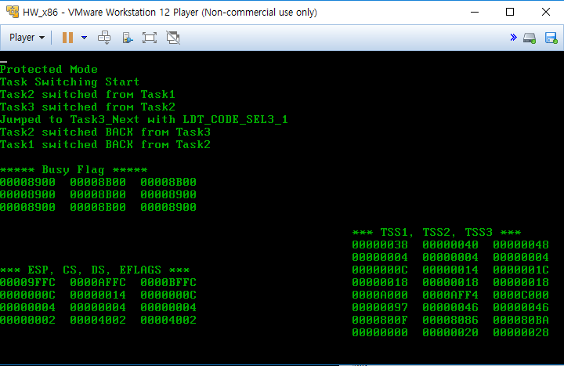
4th Homework
Result program
Task1
Task2
Task3
LDTR
DS
CS
ESP
ES
CS
ESP
DS
EFLAGS
EFLAGS
EIP
BACK LINK

Slide 22
4th Homework
Result program
EIP values in TSS can be different in your program
This value will be not checked
EFLAGS values can be different in your program
‘NT’ flag must be same with result in previous slide
Only this value will be checked

Slide 23
4th Homework
Time and Place
June 7th (Fri) 19:00
Semi-conductor building 2 floor computer room
400202, 400212
How to submit
.asm and .bin files
I-Campus, until June 7th 18:59
format
2010310000_HW4.asm
2010310000_HW4.bin

