Slide 1

Applications and Implications of The Universal Data Model
Sam Loy

Slide 2
“The more we understand the role information plays in our world, the more skillful citizens we will be.”
- James Gleick, Wired Magazine, March 2011
skillful

Slide 3

skillful
skillful
Skillful
Not “Better...”
Not “Stronger...”
Not “Evil...”
Not “Certifiable...”

Slide 4
Dipping the Cup
My Objectives for this Presentation...
Provide a high level technical overview of a DBMS using the UDM as the kernel.
Touch on the Strengths and Weaknesses.
Talk about a possible strategy to make money with it.

Slide 5
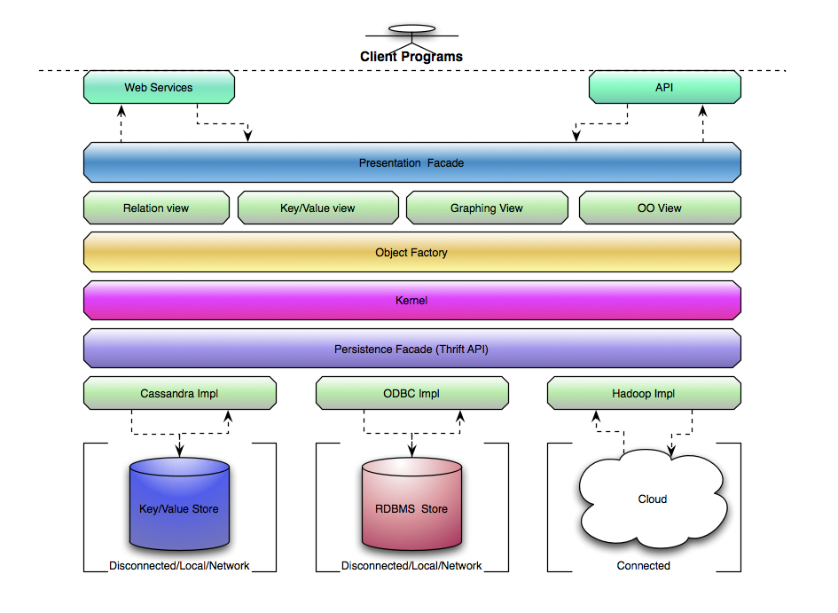
High Level Technical Overview (System)

Slide 6
Feature Highlights
ORM

Slide 7
Feature Highlights
Eliminates DAL forever - DAL is byte-code woven at runtime for client provided Meta Data
  Java Interfaces
  XML/XSD
  10x faster than Java 6 Reflection

Slide 8
Feature Highlights
Object Splicing
  Generate Objects heuristically
  Fetch only data needed for operation

Slide 9
Feature Highlights
Object Model Mapping
  Reinstate data from one object model into another
  Heuristically generate runtime object models
  Data model remains fully normalized

Slide 10
Feature Highlights
Realizes E.F. Codd’s fully Relational Data Model
  Data is naturally 6th Normal Form
  Eliminates need for surrogate PKs
  Naturally creates Referential Integrity

Slide 11
Feature Highlights
Last, but definitely NOT least....
  Can provide data context
  Can imply data context
  Can deliver data context
  Eliminates “Defining the World” for every new Software project

Slide 12
But, Why?
Traditional Data Modeling is becoming more and more futile.
The data being Modeled is changing from information Datum to Context Datum
Context, information, and discovery are changing so rapidly, that most Data Models are out-dated before they are completed.
Developer’s should be focused on solving problems, not regurgitating tired ORM layers.

Slide 13
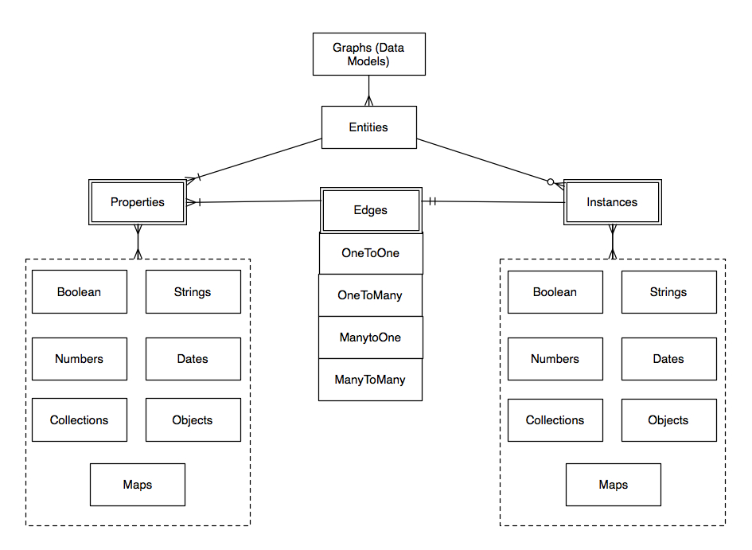
Quick look at the UDM Data Model...

Slide 14
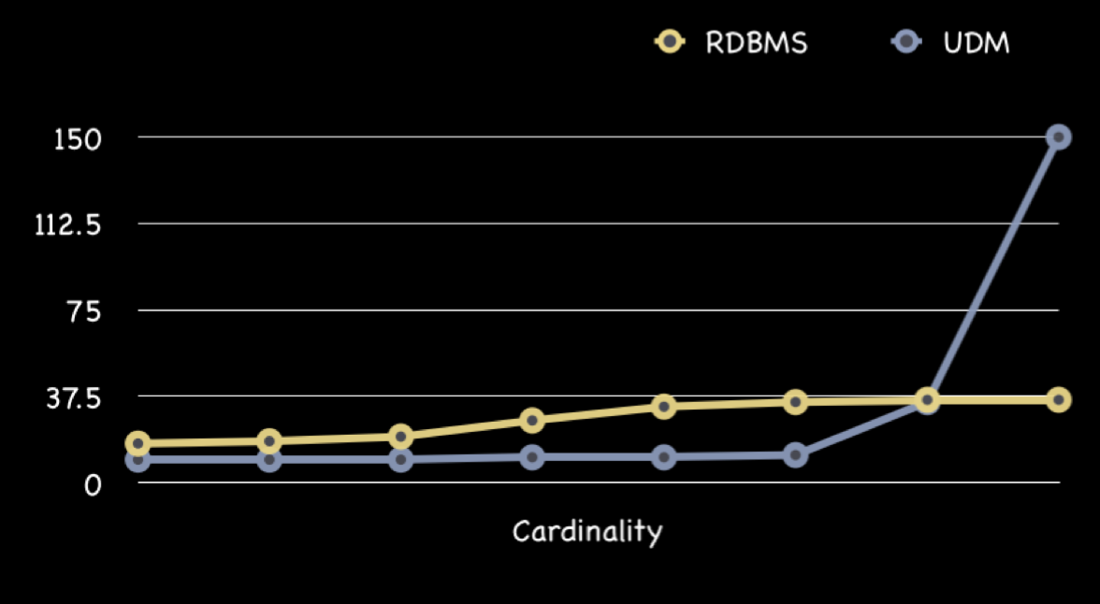
Weaknesses
The Cardinality Problem...

Slide 15
Weaknesses
Ad-hoc access to data is complex and non-intuitive
  There is no “Person” table
  Although SQL can be 100% supported, runtime “queries” must be transformed according to the underlying data store

Slide 16
Weaknesses
Lacking a known Mathematical model
  Relational Calculus/Algebra is well defined
  A new model is needed to understand how indexes can be created and utilized.

