Slide 1
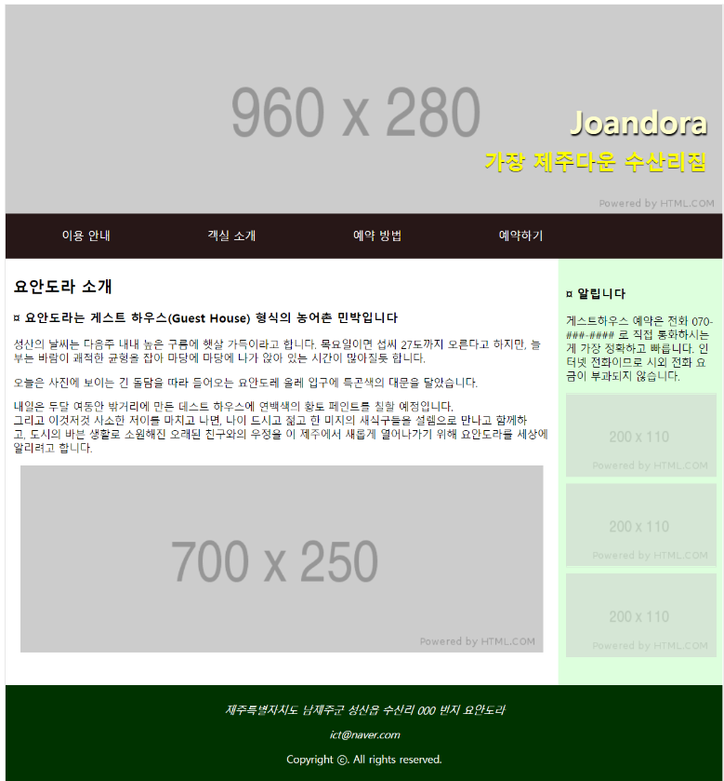
header
nav
h2
detail
p
image
section
aside
image
image
image
p
footer
p
p

