Slide 1



SAVEETHA INSTITUTE OF MEDICAL AND TECHNICAL SCIENCES
Capstone project presentation
SMART ATTENDENCE TRACKER USING RFID
CSA4101 – Internet of Things for Beginners
Guided By :
Dr. B. Prabakaran &
Dr. Geetha R
Presented by:
HARI PRASAD L S
(192413023)

Slide 2
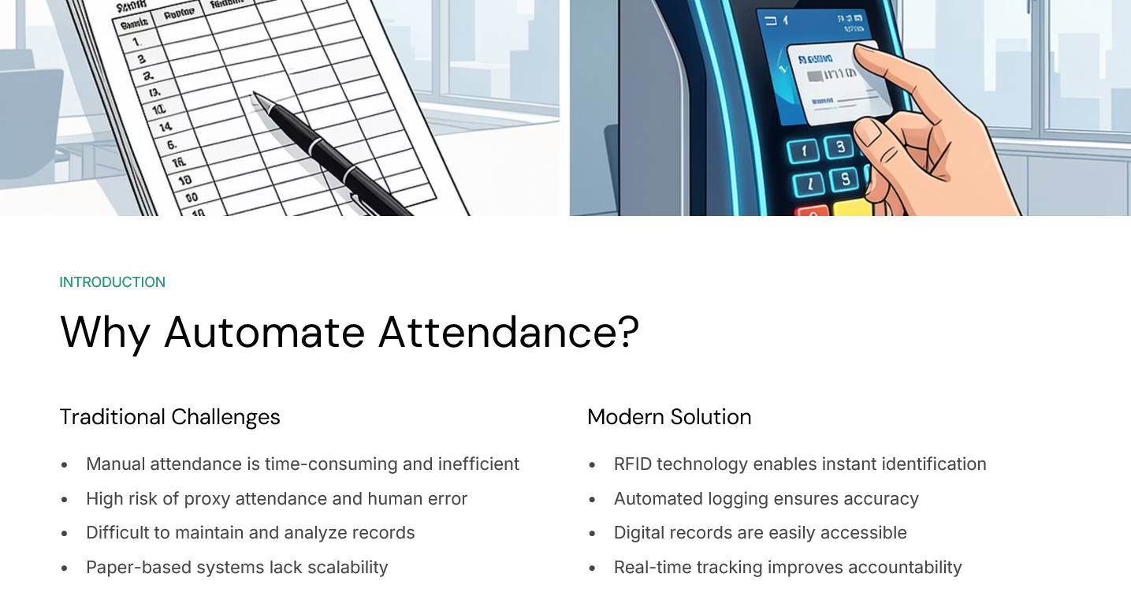





INTRODUCTION

Slide 3
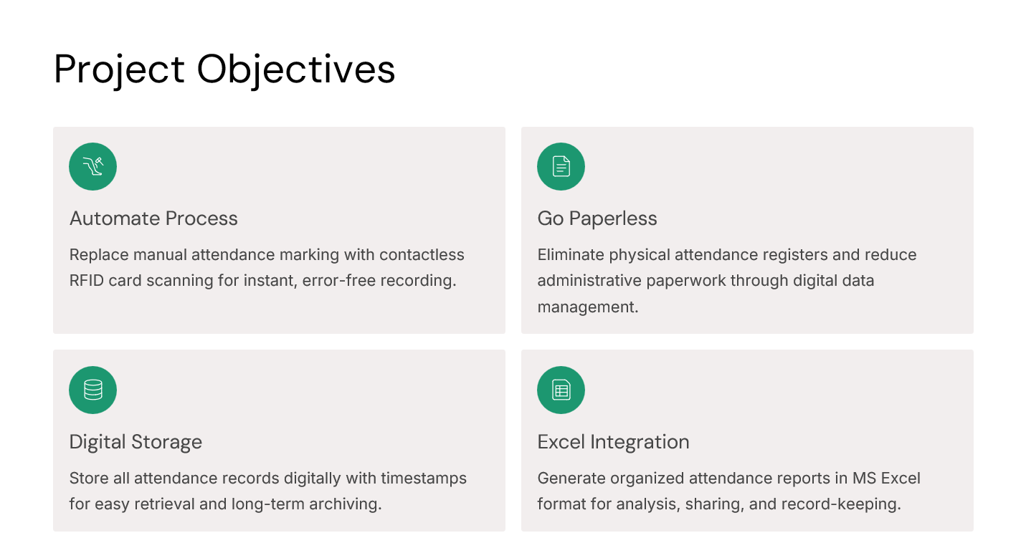

Slide 4
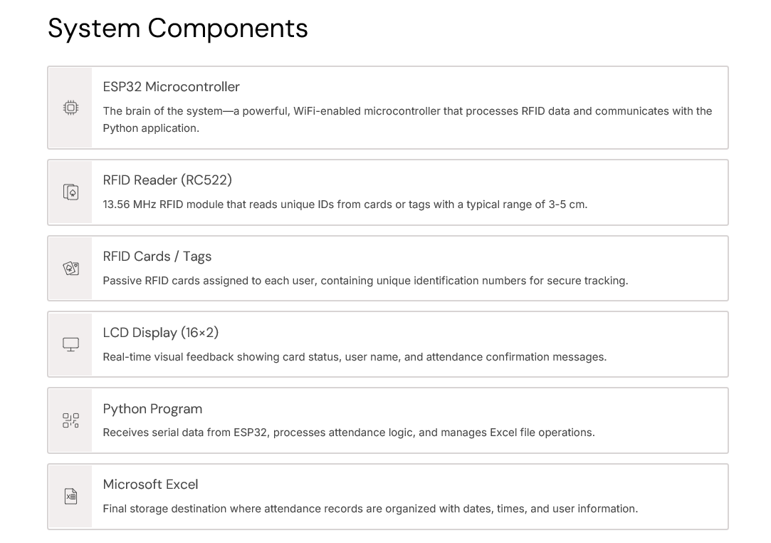

Slide 5
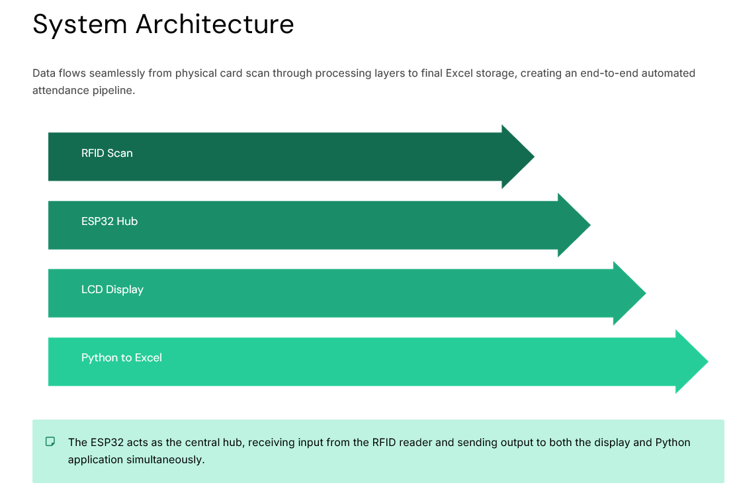

Slide 6
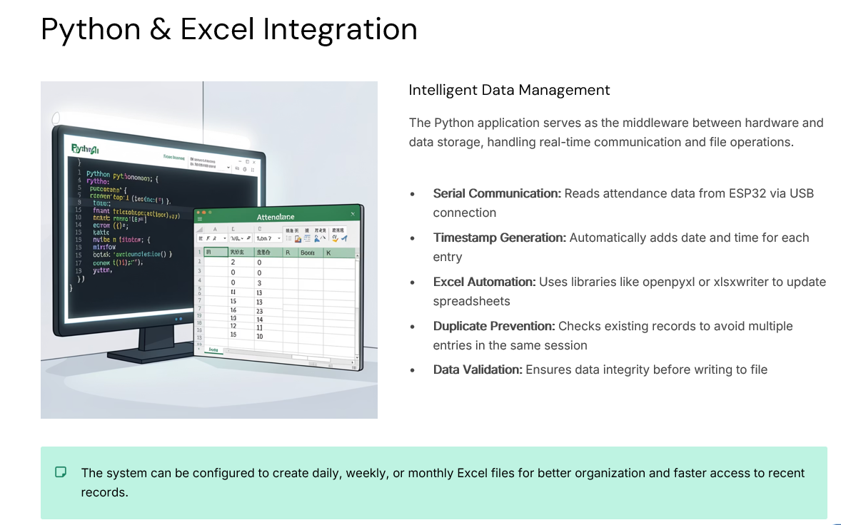

Slide 7
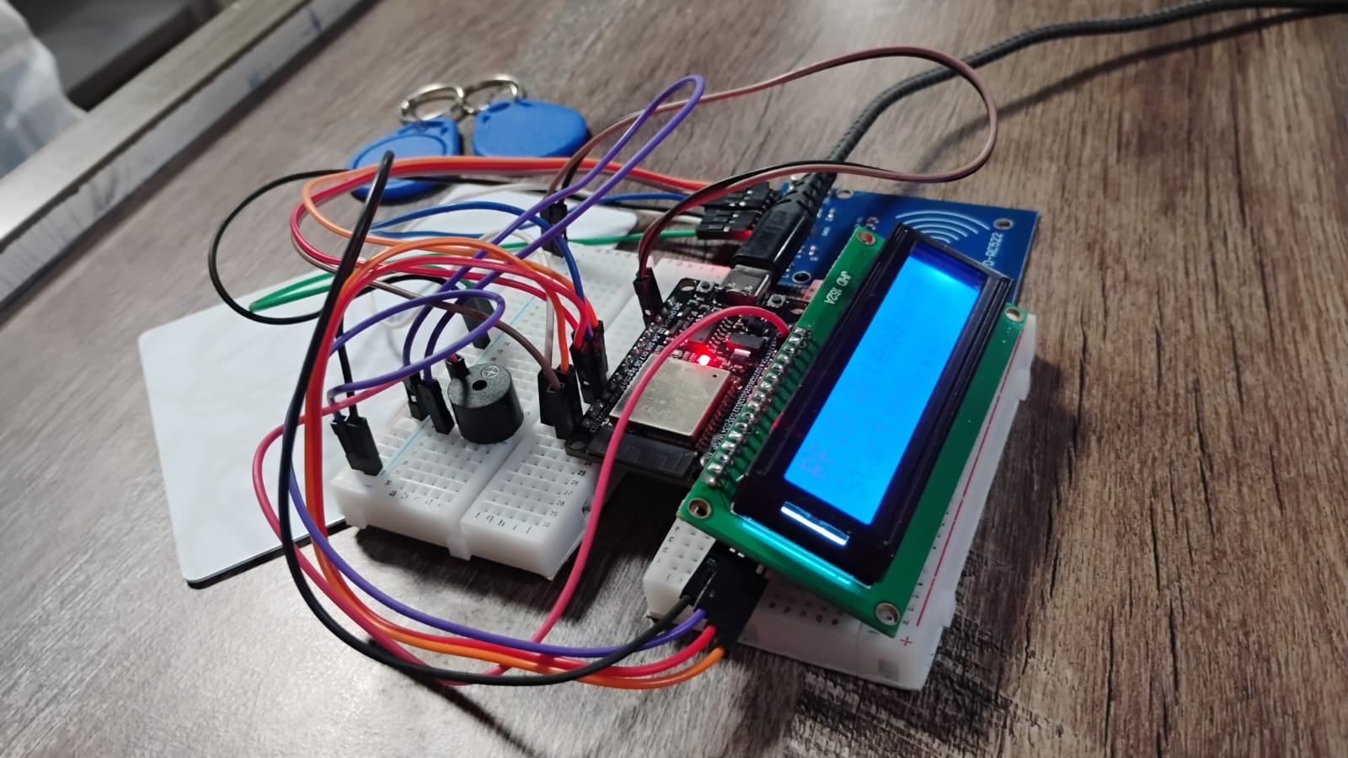
CIRCUIT DIAGRAM
24/11/2025

Slide 8


