Slide 1
Kformers: Enhanced Representations with Entities and Descriptions Qinghua Zhao, Jianxun Lian 1/5/2022

Slide 2
Motivation
Background
Pre-trained language models significantly boost the performances of various natural language processing (NLP) task.
Several knowledge enhanced approaches have been proposed to improve downstream tasks by leveraging the knowledge graph or knowledge base.
Two stages
Pre-training an encoder with knowledge-related corpus in a self-supervised manner (?).
Fine-tuning on specific downstream tasks.
Notes:
这里motivation相当于introduction的第一段
Introduction的第二段要介绍一下已有的知识增强的方法，归类，
例如从阶段上划分，分为在预训练阶段引入，在微调阶段引入，在两阶段引入等。直接的，辅助任务的
从使用知识种类上分：triple的，entity的，description的等，需要查看之前的survey。
在related work或者introduction位置提供一个表格。
--在introduction位置提供这个统计表格吧，related work至介绍几种。
--在related work位置提供表格

Slide 3
Motivation
Related Work
description is explicitly appended to input text
Description is always longer than original text, which dominant the input
Such as KT-attn
Description is used to represent entity during pre-training phase
Description plays implicitly in downstream task
Such as Kepler，太间接，造成资源浪费了，一过性计算，没有保存下来。TransE吧。
The interaction between entity and input-text is not fully explored
Such as ERNIE
Only a small number of entities are considered
Such as LUKE
Entity and description are not adopted simultaneously
How to enhance encoder with entity and description simultaneously?
Entity is used explicitly and implicitly, and more entities are considered
Description is process separately from original input text
Description representation influence the representation of original input or entity in an implicitly manner
Entity and description is used in both pre-training and fine-tuning phase
Notes:
这儿写什么呢？1. 介绍使用KG的工作。2. 介绍只使用entity or description的工作？
只介绍使用了entity或description的方法
ERNIE使用的entity， LUKE使用了entity， Kadapter使用的依存解析和关系分类预训练任务（它还作为baseline吗？它思想很好，但是这两个任务一般）
KT-attn使用了description
kepler使用了description和entity，算是吧？
这儿相当于introduction的第三段。
Motivation，已有方法的不足，已有的方法有使用entity信息的，有使用description信息，但是没有两者都使用的。其次各自有不足。

Slide 4
Method Architecture
第一个版本
output
des-aware aggregation
Layer L1
Layer L2
des-aware aggregation
…
…
Layer 2
Layer 2
des-aware aggregation
Layer 1
Layer 1
embedding
embedding
entity embedding
long description
original text
entities
输入：包括原始文本和实体

Slide 5
Method Architecture
第2个版本
output
Layer L1
Layer L2
…
…
Layer 2
Layer 2
Layer 1
Layer 1
embedding
输入：包括原始文本和实体
embedding
entity embedding
long description
original text
entities

Slide 6
Method
K-module pre-training
Prediction layer
K-module
Overview
descriptions
Fine-tuning for downstream tasks
Prediction layer
Encoder
K-module
Input & entity & short des
descriptions
Notes:
Pre-training task: predict entity according to description. Predict short description according to long description.
Full word & subword

Slide 7
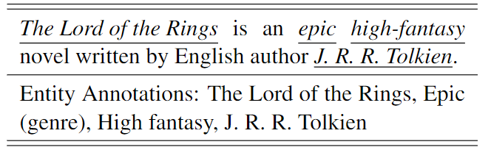
Method
第一个版本
Pre-training knowledge module
output the entity embedding and description embedding
The former is stored in entity embedding
The latter is cached during pre-traing
The network itself is injected knowledge
The embedding is what we want
predict entities in Wikidata by sentence embedding
Layer L2
predict entities in Wikidata by MLM
…
Layer 2
Layer 1
embedding
input: description
target: QID
QID=5001
Notes:
只使用最后一层

Slide 8
Method
第2个版本
Pre-training knowledge module
output the entity embedding and description embedding
The former is stored in entity embedding
The latter is cached during pre-traing
The network itself is injected knowledge
The embedding is what we want
predict entities in Wikidata by sentence embedding
Layer L2
…
Layer 2
predict entities in Wikidata by MLM
Layer 1
embedding
input: description
target: QID
QID=5001
Notes:
较低的层预测句子里的entity，较高的层预测整句的entity？

Slide 9
Method
Fine-tuning for downstream tasks
Layer L1
Layer L2
des-aware aggregation
…
…
Layer 2
Layer 2
des-aware aggregation
Layer 1
Layer 1
embedding
embedding
long description
original text
entities
short des
Notes:
右面是fixed
拼接，entity显式
Description分开处理->K-module
Description的影响隐式->des-aware aggregation
FT & PT都有entity & description
这个依然是微调阶段的框架，介绍也是介绍这个包括：entity显示拼接，并且隐式也使用缓存的entity embedding拼接。显示拼接的算到max_seq_length中去，隐式拼接的是额外的，需要固定数量，多的截取，少的pad。
也可以这样做：des-aware这部分是直接的entity embedding，des embedding和句子embedding拼接。
记住：知识模块的表征维度要降低，参考albert，不要768维，太大了。
不是每个original text都使用entity和short description，哪部分用呢？

Slide 10
Method
des-aware aggregation
compute the interaction between input representation, entity representation and description representation
the interaction is modeled by self-attention
gate mechanism is designed to select whether the description representation is accepted
the description-aware input, entity description is used as output, and then input into next layer
The motivation is that description representation influence input & entity representation in a implicitly manner. Besides, only selective description are used. Through the gate, we can control the description, for example, only tail entity’s description is accepted, frequent entity are refused to use description information.
Notes:
这个聚合模块：
计算输入，实体，描述三者之间的交互作用
交互使用的self-attention建模的，我觉得直接拼接就好了
这儿可以设置一个门机制，看motivation，tail entity才给用description，frequent的不给用。这样的motivation设计的门也可以。一篇tail entity的NER论文有写，有参考文献。
这儿也不太对，tail entity都没有描述，怎么使用？上述论文也提到了，参考一下。这里先不提门控机制了。

Slide 11
Method
Fine-tuning for downstream tasks, to reduce the inference time:
cache entity & description embedding, it is possible, since the description of each given entity is fixed.
Layer L1
Layer L2
des-aware aggregation
…
…
Layer 2
Layer 2
des-aware aggregation
Layer 1
Layer 1
embedding
embedding
long description
original text
entities
short des
Notes:
右面是fixed
拼接，entity显式
Description分开处理->K-module
Description的影响隐式->des-aware aggregation
FT & PT都有entity & description
这是inference阶段，为了尽可能的降低推理时间，将知识模块看作一个知识库，缓存了实体embedding和description每一层的表征。

Slide 12
Experimental setup
Dataset:
knowledge-oriented, Entity typing task, relation classification task. Because, several knowledge-enhanced methods have been tested on these datasets.
general task. Because we start our work from EEM, it belong to this category. Besides, we want to explore to improve these task by knowledge injection. For example, EEM, QQP, SST2/SST5.
baselines for the former task: ERNIE-THU, Kepler, Knowbert, K-Adapter, LUKE
baseline for general task: KT-E/D，KG-emb ，KT-emb ，KT-attn ，ERNIE (optional), Kepler, Knowbert, K-adapter, LUKE

Slide 13
Experimental results
Main results
知识相关任务的结果
General 任务的结果
Ablation results（重点）
改变entity：挨个去掉，替换成默认entity，替换成random entity
改变description：去掉knowledge module，KM后训练和非后训练
改变entity-description：
Input text-entity-description相互影响（full）
Entity-description之间相互影响，然后对input-text相互影响
Entity，description，input-text各自影响
验证coverage的影响
统计或变化coverage，观察结果变化
需要分析不同的知识，不同的模块对两种任务的不同影响
可能得出的结论：1. entityName对两种任务都很重要，对前者更重要 2. 知识的coverage对结果是否提升很重要 3. entityName显示拼接更好，再进一步加隐式使用更更好
LAMA task
预测entity（multiple word）？
验证inject知识？
Entity embedding
目的：测试entity embedding获得类似TransE的语义特征？
Description embedding
目的：测试description embedding获得句子表征？
Entity-description相似度
测试entity，description表征的语义相似程度？
Notes:
推理时间如何也要测试。将知识模块当作知识库之后，推理时间增加应该很少很少

Slide 14
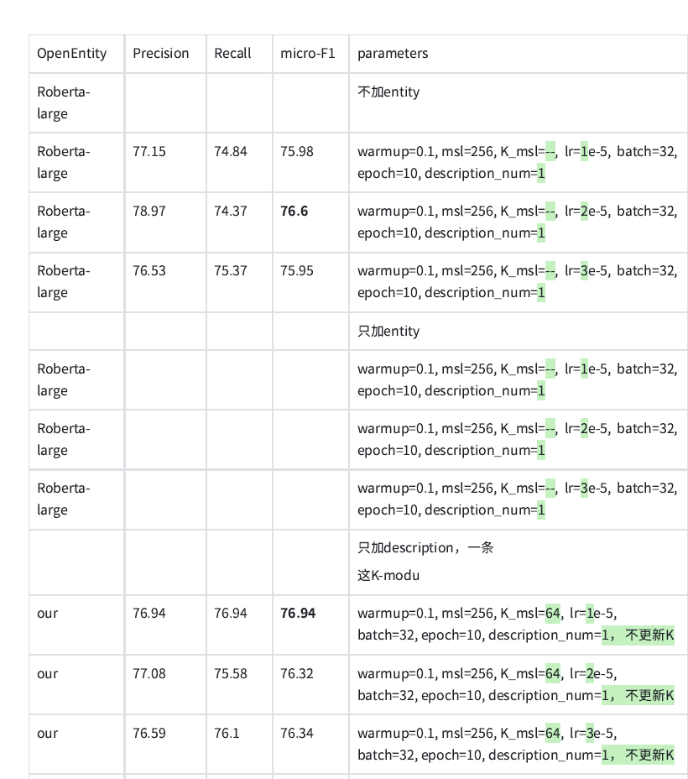
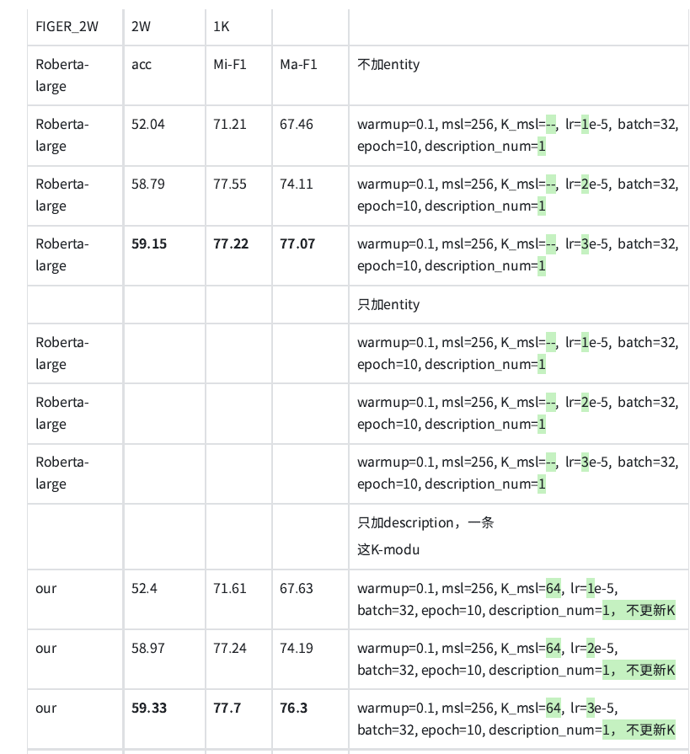

Slide 15
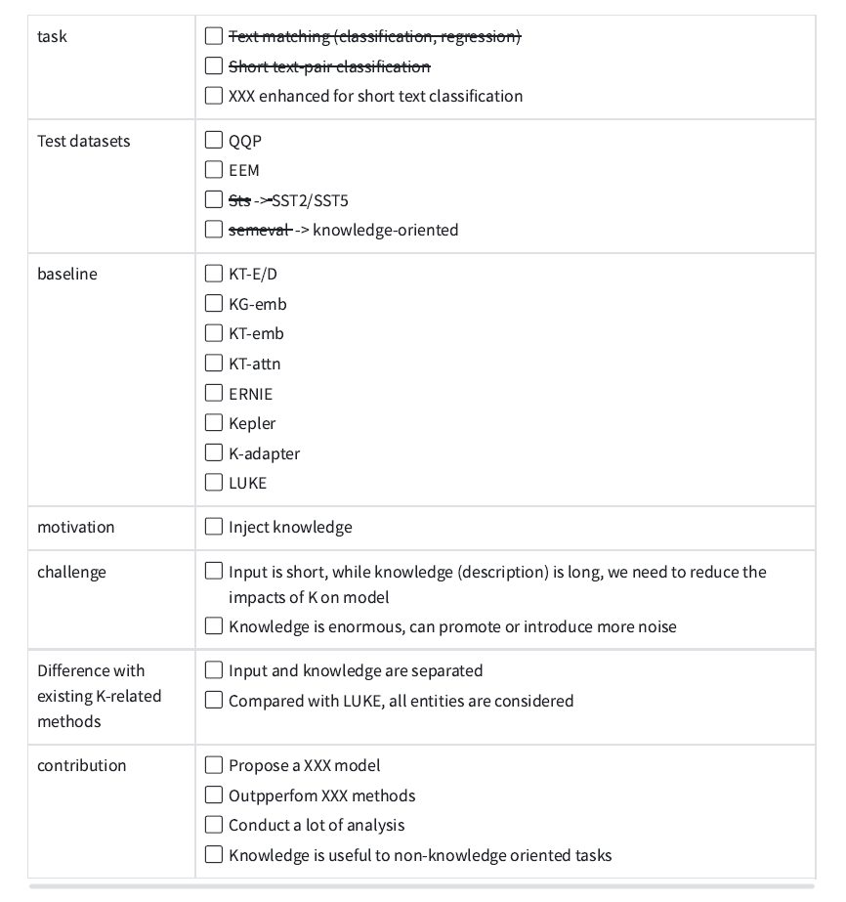

Slide 16
Notes:
总结各种预训练语料

