Slide 1

AI for drug resistance prediction
Linfeng.wang@lshtm.ac.uk

Slide 2
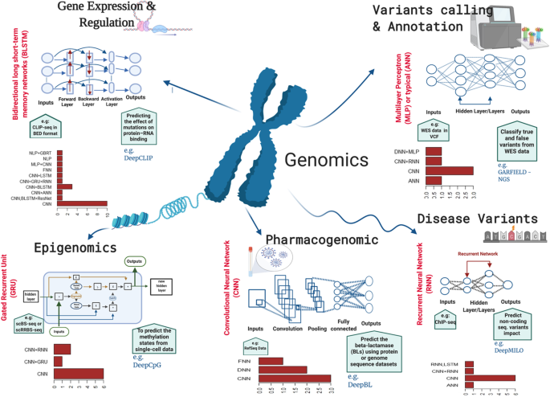
ML based genomic tools
Alharbi et al 2022

Slide 3
Machine learning (ML) based tools
Variant Calling and Annotation:
DeepVariant, Clairvoyante (CNN)
Disease Variant Prioritization:
PrimateAI, DeepWAS (CNN)
Gene Expression and Regulation:
Xpresso, SpliceAI (CNN)
Epigenomics and 3D Chromatin Structure:
Basenji and DeepMILO (CNN + RNN)

Slide 4
Machine Learning
Artificial Intelligence is a scientific field concerned with the development of algorithms that allow computers to learn without being explicitly programmed
Machine Learning is a branch of Artificial Intelligence, which focuses on methods that learn from data and make predictions on unseen data
Labeled Data
Machine Learning algorithm
Training
Prediction
Labeled Data
Learned model
Prediction
Picture from: Ismini Lourentzou – Introduction to Deep Learning

Slide 5
Comparison
 | Database Approach | Machine Learning Approach
Interpretability | High – Directly links | Low to Medium – Feature importance methods needed
Computational Cost | Low – Simple matching algorithms | High – Requires model training and tuning
Speed of Prediction | Very Fast – Simple lookup operations | Slower – Requires inference from trained models
Ability to Detect Unknown Resistance | No – Limited to known mutations | Yes – Can infer novel resistance mechanisms
Handles Epistasis (Gene Interactions) | No – Cannot model complex genetic interactions | Yes – Can learn relationships between mutations
Data Requirement | Low – Only needs a mutation database | High – Requires large, labeled genomic datasets
Adaptability to Emerging Resistance | Low – Needs frequent manual updates | High – Can adapt dynamically with new training data

Slide 6
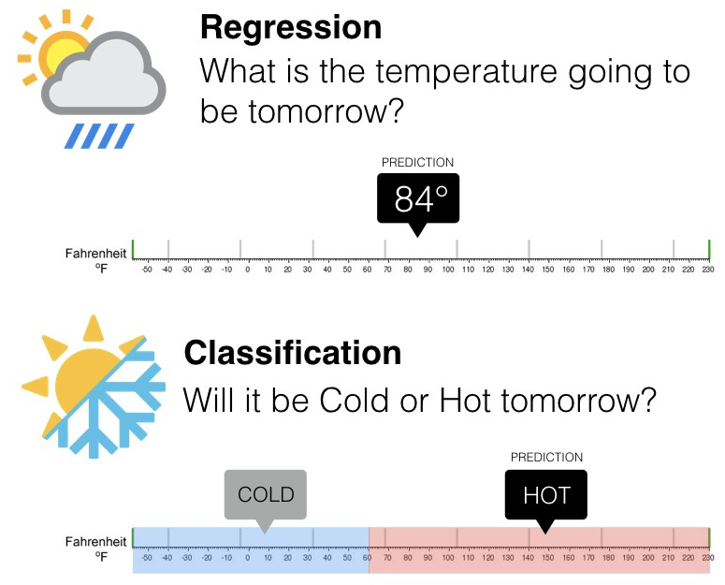

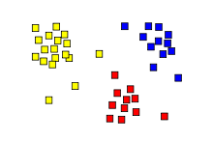
Machine learning types
Supervised: learning with labeled data
Regression: predict a continuous quantity (Minimum inhibitory concentration)
Classification: predicts discrete class labels. (Drug resistance)
Unsupervised: discover patterns in unlabeled data
Example: cluster similar data points (PCA)
class A
class B
Clustering
Classification
Regression
Ismini Lourentzou – Introduction to Deep learning
Springboard: regression-vs-classification

Slide 7
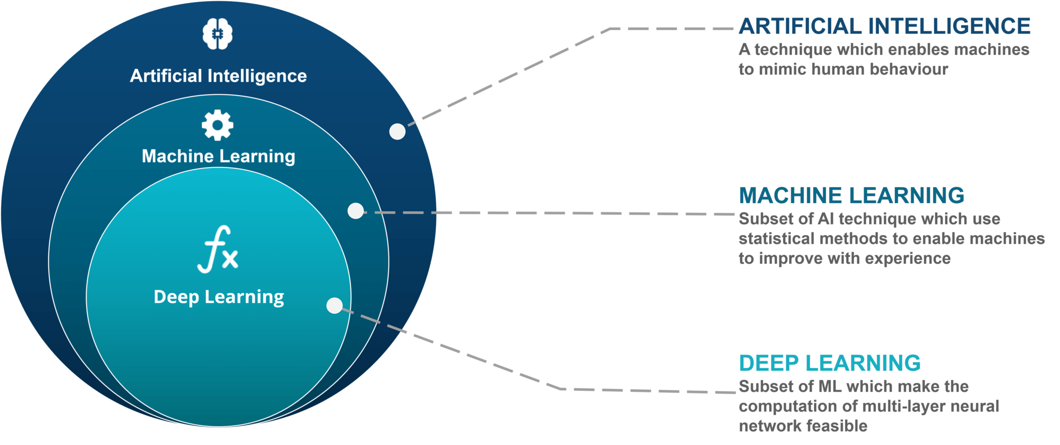
Deep Learning

Slide 8
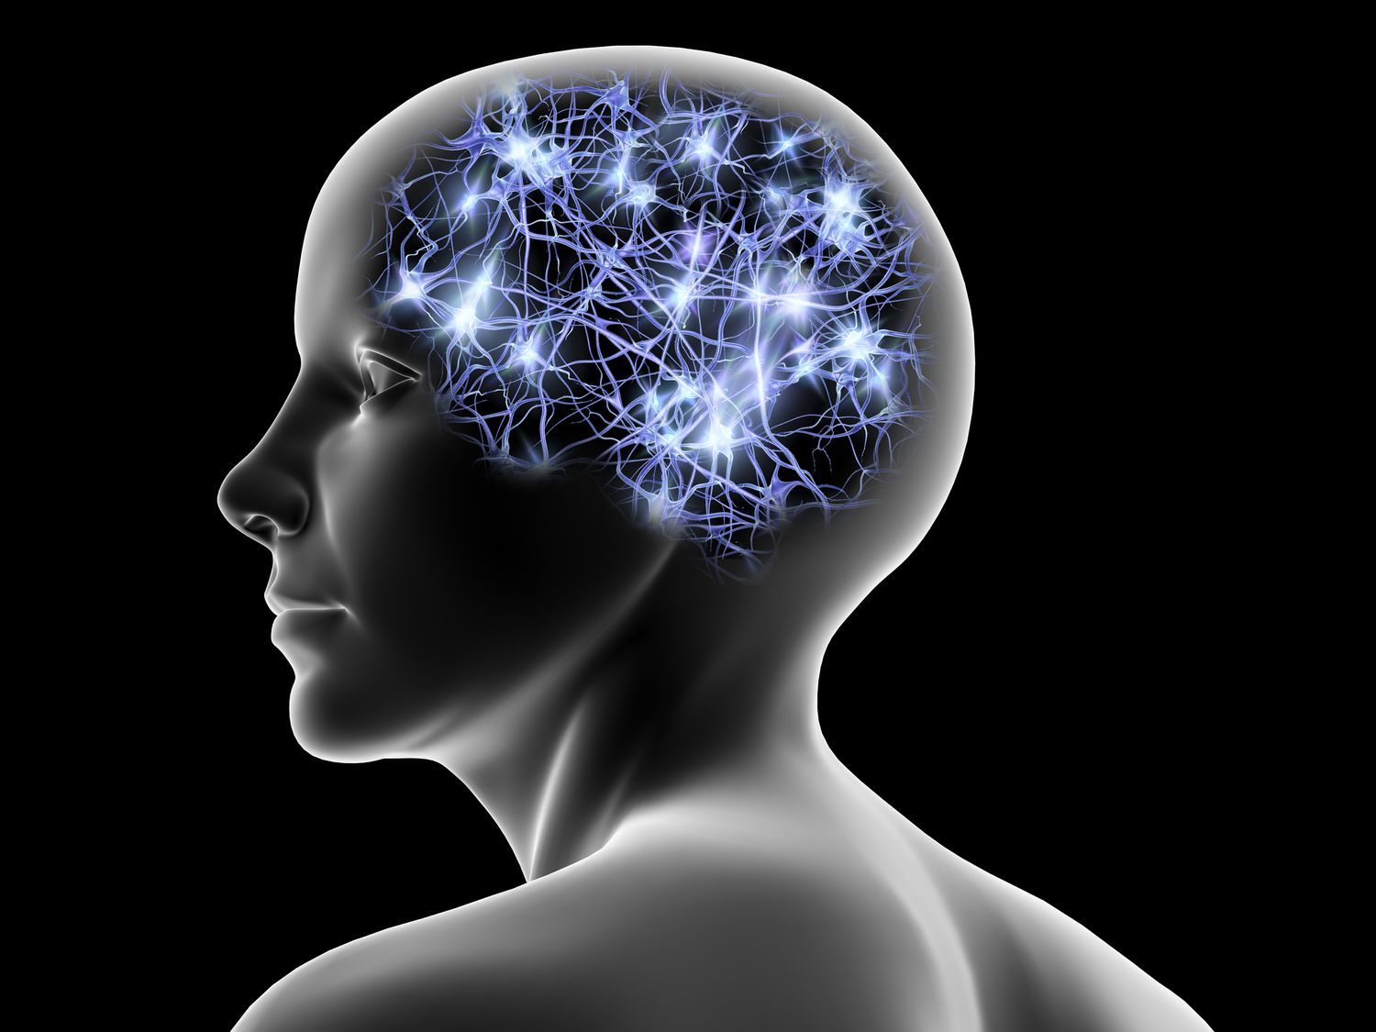
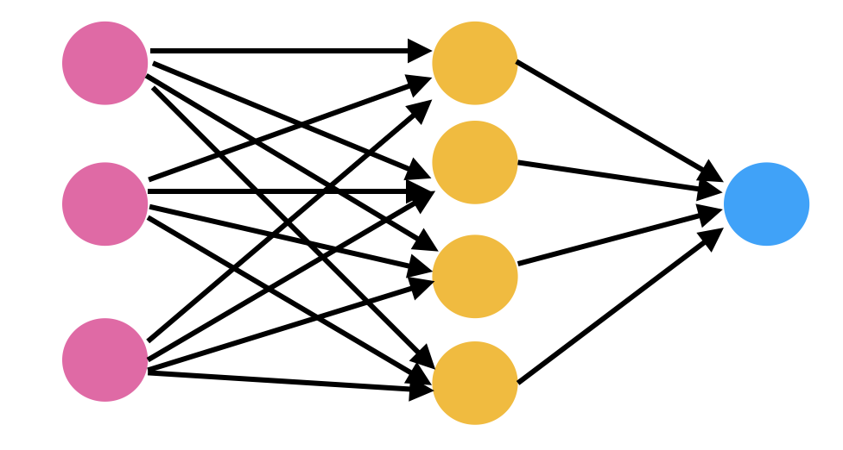
Neural network
Inputs
- DNA sequence
- DNA alignment
Outputs
- Does it have resistance to rifampicin?

Slide 9
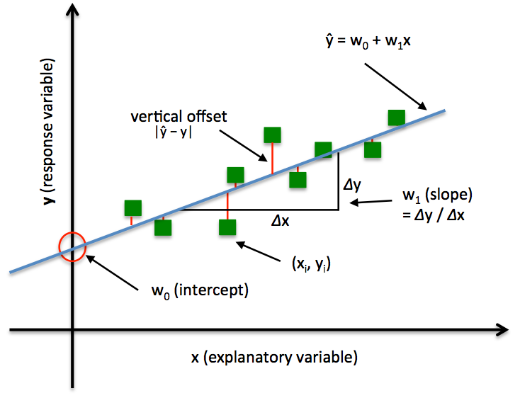
Linear Regression
http://rasbt.github.io/mlxtend/user_guide/regressor/LinearRegression/

Slide 10
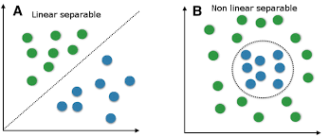


Non-linearity
For some tasks, input data can be linearly separable, and linear classifiers can be suitably applied
For other tasks, linear classifiers may have difficulties to produce adequate decision boundaries

Slide 11


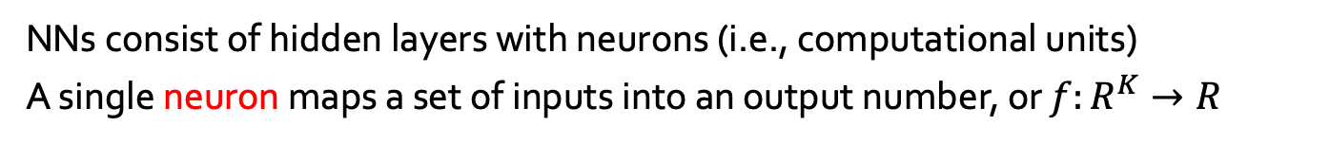
Single-Layer neural network
NNs consist of hidden layers with neurons (i.e., computational units)
A single neuron maps a set of inputs into an output number, or $f:R^{K}→R$
+ b1 + b2 + … + bk
Multiple linear regression like
…
$$a=σ\left(z\right)$$
…
output
Activation function
Weights
(Slope)
input
Hung-yi Lee – Deep Learning Tutorial

Slide 12
Multi-Layer neural network
Deep NNs have many hidden layers
Fully-connected (dense) layers (a.k.a. Multi-Layer Perceptron or MLP)
Each neuron is connected to all neurons in the succeeding layer
Input
Layer 1
Layer 2
Layer L
Output
……
y₁
……
y₂
……
……
……
……
……
……
y_{M}
Input Layer
Output Layer
Hidden Layers
Hung-yi Lee – Deep Learning Tutorial

Slide 13

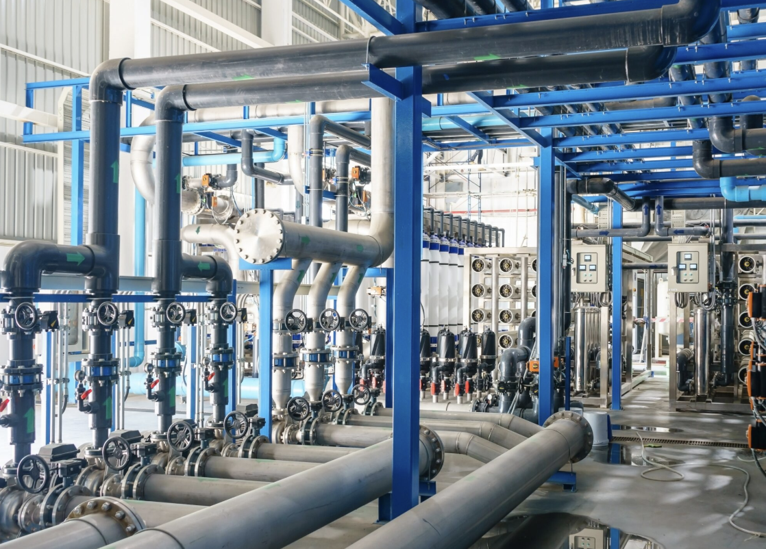

Intuition
Raw data
The processed outputs
The neural network pipeline

Slide 14
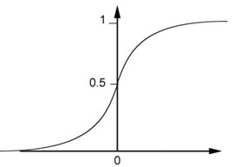


Activation function
The activation function controls the flow of numbers between layers
Activation function also introduce non-linearity into the output of a neuron.
$$\left(1∙1\right)+\left(−1\right)∙\left(−2\right)+1=4$$
4
0.98
Sigmoid Function
1
1
-2
1
-1
-2
0.12
-1
1
0
1 $∙ \left(−1\right)+\left(−1\right)∙1+0=$-2
Hung-yi Lee – Deep Learning Tutorial

Slide 15
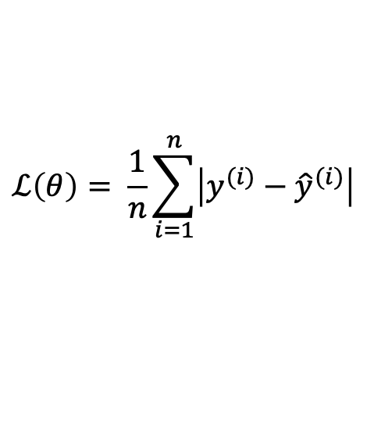
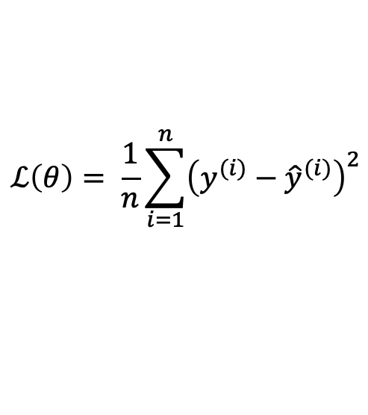
Loss function
Training
examples
Pairs of 𝑁 inputs $x_{i}$ and ground-truth output values$y_{i}$
Output
Layer
Linear (Identity) or Sigmoid Activation
$$ℒ\left(θ\right)= \frac{1}{n}\sum_{i=1}^{n}{{\left(y^{(i)}−{\hat{y}}^{(i)}\right)}^{2}}$$
Mean Squared Error
Loss function
$$ℒ\left(θ\right)= \frac{1}{n}\sum_{i=1}^{n}{\left|y^{(i)}−{\hat{y}}^{(i)}\right|}$$
Mean Absolute Error
Hung-yi Lee – Deep Learning Tutorial

Slide 16
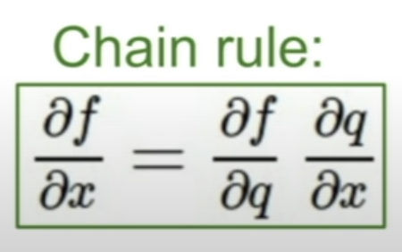
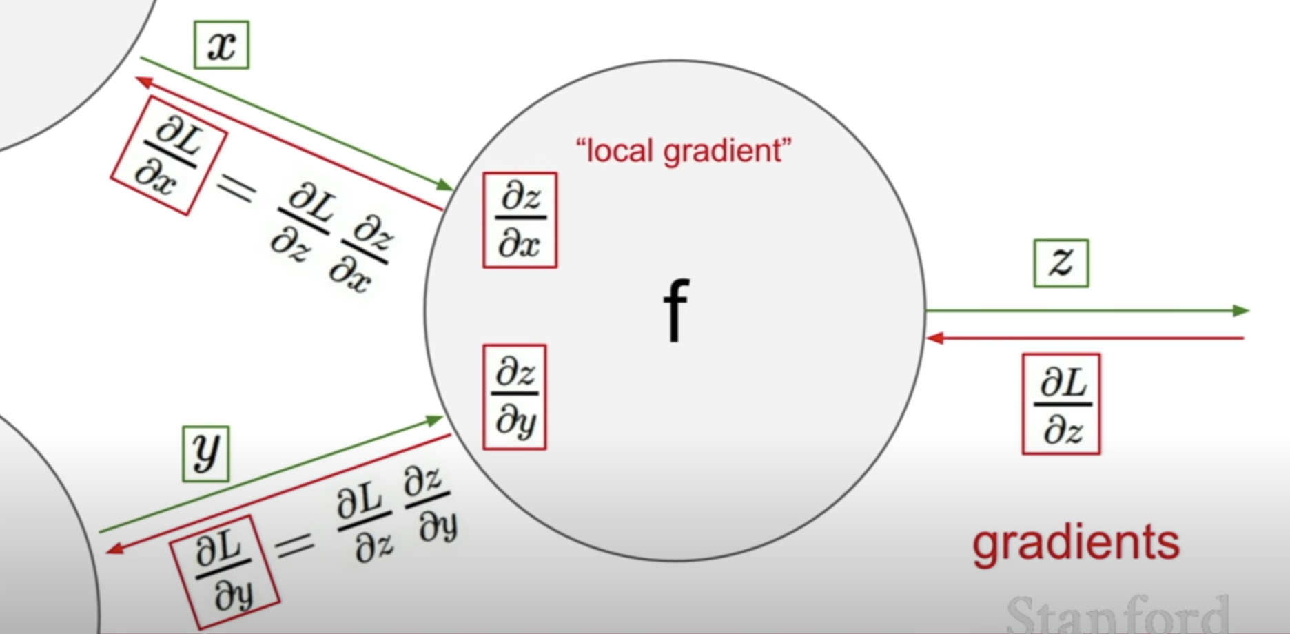

Backpropagation
Standford University CS231n

Slide 17
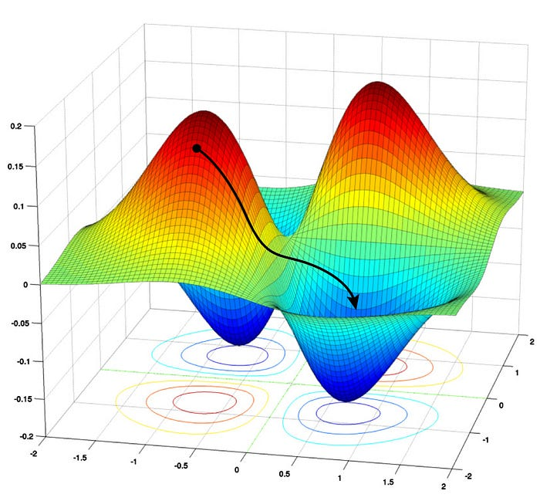
Loss landscape
Landscape of loss
Reduce loss
Reduce error the model makes
Going from read to blue
Y-axis:
The amount of error the makes
(aka Loss)
Z-axis:
Model parameter
X-axis:
Model parameter

Slide 18
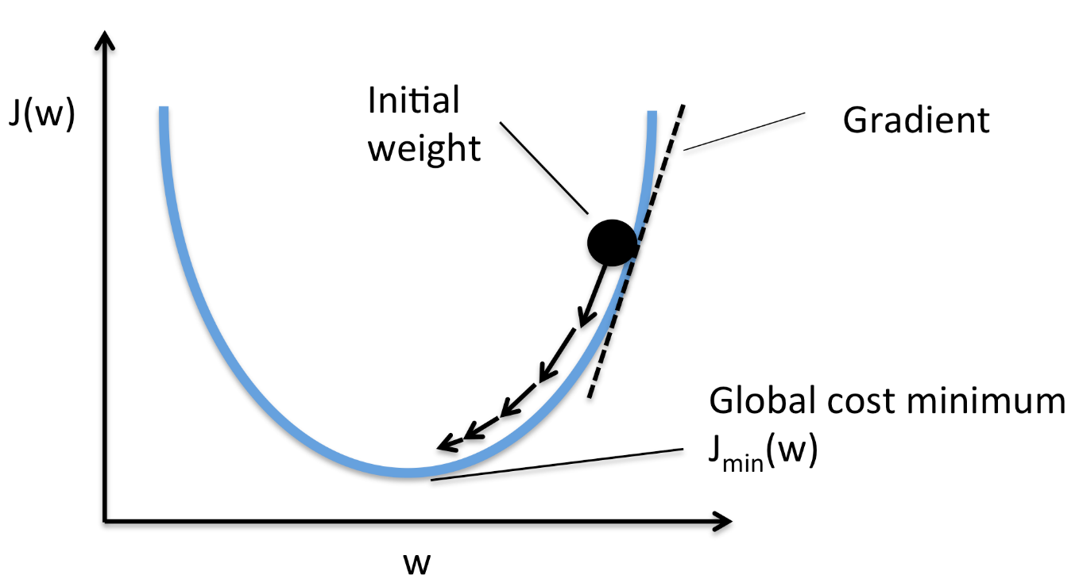
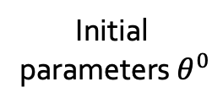

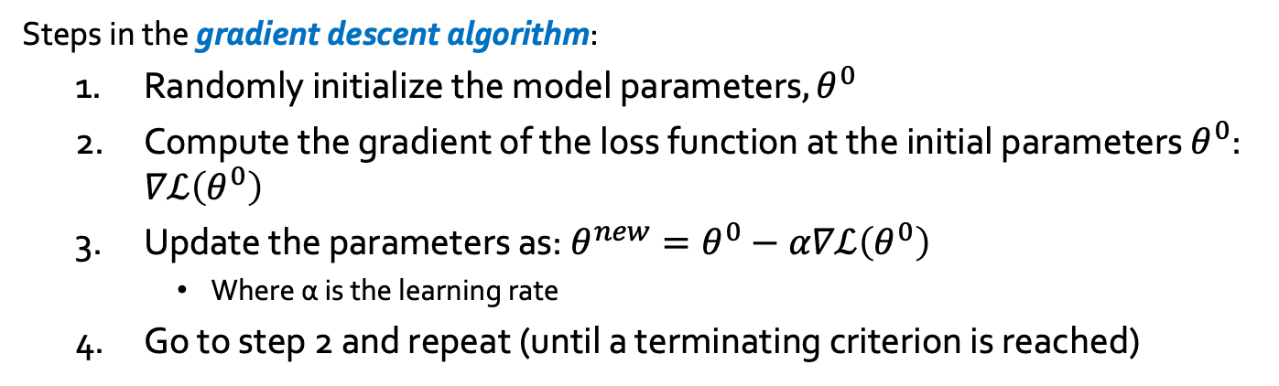
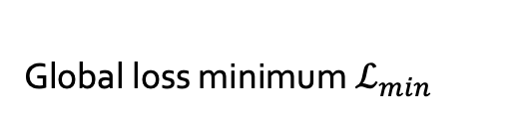



Optimizer: Gradient Descent
Steps in the gradient descent algorithm:
Randomly initialize the model parameters$,θ^{0}$
Compute the gradient of the loss function at the initial parameters $θ^{0}$: $∇ℒ\left(θ^{0}\right)$
Update the parameters as: $θ^{new}=θ^{0}−α∇ℒ\left(θ^{0}\right)$
Where α is the learning rate
Go to step 2 and repeat (until a terminating criterion is reached)
Loss $ℒ$
Initial
parameters $θ^{0}$
Gradient $∇ℒ=\frac{∂ℒ}{∂θ}$
Parameter update:${ θ}^{new}=θ−α∇ℒ\left(θ^{0}\right)$
Global loss minimum $ℒ_{min}$
Parameters $θ$

Slide 19
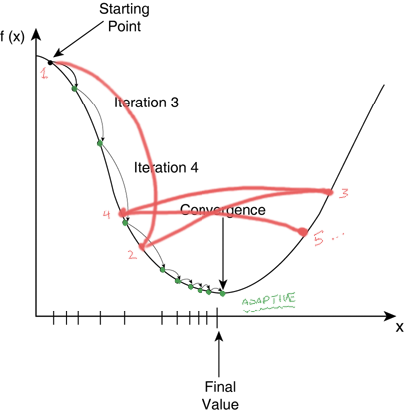
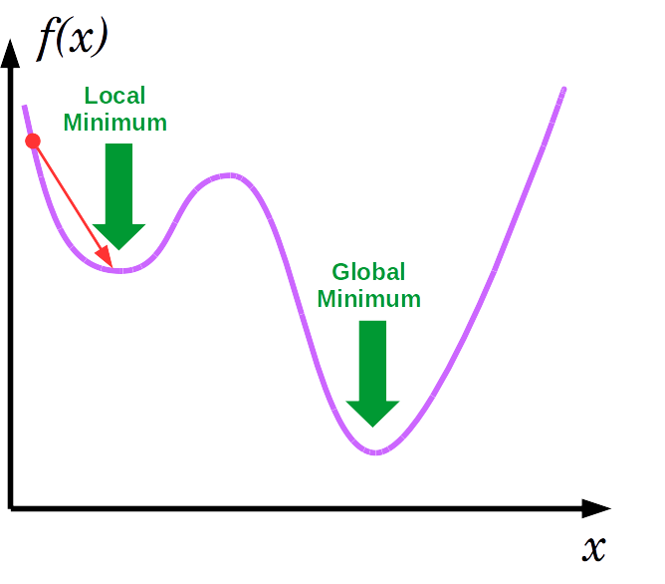
Learning rate
Learning rate to0 large
Learning rate to0 small
Notes:
https://www.quora.com/Why-does-decreasing-the-learning-rate-also-increases-over-fitting-rate-in-a-neural-network
https://lucidar.me/en/neural-networks/single-layer-gradient-descent/

Slide 20
Hyper-parameters
Network structure related
Number of Hidden Layers and units
Network Weight Initialization
Training Algorithm related
Learning Rate
Regularisations
Number of epochs
Momentum
Batch size

Slide 21
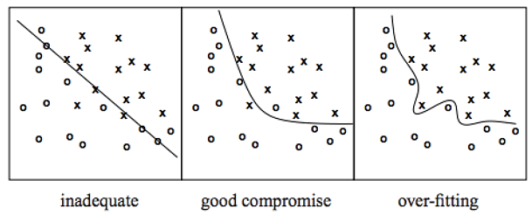
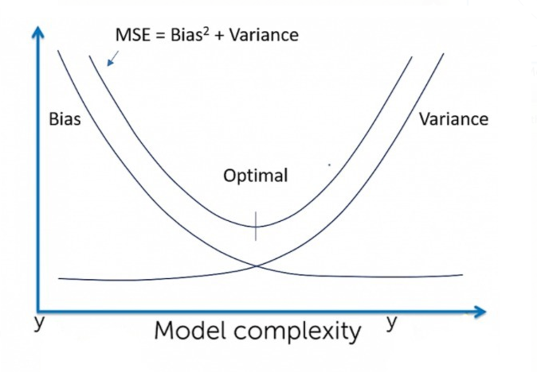
Regularisation
Overfitting – a model with high capacity fits the noise in the data instead of the underlying relationship
Regularisation
Dropout
Early Stopping
weight decay
Lasso L1
Ridge L2

Slide 22
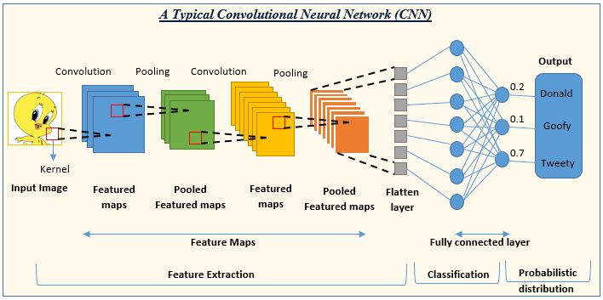
Convolutional neural network
When the convolutional filters are scanned over the image, they capture useful features
Saily Saha 2018
Notes:
https://www.analyticsvidhya.com/blog/2022/01/convolutional-neural-network-an-overview/

Slide 23
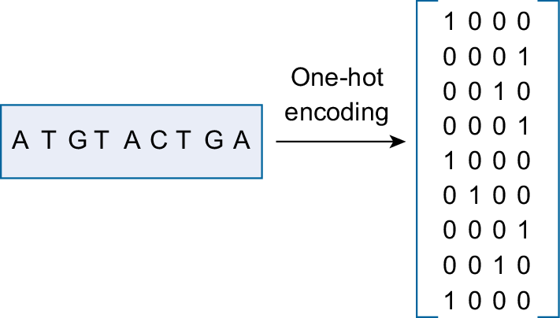
Sequence data
A : | [1 0 0 0]
C : | [0 1 0 0]
G : | [0 0 1 0]
T : | [0 0 0 1]
Amani Al-Ajlan 2018
Notes:
https://link.springer.com/article/10.1007/s12539-018-0313-4#Fig1

Slide 24
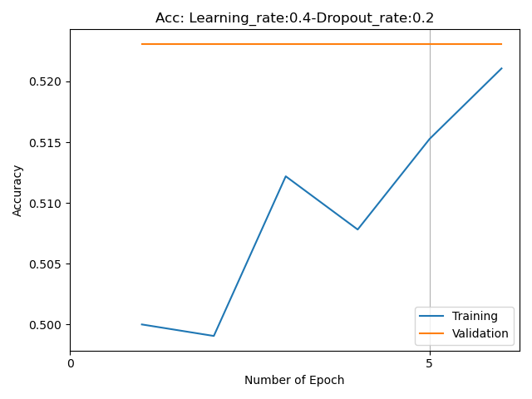
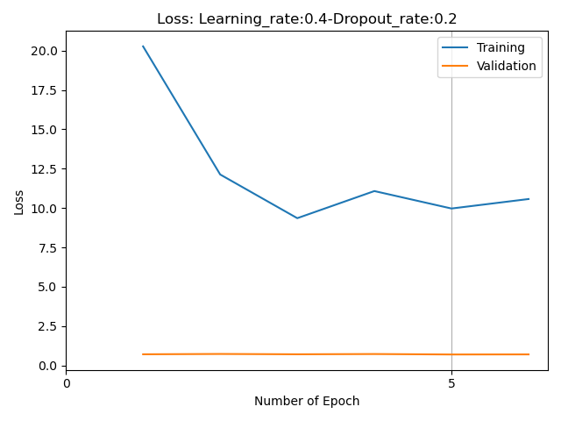
underfitting

Slide 25
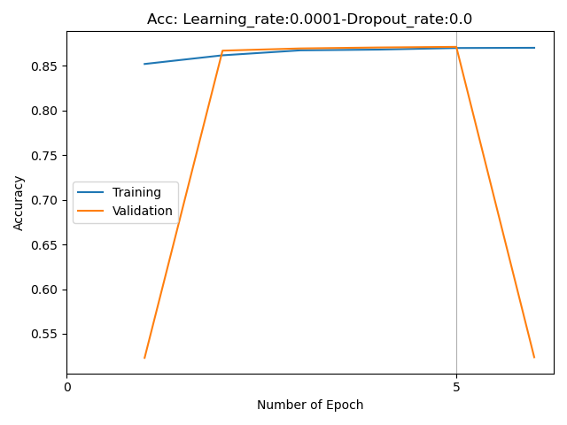
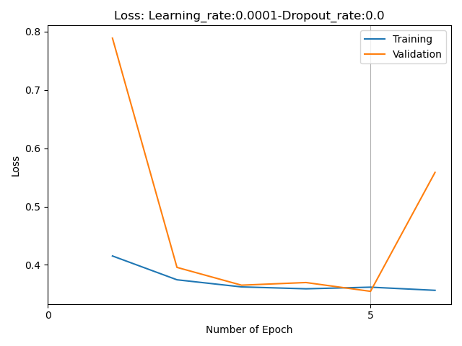
overfitting

Slide 26
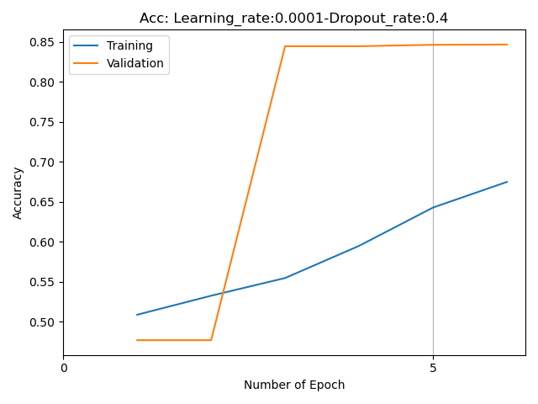
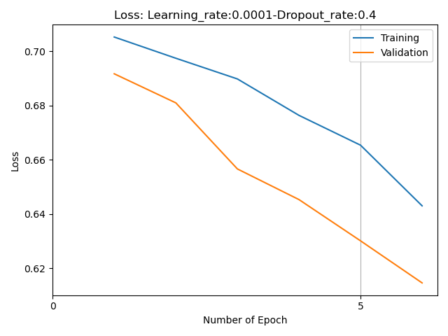
Right fit

