Slide 1

Introduction- Infectious Disease ‘Omics
Nina.Billows@lshtm.ac.uk

Slide 2
Overview
Hello and Welcome!
Introductions
Background to ‘Omics
What is ‘Omics?
Development of sequencing throughout time
The Central Dogma
Overlapping Themes
Multi-Omic Integration
What will you cover this week?
Day 1:
Getting Set Up and An Introduction to Linux
Genomic Data (Afternoon)
Quality Control
Mapping
Variant Detection

Slide 3
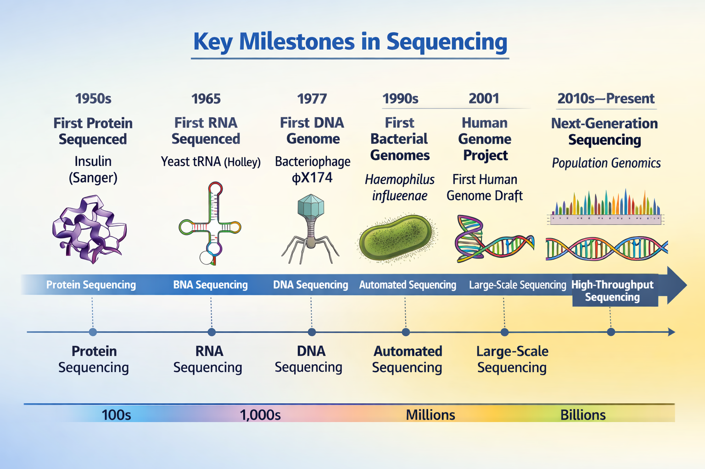
Background to ‘Omics
Before DNA sequencing was possible, proteins and RNA had already been sequenced using early biochemical methods.
The importance of DNA increased after it was established as the genetic material, and a major breakthrough came in 1953 when its double helix structure was described.
This understanding led to the development of DNA sequencing methods, beginning in the 1970s with Sanger sequencing.

Slide 4
Sequencing Throughout Time
Sequencing technology has evolved mainly in terms of read length, speed, and scale:
1970s – Sanger sequencing (first-generation)
Reads DNA fragments of about 500–900 base pairs (~700 bp typical)
Very accurate but low throughput (one fragment at a time)
2000s – Next-generation sequencing (NGS)
Produces short reads (~50–300 bp)
Extremely high throughput (millions–billions of fragments in parallel)
Much faster and cheaper per base than Sanger
2010s–present – Long-read sequencing
Reads thousands to millions of base pairs in one stretch
Examples: nanopore and PacBio technologies
Better for assembling genomes and detecting large structural changes, but historically higher error rates (now improving)
Key concept
“Short read” = high accuracy, fragmented view of genome
“Long read” = more continuous genome information, easier assembly

Slide 5
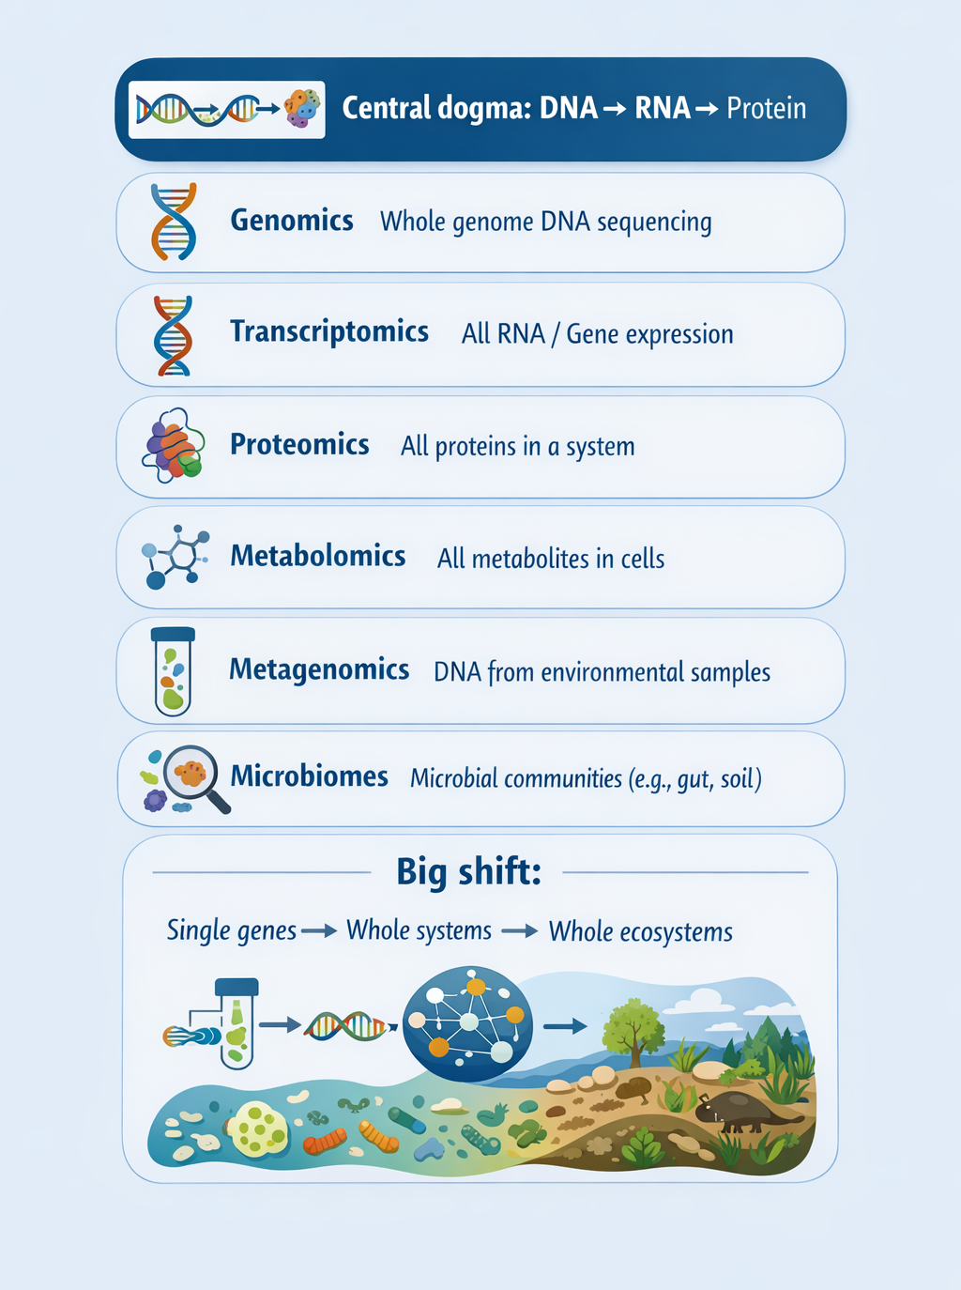
The Central Dogma
Central dogma: DNA → RNA → Protein (genetic information flow within cells)
Genomics: sequencing and analysis of whole DNA genomes/ amplicons
Transcriptomics: measurement of all RNA transcripts (gene expression)
Proteomics: large-scale study of all proteins in a system
Metabolomics: profiling of all small molecules/metabolites in cells
Metagenomics: sequencing DNA directly from environmental samples without isolating organisms
Microbiomes: study of microbial communities in environments like the gut, soil, and oceans
Overall shift from single genes and pathways → whole systems → complex multi-organism communities

Slide 6
Overlapping Themes
Aims (linking to phenotype):
Connecting molecular variation across omics layers to observable traits like disease, development, or drug response.
Analysis (mapping, variant calling, assembly, etc.):
Core shared steps including aligning data to references, identifying biological signals (e.g., variants or expression changes), and reconstructing sequences or molecular profiles when needed.
Challenges (data complexity and integration):
Handling noisy, high-dimensional data, correcting technical biases, and integrating different omics layers into a single coherent biological interpretation.
Low coverage!

Slide 7
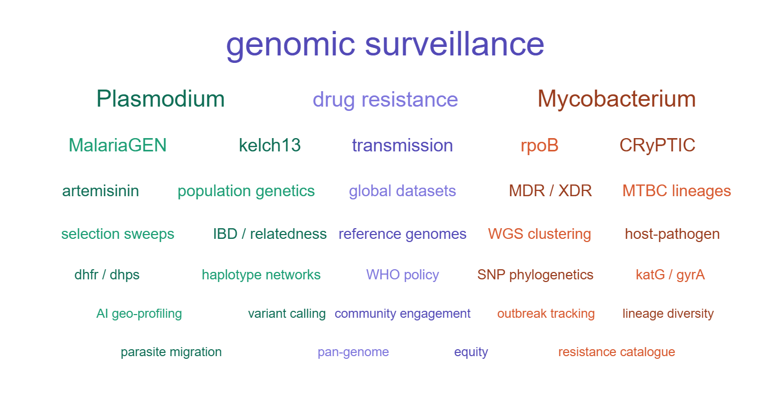
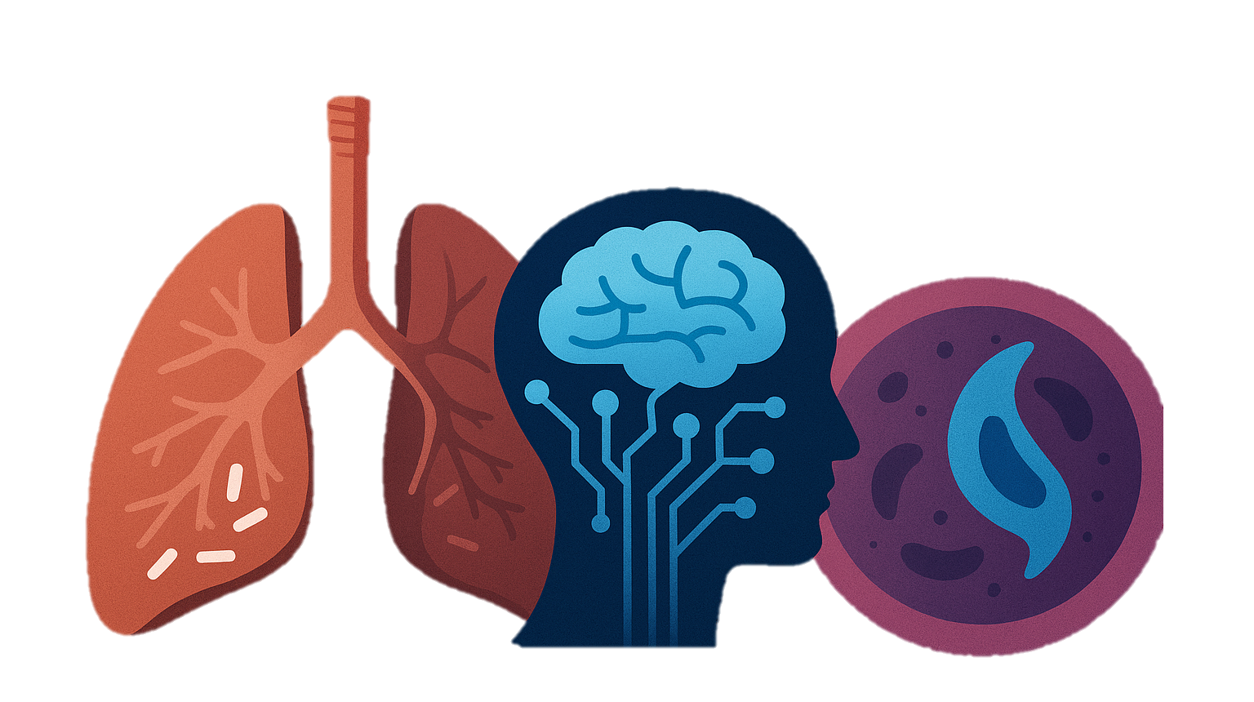
Infectious Disease
Multi-omics integration:
Combining genomics, transcriptomics, proteomics, and metabolomics to understand host–pathogen interactions and disease mechanisms.
Genomic epidemiology:
Tracking pathogen spread, evolution, and antimicrobial resistance through sequencing data.
GWAS:
Identifying host and pathogen genetic variants linked to susceptibility, severity, immune response and resistance mechanisms.
Machine learning approaches:
Large-scale data
Using ML on multi-omics and clinical data for diagnosis, risk prediction, and outbreak detection.

Slide 8
An Introduction to Linux
Nina.Billows@lshtm.ac.uk

Slide 9
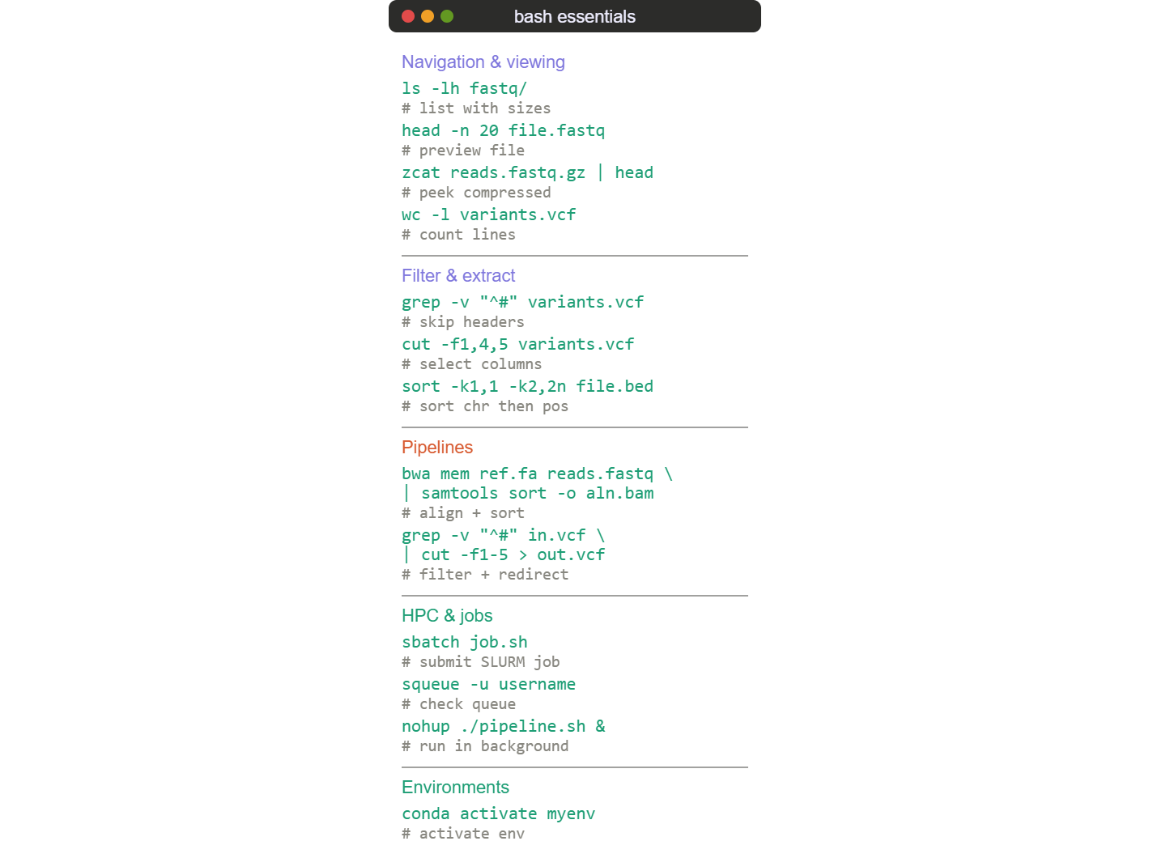
An Introduction to Linux
Linux is the default environment for bioinformatics — most tools (GATK, samtools, BWA) are built and tested on it
The command line lets you chain tools together in pipelines, process thousands of samples with a single script
File permissions and multi-user support matter on shared HPC clusters where research teams run jobs concurrently
Package managers and environments (conda, apt) keep software versions reproducible across labs and system
Shell scripting (bash) automates repetitive tasks: trimming, aligning, calling variants at scale.

Slide 10



Code Management
Conda — manages software environments and dependencies, ensuring your tools and versions are reproducible across machines
VS Code — lightweight editor with integrated terminal, remote HPC access, and support for Python, R, and Jupyter notebooks
GitHub — hosts and version-controls your code, tracking every change and enabling collaboration through branches and pull requests

Slide 11
Task 1
Get Set Up
Let us know if you have any issues with setting up!
Connect to codespace lshtm-genomics/codespaces
Choose Day 1
Move through the introduction to Linux practical

