Slide 1




Bangla Captioning Image Taken by Blind People
Mohammed Latif Siddiq
Nafis Tahmid Chowdhury
Department of Computer Science and Engineering
Bangladesh University of Engineering and Technology

Slide 2
Introduction
Notes:
When conducting research, it is easy to go to one source: Wikipedia. However, you need to include a variety of sources in your research. Consider the following sources:
Who can I interview to get more information on the topic?
Is the topic current and will it be relevant to my audience?
What articles, blogs, and magazines may have something related to my topic?
Is there a YouTube video on the topic? If so, what is it about?
What images can I find related to the topic?

Slide 3
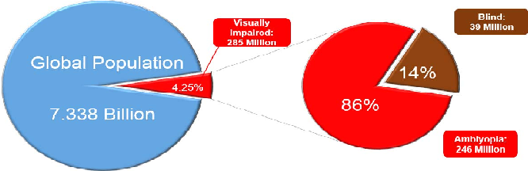
Introduction
About 4.25% of total population are blind
No automated way to describe visual surroundings captured by blind people.
Human-powered services are introduced by some startups, such as, Bespacular.com.

Slide 4
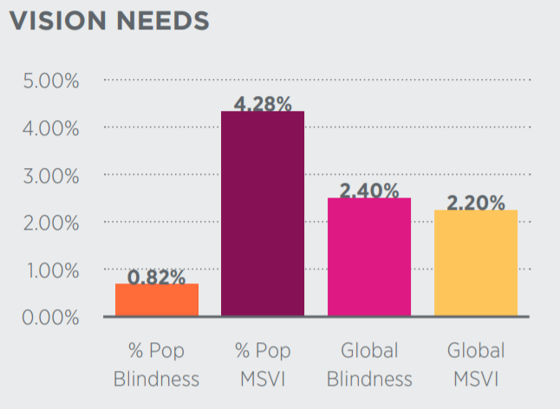
Why Automated Captioning and in Bangla?
Real time helper to describe surroundings.
Minimize the dependency on other people to get idea about surroundings.
Availability of devices to capture images by semi or fully guided commands.
About 871k people are blind in Bangladesh.

Slide 5

Dataset
Notes:
Once you find your sources, you will want to evaluate your sources using the following questions:
Author:
Who is the author?
Why should I believe what he or she has to say on the topic?
Is the author seen as an expert on the topic? How do you know?
Current:
How current is the information in the source?
When was the source published?
Is the information out-of-date?
Accuracy:
Is the content accurate?
Is the information presented objectively? Do they share the pros and cons?

Slide 6
About Viz-Wiz Dataset
Dataset is originally collected from https://vizwiz.org/
23,431 training images
117,155 training captions
7,750 validation images
38,750 validation captions
8,000 test images
40,000 test captions

Slide 7
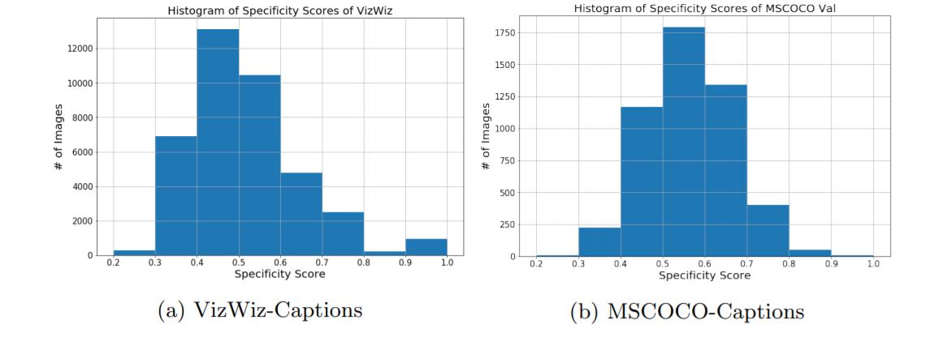
VizWiz-Captions vs MSCOCO-Captions
MSCOCO is the largest dataset with 1,026,459 captions.
VizWiz contains images taken specifically by blind people.

Slide 8
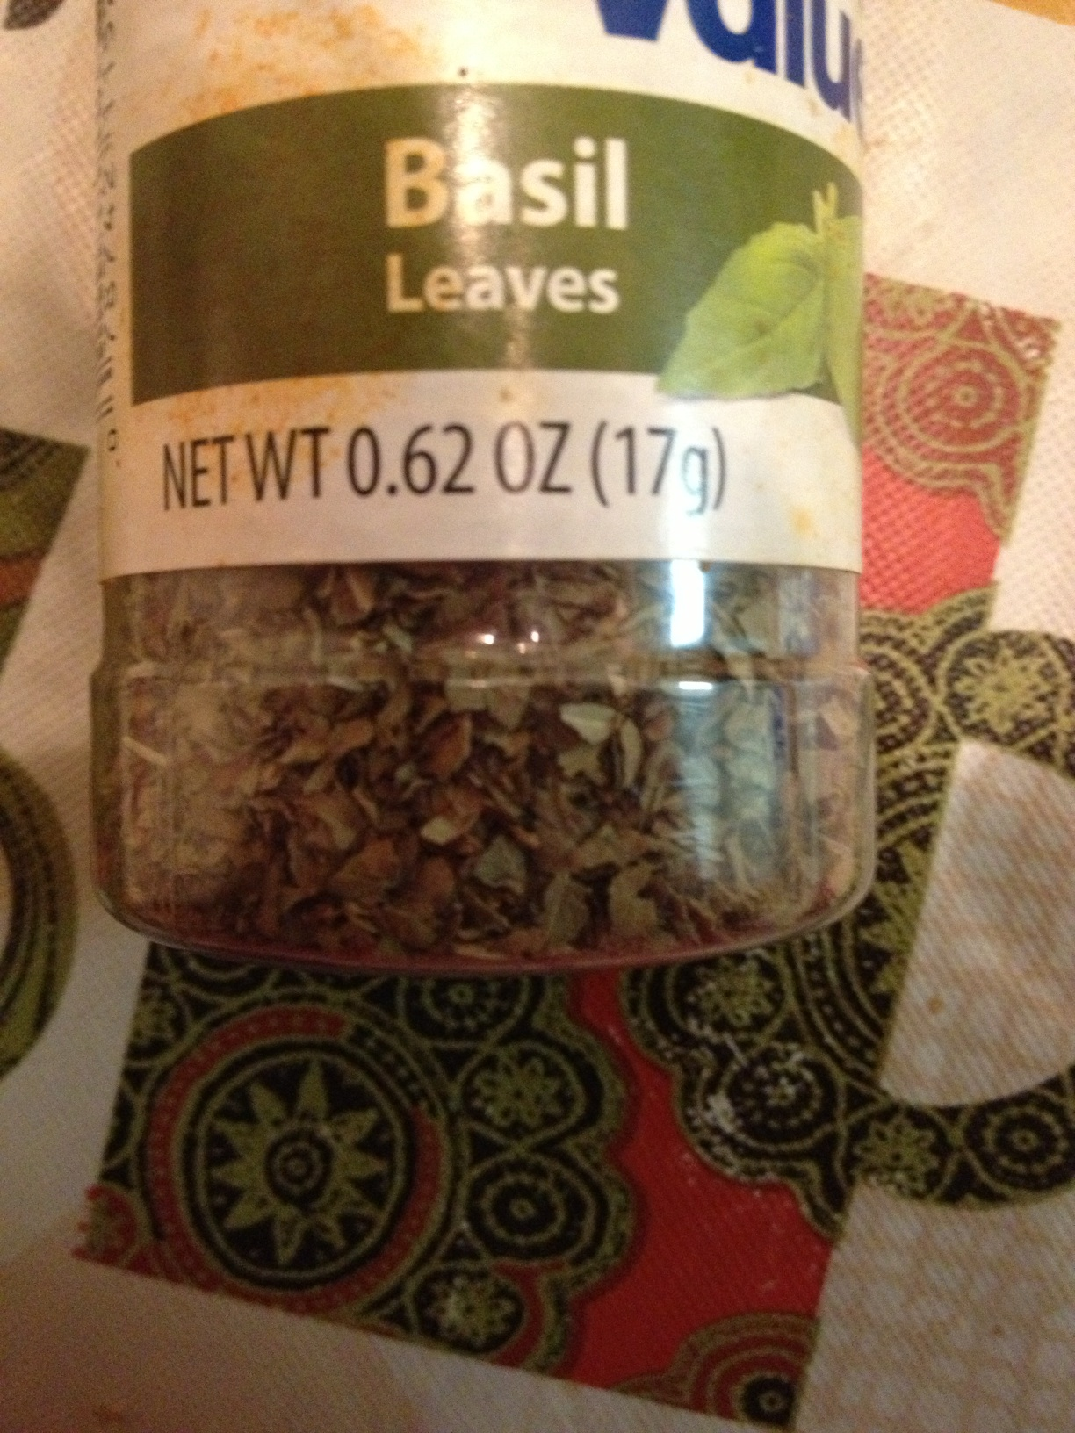
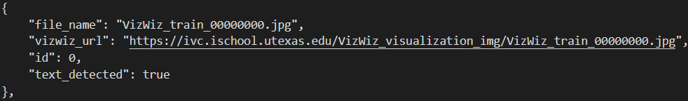
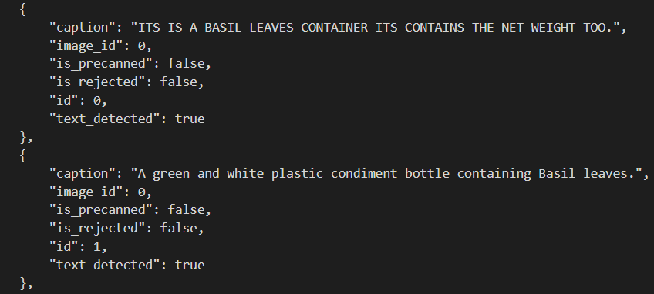
Dataset Description

Slide 9
Work Plan
Notes:
After consulting a variety of sources, you will need to narrow your topic. For example, the topic of internet safety is huge, but you could narrow that topic to include internet safety in regards to social media apps that teenagers are using heavily. A topic like that is more specific and will be relevant to your peers. Some questions to think about to help you narrow your topic:
What topics of the research interest me the most?
What topics of the research will interest my audience the most?
What topics will the audience find more engaging? Shocking? Inspiring?

Slide 10
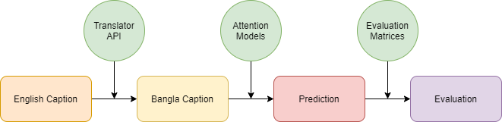
Working Pipeline
At this moment, we use translator API to convert English Caption to Bangla Caption.
After translating from English to Bangla, we will use state-of-art methods: Up-Down, SGAE, and AoANet for predicting captions from image.
Then, we will have to evaluate result with some of these matrices: BLEU-1-4, METEOR, ROUGE-L, CIDEr-D, and SPICE.

Slide 11
Drawbacks and Future Works
Notes:
Now, that you have narrowed your topic, you will want to organize your research in a structure that works. There are some common organizational patterns based on the kind of research you are doing.
Organizational Structures:
Cause and Effect- this kind of structure is great for explaining the causes and effects of a topic
Compare and Contrast- in this pattern you highlight the similarities and differences of the topic
Explain process- this structure is great for outlining a series of steps to follow;
Definition- if you want to make sure your audience understands what something is using illustrations, meanings, clarifying misconceptions, you may want to use this structure
Classification- a common organizational structure is grouping like topics or facts from the research together. For instance, in the internet safety about social media apps, you may organize the research where you look at each social media app one at a time

Slide 12
Drawbacks and Future Works
There are some drawbacks in our approach and dataset:
There are no context for Bangladesh in dataset.
We use Bangla captions from translator not prepared by Crowd-workers.
There some scopes to do further work in this area:
Prepare Bangla dataset by Bangladeshi Crowd-workers.
Collect images captured by Bangladeshi blind people.
Try out more state of the art model specially for Bangla.

Slide 13
Research Presentation End
Notes:
You can use this slide as your opening or closing slide. Should you choose to use it as a closing, make sure you review the main points of your presentation. One creative way to do that is by adding animations to the various graphics on a slide. This slide has 4 different graphics, and, when you view the slideshow, you will see that you can click to reveal the next graphic. Similarly, as you review the main topics in your presentation, you may want each point to show up when you are addressing that topic.
Add animation to images and graphics:
Select your image or graphic.
Click on the Animations tab.
Choose from the options. The animation for this slide is “Split”. The drop-down menu in the Animation section gives even more animations you can use.
If you have multiple graphics or images, you will see a number appear next to it that notes the order of the animations.
Note: You will want to choose the animations carefully. You do not want to make your audience dizzy from your presentation.

