Slide 1

PROOF OF PARTICIPATION
Notes:
Govern
Private Chain
Node DD
Lawyer / College Govern add node
Different centry different govern

Slide 2
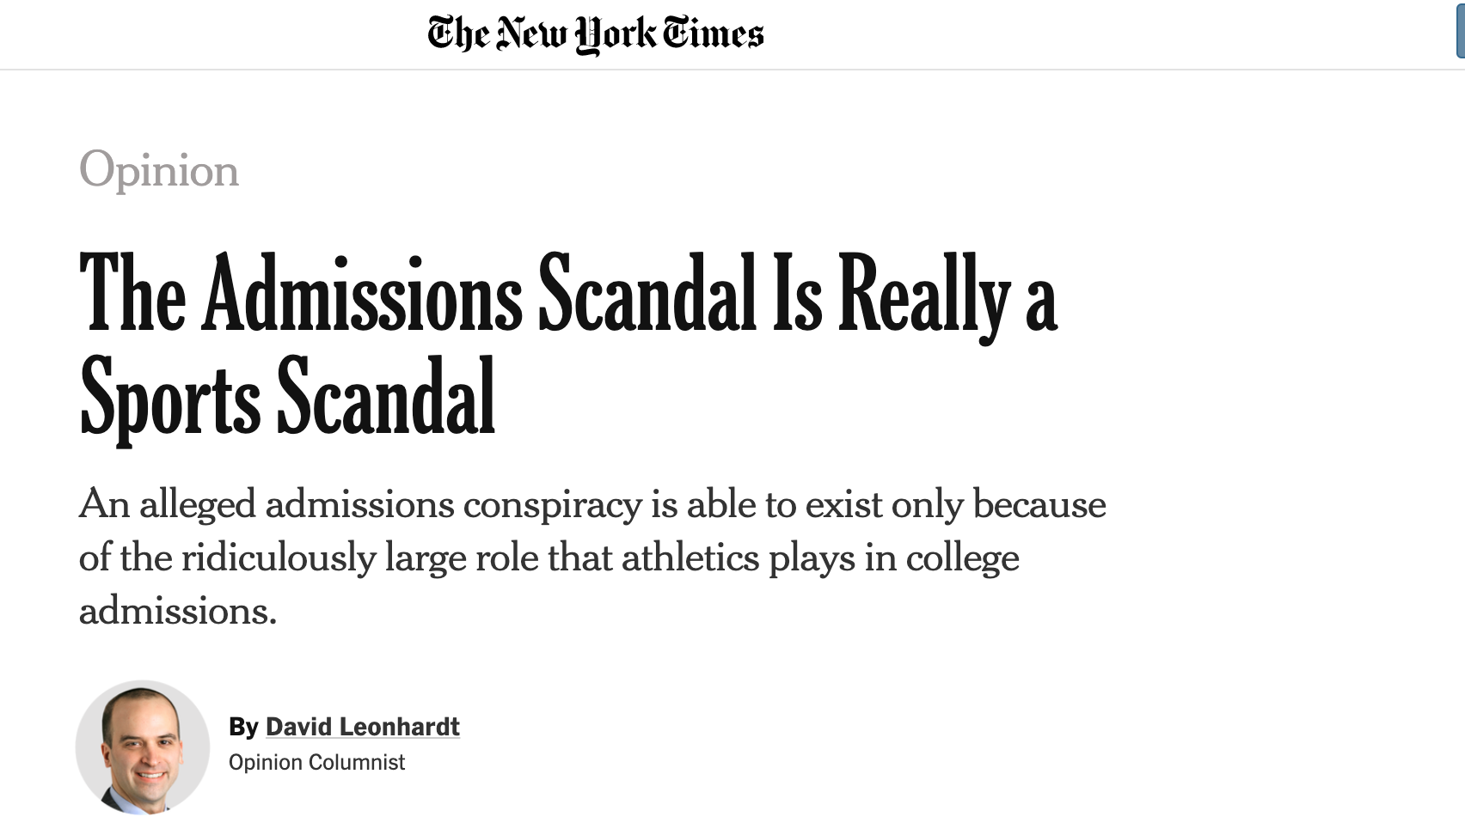
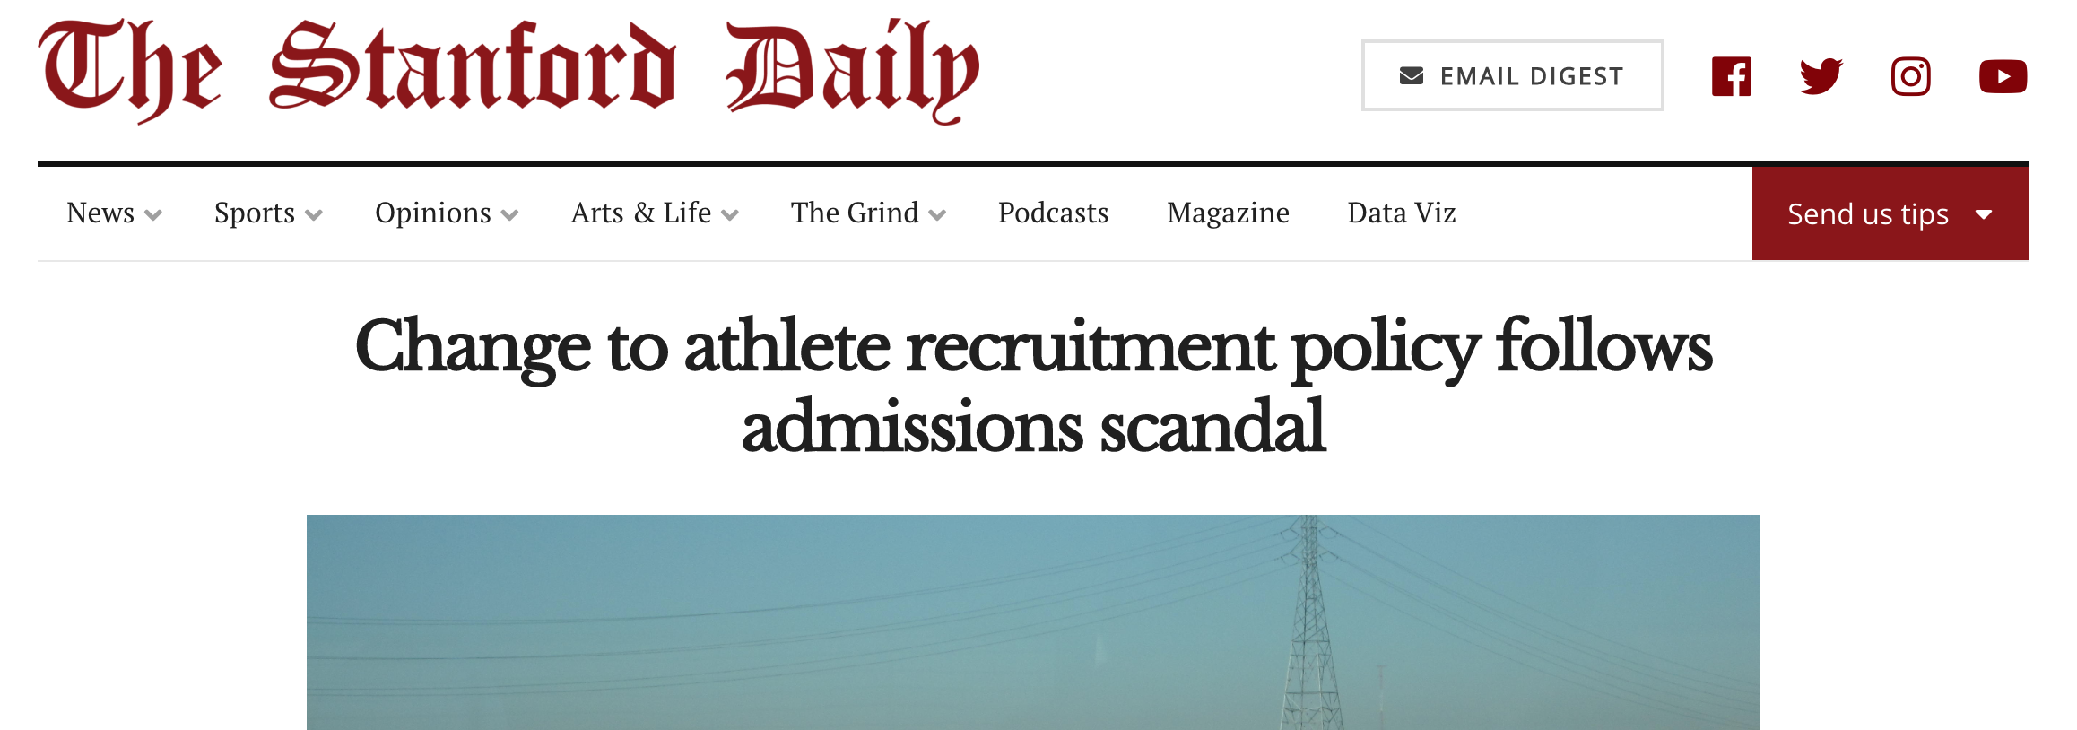

Notes:
Elite Student Athletes Admission

Slide 3
Proving the Participation Claim

Slide 4
Current Issues on Proving the Participation Claim
Issuer (Extra-curricular Activity Organizer) | Credential Holder (Student) | Verifier (Admission Office)
Manual process on paper credential issuance Manually doing the roll call | Difficult to manage paper credential Unreliable claim Timely and Costly to re-apply for issuing the lost credential | Concerns on credential’s authenticity7 Unable to verify the claims/paper credential

Slide 5
P.O.P
Introduction

Slide 6
Privacy-Protection Verifiable Proof of Participation Record

Slide 7
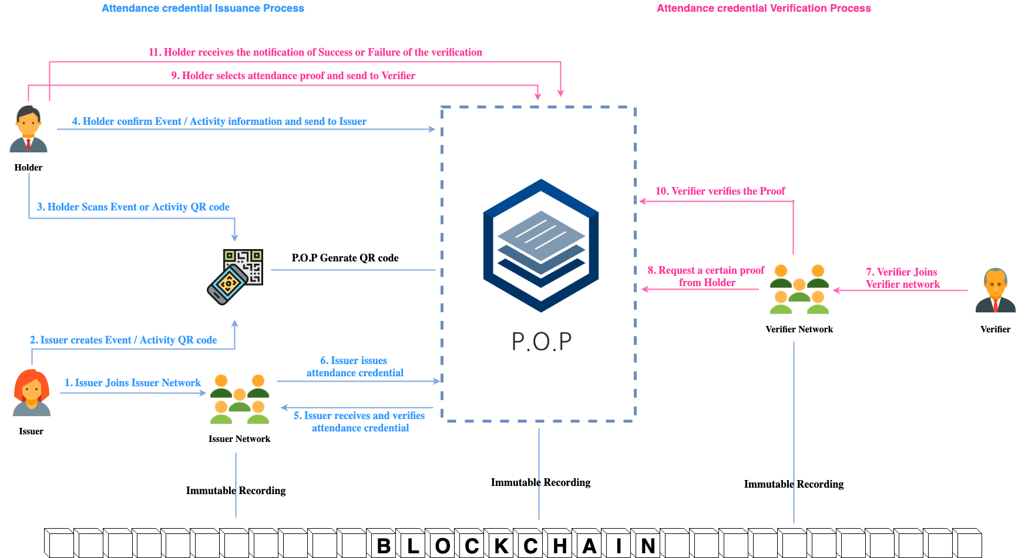
P.O.P Overview

Slide 8
Demo

Slide 9
Benefits to Stakeholders
Issuer (Extra-curricular Activity Organizer) | Credential Holder (Student) | Verifier (Admission Office)
Erase the existing paperwork for issuing paper credential Erase the manual roll call | Self-Sovereign Credential Privacy-Preserving and Provable participation Manageable participation credential using POP Wallet | Verifiable the origin of participation/attendance

Slide 10
Business Model
Issuer (Extra-curricular Activity Organizer) | Credential Holder (Student) | Verifier (Admission Office)
Fee for E-Roll Call | Re-issuing fee for lost credential Partial admission fee | Verification fee to ensure the claim of the applicants
By Transaction & By Subscription

Slide 11
THANKS!
Q & A

