Slide 1
Review On automated prepared statement generation to remove SQL injection vulnerabilities
Mohammed Latif Siddiq
Md. Rezwanur Rahman Jahin

Slide 2
SQL Injection vulnerabilities(SQLIV)
A vulnerability is the result of a software defect that gives an attacker unintended access to a computer system.
An SQLIV is a specific SQL vulnerability that exists when an attacker can insert SQL character and keywords into an SQL statement and change the logic of the SQL statement.
SQLIVs allow attacker input to modify SQL structure through an SQL injection attack (SQLIA),which changes the logic of the SQL statement.
An SQLIA is an attempt to inject SQL characters and/or keywords into an SQL statement’s input and modify the statement’s structure.

Slide 3
Prepared statement
A “prepared statement” is prepared by declaring the structure of the statement and putting bind variables, placeholders for input, in the places where SQL input goes .
The objective of this research is to propose a prepared statement replacement algorithm and corresponding automation for removing SQL injection vulnerabilities from vulnerable SQL statements by replacing them with secure prepared statements.
The authors proposed a prepared statement replacement algorithm (PSR-Algorithm), which gathers information from source code containing SQLIVs and generates secure prepared statement code that maintains functional integrity.

Slide 4
PREPARED STATEMENT REPLACEMENT ALGORITHM
The PSR-Algorithm analyzes source code containing SQLIVs and generates a specific recommended code structure containing prepared statements.
1. The PSR-Algorithm separates the SQL statement’s input from the SQL structure in the generated code structure.
2. It creates an additional string object for each string object used to create the SQL statement.
3. The new string object contains the raw string data of the original string object and any identifiers found in the original string object the PSR-Algorithm identifies as SQL structure.
4. It creates an assistant vector for each new string object. The assistant vector is created to contain any SQL input found in the original string object.

Slide 5
PSR-Generator
The PSR-Generator takes in a Java file and line numbers of SQLIV method calls and outputs a Java source file with the PSR-Algorithm-generated code structure included and the SQLIV method calls removed.
The first step of the process of securing vulnerable source code with the PSR-Generator starts with formatting the source code in preparation for the generator.
After the IDE Formatter formats the code, static analysis and code inspection is conducted to find the SQLIVs.
Once all of the SQLIV line numbers have been collected, a developer runs the PSR-Generator on each Java file that has SQLIVs.
For each vulnerable Java file, the developer passes the generator the path to the Java file, all of the SQLIV line numbers in ascending order, and any secure reference IDs. The PSR-Generator creates a converted Java file with the SQLIV execution calls removed.

Slide 6
PSR-GENERATOR LIMITATIONS
1. Assumes the language, database connector, and database all support prepared statement
2. Only analyzes and creates Java code
3. Limited to the knowledge of a single file and the PSR-Algorithm only considers variables, methods, and method calls that can be found in a single file
4. Relies solely on pattern matching and does not take into consideration call graphs, Abstract Syntax Trees, or other advanced code analysis
5. Removes all non-compiled parts of the code such as comments or documentation
before the PSR-Generator converts the file
6. Assumes that all SQL structure is contained within string objects as raw string data

Slide 7
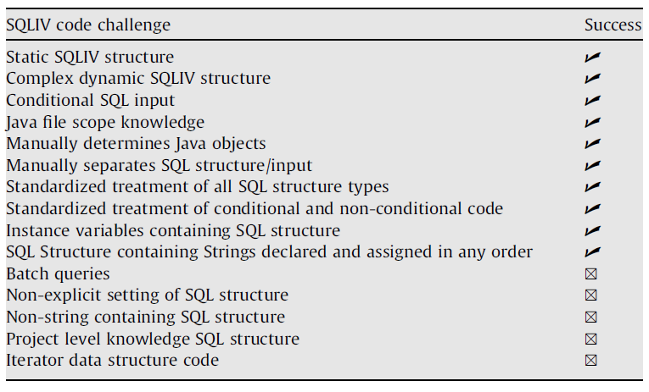
PSR-GENERATOR CHALLANGES

Slide 8
Our Targets and steps
We are going to use machine learning to remove vulnerabilities of SQL Injection.
Initially we are going to work on java code.
Our tentative steps to achieve the goal :
We build a data set to train the neural network
Proposing a model based on Natural Language Processing and Neural Network.
Then we build a generalized generator for solving this problem

Slide 9
Any QUESTION?
Thank you

