Slide 1
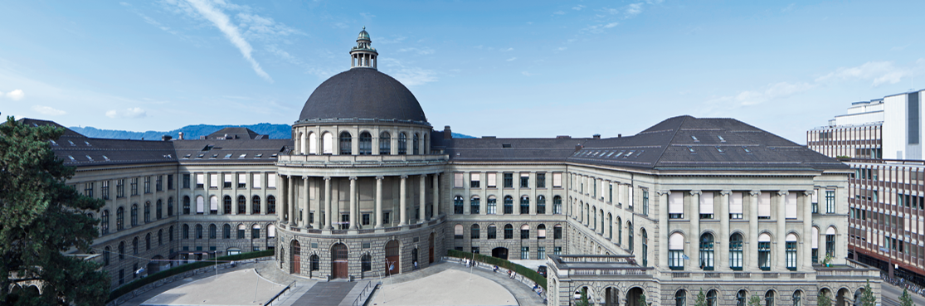



Scaling Column Imprints using Advanced Vectorization
Lefteris Sidirourgos (ETH)
Hannes Mühleisen (CWI)
Thirteenth International Workshop on
Data Management on New Hardware
(DaMoN 2017)

Slide 2
Column Imprints
Pre-filtering secondary index for columns / attribute
Bit-vectors for the values of each cacheline
Horizontally compressed (RLE style)
“Column imprints: a secondary index structure” L.Sidirourgos & M.Kersten (SIGMOD 2013)
Main (persistent) secondary index in MonetDB
  used for range selections/joins
Github for stand-alone code: https://github.com/lsidir/imprints

Slide 3
Column Imprints
...
sample
b0
b1
b2
bk
bk+1
range query [b1,bk]= 011..10
column A
cacheline
1 1 0 ... 0 1
cacheline
0 0 1 ... 1 1
dictionary
cacheline
count
repeat
2
0
1 0 1 ... 1 0
2
1
cacheline
1
0
cacheline
0 1 1 ... 0 0

Slide 4
Creating the Imprints
(scalar version)
for each cacheline
for each value v in cacheline
i = findBin (v) /* log(#bins) per value */
set i-th bit in current imprint
if current imprint ≡ previous imprint
compress and update dictionary

Slide 5
findBin

Slide 6
Querying the Imprints
(scalar version)
set mask for range query [low, high]
for each imprint
if (imprint & mask) not 0
for each value v in cacheline
check if v ∈ [low, high] /*2 comparisons per value*/

Slide 7
Advanced Vector Extensions

Slide 8
Creating the Imprints
(SIMD version)

Slide 9
Querying the Imprints
(SIMD version)

Slide 10
Cachelines and Word Sizes

Slide 11
Blocks and SIMD registers

Slide 12
x16 speed-up

Slide 13
Research outlook

Slide 14
Conclusions

Slide 15


Slide 16
Compression
Not necessary in AVX
The following things will kill SIMD performance
  branching (control flow if-statements)
  gather instructions (_mm_i32gather_epi32)
Use stream load (_mm256_stream_load_si256)

