Slide 1




Scaling Column Imprints using Advanced Vectorization
Lefteris Sidirourgos (ETH)
Hannes Mühleisen (CWI)
Thirteenth International Workshop on
Data Management on New Hardware
(DaMoN 2017)

Slide 2
Column Imprints
Pre-filtering secondary index for columns / attribute
Bit-vectors for the values of each cacheline
Horizontally compressed (RLE style)
“Column imprints: a secondary index structure” L.Sidirourgos & M.Kersten (SIGMOD 2013)
Main (persistent) secondary index in MonetDB
  used for range selections/joins
Github for stand-alone code: https://github.com/lsidir/imprints

Slide 3
Column Imprints
...
sample
b0
b1
b2
bk
bk+1
range query [b1,bk]= 011..10
column A
cacheline
1 1 0 ... 0 1
cacheline
0 0 1 ... 1 1
dictionary
cacheline
count
repeat
2
0
1 0 1 ... 1 0
2
1
cacheline
1
0
cacheline
0 1 1 ... 0 0

Slide 4
Creating the Imprints
(scalar version)
for each cacheline
for each value v in cacheline
i = findBin (v)
set i-th bit in current imprint
if current imprint ≡ previous imprint
compress and update dictionary

Slide 5
findBin()
O(log(#bins)) binary search
if v > b[k/2]
if v > b[k/2+k/4]
…
else
…
O(#bins) independent comparisons
res = 0;
for i =1 .. #bins
res += v > b[i];

Slide 6
Querying the Imprints
(scalar version)
set mask for range query [low, high]
for each imprint
if (imprint & mask) not 0
for each value v in cacheline
check if v ∈ [low, high] /*2 comparisons per value*/

Slide 7
Advanced Vector Extensions
AVX2
16 256-bit registers YMM0-YMM15
B[0]
B[1]
B[2]
B[3]
V
b0
b1
b2
b3
v0
b0
b1
b2
b3
v1
b0
b1
b2
b3
v2
b0
b1
b2
b3
v3
b0
b1
b2
b3
v4
YMM0
YMM1
YMM2
YMM3
YMM15

Slide 8
Creating the Imprints
(SIMD version)
findBin()
__m256i RES = _mm256_setzero_si256 ();
for i = 1 .. #bins
RES = _mm256_add_epi32 (RES ,
_mm256_add_epi32 (
_mm256_cmpgt_epi32 (V, B[i]),
_mm256_cmpgt_epi32 (V, B[i+1])));

Slide 9
Querying the Imprints
(SIMD version)
if ( _mm256_testz_si256 ( Q_MASK , IMPRINT )
for (all values V in a data block )
RES = _mm256_movemask_epi8 (
_mm256_sub_epi32 (
_mm256_cmpgt_epi32 (V, Q_LOW ),
_mm256_cmpgt_epi32 (V, Q_HIGH )));
Q_L
Q_H
V
l
h
v0
l
h
v1
l
h
v2
l
h
v3
l
h
v4
YMM0
YMM1
YMM2

Slide 10
Cachelines and Word Sizes
Imprint 64-bit word
  Larger imprints will not allow for fast bitwise operations
One imprint per 64-bytes cacheline
  Larger blocks will lead to misalignment and cache misses

Slide 11
Blocks and SIMD registers
Imprint up to 256-bits (or 512 soon)
Block can be larger, up to 256 bytes
The larger the imprint
  more precision
  more storage consumption / less compression
  slower creation times
The larger the block
  less precision
  faster creation time
  slower query time

Slide 12
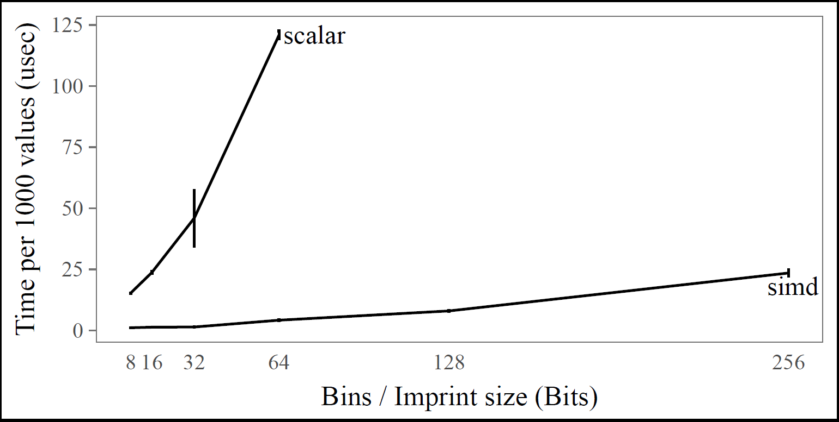
Experiments: x16 speed-up on Creation Time

Slide 13
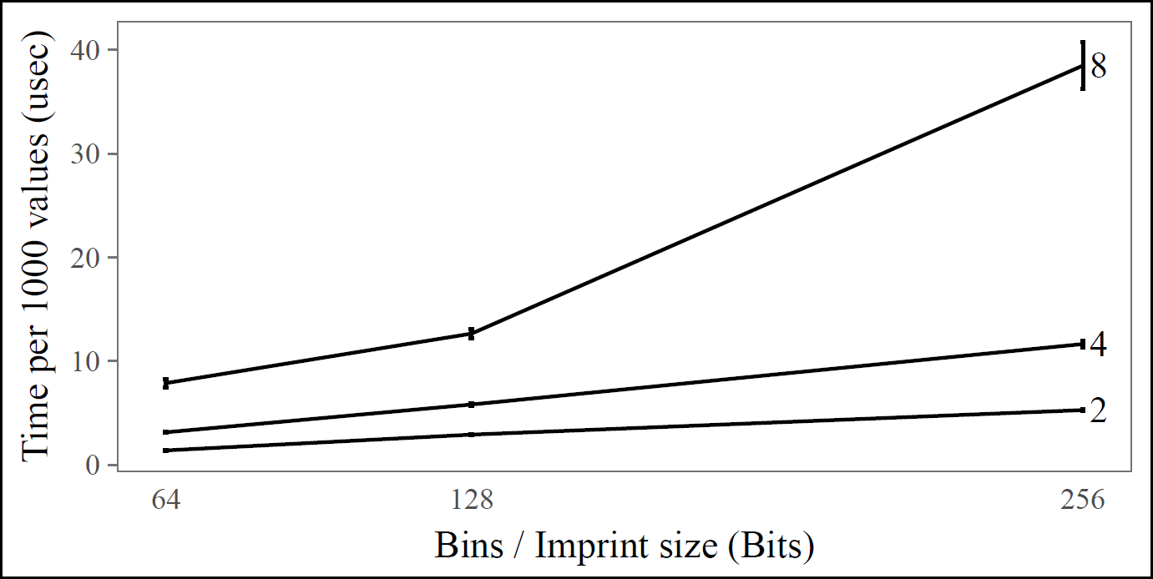
Experiments: Larger Imprint size Creation Time

Slide 14
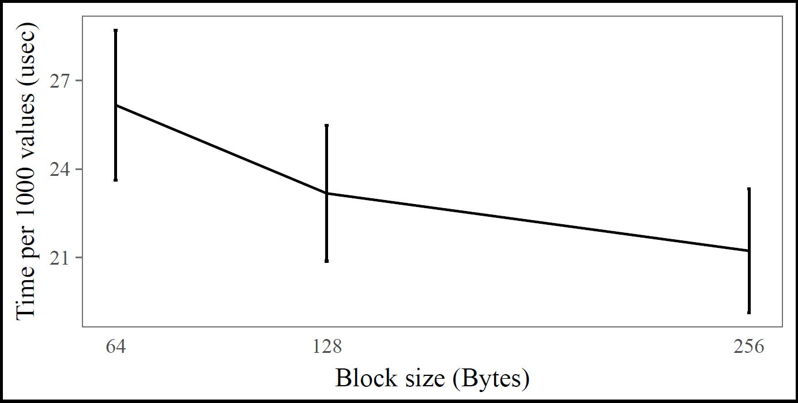
Experiments: Larger Block size Creation Time

Slide 15
Conclusions
Column imprints is an effective way to pre-filter range queries
Easy to adapt to SIMD with clear benefits
Imprint size and Block size are tunable per value domain and data distribution
AVX-512 will allow for even more speedup and query precision

Slide 16


Slide 17
Compression
Not necessary in AVX
The following things will kill SIMD performance
  branching (control flow if-statements)
  gather instructions (_mm_i32gather_epi32)
Use stream load (_mm256_stream_load_si256)

