Slide 1
Convection Under Static and Rotational Conditions
Physics 426
Stephanie Monty & Luke Siemens

Slide 2
Convection in the Atmosphere of Jupiter
Current models suggest convection occurs deep within the atmosphere
CO in upper atmosphere linked to possibility of convection at 1100K in upper atmosphere (Beer & Taylor, 1977)
Recently, long lived storms appearing as “zonal jets” or “long-lived ovals” suggest the need for a sustaining heat source within planet and method of heat transport from source to storm (Ingersoll et al., 2000)

Slide 3
Investigating Convection on Earth
Observation of convection cells on laboratory scales may serve to better characterize and understand how convection could occur on Jupiter
Main Points of Experiment and Investigation:
Jupiter does not have a constant density profile. How is convection affected by a discontinuous density profile?
Jupiter rotates rapidly, with a period of rotation about its axis of ~9.8h. How does rotation hinder or help convection?

Slide 4
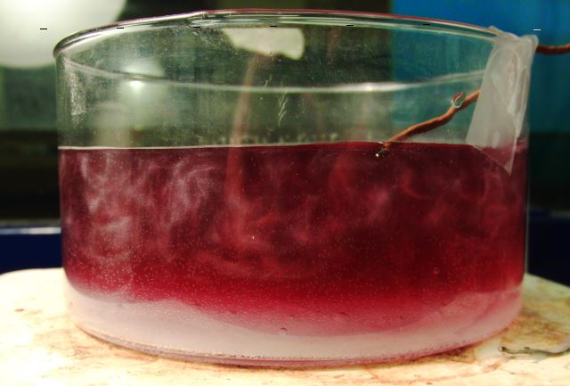
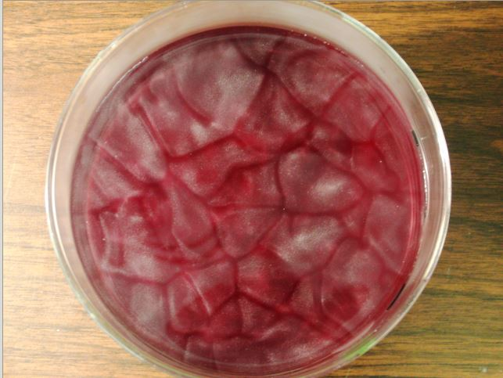
Results Thus Far: Non-Rotational
Non-rotational convection observed using rheoscopic fluid and hot plate. Cell size to be determined using radius of container for conversion between pixels and cell size.
When distinct changes occurred the time and temperature of both hot plate and fluid were recorded, along with an image to document the change. Correlations between temperature difference, time and size of cells will be explored.
Sugar layer placed on bottom created distinct boundary layer between boiling sugar-water bottom and convecting top.
Final frame after 26 minutes of heating rheoscopic fluid alone, temperature of fluid has increased by 15˚

Slide 5
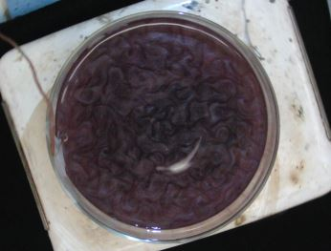
Results Thus Far: Computation & Rotational
A rotating table was used to introduce rotation into the same experimental set-up. Both a constant density profile (rheoscopic fluid alone) and a stratified profile (sugar- water) were explored.
COMSOL was used to explore non-rotational convection using parameters similar to that of the actual experiment.
After 40 min. of heating, rotating at 26 RPM, fluid has increased by 25˚

