Slide 1
Spring
Java Config vs XML Config
& annotation config bits
Łukasz Sikora
sikora.lukasz.sl@gmail.com
Notes:
Can be found on LinkedIn and Meetup.com

Slide 2
Spring Configuration history
XML configuration was available since always. At that time it was considered lighter than Java EE which was industry standard
ComponentScan introduced in Spring 3.0
@Configuration introduced in Spring 3.0
Notes:
Spring itself took one part of EJB specification, namely container based dependency injection and made it Spring Core

Slide 3
Spring Configuration history
This means that @Configuration classes are with us as long as component scans
Extensive use came with time and partially Spring Boot

Slide 4
Component scan
When Spring 3.0 came out people where already allergic to XML
Most projects moved to use XML mostly for
<context:annotation-config />
<context:component-scan base-package="com.xxx" />

Slide 5
Component scan hell
Package scan has been overused to the extent when core application package has been scanned
This led to problems with beans implementing same interfaces (Where the heck is second bean instance coming from?)
Programmers were left with huge bags of beans floating around in Spring Context hence encapsulation was broken

Slide 6
Fun fact
Spring was created as lightweight alternative to Java EE, both based on XML configuration
With Spring 3.0 released at 2009, Spring bandwagon started to laugh about Java EE XML configuration heaviness when Spring had configuration through annotations
But Java EE had annotations like @Remote for EJB
creation since 1.5 which was released 2006

Slide 7
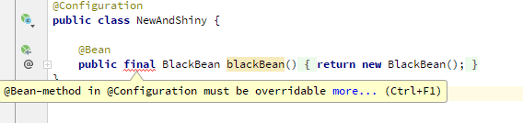
Final method that creates BlackBean
Java Config will show error if method has incorrect modifier
and fails miserably
org.springframework.beans.factory.parsing.BeanDefinitionParsingException: Configuration problem: @Bean method 'blackBean' must not be private or final; change the method's modifiers to continue
Offending resource: class path resource [somebody/somewhere/xmlvsjavaconfig/configuration/NewAndShiny.class]

Slide 8
Final method that creates BlackBean xml
Just works
someBlackBean somebody.somewhere.xmlvsjavaconfig.commonbeans.BlackBean@338c99c8

Slide 9
Chickpea bean has private constructor
package somebody.somewhere.xmlvsjavaconfig.commonbeans;
import org.springframework.aop.config.SimpleBeanFactoryAwareAspectInstanceFactory;
public class Chickpea {
private SimpleBeanFactoryAwareAspectInstanceFactory simpleBeanFactoryAwareAspectInstanceFactory;
public Chickpea(SimpleBeanFactoryAwareAspectInstanceFactory simpleBeanFactoryAwareAspectInstanceFactory) {
this.simpleBeanFactoryAwareAspectInstanceFactory = simpleBeanFactoryAwareAspectInstanceFactory;
}
private Chickpea() {
}
public SimpleBeanFactoryAwareAspectInstanceFactory getSimpleBeanFactoryAwareAspectInstanceFactory() {
return simpleBeanFactoryAwareAspectInstanceFactory;
}
}

Slide 10
Our application
@SpringBootApplication
@ImportResource(value = "classpath:oldAndUgly.xml")
public class XmlVsJavaconfigApplication {
public static void main(String[] args) {
Class<XmlVsJavaconfigApplication> primarySource = XmlVsJavaconfigApplication.class;
run(primarySource, args);
}
@Bean
public CommandLineRunner commandLineRunner(ApplicationContext ctx) {
return args -> {
System.out.println("Let's inspect the beans provided by Spring Boot:");
String[] beanNames = ctx.getBeanDefinitionNames();
Arrays.sort(beanNames);
System.out.println("chickpea" + " " + ctx.getBean("chickpea"));
System.out.println("simpleBeanFactoryAwareAspectInstanceFactory" + " " + ((Chickpea) ctx.getBean("chickpea")).getSimpleBeanFactoryAwareAspectInstanceFactory());
};
}
}

Slide 11
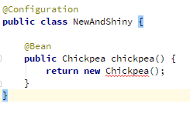
Java Config does not compile without right constructor for Chickpea
Compilation simply fails because non parameter constructor is private

Slide 12
XML config creates bean without field injected
<?xml version="1.0" encoding="UTF-8"?>
<beans xmlns:xsi="http://www.w3.org/2001/XMLSchema-instance"
xmlns="http://www.springframework.org/schema/beans"
xsi:schemaLocation="http://www.springframework.org/schema/beans http://www.springframework.org/schema/beans/spring-beans.xsd">
<bean id="newAndShiny" class="somebody.somewhere.xmlvsjavaconfig.configuration.NewAndShiny"/>
<bean id="chickpea" class="somebody.somewhere.xmlvsjavaconfig.commonbeans.Chickpea"/>
</beans>
2018-06-22 22:08:04.309 INFO 10400 --- [ main] s.s.x.app.XmlVsJavaconfigApplication : Started XmlVsJavaconfigApplication in 0.953 seconds (JVM running for 1.258)
Let's inspect the beans provided by Spring Boot:
chickpea somebody.somewhere.xmlvsjavaconfig.commonbeans.Chickpea@30c93896
simpleBeanFactoryAwareAspectInstanceFactory null

Slide 13
BlackEyedBean without parameterless constructor
public class BlackEyedBean {
private final SimpleBeanFactoryAwareAspectInstanceFactory simpleBeanFactoryAwareAspectInstanceFactory;
public BlackEyedBean(SimpleBeanFactoryAwareAspectInstanceFactory simpleBeanFactoryAwareAspectInstanceFactory) {
this.simpleBeanFactoryAwareAspectInstanceFactory = simpleBeanFactoryAwareAspectInstanceFactory;
}
public SimpleBeanFactoryAwareAspectInstanceFactory getSimpleBeanFactoryAwareAspectInstanceFactory() {
return simpleBeanFactoryAwareAspectInstanceFactory;
}
}

Slide 14

BlackEyedBean without parameterless constructor

Slide 15
BlackEyedBean without parameterless constructor
Notes:
Let’s step up the game

Slide 16
Package scan hell (* as feature)
@Component
public class BagOfBeans {
private final List<CommonBean> someBeans;
@Autowired
public BagOfBeans(List<CommonBean> someBeans) {
this.someBeans = someBeans;
}
public List<CommonBean> getCommonBeans() {
return someBeans;
}
@Override
public String toString() {
StringBuilder sb = new StringBuilder("BagOfBeans{");
sb.append("commonBeans=").append(someBeans);
sb.append('}');
return sb.toString();
}
}
Notes:
We introduce new bean which will serve as container for our common beans

Slide 17
Package scan hell (* as feature)
@Configuration
@Import(BeanBag.class)
public class NewAndShiny {
private final List<CommonBean> commonBeans;
@Autowired
public NewAndShiny(List<CommonBean> commonBeans) {
this.commonBeans = commonBeans;
}
@Bean
public BagOfBeans bagOfBeans() {
return new BagOfBeans(commonBeans);
}
}
Notes:
We use @Configuration to create instance of that bean but also import another @Configuration

Slide 18
Package scan hell (* as feature)
@Configuration
public class BeanBag {
@Bean
public List<CommonBean> commonBeans() {
return asList(new BlackEyedBean());
}
}
Notes:
This new configuration will return a list of single bean

Slide 19
Package scan hell (* as feature)
package somebody.somewhere.xmlvsjavaconfig.commonbeans.notsocommon;
import org.springframework.stereotype.Component;
import somebody.somewhere.xmlvsjavaconfig.commonbeans.CommonBean;
@Component
public class GreatNorthernBean implements CommonBean {
}
Notes:
We create subpackage with bean in it

Slide 20
Package scan hell (* as feature)
package somebody.somewhere.xmlvsjavaconfig.commonbeans;
@Component
public class Chickpea implements CommonBean {
}
public class BlackEyedBean implements CommonBean {
}
@Component
public class BlackBean implements CommonBean {
public BlackBean() {
}
}
package somebody.somewhere.xmlvsjavaconfig.commonbeans.notsocommon;
import org.springframework.stereotype.Component;
import somebody.somewhere.xmlvsjavaconfig.commonbeans.CommonBean;
@Component
public class GreatNorthernBean implements CommonBean {
}
Notes:
At that point we have 4 beans in total in our application

Slide 21
Package scan hell (* as feature)
<beans xmlns:xsi="http://www.w3.org/2001/XMLSchema-instance"
xmlns:context="http://www.springframework.org/schema/context" xmlns="http://www.springframework.org/schema/beans"
xsi:schemaLocation="http://www.springframework.org/schema/beans http://www.springframework.org/schema/beans/spring-beans.xsd http://www.springframework.org/schema/context http://www.springframework.org/schema/context/spring-context.xsd">
<bean id="newAndShiny" class="somebody.somewhere.xmlvsjavaconfig.configuration.NewAndShiny"/>
<context:annotation-config/>
<context:component-scan base-package="somebody.somewhere.xmlvsjavaconfig.commonbeans"/>
</beans>
Notes:
- We add component scanning inside xml configuration
- Feature: we scan only external package but all beans will be picked up

Slide 22
How many CommonBeans do we get?
@SpringBootApplication
@ImportResource(value = "classpath:oldAndUgly.xml")
public class XmlVsJavaconfigApplication {
public static void main(String[] args) {
Class<XmlVsJavaconfigApplication> primarySource = XmlVsJavaconfigApplication.class;
run(primarySource, args);
}
@Bean
public CommandLineRunner commandLineRunner(ApplicationContext ctx) {
return args -> {
System.out.println("Let's inspect the beans provided by Spring Boot:");
String[] beanNames = ctx.getBeanDefinitionNames();
Arrays.sort(beanNames);
System.out.println("bagOfBeans");
System.out.println(ctx.getBean("bagOfBeans"));
};
}
}
Notes:
Our application will run and display all collected beans

Slide 23
Lots
2018-06-22 23:42:55.997 INFO 9940 --- [ main] s.s.x.app.XmlVsJavaconfigApplication : Started XmlVsJavaconfigApplication in 1.015 seconds (JVM running for 1.402)
Let's inspect the beans provided by Spring Boot:
bagOfBeans
BagOfBeans{commonBeans=[somebody.somewhere.xmlvsjavaconfig.commonbeans.BlackBean@1205bd62, somebody.somewhere.xmlvsjavaconfig.commonbeans.Chickpea@7ef27d7f, somebody.somewhere.xmlvsjavaconfig.commonbeans.notsocommon.GreatNorthernBean@490caf5f]}
Notes:
We get only beans from package scan, no beans from @Configuration are available here

Slide 24
Package scan hell (* as feature)
<beans xmlns:xsi="http://www.w3.org/2001/XMLSchema-instance"
xmlns:context="http://www.springframework.org/schema/context" xmlns="http://www.springframework.org/schema/beans"
xsi:schemaLocation="http://www.springframework.org/schema/beans http://www.springframework.org/schema/beans/spring-beans.xsd http://www.springframework.org/schema/context http://www.springframework.org/schema/context/spring-context.xsd">
<bean id="newAndShiny" class="somebody.somewhere.xmlvsjavaconfig.configuration.NewAndShiny"/>
</beans>
Notes:
Lets remove package scan

Slide 25
Package scan hell (* as feature)
2018-06-23 00:09:33.933 INFO 7576 --- [ main] s.s.x.app.XmlVsJavaconfigApplication : Started XmlVsJavaconfigApplication in 0.937 seconds (JVM running for 1.274)
Let's inspect the beans provided by Spring Boot:
bagOfBeans
BagOfBeans{commonBeans=[somebody.somewhere.xmlvsjavaconfig.commonbeans.BlackEyedBean@74bf1791]}
Notes:
And we get our bean from Java configuration

Slide 26
Package scan hell (* as feature)
Tread carefully with mixing XML and Java Configuration
Spring is also able to inject all package scanned beans and the bean from Java Configuration

Slide 27
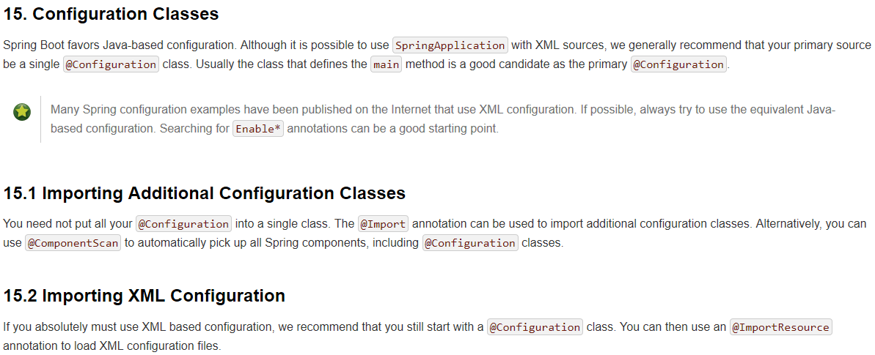
Pivotal stance

Slide 28
Q&A
42
But what is the qustion

Slide 29

Q&A

Slide 30
DuckDuckGo
Blocks Ad Trackers
Full control about search data - even before GDPR
Supports !bangs, !w will search Wikipedia directly
Favours StackOverflow answers
Drops out pure searches instead of tailored ones like G

Slide 31
Q&A
This time for real

