Slide 1
Automation
JFrog Platform
capabilities of the

Slide 2
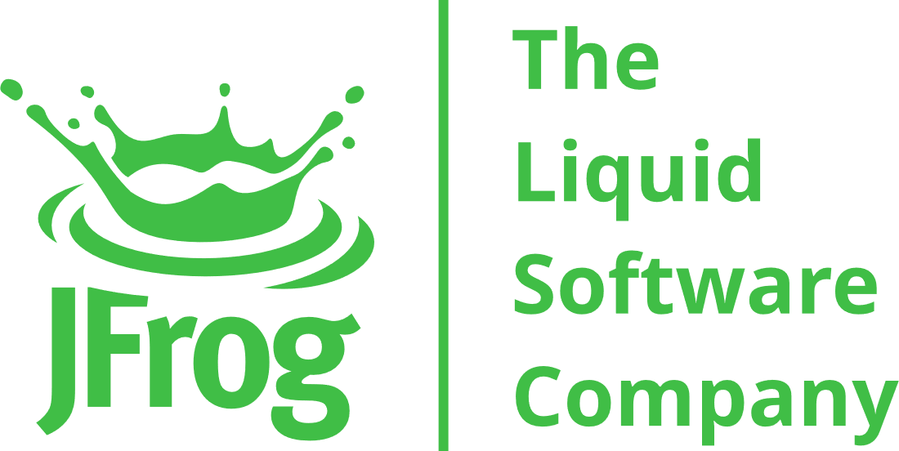
AGENDA
JFrog Platform Automation
- REST API - JFrog CLI - Artifactory Query Language - File Spec - Webhooks
Demo
Q&A

Slide 3

REST API

Slide 4
REST API
Extensive and advanced API for all JFrog products.
Different domains of functionality (repositories, builds, security, etc.)
Utilized by the UI, CLI and other tools
Can be used from any automation you might implement
Fully documented and maintained
Include new released functionality
Different options for authentication (basic auth, API key, access token)

Slide 5
REST API - examples
# System ping curl https://jfrog.address/artifactory/api/system/ping
# Using encrypted password
curl -uadmin:AP86Mv9An2neryqDCXQqVexVNhK https://jfrog.address/artifactory/api/system/service_id
# Downloading a file
curl –I -uadmin:password "https://jfrog.address/artifactory/docker-stage-local/docker-app/58/manifest.json”
# Create a repo
curl -v -uadmin:password -XPUT 'https://jfrog.address/artifactory/api/repositories/my2proj-docker-dev-us' -H 'Content-Type: application/json' -d @createLocalRepo.json

Slide 6
JFrog CLI

Slide 7
JFrog CLI
A smart client with a simple interface to JFrog products
Aimed for automation and for simplifying automation scripts by making your scripts more efficient, reliable and maintainable.
Advantages:
High level functionality (Parallelism, resumability, wildcards, etc.)
Checksum awareness
Multiple configurations support
Simulation mode
CLI Plugins supported ( https://github.com/jfrog/jfrog-cli-plugins-reg )

Slide 8
JFrog CLI - Syntax
jfrog target command-name global-options command-options arguments
Possible Targets:
rt: Artifactory
rt: Distribution
mc: Mission Control
xr: Xray
Command to execute:
config
upload & download
copy, move, delete
search & properties
build integration
create release bundle
more
Global Options:
--url
--user
--password
--ssh-key-path
Command options:
--props
--recursive
--regexp
--threads
--dry-run
--deb
Command args

Slide 9
JFrog CLI - Examples 1/2
# List version of cli
jfrog -v
# List all env configurations
jfrog config show
# For adding a new artifactory configuration
jfrog config add --url=http://mydomain/artifactory --user=myuser --password=mypwd mylogicalname
# Upload a single file to artifactory
jfrog rt u "*file.*" my-repo-name
jfrog rt u "*file.*" my-repo-name/subfolder/anothersubfolder/
# Search artifacts
jfrog rt s “my-repo-name/*.zip”

Slide 10
JFrog CLI - Examples 2/2
# For downloading all files from a specific folder in a repository with unconfigured artifactory
jfrog rt dl "my-repo/all-my-frogs/" --url=http://domain/artifactory --user=admin --password=pwd
# For copying some files in a specific path to another repo/path
jfrog rt cp source-frog-repo/rabbit/ target-frog-repo/rabbit/
# For moving specific artifactory based on file spec
jfrog rt mv source-frog-repo/*.zip target-frog-repo
# For deleting some files from a specific repo/path - including interactive confirmation
jfrog rt delete my-other-generic-local/*.png

Slide 11
AQL

Slide 12
Artifactory Query Language
Proprietary JSON-like syntax
Very powerful
Translated to efficient DB queries
Universal - any repository type is supported
Can be used as REST API payloads and in JFrog CLI commands
Notes:
Emphasize efficient queries capabilities against the Artifactory DB => differentiator

Slide 13
AQL - examples
//Find the content of a repo
items.find(
{“type":"file",
"size":{"$lt":"1000000"},
"stat.downloads":{"$eq":null},
"@uploadedBy":"John",
"$or":[
{"name":{"$match":"*.jar"}},
{"name":{"$match":"*.zip"}}
]
}
).include("name","size")
.sort({"$desc":["size","name"]})

Slide 14
File Spec

Slide 15
File Spec
Specify the details of files you want to manipulate with Artifactory
Separation of File Specification from code
Resolve dependencies
Download artifacts based on software life cycle maturity
Upload Third Party software to Artifactory
Find latest artifacts
Based on AQL
Wildcard or regular expression with placeholders
Notes:
https://www.jfrog.com/confluence/display/CLI/CLI+for+JFrog+Artifactory#CLIforJFrogArtifactory-UsingFileSpecs

Slide 16
File Spec - Format
{
"files": [
{
"pattern" or "aql": "[Mandatory]",
"props": "[Optional]",
"excludeProps": "[Optional]",
"recursive": "[Optional, Default: 'true']",
"exclusions": ["[Optional, Applicable only when 'pattern' is specified]"],
"archiveEntries": "[Optional]",
"build": "[Optional]",
"bundle": "[Optional]",
"sortBy" : ["[Optional]"],
"sortOrder": "[Optional, Default: 'asc']",
"limit": [Optional],
"offset": [Optional]
}
]
}

Slide 17
Webhooks

Slide 18
Webhooks
A Webhook is an automated notification mechanism that is triggered by events that you define.
When a webhook is triggered, it sends relevant information about the event to a web location that is listening for that specific event notification.
The webhook is comprised of three simple components
triggering event
information about the event (the “payload”)
web location listening for the event
Notes:
A best practice in terms of external systems notifications about Artifactory events. Preferable over user plugins => which should be avoided if possible due to the potential to cause performance degradation to the system if not written/implemented correctly

Slide 19
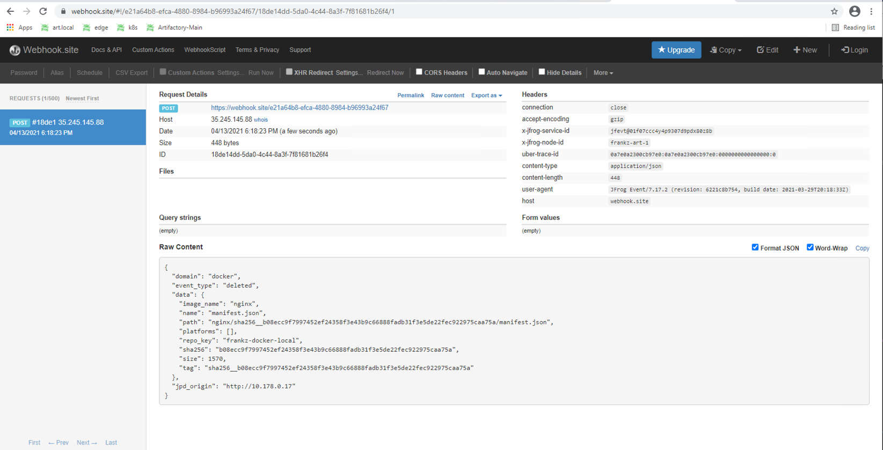
Webhooks Payload - Testing

Slide 20
JFrog Automation Tools - Choose as Appropriate
Method | Application
REST API | Full flexibility with custom code. Recommend to use if any of the below does not suffice
JFrog CLI | Can achieve query with one CLI command
FileSpec | Aggregate multiple CLI commands in one FileSpec
AQL | Formulate complex queries that specify any number of search criteria, filters, sorting options and output parameters

Slide 21
Q & A

Slide 22
THANK YOU!

Slide 23
References
JFrog REST API Documentation https://www.jfrog.com/confluence/display/JFROG/REST+API
JFrog CLI https://www.jfrog.com/confluence/display/CLI/JFrog+CLI
Using File Specs https://www.jfrog.com/confluence/display/CLI/CLI+for+JFrog+Artifactory#CLIforJFrogArtifactory-UsingFileSpecs
JFrog Artifactory Query Language https://www.jfrog.com/confluence/display/JFROG/Artifactory+Query+Language
AQL and JFrog CLI - blog https://jfrog.com/blog/aql-cli-a-match-made-in-heaven/
Notes:
https://stackoverflow.com/tags/jfrog-cli/hot?filter=all

