Slide 1
Apache Gump
Continuous Integration on Steroids

Slide 2
About LSD
http://www.leosimons.com/
leosimons@apache.org
ASF Member
Apache Excalibur, Gump, Wiki, Infrastructure
Physics Student, Enschede

Slide 3
Presentations, Pragmatic Open Source Style™
Please ask questions
The bikeshed is definitely red
SubEthaEdit, not Vi, not Emacs
We don’t talk about licensing
We talk too much about everything else
And do ask questions!

Slide 4
About the audience
There are about this many people here:
Many are F/OSS developers:
And these people don’t do java:

Slide 5
In this presentation
Apache Cocoon (briefly)
  XML publishing framework
Apache Excalibur (briefer)
  IoC framework
Apache ${foo} (honerable mention)
  There’s a lot
Apache Gump (kewl!)
  Making all that work together
  Past, present, future
  Building bridges
  And the steroids

Slide 6
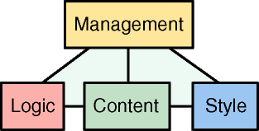
Apache Cocoon: Goal
This image ripped from cocoon documentation, © ASF and stuff

Slide 7
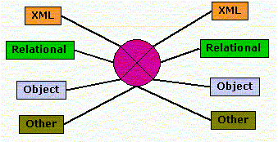
Apache Cocoon: Glue
This image ripped from cocoon documentation, © ASF and stuff

Slide 8
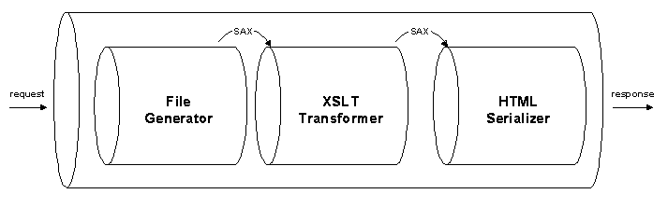
Apache Cocoon: Pipelines
This image ripped from cocoon documentation, © ASF and stuff

Slide 9
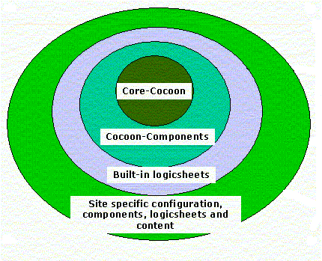
Apache Cocoon: Architecture
This image ripped from cocoon documentation, © ASF and stuff

Slide 10
Apache Cocoon: Oh boy!
2400+ java sourcefiles
300.000+ lines of code (excluding comments)
Integrates with dozens of other F/OSS projects using component architecture
Cocoon “core” has 338 dependencies

Slide 11
Apache Excalibur: Goal
Somewhere
In there…
This image ripped from cocoon documentation, © ASF and stuff

Slide 12
Apache Excalibur: Inversion of Control
“Container”
Container
Container
Container

Slide 13
Apache Excalibur: Umpf!
800+ java sourcefiles
90000+ lines of code (excluding comments)
50+ separate distributables
Excalibur “core” has 100s of dependencies

Slide 14
Apache ${foo}
Majority of activity at ASF is java-based now
1000+ committers
Apache is on the JCP
A big chunk of server-side java happens at Apache
Some of the de-facto standards such as Ant
Millions of lines of java code

Slide 15
Artist impression

Slide 16
Okay, so we do java…

Slide 17
…how on earth do we know it all actually works?

Slide 18
Introducing Continuous integration
Get yourself a beefy server
Automate all project builds
Automate all project tests
Generate reports and statistics
Make it all part of your development process (i.e. send yourself e-mail)

Slide 19
Introducing Gump
A batch-processing continuous integration package written in python
Lots of useful features like e-mail notification, RSS syndication, etc.
Understands ant, maven, make, etc
XML descriptors in a central repositories for shared maintenance

Slide 20
When continuous integration fails…
Project B depends on project A
Project A makes a teeny weenie small incompatible change in CVS head
Project B releases 1.1
Project A releases 1.1
1.1 of B does not work with 1.1 of A
A
B

Slide 21
…it can fail miserably…
Project B depends on project A, Project C on A and B
Project A makes a small incompatible change in CVS head
Project B adds a cool new feature
Project C notices the change in CVS head of A in time, and adapts, using a “snapshot” version. Same for B.
Project C releases 1.1
Project B releases 1.1
Project A releases 1.1
A
C
B

Slide 22
Welcome to jar hell!
The problem is only noticed months later…
So what’s the best recovery solution? Complex!
Now imagine you’ve got 400 dependencies, not 2…

Slide 23
Gump on Steroids
Project B might declare it depends on Project A version 1.0
We override that declaration, and instead compile it against A from CVS head that we just built
<!-- maven buildfile snippet -->
<project>
<name>B</name>
<dependencies>
<depend>
<groupId>A<groupId>
<artifactId>A</artifactId>
<version>1.0</version>
</depend>
</dependencies>
</project>

Slide 24
The World on Steroids
Gump builds 100s of projects (not just A and B)
Gump compiles over 150.000 java sourcefiles several times a day
We send out lots of e-mails to developer mailing lists when stuff breaks

Slide 25
Example: change to log4j
Subject: [human-assisted gump] log4j back incompatible change
Date: Fri, 29 Oct 2004 01:07:38 -0400
(...) change
http://cvs.apache.org/viewcvs.cgi/logging-log4j/src/java/org/apache/log4j/Category.java?r1=1.88&r2=1.89&diff_format=h
caused a compilation failure of the following projects:
- commons-logging
- velocity
- ant
and, as a result, caused a drop in the gump's success from 83% to 53%
(...)

Slide 26
It actually works! (sometimes)
Without Gump, it would be near-impossible to upgrade one of Cocoon’s 338 dependencies without a lot of stuff breaking
In fairness, Gump is quite far from being perfect, and incompatibility problems still do occur frequently
But Gump really does help to increase awareness and really does get people to talk early and often

Slide 27
Building Bridges:
Kaffe on Steroids
Each night, we do a gump run against a CVS snapshot of Kaffe
http://brutus.apache.org/gump/kaffe/index.html
Measure of compatibility between ASF projects and the free java implementations

Slide 28


Where we’re at
Kaffe-CVS
JDK 1.4
(Numbers for Friday afternoon)

Slide 29
Example: Ant on kaffe
On Wed, 23 Feb 2005, Dalibor Topic <robilad@kaffe.org> wrote:
> Stefan Bodewig <bodewig <at> apache.org> writes:
>> ... since optional/condition/IsPingable.java shouldn't be compiled
>> otherwise.
>>
>> Ant checks for the class java.lang.Readable to detect JDK 1.5, has
>> this recently been added to Kaffe?
>
> Yeah, just yesterday. Merge of a few non-generics bits from the
> generics branch within GNU classpath. I guess the
> java.lang.management classes are a safe bet, though :)
So far the only JDK 1.5 feature Ant uses is InetAddress.isReachable.
Do us a favor and implement it ;-)
I'll modify Ant's build file to adapt, but I'd like to keep the
Readable class as marker. It may be good to revisit each JDK 1.5
feature we add (if we do) to see whether Kaffe can support it.
Stefan

Slide 30
What does gump do here?
Help pinpoint exactly where to focus developer effort (both sides) to improve interop
Provide a measure of progress
Act as a really big integration test for Kaffe and classpath

Slide 31
Gump3: where we’re going
Fancy Web UI
(thanks to cocoon and the mozilla team :-)

Slide 32
Gump3: a lot smarter
A
We figured out the algorithm that shows exactly what change where caused what problems
“Just” need to convert it to code
A-
A+
2
B
A
B+
B-
2
C
B
C+
C-
D
1
C
D+
D-
0
D

Slide 33
Gump3: Historical Database
time-invariant
environment
Host
Run
0
n
Package
n
address|properties
0
uri|timestamp
uri|name
0
n
0
Workspace
dependencies
n
0
Result
Build
1
Project_version
1
success|failure|halt
uri|log
timestamp
n
1
Module
Project
1
url|descriptor
uri|descriptor

Slide 34
Gump3: Fancy CLI
paddo:~/svn/gump/branches/Gump3 lsimons$ ./gump help
Utility commandline interface for Gump.
Usage:
./gump command [opts ...]
Available commands are:
run -- run pygump
debug -- run pygump in debug mode
test -- run the pygump unit tests
dynagump -- run the dynagump web application server
update-host -- update the configuration of a gump host
create-database -- create a new gump MySQL database
pycompile -- compile all pyump source files
(...)

Slide 35
Gump3: Plugin architecture
class LoggingPlugin(AbstractPlugin):
"""Plugin that prints debug messages as it visits model objects."""
def __init__(self, log):
self.log = log
def initialize(self):
self.log.debug("Initializing...")
def visit_workspace(self, workspace):
self.log.debug("Visiting workspace.")
def visit_repository(self, repository):
self.log.debug("Visiting repository '%s'." % repository.name)
(...)
def finalize(self):
self.log.debug("Finishing up...")

Slide 36
Gump3: You tell us!

Slide 37
Questions, comments, criticism, offers to buy me beer?

Slide 38
ApacheCon Europe 2006
Stuttgart, July 18-22
http://www.apachecon.com/
Everything you ever wanted to know about Apache and more!

