Slide 1
Terraform
Automated delivery and management of cloud resources

Slide 2
What is Infrastructure as Code (IaC)?
Infrastructure as Code (IaC) is a paradigm where we define/characterize our computing infrastructure using configuration files. Benefits of Infrastructure as Code (IaC), Faster Release Cycles and High-Quality Delivery More Institutional knowledge Predictability and Idempotency Better Collaboration between Dev and Operations Enables Effective DevOps

Slide 3
Terraform
HashiCorp’s Terraform is one of the leading open-source, cross-platform, multi-cloud, hybrid IaC tools available to provision and manage IT and development resources on any cloud. Benefits of using Terraform, Open-source, multi-cloud and Declarative IaC tool Can be used to manage various cloud resources Logging, auditing, remote state and locking feature Time and resource savings All the benefits of IaC like multiple instances of a resource, multiple working environments, etc.

Slide 4
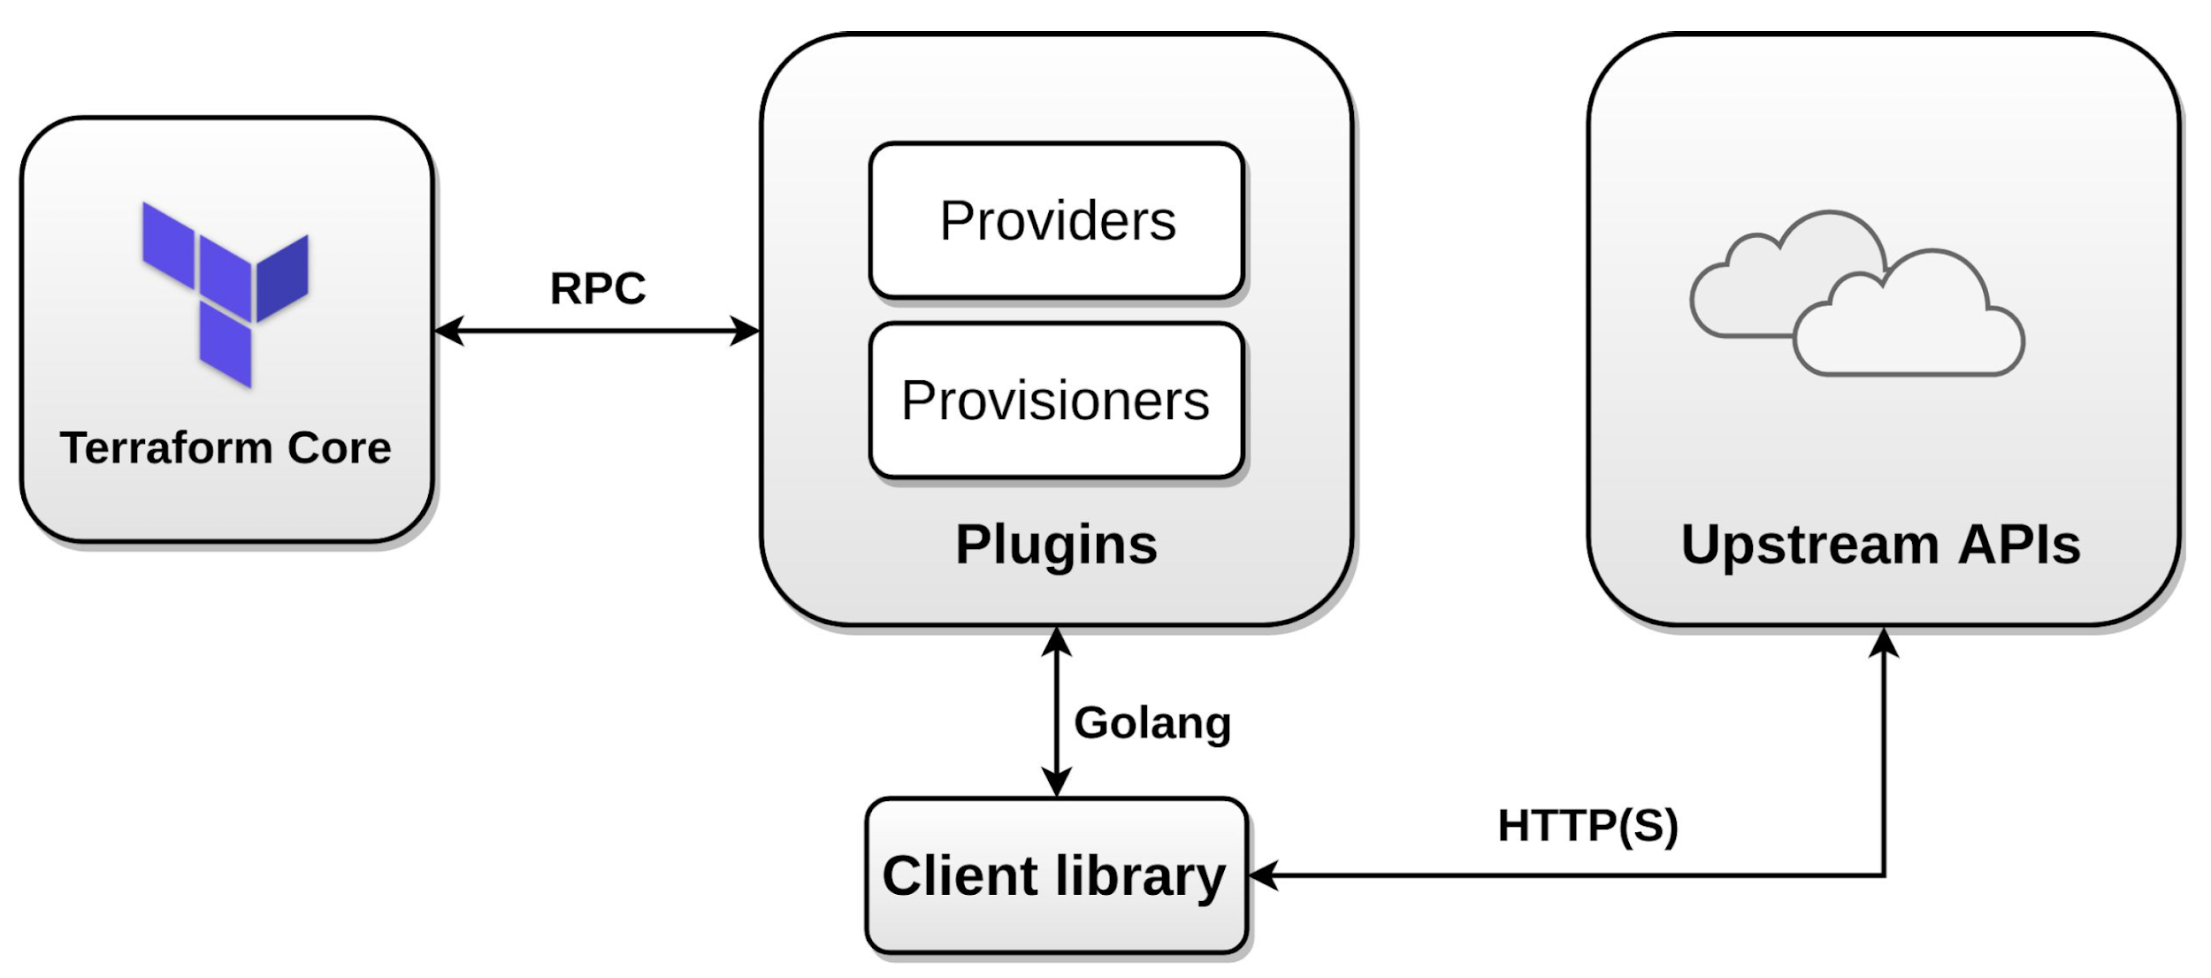
Terraform architecture

Slide 5
Components of Terraform script
Some of the building blocks of a terraform script are: State file: A state file is a Terraform owned, text-based (JSON), dynamically generated file containing information about the resource configuration. Variables: Variables are placeholders in the configuration that accept external values as parameters during execution time. Resources: They describes one or more infrastructure objects. Data resources: Data sources allow Terraform to use the resource objects defined outside of Terraform. Modules: A module is a container for multiple resources that are used together.

Slide 6
Objectives
The objectives of this project are: Deploy a single resource (Virtual Machine) using Terraform. Deploy multiple instances of a resource (Virtual Machine) by running Terraform script single time.

Slide 7
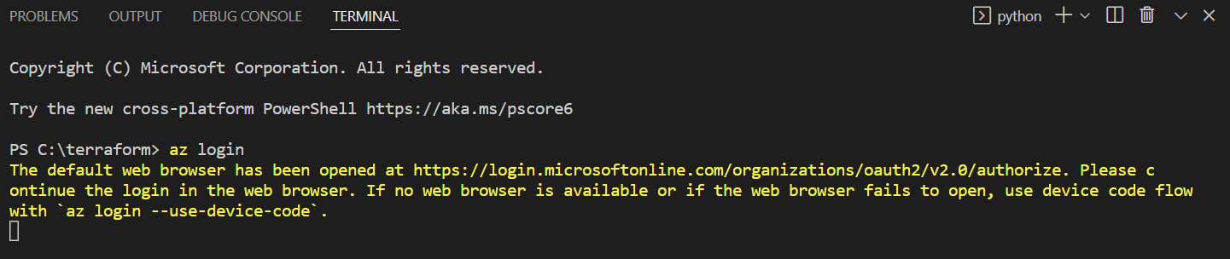
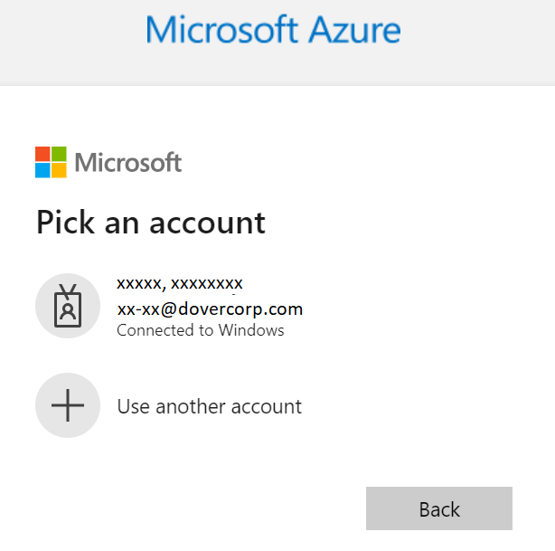
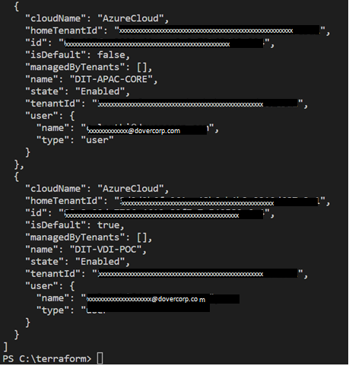
Deployment of resource using Terraform
In order to deploy a resource using Terraform we need to follow the following workflow: Authenticate and authorize Terraform with Azure: We can do this by using “az login” command. Once authenticated, it lists all the available subscriptions. Figure 1) Searching for Policy in Azure Portal
Fig 1) “az login” command
Fig 2) Logging in with Azure account
Fig 3) Available subscriptions

Slide 8
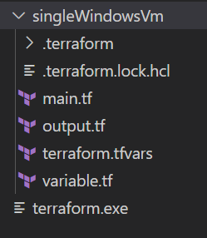
Deployment of resource using Terraform
Select operating subscription Organize working directory structure: Instead of using one large monolithic Terraform file it is recommended to use multiple small manageable files.
Fig 4) Selecting operating subscription
Fig 5) Working directory structure

Slide 9
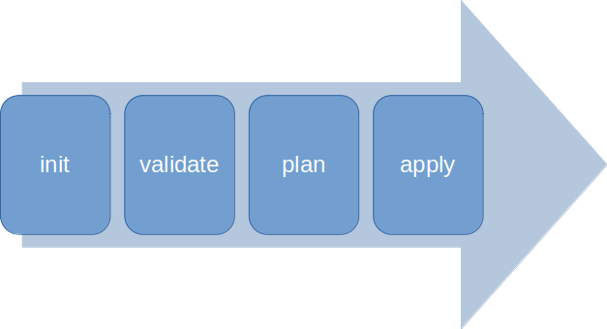
Deployment of resource using Terraform
Preparing script file: We need to prepare the terraform script that contain the target resource configurations. Apply the script: Once we have prepared the script next we need to follow the Terraform’s “apply” workflow.
Fig 6) Apply workflow

Slide 10
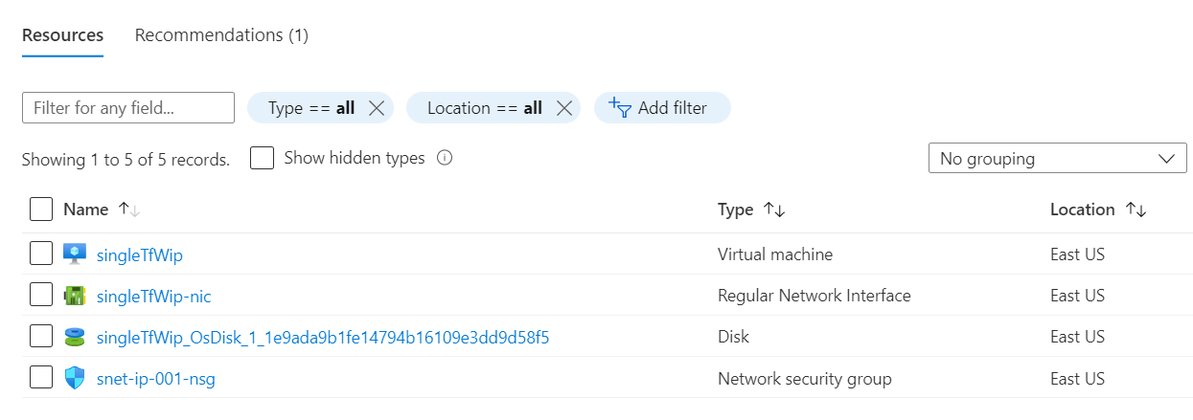
Output
After applying the script we can confirm the results at azure portal:
Fig 7) Azure Portal screenshot with the Windows VM deployed using Terraform

Slide 11
Deployment of multiple instances of a resource using Terraform
To deploy multiple instances of a resource using Terraform we need to follow the following workflow: Here steps 1- 3 are same as of the deployment of a resource, the modification is in the script that we need to prepare. Prepare the script: To deploy multiple instances of a resource we need to put the configuration of that resource in a module then call that module multiple times from the root script. Apply the script: To apply the script we need to follow the same workflow as before.

Slide 12
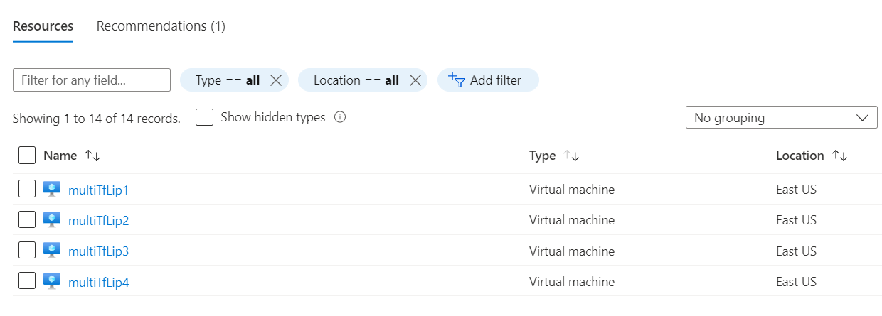
Output After applying the script we can confirm the results at azure portal:
Figure 8) 4 Linux VMs deployed using a single script

Slide 13
Thank you!!!
Questions??? Presented by - Dover IT
Lakshay Sethi - c-lsethi@dovercorp.com
Abdul Razik - arazik@dovercorp.com

