Slide 1
Lingua Franca Verification
Meeting Notes
6.12.20

Slide 2
The Big Picture
Verification Workflow
Lingua Franca
Approach #1
Approach #2
(Higher level) Model
Correct Model
Correct Model
Impl. (lower level model)
lfc
codegen
specs => runtime assertions
Impl. (lower level model)
Correct-by-construction
Impl.
Impl.
(correct under
assumptions)
Dependencies:
LF transpiler
Code generation
New LF target
Dependencies:
LF transpiler
Specification parser
Notes:
The assumption is that given specifications can fully describe the reaction behavior.
Approach #1: LF Model is an outer model. Both are models.
Formalized formulation of the coordination layer + formulation of the reactions.

Slide 3
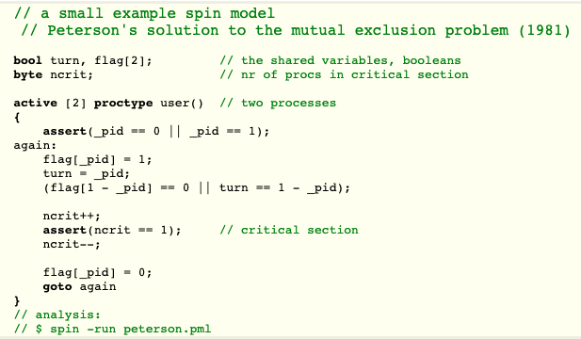
Specification languages as LF targets?
Spin/Promela
https://github.com/nimble-code/Spin

Slide 4
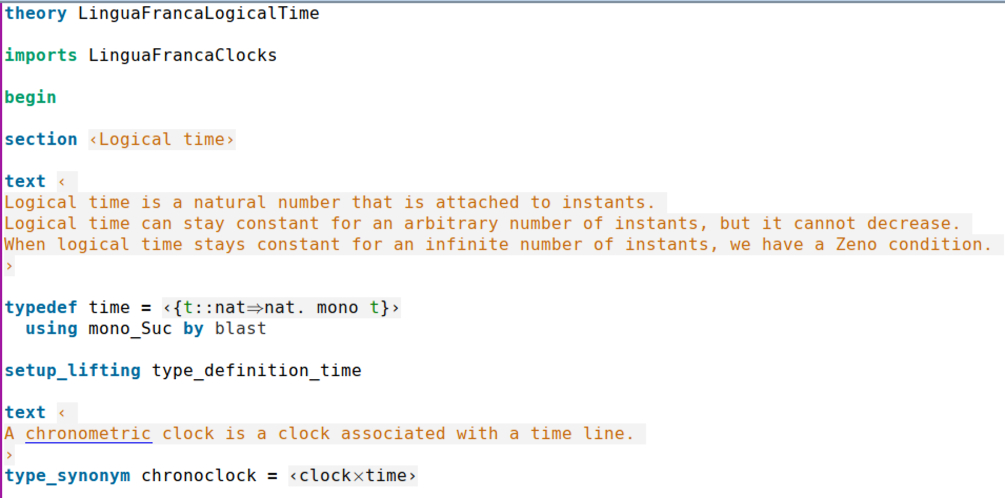
Specification languages as LF targets?
Isabelle/HOL

Slide 5
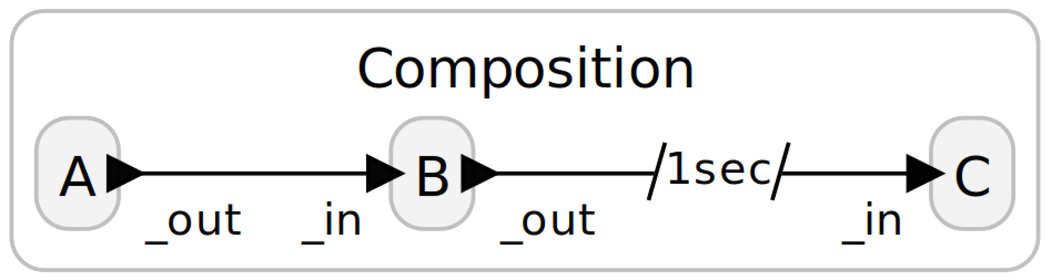
An LF example
Assume all logical delays are defined at the connection declarations.
E
T = 0
Notes:
two queues: event queue and reaction queue.
Keep pulling events with the same timestamp (including microstep)
Put corresponding reactions in the reaction code. Handling all the reaction queue until it is empty.
Then look at the event queue again.
Advance logical time when physic time exceed

Slide 6
An LF example
Assume all logical delays are defined at the connection declarations.
E
T = 1

Slide 7
An LF example
Assume all logical delays are defined at the connection declarations.
E
T = 1

Slide 8
UCLID5 Formulation
Assume all logical delays are defined at the connection declarations.
E
T = 0
Transition #1

Slide 9
UCLID5 Formulation
Assume all logical delays are defined at the connection declarations.
E
T = 0
Transition #2

Slide 10
UCLID5 Formulation
Assume all logical delays are defined at the connection declarations.
E
T = 0
Transition #3

Slide 11
UCLID5 Formulation
Assume all logical delays are defined at the connection declarations.
E
T = 1
Transition #4

Slide 12
UCLID5 Formulation
Assume all logical delays are defined at the connection declarations.
E
T = 1
Transition #5

Slide 13
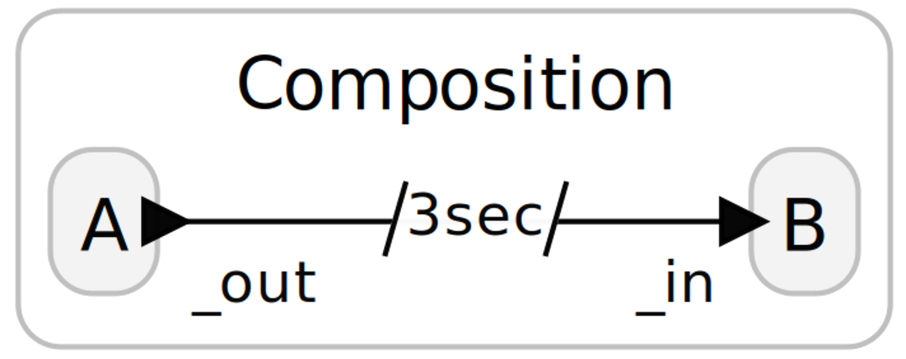
Demo (timed_reactor.ucl)

