Slide 1
Verifying Cyber-Physical Systems
Formal
System
Model
Real-time
Behavior
Analysis
nondeterministic
and
probabilistic
Does a reaction modify state in a certain way?
Given network traffic, how likely do unsafe states occur?
Given event A, does the reaction output event B and not C?
Given network traffic, what is a safe logical delay?
Do certain properties hold throughout execution?
Is the system able to handle frequent physical actions?
Does the system eventually reach a certain state?
…
…

Slide 2
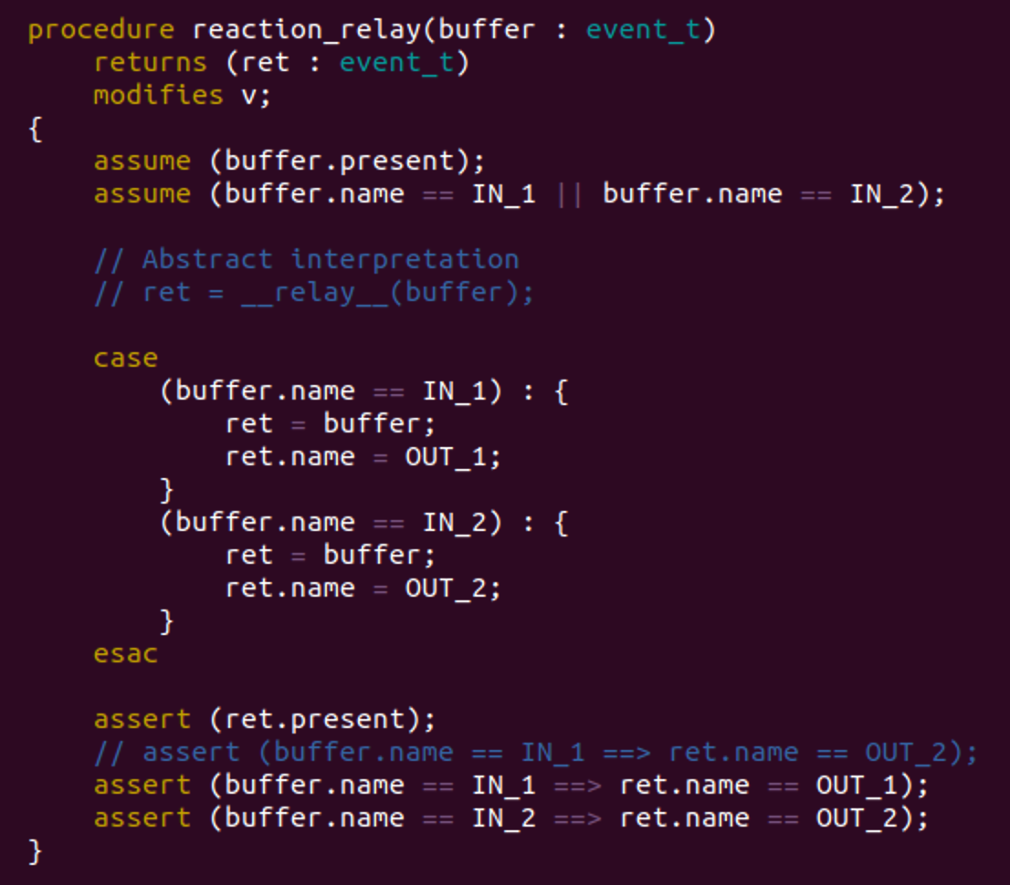
Formal Modeling using UCLID5

Slide 3
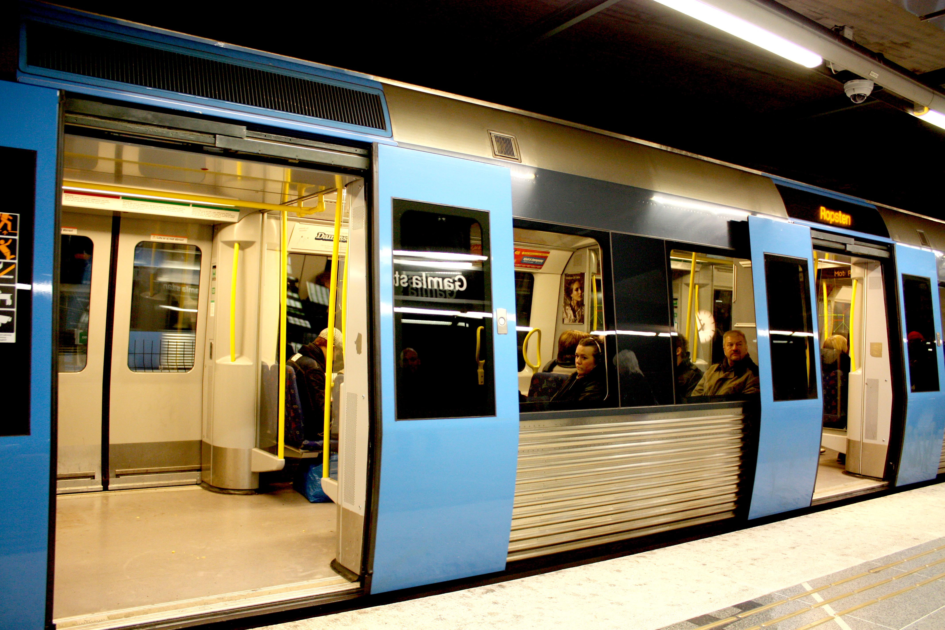
Train Door Example
Unlocked,
stopped
Locked,
moving
Press button
What if Controller, Train, and Door are separated by a network?
What if the button is pressed too frequently?
Error state: unlocked while moving

Slide 4
Probabilistic View
Pr
Lock
Move
0
t

