Slide 1
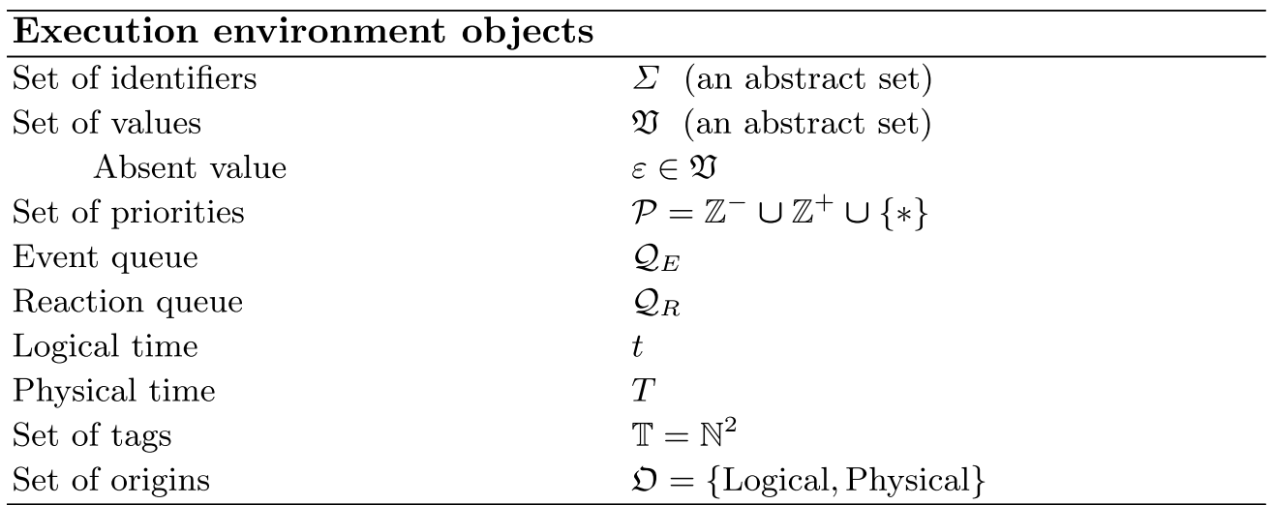
Lingua Franca - Environment
Notes:
Logical time: monotonically increasing sequence of tags of the form (a, b), where a is referred to as the time value and to b as the microstep index.
Physical time: time value that is obtained from a clock on the execution platform.

Slide 2
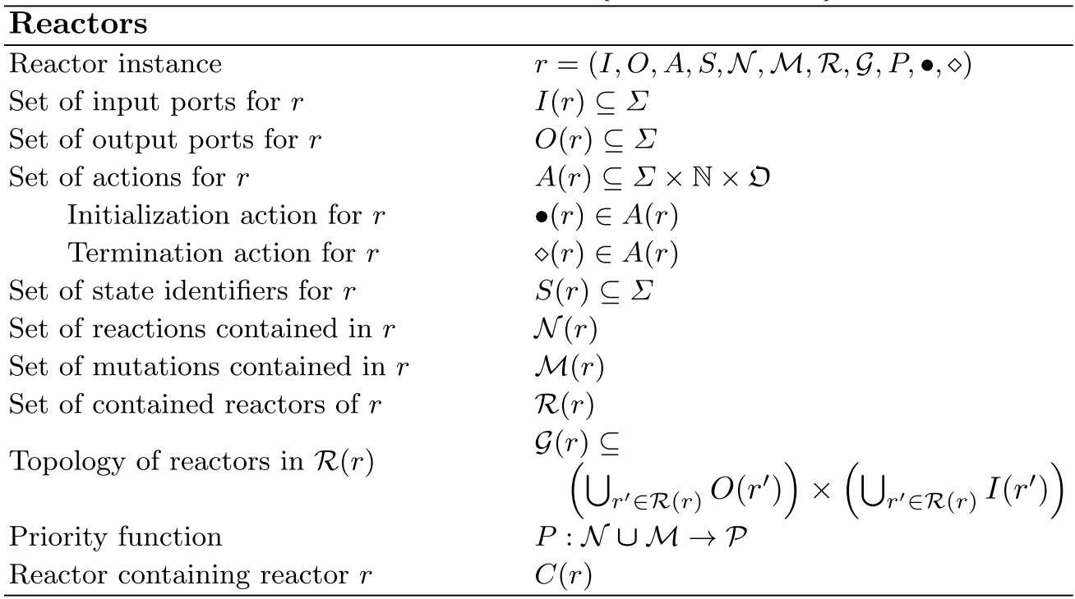
Lingua Franca - Reactors

Slide 3
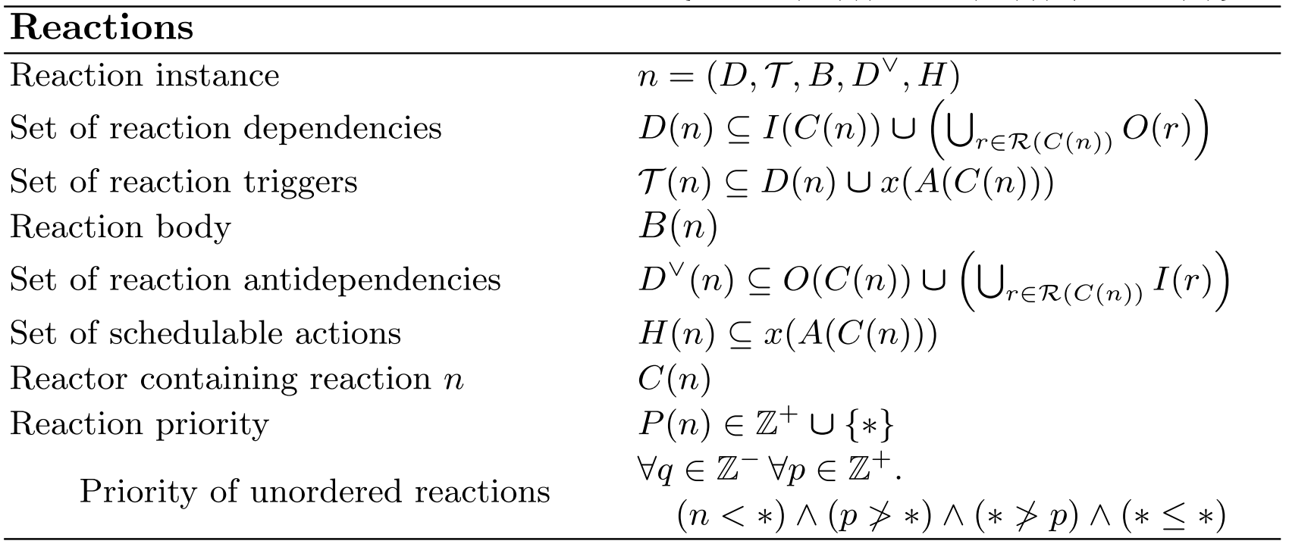
Lingua Franca - Reactions
Notes:
Logical time: monotonically increasing sequence of tags of the form (a, b), where a is referred to as the time value and to b as the microstep index.
Physical time: time value that is obtained from a clock on the execution platform.

Slide 4
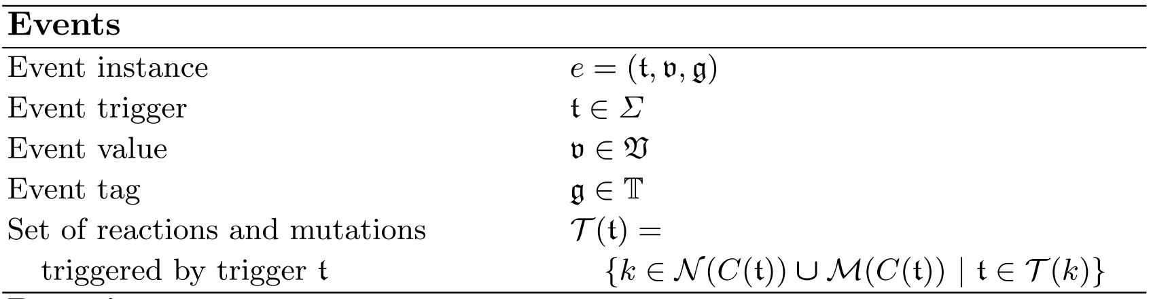
Lingua Franca - Events
Notes:
Logical time: monotonically increasing sequence of tags of the form (a, b), where a is referred to as the time value and to b as the microstep index.
Physical time: time value that is obtained from a clock on the execution platform.

Slide 5
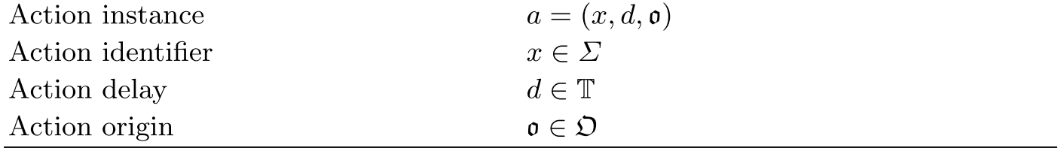
Lingua Franca - Actions
Notes:
Logical time: monotonically increasing sequence of tags of the form (a, b), where a is referred to as the time value and to b as the microstep index.
Physical time: time value that is obtained from a clock on the execution platform.

Slide 6
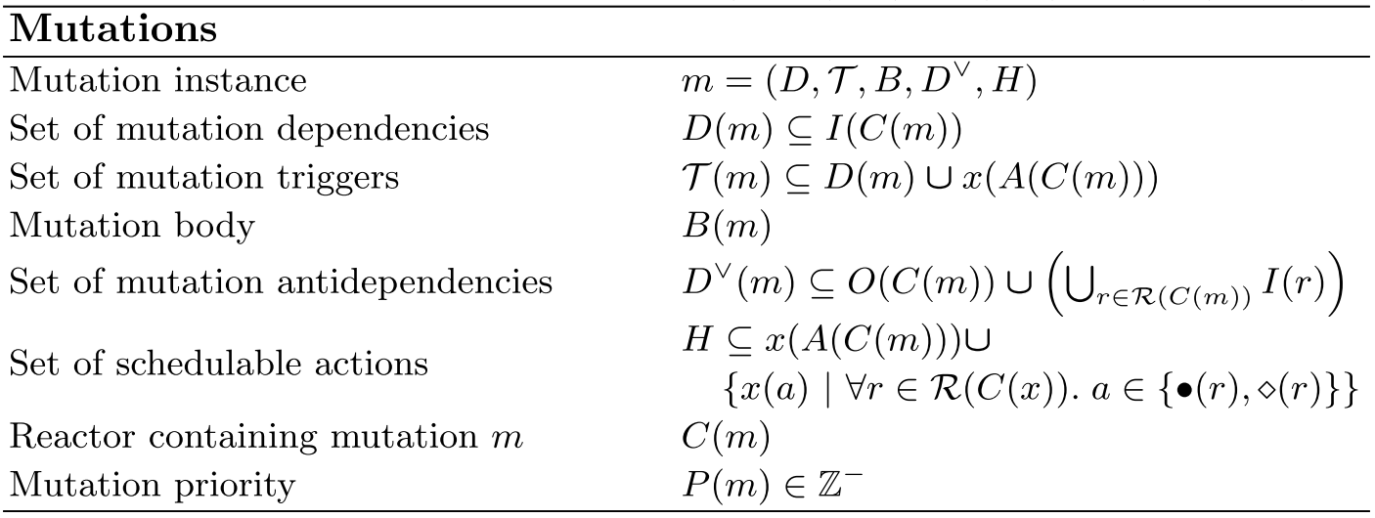
Lingua Franca - Mutations
Notes:
a mutation can modify the dependency graph of the reactor that contains it
by adding connections to its topology, removing connections, and/or adding or removing its reactions.
As a consequence, to preserve determinism, all mutations triggered at
a given logical time t must be carried out prior to the execution of any contained
reactions that are triggered at t.

Slide 7
Reaction precedence
B
A
C
Reaction C waits for B to finish.

Slide 8
Reaction precedence
B
C1
A
C2
Reaction C1 executes before reaction C2.

Slide 9
Reaction precedence
B
C1
A
C2
Reaction C2 executes before reaction C1.

Slide 10
Previous UCLID Formulation
Advance t?
“false”
Time
Controller
Clock
t
t
All null events?
“false”
E1
E2
N
A
Delay
B
“not null”
“not null”
“null”

Slide 11
Previous UCLID Formulation
Advance t?
“false”
Time
Controller
Clock
t
t
All null events?
“false”
N
E1
E2
A
Delay
B
“null”
“not null”
“not null”

Slide 12
Previous UCLID Formulation
Advance t?
“false”
Time
Controller
Clock
t
t
All null events?
“false”
N
N
E1
A
Delay
B
“null”
“null”
“not null”

Slide 13
Previous UCLID Formulation
Advance t?
“true”
Time
Controller
Clock
t
t
All null events?
“true”
N
N
N
A
Delay
B
“null”
“null”
“null”

Slide 14
Drawbacks
The lack of a global view of events in the system
The abstraction does not faithfully model LF implementation.
The timing mechanism is inefficient. The system “actively” advances time instead of “passively.”
Cannot schedule actions
Reactions happening in the same logical time do not preserve dependency.
Notes:
The lack of a global view of events in the system
Events are only local to modules that are hosting them.
The abstraction might not faithfully model LF implementation.
The notion of sending ”null events” between reactors can be misleading and potentially create problems.
The timing mechanism is inefficient. “Active” advancement strategy.
Search for an instant to advance time
Need to determine how much to advance
More burden on the solver

Slide 15
New UCLID Formulation
Time
Controller
Clock
RTI
clock
A
B
event_q
A
Delay
B
reaction_q

Slide 16
New UCLID Formulation
Stores the current logical time.
Stores events with logical time greater than the current logical time. Events are sorted by logical time.
RTI
clock
A
B
event_q
reaction_q
Stores events with logical time equal to the current logical time. Events are sorted by precedence.

Slide 17
New UCLID Formulation
Precedence is reflected by assigning priorities to reactions.
When a reaction outputs an event, the priority is attached to the event.
RTI
clock
A
B
event_q
reaction_q

Slide 18
New UCLID Formulation
Precedence is reflected by assigning priorities to reactions.
When a reaction outputs an event, the priority is attached to the event.
RTI
clock
A
B
event_q
reaction_q
A: 1
C2: 2
B: 3
C1: 4
B
C1
A
C2

Slide 19
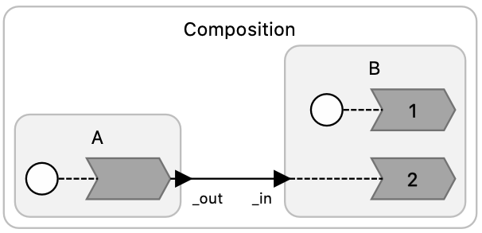
A_B.lf (using reaction_q only)
UCLID step: 1
RTI
E1
t = 0
A
B
event_q
event_q
(empty)
reaction_q
(empty)
reaction_q
Notes:
The triggering of reaction in LF does not elapse logical time. So E1 is added to reaction_q.

Slide 20
A_B.lf (using reaction_q only)
UCLID step: 2
RTI
t = 0
A
B
event_q
event_q
(empty)
reaction_q
E1
reaction_q
Notes:
The triggering of reaction in LF does not elapse logical time. So E1 is added to reaction_q.

Slide 21
A_B.lf (using reaction_q only)
UCLID step: 3
RTI
t = 0
A
B
event_q
event_q
(empty)
reaction_q
(empty)
reaction_q
E1
Notes:
The triggering of reaction in LF does not elapse logical time. So E1 is added to reaction_q.

Slide 22
A_B.lf (using reaction_q only)
UCLID step: 4
RTI
t = 0
A
B
event_q
event_q
(empty)
reaction_q
(empty)
E1
reaction_q
Notes:
The triggering of reaction in LF does not elapse logical time. So E1 is added to reaction_q.

Slide 23
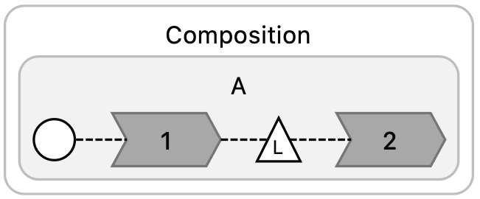
A_delayed.lf (using event_q only)
UCLID step: 1
RTI
E1
t = 0
A
event_q
(empty)
reaction_q
(empty)
event_q
reaction_q

Slide 24
A_delayed.lf (using event_q only)
UCLID step: 2
RTI
t = 0
A
event_q
reaction_q
(empty)
event_q
E1
reaction_q

Slide 25
A_delayed.lf (using event_q only)
UCLID step: 3
RTI
t = 5
A
event_q
(empty)
reaction_q
(empty)
event_q
reaction_q
E1

Slide 26
A_delayed.lf (using event_q only)
UCLID step: 4
RTI
t = 5
A
event_q
(empty)
reaction_q
(empty)
event_q
E1
reaction_q

Slide 27
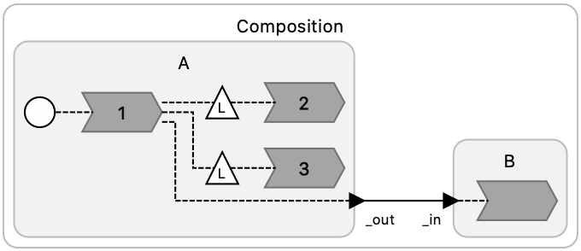
A_B_action.lf (using both)
UCLID step: 1
RTI
t = 0
_out
foo
bar
event_q
(empty)
reaction_q
(empty)
A
B
event_q
reaction_q

Slide 28
A_B_action.lf (using both)
UCLID step: 2
RTI
t = 0
event_q
reaction_q
A
B
bar
_out
event_q
foo
reaction_q

Slide 29
A_B_action.lf (using both)
UCLID step: 3
RTI
t = 0
event_q
reaction_q
(empty)
A
B
bar
event_q
foo
reaction_q
_out

Slide 30
A_B_action.lf (using both)
UCLID step: 4
RTI
t = 1
event_q
reaction_q
(empty)
A
B
foo
event_q
_out
reaction_q
bar

Slide 31
A_B_action.lf (using both)
UCLID step: 5
RTI
t = 2
event_q
(empty)
reaction_q
(empty)
A
B
event_q
bar
reaction_q
foo

Slide 32
A_B_action.lf (using both)
UCLID step: 6
RTI
t = 2
event_q
(empty)
reaction_q
(empty)
A
B
event_q
foo
reaction_q

Slide 33
A_B_action.lf (using both)
UCLID step: 7
RTI
t = 2
event_q
(empty)
reaction_q
(empty)
A
B
event_q
reaction_q

Slide 34
Specifications
main
RTI
clock
A
B
event_q
Verify reactions’ behaviors using pre/post conditions:
After the exec. of reaction R_1, does the state variable V_1 change?
If certain inputs are present, will certain output events be generated?
reaction_q
Verify temporal properties, such as:
Do event E_1 and E_2 always occur at the same time?
Will event E_3 eventually occur?
By the time E_4 is popped off the event_q, is E_5 scheduled?
…

Slide 35
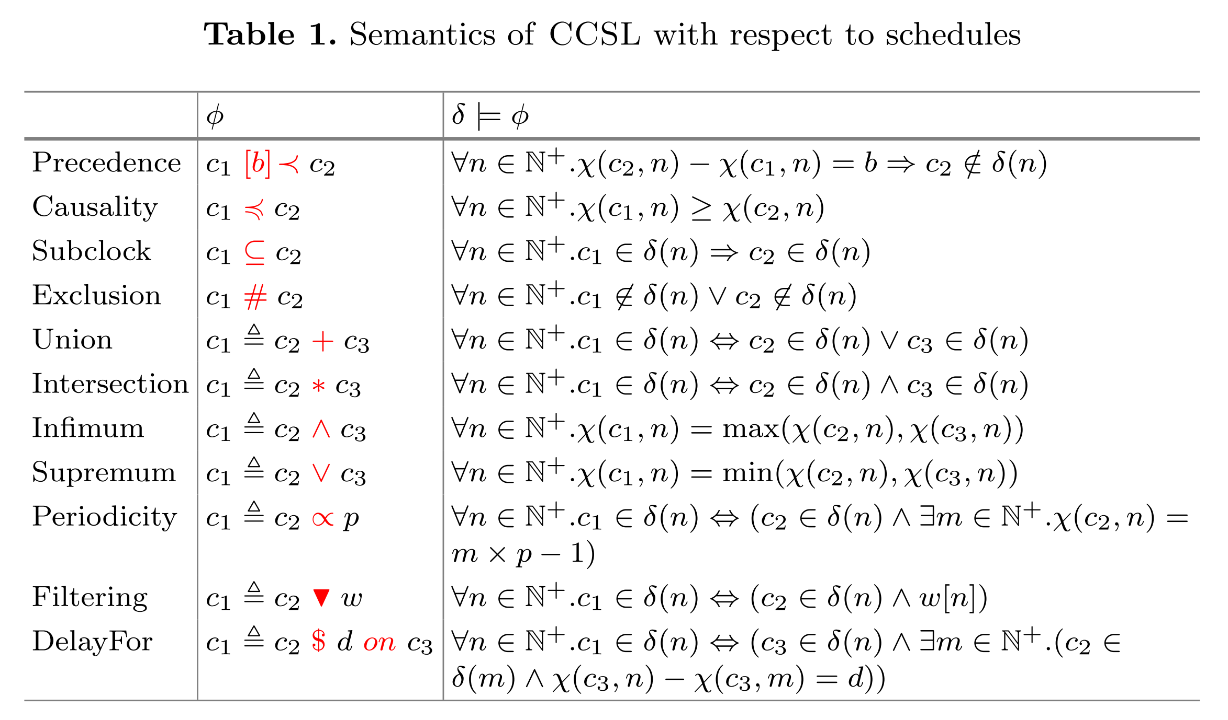
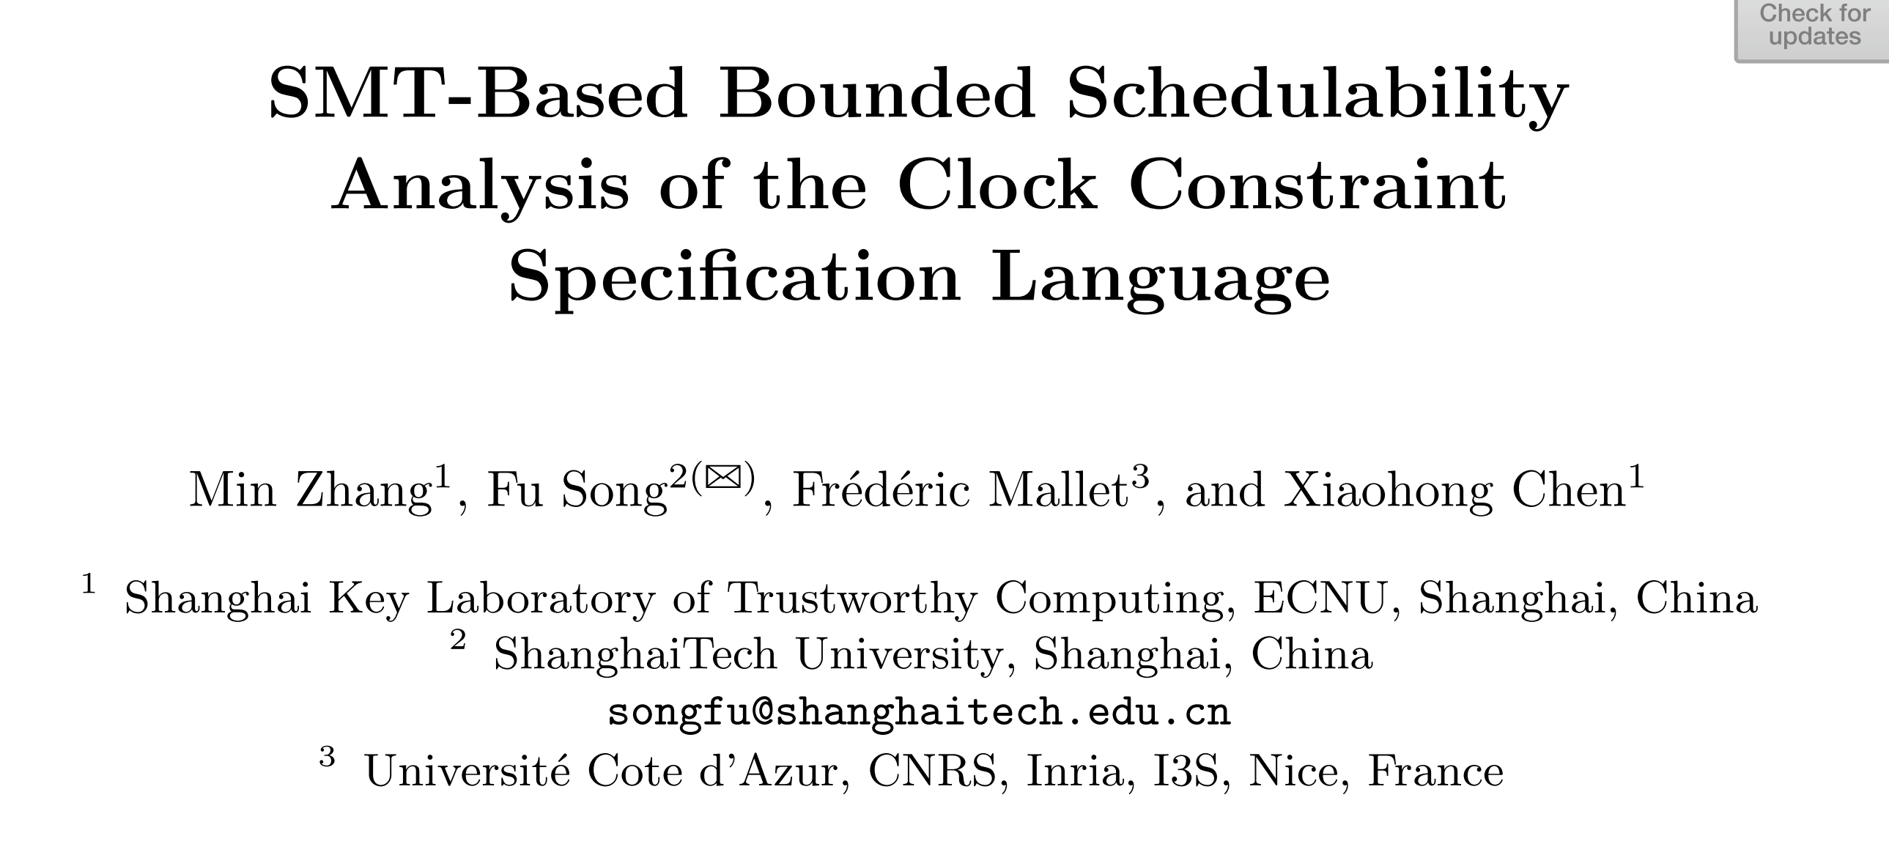
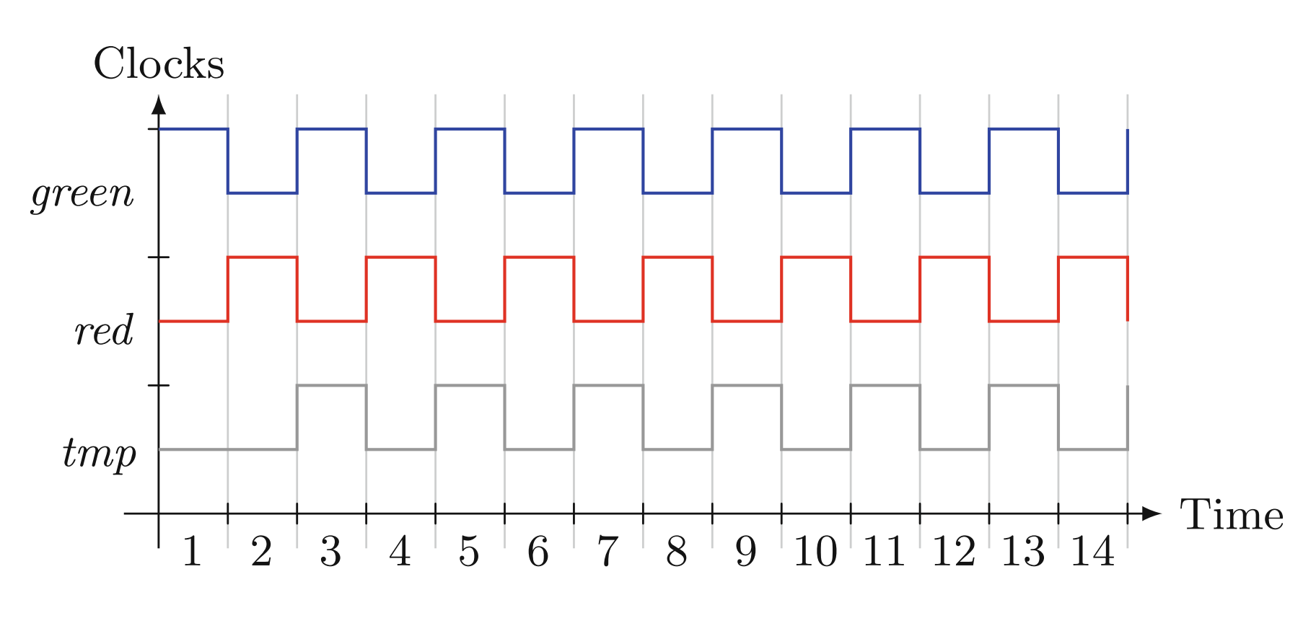
SMT in solving temporal properties?

Slide 36
PQueue

Slide 37
New UCLID Formulation
Event_q
Priority_q
RTI
clock
A
B
event_q
reaction_q

Slide 38
New UCLID Formulation
N
A
RTI
E1
E2
event_q
t = 0
reaction_q
E3
E4
B
N

Slide 39
New UCLID Formulation
Event_q
Priority_q
N
A
RTI
E1
E2
event_q
t = 0
reaction_q
E3
E4
B
N

Slide 40
New UCLID Formulation
E5
E6
A
RTI
N
event_q
t = 0
N
B
E7
E8
Event priority queue: [ E5(t=1, dest=B), E7(t=1, dest=A), E8(t=2, dest=A), E6(t=3, dest=B) ]

Slide 41
New UCLID Formulation
N
A
RTI
E7
event_q
t = 1
E5
B
N
Event priority queue: [ E8(t=2, dest=A), E6(t=3, dest=B) ]

Slide 42
Translation
Event_q
Priority_q
RTI
clock
A
B
event_q
reaction_q

Slide 43
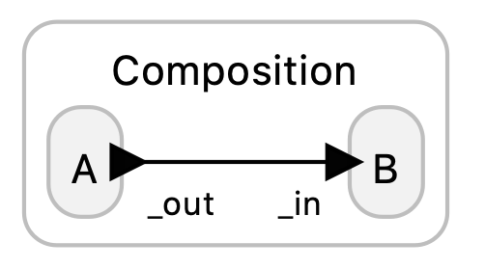
A_B.lf (using reaction_q only)
RTI
t = 0
A
B
event_q
Event_q
(empty)
Priority_q
(empty)
reaction_q

