Slide 1
Verifying Cyber-Physical Systems
Cyber
(software)
Physical
For the cyber part alone, there are a few questions to consider:
Correctness of reaction code
Schedulability
Single-threaded, multi-threaded, distributed executions
Uncertainties (network delay, sensor output, etc.)
Properties related to these questions can be specified using pre/post conditions, and Linear Temporal Logic (LTL).
Notes:
Logical time: monotonically increasing sequence of tags of the form (a, b), where a is referred to as the time value and to b as the microstep index.
Physical time: time value that is obtained from a clock on the execution platform.

Slide 2
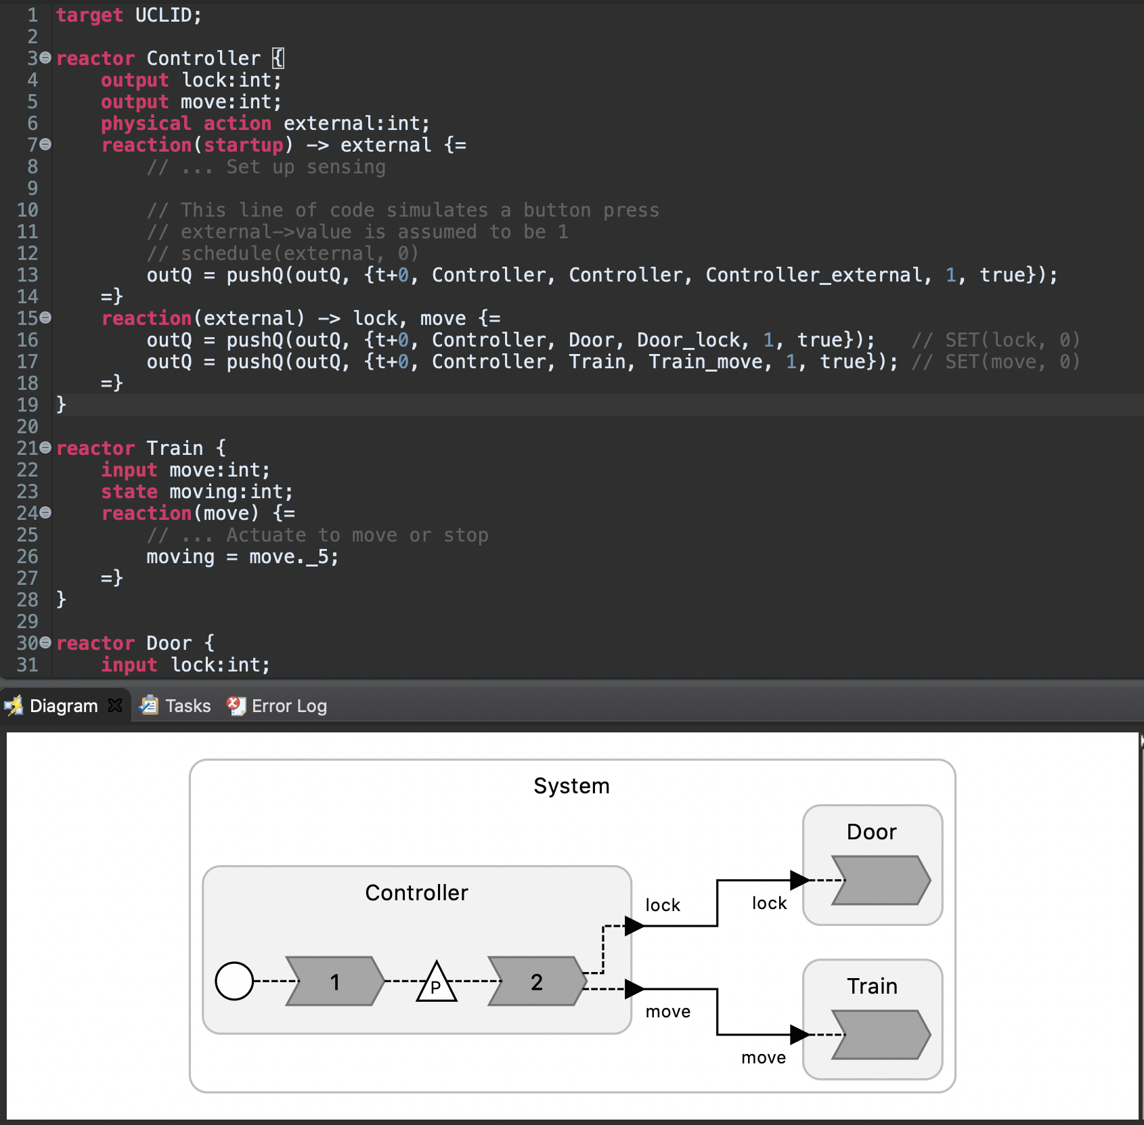
What has been done this summer
Started a formulation of LF semantics in UCLID5
Adopts interleaving semantics
Capable of handling a subset of partial order execution scenarios
Can verify reachability properties through bounded model checking
Started to build a UCLID target language in the Lingua Franca compiler

Slide 3
Looking ahead
Concurrent semantics
- To account for most execution settings
Proof by induction
- To obtain unbounded guarantees

Slide 4
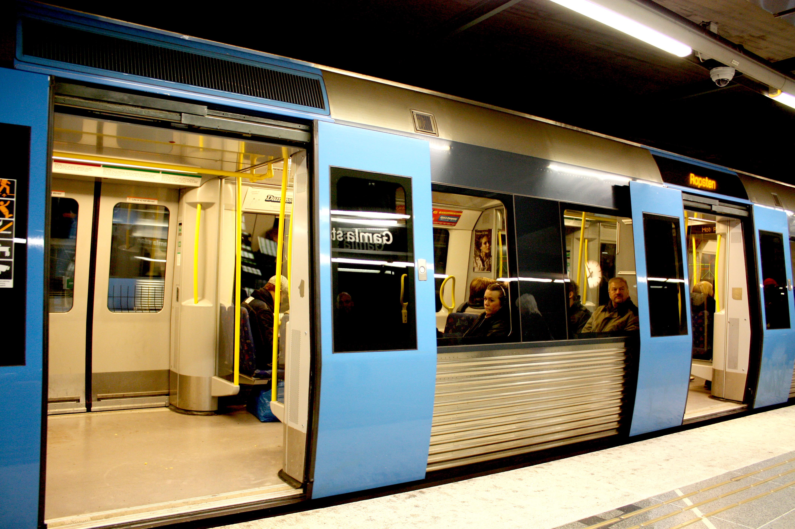
Train Door Example
Unlocked,
stopped
Locked,
moving
Press button
What if Controller, Train, and Door are separated by a network?
Error state: unlocked while moving

Slide 5
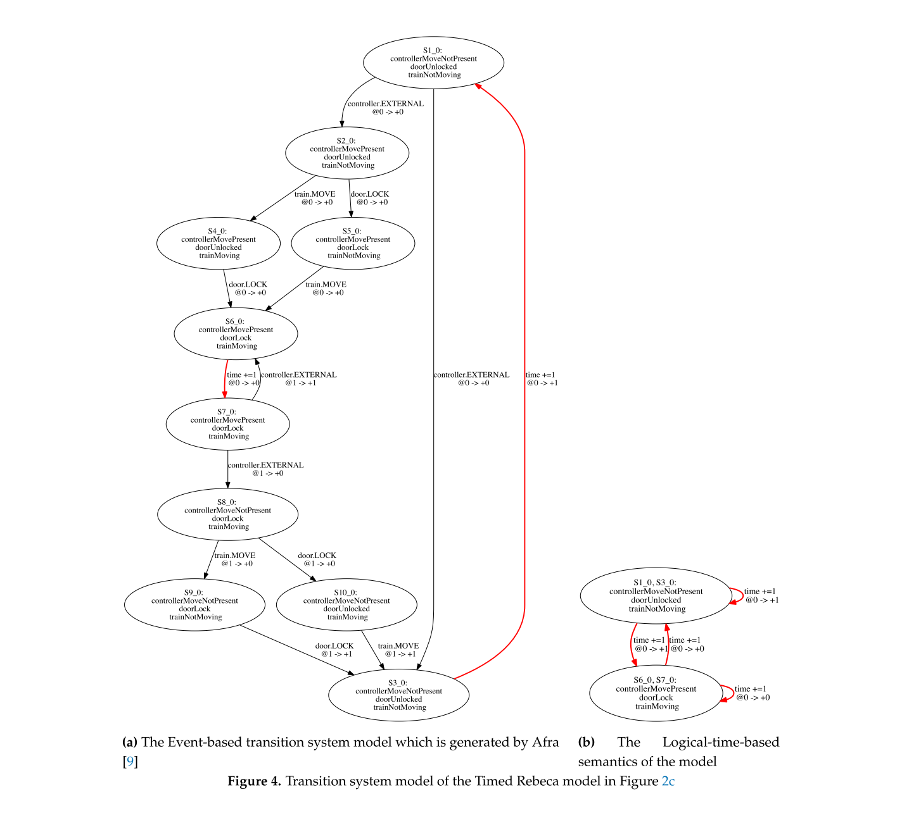
Semantics

