Slide 1

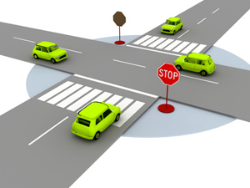
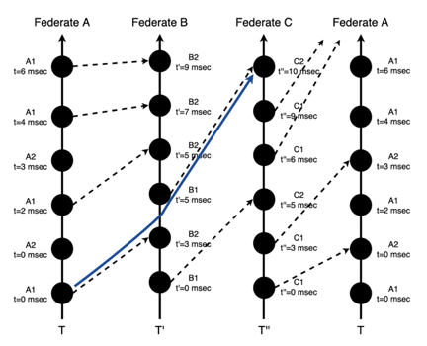
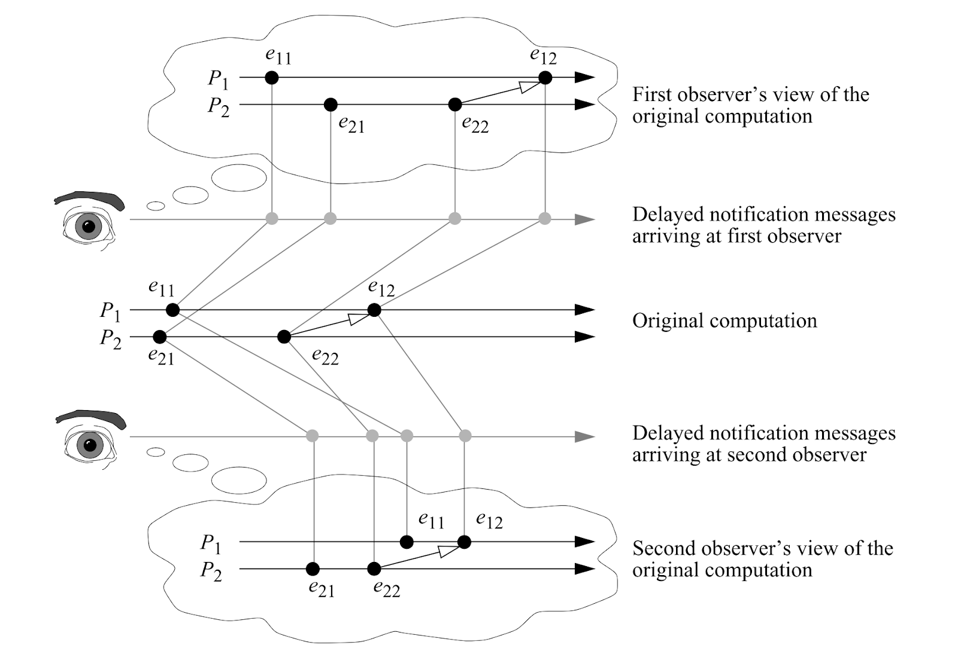
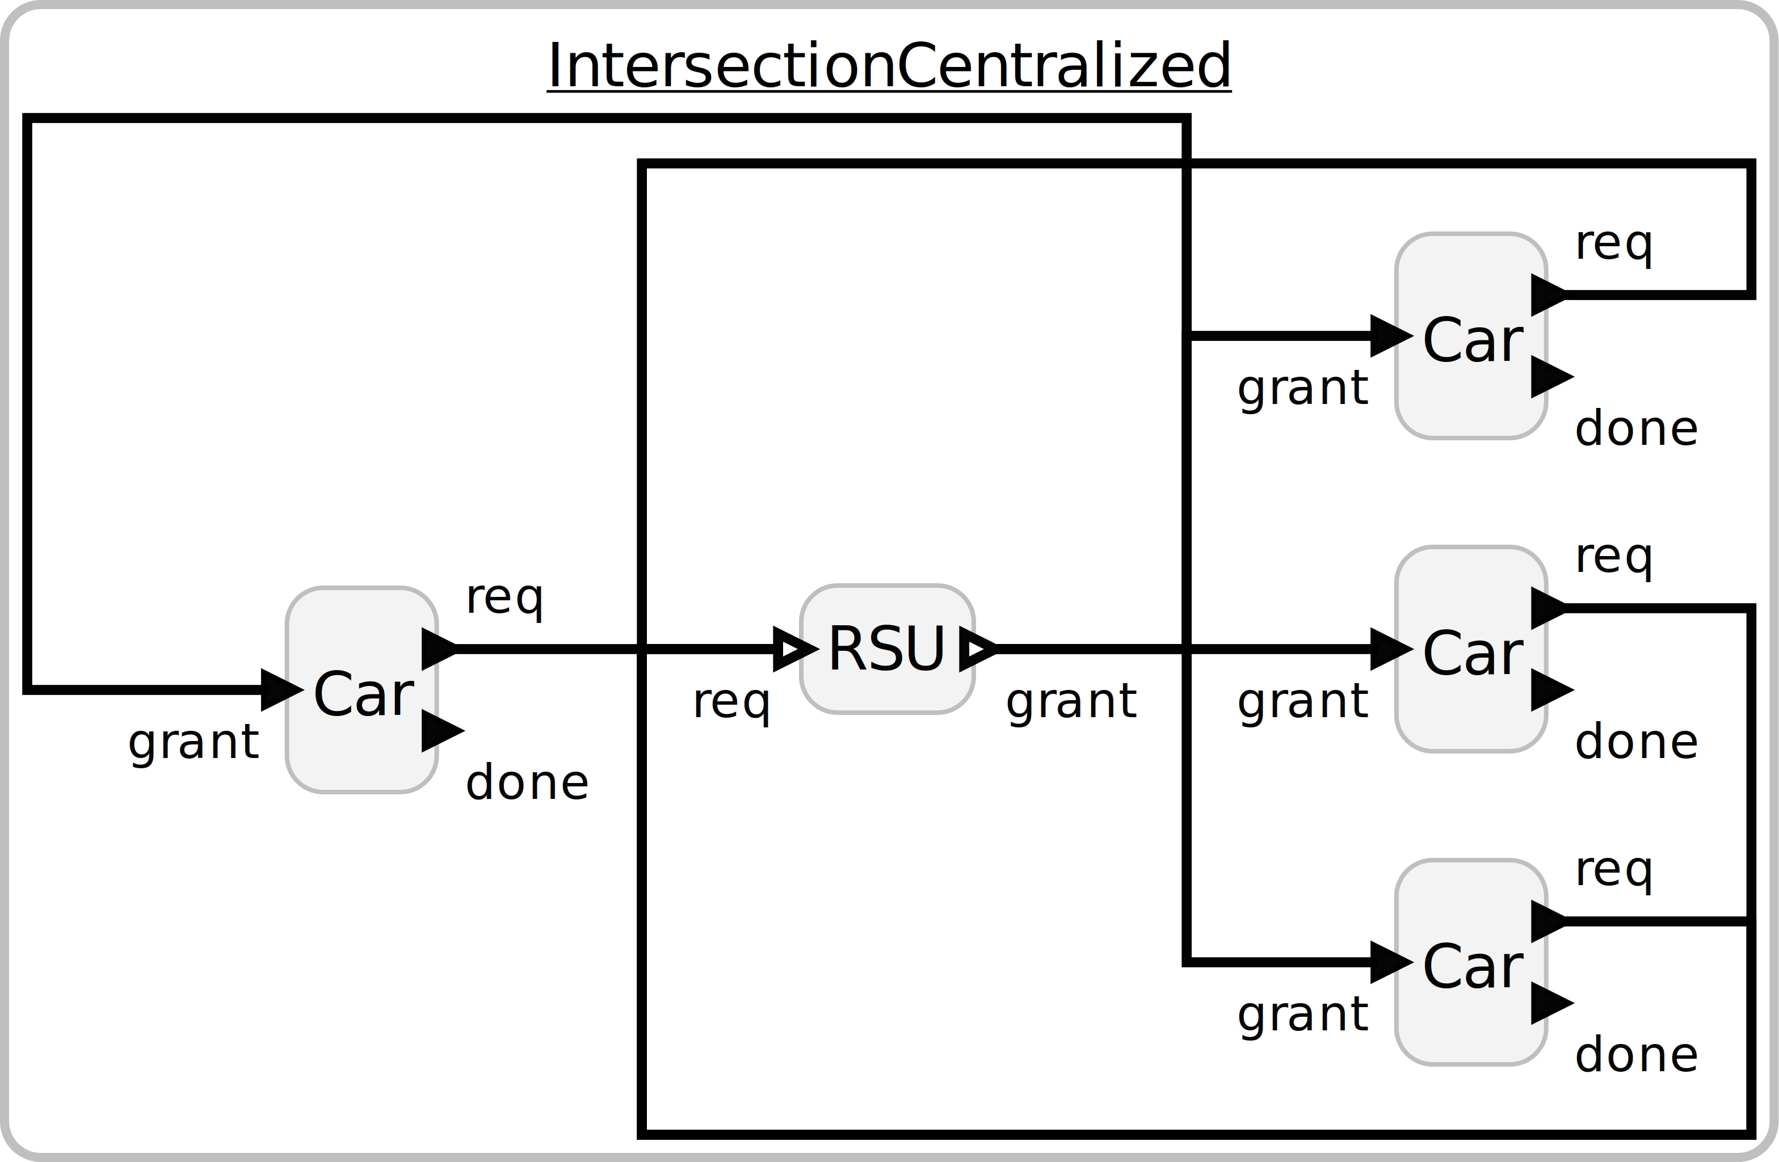
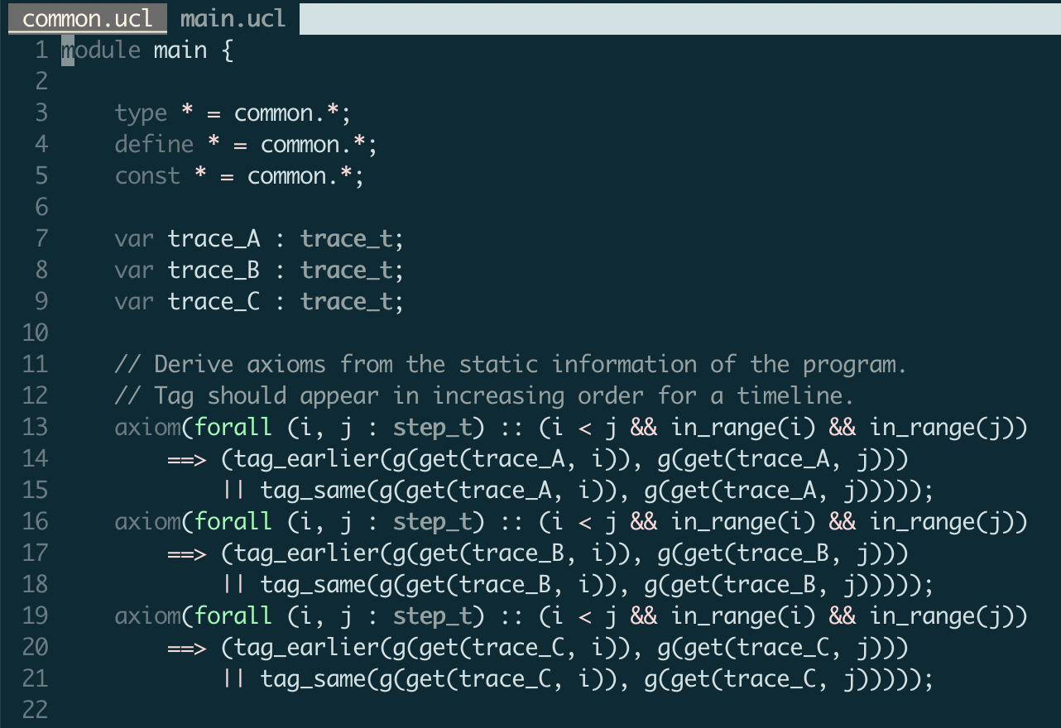

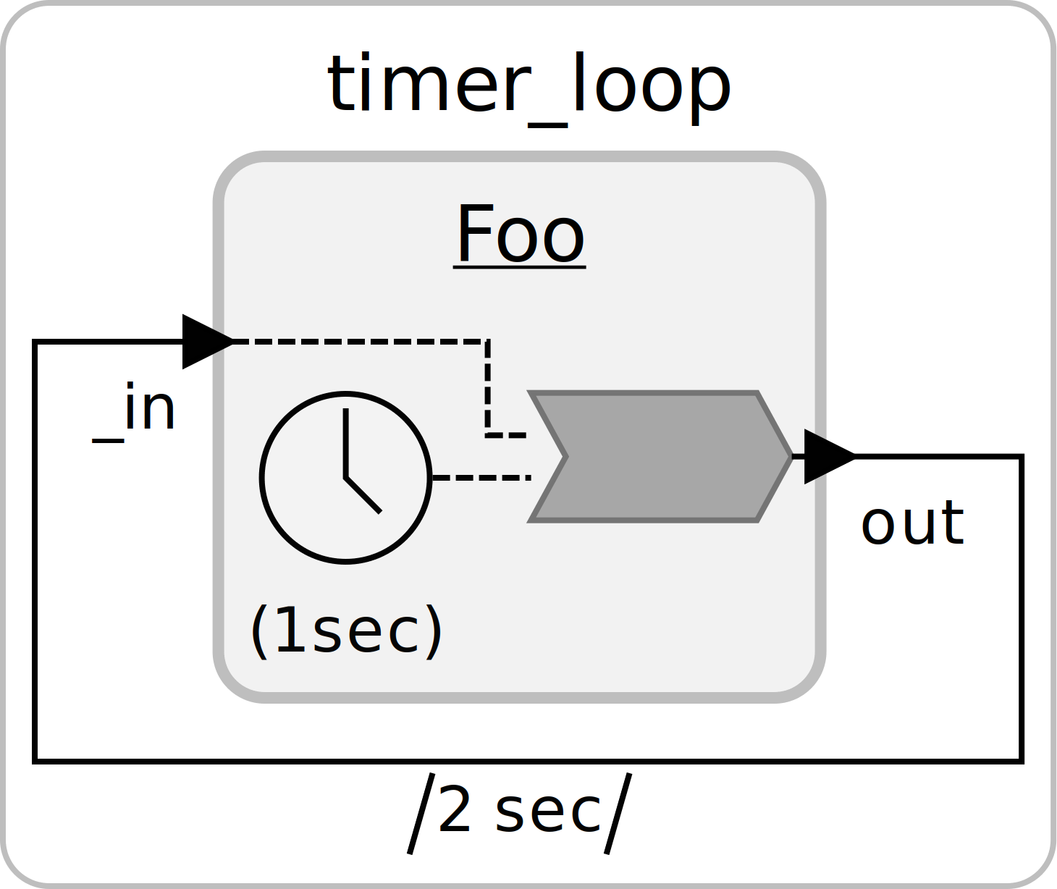
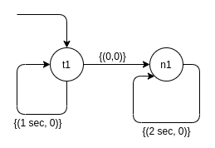


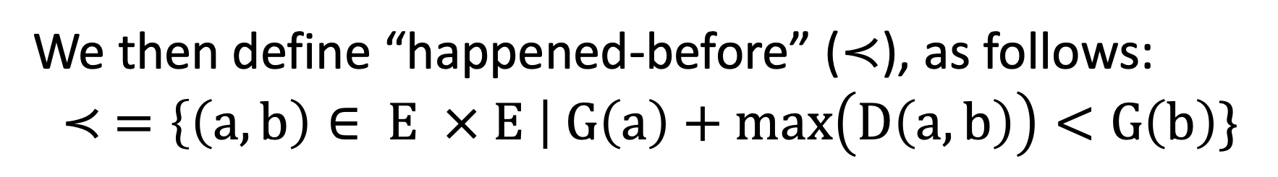

Multi-Observer Verification of Reactor Systems
Shaokai Lin
This is a work-in-progress and has not published yet.
Motivation
Partial Order Traces (Po-Trace)
Case Study (In Progress)
Cyber-physical systems (CPS) tend to be concurrent and, often, distributed. Different observers can see different sequences of events originated in the same system. [1] How do we perform verification to ensure that properties of interest hold for all observers?
We explore this issue in the context of reactors,
a deterministic model of computation for modeling
CPS applications.[2]
We can then use the “happened-before” relation to map trace events onto a partial order trace (po-trace).
We are in the process of verifying a four-way stop coordination system modeled using reactors.
The main property of interest is:
A partial order trace is a tuple: $T=\left(E, ≺\right)$.
Use cuts to capture ”instants” during exec.
Plot all the cuts onto a grid to generate a state lattice, from which we can obtain the set of linearized sequences.
Image from the internet
At all times, there can be no more than 2 cars occupying the intersection.
This is a problem suitable for the multi-observer framework, since we want this property to hold for not just one car, but all the cars entering the intersection.
Define a Linear Temporal Logic (LTL) over po-trace.
$LTL∷=⊤ \left| p \right| ¬ϕ \left| φ∨φ \right| φ 𝒰 φ | 𝒳φ$
Formulate properties using LTL and check satisfiability over the set of linearized event sequences.
Axiomatic Encoding
[Schwarz et al., 1994]
We then apply axiomatic encoding in UCLID5 [3] to symbolically model 1. partial order traces, 2. the system under verification, and 3. the properties of interest. The solver returns a violating trace when possible; otherwise, the properties are valid.
The “Happened-Before” Relation
We define trace event $e∈E$produced during the execution of the system as a 3-tuple:
$$e=(i,v,g)$$
Future Work
To determine the “happened-before” relation in reactors, we generate a connectivity graph.
Finish the challenge problem.
Validate the usefulness of LTL over po-trace.
Use contract-based design and verification techniques.
Automatically generate UCLID5 model from Lingua Franca [4].
[1] Schwarz, Reinhard, and Friedemann Mattern. "Detecting causal relationships in distributed computations: In search of the holy grail." Distributed computing 7.3 (1994): 149-174.[2] Marten [2] Lohstroh. Reactors: A Deterministic Model of Concurrent Computation for Reactive Systems. PhD thesis, EECS Department, University of California, Berkeley, Dec 2020
[3] https://github.com/uclid-org/uclid
[4] https://github.com/icyphy/lingua-franca
We then define “happened-before” ($≺$), as follows:
$$≺ =\left\{\left(a, b\right)∈ E × E \right| G\left(a\right)+max\left(D\left(a, b\right)\right)<G\left(b\right)\}$$
Notes:
Please put in notes here to explain poster so that someone else could summarize what your poster is about

