Slide 1
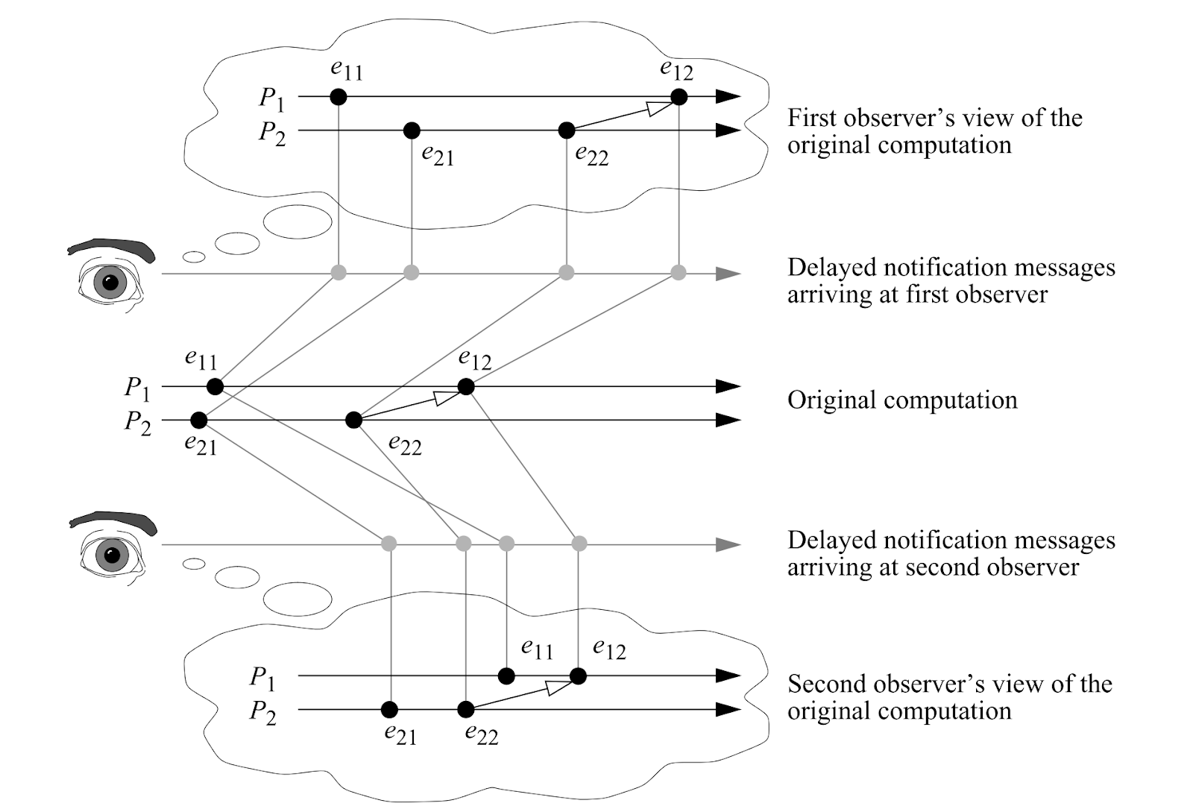
Multi-Observer Verification of Reactor Systems
Shaokai Lin
Motivation: Cyber-physical systems (CPS) tend to be concurrent and, often, distributed. Different observers can see different sequences of events originated in the same system.
Question:
How do we perform verification to ensure that properties of interest hold for all observers?
[Schwarz et al., 1994]

Slide 2
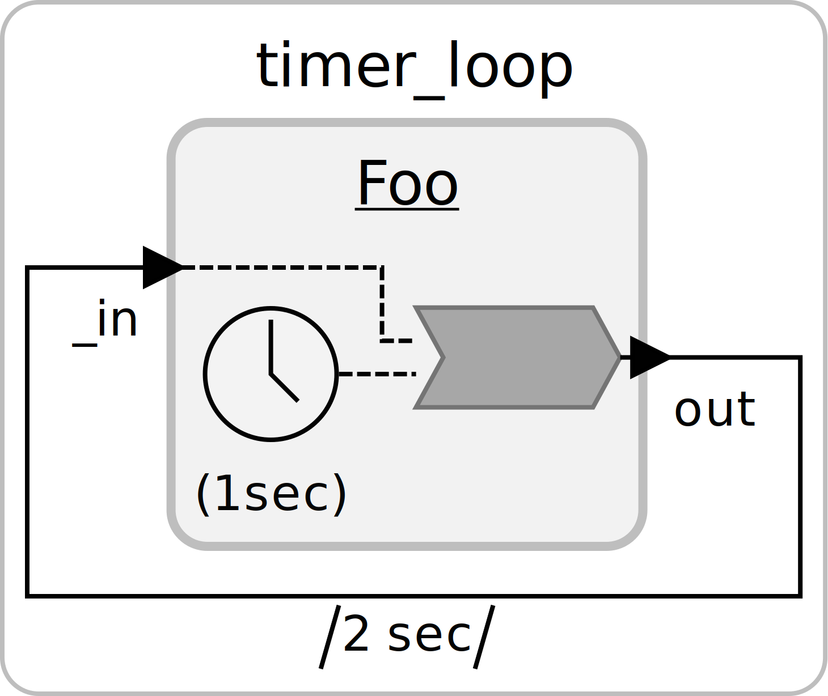
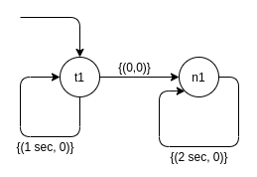
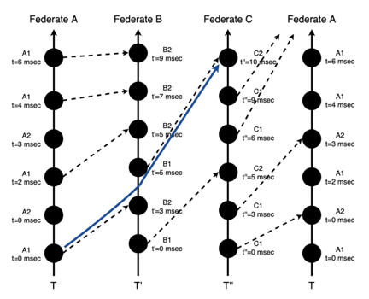
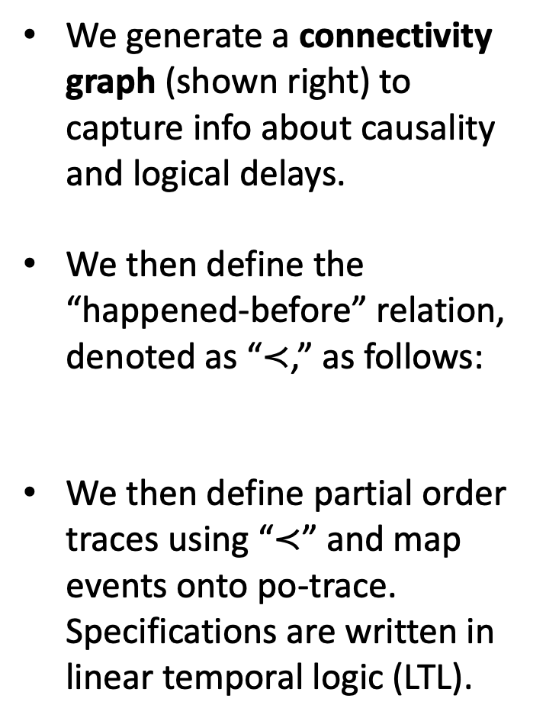
Modeling Reactors Using Partial Order Traces
We generate a connectivity graph (shown right) to capture info about causality and logical delays.
We then define the “happened-before” relation, denoted as “$≺$,” as follows:
We then define partial order traces using “$≺$” and map events onto po-trace. Specifications are written in linear temporal logic (LTL).
Reactor System
Connectivity Graph
$$≺ =\left\{\left(a, b\right)∈ E × E \right| G\left(a\right)+max\left(D\left(a, b\right)\right)<G\left(b\right)\}$$
Partial Order Trace

Slide 3
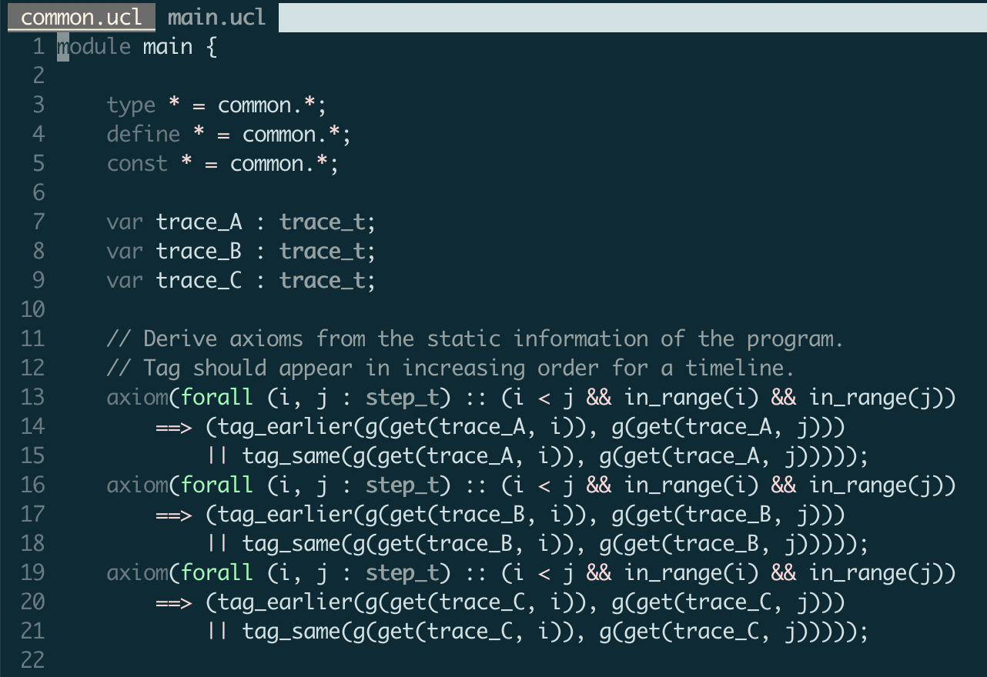

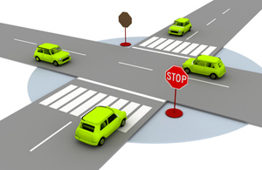
Verification via Axiomatic Encoding
We then apply axiomatic encoding in UCLID5 to symbolically model po-trace and reactor system, and verify the properties of interest.
We are in the process of verifying a four-way stop coordination system implemented using reactors.
Image from the internet

