Slide 1



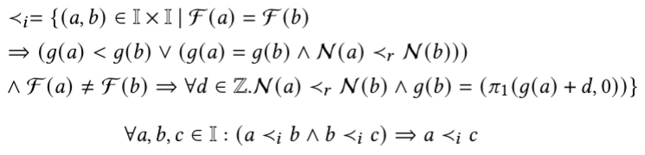
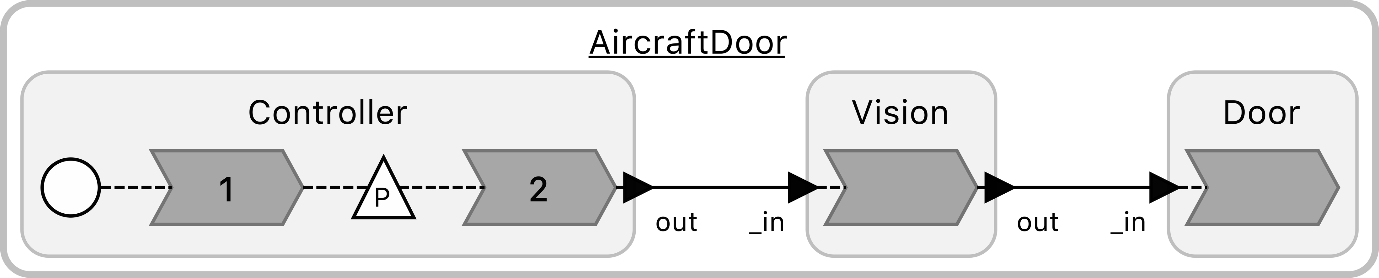
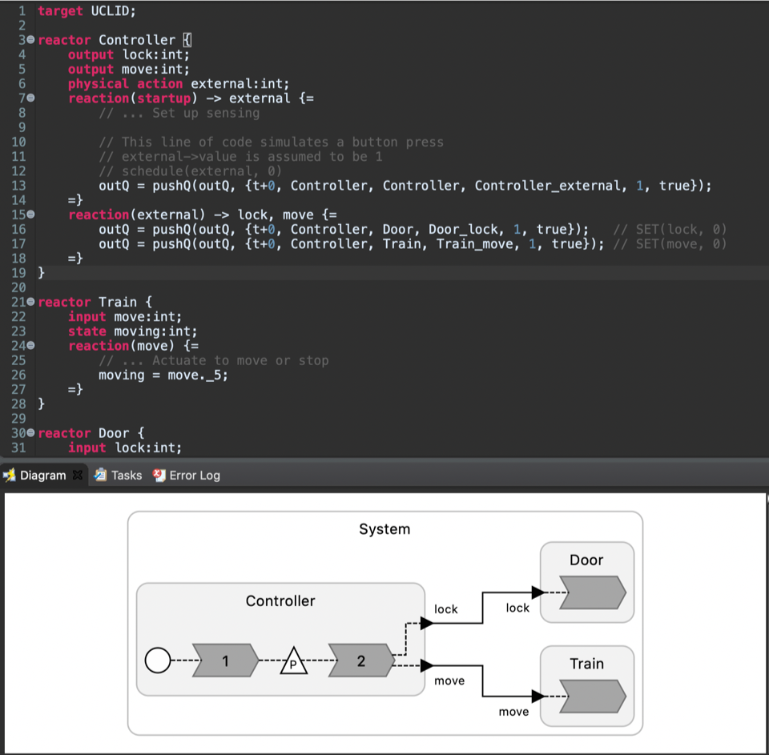
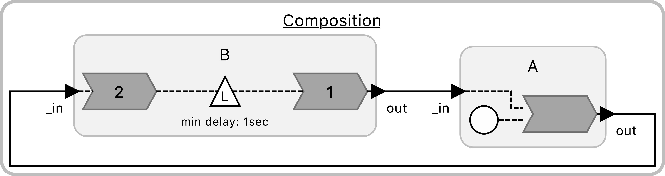
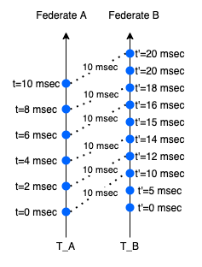
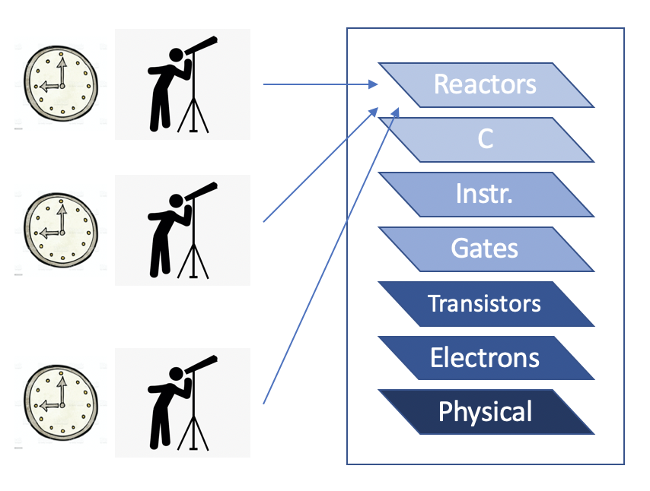
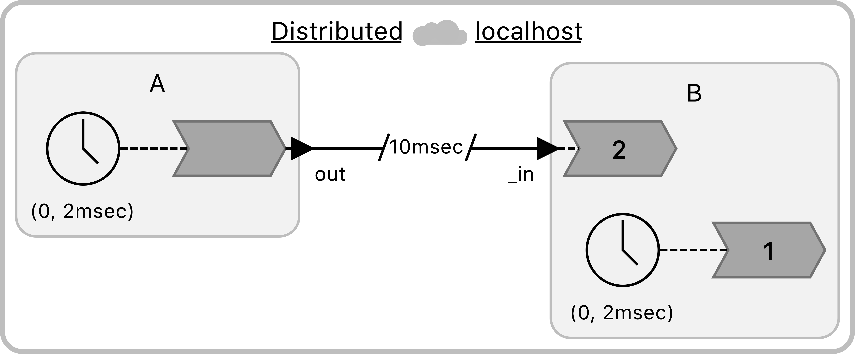
Verification of Reactor-Based Systems
Shaokai Lin
Motivation
Specifications
Model Checking
Verification of cyber-physical systems (CPS) is difficult due to multiple levels of abstraction as well as the concurrent nature of CPS. To enhance verifiability,
we use Reactors [1], a deterministic model of computation, to design and build CPS applications.
Question: How do we determine whether these deterministic models are correct w.r.t. specifications?
Reaction invocation is defined as a 3-tuple that contains a reaction, triggers, and a logical time tag:
Defining “Invoked Before”:
Example: AircraftDoor
Correctness Specification:
Developing an encoding of the
Reactors semantics in UCLID5
[3] and a Lingua Franca [4]
target for model generation
Using LTL to write correctness
specifications
For an observer that sees the
effects of two concurrent reaction invocations, the
model uses an interleaving semantics to check
possible violations of the specifications.
Specifications
Correct / Incorrect with counterexamples
Challenges
The lack of a suitable specification language
Multiple timelines
Each federate reactor maintains logical time and physical time.
A federated system has multiple logical timelines and physical timelines.
Reaction invocations are partially ordered
The lack of a global system state
Newtonian spacetime does not align with modern physics.
Correctness specifications must be checked against explicitly specified observers
Spacetime & Observers
Special relativity states that two different observers may perceive the spacetime differently.
Therefore, when defining the “state” of a distributed system [2], we need to specify:
1. Who the observer is
2. What the observer can see
Future Work
This is especially important for distributed systems, since timelines across federates (logical or physical) cannot be directly compared.
Develop a complete specification language
Enable automated theorem proving
Account for physical actions / input from the environment
Enable explicit definition of observers in the model
[1] Leslie Lamport. Time, clocks, and the ordering of events in a distributed system. Commun. ACM, 21(7):558–565, July 1978
[2] Marten Lohstroh. Reactors: A Deterministic Model of Concurrent Computation for Reactive Systems. PhD thesis, EECS Department, University of California, Berkeley, Dec 2020
[3] https://github.com/uclid-org/uclid
[4] https://github.com/icyphy/lingua-franca
Notes:
Please put in notes here to explain poster so that someone else could summarize what your poster is about

