Slide 1
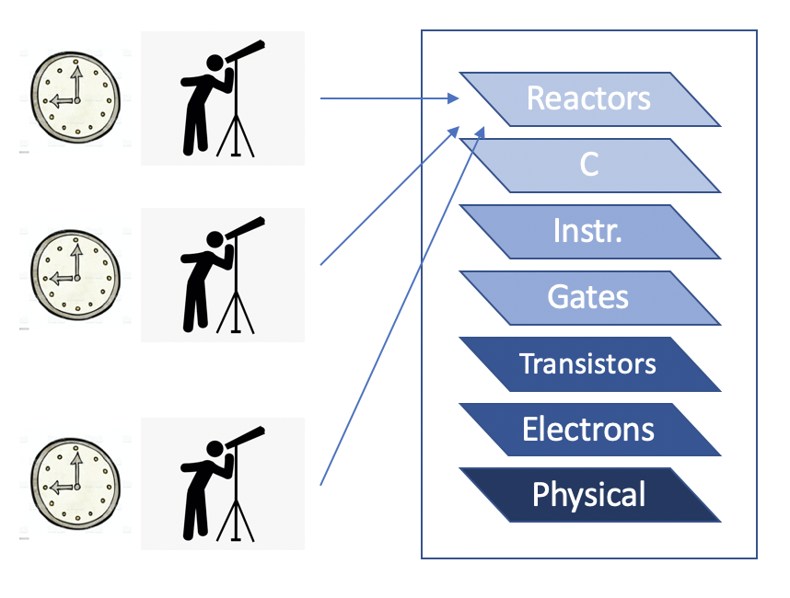
Verification of Reactor-Based Systems
Shaokai Lin
Motivation: Verifying cyber-physical systems (CPS) is difficult due to multiple levels of abstraction as well as the concurrent nature of CPS.
Solution: To improve verifiability, we build CPS applications using Reactors, a deterministic model of computation and verify the high-level Reactors model.
This approach simplifies the verification problem.
Challenges:
The lack of a suitable specification language
Multiple timelines in the system
Logical time vs. physical time
Each node in the distributed system has its own logical and physical time
The lack of a global system state
Specifications need to be checked w.r.t. explicitly specified observers
Notes:
Hello, my name is Shaokai Lin, and the poster I am presenting today is titled verification of reactor-based systems.
Verifying cyber-physical systems is a difficult task due to many levels of abstraction involved and inherent concurrency.
To tackle this challenge, we choose to build CPS applications using Reactors, a deterministic model of computation, and
verify the high-level reactor model. This approach simplifies the verification problem.
However, there are several challenges that remain…

Slide 2

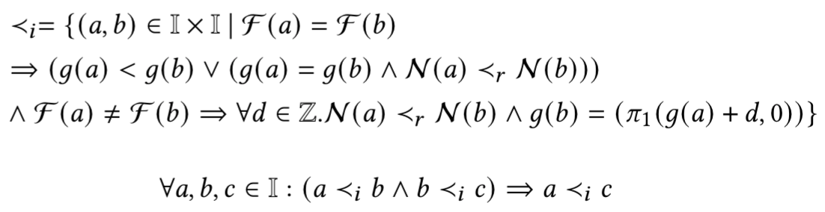
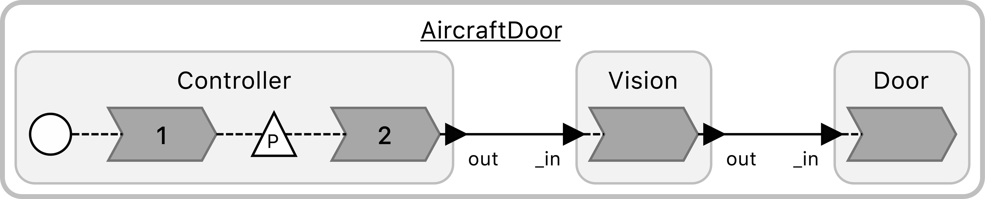

Specifications
Reaction Invocation:
a reaction instance
a set of triggers
a logical time tag.
The “Invoked Before” Relation:
Example: AircraftDoor
Specification (natural language):
“No signals produced by
Controller can reach Door
without going through Vision.”
Specification (formal):
Notes:
We extended the reactors formalism in order to capture key specifications of a system.
One of the important construct we formalized is “reaction invocation.”
In addition, we formalized the “invoked before” relation.
We can use the new formalism to encode certain desired properties of the system,
like the AircraftDoor system below.

Slide 3
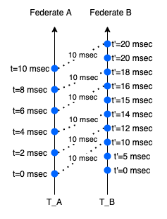
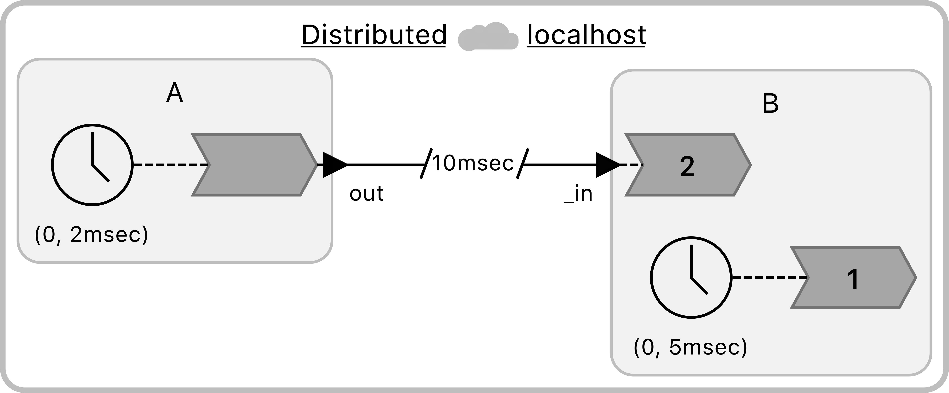
Spacetime & Observers
In a distributed system, determining invocation precedence is trickier due to multiple timelines.
A spacetime diagram can:
Visualize observed behaviors from the perspective of
each federate
Trace out the causal relations in a distributed system
Notes:
In a distributed system, there are more subtleties involved:
two federates can have unsynchronized logical time.
We tackle this issue by mapping invocations onto a spacetime diagram, with which
we can visualize the observed behaviors from the perspective of each federate
and trace out causal relations in a distributed system.
Thank you and feel free to stop by my virtual booth to learn more!

