Slide 1
State Transitions
What is the state of an application?
Different layers of abstraction have different answers.
logical time
Reactors
Reactors
C
C
Instr.
Instr.
Gates
Gates
Transistors
Transistors
Electrons
Electrons
Physical
Physical
State i
State i+1

Slide 2
Some Thoughts
The definition of “state” depends on the level at which the system is modeled.
Models can be more useful by selecting the “appropriate” levels.
If level is too high, some critical details can be missed (TrainDoor).
If level is too low, modeling and verification can get out of hand (e.g. state explosion).
A CPS application can be involved in multiple levels!
logical time
Reactors
C
Instr.
Gates
Transistors
Electrons
Physical

Slide 3
Model Selection
Where should we stand on the scale ?
Use low-level models
Use high-level models
Problems:
Models are always wrong, not matter how precise they are.
The state explosion problem is more severe when we model at a fine-grained level.
Problems:
Important details could be hidden by the abstraction (TrainDoor), making these models less useful.

Slide 4
Model Selection
Where should we stand on the scale ?
Use low-level models
Use high-level models
Depends on how we select the observers in the model!

Slide 5
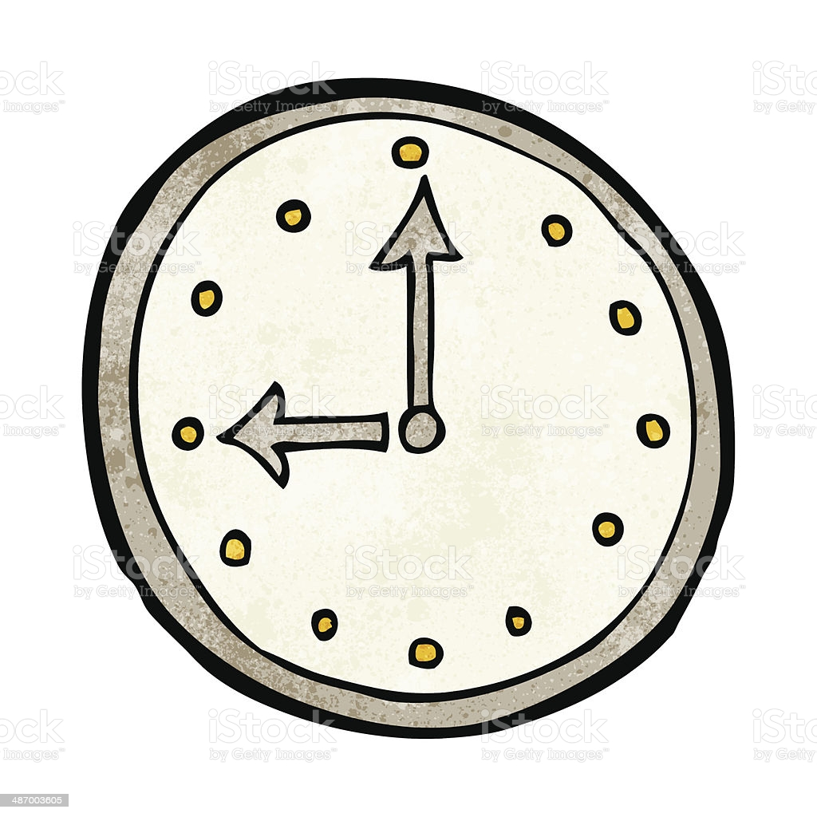

Observers
Defining observers:
“An observer is a participant of the system or a bystander process whose perception can influence the outcome of verification.”
An observer can be a reactor in the topology, a process monitoring the environment, the OS, etc…
Reactors
C
Instr.
Gates
Transistors
Electrons
Physical

Slide 6
Observers
My attempt at defining observers:
“An observer is a participant of the system or a bystander process whose perception can influence the outcome of verification.”
An observer
1. has a sense of time
2. observes at an abstraction level
Reactors
C
Instr.
Gates
Transistors
Electrons
Physical

Slide 7
Another Thought
Engineering for verifiability:
Engineer the system such that the system matches the observers in our model.
Reactors
C
Instr.
Gates
Transistors
Electrons
Physical

Slide 8
Yet Another Thought
Since time is relative, defining observers enables verifying temporal properties.
Reactors
C
Instr.
Gates
Transistors
Electrons
Physical

Slide 9

Observer Examples (Temporal Aspect)
A
C
P
B
D
P
How should we press the buttons such that “A precedes B” for both ?
Our model needs to take into account different timelines in the system, clock synchronization errors, as well as network delays.

Slide 10
Observer Examples (Abstraction Level)
A
B
P
Each dashed line can be an IO operation that would generate observable effects in the physical world.
Our model needs to account for that.

Slide 11
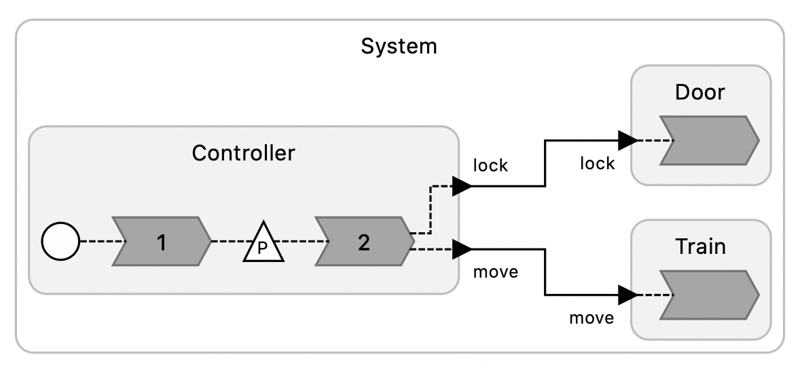
Engineering/Modeling with observers in mind
How should we model the system / select appropriate observers?
Depends on how we engineer the system!
If the system exposes states at the end of the logical time, then we should use logical time-based semantics.
If the system exposes states after the execution of each reaction, then we should use event-based semantics.
If the system exposes states after the execution of each C statement, then we should use some finer-grained semantics.
TrainDoor

Slide 12
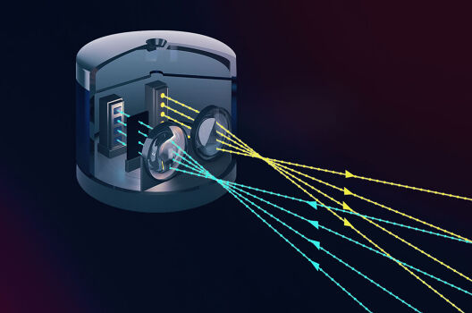


(Demo) Autonomous Vehicle Design
P
Lidar
Vision System
AV Controller
Given certain assumptions, can we check if the system can respond in time ?
Lidar: an observer of the environment at the rate of 10hz.
AV Controller, an observer of the danger signal coming from the vision system at 100 ms / frame.
Code: https://github.com/lsk567/LF-UCLID-verification/blob/master/src/ucl/timing/av.ucl

Slide 13
(Demo) A Better Design
P
Lidar
Vision System
AV Controller
Given certain assumptions, can we check if the system can respond in time ?
With the updated design, it is more likely.
Code: https://github.com/lsk567/LF-UCLID-verification/blob/master/src/ucl/timing/av_updated.ucl

