Slide 1
Sequencing formats
2025-02-05

Slide 2
Outline
Things we need to describe
Fundamental sequence formats
Mapping and SNP formats
Other formats not covered
Notes:
Fundamental formats
FASTA
GenBank
FASTQ
BED
GFF
Advanced formats
SAM
VCF
Other formats not covered
SCF/AB1
HDF5
SFF

Slide 3
Things we need to describe
How do I…?
… record a nucleotide sequence from Illumina?
… record the chromosome sequence of my sample?
… record where my gene is in the genome?

Slide 4
Things we need to describe
How do I…?
… describe where my raw reads mapped onto the genome?
… describe the differences between my genome and the other genome?

Slide 5
Sequencing formats

Slide 6
Fasta
Describes
Sequence
Identifier
Metadata
Two parts
Defline (description line)
Sequence
Extensions
general: fasta, fa, fas
nucleotide: fna
nucleotide genes: ffn
protein: faa
>ID_1 metadata1
MTEITAAMVKELRESTGAGMMDCKNALSETNGDFD
LVSVKVSDDFTIAAMRPSYLSYEDLDMTFVENEYK
IPQFASRKQLSDAILKEAEEKIKEELKAQGKPEKI
MGQFYVMDDKKTVEQVIAEKEKEFGGKIKIVEFIC
>ID_2
SATVSEINSETDFVAKNDQFIALTKDTTAHIQSNS
ATIGENLVVRRFATLKAGANGVVNGYIHTNGRVGV
Notes:
Sequence starts after the first newline
identifier starts with > and ends with whitespace
metadata field is very loosely defined and starts after any whitespace. Ends after newline
Some formats:
NCBI: type|accession|name where type is a database type, accession is the identifier in NCBI, and name is an alternate identifier but perhaps not a unique identifier
free text: just any text including whitespace
key=value pairs, separated by whitespace

Slide 7
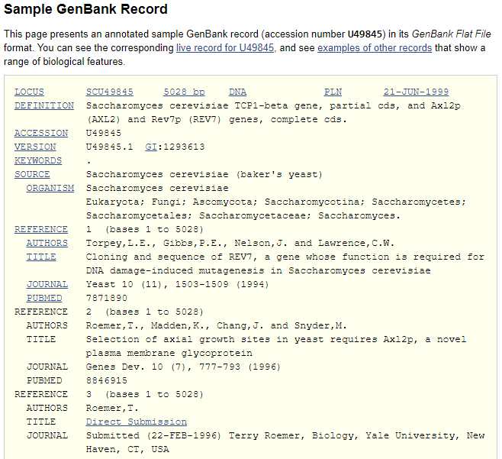
GenBank
Describes
Sequence
Identifier
Metadata - much more rich
Three parts
Locus definition
Features
Sequence
Extensions
general: gbk, gb, gbf
Notes:
https://www.ncbi.nlm.nih.gov/genbank/samplerecord/
Locus definition contains things like
locus name, equivalent to sequence identifier in fasta file
sequence length
molecule type (usually simply “DNA”)
Accession, usually for NCBI
Authorship information
etc
FEATURES
source: contig information especially length
taxon
coding features, noncoding features
Protein translation
etc
ORIGIN
The sequence itself

Slide 8

Fastq
Describes
Sequence
Identifier
Metadata
quality data
Four parts
Defline (description line)
Sequence
+ line
Quality scores
Extensions
General: fastq, fq
Compressed: fastq.gz, fq.gz
@SRR001666.1 071112_SLXA-EAS1_s_7:5:1:817:345 length=72
GGGTGATGGCCGCTGCCGATGGCGTCAAATCCCACCAAGTTACCCTTAACAACTTAAGGGTTTTCAAATAGA
+SRR001666.1 071112_SLXA-EAS1_s_7:5:1:817:345 length=72
IIIIIIIIIIIIIIIIIIIIIIIIIIIIII9IG9ICIIIIIIIIIIIIIIIIIIIIDIIIIIII>IIIIII/
@SRR001666.2 071112_SLXA-EAS1_s_7:5:1:801:338 length=72
GTTCAGGGATACGACGTTTGTATTTTAAGAATCTGAAGCAGAAGTCGATGATAATACGCGTCGTTTTATCAT
+SRR001666.2 071112_SLXA-EAS1_s_7:5:1:801:338 length=72
IIIIIIIIIIIIIIIIIIIIIIIIIIIIIIII6IBIIIIIIIIIIIIIIIIIIIIIIIGII>IIIII-I)8I1
Notes:
https://soundcloud.com/microbinfie/fastq-all-your-bases?si=27b1c34fd0794caaac63ad0640f4f6c6&utm_source=clipboard&utm_medium=text&utm_campaign=social_sharing

Slide 9
Quality data (small tangent)
each character is a phred score of the corresponding nucleotide
phred = -10 x log₁₀(p)
Phred scores are used in many file formats including fastq and sam
Phred Quality Score | Probability of incorrect base call | Base call accuracy
10 | 1 in 10 | 90%
20 | 1 in 100 | 99%
30 | 1 in 1000 | 99.9%
40 | 1 in 10,000 | 99.99%
50 | 1 in 100,000 | 99.999%
60 | 1 in 1,000,000 | 99.9999%
Notes:
https://en.wikipedia.org/wiki/Phred_quality_score

Slide 10
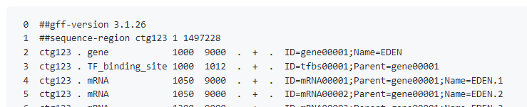
GFF
Describes
Features
(optional) sequence
One or two parts
Header
Feature lines
(optional) sequence
Extensions
.gff
header starts with ##gff-version
may also include other information like contig boundaries
next lines are features
9 columns: seqid, source, type, start, end, score, strand, phase, attributes
Attributes can further be divided

Slide 11
BED
Describes
Features
One part
Each line is a feature
Extensions
.bed
Software
BEDTools
12 columns, first three required
chrom
start
end
name
score
strand
thickStart
thickEnd
itemRgb
blockCount
blockSizes
blockStart
Notes:
chrom - like seqid
start - position on chrom, inclusive
end - end position on chrom, exclusive
name - feature name
score - for any arbitrary scoring system, 0-100
strand - “+” or “-”
thickStart - chromosomal position on where to emphasize the feature
thickEnd
itemRgb - color for the feature in RGB format
blockCount - how many blocks (usually exons) in the feature
blockSizes - how big each block is, comma separated
blockStart - start positions of each block, comma separated

Slide 12
Newick
Describes
clustering
One part
Extensions
.dnd, .nwk, .tre, .tree
(A,B,(C,D));
(A:0.1,B:0.2,(C:0.3,D:0.4):0.5);
Notes:
First example just has leaf names
Second example has leaf names and distances
Could ask: which sample is C clustered with? Answer: D

Slide 13
Advanced formats

Slide 14
Alignment formats - multi-fasta
Complies with fasta format
defline
sequence
At least two entries
same length
>ID_1
MTEITAAMVKELRESTGAGMMDCKNALSETNGDFD
>ID_2
MTEITAAMVKELRESTGAGMMDCKNALSETAGDFD

Slide 15
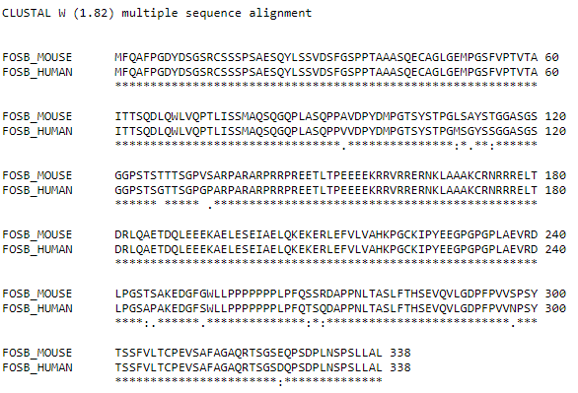
Alignment formats - clustal
Header - must be “CLUSTALW”
Alignment section
Blocks of 60 characters at a time
ID is <= 10 characters
Block ends with consensus characters, either whitespace for mismatch or * for match
Can have >=2 samples per block
Software: clustal omega, MEGA

Slide 16
SAM
Describes many alignments against a reference
Sections
Header: sam version, contigs, file creation information
alignments
Alignments have 12 columns
Qname: read name
Flag: bitwise flag
Rname (seqid)
Pos: leftmost position on Rname
Mapq: mapping quality
CIGAR: description of alignment
Rnext: seqid of read pair
Pnext: position of read pair
Tlen: distance between pair
Seq: sequence
Qual: quality of sequence
Tags: other information

Slide 17
SAM - flags
# | Decimal | Description of read | 163 | 73
1 | 1 | Read paired | 1 | 1
2 | 2 | Read mapped in proper pair | 1 | 0
3 | 4 | Read unmapped | 0 | 0
4 | 8 | Mate unmapped | 0 | 1
5 | 16 | Read reverse strand | 0 | 0
6 | 32 | Mate reverse strand | 1 | 0
7 | 64 | First in pair | 0 | 1
8 | 128 | Second in pair | 1
9 | 256 | Not primary alignment
10 | 512 | Read fails platform/vendor quality checks
11 | 1024 | Read is PCR or optical duplicate
12 | 2048 | Supplementary alignment
what do the following flags mean?
163
Answer
=> 10100011
read paired, proper pair, mate reverse strand, second in pair
163 = 128+32+2+1
73
Answer
=> 1001001
read paired, mate unmapped, first in pair
73 = 64+8+1
Interactive flags: https://www.samformat.info/sam-format-flag
Notes:
Each property of an alignment has a power-of-two value. To ascribe all values, add up those integers.
Let’s play a game

Slide 18
SAM - CIGAR
Concise Idiosyncratic Gapped Alignment Report
M: match or mismatch of 1 position
D: deletion
I: insertion
S: soft clip
H hard clip
=: exact match
X: mismatch
Pos 1 2 3 4 5 6 7 8 9
Ref A C G T A C G T A
Read1 A C G T A C G T A
CIGAR1 9M or 9=
Read2 A C G G A C G T A
CIGAR2 9M or 3=1X5=
Read3 A C G A C G T A
CIGAR3 3M1D5M
https://youtu.be/vh6l9aPFUgU?t=278
Notes:
https://youtu.be/vh6l9aPFUgU?t=278
Most common cigar keys used are M, D, I.

Slide 19
SAM - CIGAR
Concise Idiosyncratic Gapped Alignment Report
M: match or mismatch of 1 position
D: deletion
I: insertion
S: soft clip
H hard clip
=: exact match
X: mismatch
100M
A: sequence is the same length as target.
33M1I33M
A: Sequence is 67bp, one longer than target sequence
33M1D33M
A: Sequence is 65bp, one shorter than target sequence
10S100M10S
A: Sequence matches 100bp at the starting position but there are 10bp on either side that are not aligned and are included in the Seq field
10H100M10H
A: Sequence matches 100bp at the starting position but there are 10bp on either side that are not aligned and are not included in the Seq field
Notes:
Interactive flags: https://www.samformat.info/sam-format-flag
Most common cigar keys used are M, D, I.

Slide 20

BAM
Binary version of SAM
Compressed with gzip
Can be
unsorted or sorted
unindexed or indexed

Slide 21
VCF (variant call format)
Describes
Variants (SNPs + indels)
two parts
Header
Variant lines
Extensions
.vcf
Compressed: .vcf.gz
Headers start with ##
##fileformat=VCFv4.3
##fileDate=20090805
Last header has a single #
#CHROM POS ID REF ALT QUAL FILTER INFO FORMAT SAMPLE1 SAMPLE2
Each next line is a variant

Slide 22
VCF variant lines
Each line is a variant
Variants have 9 columns
Chrom (seqid) chromosome name
Pos position on the chromosome
ID identifier for the variant
Ref reference nucleotide(s)
Alt variant nucleotide(s)
Qual quality score given to the variant
Filter reasons why this fails QC, or “PASS”
Info key/values for variant
Format additional keys for each sample
Optional next columns can be sample names and their values to the format column
SAMPLE1
SAMPLE2
OTHERSAMPLE
YetAnother

Slide 23
VCF variant lines
Example row
20 14370 rs6054257 G A 29 PASS NS=3;DP=14;AF=0.5;DB;H2 GT:GQ:DP:HQ 0|0:48:1:51,51 1|0:48:8:51,51 1/1:43:5:.,.
Explanation of each column
On chromosome or contig 20
At position 14370
The variant has an ID. Many times it is not identified and given “.”
The reference base is “G”
The variant/allele is “A”
The VCF program gave this allele a quality score of 29
PASS - this variant passed Q/C
keys/values
DP=14 -> depth of 14 reads
AF=0.5 -> 50% of reads agree with variant
attribute keys
GT: 0|1 1|0 1/1
DP: 1 8 5

Slide 24
Visualization
Sequence files and tree files using MEGA

Slide 25
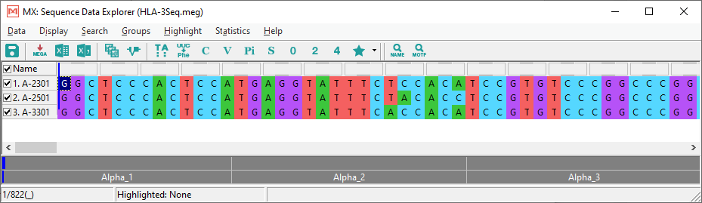
Nucleotide sequences of three human class I HLA-A alleles
Notes:
https://www.megasoftware.net/docs
https://www.megasoftware.net/examples

Slide 26
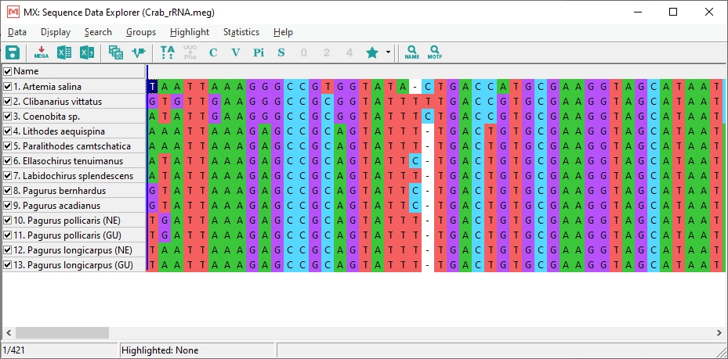
Sequences for gene encoding mitochondrial large-subunit ribosomal RNA

Slide 27
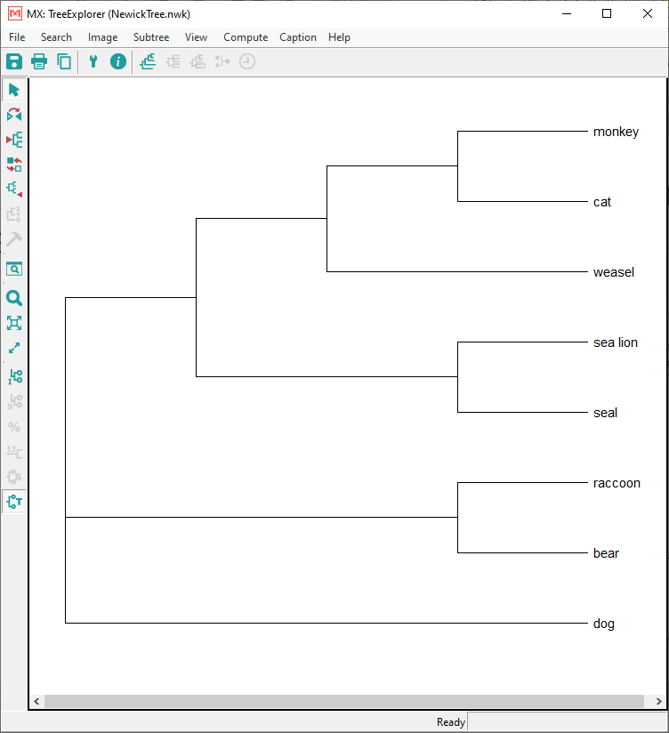
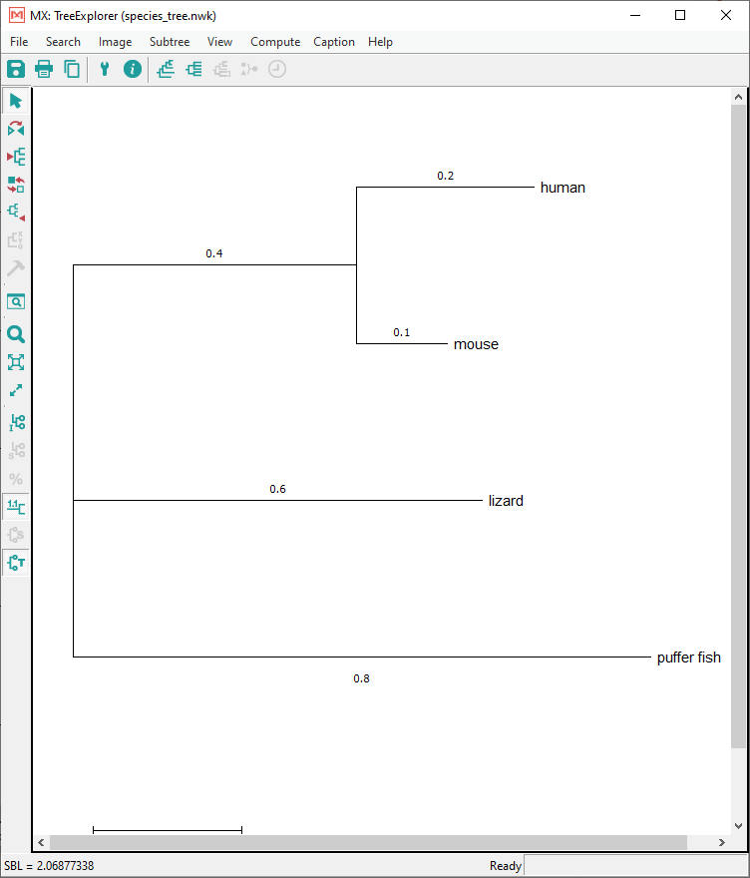
A sample tree topology in Newick file format.

Slide 28
Visualization
Advanced

Slide 29

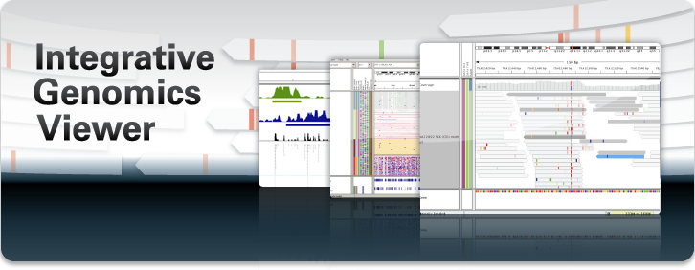
IGV
The Integrative Genomics Viewer (IGV) is a high-performance, easy-to-use, interactive tool for the visual exploration of genomic data.
It supports flexible integration of all the common types of genomic data and metadata, investigator-generated or publicly available, loaded from local or cloud sources.
https://software.broadinstitute.org/software/igv/
https://igv.org/

Slide 30
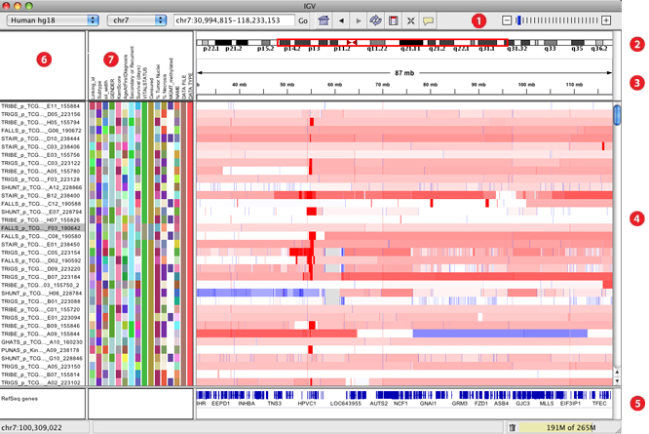
Main window
Notes:
https://software.broadinstitute.org/software/igv/MainWindow
The tool bar provides access to commonly used functions. The menu bar and pop-up menus (not shown) provide access to all other functions.
The red box on the chromosome ideogram indicates which portion of the chromosome is displayed. When zoomed out to display the full chromosome, the red box disappears from the ideogram.
The ruler reflects the visible portion of the chromosome. The tick marks indicate chromosome locations. The span lists the number of bases currently displayed.
IGV displays data in horizontal rows called tracks. Typically, each track represents one sample or experiment. This example shows segmented copy number data.
IGV also displays features, such as genes, in tracks. By default, IGV displays data in one panel and features in another, as shown here. Drag-and-drop a track name to move a track from one panel to another. Combine data and feature panels by selecting the option to display all tracks in a single panel on the General tab of the Preferences window.
Track names are listed in the far left panel. Legibility of the names depends on the height of the tracks; i.e., the smaller the track the less legible the name.
An optional attribute panel displays sample/track attributes represented as colored blocks, where each unique value is assigned a unique color.

Slide 31
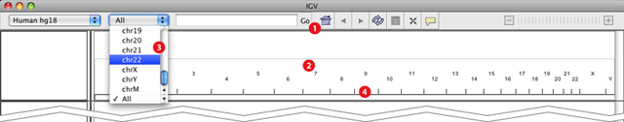
Navigation
Notes:
Click the "home" icon to zoom out to the whole-genome view.
From the whole-genome view, zoom to a chromosome by clicking its label.
Select a chromosome from the drop-down menu to zoom to it; or select "All" to zoom out to the whole genome view
Can alternately click on a chromosome name in the main panel

Slide 32
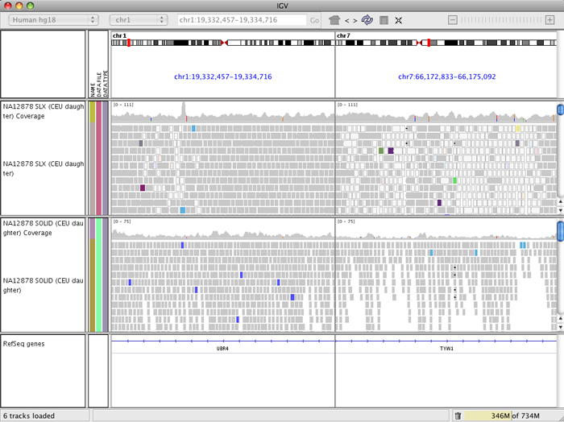
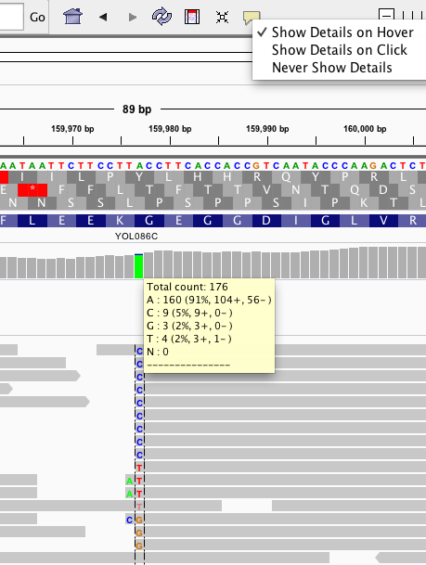
Viewing BAM
Medium zoom
High zoom

Slide 33
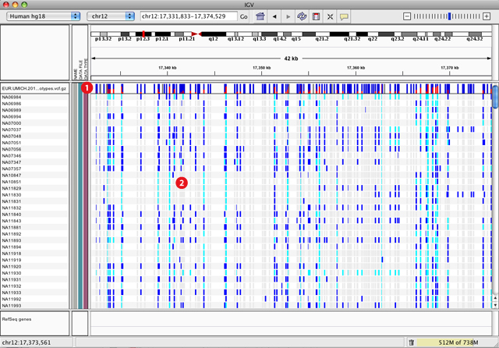
Viewing VCF files
Notes:
Each bar across the top of the plot shows the allele fraction for a single locus.
The genotypes for each locus in each sample. Dark blue = heterozygous, Cyan = homozygous variant, Grey = reference. Filtered entries are transparent.

Slide 34
Putting it all together
Let’s visualize some files from NCBI

Slide 35
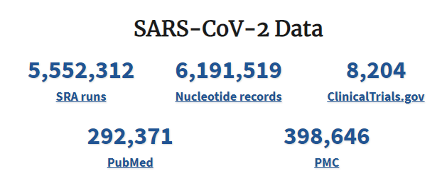

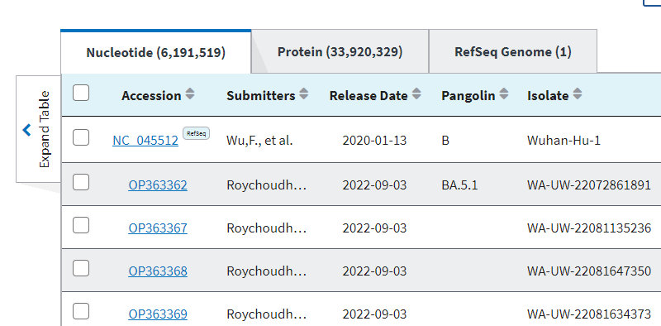
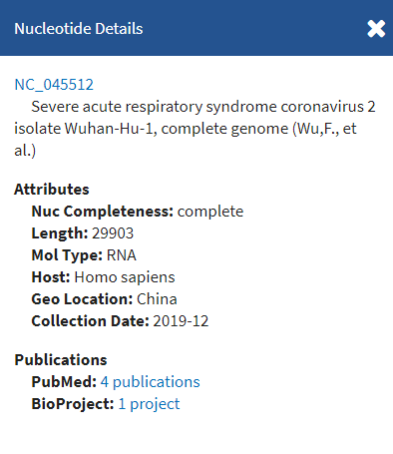
Download data
https://ncbi.nlm.nih.gov/sars-cov-2/
Go to nucleotide
Click on the Wuhan-Hu-1 reference genome

Slide 36
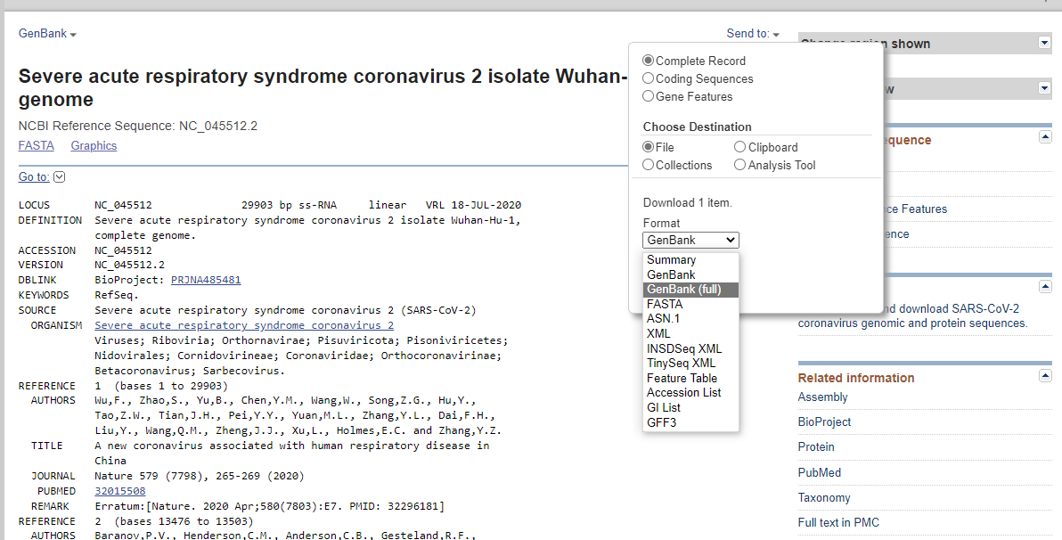
Download GenBank file

Slide 37
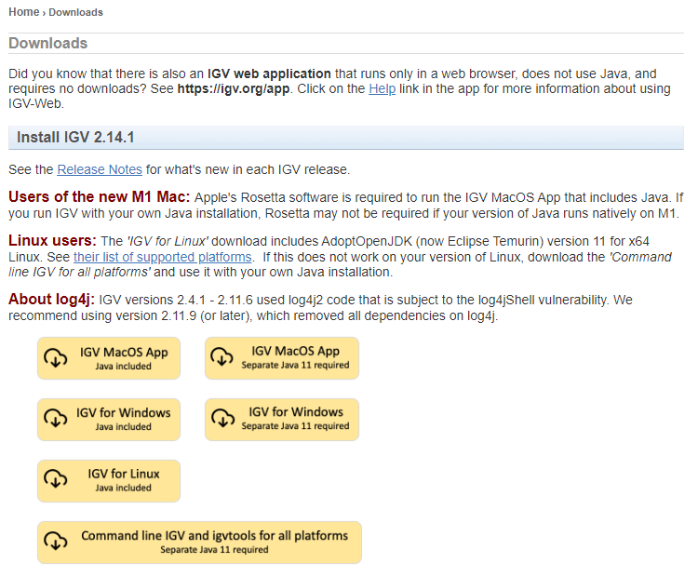
Download IGV
https://software.broadinstitute.org/software/igv/download

Slide 38
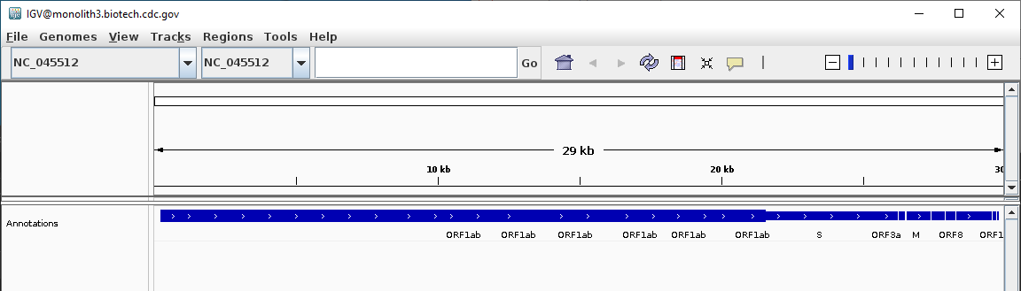
Load the annotations
Interactive: what do you all see in these annotations? 🤔
What would you describe in a report to your colleague?

Slide 39
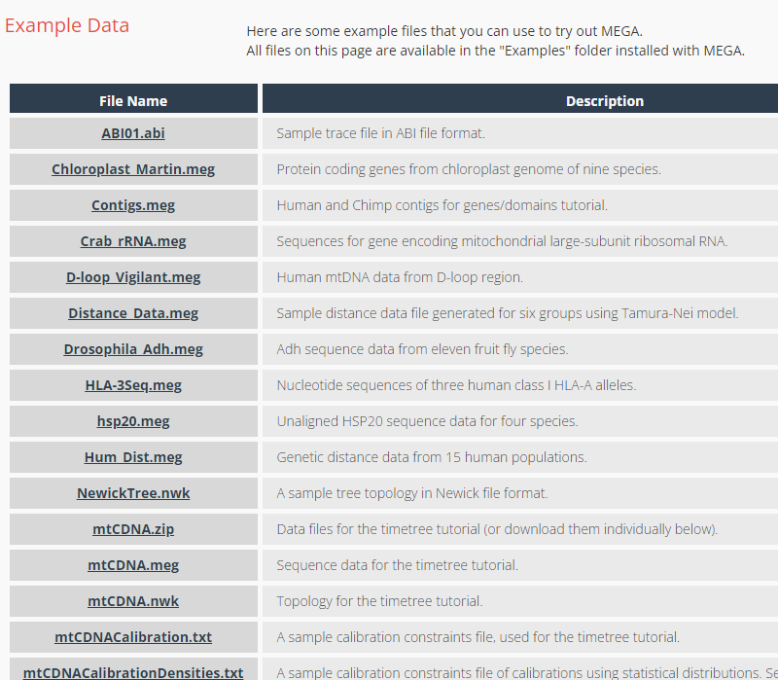
Download from MEGA
https://www.megasoftware.net/examples

Slide 40
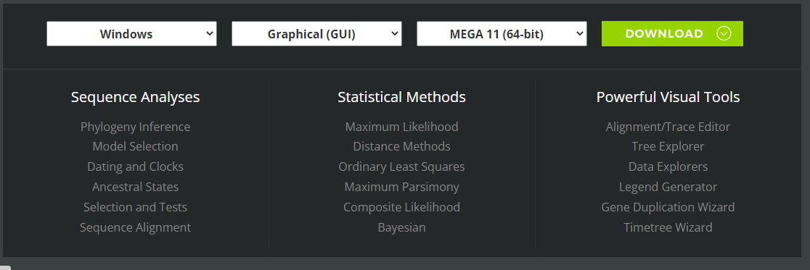
Download MEGA

Slide 41
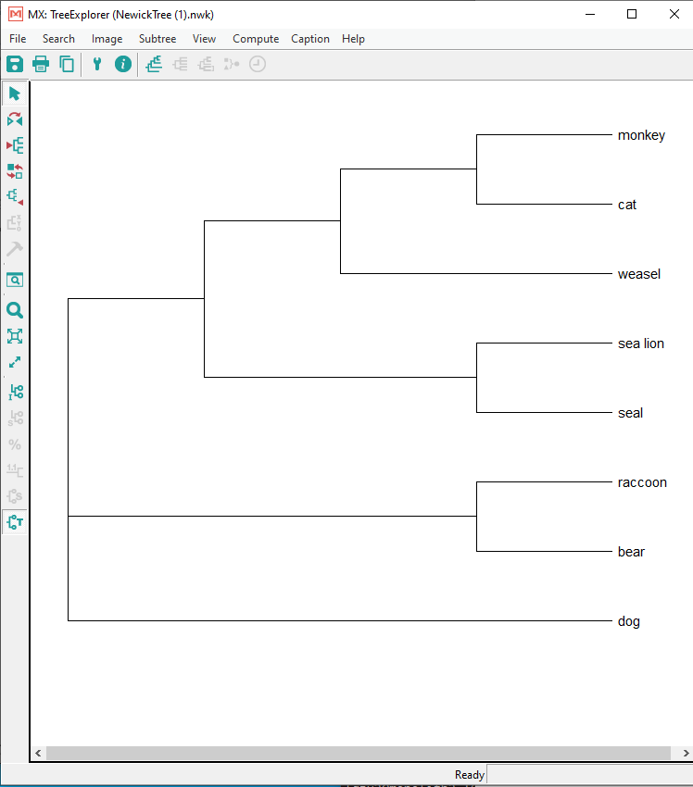
Reflection
What do you all see in this tree? 🤔
What would you describe in a report to your colleague?

Slide 42
Professional development section
Blogs

Slide 43


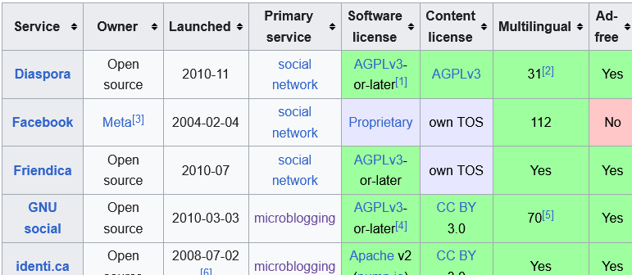


Micro blogging
https://en.wikipedia.org/wiki/Comparison_of_microblogging_and_similar_services
Notes:
Twitter/X
Threads
Mastodon
Bluesky

Slide 44


Microblog communities
https://twitter.com/i/communities/1506791236987879425
https://mstdn.science

Slide 45

Microblog communities
https://bsky.app/starter-pack/andrewjpage.bsky.social/3lfeqdhboxy2s

Slide 46
Done
Homework and quiz

Slide 47
SAM - CIGAR
Concise Idiosyncratic Gapped Alignment Report
M: match or mismatch of 1 position
D: deletion
I: insertion
S: soft clip
H hard clip
=: exact match
X: mismatch
Pos 1 2 3 4 5 6 7 8 9 0
Ref A C G T A C G T A A
Read3 A C G T A C G T A
CIGAR3 8M1D1M
https://youtu.be/vh6l9aPFUgU?t=278
Notes:
https://youtu.be/vh6l9aPFUgU?t=278
Most common cigar keys used are M, D, I.

