Slide 1
Installation of Software
2025-02-12

Slide 2
Outline
The problem
Methods to install software
Let's do some analysis

Slide 3
The problem
You want to do this really amazing analysis
… but it requires cutting edge software
… the cutting edge software is difficult to install

Slide 4
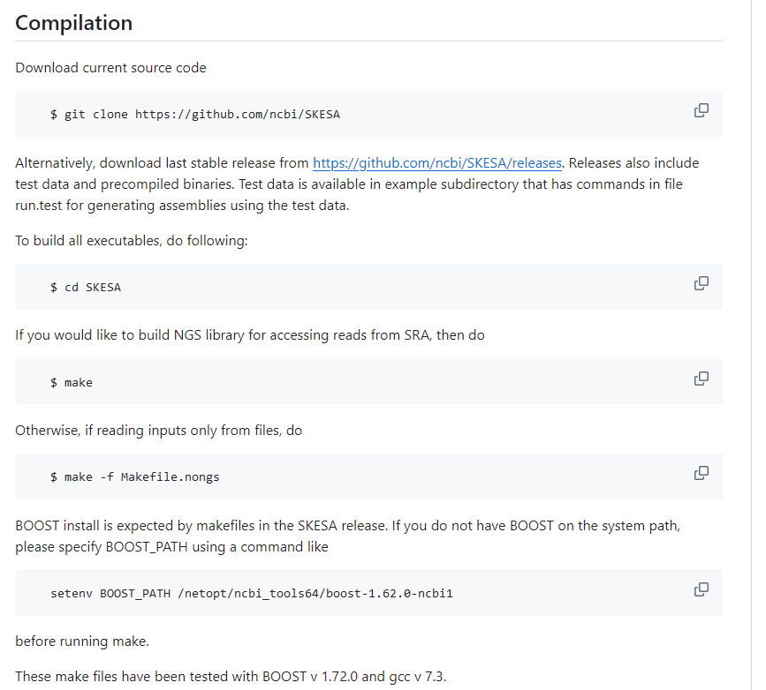
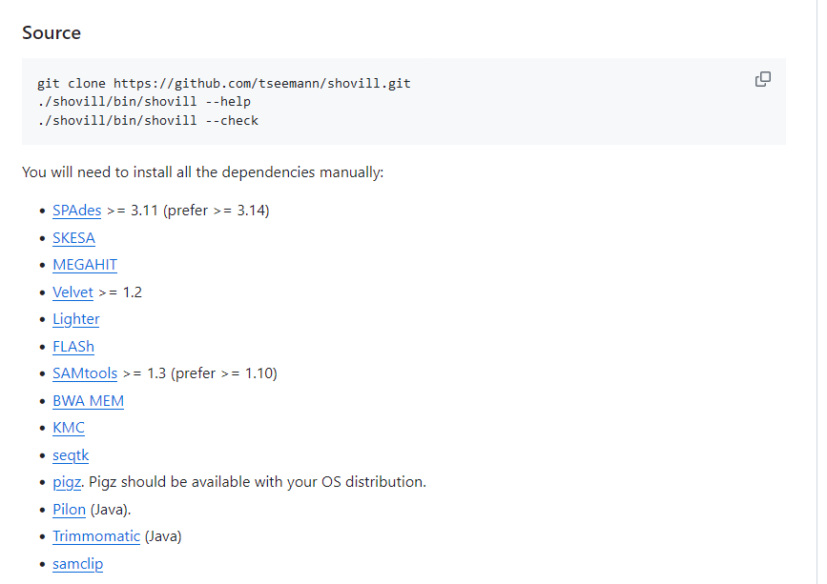
Installation can be difficult
Notes:
and then you click on skesa and here is another set of things to install

Slide 5
Some fun analyses
Compare two+ genes
Predict genes
=> blast, clustal
=> gene prediction program

Slide 6
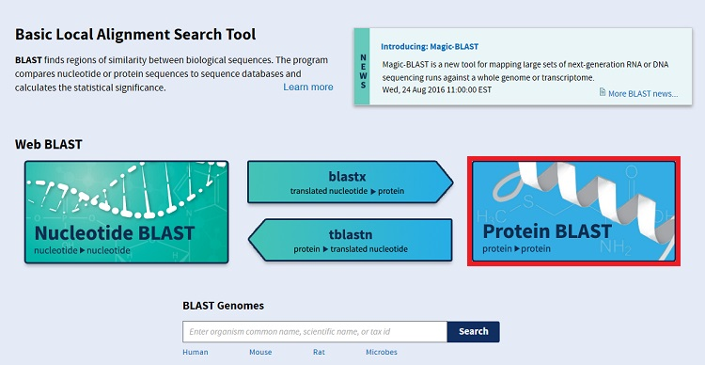
What is BLAST?
Basic Local Alignment Search Tool
Compares query against reference
Query reference
nt nt
protein protein
Blastn (tblastx)
blastx
tblastn
blastp
Notes:
5 flavors of blast

Slide 7
Basic questions answered
What are similar sequences to mine?
Has anyone else found this gene before?
What organisms can my gene be found in?
What are the different "flavors" of my gene?
what could the function of my gene be?
How does my gene compare to another allele?
=> let's just try to answer the last question for now
Notes:
What kinds of questions can BLAST help us answer?

Slide 8
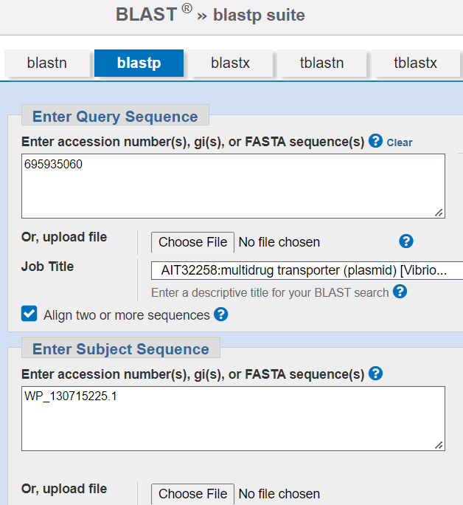
Blastp on website
https://blast.ncbi.nlm.nih.gov/Blast.cgi?PAGE=Proteins
Query accession: 695935060
Subject accession: WP_130715225.1
Notes:
Let’s start with the GUI (graphic user interface) version of BLAST

Slide 9
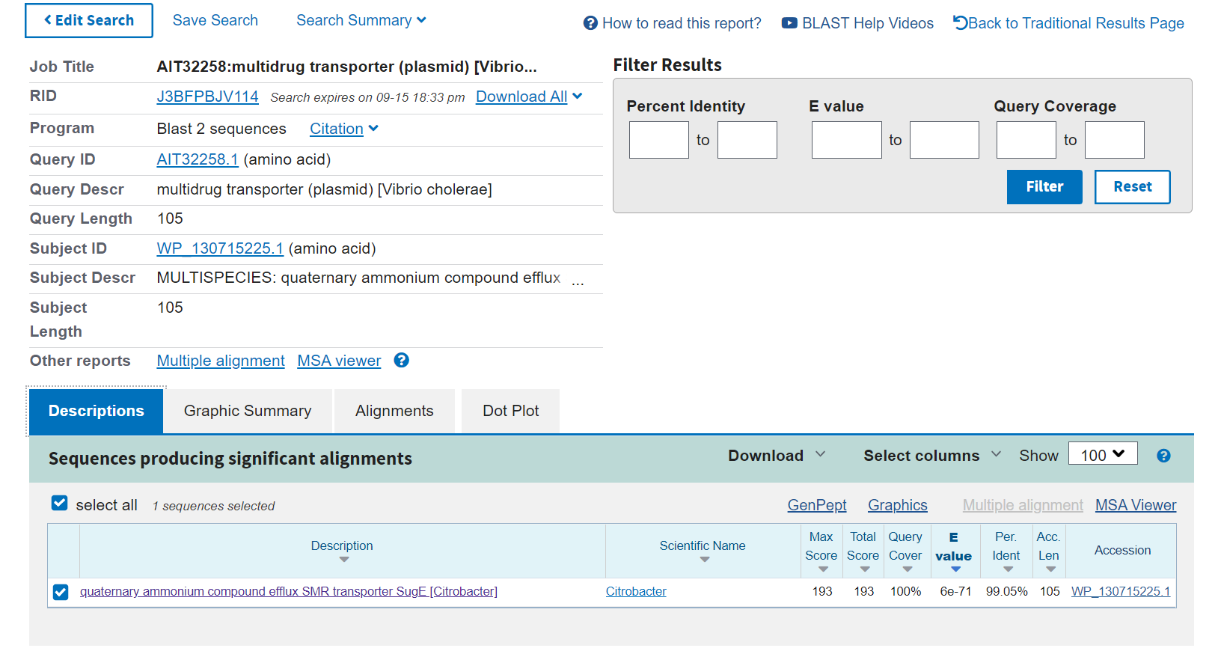
Web results

Slide 10
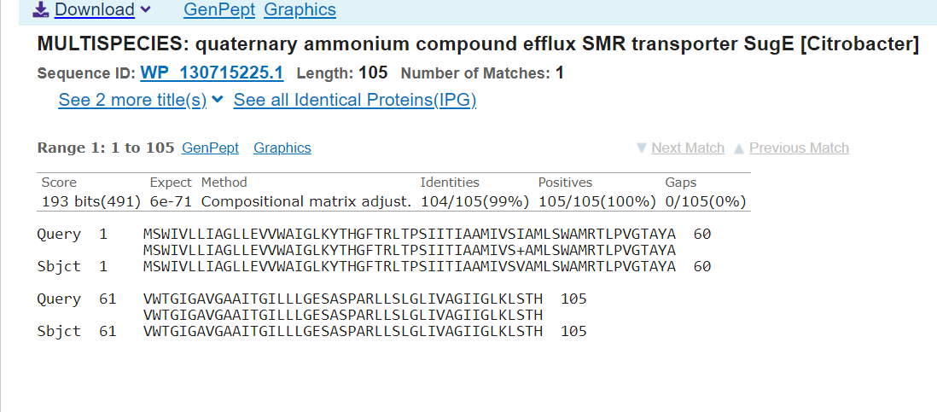
Web results

Slide 11
How do we run BLAST on the command line though??
Answer: we need to learn Conda

Slide 12
Conda
Supercharge your installations

Slide 13
What is conda?
The long
The short
Conda is an open source package management system and environment management system that runs on Windows, macOS, Linux and z/OS. Conda quickly installs, runs and updates packages and their dependencies. Conda easily creates, saves, loads and switches between environments on your local computer.
Installs things
Creates environments
You can “activate” or “deactivate” environments

Slide 14
One time setup
$ mkdir tmp
$ cd tmp
$ wget -c https://repo.anaconda.com/miniconda/Miniconda3-latest-Linux-x86_64.sh
--2022-09-18 15:46:54-- https://repo.anaconda.com/miniconda/Miniconda3-latest-Linux-x86_64.sh
Resolving repo.anaconda.com (repo.anaconda.com)... 104.16.131.3, 104.16.130.3, 2606:4700::6810:8303, ...
Connecting to repo.anaconda.com (repo.anaconda.com)|104.16.131.3|:443... connected.
HTTP request sent, awaiting response... 200 OK
Length: 76607678 (73M) [application/x-sh]
Saving to: 'Miniconda3-latest-Linux-x86_64.sh'
100%[==============================================================================>] 76,607,678 79.7MB/s in 0.9s
2022-09-18 15:46:55 (79.7 MB/s) - 'Miniconda3-latest-Linux-x86_64.sh' saved [76607678/76607678]
$ bash Miniconda3-latest-Linux-x86_64.sh
# answer the prompts
Notes:
https://medium.com/featurepreneur/setting-up-miniconda-on-ubuntu-4bf6bece6f9b

Slide 15
One time setup
# Answer the prompts for conda:
# accept the agreement
# accept the default for the path to conda
Do you wish the installer to initialize Miniconda3
by running conda init? [yes|no]
# Answer with “yes”
$ conda config --set auto_activate_base false
$ conda config --add channels bioconda
$ conda config --add channels conda-forge
$ conda config --set channel_priority strict
Notes:
https://medium.com/featurepreneur/setting-up-miniconda-on-ubuntu-4bf6bece6f9b

Slide 16
Install mamba
$ conda install mamba
# Wait a while for this to finish
# Click ‘y’ to proceed when prompted
Mamba is a faster installer
Usually when you see ‘conda,’ you can replace it with ‘mamba’
We are going to use mamba to install a multiple sequence aligner
https://medium.com/featurepreneur/setting-up-miniconda-on-ubuntu-4bf6bece6f9b

Slide 17

Mamba is part of conda now
Many slides going forward today and this semester contain the command mamba
We no longer need to use mamba
If/when you see mamba, you can substitute with conda

Slide 18
Don’t have to do that again
We have installed conda
manages virtual environments (envs)
activates and deactivates envs
Can install, uninstall, create, etc
We have installed mamba
Preferred way to install, uninstall, create
Cannot activate/deactivate envs

Slide 19
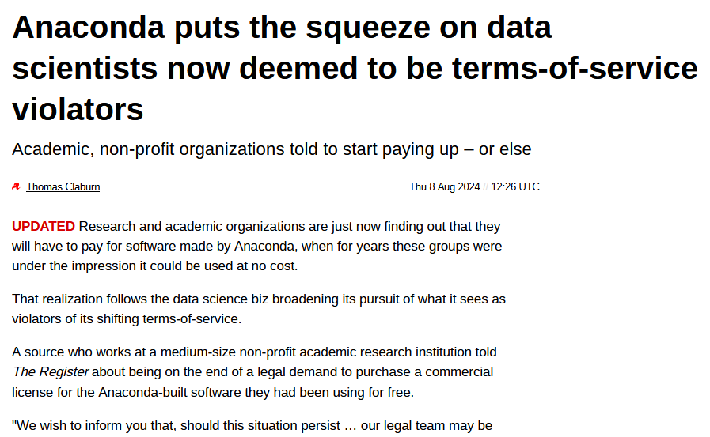
Quick word of warning
Conda might not be 100% free in the long-term
There are probably ways around this

Slide 20
BLAST on the command line

Slide 21
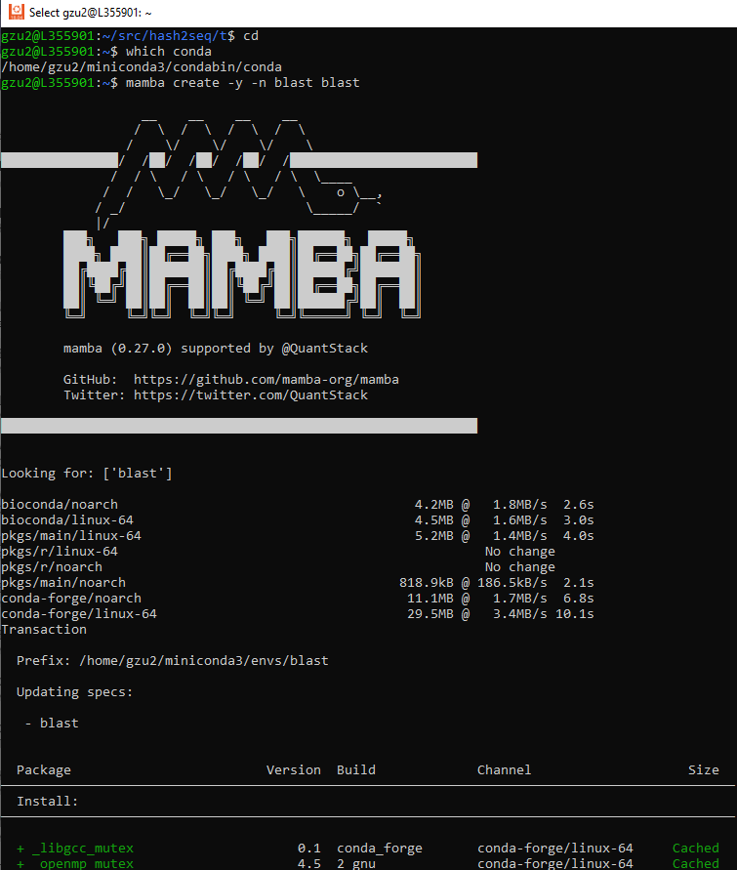
Installation
Command
mamba create -y -n blast blast
create: the subcommand to create a new environment
-y: answer yes to everything
-n blast: name of the environment is “blast”
blast: install the package blast
This command installs blast, without prompting, to a new environment called blast

Slide 22
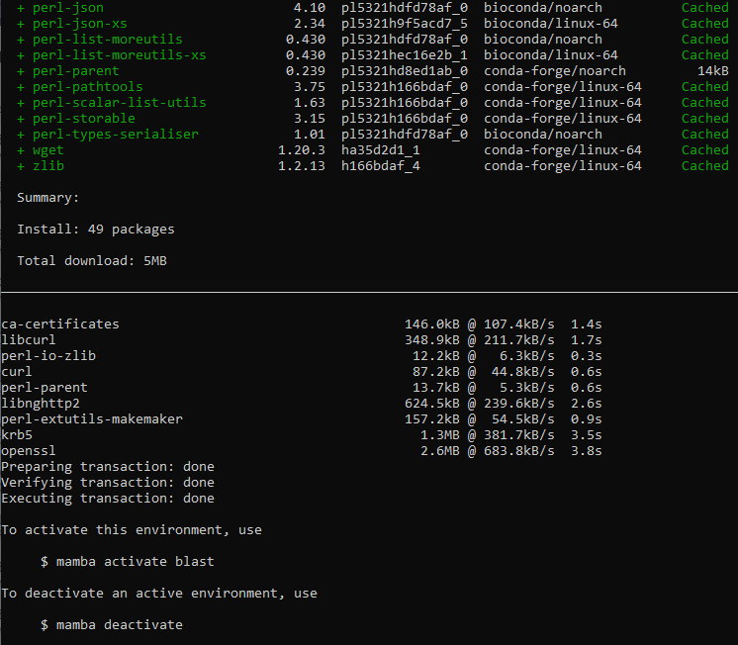
End of installation
To activate the environment:
conda activate blast
conda: the name of the program, conda
activate: the subcommand to load an environment
blast: the name of the environment we set up earlier with “-n”

Slide 23
Blast on command line interface (CLI)

Slide 24
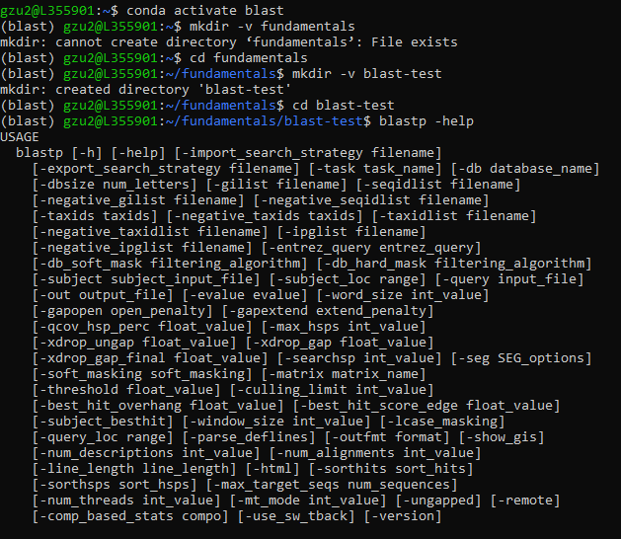
Setup for today on the command line
Create a new area for this semester called “fundamentals” Create a subfolder called blast-test
Try out blast with “blastp -help”
should make a lengthy help menu

Slide 25
Let’s get the data with curl
(blast) gzu2@L355901:~/fundamentals/blast-test$ curl 'https://ncbi.nlm.nih.gov/sviewer/viewer.cgi?tool=portal&save=file&log$=seqview&db=protein&report=fasta&id=695935060&conwithfeat=on&show-cdd=on' > prot1.fasta
% Total % Received % Xferd Average Speed Time Time Time Current
Dload Upload Total Spent Left Speed
100 170 0 170 0 0 482 0 --:--:-- --:--:-- --:--:-- 482
curl - the executable
'https://….' - the ridiculously long URL your teacher gave you to download
> - a redirect of the curl output into a file
prot1.fasta - the file that will be created

Slide 26
Let's get the data: use curl
(blast) gzu2@L355901:~/fundamentals/blast-test$ curl 'https://www.ncbi.nlm.nih.gov/sviewer/viewer.cgi?tool=portal&save=file&log$=seqview&db=protein&report=fasta&id=1583900798&conwithfeat=on&show-cdd=on' > prot2.fasta
% Total % Received % Xferd Average Speed Time Time Time Current
Dload Upload Total Spent Left Speed
100 209 0 209 0 0 515 0 --:--:-- --:--:-- --:--:-- 516
(blast) gzu2@L355901:~/fundamentals/blast-test$ head *.fasta
==> prot1.fasta <==
>AIT32258.1 multidrug transporter (plasmid) [Vibrio cholerae]
MSWIVLLIAGLLEVVWAIGLKYTHGFTRLTPSIITIAAMIVSIAMLSWAMRTLPVGTAYAVWTGIGAVGA
AITGILLLGESASPARLLSLGLIVAGIIGLKLSTH
==> prot2.fasta <==
>WP_130715225.1 MULTISPECIES: quaternary ammonium compound efflux SMR transporter SugE [Citrobacter]
MSWIVLLIAGLLEVVWAIGLKYTHGFTRLTPSIITIAAMIVSVAMLSWAMRTLPVGTAYAVWTGIGAVGA
AITGILLLGESASPARLLSLGLIVAGIIGLKLSTH
Notes:
After downloading both sequences, you can use ‘head’ to see both of them

Slide 27
Format the database with makeblastdb
(blast) gzu2@L355901:~/fundamentals/blast-test$ makeblastdb -in prot2.fasta -dbtype prot
Building a new DB, current time: 02/07/2023 14:50:01
New DB name: /home/gzu2/fundamentals/blast-test/prot2.fasta
New DB title: prot2.fasta
Sequence type: Protein
Keep MBits: T
Maximum file size: 3000000000B
Adding sequences from FASTA; added 1 sequences in 0.00746107 seconds.
makeblastdb - the executable
-in - the next parameter is the fasta file to create a database from
prot2.fasta - the fasta file that will also be a database
-dbtype - the next parameter will either describe the database as nucleotide or protein
prot - this database will be protein

Slide 28
Format the database with makeblastdb
(blast) gzu2@L355901:~/fundamentals/blast-test$ ls -lh
total 52K
-rw-r--r-- 1 gzu2 gzu2 170 Feb 7 14:48 prot1.fasta
-rw-r--r-- 1 gzu2 gzu2 209 Feb 7 14:49 prot2.fasta
-rw-r--r-- 1 gzu2 gzu2 20K Feb 7 14:50 prot2.fasta.pdb
-rw-r--r-- 1 gzu2 gzu2 162 Feb 7 14:50 prot2.fasta.phr
-rw-r--r-- 1 gzu2 gzu2 104 Feb 7 14:50 prot2.fasta.pin
-rw-r--r-- 1 gzu2 gzu2 474 Feb 7 14:50 prot2.fasta.pjs
-rw-r--r-- 1 gzu2 gzu2 20 Feb 7 14:50 prot2.fasta.pot
-rw-r--r-- 1 gzu2 gzu2 107 Feb 7 14:50 prot2.fasta.psq
-rw-r--r-- 1 gzu2 gzu2 16K Feb 7 14:50 prot2.fasta.ptf
-rw-r--r-- 1 gzu2 gzu2 8 Feb 7 14:50 prot2.fasta.pto
Notes:
Let’s look at the files. The fasta file that we indexed has all these extra files associated with it.

Slide 29
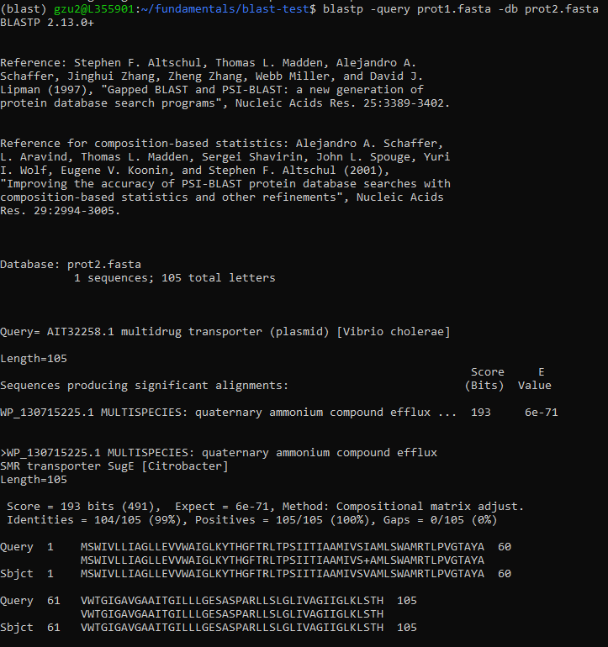
Query the database with blastp
blastp -query prot1.fasta -db prot2.fasta
blastp - the executable
-query - the next parameter will be the query fasta file
prot1.fasta - the query fasta file
-db - the next parameter will be the database which was created with makeblastdb
prot2.fasta - the blast database

Slide 30
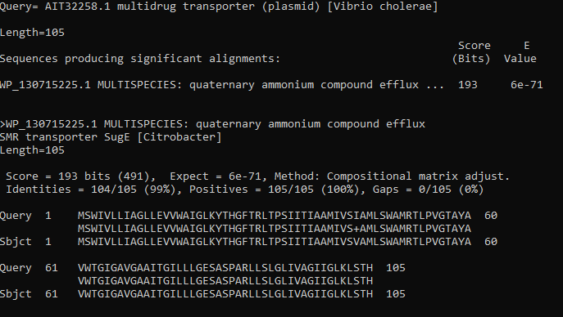
The actual result
Is it the same protein product?
Notes:
Some parts to look at:
query=
length=105
Score (bits), e-value
Identities = 105/105
Gaps = 0
The + where the “positive but not identity” is located

Slide 31
alignments

Slide 32
What is gene alignment?
Compare two or more DNA sequences
Find similarities and differences
Differences can be SNPs
Synonymous
Nonsynonymous
Differences can be indels
Insertion
Deletion
How do we align genes?
MEGA
Clustal Omega

Slide 33
Install clustal: search for what to install
$ mamba search clustal
Loading channels: done
No match found for: clustal. Search: *clustal*
# Name Version Build Channel
clustalo 1.2.3 0 bioconda
clustalo 1.2.4 0 bioconda
clustalo 1.2.4 1 bioconda
clustalo 1.2.4 h1b792b2_4 bioconda
clustalo 1.2.4 h87f3376_5 bioconda
clustalo 1.2.4 he1b5a44_3 bioconda
clustalo 1.2.4 hfc679d8_2 bioconda
clustalw 2.1 0 bioconda
clustalw 2.1 1 bioconda
clustalw 2.1 h2d50403_2 bioconda
clustalw 2.1 h6bb024c_3 bioconda
clustalw 2.1 h6bb024c_4 bioconda
clustalw 2.1 h7d875b9_6 bioconda
clustalw 2.1 h9f5acd7_7 bioconda
clustalw 2.1 hc9558a2_5 bioconda
perl-bio-tools-run-alignment-clustalw 1.7.4 pl5262hdfd78af_2 bioconda
perl-bio-tools-run-alignment-clustalw 1.7.4 pl526_0 bioconda
perl-bio-tools-run-alignment-clustalw 1.7.4 pl526_1 bioconda
perl-bio-tools-run-alignment-clustalw 1.7.4 pl5321hdfd78af_3 bioconda
Notes:
Let’s start with the CLI method and making an env with Conda
Start by searching conda for clustal

Slide 34
Install clustal omega
$ mamba create -n clustal clustalo clustalw
# push “y” to confirm changes when prompted
$ conda activate clustal
$ clustalo --help
$ conda deactivate
mamba - the executable
create - the subcommand to create a new environment
-n clustal - the name of the environment is “clustal”
clustalo clustalw - install the latest clustalo and clustalw packages
conda activate clustal - activate the new clustal environment you created
conda deactivate - unload the current environment which is currently “clustal”

Slide 35
Align two genes: activate the environment and create input file proteins.fasta
$ cd fundamentals/blast-test/
$ ls
prot1.fasta prot2.fasta.pdb prot2.fasta.pin prot2.fasta.pot prot2.fasta.ptf
prot2.fasta prot2.fasta.phr prot2.fasta.pjs prot2.fasta.psq prot2.fasta.pto
$ conda activate clustal
$ cat prot1.fasta prot2.fasta > proteins.fasta

Slide 36
Align two genes and view it
$ clustalo --in proteins.fasta --outfmt clustal --out proteins.clw
$ cat proteins.clw
CLUSTAL O(1.2.4) multiple sequence alignment
AIT32258.1 MSWIVLLIAGLLEVVWAIGLKYTHGFTRLTPSIITIAAMIVSIAMLSWAMRTLPVGTAYA
WP_130715225.1 MSWIVLLIAGLLEVVWAIGLKYTHGFTRLTPSIITIAAMIVSVAMLSWAMRTLPVGTAYA
******************************************:*****************
AIT32258.1 VWTGIGAVGAAITGILLLGESASPARLLSLGLIVAGIIGLKLSTH
WP_130715225.1 VWTGIGAVGAAITGILLLGESASPARLLSLGLIVAGIIGLKLSTH
*********************************************
$ conda deactivate
Notes:
Question: where is the different residue?

Slide 37
Gene prediction

Slide 38
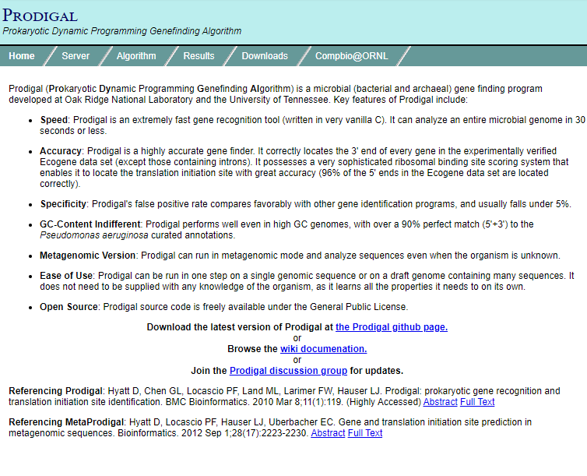
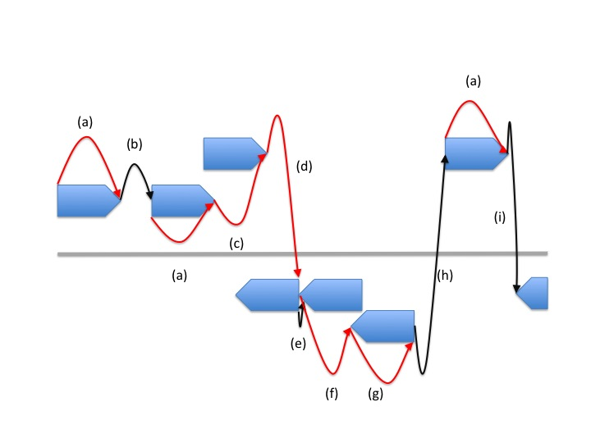
Prodigal
Notes:
https://web.archive.org/web/20170823035747/http://prodigal.ornl.gov/
Prodigal's algorithm for gene prediction follows the basic principle of KISS (Keep It Simple, Stupid). Compared to other methods, Prodigal's naive log-likelihood functions seem deceptively simple. Despite its lack of complexity (no Hidden Markov Model, no Interpolated Markov Model, etc.), Prodigal nonetheless achieves good results.
The basic steps of the Prodigal algorithm can be summarized as follows:
Constructing a training set for protein coding: Many genefinders just take all open reading frames, or ORFs, above a certain size and consider them to be real genes. While this may be fine for low-GC genomes, this assumption proves dangerous in high GC organisms. Due to the lack of A and T in high GC genomes, there are many fewer stop codons. Long ORFs occur simply by chance in high GC genomes, and many of them aren't real genes at all. Prodigal addresses this problem with GC frame plot based training, wherein it examines all the ORFs in a genome looking for a bias for G or C in the 1st, 2nd, and 3rd positions of each codon. It then does a dynamic programming across the entire genome, building gene models using this frame plot bias as its only coding scoring function. While the gene models built by this initial run are far from perfect, they provide a sound enough basis to gather coding statistics from, and a far better basis than merely choosing all ORFs above a certain size.
Building log-likelihood coding statistics from the training data: Prodigal gathers dicodon (hexamer) statistics for all the genes in its initial dynamic programming model. The coding function is a simple log-likelihood of signal to background. Once this function has been established, every potential gene in the genome (all possible starts and stops) is scored. This simple function, plus the two factors listed below, are all Prodigal uses in the way of coding scores.
Sharpening coding scores: Once Prodigal has scored all potential candidates in a given ORF, it then implements a "sharpening" of the coding score, wherein it penalizes all potential start candidates that lie downstream from a higher-scoring start. The reason for this is that if we choose a more interior start in the dynamic programming stage, we are also NOT choosing the region upstream of that start. Therefore, an additional penalty is assigned representing this bypassing of a good coding region. For example, gene 3701-4000 has a score of 100. Gene 3763-4000 has a score of 75. We revise the score of gene 3763-4000 to be 75 minus the coding not selected (25), or 50.
Length factor to coding: A static length factor is added to the coding score. This factor is higher in low GC genomes, and lower in high GC genomes. If an ORF is especially long, but has negative coding, its coding score is artificially replaced with a small positive coding per base. This enables the long ORF to be recognized as a true gene, but it won't be chosen over a genuinely good alternative.
Iterative start training: For every open reading frame containing a gene with a coding score above a certain threshold, the translation initiation site with the highest coding score is recorded. This set of "coding peaks", although usually only 60-70% likely to be the true gene start, provides a sound foundation for start training. These starts are examined for ATG/GTG/TTG frequency and ribosomal binding site (RBS) motifs. The starts are then rescored based on these discoveries, and the new set of starts with the highest score in each ORF is selected. The start trainer iterates until the set of "best starts" no longer changes (usually only a few iterations). This final set of "best starts" is used as the training set for start scoring, and data is gathered from this set regarding RBS motifs, distances, and ATG/GTG/TTG frequency.
Final dynamic programming: A final dynamic programming is performed over the set of all start-stop pairs in the genome. Each potential gene's score is the sum of its start score and its coding score. Some small overlap is allowed between two genes on the same strand, and a greater amount of overlap is allowed for 3' ends of two genes on opposite strands. Bonuses are given to the scoring for potential operon distances, with larger bonuses given to -1 and -4 base overlaps between two genes on the same strand.

Slide 39
Get the software
$ conda create -n prodigal prodigal
$ conda activate prodigal
$ mkdir -pv ~/fundamentals/gene-prediction
$ cd ~/fundamentals/gene-prediction
$ wget 'https://www.ncbi.nlm.nih.gov/sviewer/viewer.cgi?tool=portal&save=file&log$=seqview&db=nuccore&report=fasta&id=545778205&conwithfeat=on&hide-sequence=on&hide-cdd=on' -O K12.fasta
$ prodigal -h
Notes:
create an environment called prodigal. Can also use ‘mamba’ in the create step
activate prodigal
make directory for gene prediction and then navigate there with cd
wget K12 genome and put it into K12.fasta
Run prodigal help

Slide 40
Run gene prediction
$ prodigal -i K12.fasta > K12.prodigal.gbk
-------------------------------------
PRODIGAL v2.6.3 [February, 2016]
Univ of Tenn / Oak Ridge National Lab
Doug Hyatt, Loren Hauser, et al.
-------------------------------------
Request: Single Genome, Phase: Training
Reading in the sequence(s) to train...4641652 bp seq created, 50.79 pct GC
Locating all potential starts and stops...240856 nodes
Looking for GC bias in different frames...frame bias scores: 1.56 0.18 1.26
Building initial set of genes to train from...done!
Creating coding model and scoring nodes...done!
Examining upstream regions and training starts...done!
-------------------------------------
Request: Single Genome, Phase: Gene Finding
Finding genes in sequence #1 (4641652 bp)...done!
Notes:
Question: how would I look inside the file? less, head, tail, cat, …

Slide 41
What did the gene prediction look like?
$ head K12.prodigal.gbk
DEFINITION seqnum=1;seqlen=4641652;seqhdr="U00096.3 Escherichia coli str. K-12 substr. MG1655, complete genome";version=Prodigal.v2.6.3;run_type=Single;model="Ab initio";gc_cont=50.79;transl_table=11;uses_sd=1
FEATURES Location/Qualifiers
CDS <3..98
/note="ID=1_1;partial=10;start_type=Edge;rbs_motif=None;rbs_spacer=None;gc_cont=0.427;conf=56.57;score=1.15;cscore=-1.57;sscore=2.72;rscore=0.00;uscore=0.00;tscore=3.22;"
CDS 337..2799
/note="ID=1_2;partial=00;start_type=ATG;rbs_motif=GGAG/GAGG;rbs_spacer=5-10bp;gc_cont=0.531;conf=99.99;score=336.87;cscore=320.95;sscore=15.93;rscore=11.24;uscore=1.40;tscore=3.94;"
CDS 2801..3733
/note="ID=1_3;partial=00;start_type=ATG;rbs_motif=AGGAG;rbs_spacer=5-10bp;gc_cont=0.563;conf=100.00;score=118.08;cscore=97.71;sscore=20.37;rscore=14.85;uscore=0.32;tscore=3.94;"
CDS 3734..5020
/note="ID=1_4;partial=00;start_type=ATG;rbs_motif=GGA/GAG/AGG;rbs_spacer=5-10bp;gc_cont=0.528;conf=99.99;score=194.29;cscore=189.96;sscore=4.33;rscore=2.99;uscore=-3.88;tscore=3.94;"
Notes:
Question: how would I count the number of coding sequences found? These coding sequences are tagged with “CDS”
grep -c CDS K12.prodigal.gbk

Slide 42
Docker In conclusion
Sai
We learned a little about running BLAST online
We learned how to install with conda
BLAST - align one sequence with other sequences
Clustal - multiple sequence alignment
Prodigal - gene prediction

Slide 43
Professional dev

Slide 44

Your Digital Mentor Podcast
Your Digital Mentor Podcast explores topics around mentoring and career development, tackling the challenges through real stories and honest discussions from expert guests across the world.
https://coursesandconferences.wellcomeconnectingscience.org/our-events/your-digital-mentor-podcast/

