Slide 1
Sequence querying
2025-03-12

Slide 2
Outline
BLAST+
Mash
Getting help online

Slide 3
Querying sequences with BLAST+

Slide 4
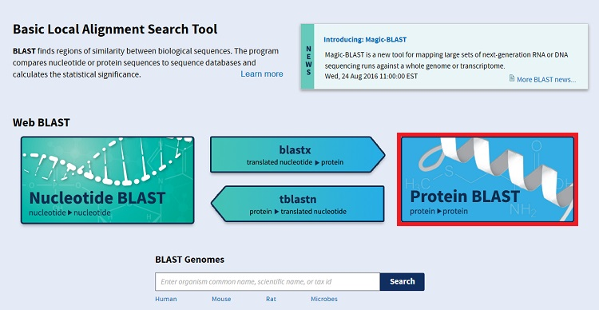
What is BLAST?
Basic Local Alignment Search Tool
Compares query against reference
Query reference
nt nt
protein protein
Blastn (tblastx)
blastx
tblastn
blastp
Notes:
5 flavors of blast

Slide 5
Basic questions answered
What are similar sequences to mine?
Has anyone else found this gene before?
What organisms can my gene be found in?
What are the different "flavors" of my gene?
what could the function of my gene be?
How does my gene compare to another allele?
=> let's just try to answer the last question for now

Slide 6

Salmonella Infantis
One of the most common Salmonella serotypes in the US
Found in foods, animals, and environmental settings
Recall about Salmonella
About 4.7Mbp
Has antimicrobial resistance (AMR) determining genes
Salmonella pathogenicity Islands (SPIs)
Notes:
https://www.ncbi.nlm.nih.gov/pmc/articles/PMC6256390/

Slide 7

Find AMR genes in your genome
BLAST assembly against resfinder database
Find location
Identify the hit

Slide 8
Conda environment
conda create -n querying git ncbi-datasets-cli mash==2.2 blast
conda activate querying

Slide 9
Resfinder database
mkdir ~/fundamentals/querying/
cd ~/fundamentals/querying/
git clone https://bitbucket.org/genomicepidemiology/resfinder_db.git
cd resfinder_db
makeblastdb -in beta-lactam.fsa -dbtype nucl
cd ..

Slide 10
Find where the beta lactams are
pwd ~/fundamentals/querying
blastn -query ../annotation/asm/SRR2485281/contigs.fa -db resfinder_db/beta-lactam.fsa > blast.txt
less blast.txt

Slide 11
less blast.txt
BLASTN 2.6.0+
Reference: Zheng Zhang, Scott Schwartz, Lukas Wagner, and Webb
Miller (2000), "A greedy algorithm for aligning DNA sequences", J
Comput Biol 2000; 7(1-2):203-14.
Database: beta-lactam.fsa
2,013 sequences; 1,793,976 total letters
Query= contig00001 len=1195375 cov=17.0 corr=0
origname=NODE_1_length_1195375_cov_16.972618_pilon
sw=shovill-spades/1.1.0 date=20221030
Length=1195375
***** No hits found *****
Lambda K H
1.33 0.621 1.12
Gapped
Lambda K H
1.28 0.460 0.850
Effective search space used: 2072233357170
Nucleotide blast against beta-lactams
Many or most contigs will not have hits
Scroll down to where there are hits
Use arrow keys to scroll
Use page up or page down keys too
q to quit

Slide 12
less blast.txt
Query= contig00040 len=5002 cov=12.9 corr=0
origname=NODE_40_length_5002_cov_12.867282_pilon
sw=shovill-spades/1.1.0 date=20221030
Length=5002
Score E
Sequences producing significant alignments: (Bits) Value
blaCTX-M-65_1_EF418608 1618 0.0
blaCTX-M-148_1_KJ020574 1613 0.0
blaCTX-M-90_1_FJ907381 1613 0.0
blaCTX-M-122_1_JN790863 1607 0.0
blaCTX-M-196_1_KY563769 1607 0.0
blaCTX-M-147_1_KF513180 1607 0.0
blaCTX-M-125_1_JQ724542 1607 0.0
blaCTX-M-99_1_HM803271 1607 0.0
blaCTX-M-98_1_HM755448 1607 0.0
blaCTX-M-87_1_EU545409 1607 0.0
blaCTX-M-14_1_AF252622 1607 0.0
blaCTX-M-27_1_AY156923 1602 0.0
blaCTX-M-38_1_AY822595 1602 0.0
blaCTX-M-201_1_KY997189 1602 0.0
blaCTX-M-198_1_KY646304 1602 0.0
blaCTX-M-191_1_KY271097 1602 0.0
Finally, some hits on contig00040
Your contig number may differ
Score
E-value
What is the most likely allele of blaCTX in this genome?
65, 148, 198, or 191? Other?
Notes:
Score - cumulative of points and penalties for matches and mismatches. Higher the score, better the match
E - The Expect value (E) is a parameter that describes the number of hits one can "expect" to see by chance when searching a database of a particular size. It decreases exponentially as the Score (S) of the match increases. Essentially, the E value describes the random background noise. For example, an E value of 1 assigned to a hit can be interpreted as meaning that in a database of the current size one might expect to see 1 match with a similar score simply by chance.

Slide 13
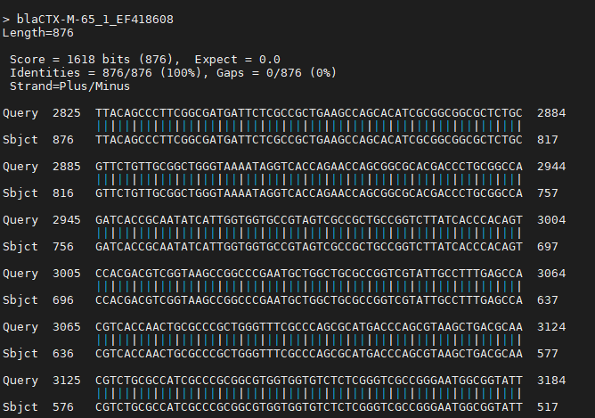
What can we say about this first hit?
Notes:
Target/subject/hit is blaCTX-M-65 (allele 65)
Length of hit is 876 nucleotides
Score is 1618
E value is 0.0
Percent ID is 100%, 876 matches
Zero gaps
Plus/minus strand
Gene starts at position 2825
Position 2825 matches against the hit at position 876 which makes sense: this is the last bp in the full length target gene
Personally I would conclude that our genome has allele 65 of the blaCTX gene

Slide 14
Smith Waterman
Algorithm: Comparison of two sequences

Slide 15
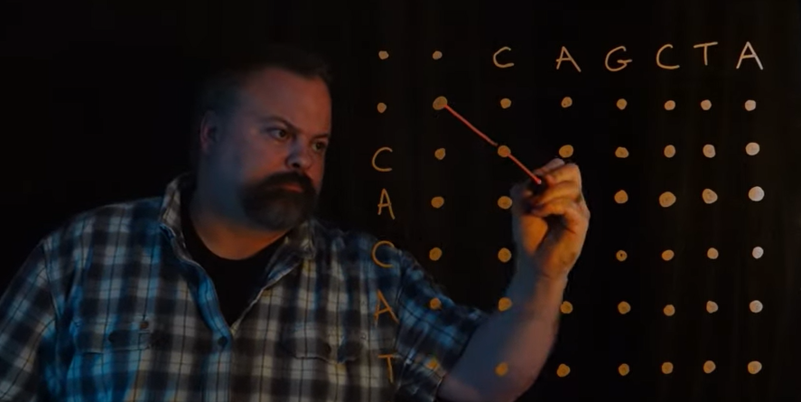
Smith-Waterman algorithm initialization
 | . | C | A | G | C | T | A
. | 0 | -1 | -2 | -3 | -4 | -5 | -6
C | -1
A | -2
C | -3
A | -4
T | -5
A | -6
https://www.youtube.com/watch?v=b6xBvl0yPAY
Notes:
dynamic algorithm because you solve sub problems to add up to a wholistic solution: a solution of the whole problem

Slide 16
Smith-Waterman algorithm
 | . | C | A | G | C | T | A
. | 0 | -1 | -2 | -3 | -4 | -5 | -6
C | -1 | 1 | 0 | -1 | -2 | -3 | -4
A | -2 | 0 | 2 | 1 | 0 | -1 | -2
C | -3 | -1 | 1 | 1 | 2 | 1 | 0
A | -4 | -2 | 0 | 0 | 1 | 1 | 2
T | -5 | -3 | -1 | -1 | 0 | 2 | 1
A | -6 | -4 | -2 | -2 | -1 | 1 | 3
https://www.youtube.com/watch?v=b6xBvl0yPAY
Notes:
dynamic algorithm because you solve sub problems to add up to a wholistic solution: a solution of the whole problem

Slide 17
Smith-Waterman traceback
 | . | C | A | G | C | T | A
. | 0 | -1 | -2 | -3 | -4 | -5 | -6
C | -1 | 1↖ | 0⬅ | -1⬅ | -2⬅ | -3⬅ | -4⬅
A | -2 | 0⬆ | 2↖ | 1⬅ | 0⬅ | -1⬅ | -2⬅
C | -3 | -1⬆ | 1⬆ | 1↖ | 2↖ | 1⬅ | 0⬅
A | -4 | -2⬆ | 0⬆ | 0↖ | 1⬆ | 1↖ | 2↖
T | -5 | -3⬆ | -1⬆ | -1↖ | 0⬆ | 2↖ | 1⬅
A | -6 | -4⬆ | -2⬆ | -2↖ | -1⬆ | 1⬆ | 3↖
https://www.youtube.com/watch?v=b6xBvl0yPAY
Notes:
dynamic algorithm because you solve sub problems to add up to a wholistic solution: a solution of the whole problem

Slide 18
Smith-Waterman finishing up
Find the largest score
Follow the path from largest score to top left
If you come to a negative number, terminate
CAGC-TA
|| | ||
CA-CATA
 | . | C | A | G | C | T | A
. | 0 | -1 | -2 | -3 | -4 | -5 | -6
C | -1 | 1↖ | 0⬅ | -1⬅ | -2⬅ | -3⬅ | -4⬅
A | -2 | 0⬆ | 2↖ | 1⬅ | 0⬅ | -1⬅ | -2⬅
C | -3 | -1⬆ | 1⬆ | 1↖ | 2↖ | 1⬅ | 0⬅
A | -4 | -2⬆ | 0⬆ | 0↖ | 1⬆ | 1↖ | 2↖
T | -5 | -3⬆ | -1⬆ | -1↖ | 0⬆ | 2↖ | 1⬅
A | -6 | -4⬆ | -2⬆ | -2↖ | -1⬆ | 1⬆ | 3↖
https://www.youtube.com/watch?v=b6xBvl0yPAY
Notes:
dynamic algorithm because you solve sub problems to add up to a wholistic solution: a solution of the whole problem

Slide 19
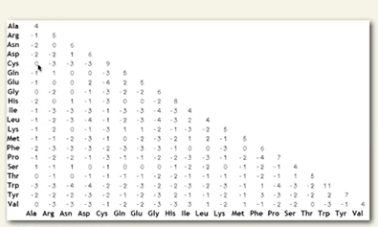
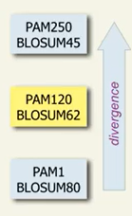
Blast scoring
PAM, BLOSUM
https://www.youtube.com/watch?v=4AcnZnZRss8
Notes:
You can come up with more complex scoring tables especially for proteins
This will change the way we score the alignment in the step before the traceback

Slide 20
Mash

Slide 21
Min-hash visualization
A = +
B = +
S(A) =
S(B) =

Slide 22
How does Mash work?
“Sketch”
Min-hash
@read1
GGATTAGG
+
IIIIIIII
@read2
GGATTAAA
+
IIIIIIII
…
Hashing; counting
GGATT - 2
GATTA - 2
ATTAG - 1
TTAGG - 1
ATTAA - 1
TTAAA - 1
66 - 2
42 - 2
82 - 1
87 - 1
64 - 1
22 – 1
…
Kmer counting
Many, many more rows
Ondov et al, “Mash”, Genome Biology. http://genomebiology.biomedcentral.com/articles/10.1186/s13059-016-0997-x

Slide 23
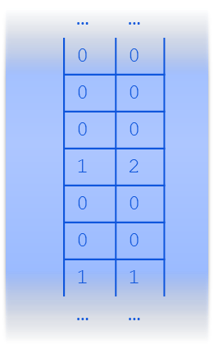
How does Mash work?
Based on the software Mash
Mash implements the min-hash algorithm for sequence data
“Sketch”
Min-Hash
2
5
24
33
34
2
5
24
33
34
60
66
…
66 - 2
42 – 2
33 – 5
44 - 5
24 – 7
34 – 3
…
Filter low-count
66 - 2
42 - 2
82 - 1
87 - 1
64 - 1
22 – 1
…
“min”
sort
This example: just keep five hashes
And focus on hashes
Ondov et al, “Mash”, Genome Biology. http://genomebiology.biomedcentral.com/articles/10.1186/s13059-016-0997-x

Slide 24
How does Mash work?
Min-hash
Based on the software Mash
Mash implements the min-hash algorithm for sequence data
“Distance” or “dist”
sketch1
sketch2
2
5
24
33
34
2
7
24
33
34
Five slots, one position difference.
Jaccard distance = 1/5 = 0.2
The resolution gets better with more hashes.
Ondov et al, “Mash”, Genome Biology. http://genomebiology.biomedcentral.com/articles/10.1186/s13059-016-0997-x

Slide 25
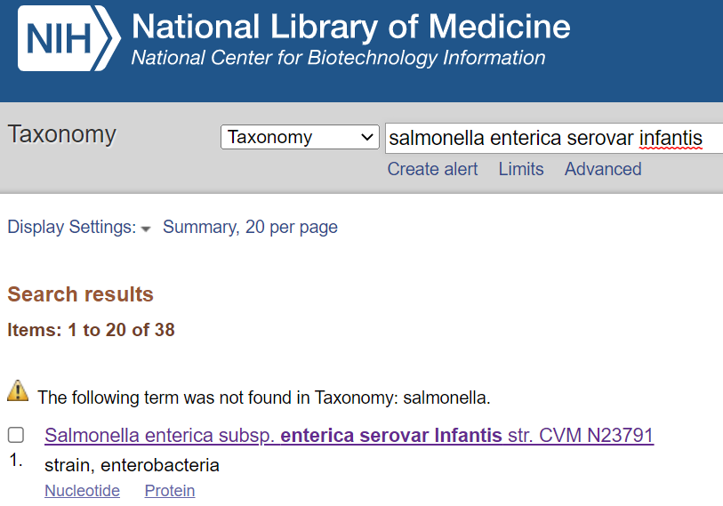
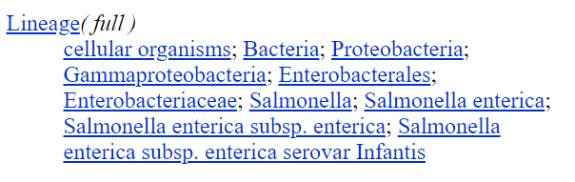
Let’s get some data

Slide 26
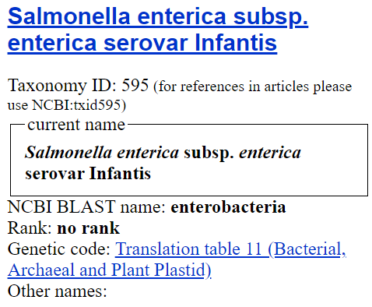
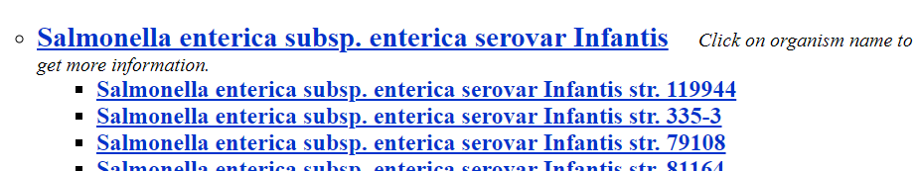
Click into Infantis to find the taxid

Slide 27
Build Mash database of Salmonella Infantis (taxid: 595)
./datasets download genome taxon --assembly-source refseq --released-after '01/01/2022' --filename 2022.infantis.zip 595
unzip 2022.infantis.zip
mash sketch -o infantis.msh ncbi_dataset/data/GCF_*/*.fna
mash info infantis.msh | head
Header:
Hash function (seed): MurmurHash3_x64_128 (42)
K-mer size: 21 (64-bit hashes)
Alphabet: ACGT (canonical)
Target min-hashes per sketch: 1000
Sketches: 35
# sketch three more: the reads from last time and the E. coli
# reads from the assembly lecture
mash sketch ../annotation/reads/SRR2485281/SRR2485281_1.fastq.gz
mash sketch ../assembly/reads/SRR21726463/SRR21726463_1.fastq.gz

Slide 28
Inspect one of the queries
# produced two .msh files
ls -l ../annotation/reads/SRR2485281/SRR2485281_1.fastq.gz.msh ../annotation/asm/SRR2485281/contigs.fa.msh
mash info -d ../annotation/reads/SRR2485281/SRR2485281_1.fastq.gz.msh | head -n 20
{
"kmer" : 21,
"alphabet" : "ACGT",
"preserveCase" : false,
"canonical" : true,
"sketchSize" : 1000,
"hashType" : "MurmurHash3_x64_128",
"hashBits" : 64,
"hashSeed" : 42,
"sketches" :
[
{
"name" : "../annotation/reads/SRR2485281/SRR2485281_1.fastq.gz",
"length" : 175914318,
"comment" : "[947910 seqs] SRR2485281.1 1 length=251 [...]",
"hashes" :
[
128352611499,
452975526679,
811475989729,
Notes:
mash info -d prints the information on the sketch in JSON format.
A few things
kmer 21: k was set to length 21
alphabet: ACGT. DNA sequence.
SketchSize: 1000 hashed kmers
hashType: the hashing algorithm
Hash Seed is always default 42 but can be changed
sketches: this one only has one sketch
length: how many nts there originally were
hashes: all the integers derived from kmers

Slide 29
Which of our genomes is closest to the infantis set?
mash dist ../annotation/reads/SRR2485281/SRR2485281_1.fastq.gz.msh infantis.msh | head -n 5
../annotation/reads/SRR2485281/SRR2485281_1.fastq.gz ncbi_dataset/data/GCF_021344065.1/GCF_021344065.1_ASM2134406v1_genomic.fna 0.0310744 0 352/1000
../annotation/reads/SRR2485281/SRR2485281_1.fastq.gz ncbi_dataset/data/GCF_021394455.1/GCF_021394455.1_ASM2139445v1_genomic.fna 0.030875 0 354/1000
../annotation/reads/SRR2485281/SRR2485281_1.fastq.gz ncbi_dataset/data/GCF_021394515.1/GCF_021394515.1_ASM2139451v1_genomic.fna 0.0311746 0 351/1000
../annotation/reads/SRR2485281/SRR2485281_1.fastq.gz ncbi_dataset/data/GCF_021394525.1/GCF_021394525.1_ASM2139452v1_genomic.fna 0.0311746 0 351/1000
../annotation/reads/SRR2485281/SRR2485281_1.fastq.gz ncbi_dataset/data/GCF_021395095.1/GCF_021395095.1_ASM2139509v1_genomic.fna 0.0314775 0 348/1000
(the formatting is a bit of a mess)
Notes:
5 columns:
query, subj, mash distance, p value, and fraction of shared kmers

Slide 30
Fix the command a bit
mash dist ../annotation/reads/SRR2485281/SRR2485281_1.fastq.gz.msh infantis.msh | sort -k3,3n | head -n 3 | cut -f 2-5 | column -t
ncbi_dataset/data/GCF_021394455.1/GCF_021394455.1_ASM2139445v1_genomic.fna 0.030875 0 354/1000
ncbi_dataset/data/GCF_025834295.1/GCF_025834295.1_ASM2583429v1_genomic.fna 0.030875 0 354/1000
ncbi_dataset/data/GCF_025834955.1/GCF_025834955.1_ASM2583495v1_genomic.fna 0.030875 0 354/1000
mash dist: find distances
sort -k3,3n: sort the 3rd column numerically
head -n 3: top three lines
cut -f 2-5: get the 2nd to 5th columns
column -t: column output for tables

Slide 31
Compare 0.030875 to what we get with an E. coli query.
mash dist ../assembly/reads/SRR21726463/SRR21726463_1.fastq.gz.msh infantis.msh | sort -k3,3n | head -n 3 | cut -f 2-5 | column -t
ncbi_dataset/data/GCF_021344065.1/GCF_021344065.1_ASM2134406v1_genomic.fna 0.219531 1.40584e-17 5/1000
ncbi_dataset/data/GCF_021394455.1/GCF_021394455.1_ASM2139445v1_genomic.fna 0.219531 1.42949e-17 5/1000
ncbi_dataset/data/GCF_021394515.1/GCF_021394515.1_ASM2139451v1_genomic.fna 0.219531 1.58762e-17 5/1000
mash dist: find distances
sort -k3,3n: sort the 3rd column numerically
head -n 3: top three lines
cut -f 2-5: get the 2nd to 5th columns
column -t: column output for tables
Answer: our infantis set is closer in distance to our infantis query than the E. coli query

Slide 32
Conclusions
Querying with Blast
Querying with Mash

Slide 33
Getting online help
You’re stuck…. so how do you get unstuck?

Slide 34

Sites to get help - discussion forums
SEQanswers — the most popular online forum devoted to bioinformatics?
Biostars — another very popular forum.
Stack Overflow — more suited for questions related to programming languages or Unix/Linux.
Notes:
http://www.acgt.me/blog/2015/11/1/where-to-ask-for-bioinformatics-help-online

Slide 35
Sites to get help - a more complete list
SEQanswers — the most popular online forum devoted to bioinformatics?
Biostars — another very popular forum.
Mailing lists — many useful bioinformatics tools have their own mailing lists where you can ask questions and get help from the developers or from other users, e.g. SAMtools and Bioconductor. Also note that resources such as Ensembl have their own mailing lists for developers.
Google Discussion Groups — as well as having very general discussion groups, e.g. Bioinformatics, there are also groups like Tuxedo Tool Users…the perfect place to ask your TopHat or Cufflinks question.
Stack Overflow — more suited for questions related to programming languages or Unix/Linux.
Google — I'm including this here because I have solved countless bioinformatics problems just by searching Google with an error message.
Reddit — try asking in r/bioinformatics or r/genome.
Twitter — this may be more useful if you have enough followers who know something about bioinformatics, but it is potentially a good place to ask a question, though not a great forum for long questions (or replies). Try using the hashtag #askabioinformatician (this was @sjcockell's idea).
mstdn.science - this is a nice mastodon instance where many microbial bioinformaticians have migrated to
Research Gate — you may know it better as 'that site that sends me email every day', but some people use this site to ask questions about science. Surprisingly, they have 15 different categories relating to bioinformatics.
LinkedIn — Another generator of too many emails, but they do have discussion groups for bioinformatics geeks and NGS.
Notes:
http://www.acgt.me/blog/2015/11/1/where-to-ask-for-bioinformatics-help-online

Slide 36
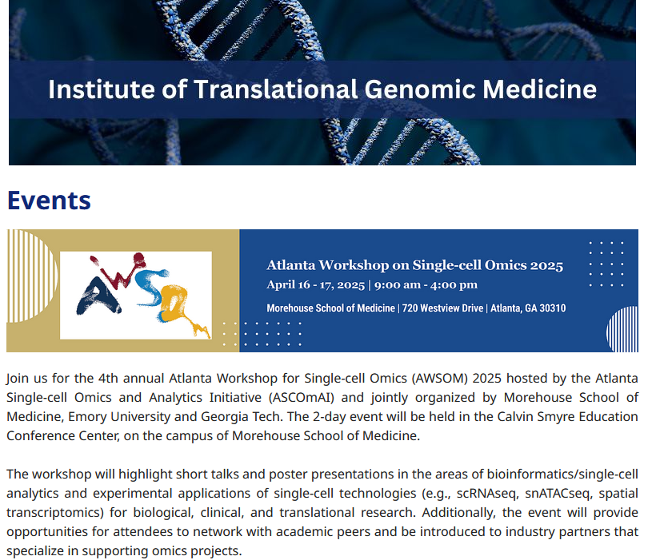
Conference coming up
https://www.msm.edu/Research/research_centersandinstitutes/ITGM/Events.php
The abstract submission deadline is March 17, 2025 at 11:59 EST.

