Slide 1
Multiple Sequence Alignment
2025-03-26

Slide 2

“Hey can you do this for me…?”
Is my gene part of a larger gene family? How does it compare?
Where is my gene different than the reference gene?
What depth of coverage did I sequence my genome?
Do you think we can find some differences between my genome and the reference?

Slide 3

Outline
Sequencing
prediction
annotation
Display
Assembly
Multiple sequence alignment (MSA)
Read mapping and read alignment
MSA
Phylogeny
downstream studies
Notes:
We have been looking at this genome project track (sequencing… display)
but let’s take a break from that for now
and let’s look at the MSA and phylogeny track

Slide 4
Multiple sequence alignments (MSA)
Notes:
Changing topics

Slide 5
β-lactamase gene alignments
β-lactamases are Bacterial enzymes that break down β-lactam antibiotics (e.g. penicillins, cephalosporins, carbapenams)
β-lactamases can be grouped into different genes families, initially named by their phenotypes or in what organism they were first identified.
bla_{CTX-M} genes:
A Class A extended spectrum β-lactamase (ESBL)
Resistant to penicillins, cephalosporins but not the most last line antibiotics like carbapenams
Appear to be from the chromosome of Kluyvera spp originally but are mobilized on plasmids.
bla_{CMY} genes:
AmpC β-lactamase
Resistant to penicillins, cephalosporins, β -lactam/inhibitor combos but not carbapenams)
CMY-2 originates from chromosomal ampC of Citrobacter freundii and has been mobilized on plasmids.

Slide 6
Resfinder database
# Database of antimicrobial resistance genes
mkdir ~/fundamentals/msa
cd ~/fundamentals/msa
conda create -y -n msa muscle samtools git clustalw clustalo clustalx
conda activate msa
git clone https://bitbucket.org/genomicepidemiology/resfinder_db.git
cd resfinder_db

Slide 7
Resfinder database
grep -m 10 -n blaCTX beta-lactam.fsa
5480:>blaCTX-M-1_1_DQ915955
5496:>blaCTX-M-4_1_Y14156
5512:>blaCTX-M-6_1_AJ005044
5528:>blaCTX-M-8_1_AF189721
5544:>blaCTX-M-9_1_AF174129
5560:>blaCTX-M-10_1_AY598759
5576:>blaCTX-M-12_1_DQ821704
5592:>blaCTX-M-13_2_AF252623
5608:>blaCTX-M-14_1_AF252622
5624:>blaCTX-M-14b_1_DQ359215
look for “blaCTX”
-m 10 find the first 10 matches
-n show the line numbers
results: we see the first 10 matches from lines 5480 to 5624
line 5624 -1 is the end of blaCTX-M-14_1 (5623)
line 5480 is 144 lines away from 5624
To get the first nine entries, we’ll need lines:
5623 and 144 lines upwards

Slide 8
Resfinder database
head -n 5623 beta-lactam.fsa | tail -n 144 > blaCTX.fasta
clustalo --in blaCTX.fasta --outfmt clustal | less
look for “blaCTX”
head -n 5623 to get up to that last match on the previous slide
tail -n 144 is the difference between the line numbers

Slide 9
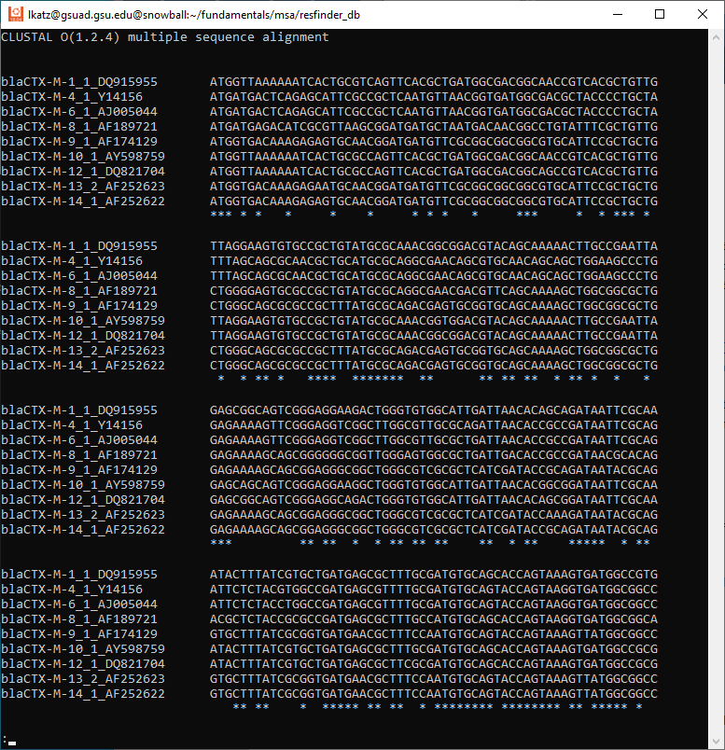

Slide 10
GUI way
with MEGA

Slide 11
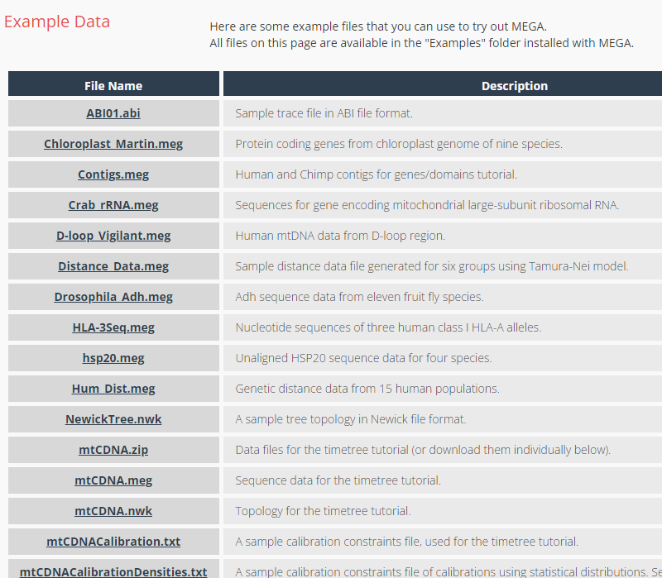

Download from MEGA
https://www.megasoftware.net/examples

Slide 12
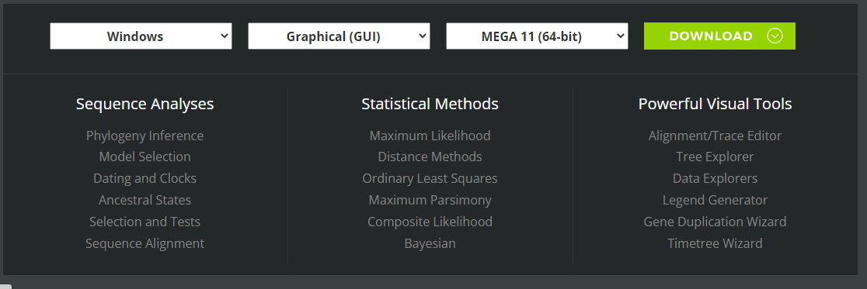
Download MEGA

Slide 13
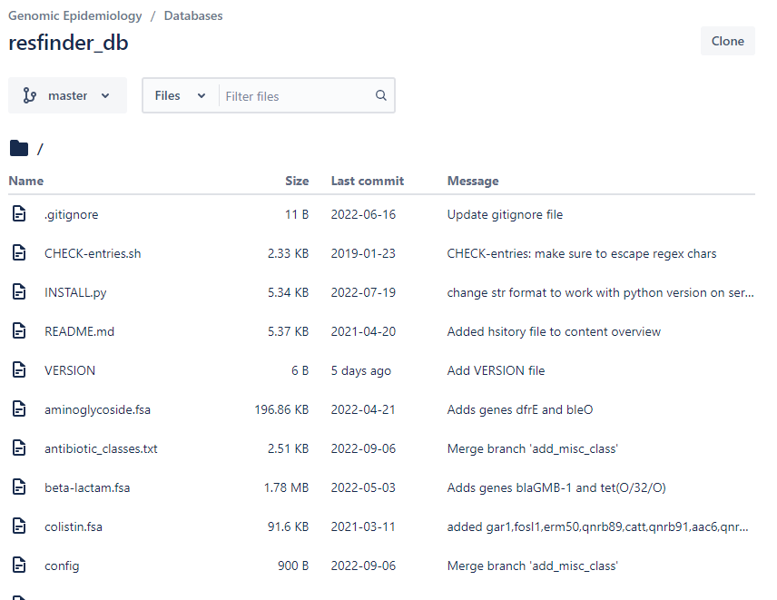
Get the data
https://bitbucket.org/genomicepidemiology/resfinder_db
Click into beta-lactam.fsa
ctrl-F your way to blaCTX
Copy and paste the first 9 sequences into a file

Slide 14
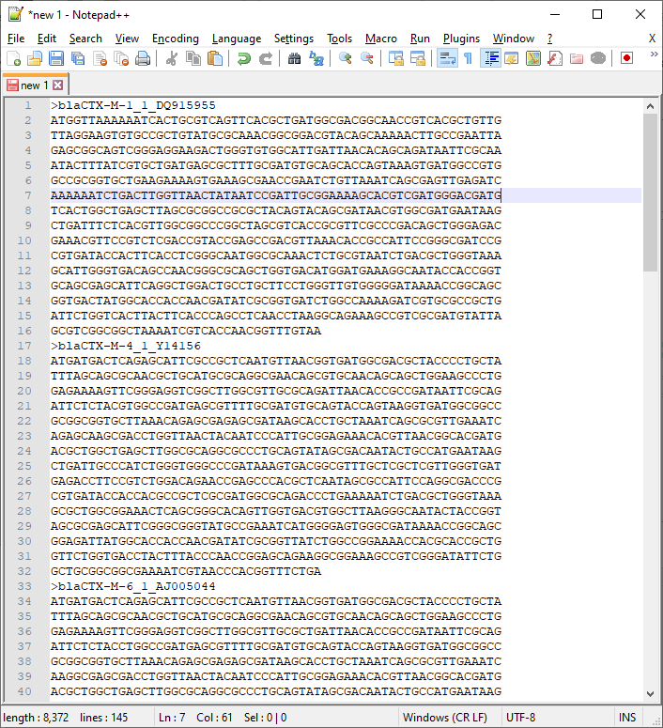
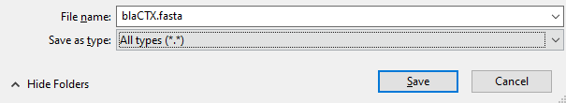
Make the data file for yourself
Pasted the first 9 sequences, 144 lines
Save as blaCTX.fasta
as type “All types”
Similar in MacOS

Slide 15
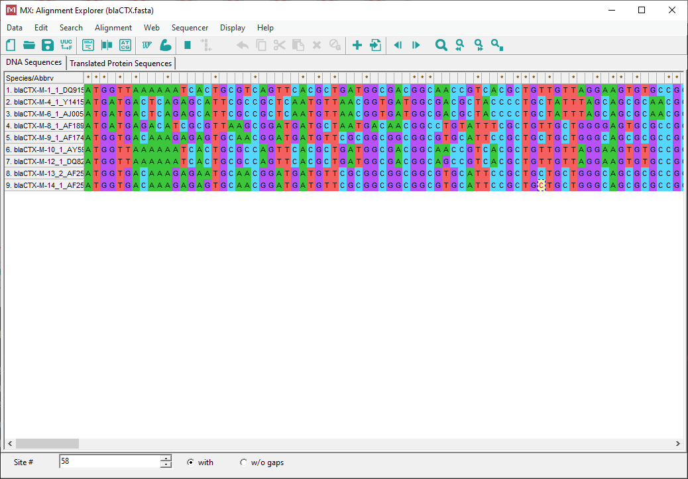
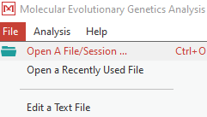
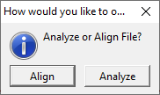
Open in MEGA

Slide 16
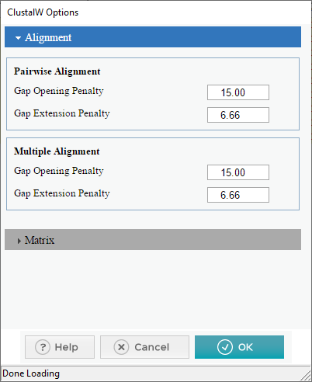
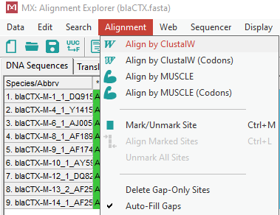
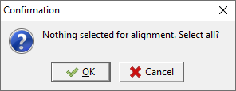
Alignment

Slide 17
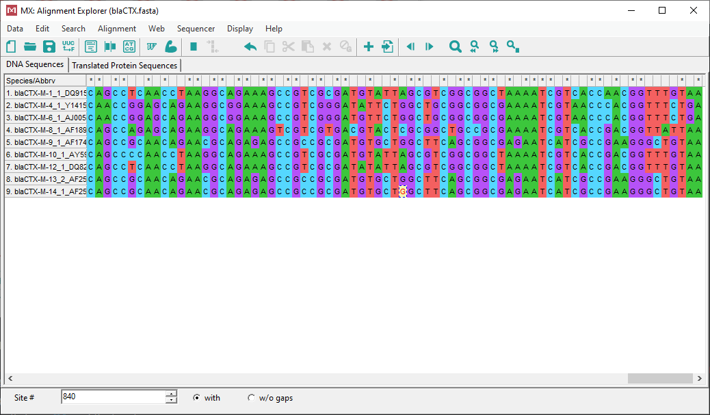
Beautiful alignment

Slide 18
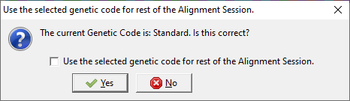
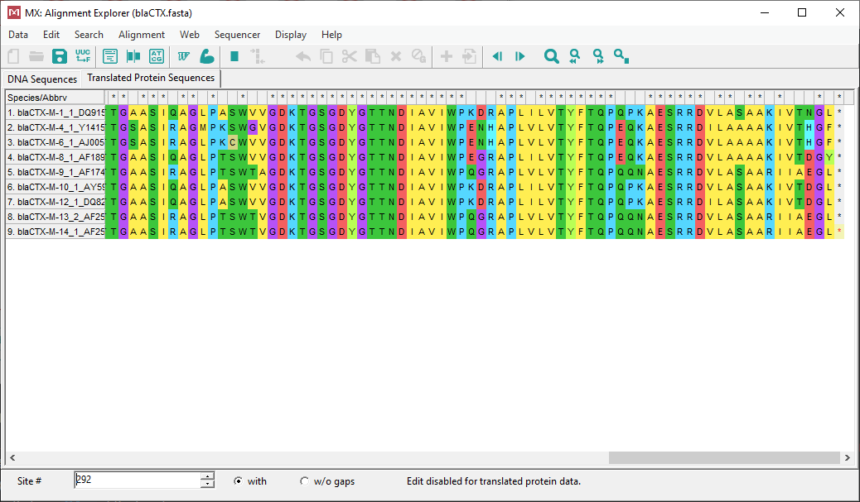
Translation tab

Slide 19
Mapping
Sequencing
prediction
annotation
Display
Assembly
mapping
SNPs

Slide 20
Read mapping
Use raw read data to see where it matches against the assembly
Where the reads match -> mapping
Read mapping methods
Burrow Wheeler Algorithm
Smith Waterman Algorithm
Kmer matching (technically not read mapping)
Why?
Polishing genome assemblies
Finding differences between genomes
Finding commonalities between genomes

Slide 21
Animation of read mapping
Reference genome

Slide 22
Read mapping
$ mkdir -pv ~/fundamentals/mapping
$ cd ~/fundamentals/mapping/
$ SRR=SRR1267526
$ fasterq-dump --threads 1 --outdir $SRR.reads --split-files --skip-technical $SRR
$ gzip -v $SRR.reads/*.fastq
$ R1=SRR1267526.reads/SRR1267526_1.fastq.gz
$ R2=SRR1267526.reads/SRR1267526_2.fastq.gz
$ conda activate shovill
$ shovill --outdir asm/$SRR.shovill --assembler spades --R1 $R1 --R2 $R2
$ conda deactivate
Notes:
Repeat the downloading of reads and running assembly, or just `cp` from last time’s outputs

Slide 23
Read mapping: create the conda environment
$ conda create -n mapping bowtie2 samtools bcftools
$ conda activate mapping
$ bowtie2 --help | less
Bowtie 2 version 2.4.5 by Ben Langmead (langmea@cs.jhu.edu, www.cs.jhu.edu/~langmea)
Usage:
bowtie2 [options]* -x <bt2-idx> {-1 <m1> -2 <m2> | -U <r> | --interleaved <i> | -b <bam>} [-S <sam>]
<bt2-idx> Index filename prefix (minus trailing .X.bt2).
NOTE: Bowtie 1 and Bowtie 2 indexes are not compatible.
<m1> Files with #1 mates, paired with files in <m2>.
Could be gzip'ed (extension: .gz) or bzip2'ed (extension: .bz2).
<m2> Files with #2 mates, paired with files in <m1>.
Could be gzip'ed (extension: .gz) or bzip2'ed (extension: .bz2).
<r> Files with unpaired reads.
Could be gzip'ed (extension: .gz) or bzip2'ed (extension: .bz2).
<i> Files with interleaved paired-end FASTQ/FASTA reads
Could be gzip'ed (extension: .gz) or bzip2'ed (extension: .bz2).
<bam> Files are unaligned BAM sorted by read name.
<sam> File for SAM output (default: stdout)
<m1>, <m2>, <r> can be comma-separated lists (no whitespace) and can be
specified many times. E.g. '-U file1.fq,file2.fq -U file3.fq'.
Notes:
use conda to create the env, conda to activate, then see how to run bowtie2
Please get used to using --help to view usage on programs

Slide 24
Read mapping: index the assembly
$ bowtie2-build --help
Bowtie 2 version 2.4.5 by Ben Langmead (langmea@cs.jhu.edu, www.cs.jhu.edu/~langmea)
Usage: bowtie2-build [options]* <reference_in> <bt2_index_base>
reference_in comma-separated list of files with ref sequences
bt2_index_base write bt2 data to files with this dir/basename
$ bowtie2-build asm/SRR1267526.shovill/contigs.fa asm/SRR1267526.shovill/contigs.fa
$ ls asm/SRR1267526.shovill/
contigs.fa contigs.fa.2.bt2 contigs.fa.4.bt2 contigs.fa.rev.2.bt2 shovill.corrections spades.fasta
contigs.fa.1.bt2 contigs.fa.3.bt2 contigs.fa.rev.1.bt2 contigs.gfa shovill.log
Notes:
All mappers need to index the assembly somehow. Bowtie2 uses bowtie2-build
All these new bt2 files get created. I will not pretend to know what each individual file does. However, these files need to be there, next to the fasta file for it to work.

Slide 25
Read mapping: map
$ bowtie2 --help | less
Bowtie 2 version 2.4.5 by Ben Langmead (langmea@cs.jhu.edu, www.cs.jhu.edu/~langmea)
Usage:
bowtie2 [options]* -x <bt2-idx> {-1 <m1> -2 <m2> | -U <r> | --interleaved <i> | -b <bam>} [-S <sam>]
<bt2-idx> Index filename prefix (minus trailing .X.bt2).
NOTE: Bowtie 1 and Bowtie 2 indexes are not compatible.
<m1> Files with #1 mates, paired with files in <m2>.
Could be gzip'ed (extension: .gz) or bzip2'ed (extension: .bz2).
<m2> Files with #2 mates, paired with files in <m1>.
Could be gzip'ed (extension: .gz) or bzip2'ed (extension: .bz2).
<r> Files with unpaired reads.
Could be gzip'ed (extension: .gz) or bzip2'ed (extension: .bz2).
<i> Files with interleaved paired-end FASTQ/FASTA reads
Could be gzip'ed (extension: .gz) or bzip2'ed (extension: .bz2).
<bam> Files are unaligned BAM sorted by read name.
<sam> File for SAM output (default: stdout)
<m1>, <m2>, <r> can be comma-separated lists (no whitespace) and can be
specified many times. E.g. '-U file1.fq,file2.fq -U file3.fq’.
$ bowtie2 -x asm/SRR1267526.shovill/contigs.fa -1 SRR1267526.reads/SRR1267526_1.fastq.gz -2 SRR1267526.reads/SRR1267526_2.fastq.gz > SRR1267526.sam
Notes:
All mappers need to index the assembly somehow. Bowtie2 uses bowtie2-build
All these new bt2 files get created. I will not pretend to know what each individual file does. However, these files need to be there, next to the fasta file for it to work.

Slide 26
Read mapping: map
$ bowtie2 -x SRR1267526.shovill/contigs.fa -1 SRR1267526.reads/SRR1267526_1.fastq.gz -2 SRR1267526.reads/SRR1267526_2.fastq.gz >
SRR1267526.sam
1924037 reads; of these:
1924037 (100.00%) were paired; of these:
384840 (20.00%) aligned concordantly 0 times
1520526 (79.03%) aligned concordantly exactly 1 time
18671 (0.97%) aligned concordantly >1 times
----
384840 pairs aligned concordantly 0 times; of these:
289408 (75.20%) aligned discordantly 1 time
----
95432 pairs aligned 0 times concordantly or discordantly; of these:
190864 mates make up the pairs; of these:
90969 (47.66%) aligned 0 times
86875 (45.52%) aligned exactly 1 time
13020 (6.82%) aligned >1 times
97.64% overall alignment rate
Notes:
bowtie2 gives a nice stats output

Slide 27
SAM format, revisited
Describes many alignments against a reference
Sections
Header: sam version, contigs, file creation information
alignments
Alignments have 12 columns
Qname: read name
Flag: bitwise flag
Rname (seqid)
Pos: leftmost position on Rname
Mapq: mapping quality
CIGAR: description of alignment
Rnext: seqid of read pair
Pnext: position of read pair
Tlen: distance between pair
Seq: sequence
Qual: quality of sequence
Tags: other information

Slide 28
Sam -> bam conversion
$ samtools view -b SRR1267526.sam > SRR1267526.unsorted.bam
$ samtools sort -o SRR1267526.bam SRR1267526.unsorted.bam
$ samtools index SRR1267526.bam
$ rm SRR1267526.unsorted.bam
$ rm SRR1267526.sam
$ ls
SRR1267526.bam SRR1267526.bam.bai SRR1267526.reads SRR1267526.shovill
Now we can do all sorts of stuff!
Notes:
samtools view -b -> convert sam to bam
samtools sort -> sort the bam file by coordinates
samtools index -> index the bam file

Slide 29
depth and breadth of coverage
$ samtools depth -aa SRR1267526.bam | head
contig00001 1 168
contig00001 2 224
contig00001 3 264
contig00001 4 296
contig00001 5 311
contig00001 6 345
contig00001 7 358
contig00001 8 360
contig00001 9 373
contig00001 10 373
Notes:
3 column format separated by tabs: contig name, position, and depth of coverage
-aa: shows every position even if it’s zero depth

Slide 30
flagstat
$ samtools flagstat SRR1267526.bam
3848074 + 0 in total (QC-passed reads + QC-failed reads)
3848074 + 0 primary
0 + 0 secondary
0 + 0 supplementary
0 + 0 duplicates
0 + 0 primary duplicates
3757105 + 0 mapped (97.64% : N/A)
3757105 + 0 primary mapped (97.64% : N/A)
3848074 + 0 paired in sequencing
1924037 + 0 read1
1924037 + 0 read2
3078394 + 0 properly paired (80.00% : N/A)
3677230 + 0 with itself and mate mapped
79875 + 0 singletons (2.08% : N/A)
29774 + 0 with mate mapped to a different chr
28053 + 0 with mate mapped to a different chr (mapQ>=5)
Notes:
How many reads mapped? How many reads mapped properly in pairs?

Slide 31
view
$ samtools view SRR1267526.bam | less -S
SRR1267526.73383 99 contig00001 1 23 4M19I126M =
SRR1267526.410852 99 contig00001 1 42 3M6I142M =
SRR1267526.563706 73 contig00001 1 0 4M18I128M =
SRR1267526.563706 133 contig00001 1 0 * =
SRR1267526.612903 161 contig00001 1 3 3M16I132M =
SRR1267526.704631 163 contig00001 1 24 3M16I132M =
SRR1267526.869024 163 contig00001 1 8 3M27I121M =
SRR1267526.873073 99 contig00001 1 40 3M7I141M =
SRR1267526.875981 165 contig00001 1 0 * =
SRR1267526.922248 165 contig00001 1 0 * =
Notes:
Alignments have 12 columns
Qname: read name
Flag: bitwise flag
Rname (seqid)
Pos: leftmost position on Rname
Mapq: mapping quality
CIGAR: description of alignment
Rnext: seqid of read pair
Pnext: position of read pair
Tlen: distance between pair
Seq: sequence
Qual: quality of sequence
Tags: other information

Slide 32
SNPs
$ bcftools mpileup -O u --fasta-ref asm/SRR1267526.shovill/contigs.fa SRR1267526.bam | \
bcftools call -c -v -O v | \
grep -v '^#’ | \
cut -f 1-5 | \
head -n 20 | \
column -t
bcftools mpileup: transposes reads against the assembly and seeks position-by-position differences
-O u: uncompressed VCF format (don’t need to know this right now)
--fasta-ref: which reference fasta file to compare against
SRR1267526.bam: the bam file
bcftools call: marks up differences from bcftools mpileup
-c: consensus calling allele method
-v: output variants only
-O v: output VCF format (don’t need to know this right now)
Then, grep, cut, head, column -t
Notes:
grep -v ‘^#’: ignore lines starting with #
cut -f 1-5: show columns 1 through 5, inclusive
head -n 20: show the first 20 lines
column -t: align the columns in the output

Slide 33
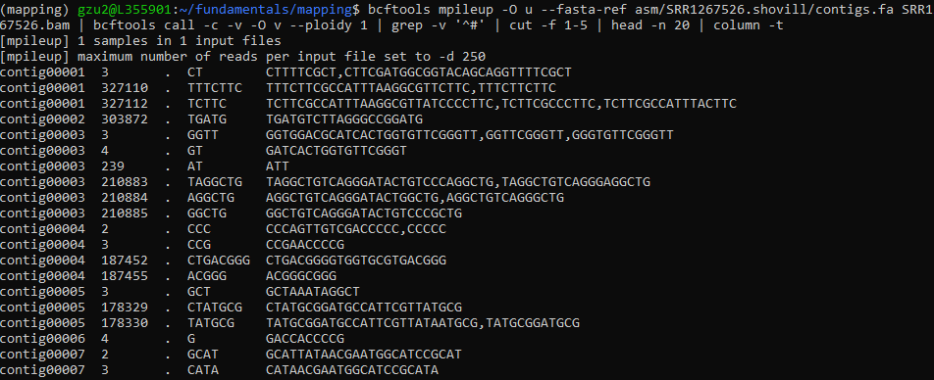
SNPs
Notes:
Calling SNPs is advanced and we might not go into details in this class.
Columns:
Contig name. In our case, Shovill automatically named it, commonly called CHROM or RSEQ or SEQNAME
position on the contig, commonly called POS
SNP identifier. If no ID is given, then “.” is used
Reference base(s), commonly called REF.
Alternate base(s), commonly called ALT. The reference is swapped for this. So if there is a G in the reference and an A in the ALT, then it is a simple SNP. If there are different lengths in REF and ALT, then it is an indel.

Slide 34
Visualize the alignments
IGV from Broad Institute

Slide 35
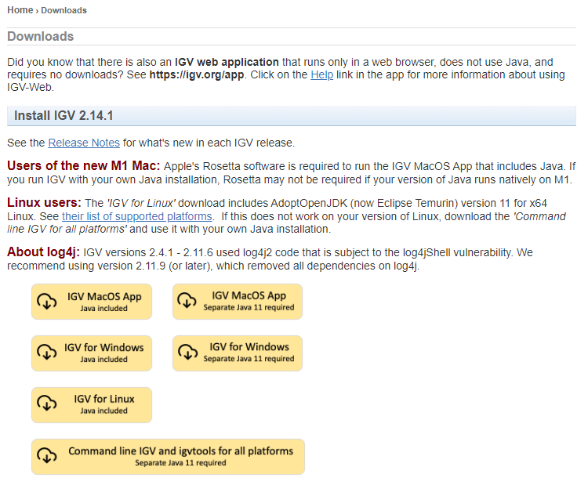
Download IGV
https://software.broadinstitute.org/software/igv/download
Notes:
Details for another time

Slide 36
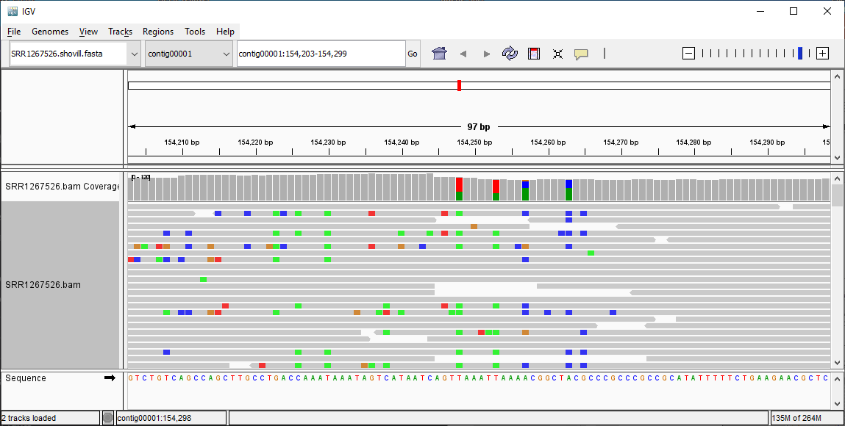
IGV viewer
Notes:
There are some SNPs towards the left side, colored

Slide 37
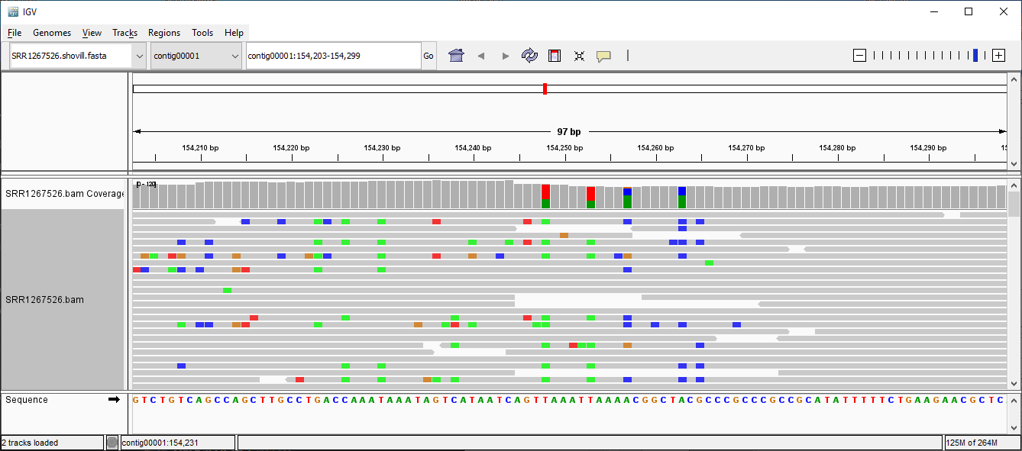
IGV: zoom in a bit
Notes:
zoom in and see the SNPs. Can click on them, see the composition, etc

Slide 38
Done!
We learned
Multiple sequence alignment
read alignment
Previews: SNPs and Viz

