Slide 1
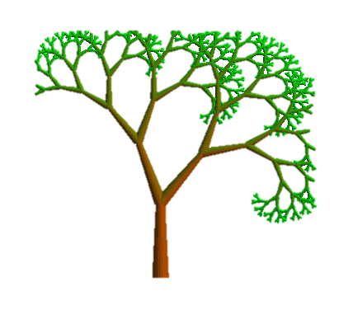
Phylogeny
“I wonder about the trees”
- Robert Frost
“There is a thing in me that dreamed of trees”
- Mary Oliver
“I think that I shall never see
A poem lovely as a tree.”
- Joyce Kilmer

Slide 2
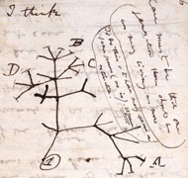
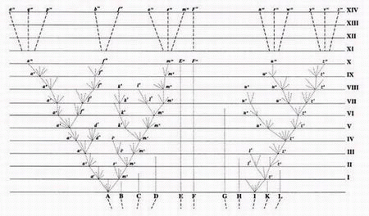
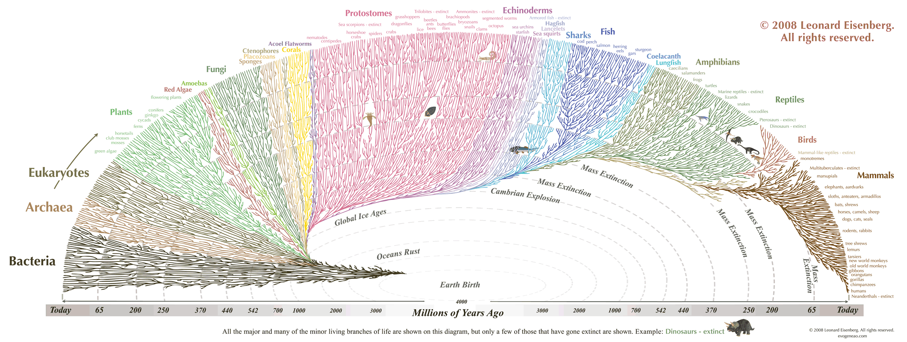
What is a phylogenetic tree?
Two-dimensional representation of evolutionary relationships between a collection of items. In bioinformatics, these items are often aligned sequences.
Darwin’s notebooks, 1837
Darwin, Origin of Species by Natural Selection, 1859
you are here
Notes:
“The affinities of all the beings of the same class have sometimes been represented by a great tree. I believe this simile largely speaks the truth. The green and budding twigs may represent existing species; and those produced during former years may represent the long succession of extinct species.” –C. Darwin

Slide 3
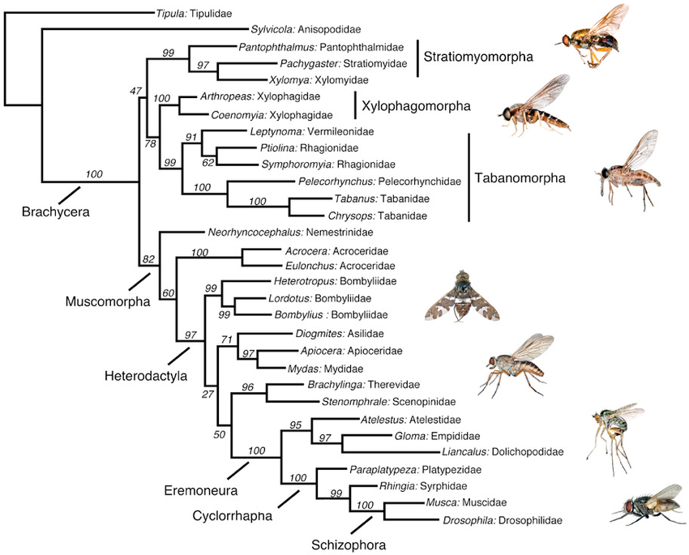
What can I use a phylogenetic tree for?
How are species related?
Notes:
I am only going to discuss tree reconstruction from molecular sequence data. This would typically be nucleotide (DNA/RNA) sequence data or amino acid data. Occasionally this same data will be analyzed as codons, but that isn’t typical. You should be aware that phylogenetic trees can also be built from other clusterable data that we infer to represent evolutionary distance. This can include morphological trait matrices, dna hybridization data, and other data you’re less likely to encounter
One of the common use cases of molecular phylogenetics is inferring the relationships between species. There are actually many outstanding questions about the relationships between species and even major clades of life

Slide 4
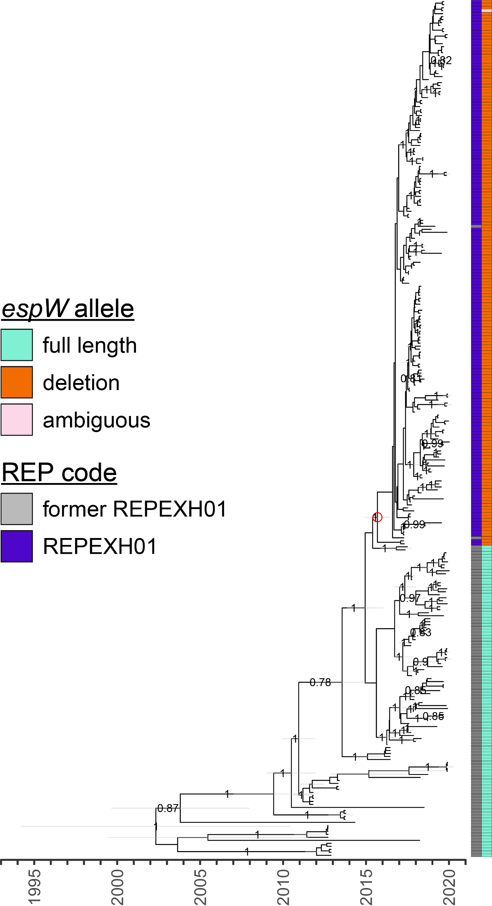
What can I use a phylogenetic tree for?
How are individuals or strains in one species related?

Slide 5
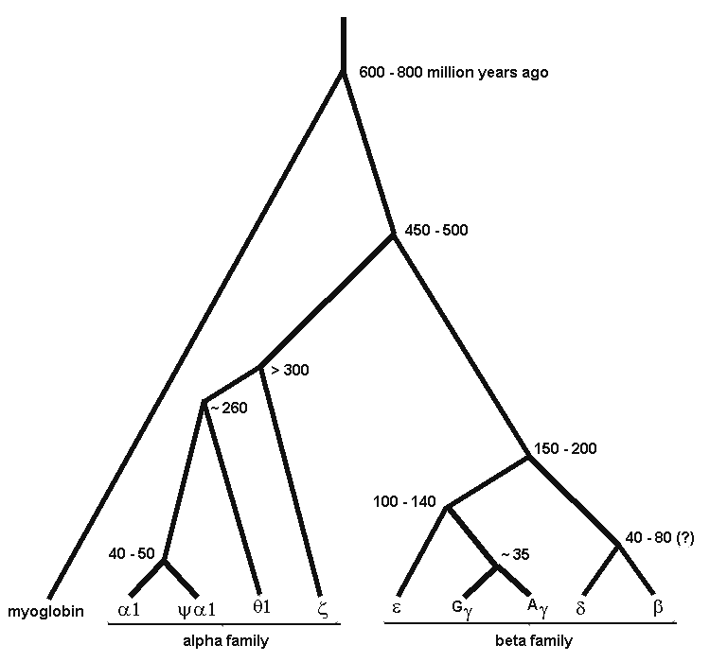
What can I use a phylogenetic tree for?
What is the history of a gene family?
Notes:
A complex history of duplication and subfunctionalization marks the evolution of the globin gene family. All of these proteins have evolved from a single ancestral gene to fill different roles at different developmental timings. The history of the gene can be inferred through phylogenetics

Slide 6
What can I use a phylogenetic tree for?
Are pathogens co-evolving with their hosts?
Gorilla
Gorilla
Human
Human
Common chimpanzee
Common chimpanzee
Bonobo
Bonobo
Notes:
Foamy viruses are retro-viruses which infect primates. They are extremely mild—causing few if any symptoms in their hosts. They are persistent and often endemic in primate populations. These are the kind of circumstances where you might expect to find host and pathogen trees corresponding. And indeed you do.
The host tree here is purple. And the virus tree is orange. This is a mapping based on which viral strains infect which host species. Note that we have multiple samples from chimp and gorilla. There’s a closely related clade of viruses all of which infect chimpanzee. The same is true with gorilla. There doesn’t seem to be a human specific foamy virus. Humans do get FV infections, but these are always simian viruses acquired by being in contact with non human primates.
If you look at these trees a bit, you can see that the virus tree has a fairly similar shape to the host tree.
And indeed, we can construct a co-evolutionary scenario, which I’m representing on the right. So this scenario involves co-evolution from a common ancestor. But with the human lineage losing its foamy virus.
Simian Foamy Viruses have a phylogeny matching primates.
http://www.nature.com/nature/journal/v434/n7031/pdf/nature03341.pdf

Slide 7
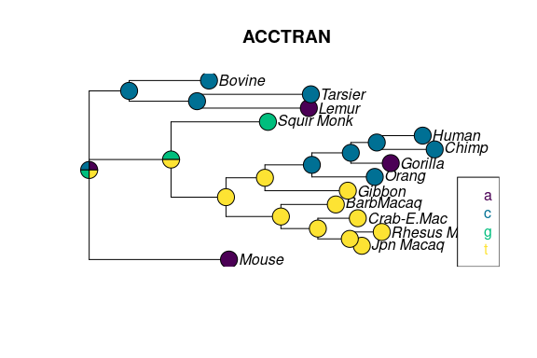
What can I use a phylogenetic tree for?
Most Recent Common Ancestor (MRCA) Reconstruction
What sequence did the ancestor have?
By reconstructing the MRCAs backwards through the tree, truly ancient sequences can be inferred
Notes:
By looking at the state at the tips, you can guess the possible state(s) of the parent node. These inferred ancestral states can then be used to infer further back in the tree where no immediate descendants are in the tree.

Slide 8
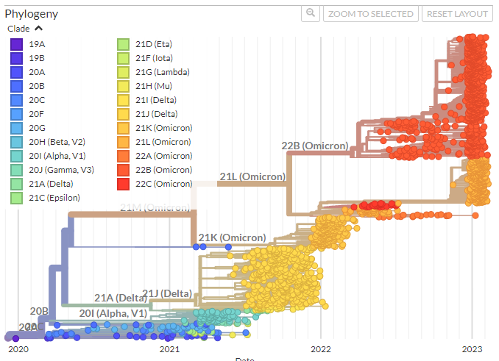
What can I use a phylogenetic tree for?
Divergence Time Estimation
When did the divergences (nodes) occur
Notes:
In this tree, branch lengths represent the amount of time passed, and nodes are reconstructed at the estimated time when a divergence occurred. Requires time calibration points
A tree made this way is called a “chronogram” and branch lengths represent elapsed time

Slide 9
Phylogenetic tree terminology
branches or lineages
Notes
All nodes are connected
There is one path between any pair of nodes (no cycles)
A
B
C
D
root node
(also an internal node)
E
internal nodes
(represent hypothetical ancestors of taxa)
leaves, tips or terminal nodes
(represent taxa [genes, species, populations, etc] used to infer phylogeny)

Slide 10
Phylogenetic tree terminology
Trees are typically bifurcating
Internal nodes have three connections
Tips have only one connection
Trees can be rooted or unrooted
Rooting requires an outgroup
past
rooted tree
unrooted tree
B
A
C
D
present
A
B
C
D
indicates direction of time
does not tell us about time
outgroup
Notes:
In this example, A is the outgroup

Slide 11
Phylogenetic tree terminology
Trees are typically bifurcating
Internal nodes have three connections
Tips have only one connection
Trees can be rooted or unrooted
rooted tree
to go from this rooted tree to the corresponding unrooted tree, remove node 0 and join branches u and v to create v’
unrooted tree
0
v
x
B
w
1
A
v’
w
u
2
z
1
y
x
2
y
z
to go from this unrooted tree to this particular rooted tree, add a new root node in the middle of branch v’, splitting it into two branches (u and v)
C
D
A
B
C
D

Slide 12
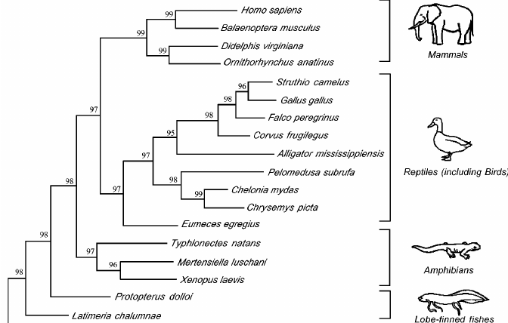
Phylogenetic tree terminology
Branch Support Value
A measure of confidence at a node. Higher is better

Slide 13
Assumptions
Traits are heritable
Vertical evolution comprises the majority of events
A mutation is acquired de novo or inherited; not horizontally transferred
Assumes most mutations were inherited

Slide 14
Assumptions
Traits are homologous
apples-to-apples comparisons
Don’t do this!
Human
Horse
Deer
Blue Whale
Hippopotamus
Notes:
Homology: The sequences compared must be comparable. You must use the same genes from different species/strains. This is the globin gene tree I used as an example of gene duplication earlier. If you were to choose different globin genes to represent a species in your tree, the resulting phylogenetic tree would reflect the history of globin genes, not the species history. To do a species level phylogenetic tree, you would need to choose the same globin gene from each species.

Slide 15
Assumptions
Traits are homologous
apples-to-apples comparisons
valid alignments
Sequence 1
Sequence 2
A | C | T | A | A | A | T | G | T
A | C | T | C | - | - | - | G | T
Translate
Sequence 1
Sequence 2
T | K | C
T | X | X
Notes:
Insertion/deletion events can lead to uncertain homology of surrounding sites
Alignment algorithms can introduce biases or uncertain homology around gaps. In this example, you can see how misplacing one nucleotide in a gap disrupts the translation of the sequence, causing two unknown (X) codons to appear. The correct homology is almost certainly placing it at the start of the third codon. If placed there, you would introduce a single amino acid gap in the translated sequence and restore the arginine codon

Slide 16
Assumptions
Traits are homologous
apples-to-apples comparisons
valid alignments
Sequence 1
Sequence 2
A | C | T | A | A | A | T | G | T
A | C | T | - | - | - | C | G | T
Translate
Sequence 1
Sequence 2
T | K | C
T | - | R
Notes:
Insertion/deletion events can lead to uncertain homology of surrounding sites
Alignment algorithms can introduce biases or uncertain homology around gaps. In this example, you can see how misplacing one nucleotide in a gap disrupts the translation of the sequence, causing two unknown (X) codons to appear. The correct homology is almost certainly placing it at the start of the third codon. If placed there, you would introduce a single amino acid gap in the translated sequence and restore the arginine codon

Slide 17
Assumptions
Sites are independent
substitution at one site does not impact any other sites in the alignment
not totally correct, but it waaay too complicated to model accurately

Slide 18
Interpreting trees
Scale bar
Direction of evolution
Outgroup1
taxon
0.01
Outgroup2
taxon
Vertical distance is irrelevant
taxon3
Root
(MRCA of all taxa)
100
taxon4
clade
taxon5
100
taxon6
Percent confidence in hypothetical ancestor
taxon7
Hypothetical most recent common ancestor (MRCA) of taxa 3-7

Slide 19

Interpreting trees
Human
Human-chimp clade
Chimpanzee
Gorilla
Dinosaur
Lizard
Salamander
Frog
1. Which is more closely related to a chimpanzee, a gorilla or a human?
2. Which is more closely related to a lizard, a salamander or a human?
3. Which is more closely related to a dinosaur, a frog or a human?

Slide 20
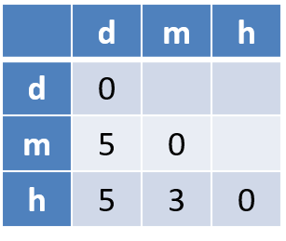
Two types of treeing methods
Multiple Alignment
Character-Based Methods
directly use characters (e.g. nucleotides)
consider sequences of evolutionary events that could have led to observed changes
dog: -AATGTACC
mouse: AATTG-TCG
human: AA-GG-TCC
cut out middleman
Phylogenetic Tree
Distance Matrix
Distance-Based Methods
Create distance matrix of distances b/w pairs of species
Then reconstruct tree consistent with distance matrix
dog mouse human

Slide 21
Two types of treeing methods
Distance-Based methods
Character-Based methods
Methods:
UPGMA
Neighbor-Joining
Reasonably accurate under some conditions
Easier to implement
Faster
Methods:
Maximum parsimony
Maximum likelihood
Accurate under wider range of conditions
More difficult to implement
Slower

Slide 22
Evaluating character-based trees
Generate all possible trees
Score each tree (calculate parsimony or likelihood)
Pick the tree with the best score
Simple, right?

Slide 23
Generating all possible trees
A
B
C
A
A
A
C
B
B
A
B
C
# species (leaves)
1
2
3
4
# possible trees
1
1
3

Slide 24
Generating all possible trees
A
A
A
A
B
B
B
C
C
D
B
D
D
C
C
A
A
D
D
B
B
C
C

Slide 25
Generating all (bifurcating) possible trees
A
B
C
A
A
A
C
B
B
A
B
C
# species (leaves)
1
2
3
4
5
# possible trees
1
1
3
15
105

Slide 26
Generating all possible (bifurcating) trees
Tips | Equation | Possible trees
3 | 3 | 3
4 | 3 * (2*4 - 3) | 15
5 | 3 * (2*4 - 3) * (2*5 - 3) | 105
6 | 3 * (2*4 - 3) * (2*5 - 3) * (2*6 - 3) | 945
7 | 3 * (2*4 - 3) * (2*5 - 3) * (2*6 - 3) * (2*7 - 3) | 10,395
8 | 3 * (2*4 - 3) * (2*5 - 3) * (2*6 - 3) * (2*7 - 3) * (2*8 - 3) | 135,135
9 | 3 * (2*4 - 3) * (2*5 - 3) * (2*6 - 3) * (2*7 - 3) * (2*8 - 3) * (2*9 - 3) | 2,027,025
10 | 3 * (2*4 - 3) * (2*5 - 3) * (2*6 - 3) * (2*7 - 3) * (2*8 - 3) * (2*9 - 3) * (2*10 - 3) | 34,459,425
This problem is scaling factorially!

Slide 27

Generating all possible (bifurcating) trees
Tips | Possible trees | Order of magnitude
10 | 34,459,425 | 10⁷
20 | 8,200,794,532,637,890,000,000 | 10²¹
50 | 27,529,213,532,835,600,000,000,000,000,000,000,000,000,000,000,000,000,000,000,000,000,000,000,000,000 | 10⁷⁶
100 | 33,499,038,543,080,200,000,000,000,000,000,000,000,000,000,000,000,000,000,000,000,000,000,000,000,000,000,000,000,000,000,000,000,000,000,000,000,000,000,000,000,000,000,000,000,000,000,000,000,000,000,000,000,000,000,000,000,000,000,000,000,000 | 10¹⁸⁴
atoms | 100,000,000,000,000,000,000,000,000,000,000,000,000,000,000,000,000,000,000,000,000,000,000,000,000,000,000 | 10⁸⁰
We can’t evaluate every possible tree.

Slide 28
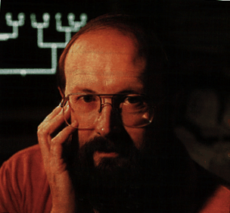
Generating all possible (bifurcating) trees
Tips | Possible trees | Order of magnitude
10 | 34,459,425 | 10⁷
20 | 8,200,794,532,637,890,000,000 | 10²¹
50 | 27,529,213,532,835,600,000,000,000,000,000,000,000,000,000,000,000,000,000,000,000,000,000,000,000,000 | 10⁷⁶
100 | 33,499,038,543,080,200,000,000,000,000,000,000,000,000,000,000,000,000,000,000,000,000,000,000,000,000,000,000,000,000,000,000,000,000,000,000,000,000,000,000,000,000,000,000,000,000,000,000,000,000,000,000,000,000,000,000,000,000,000,000,000,000 | 10¹⁸⁴
atoms | 100,000,000,000,000,000,000,000,000,000,000,000,000,000,000,000,000,000,000,000,000,000,000,000,000,000,000 | 10⁸⁰
“The principal uses of these numbers will be to double-check algorithms and notation systems, and to frighten taxonomists.”
- Joseph Felsenstein
We can’t evaluate every possible tree.

Slide 29
Simple heuristic tree search
Start with an initial tree and score it
Permutate this tree many times and score the “neighbors”
Pick the neighbor with the best score
Repeat this process until the score stops increasing
What is the potential pitfall here?

Slide 30
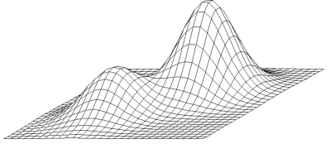
Tree algorithms cannot guarantee optimal solutions
Global maximum
Local maximum
scoring function
tree space
If we can’t guarantee we found the best tree, then we need a way to evaluate how confident we are in the tree we have.

Slide 31
Bootstrap replicates
Site #
Sequence 1
Sequence 2
1 | 2 | 3 | 4 | 5 | 6 | 7 | 8 | 9
A | C | T | A | A | A | A | G | T
A | C | T | A | - | - | - | G | T
Generate bootstrap replicate (pseudoreplicate)
Site #
Sequence 1
Sequence 2
7 | 4 | 8 | 7 | 4 | 3 | 3 | 5 | 6
A | A | G | A | A | T | T | A | A
- | A | G | - | A | T | T | - | -
Repeat this process at least 100 times
Notes:
Branch support: A single tree typically only gives you a snapshot of the tree best supported by the data. It will always try to give you the single *best* tree, but without assessing support, you don’t have any idea how many sites this is based on or how much conflicting signal is present in the data. By resampling hundreds or thousands of times, you produce data sets that will reflect competing signals in the data and can use these to assess confidence Bootstrap replicates are generated by randomly selecting sites from the original alignment to produce a new alignment of the same length. This is a “resampling with replacement” operation.

Slide 32
Let’s build a tree!
align sequences using ClustalO (webtool)
install FigTree
https://github.com/rambaut/figtree/releases
install IQTree
conda create -n iqtree
conda activate iqtree
conda install -c bioconda iqtree
reconstruct the tree
iqtree -s gyrB.aln -b 100
View tree using FigTree

Slide 33

Professional Development: attending conferences
Attending conferences is one of the best ways to obtain future employment
NETWORK!!! Don’t go and only hang out with your friends. Go meet strangers and talk to the superstars. You never know who is hiring.
ISCB Rocky is a great conference if you’re looking to present your research.

Slide 34
Professional development

Slide 35



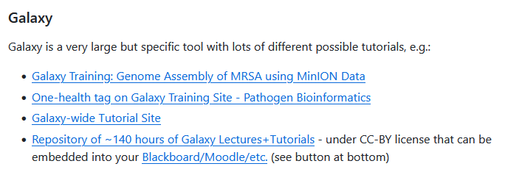

Educational Resources
https://github.com/lskatz/awesome-bioinformatics-education

