Slide 1

Data Lake Value Proposition
Medical Data Processing Company
LE SY KHANH DUY
Udacity IPS Version 1.0

Slide 2
Agenda
What is a Data Lake
Components of a Data Lake
Data Lake vs Data Warehouse
Business Value of Data Lake Solution
Proposed Data Lake Architecture for Medical Data Processing system
Udacity IPS Ver. 1 2/2020

Slide 3
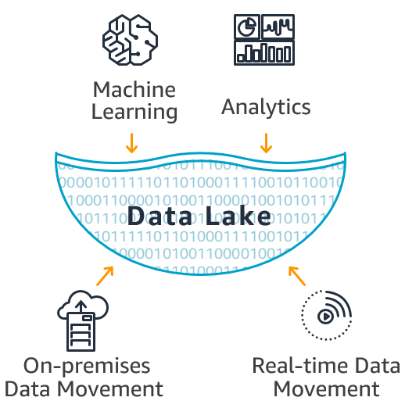
What is a Data Lake
A data lake is a centralized repository that allows you to migrate and store all structured and unstructured data at unlimited scale…

Slide 4
Components of Data Lake
In most case there are 4 layers in data lake.
Data Ingesting Layer (ex : Kafka, Sqoop)
Data Storage Layer (ex : Hadoop Distributed File System, Hbase)
Data Process Layer (ex : Apache Spark, Hive, Pig)
Govern and Secure Layer (ex: Apache Ranger, Kerberos)

Slide 5
Data Lake vs Data Warehouse
"A data lake is a vast pool of raw data, the purpose for which is not yet defined. A data warehouse is a repository for structured, filtered data that has already been processed for a specific purpose.”

Slide 6
 | Data Lake | Data Warehouse
Data Structure | Raw | Processed, Structured and well understood
Tools | In-place Querying, ad hoc | SQL, BI
Purpose of Data | Not yet determined | Currently in use
Users | Data Scientists, Data Explores | Business Professionals
Acessibility | Highly accessible and quick to update | More complicated and costly to make changes

Slide 7
Business Value of Data Lake
Break Silos
Handling data at speed
Provides quality data for real-time analytics
Gives room for future technology changes

Slide 8
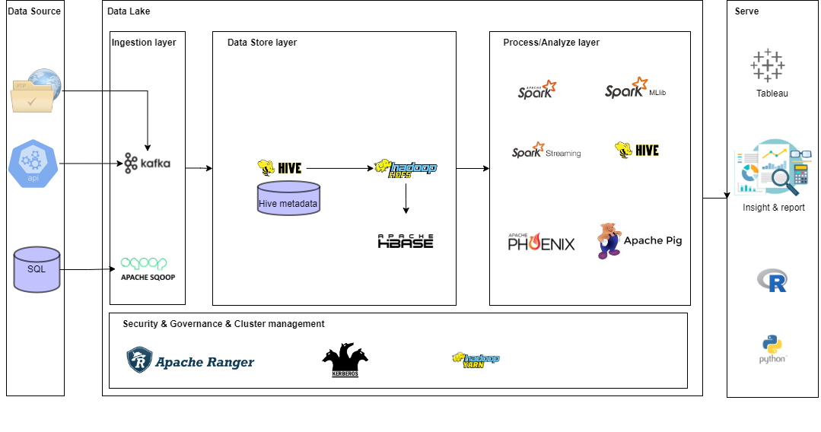
Data Lake Architecture

Slide 9
THANK YOU
Udacity IPS Version 1.0

